Slide 1

Notes:
Hi,
Thank you so much for joining me here today, it'd be great to hear where you're all from so please do leave a comment in the chat and introduce yourself.
Likewise please use the comments if you've got any questions throughout this webinar and I'll do my best to get to them at the end, I'm also joined by some friends helping me in the chat who may get to them before I do.

Slide 2
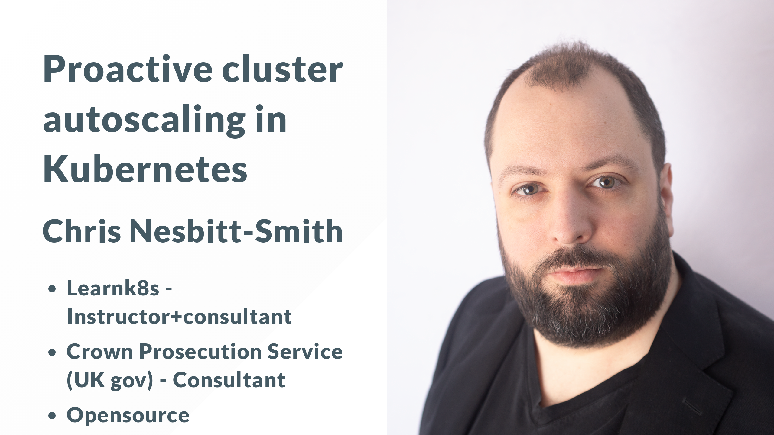
Notes:
So, to kick things off my name is Chris Nesbitt-Smith, I'm based in London and currently an instructor for Learnk8s, consultant to UK Government and tinkerer of open source stuff.
I've using and abusing Kubernetes in production since it was 0.4, believe me when I say its been a journey!
I've definitely got the scars to show for it.

Slide 3

Notes:
So you believed the hype, that Kubernetes lets you scale infinitely, auto heal and so on.
Your cluster is self monitoring and scaling up instances of your cloud native stateless applications on demand when you need more.

Slide 4
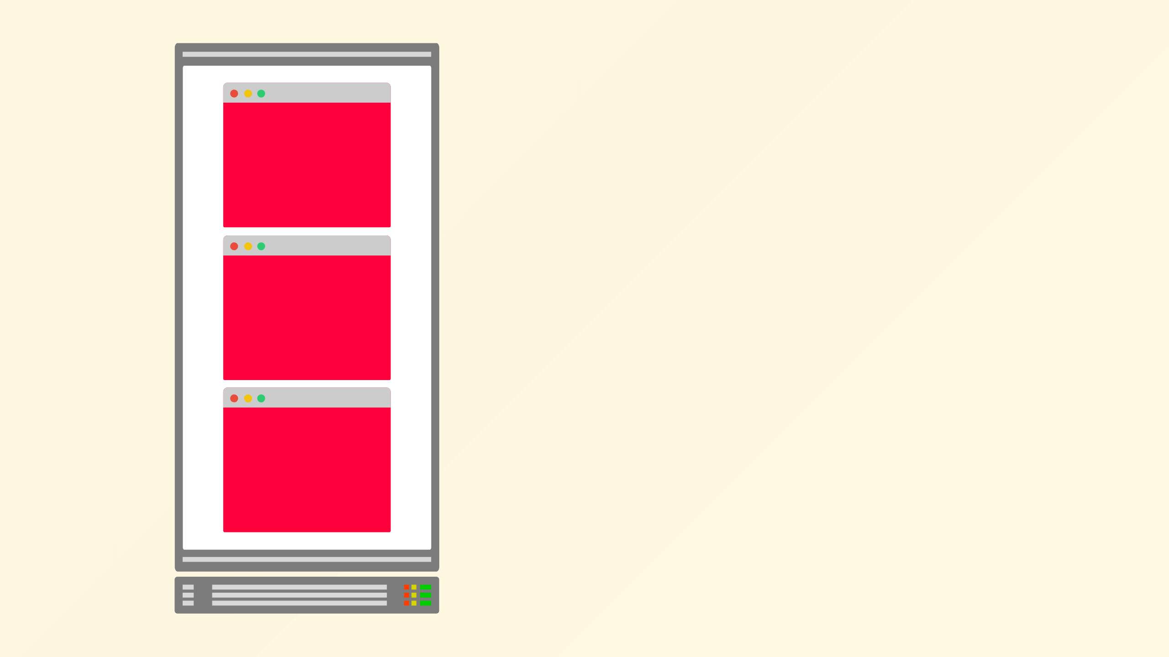
Notes:
But all of a sudden your nodes are full, you can scale no more

Slide 5
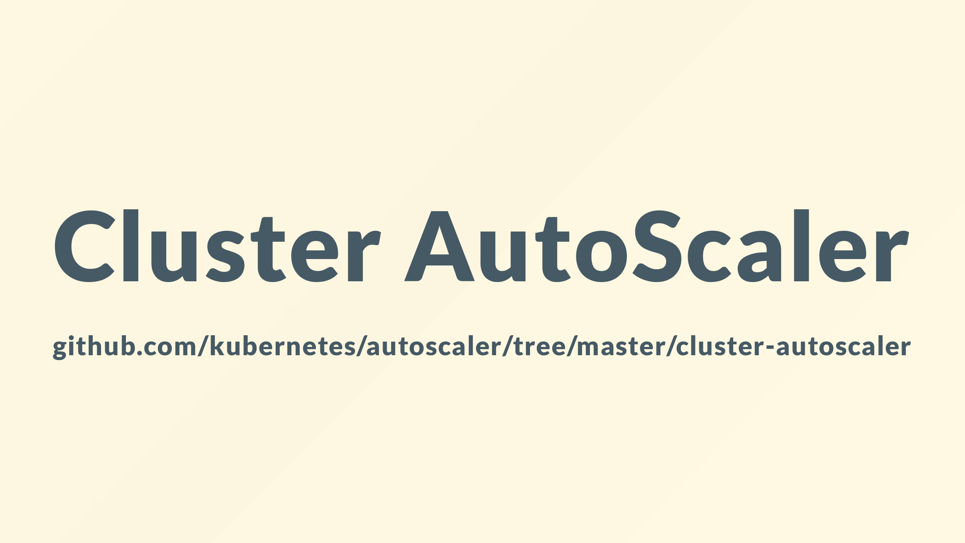
Notes:
Enter the cluster autoscaler and of course a splash of yaml to save the day

Slide 6
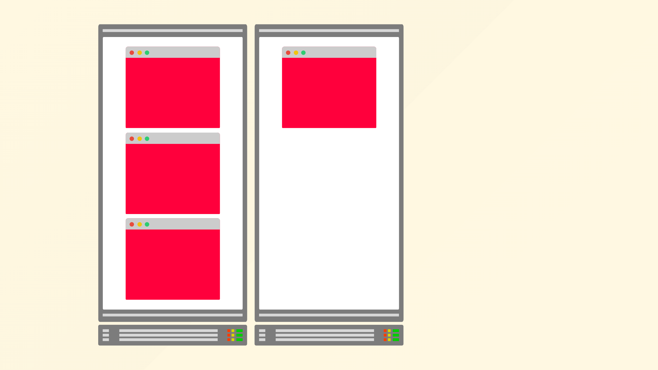
Notes:
It can integrate with your cloud vendor

Slide 7
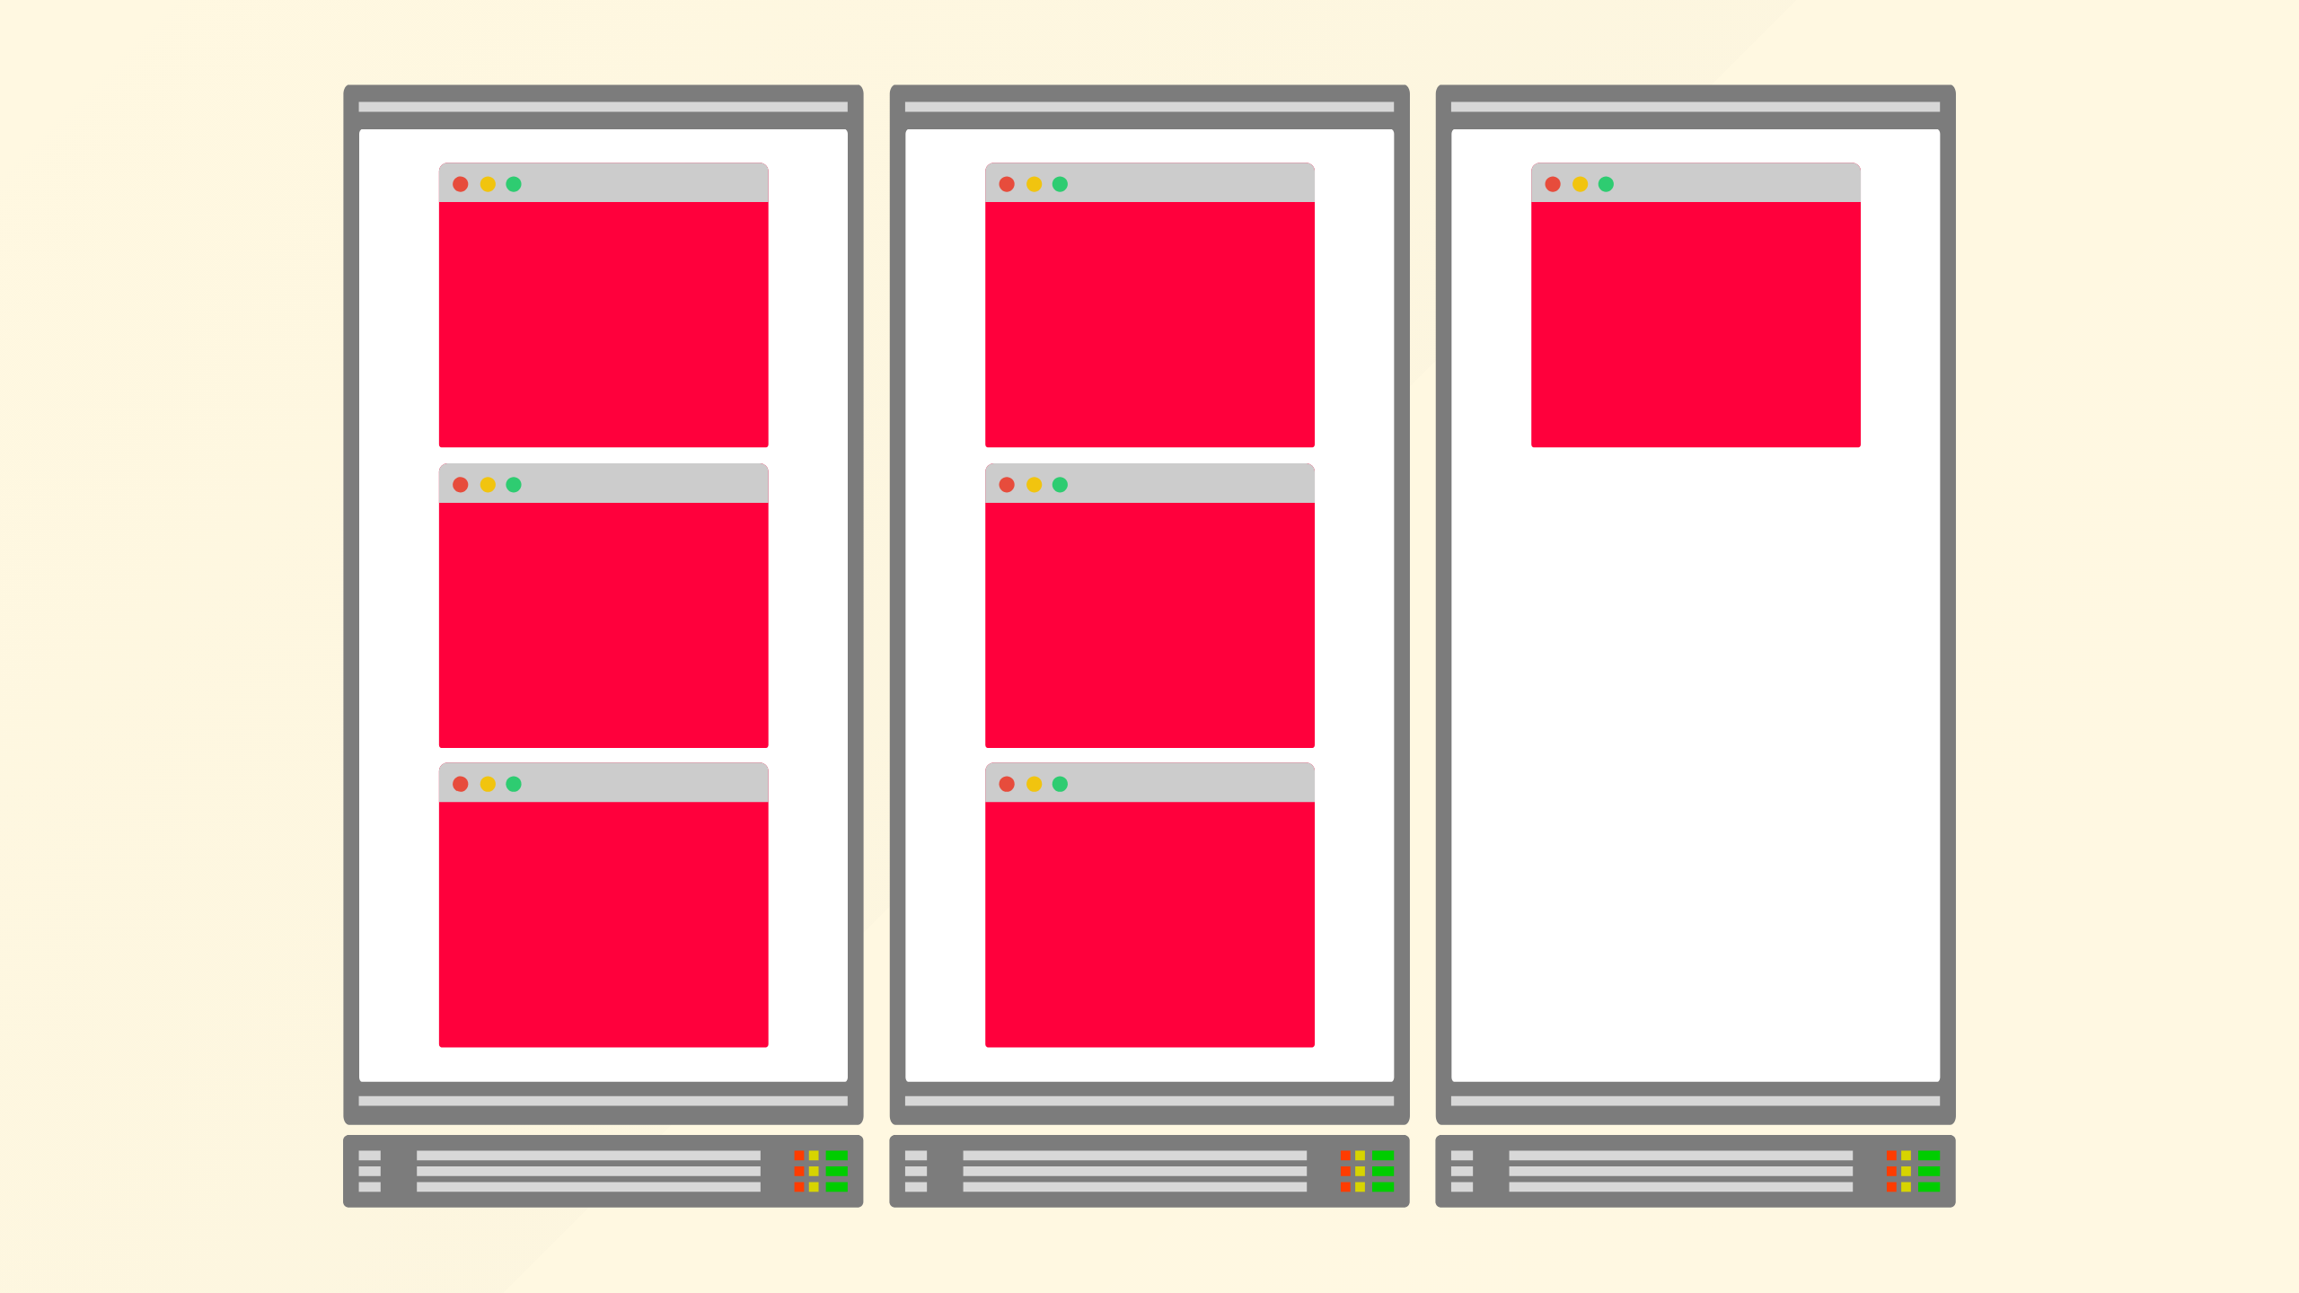
Notes:
To provision necessary nodes

Slide 8
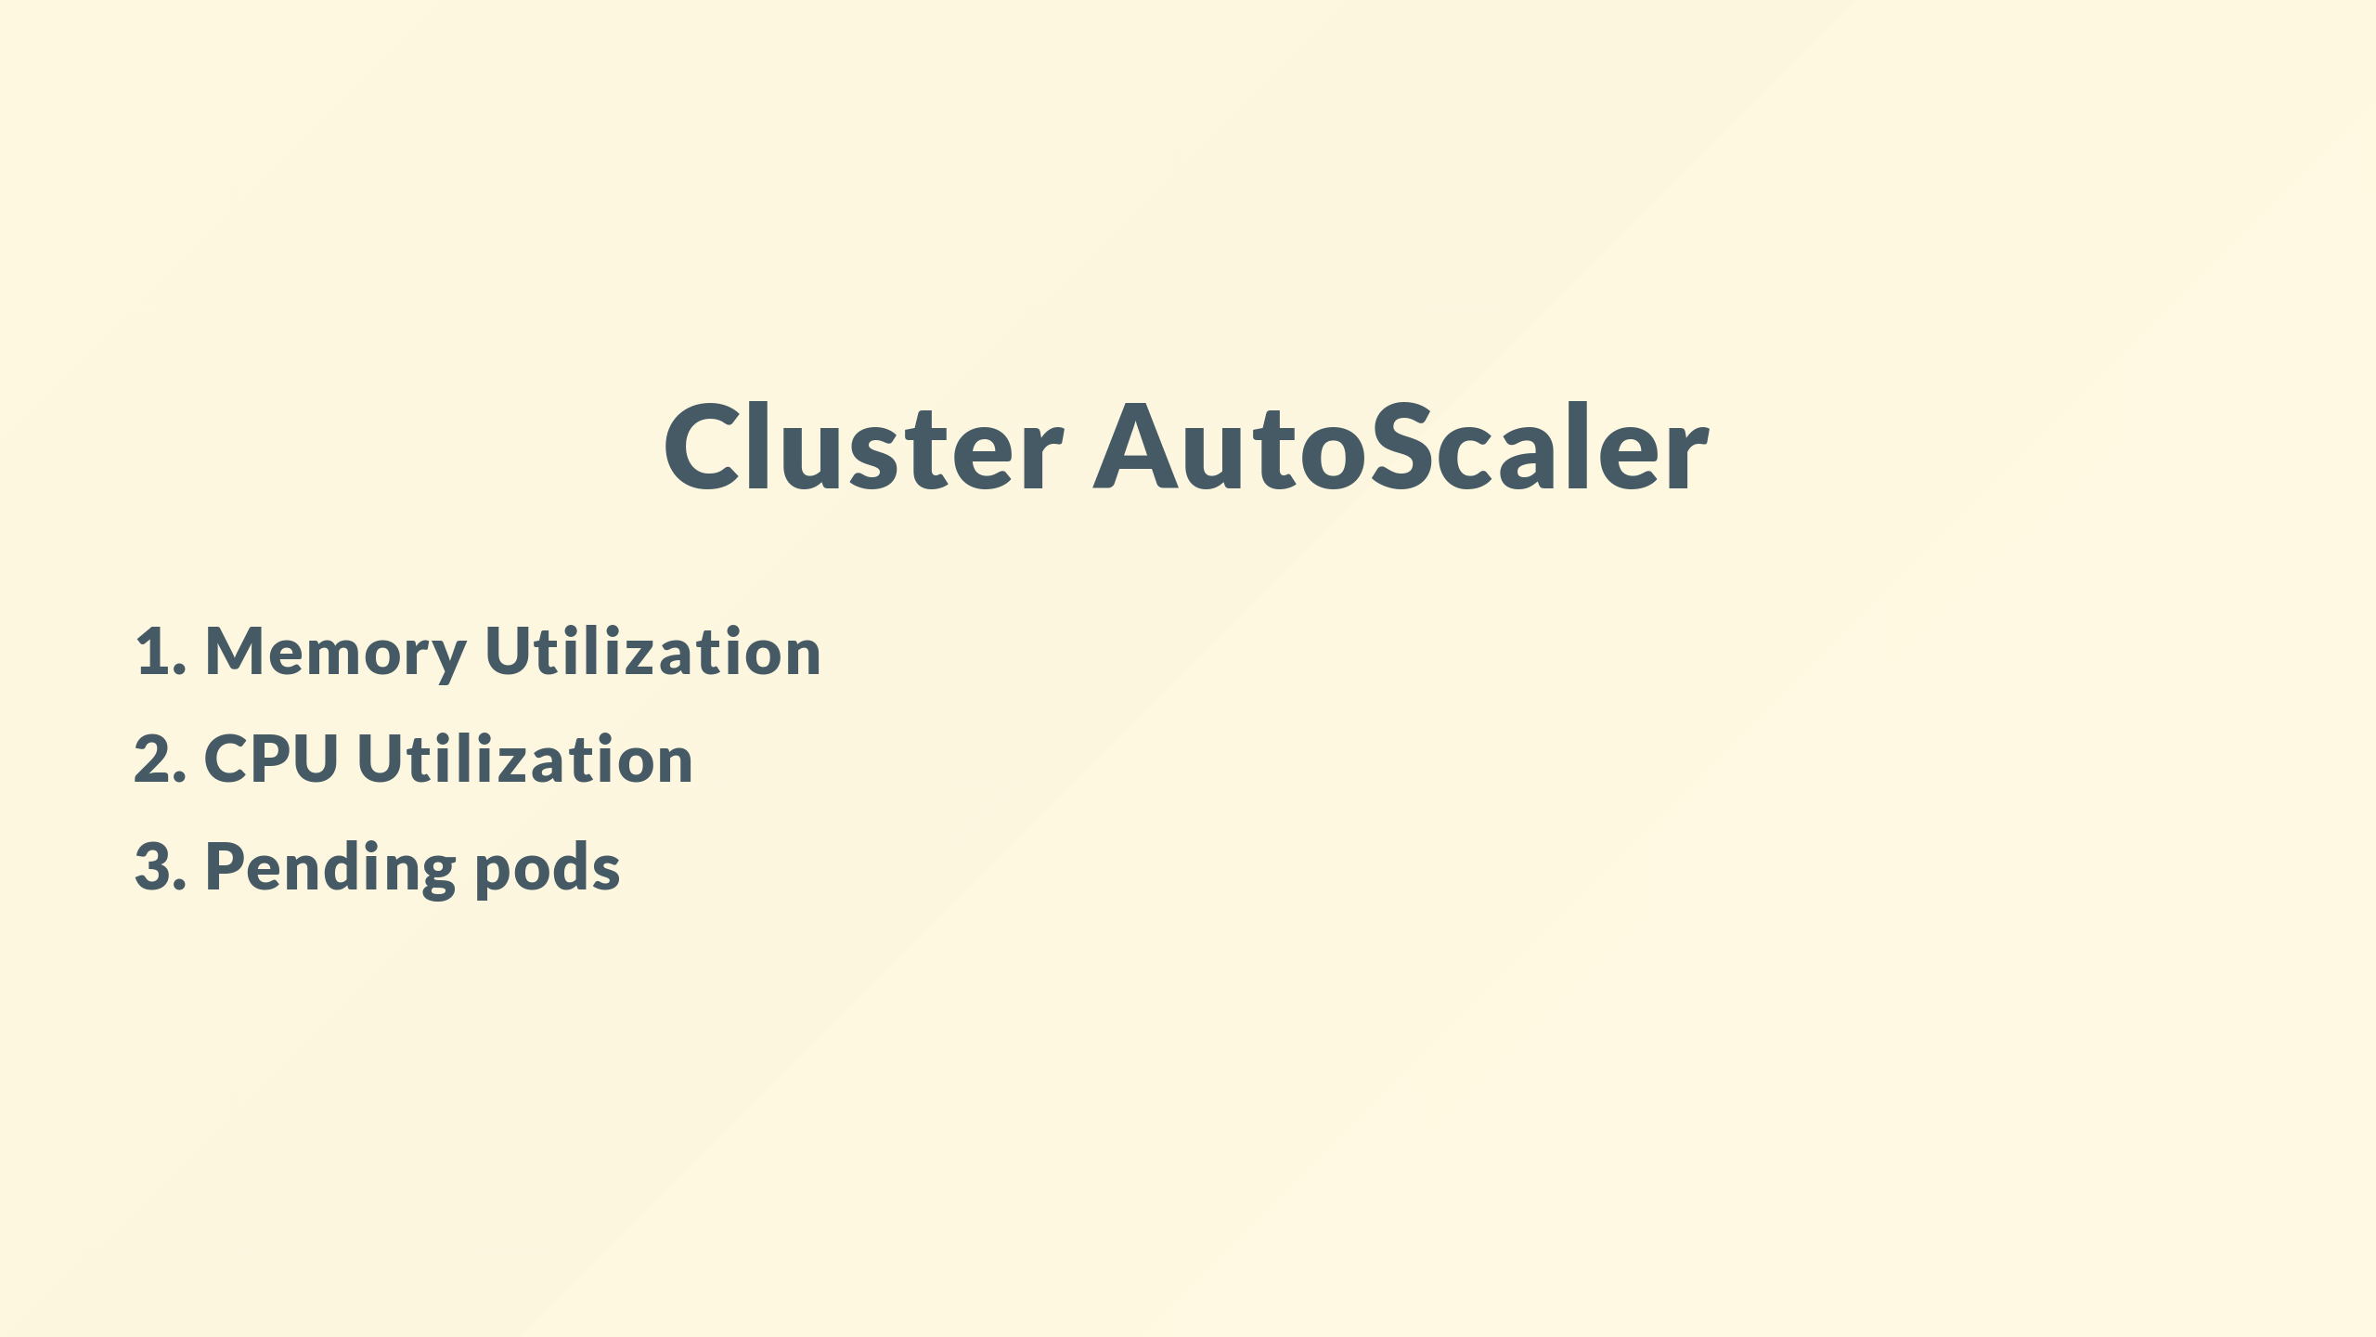
Notes:
and good news the autoscaler is configurable

Slide 9
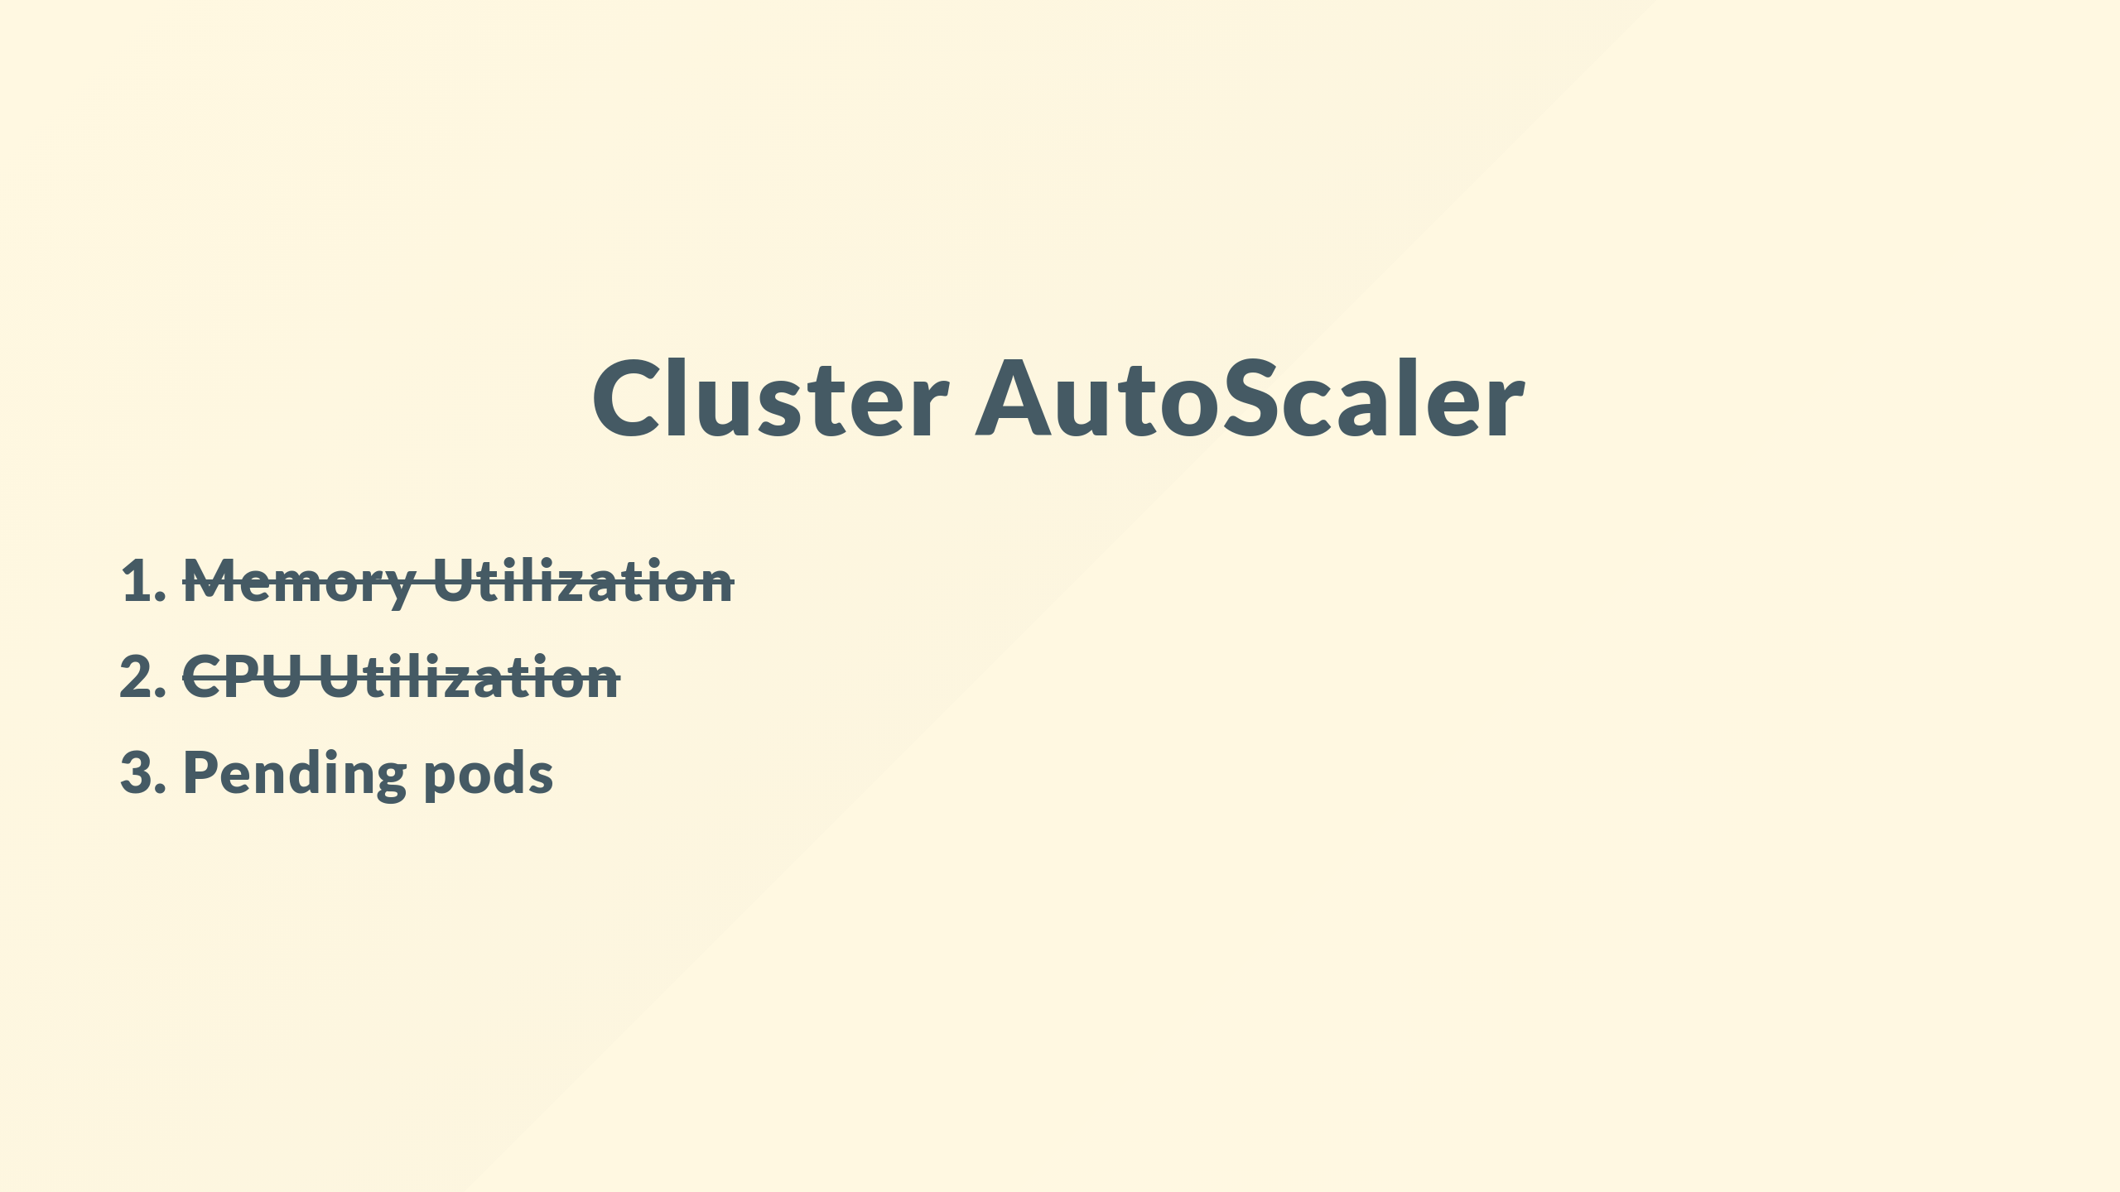
Notes:
though sadly as we'll see its not quite as configurable as you might expect

Slide 10
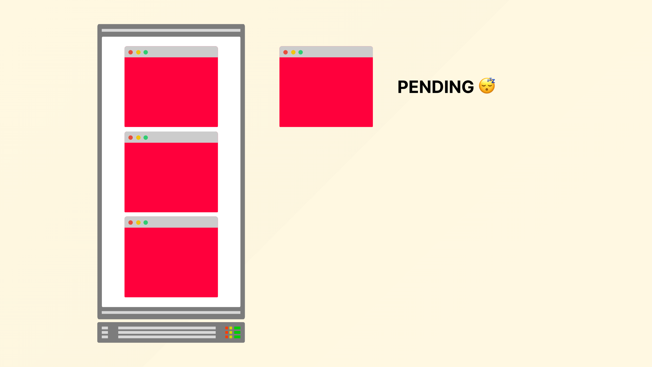
Notes:
there are alternatives but the official cluster autoscaler only scales up when there are pending pods

Slide 11

Notes:
in order to satisfy the demand, which is probably a good idea
since there is little point adding more nodes unless you have workload that needs them

Slide 12
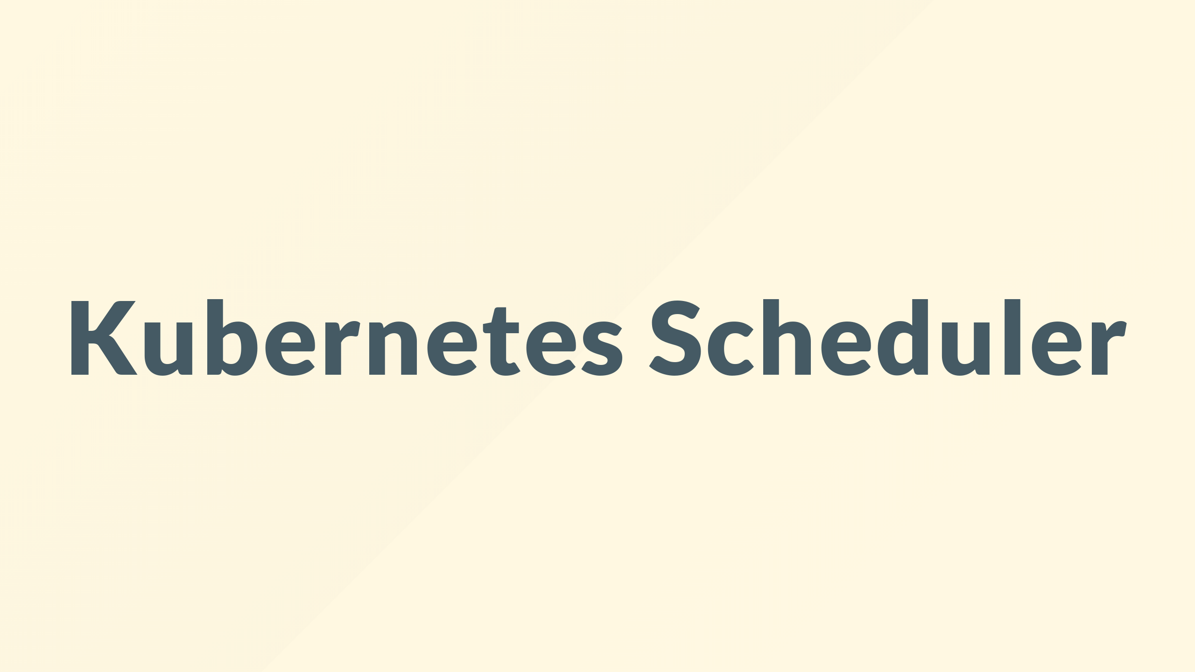
Notes:
ok, so first lets refresh ourselves on how the Kubernetes scheduler works

Slide 13
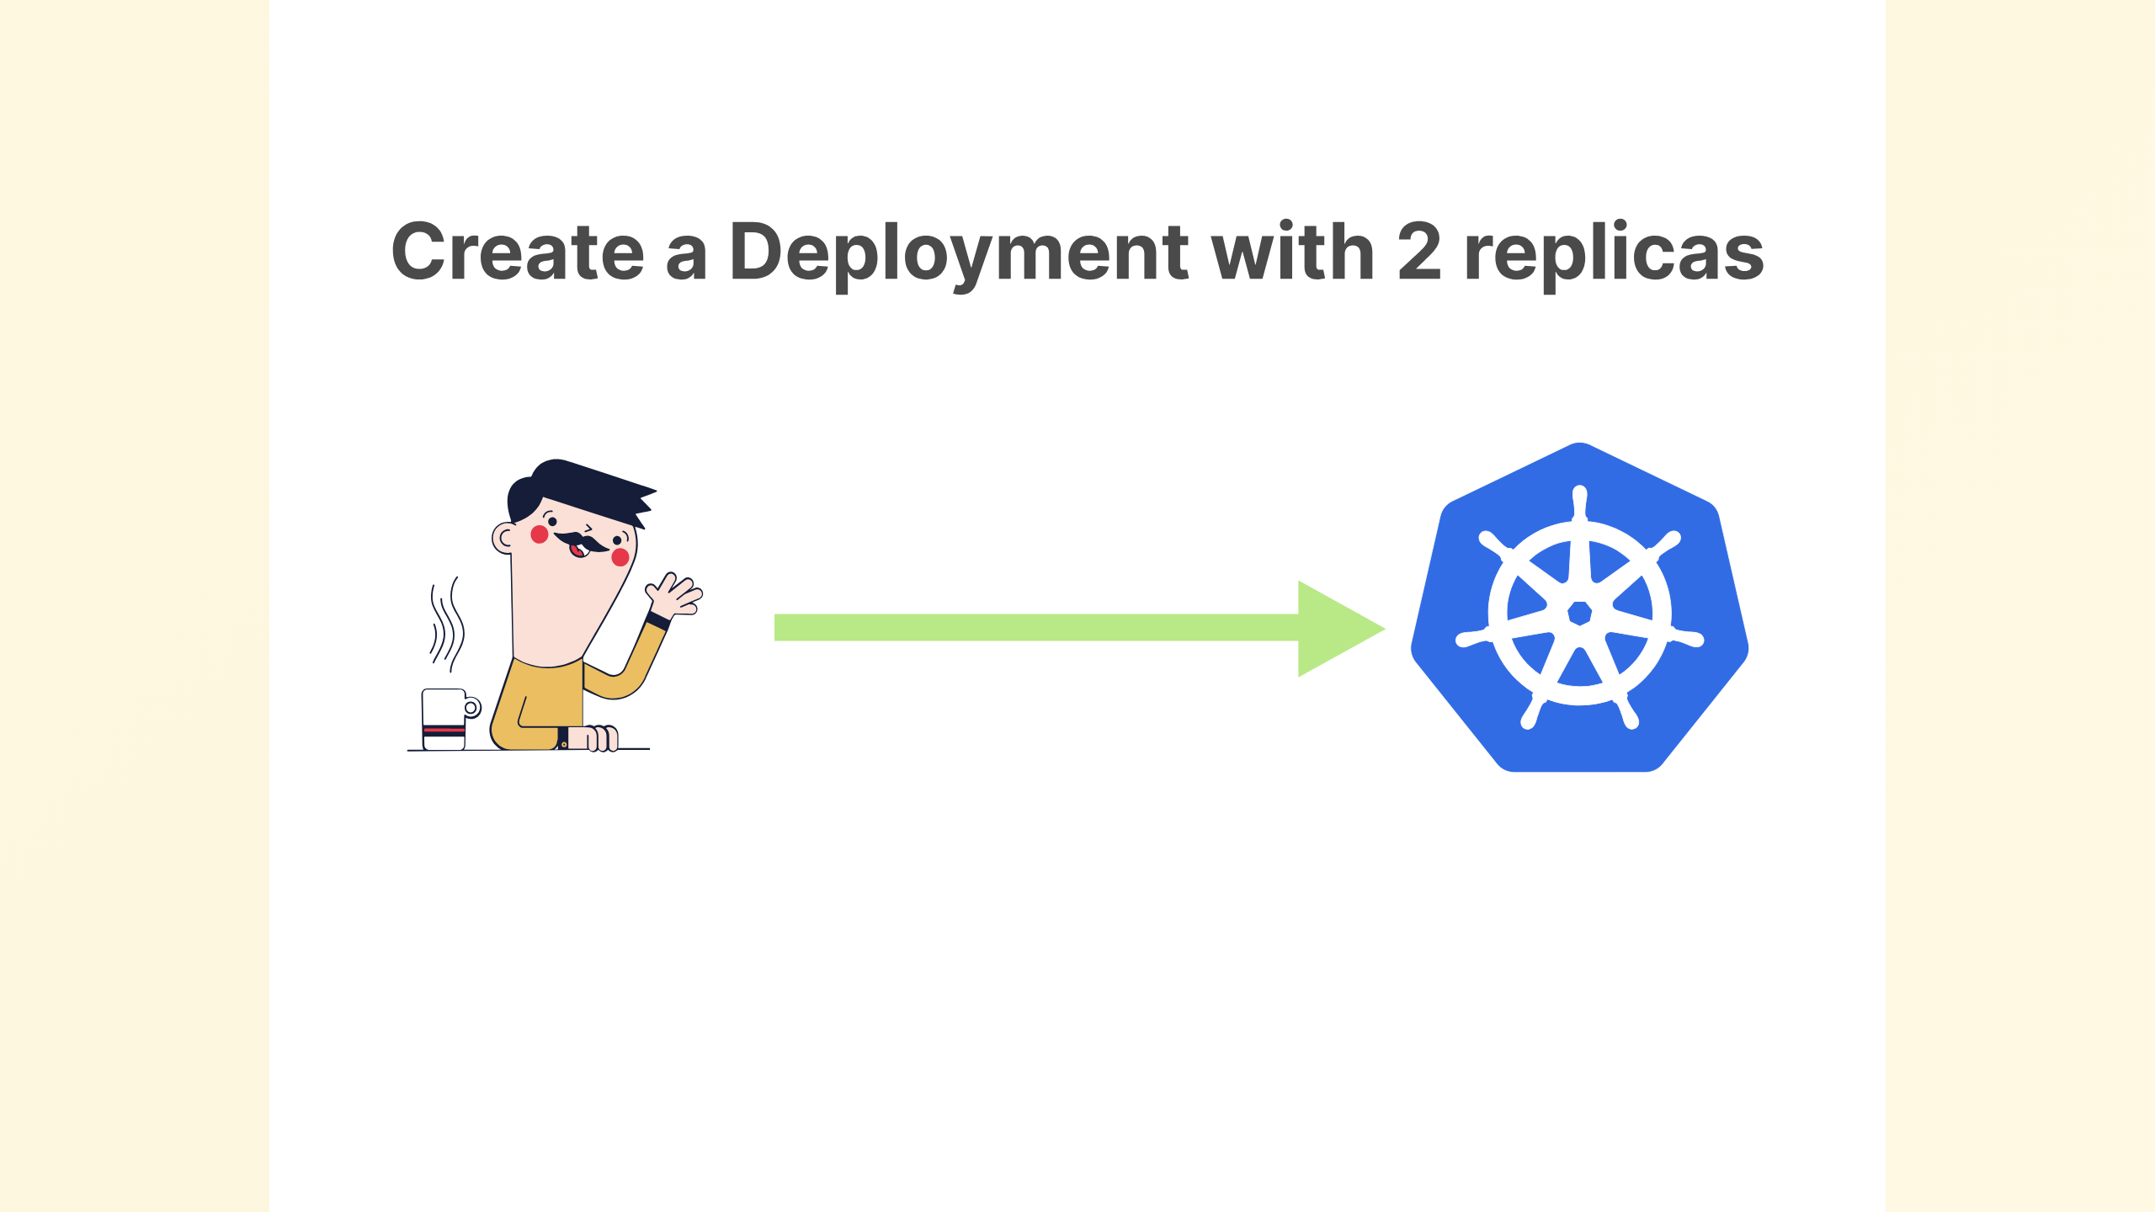
Notes:
If I create a deployment with 2 replicas

Slide 14
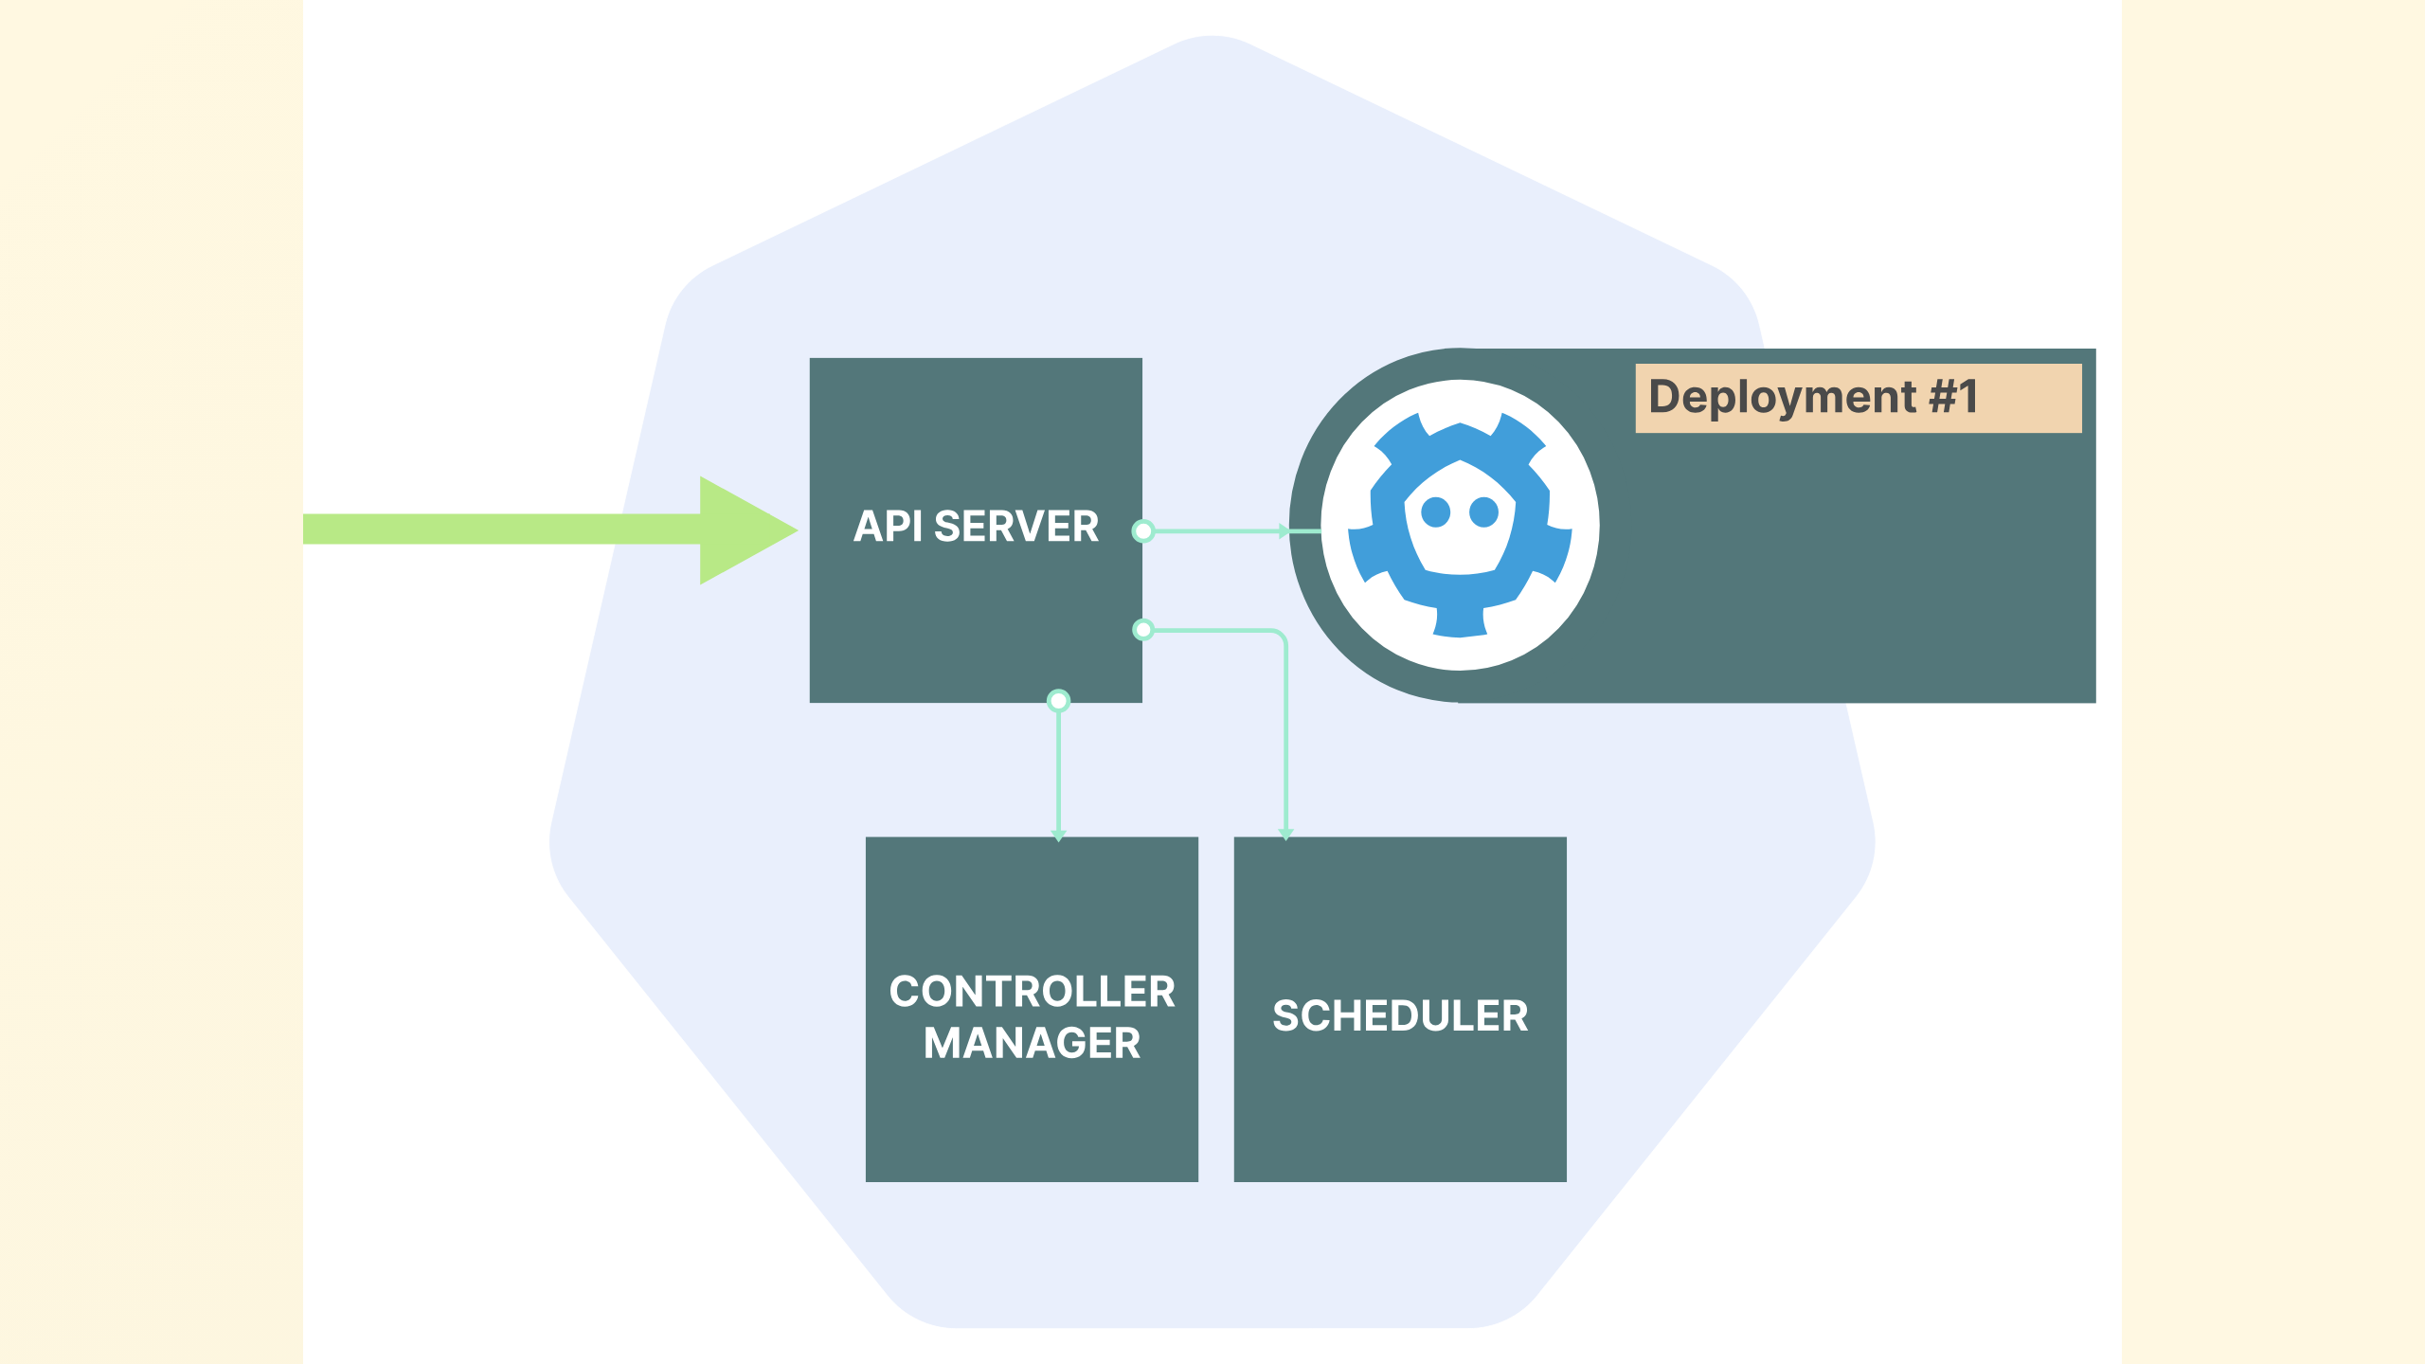
Notes:
I do this by submitting my yaml to the API server, which writes it to etcd

Slide 15
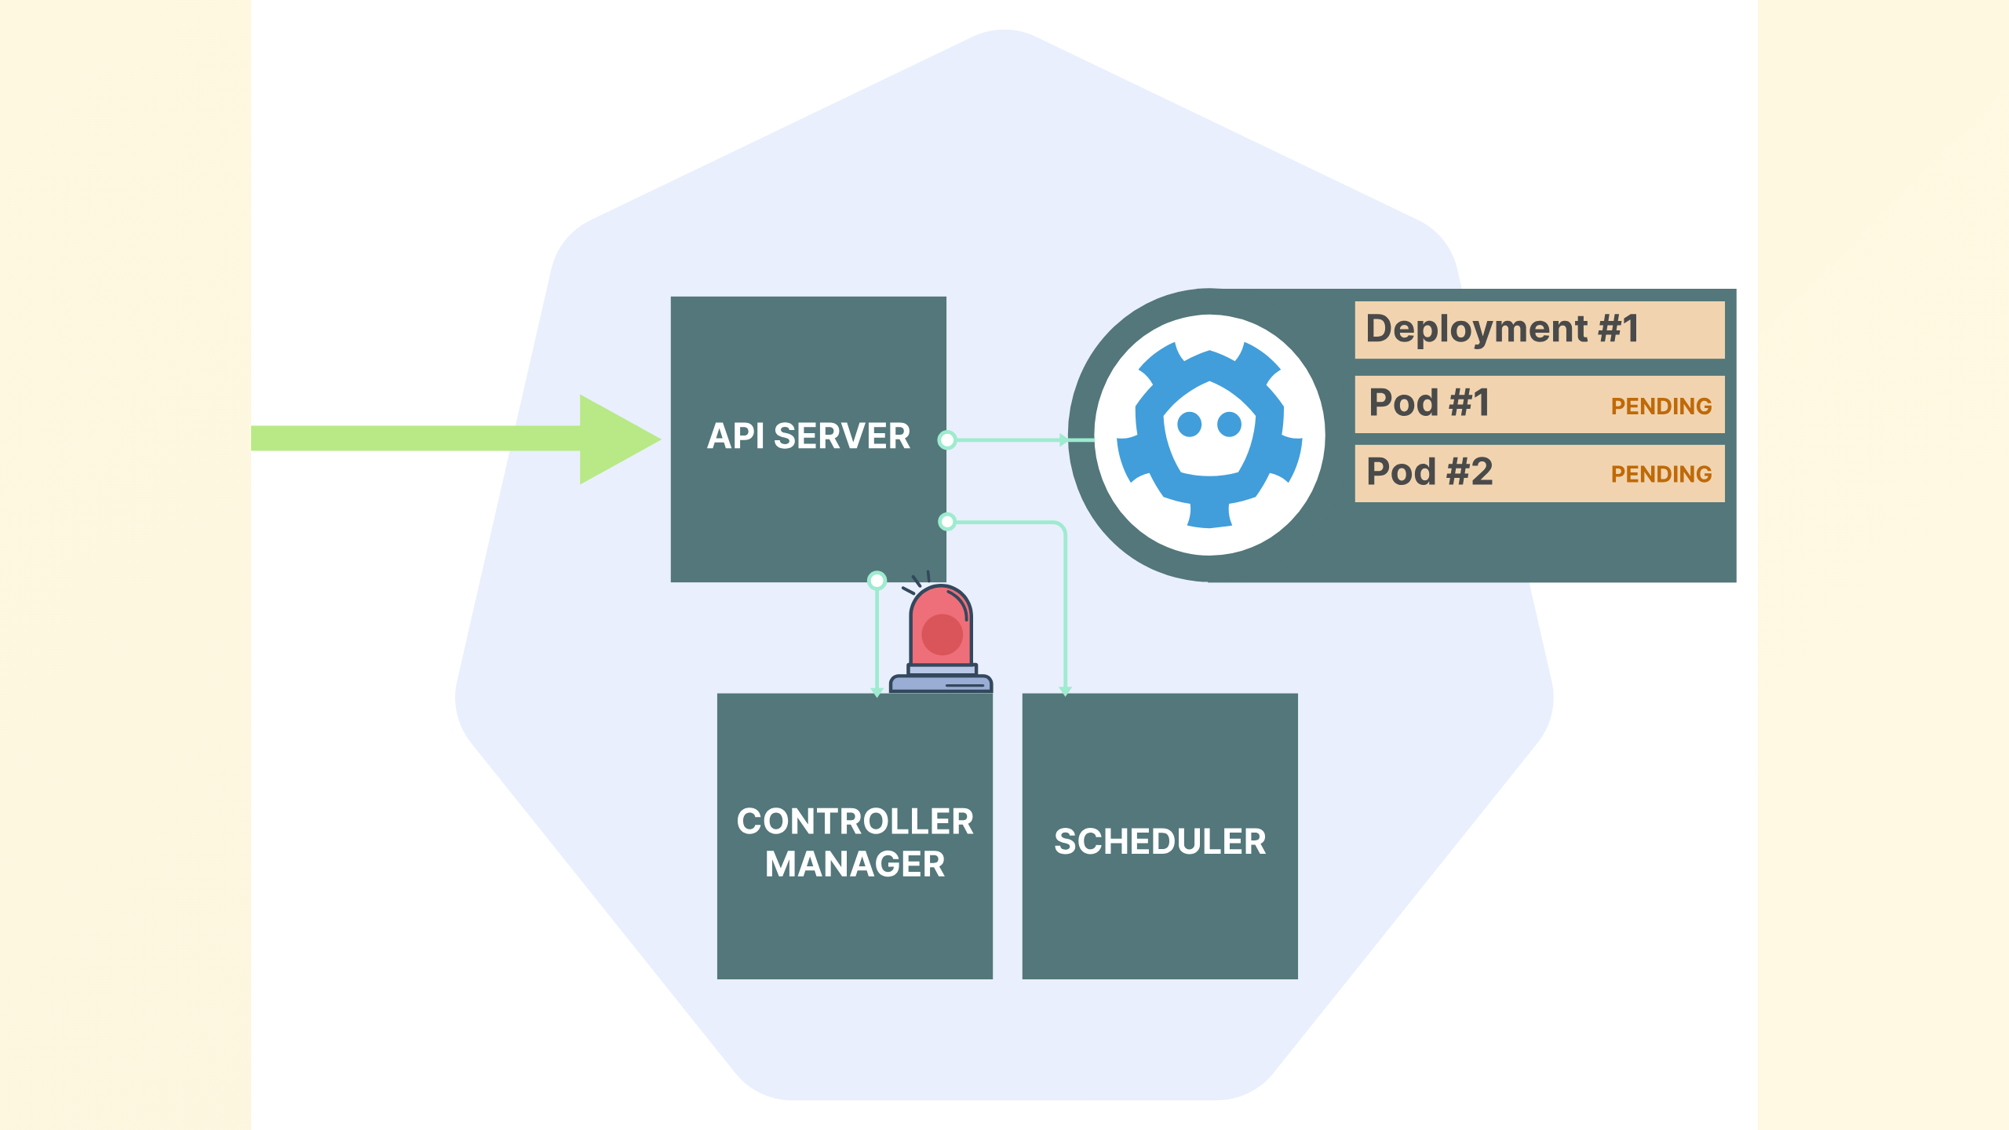
Notes:
the controller is watching for this type of event, recognizes it needs to create some pods, which it does and these are now pending

Slide 16
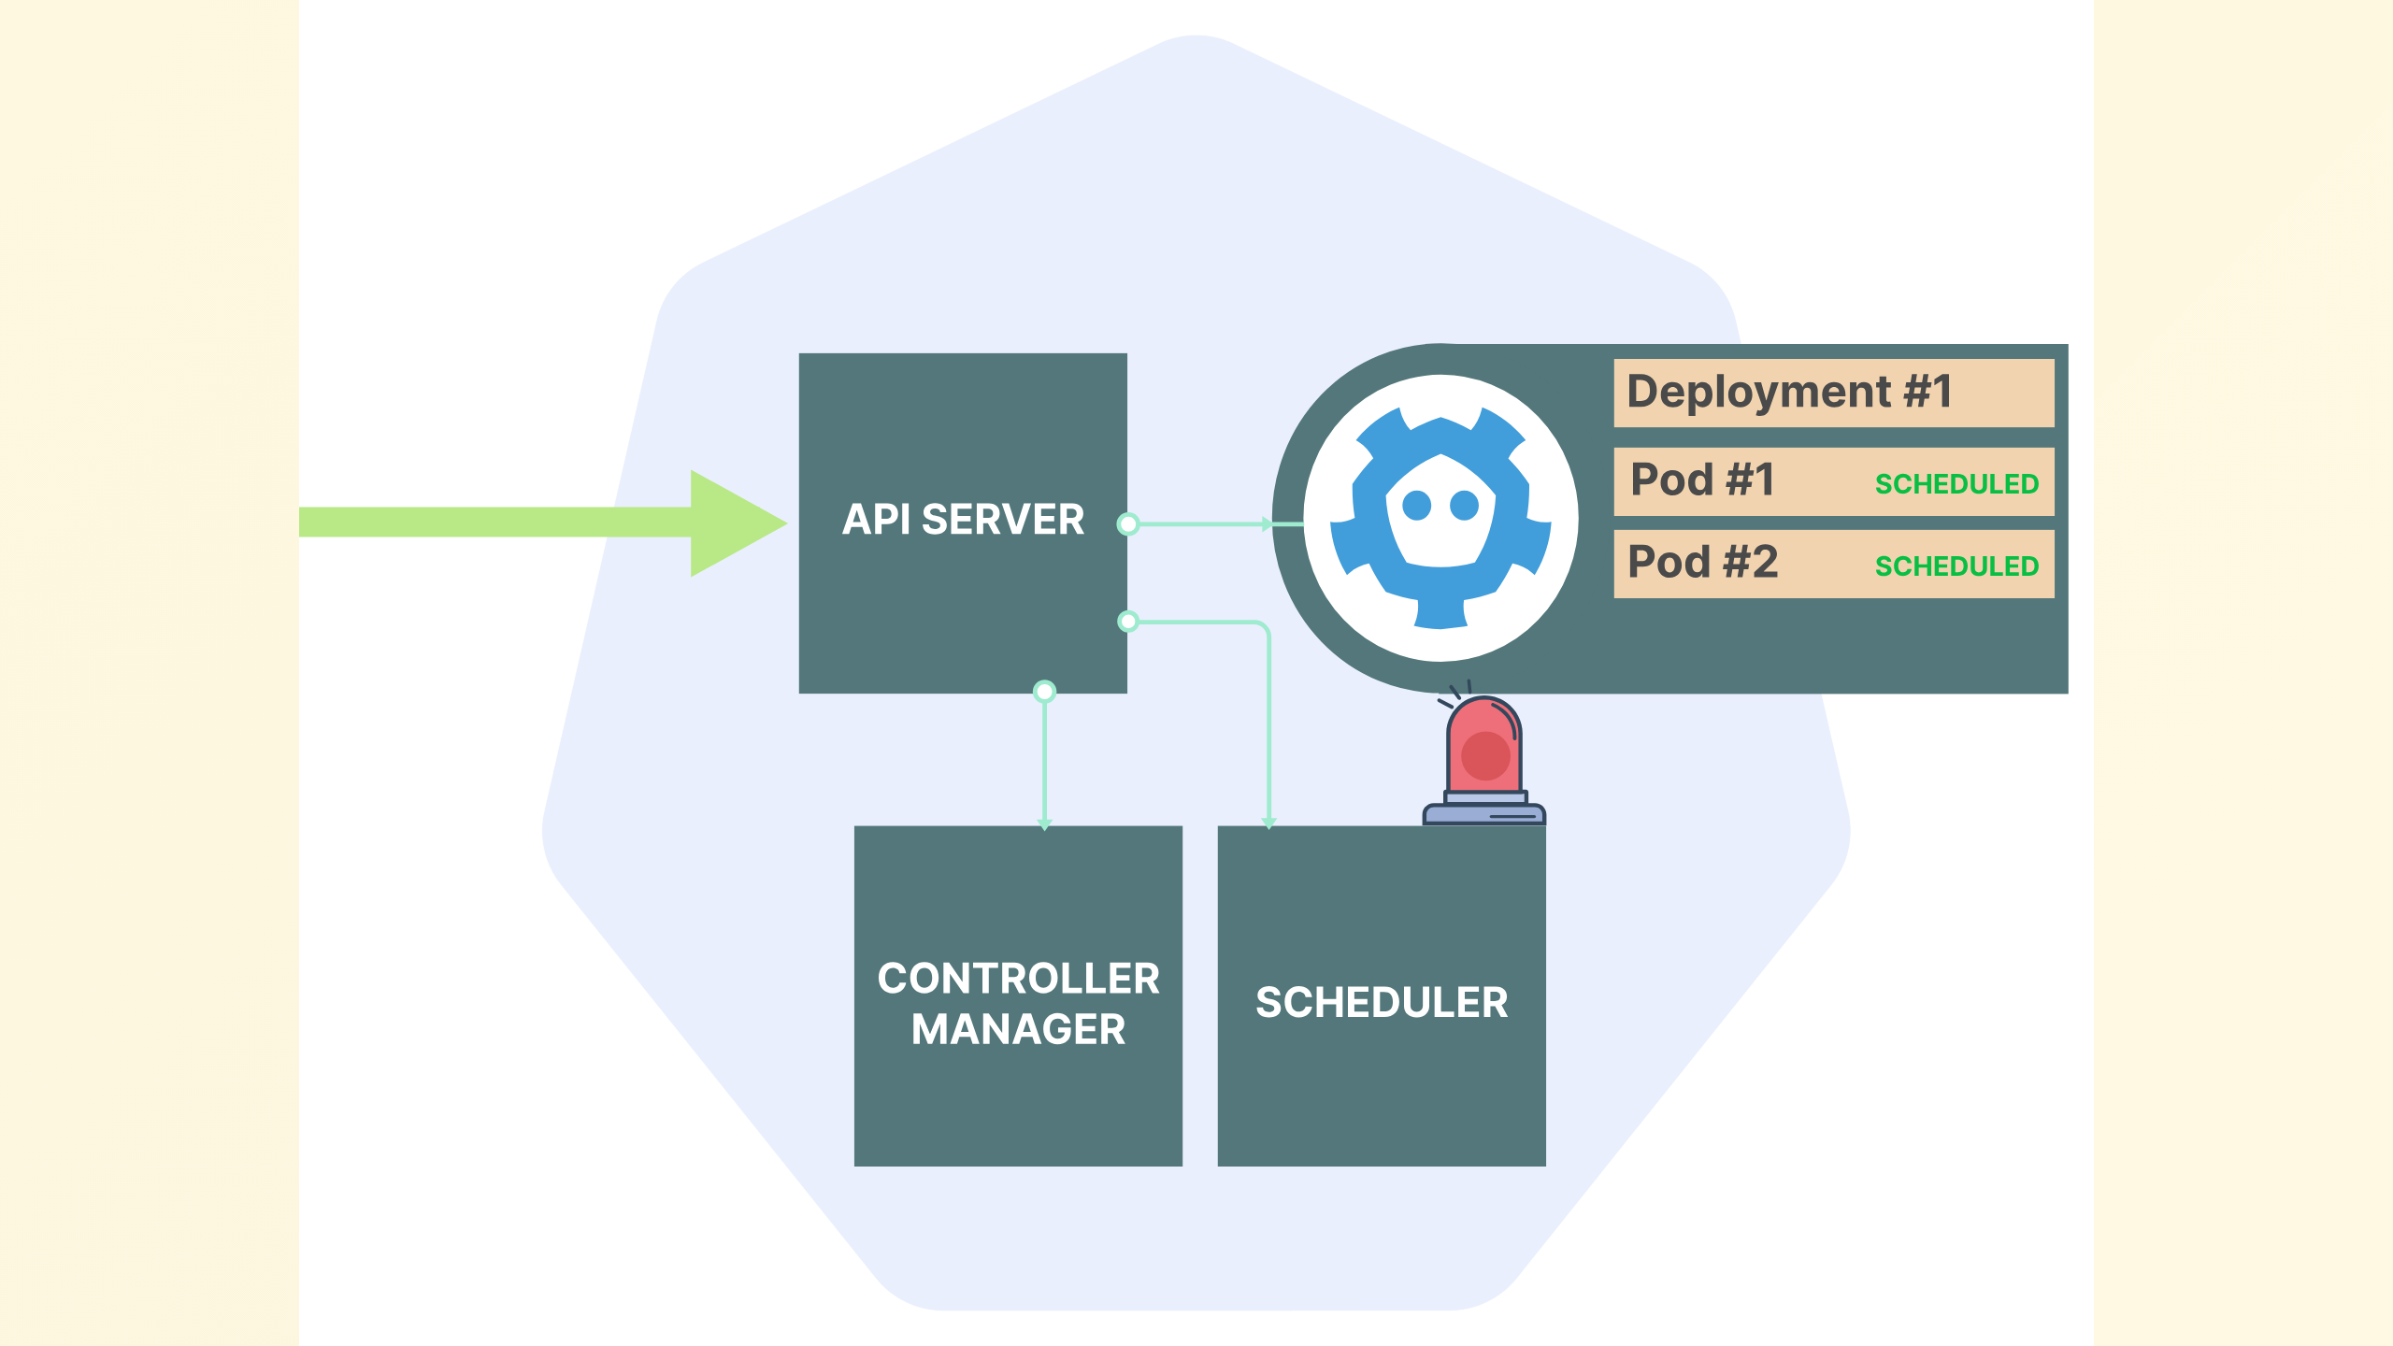
Notes:
the scheduler is the component that is looking for pending pods, sees these and then schedules them to a node

Slide 17
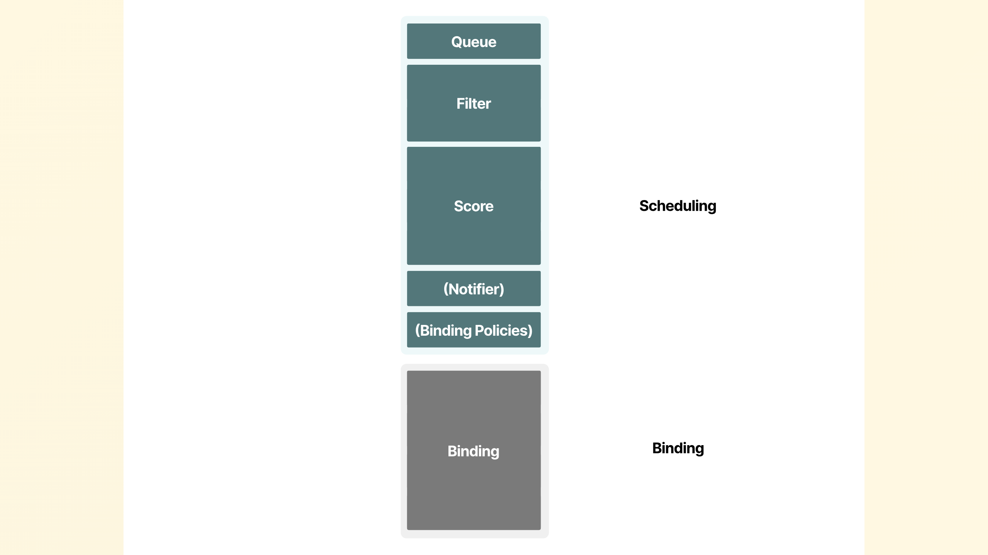
Notes:
the scheduling however is broken into a few steps
From the initial queue
through filtering viable nodes to then scoring them before creating a binding

Slide 18
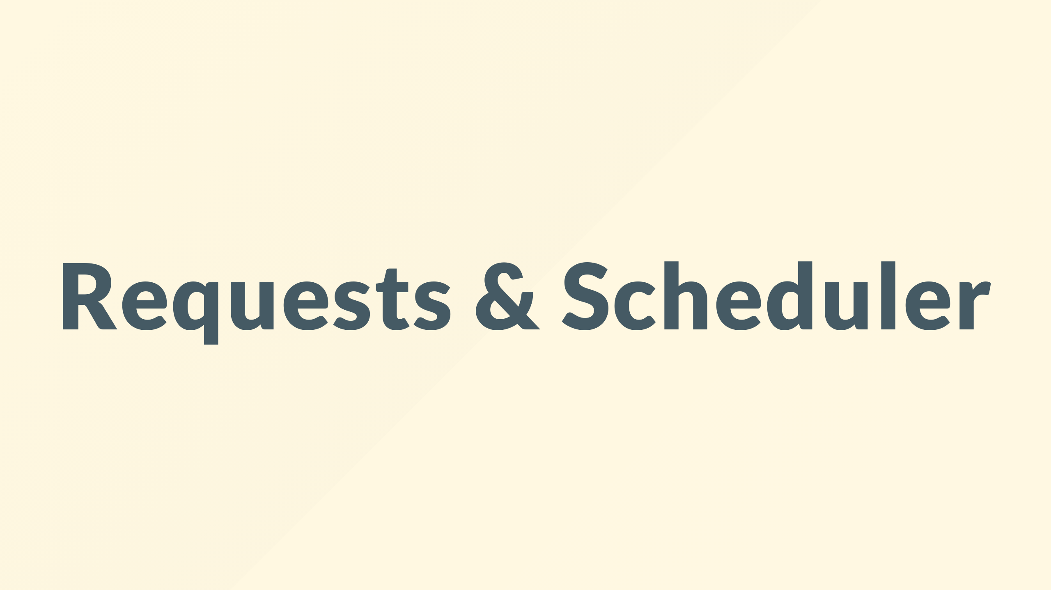
Notes:
but how does the scheduler know how much memory and cpu a pod uses? It does not…

Slide 19
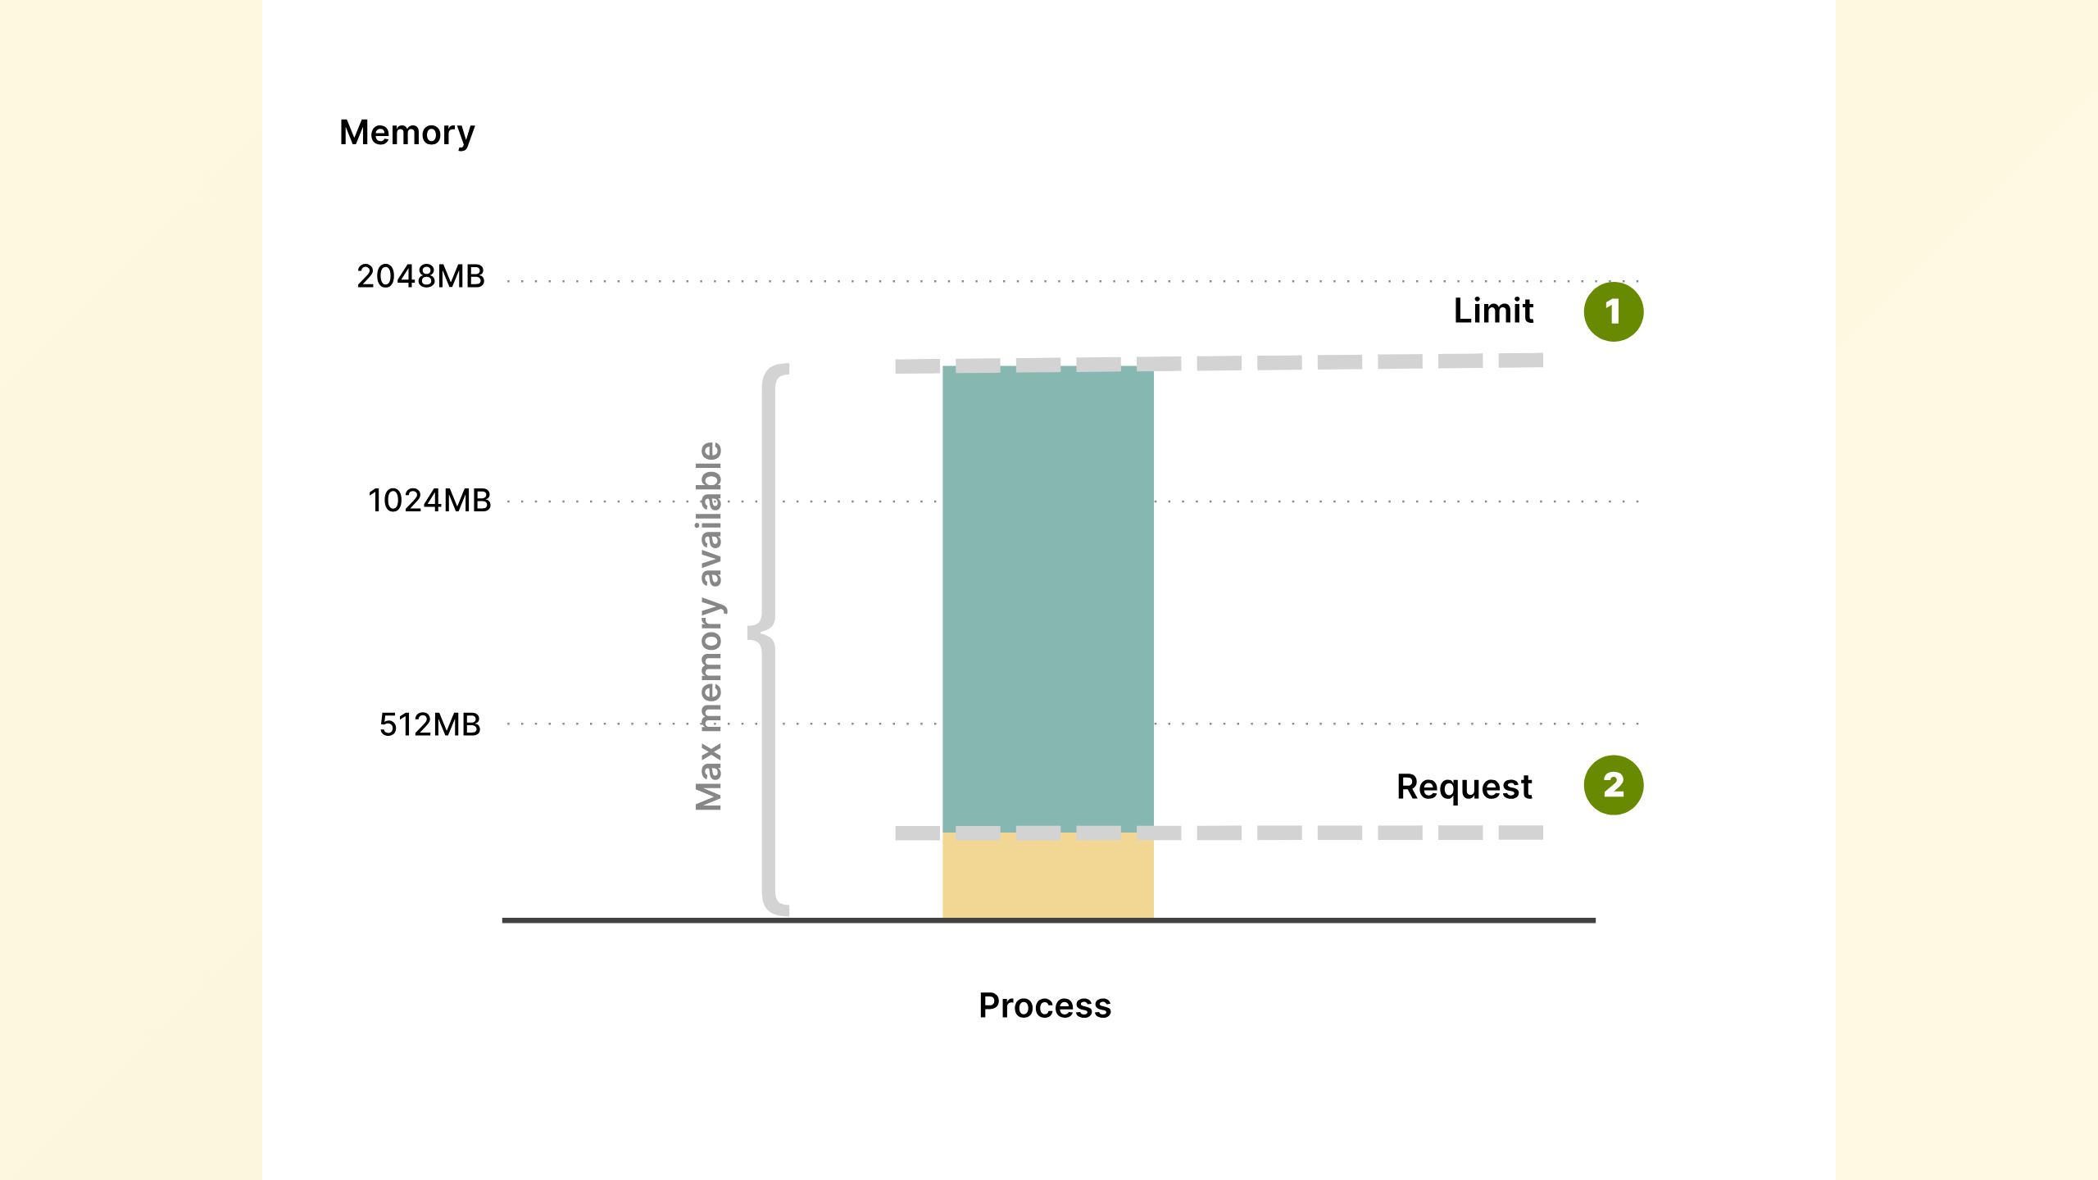
Notes:
you need to spoon feed this with requests and limits

Slide 20
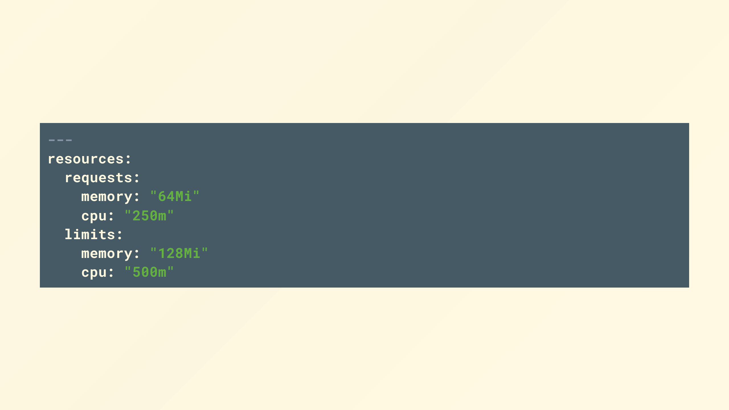
Notes:
If you don't specify requests and limits Kubernetes will play blind, your cluster will become overloaded, nodes will become over subscribed and you'll be constantly fighting fires.
So if your only takeaway is that all your containers should have requests and limits defined then we've done something useful here!
Requests are the initial ask, and limits are the point that your container will be throttled if its CPU or killed if its memory,

Slide 21
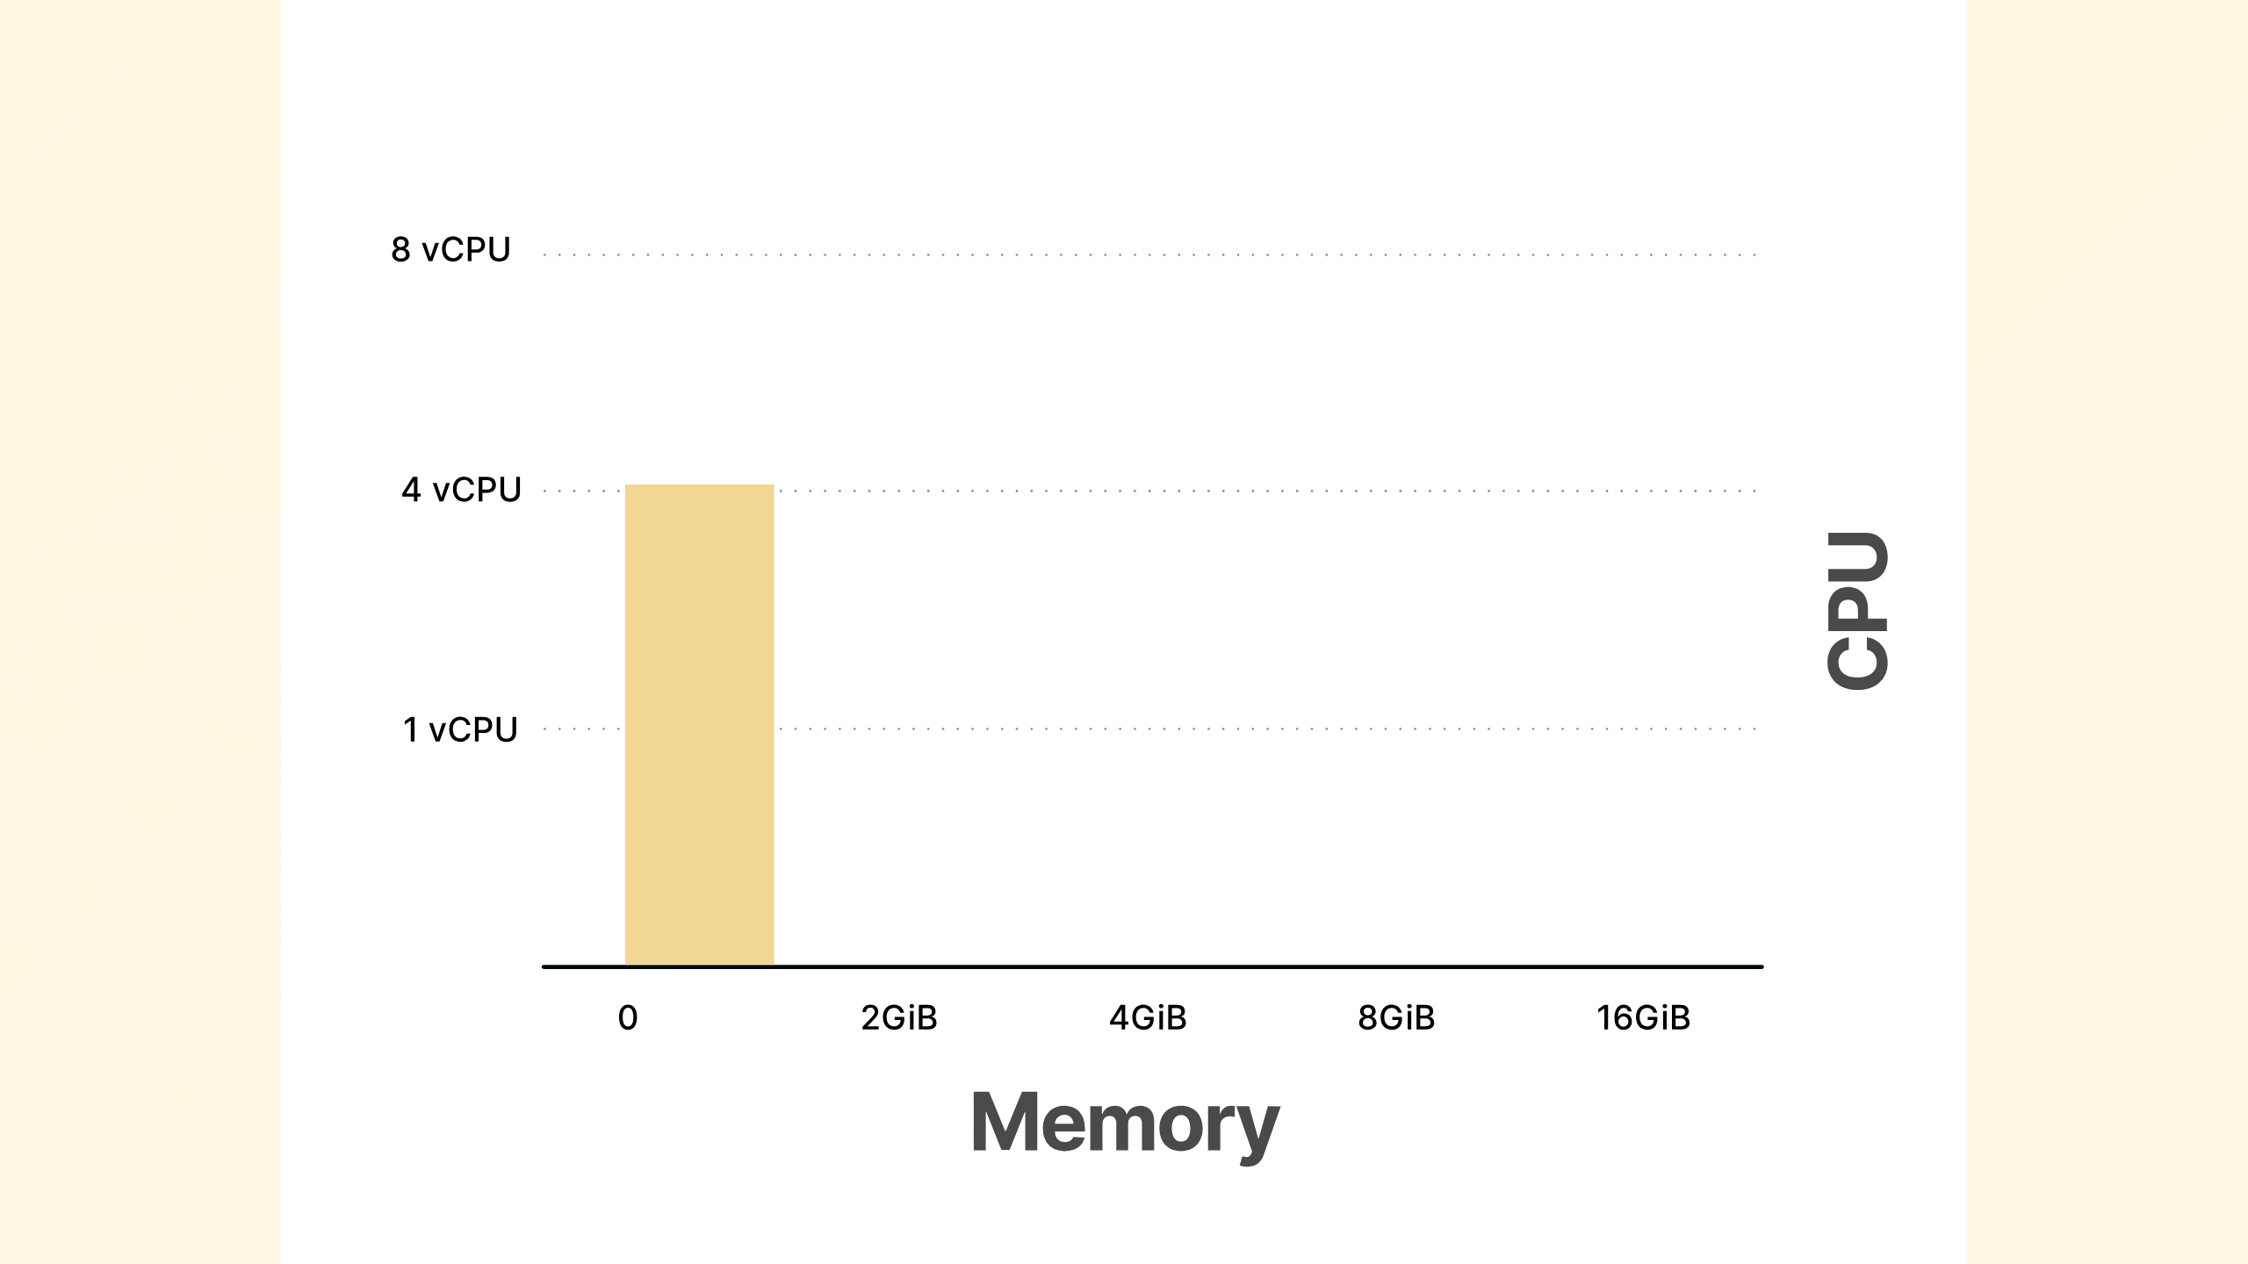
Notes:
Applications come in all sorts of shapes and sizes, so you may have some applications that are CPU intensive but don't require much memory, while others

Slide 22
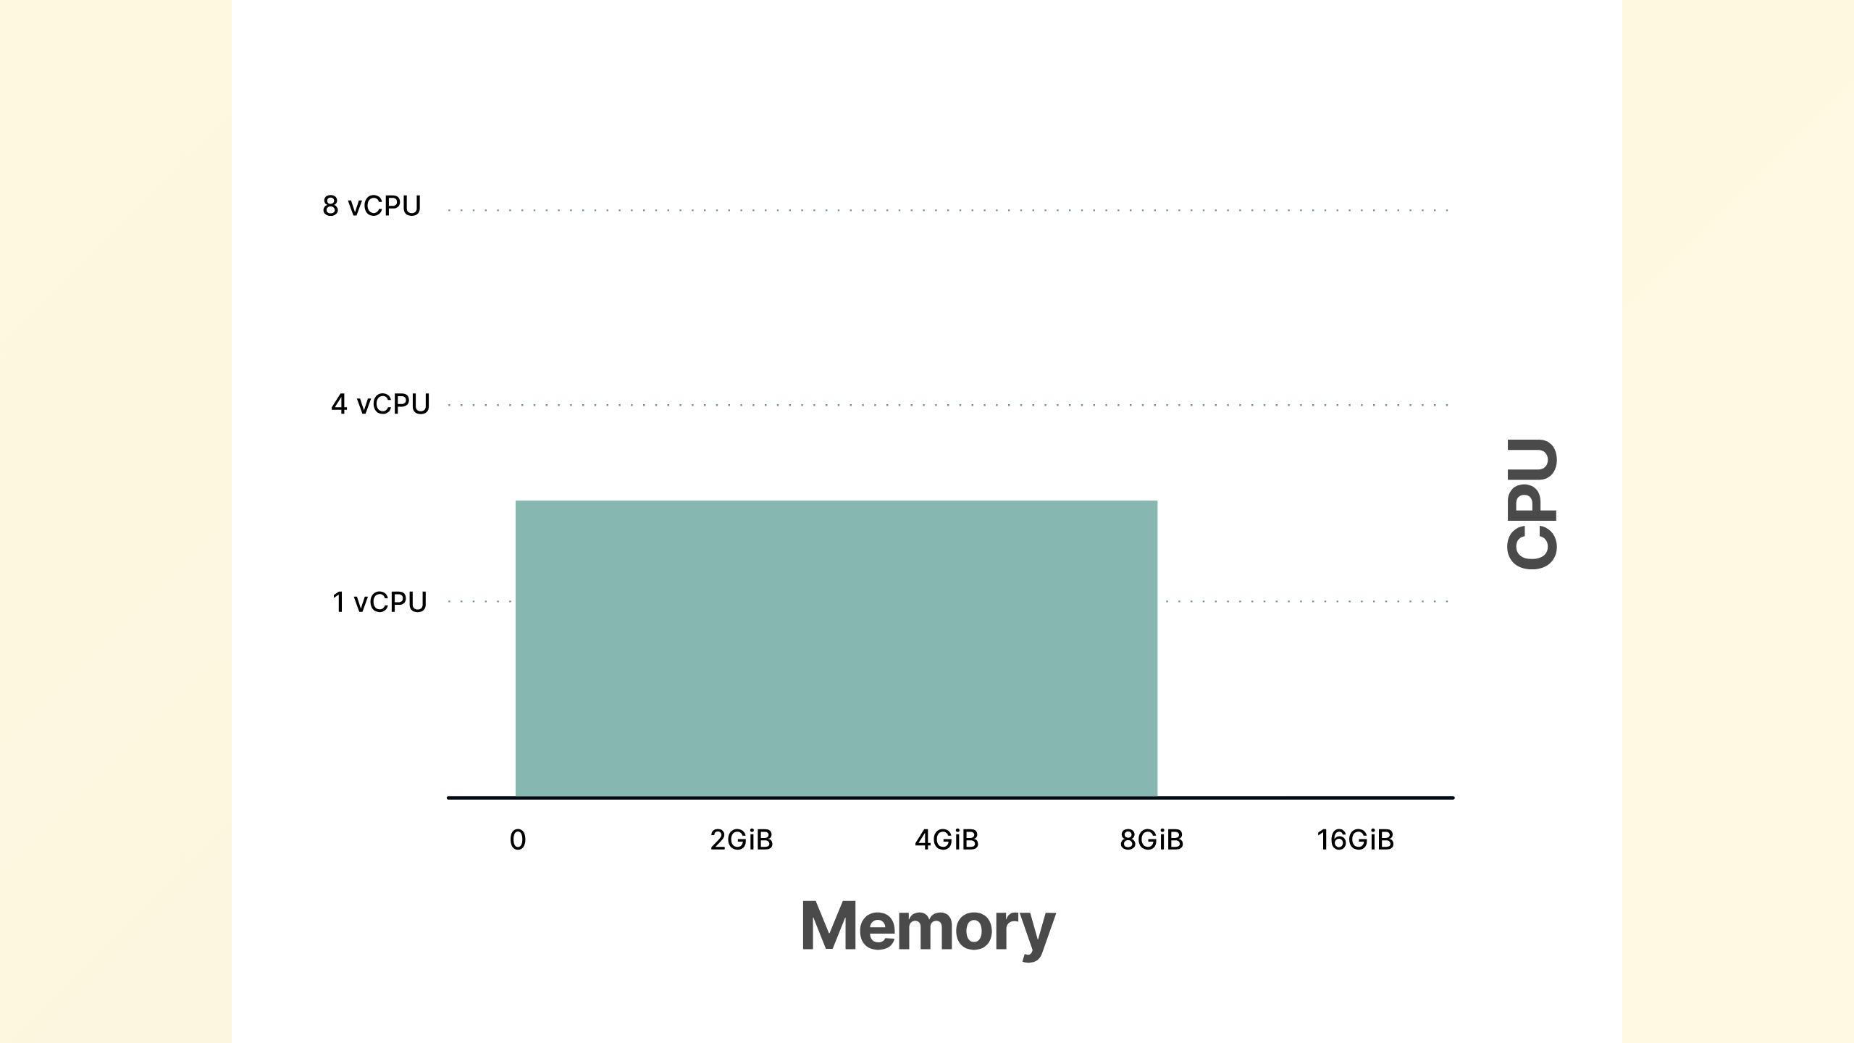
Notes:
May have a greater memory than CPU footprint

Slide 23
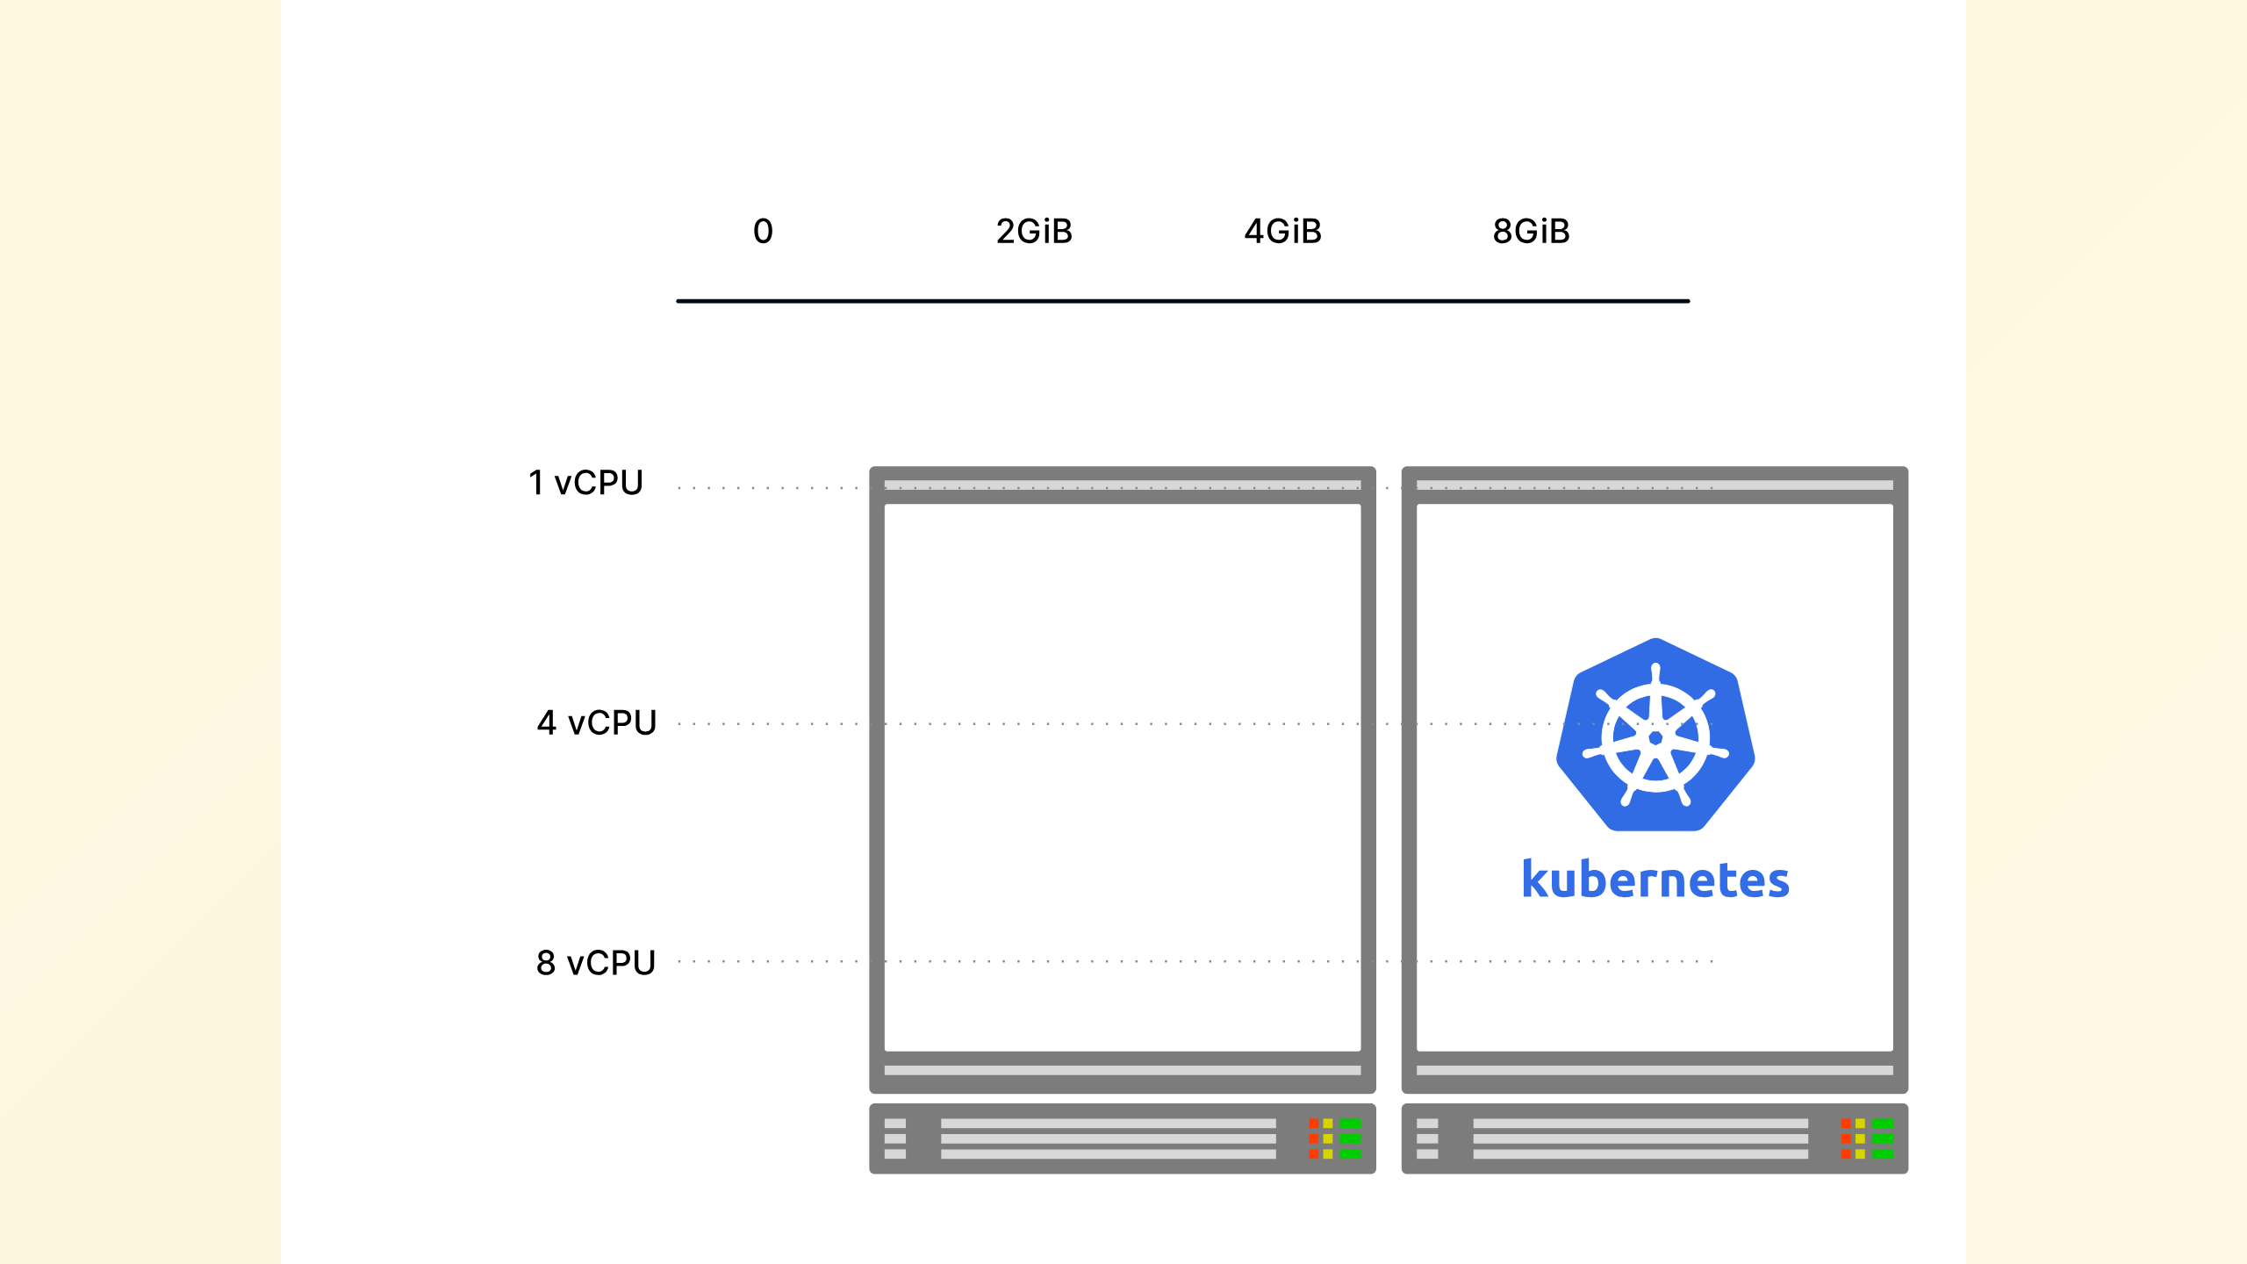
Notes:
Those applications have to be deployed inside computing units which have (again) CPU and memory characteristics.

Slide 24
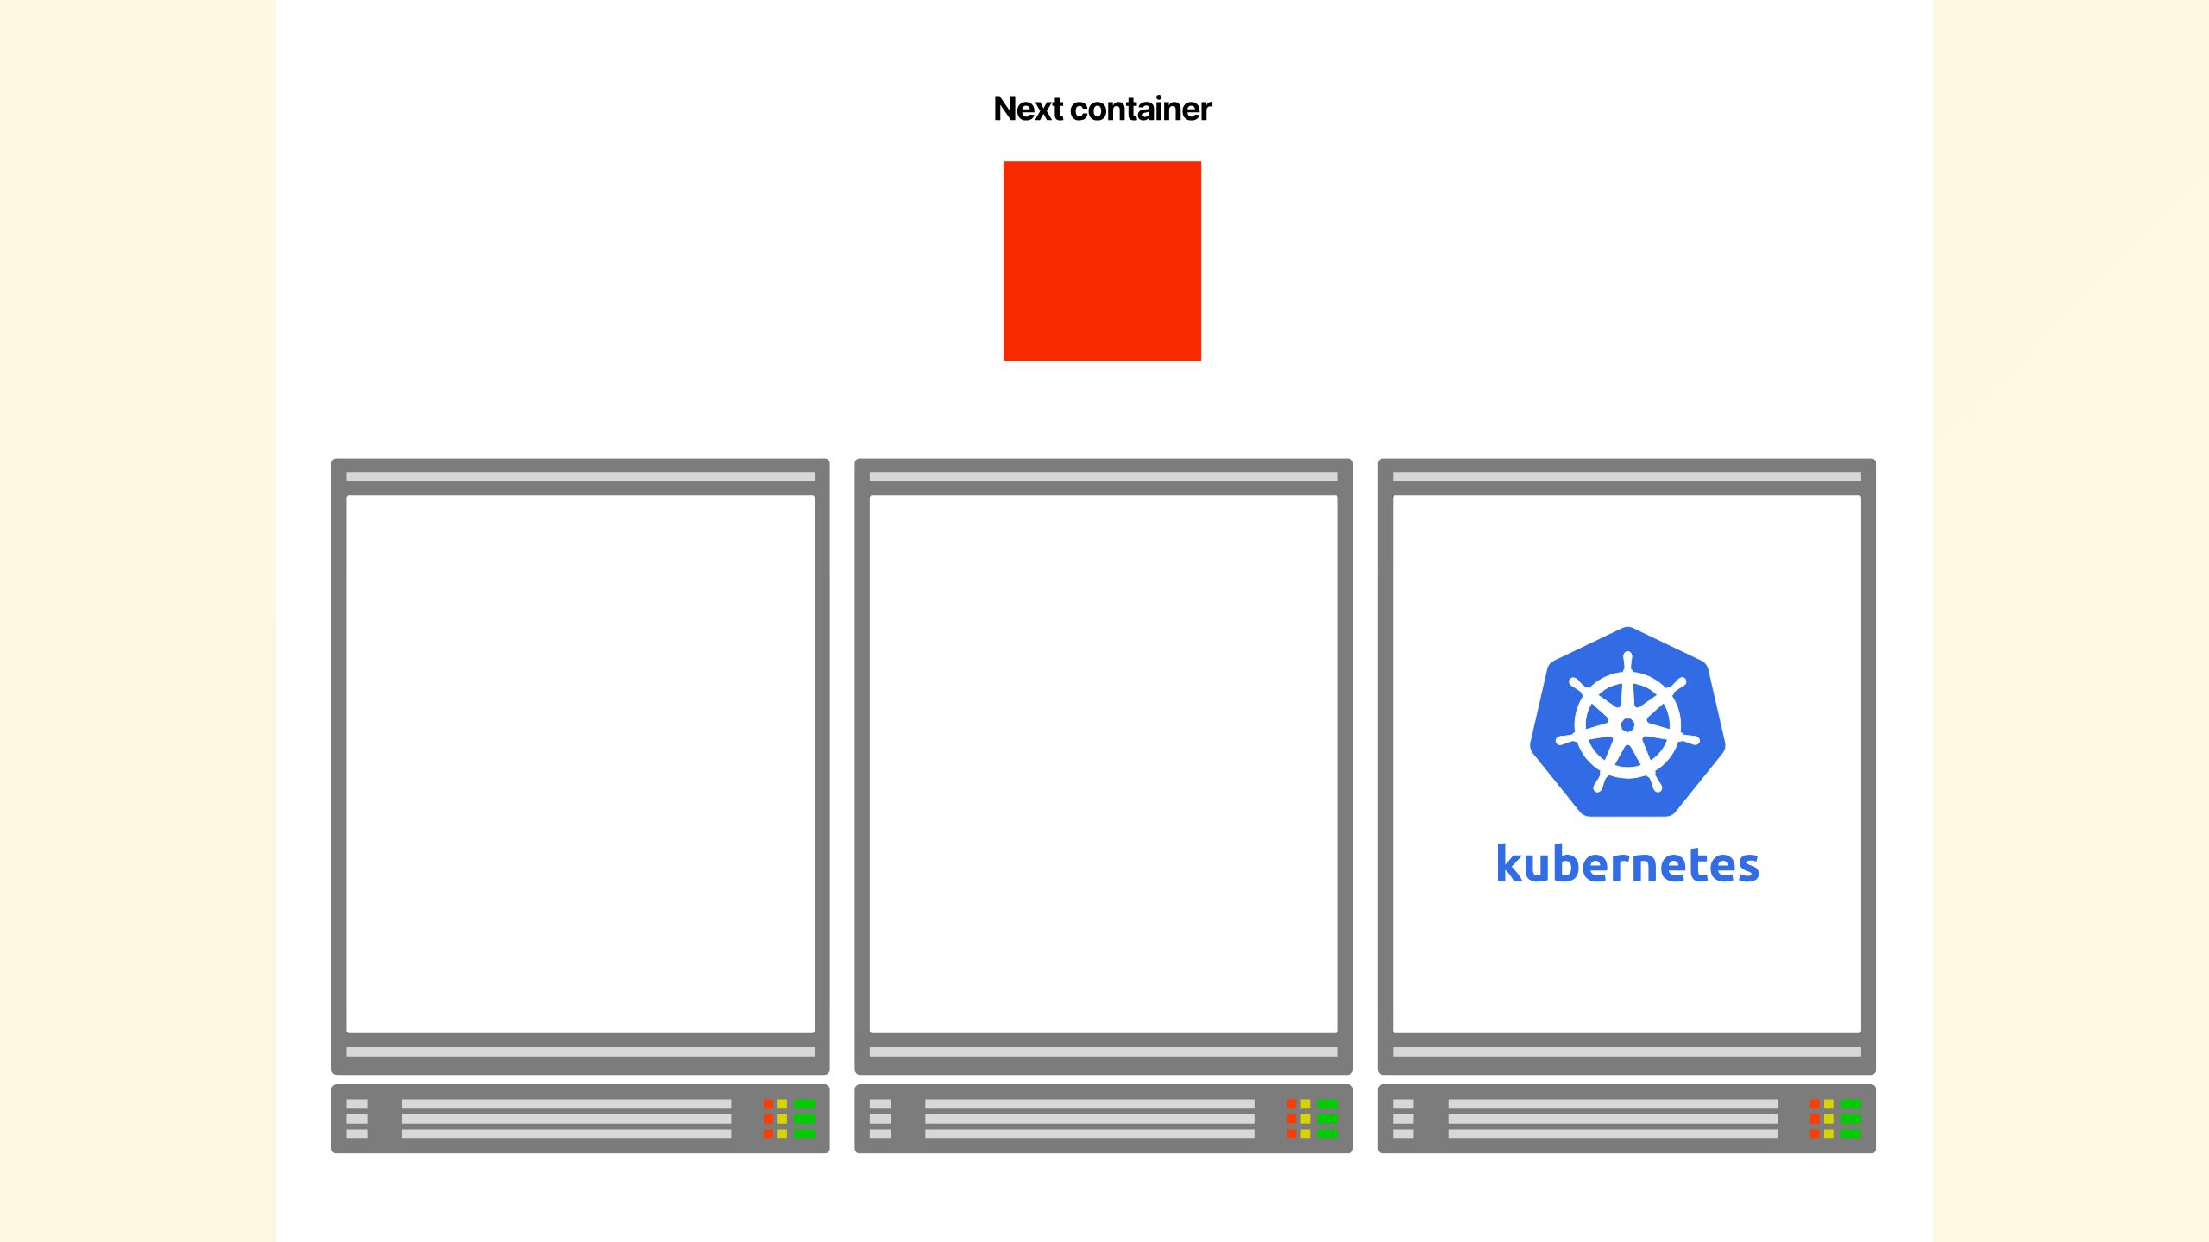
Notes:
For every application deployed in the cluster, Kubernetes makes a note of the memory and CPU requirement.

Slide 25
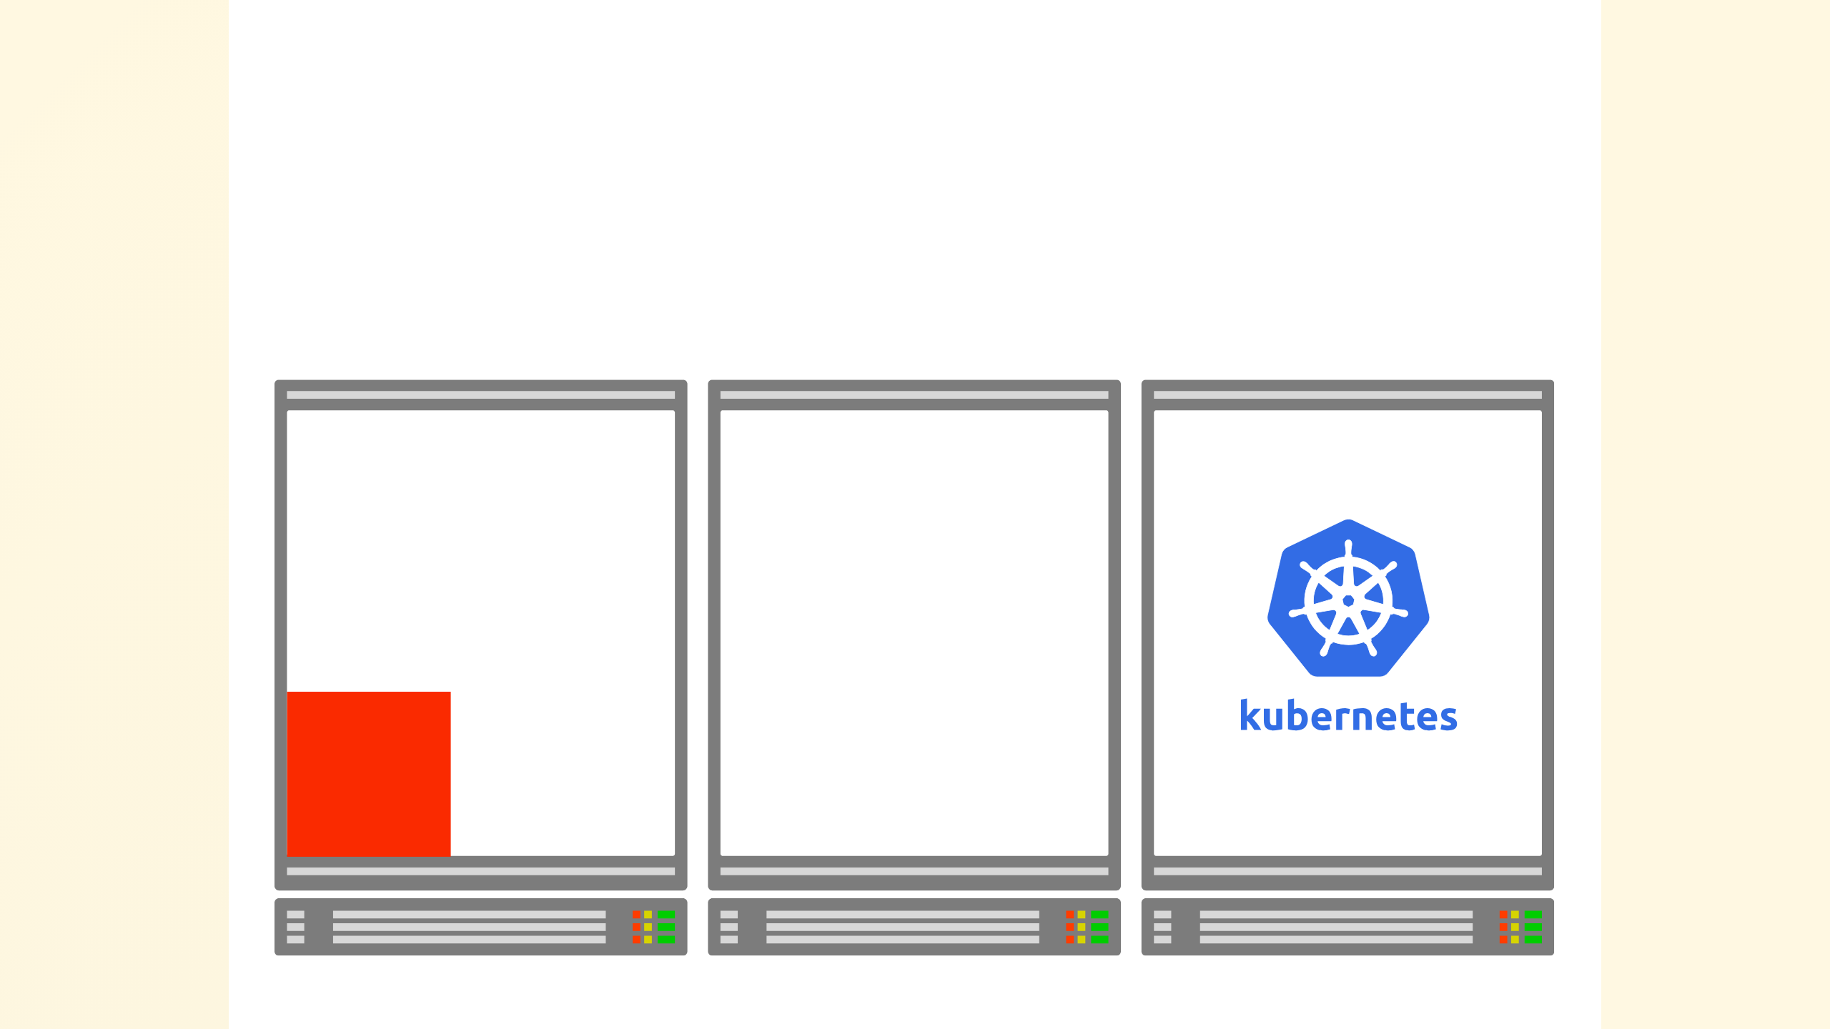
Notes:
It then decides where to place the application in the cluster. In this case, it's the node on the left.

Slide 26
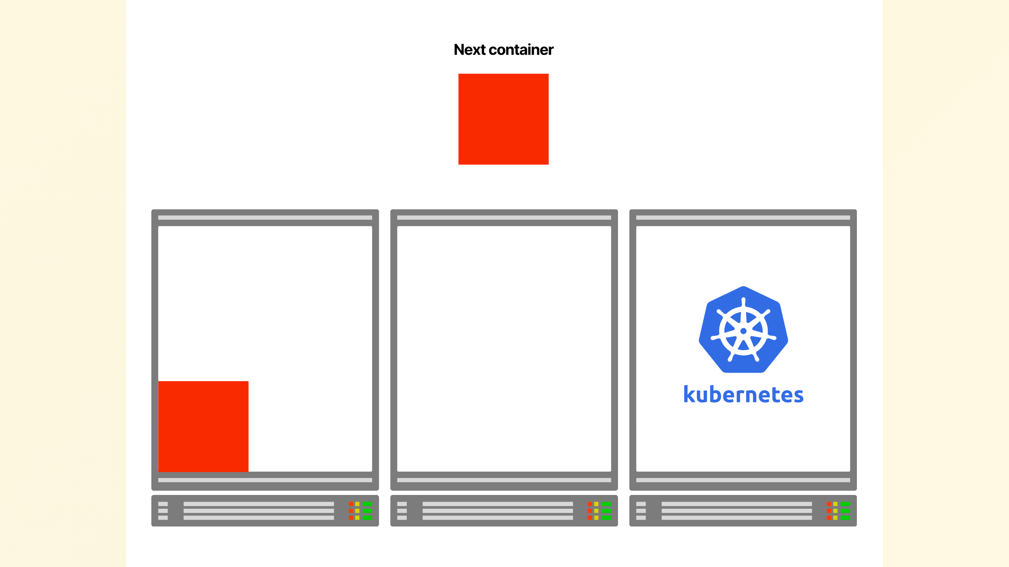
Notes:
If another application of the same size is deployed, Kubernetes goes through the same process and finds the best node to run the app.

Slide 27
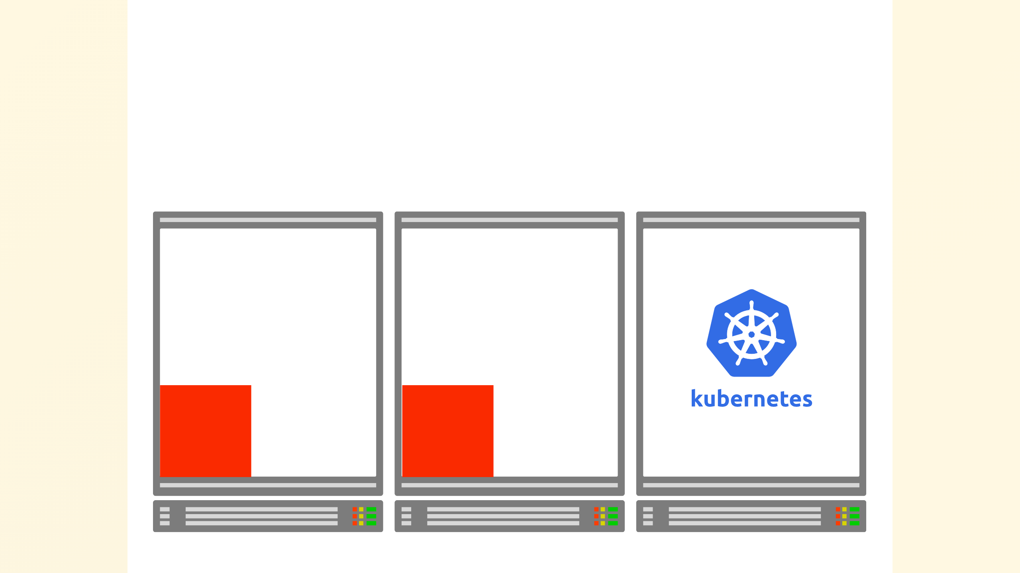
Notes:
In this case, Kubernetes places the app on the right side.

Slide 28
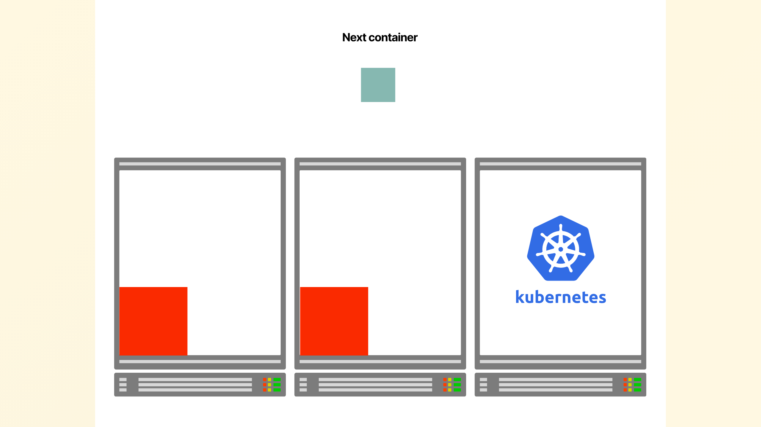
Notes:
As more applications

Slide 29
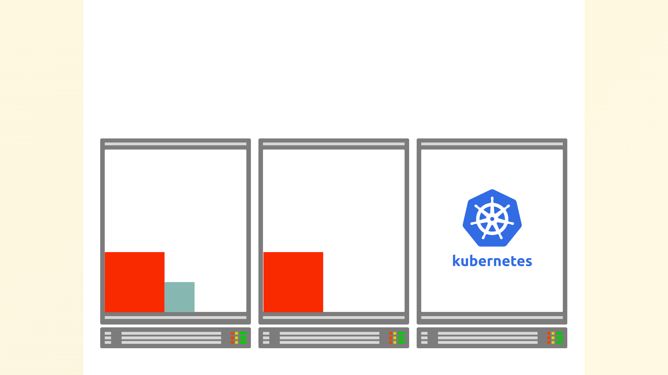
Notes:
are submitted to the cluster,

Slide 30
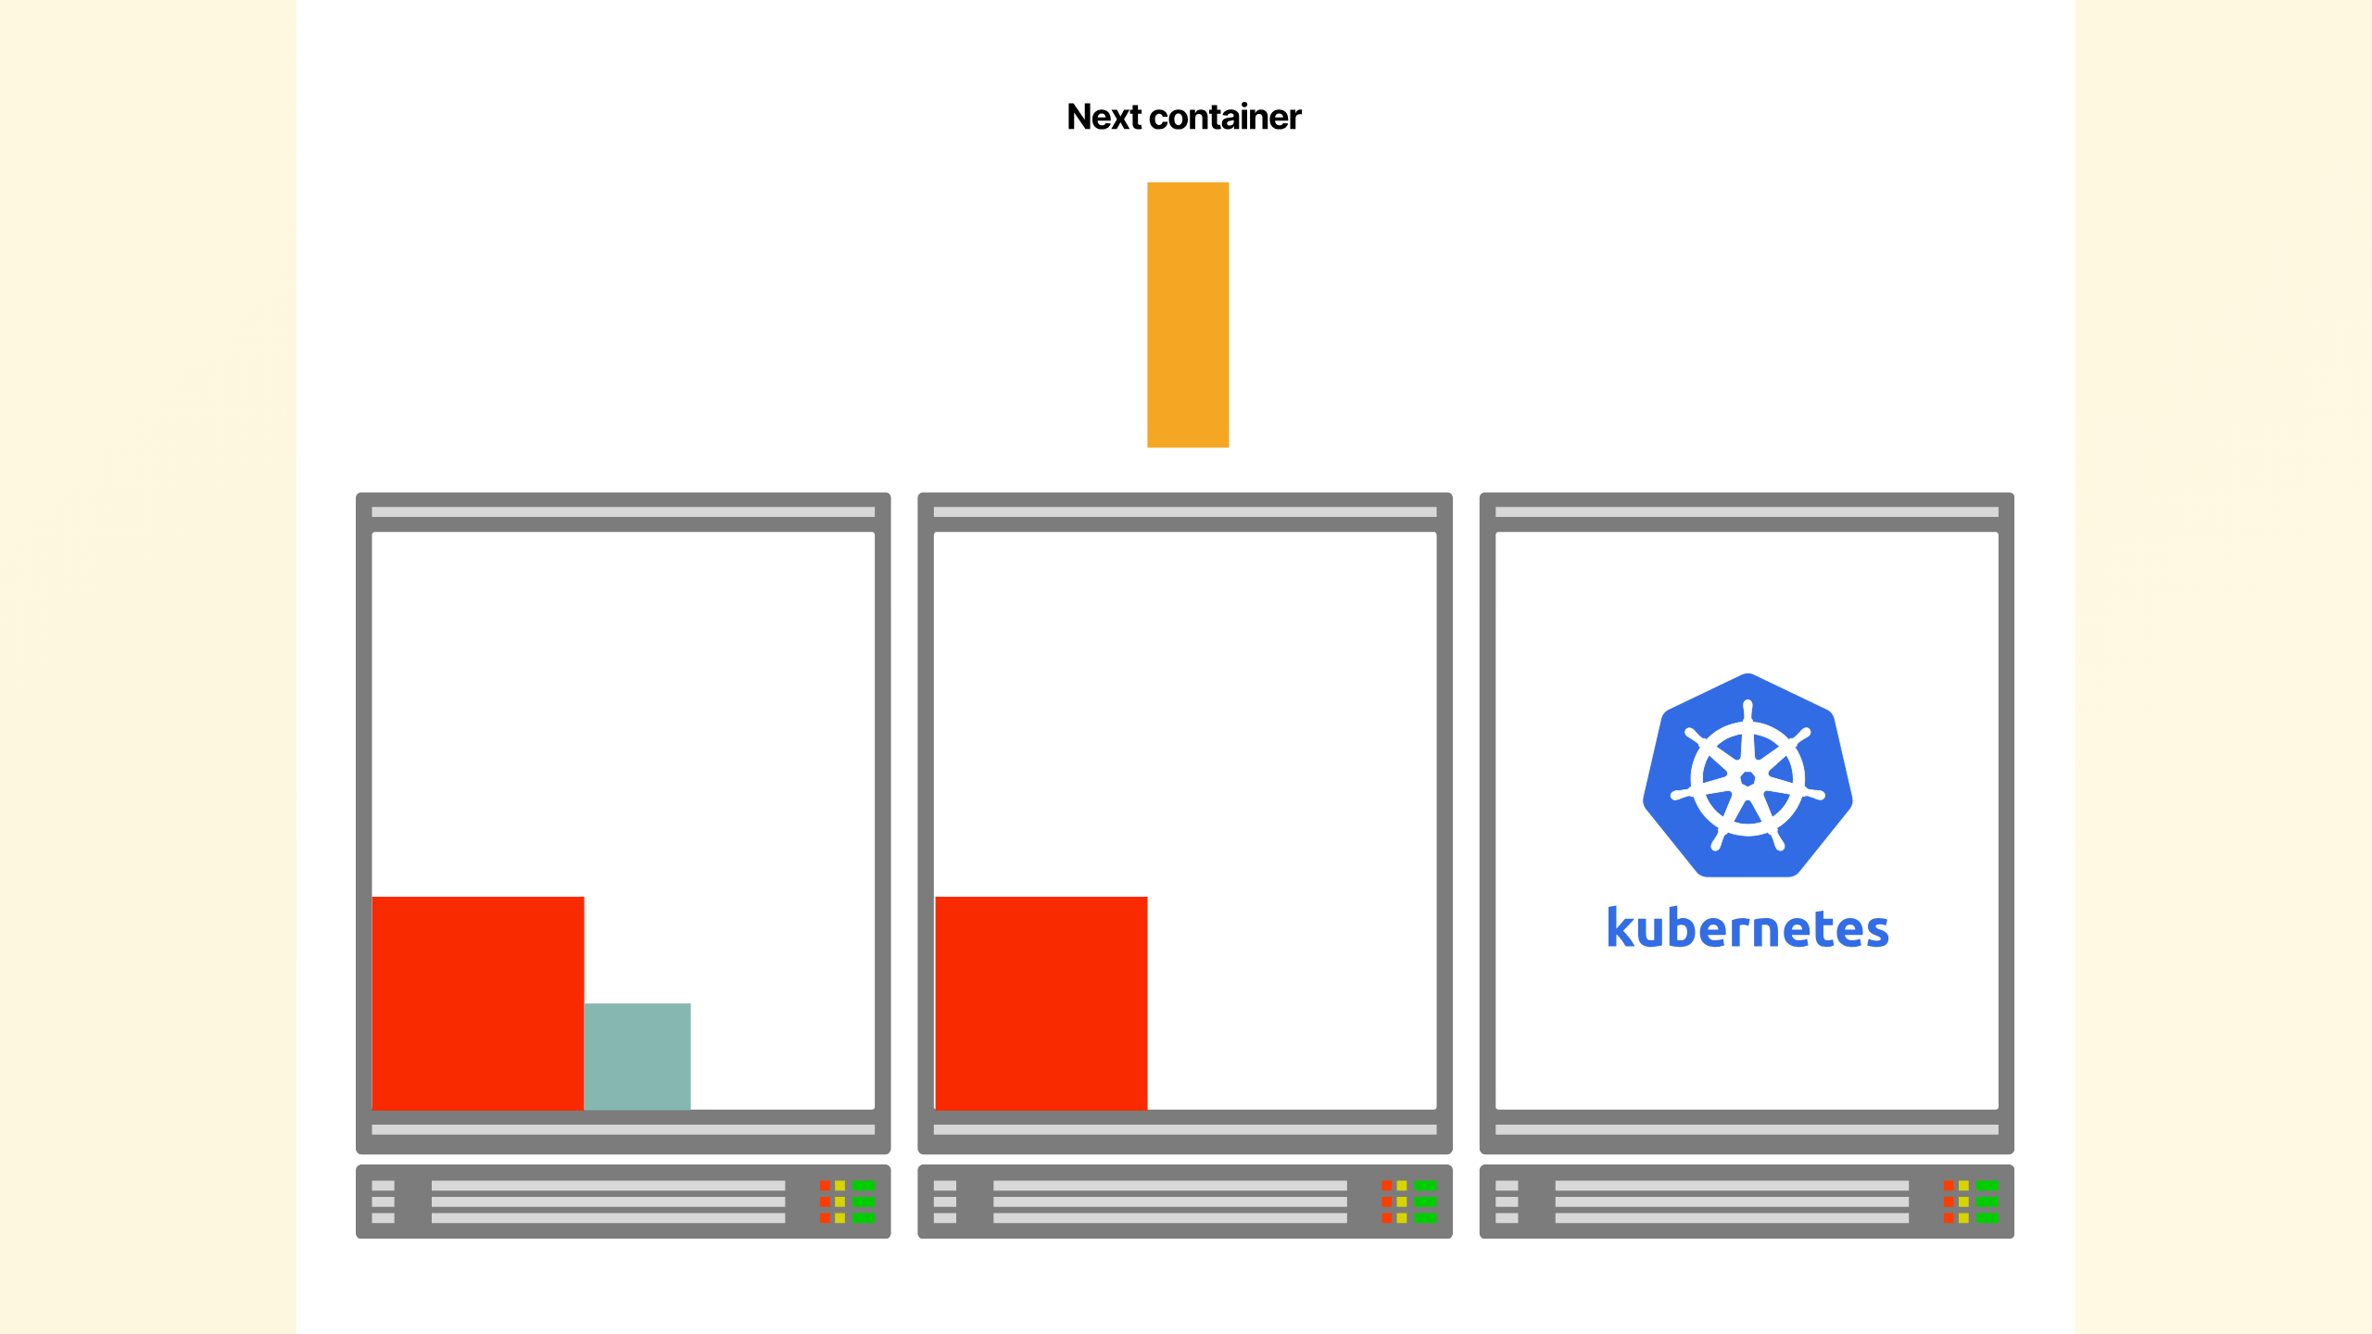
Notes:
Kubernetes keeps making

Slide 31
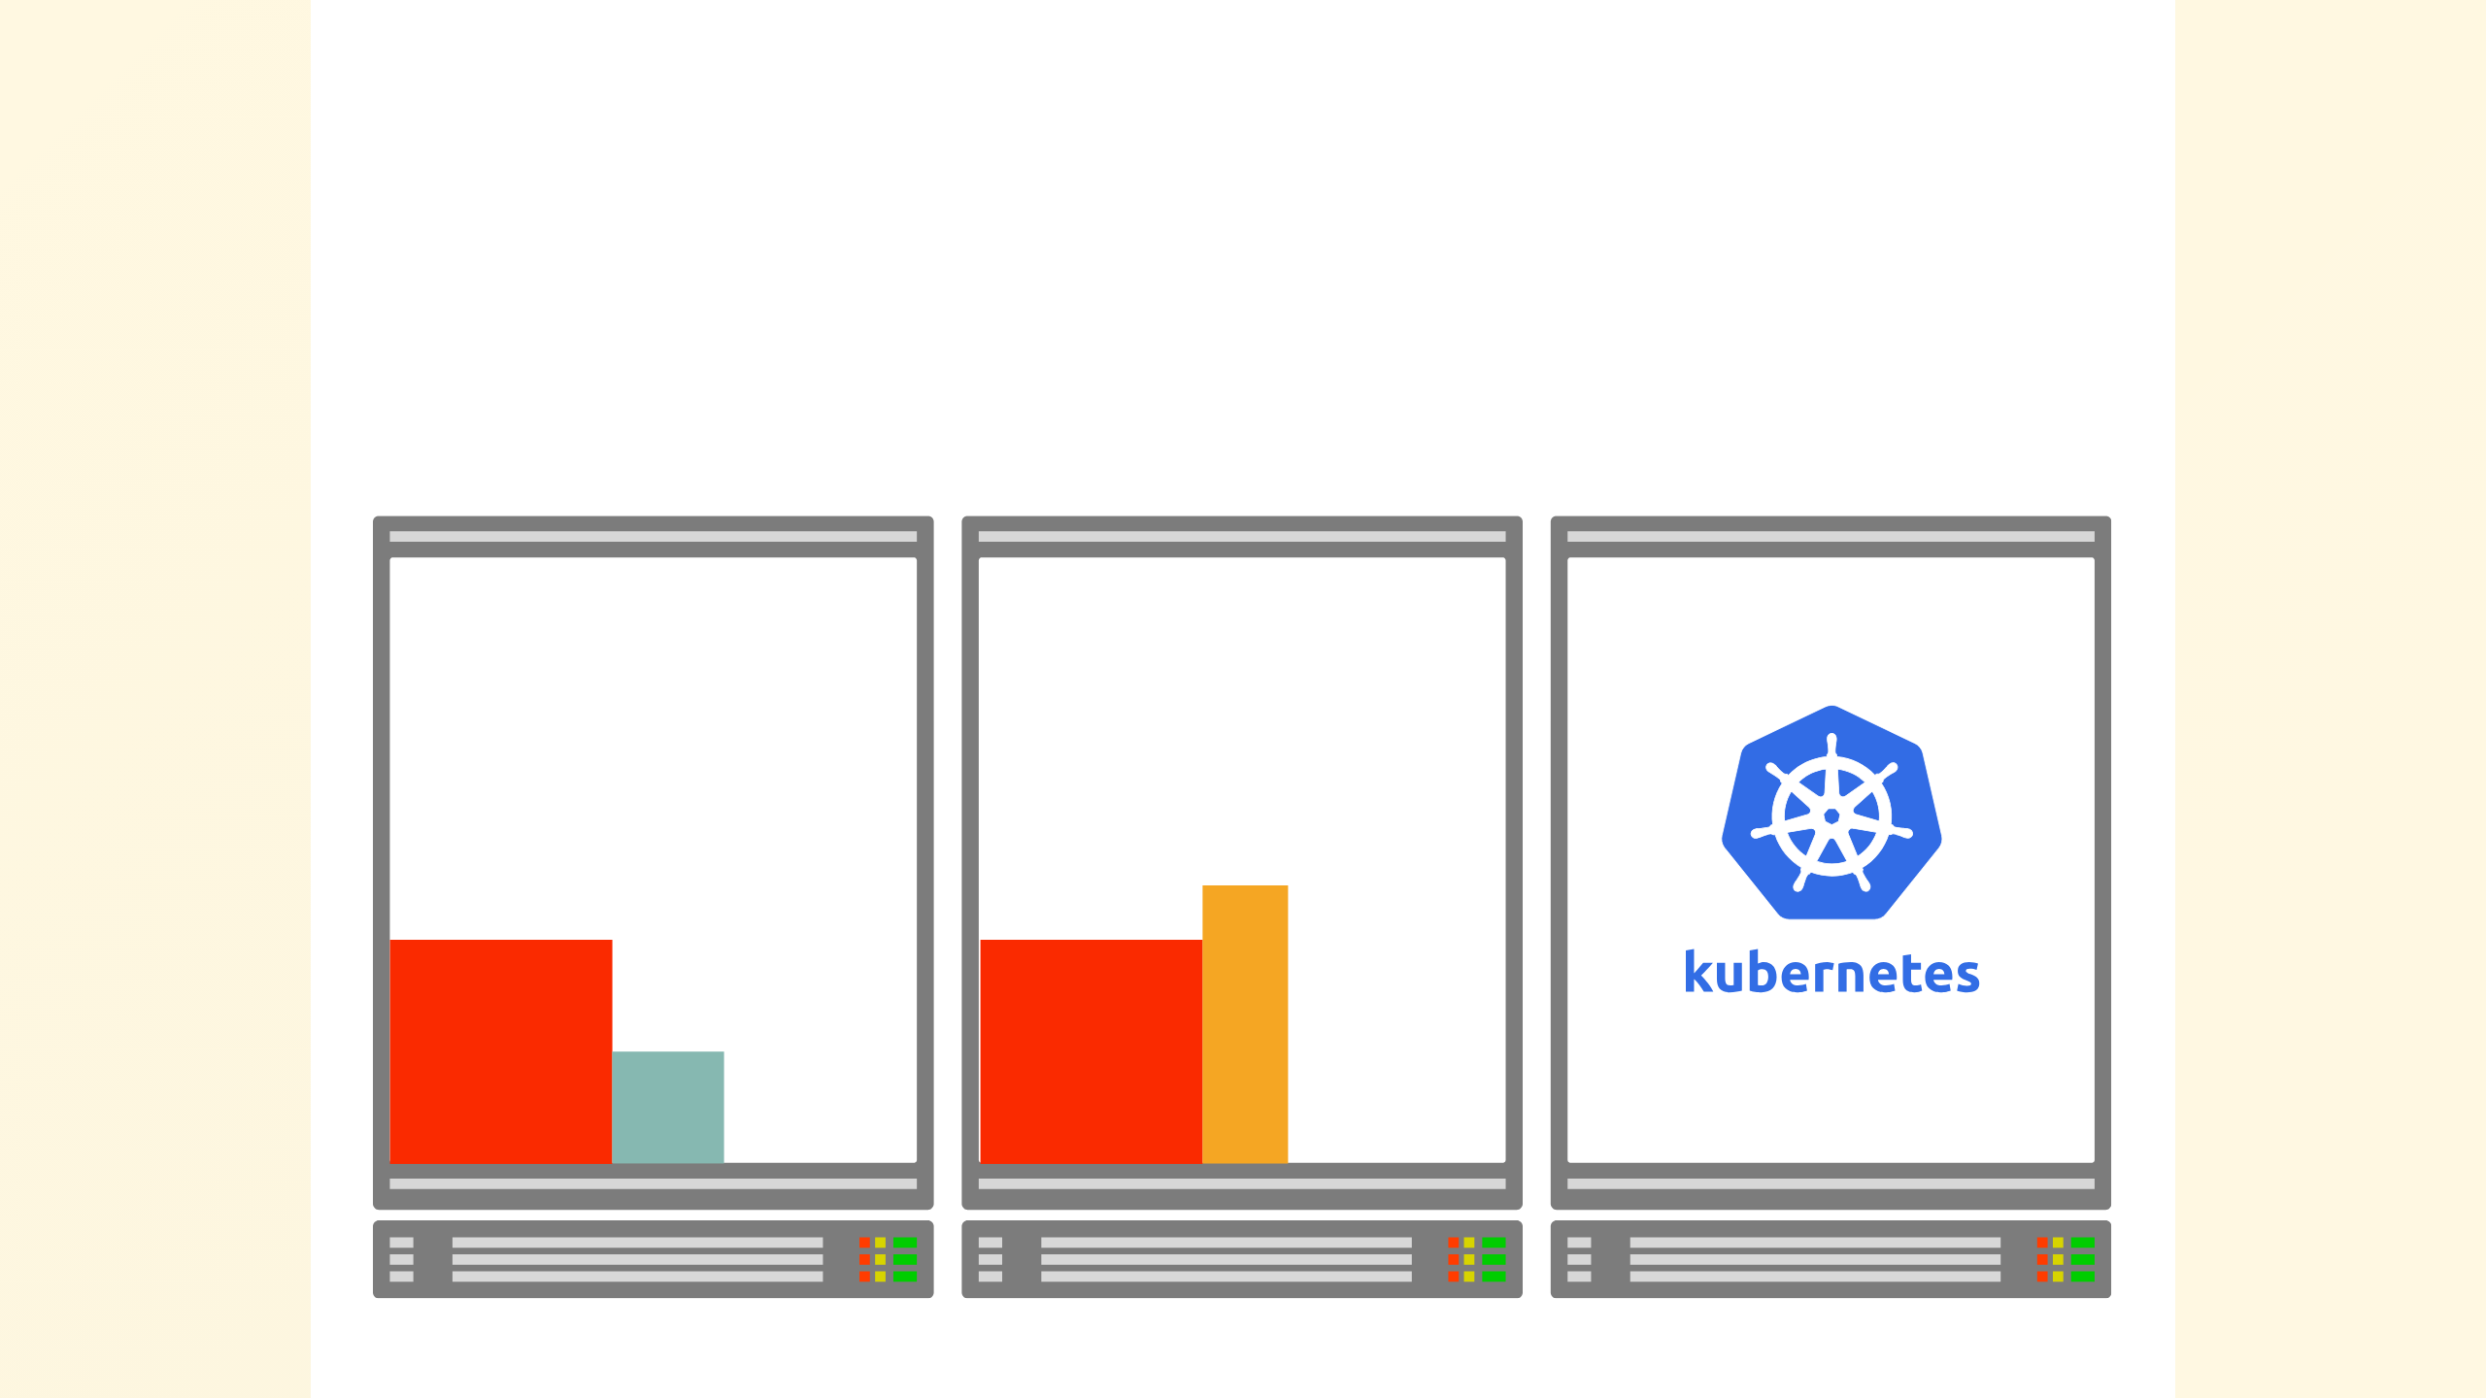
Notes:
notes of the CPU and

Slide 32
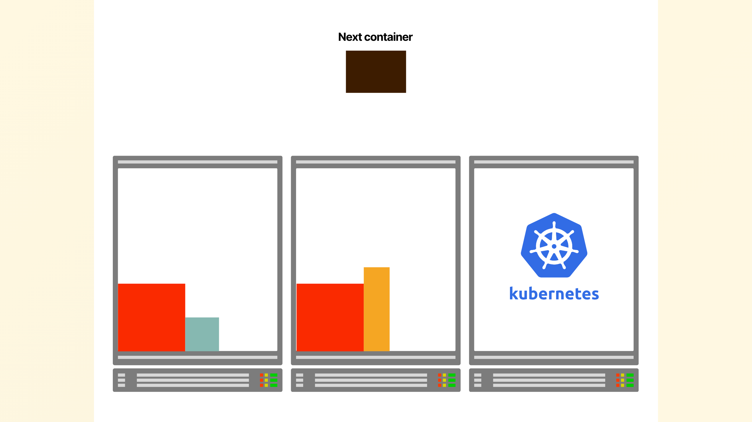
Notes:
memory requirements...

Slide 33
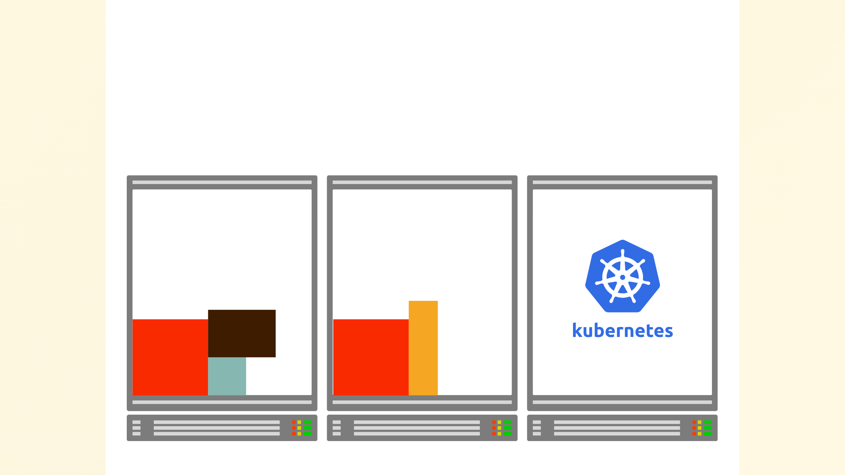
Notes:
... and allocating these apps in the cluster.

Slide 34
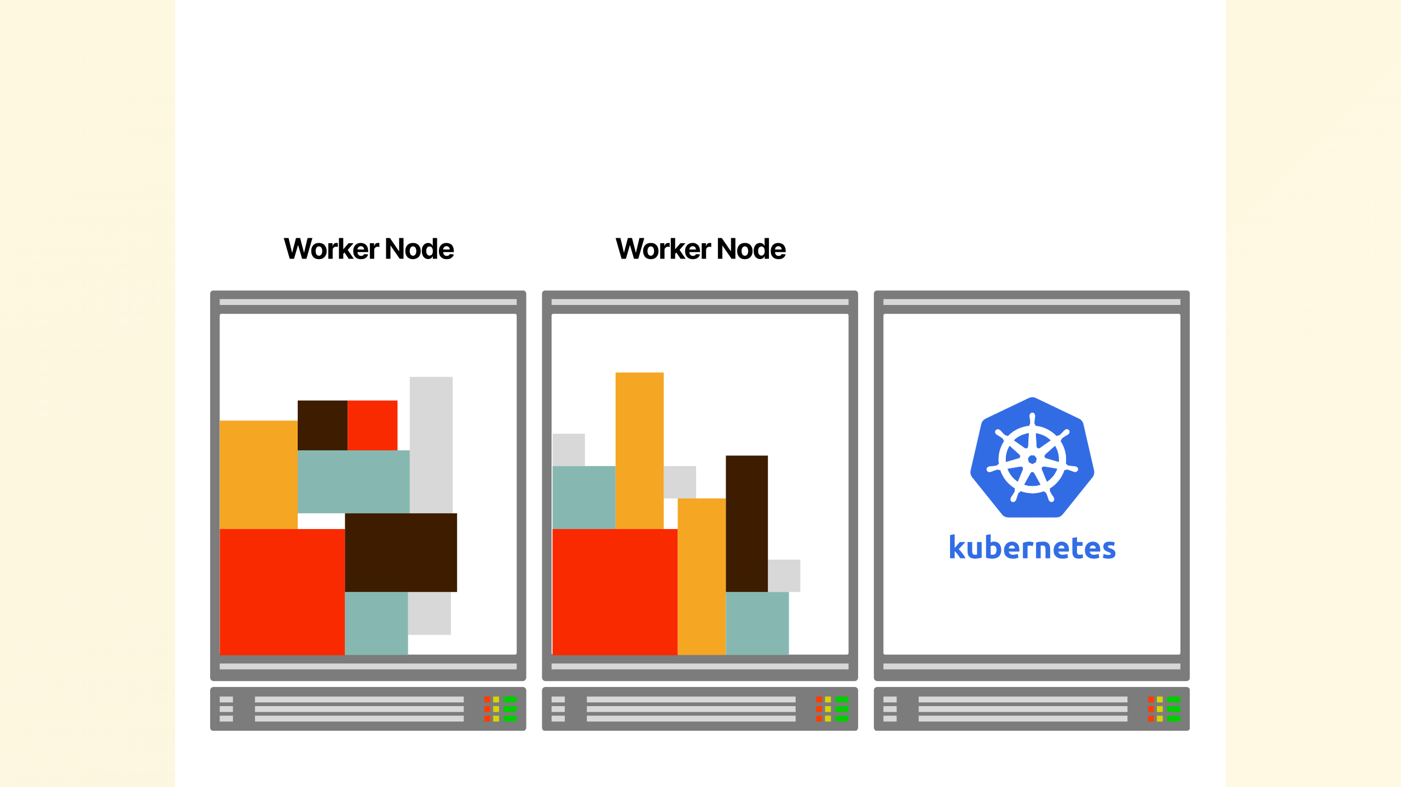
Notes:
If you play the game long enough, you might notice that Kubernetes is a skilled Tetris player:
- Your servers are the board.
- The apps are the blocks.
Kubernetes tries to fit as many blocks as efficiently as possible.

Slide 35
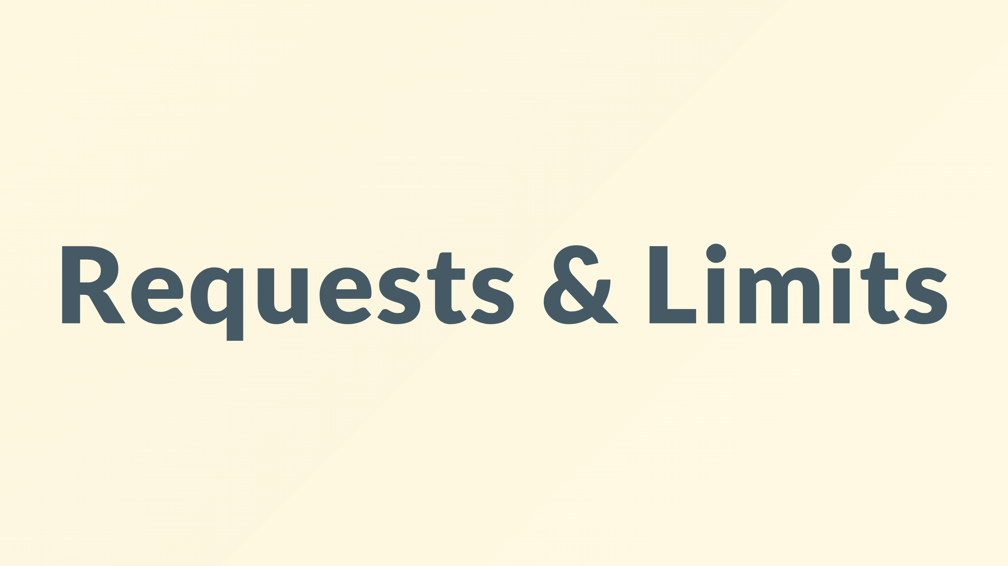
Notes:
But what about the size of the worker nodes
What kind of instance types can you use to build the cluster?
Nowadays the cloud vendors make almost every instance type available to be part of a cluster, so you've got free choice.
There's a catch, though.

Slide 36
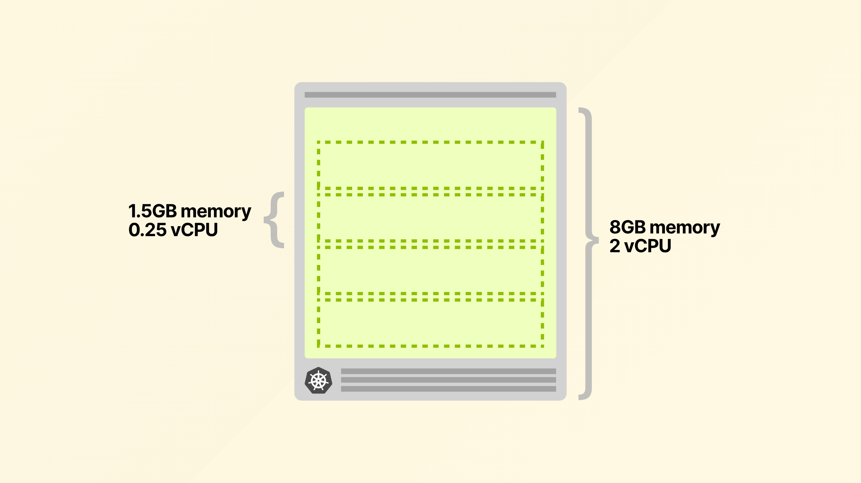
Notes:
You'd be forgiven for thinking that if you get an 8gb ram 2 cpu node from your cloud vendor
you could deploy 4 pods that are 1.5gb ram and need a quarter CPU

Slide 37
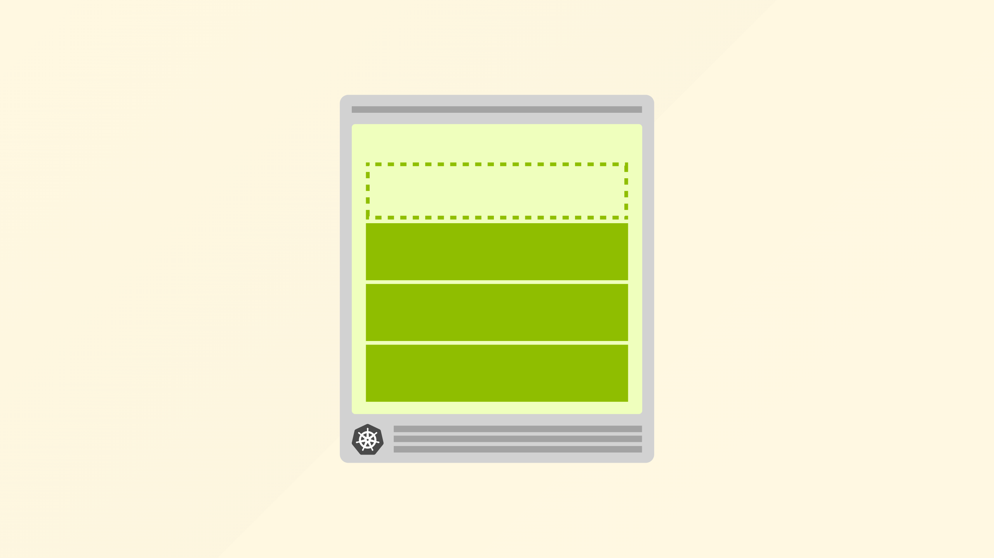
Notes:
however its not quite so

Slide 38
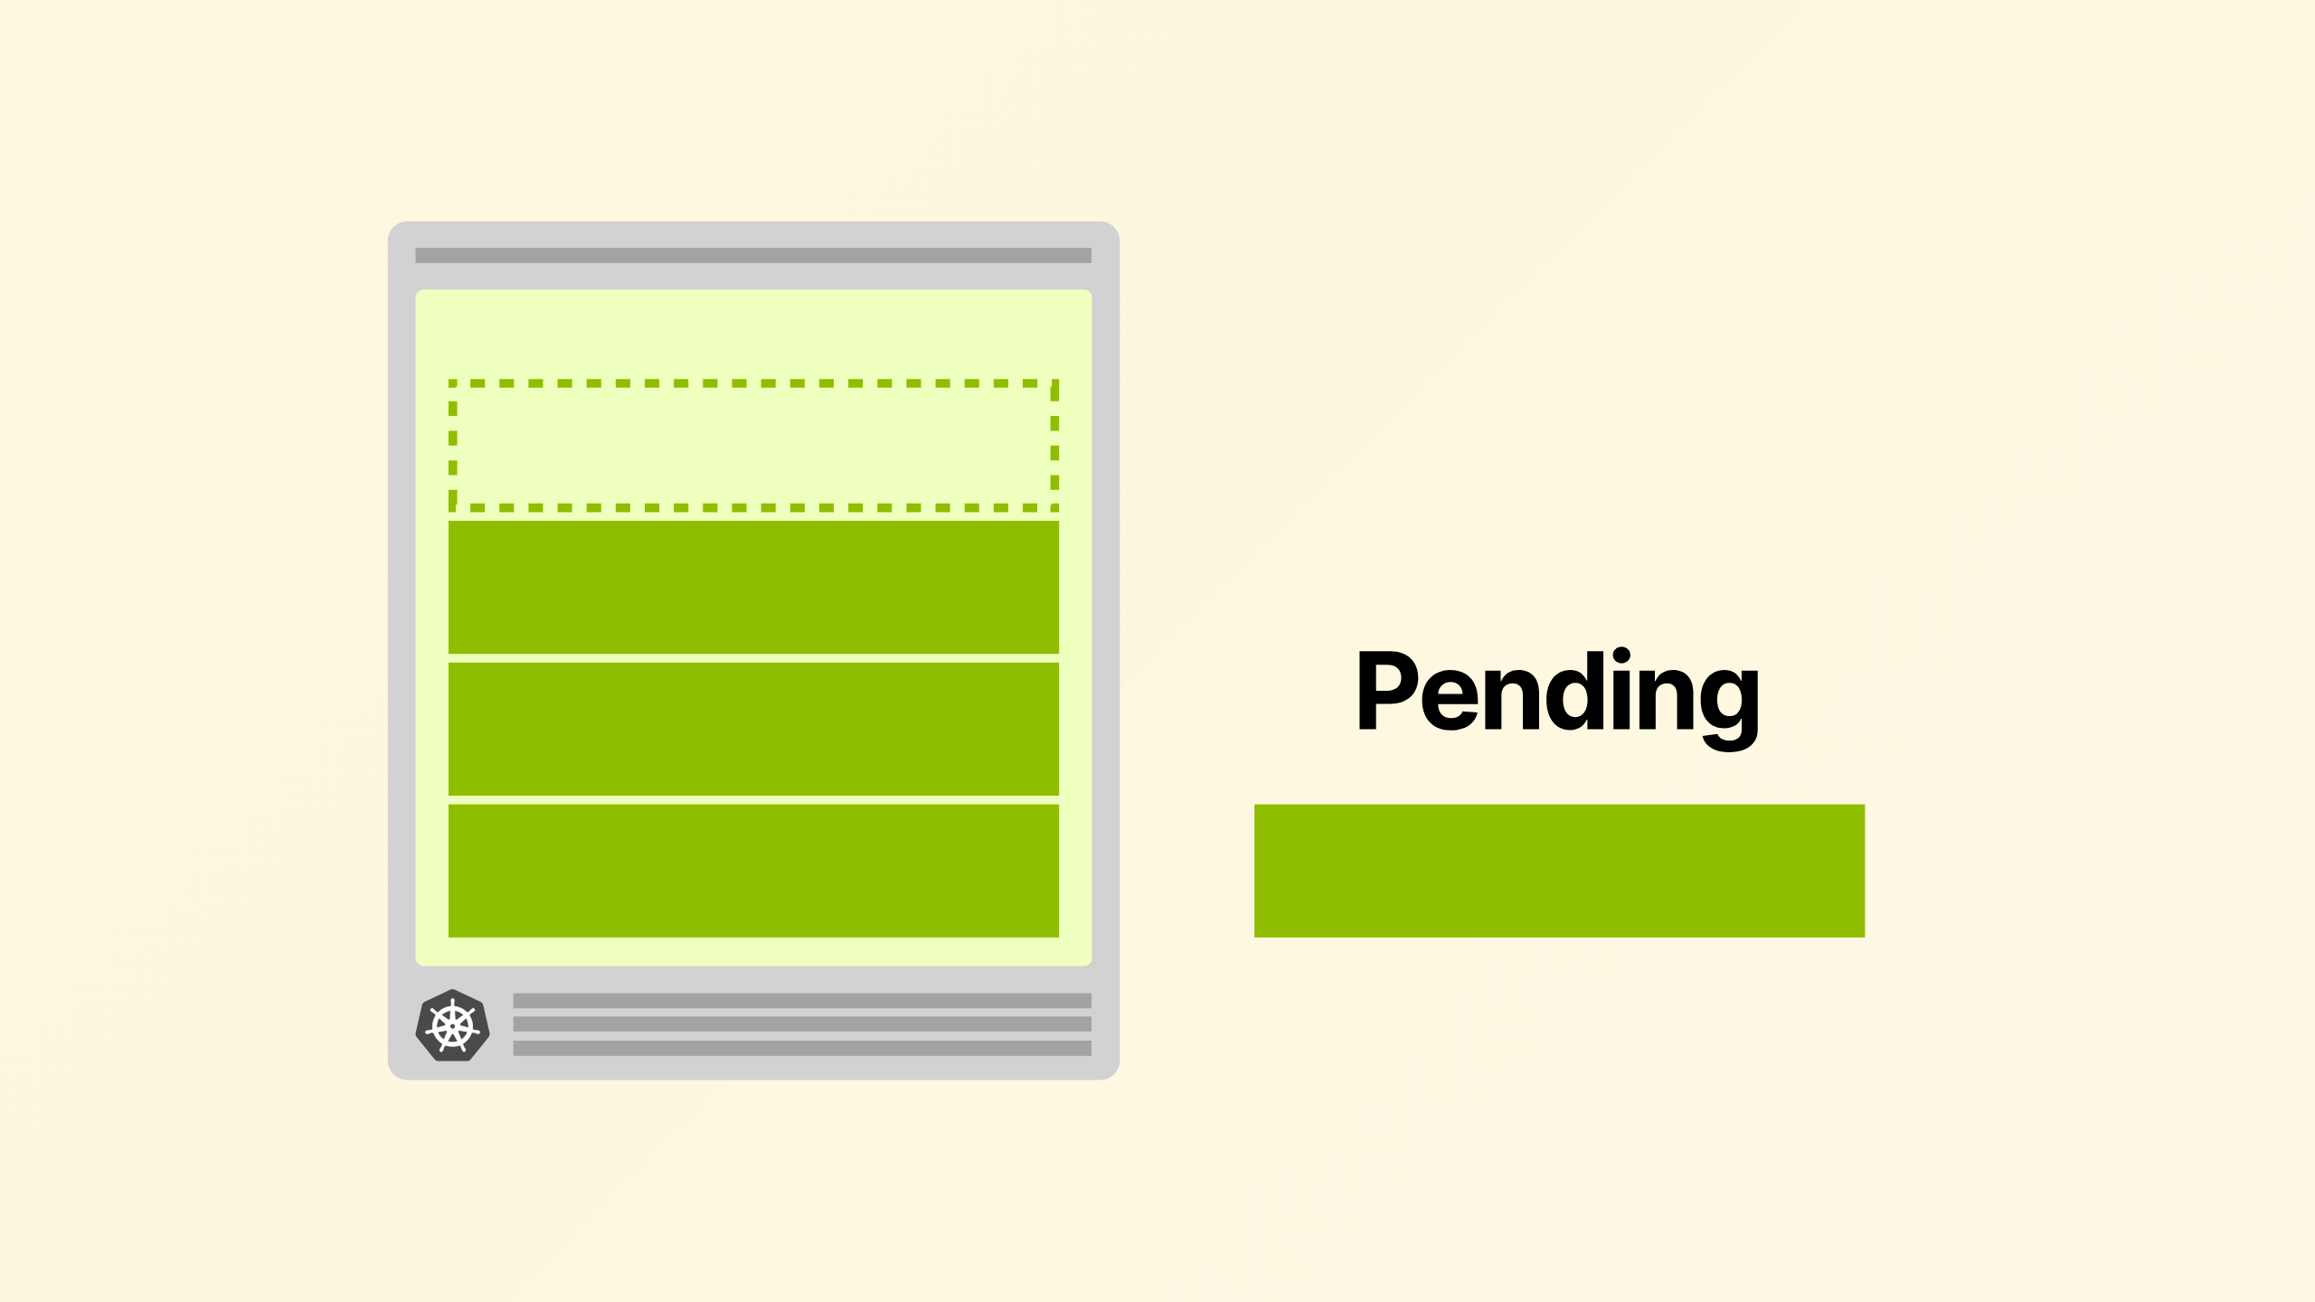
Notes:
one pod remains pending, which if configured will of course cause the

Slide 39
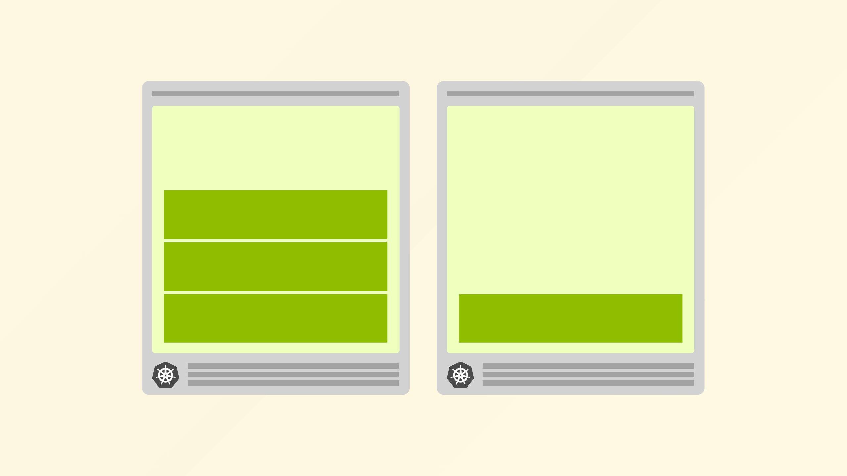
Notes:
cluster autoscaler to create a new node and then your workload is eventually scheduled

Slide 40
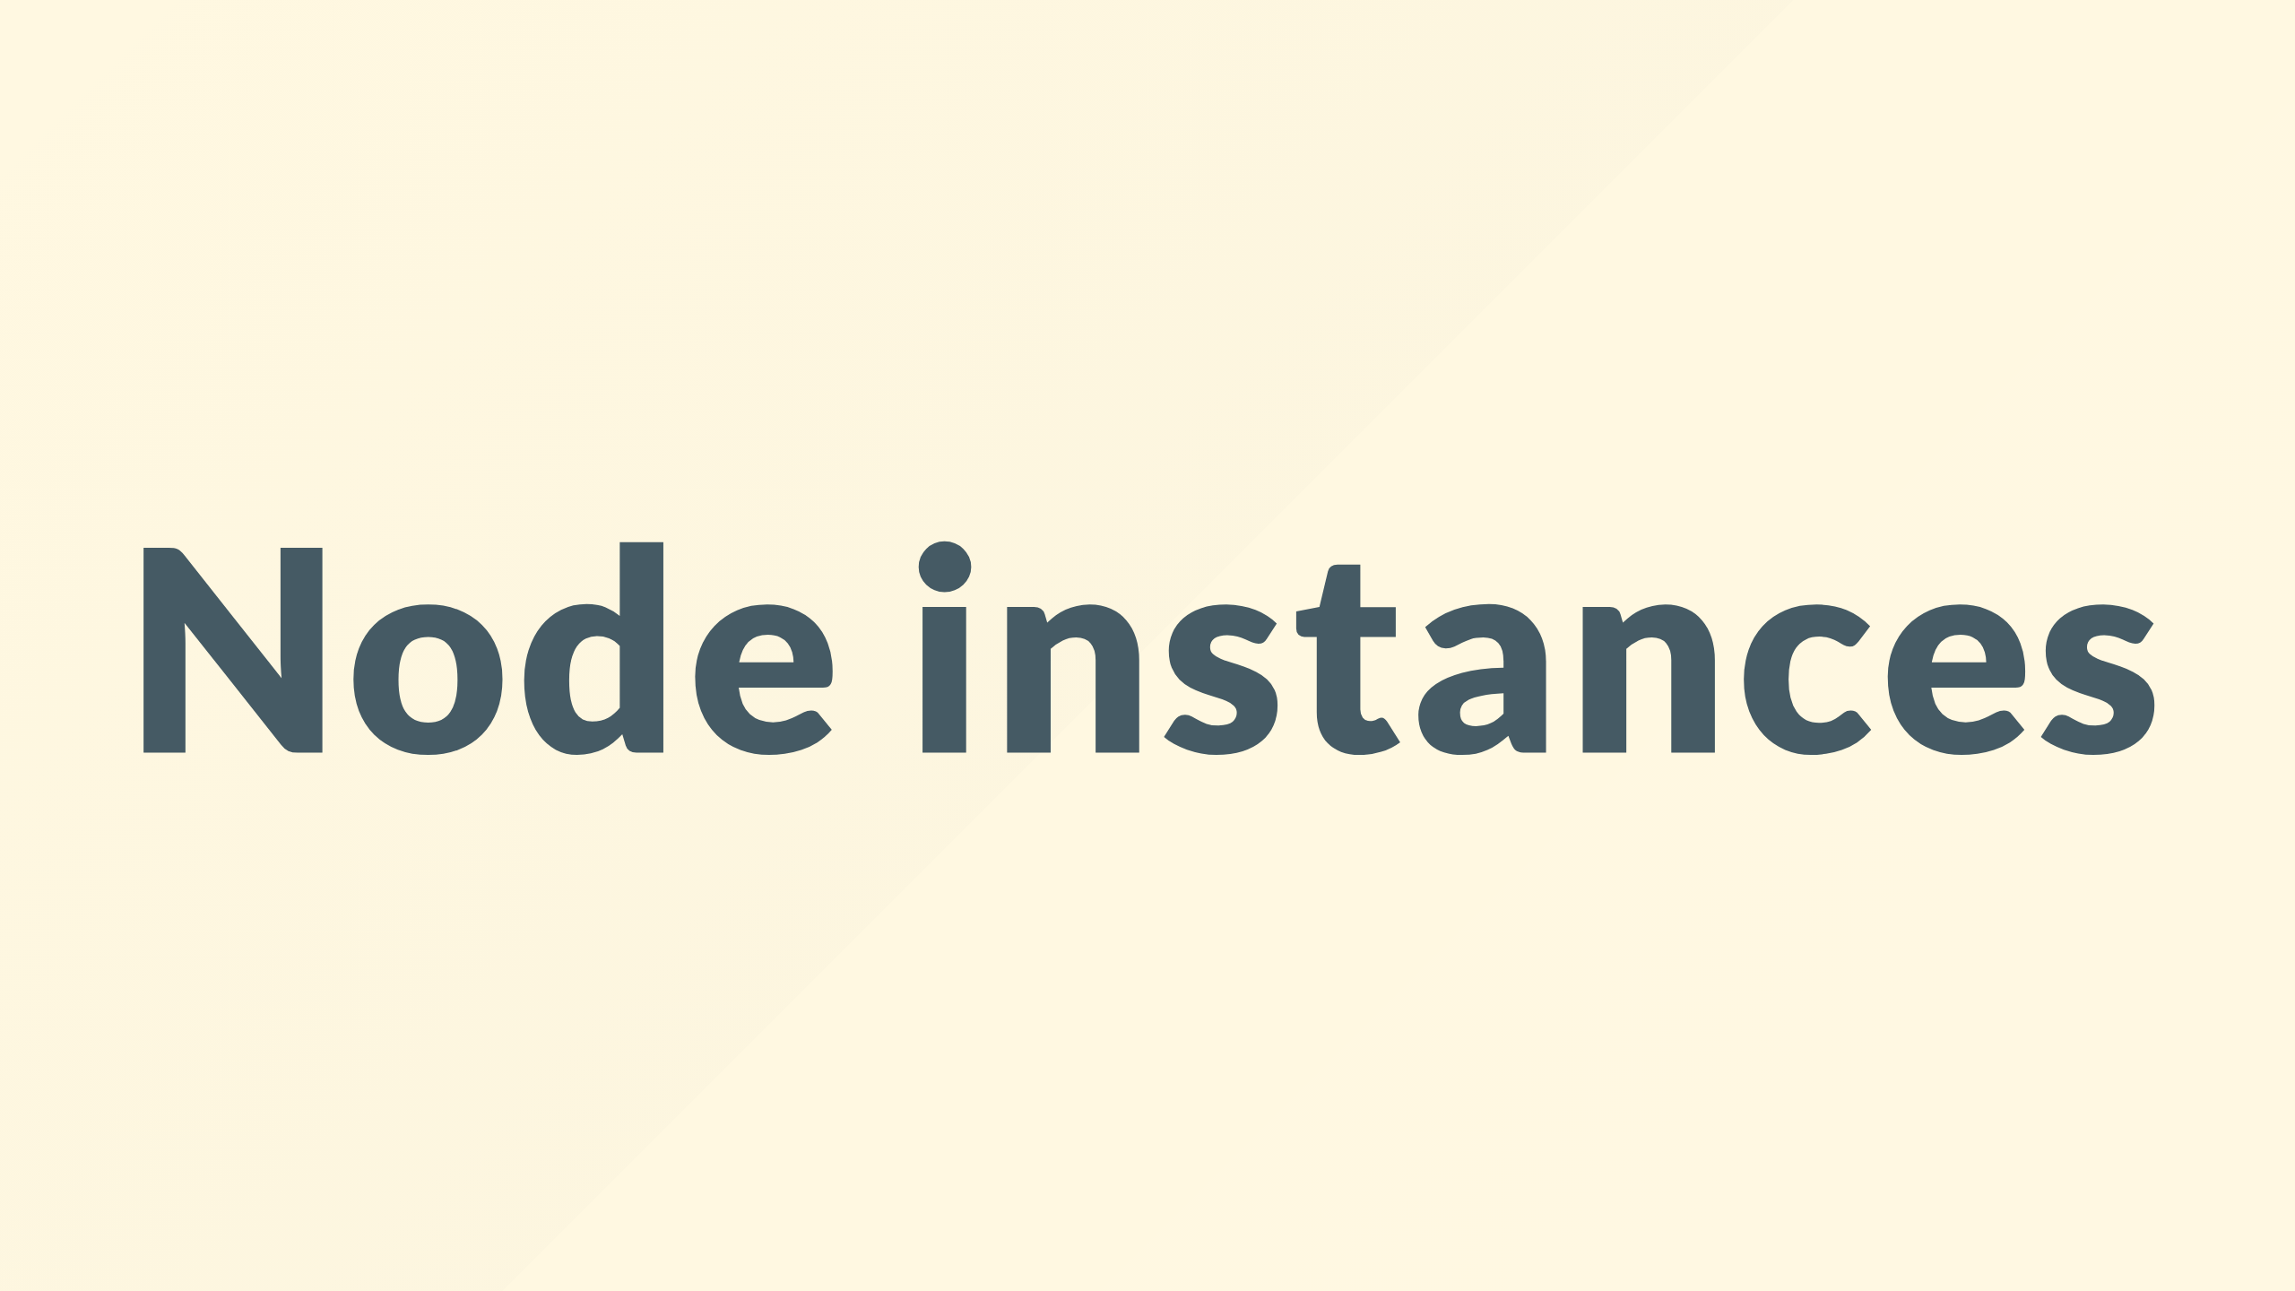
Notes:
but why is this

Slide 41
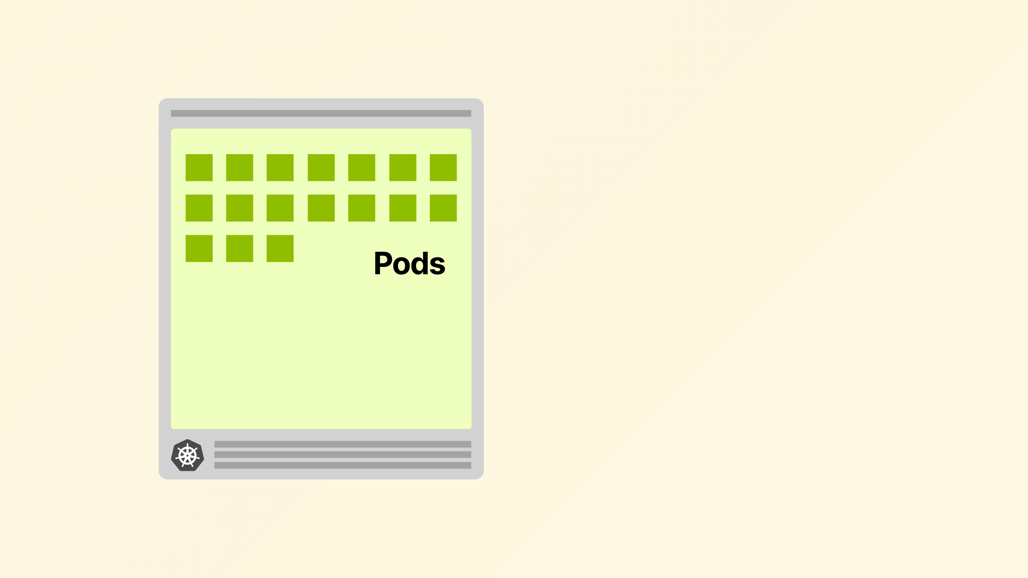
Notes:
When you provision a managed instance, you might think that the memory and CPU available can be used for running Pods.
And you are right.

Slide 42
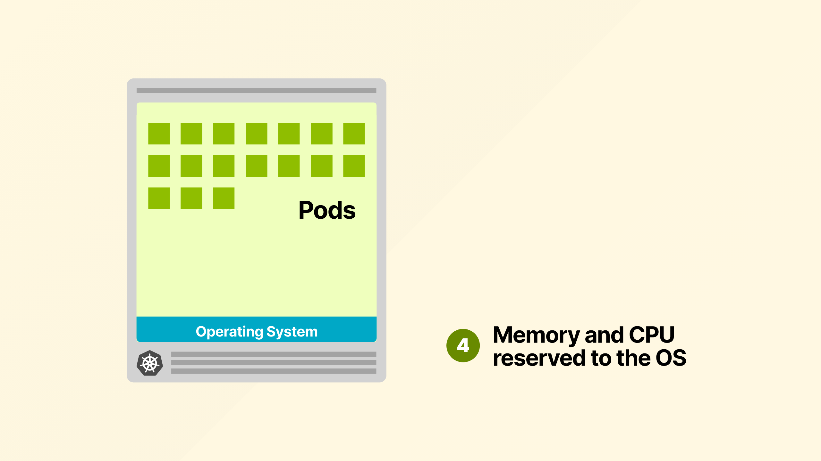
Notes:
However, some memory and CPU should be saved for the operating system.

Slide 43
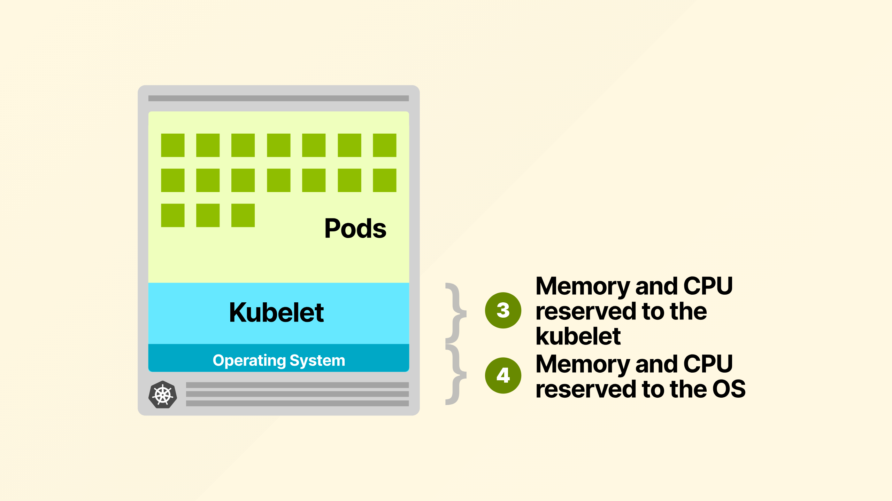
Notes:
And you should also reserve memory and CPU for the kubelet.

Slide 44
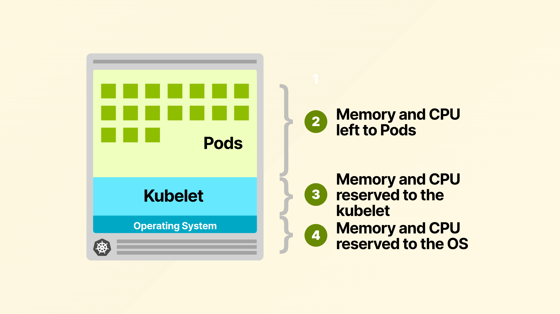
Notes:
Surely the the rest is made available to the pods?

Slide 45
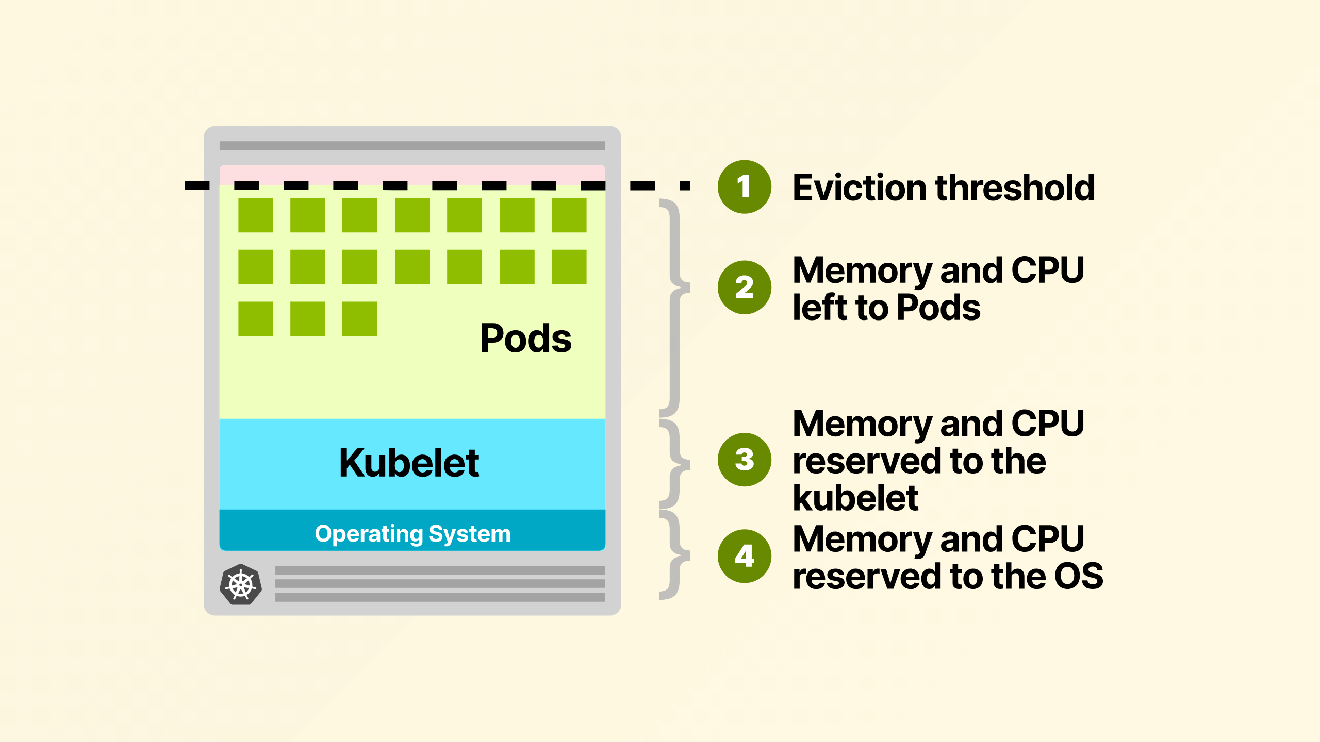
Notes:
Not quite yet. You also need to reserve memory for the Eviction threshold.
If the kubelet notices that memory usage is going over that threshold, it will start evicting pods.

Slide 46
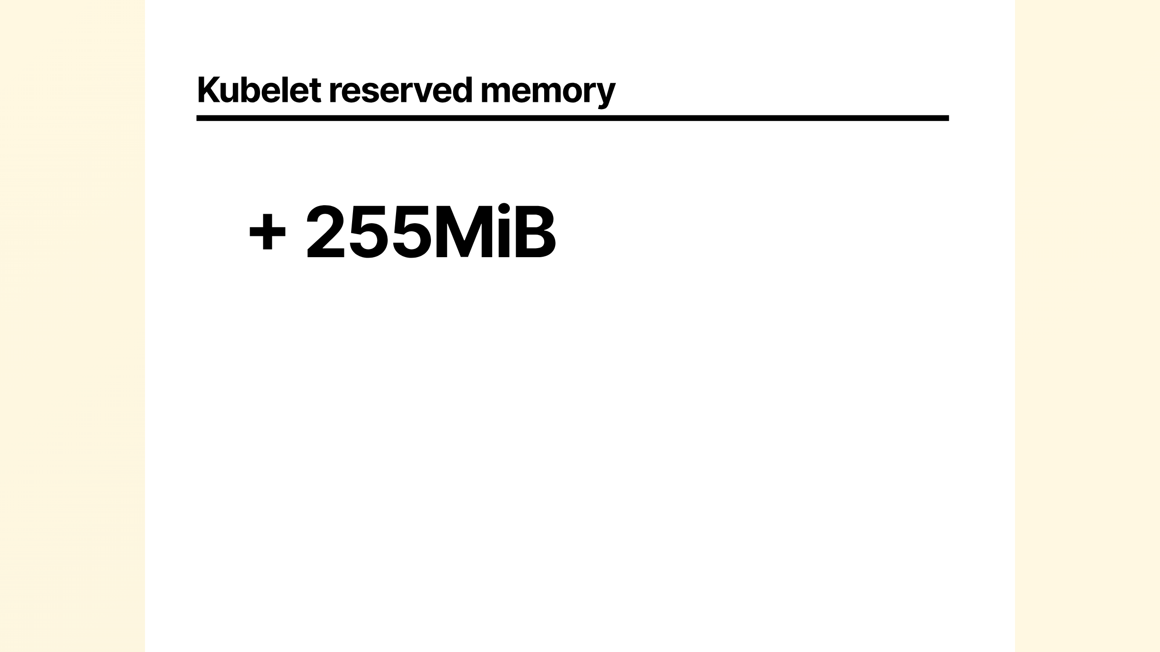
Notes:
Your cloud vendor will usually choose these numbers for you
For example AWS reserves 255MB of memory for the kubelet...

Slide 47
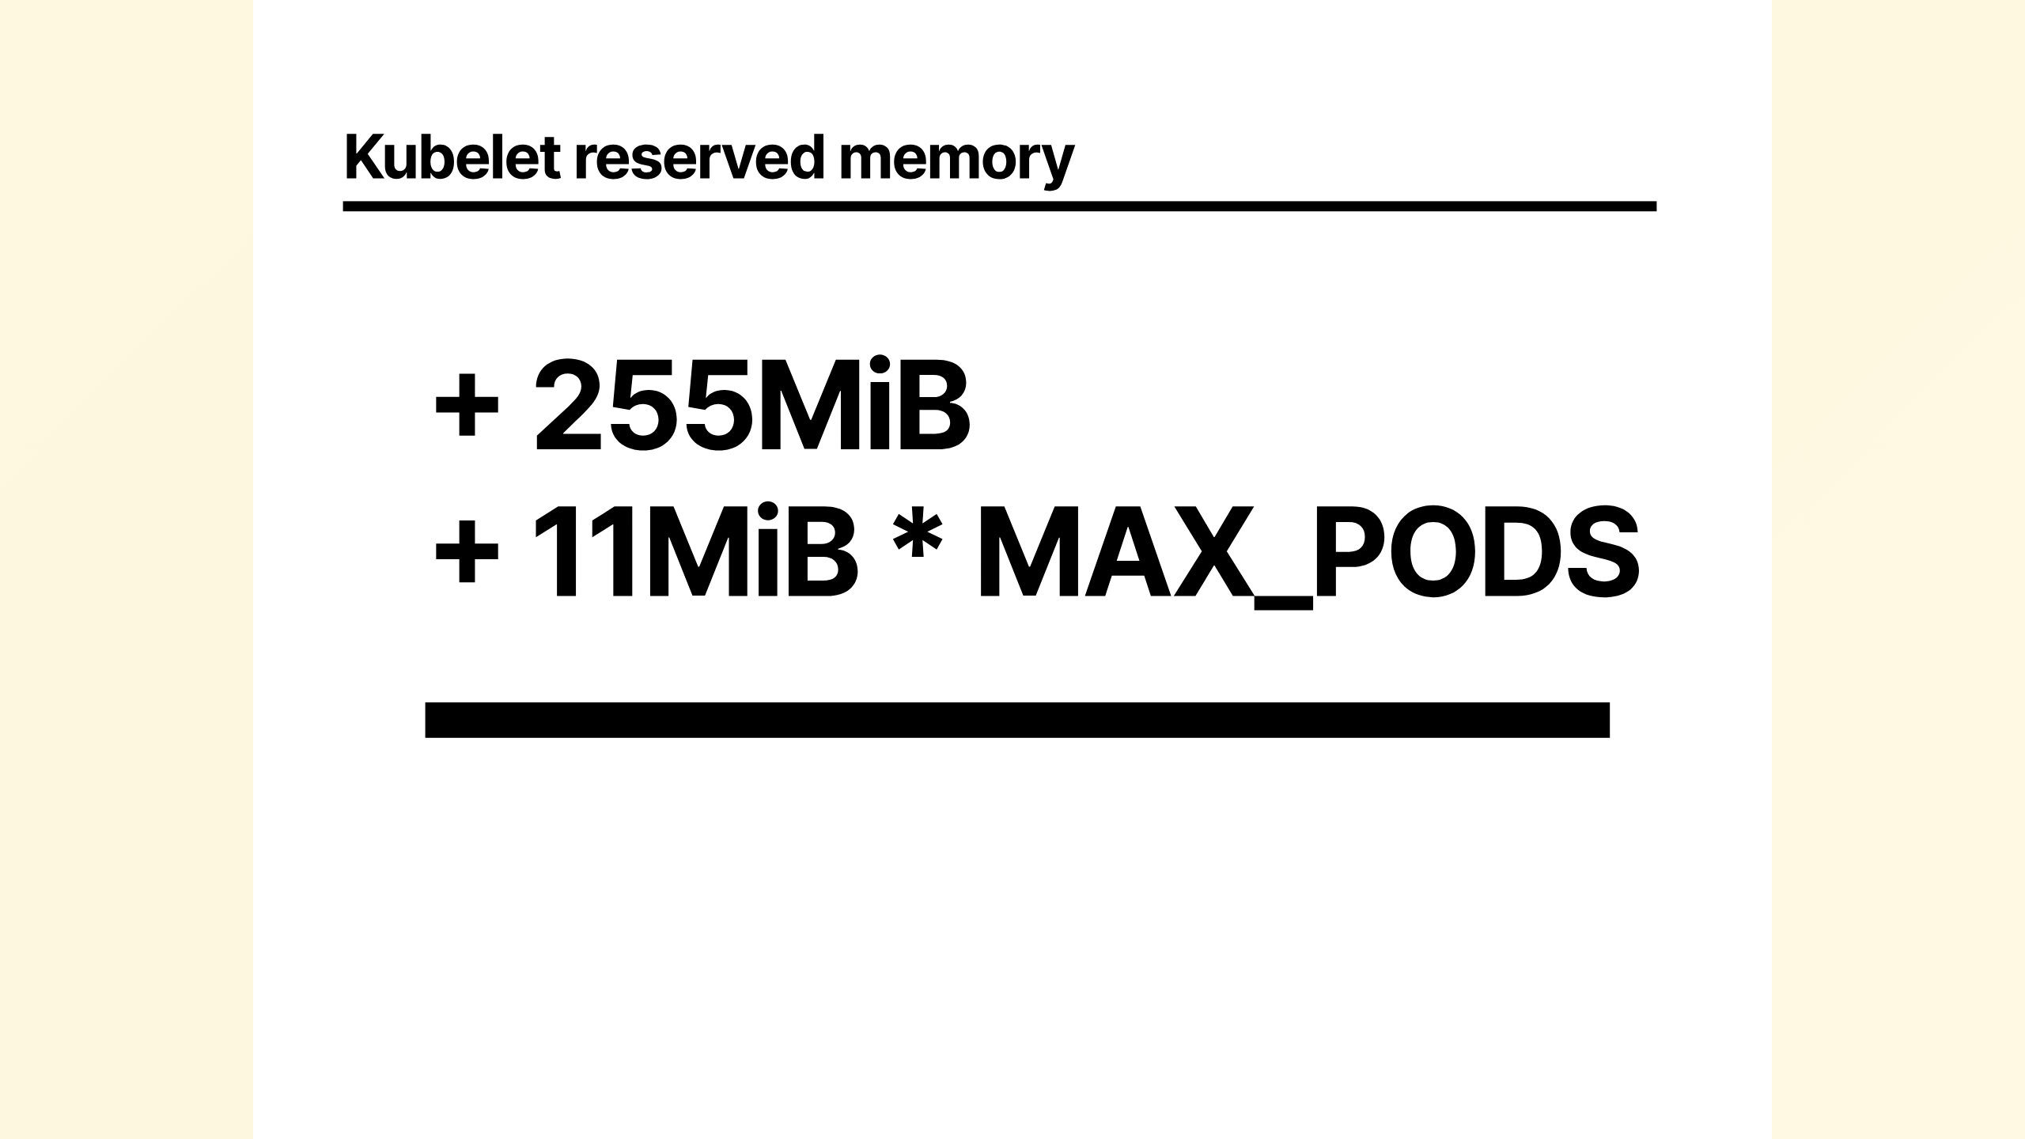
Notes:
And 11MB of memory for each Pod that you could deploy on that instance.

Slide 48
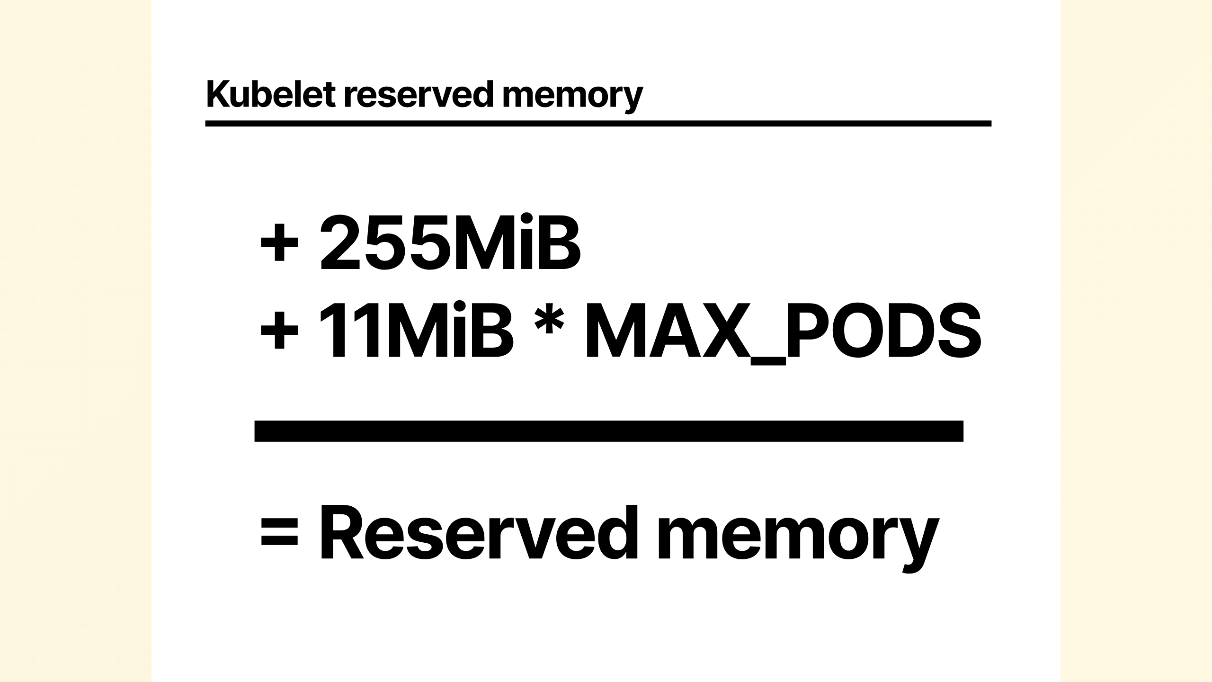
Notes:
This is the reserved memory for the kubelet. The CPU reserved is usually around 0.3 to 0.4.
For the operating system they reserve 100MB of memory and 0.1 CPU and for the eviction threshold, another 100 MB.

Slide 49
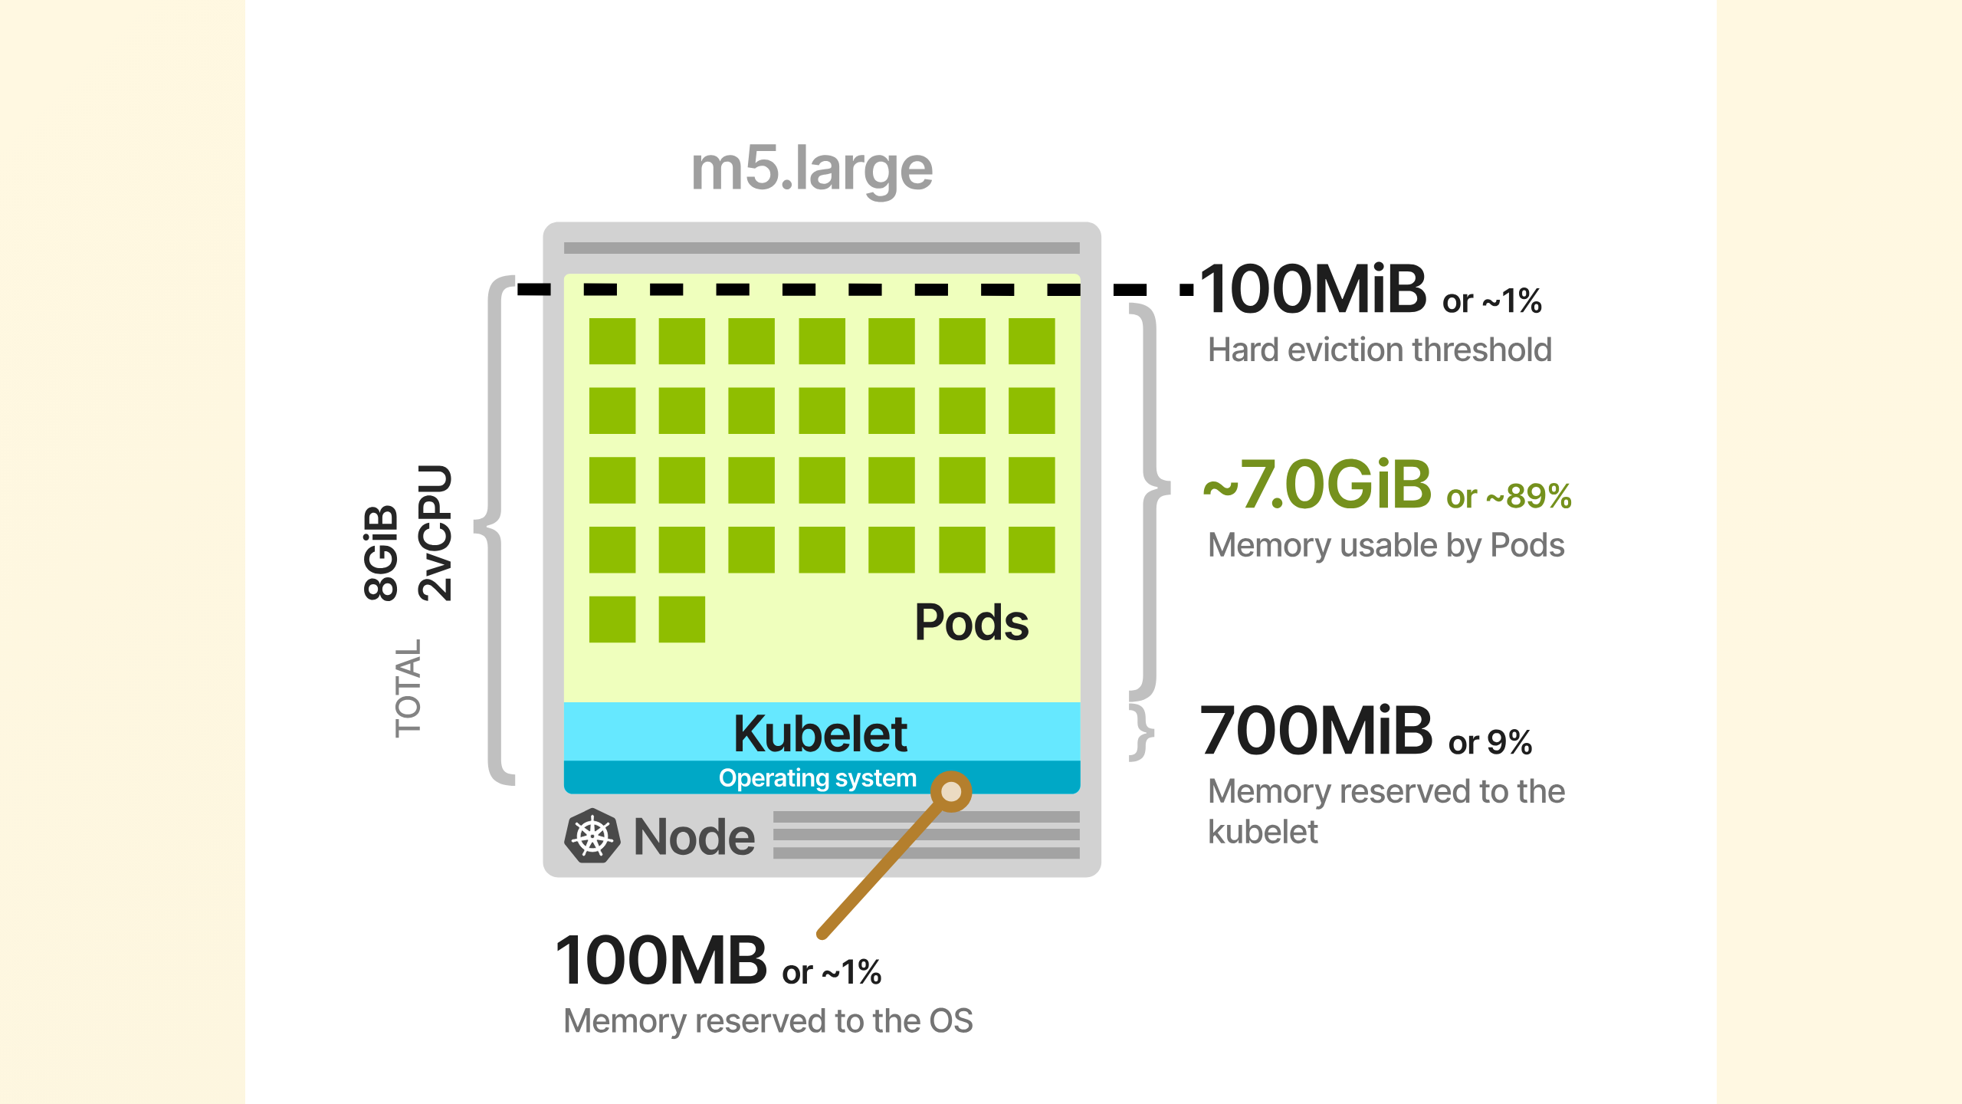
Notes:
In AWS If you select an M5.large, here's a visual recap of how the resources are subdivided.
With this particular instance, you can deploy up to 27 pods.

Slide 50
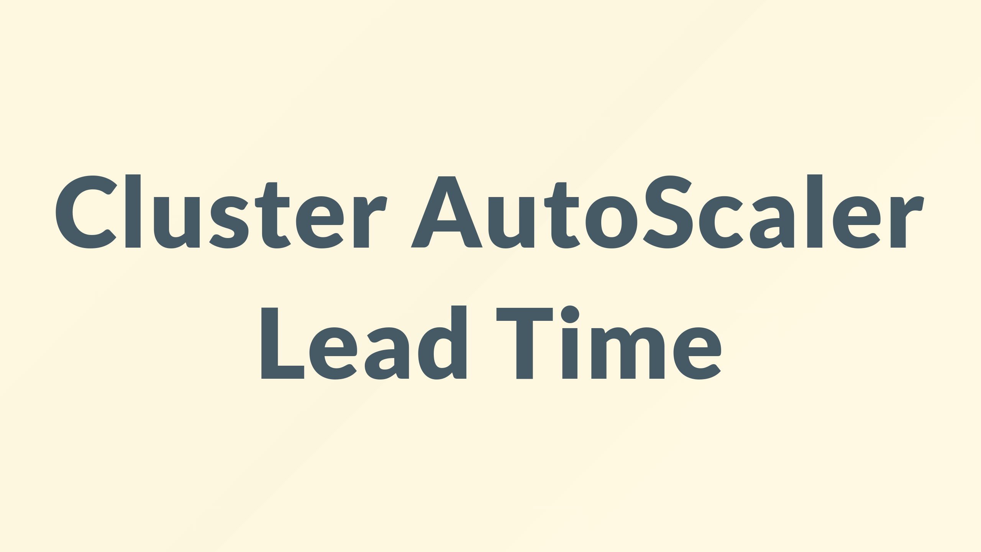
Notes:
The other thing to consider is all this takes time

Slide 51
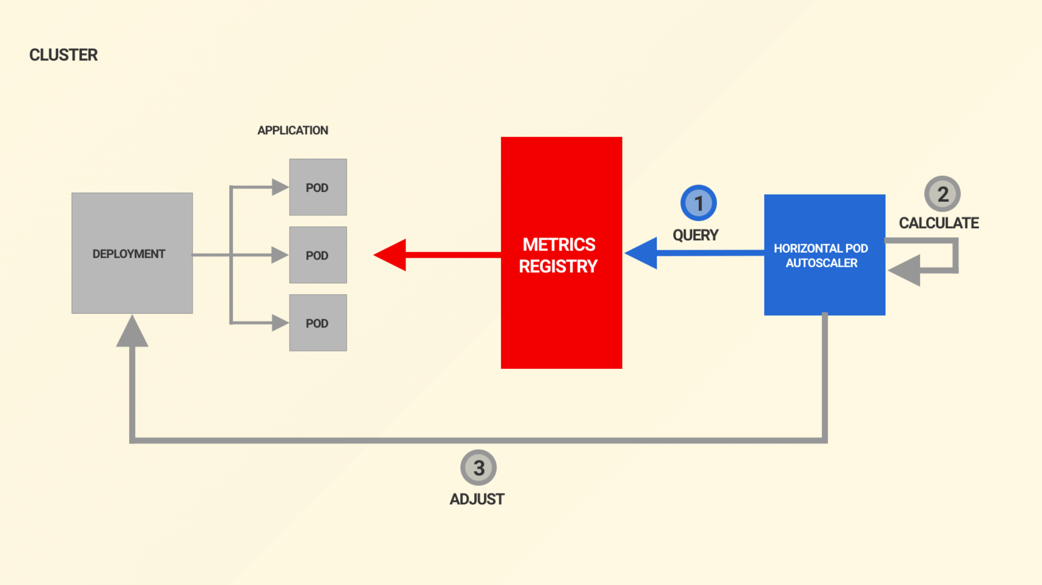
Notes:
Lets assume you've configured the horizontal pod autoscaler or HPA to scale up your pods dynamically, well thats where the journey probably starts

Slide 52
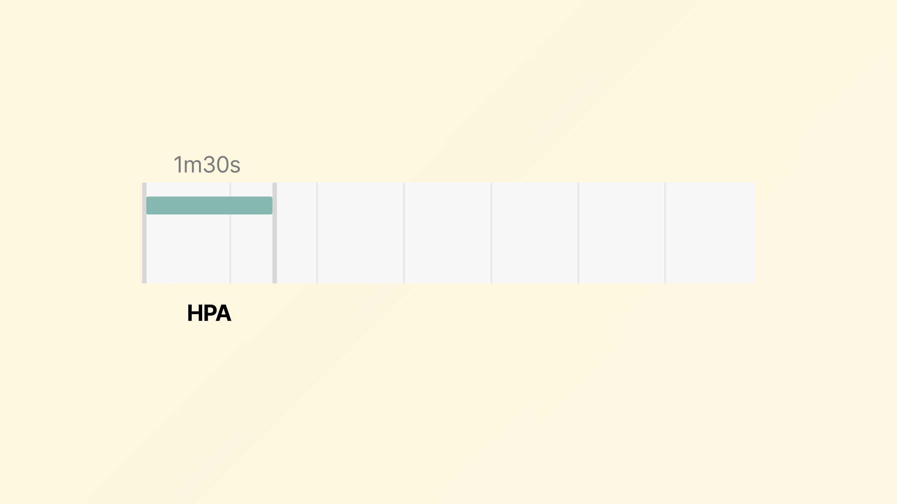
Notes:
to start with about 90 seconds for your Horizontal Pod Autoscaler to react and decide to scale up

Slide 53
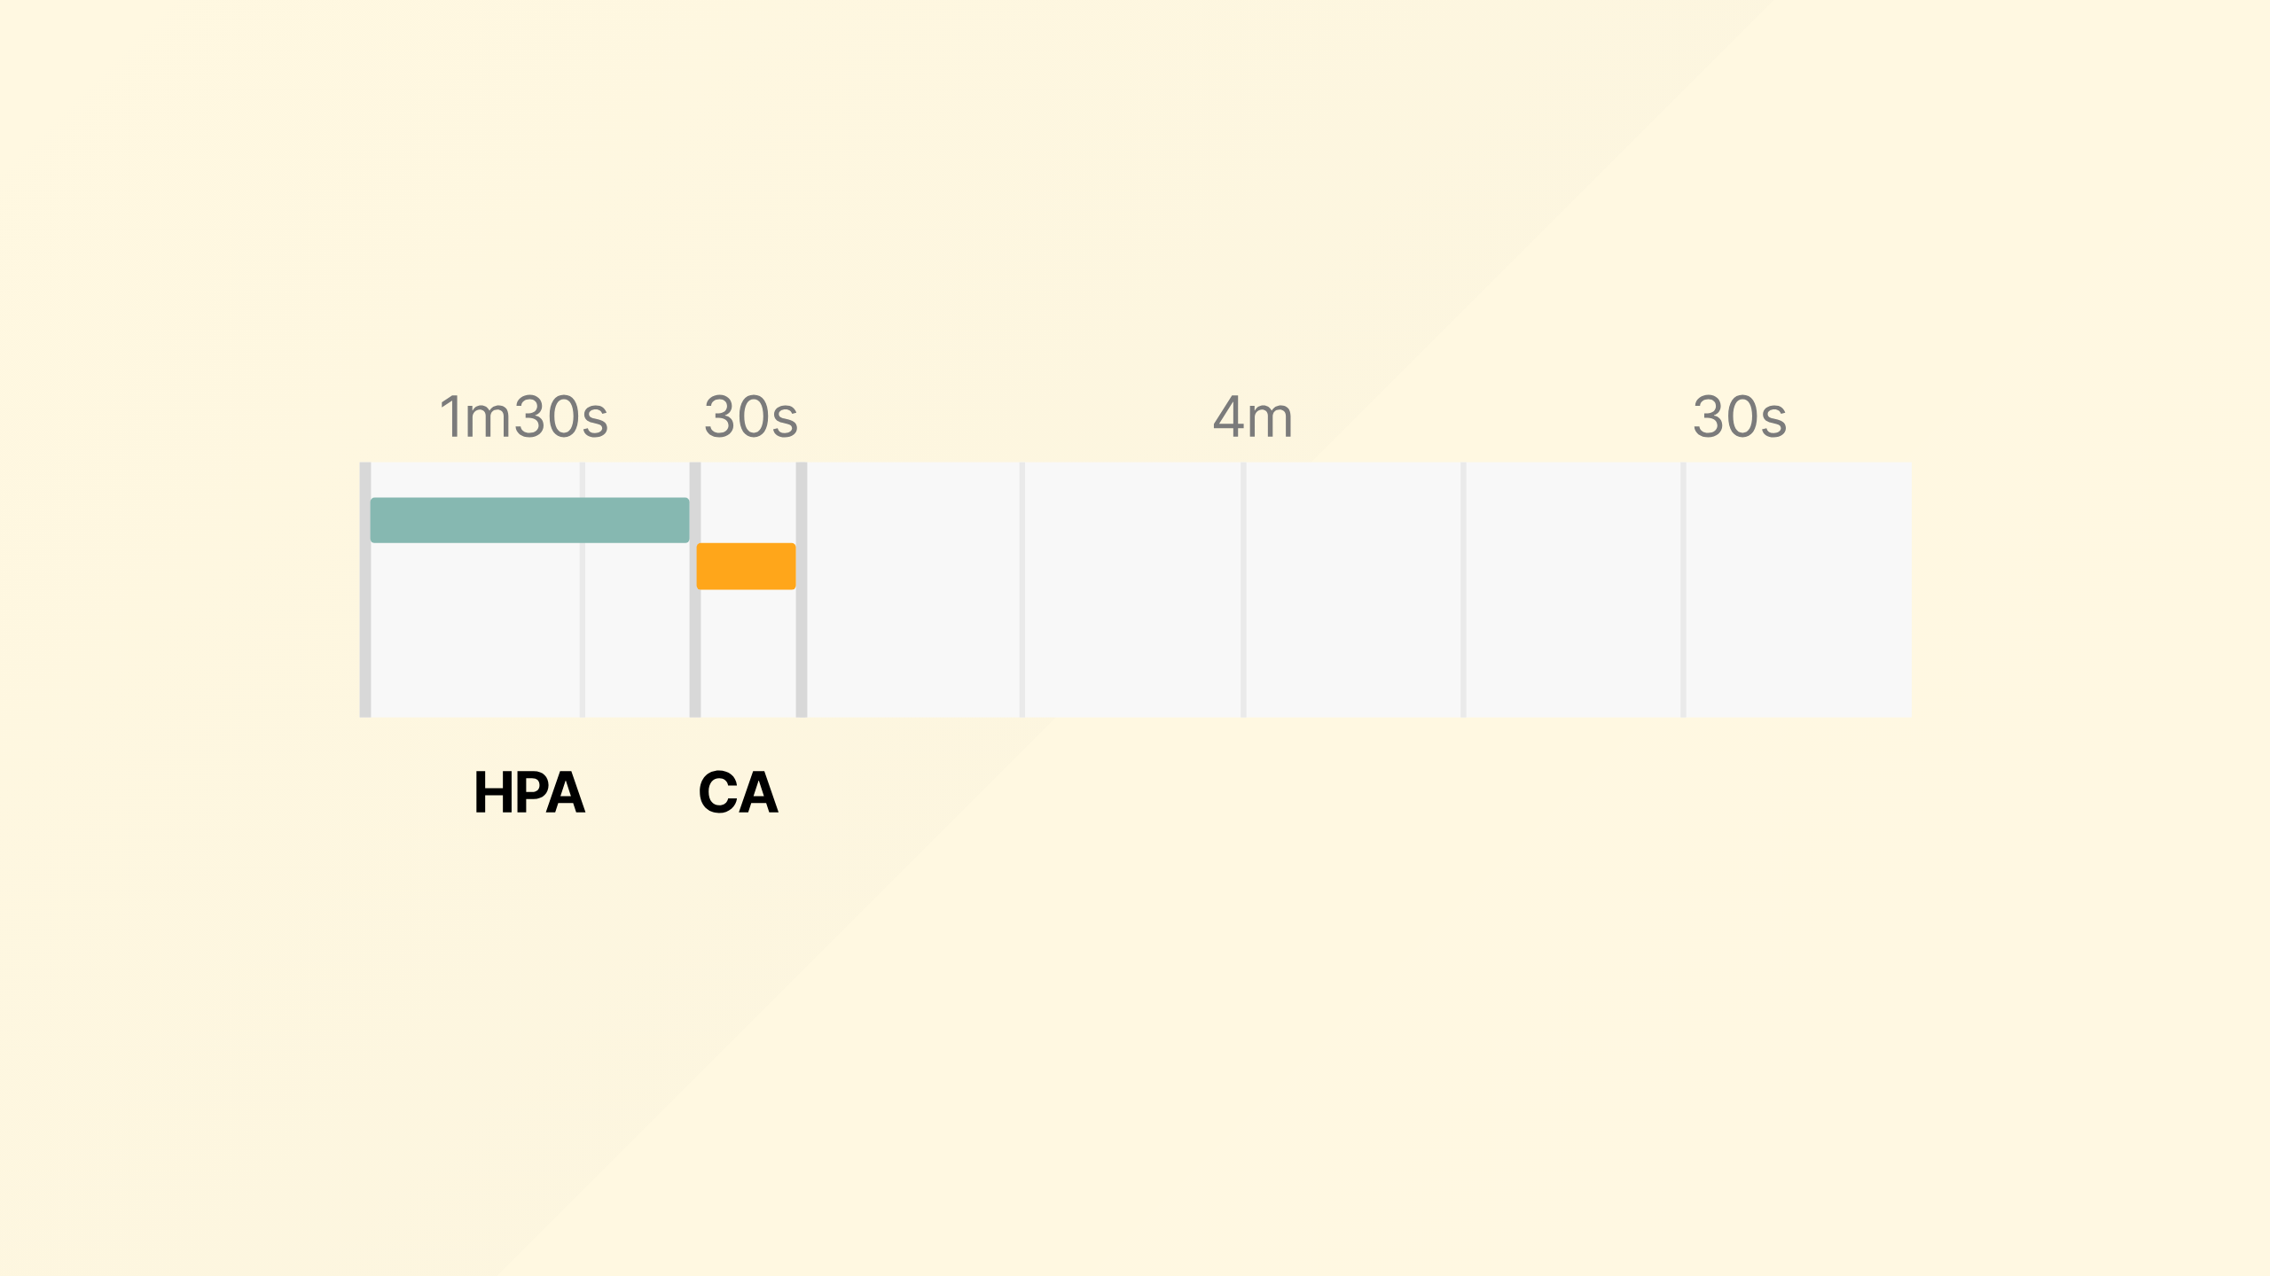
Notes:
Then the cluster autoscaler takes around 30 seconds to request a new node from the cloud vendor

Slide 54

Notes:
Then around 4minutes for the machine to boot

Slide 55

Notes:
Then around another 30 seconds to join the cluster and be ready to run workload
Then you can of course add on time for pulling your container image that won't be cached

Slide 56

Notes:
To help visualize the impact this can have I have made a library that fakes a Kubernetes scheduler, and it allows you to specify many different types of pods, and model their scaling dynamics, tracking container startup times, and so on.
And define your node properties, it takes a lot of shortcuts in order to provide hundreds of thousands of intervals representing days in tens of milliseconds, it is not the real Kubernetes scheduler.
Pull requests are very welcome if you'd like to improve it!

Slide 57

Notes:
And to give you a way to play with it, I also made a game as a novelty for kubecon last year called Black Friday.
The scenario is that you're an SRE team supporting a retailer facing a spike in traffic on black friday and again on cyber Monday, with a lull between and a calm before and after.
It is a three tier service of frontend, backend, and database all of which have different scaling properties, startup times etc
So the scenario starts Thursday midnight, and ends Tuesday 23:59
You're on the hook for it so there are SLA penalties if you cause a request to be failed
It's a simple three tier app, if you go into the hints, you'll see some of the constraints.
The goal is configure your cluster to as closely follow the traffic spike, with just enough infra, failing some requests and getting a few SLA penalties might actually result in a greater profit.
DEMO POINT CLICK, CHANGE MIN THINGS TO 1 OF EACH AND DEMONSTRATE PROFIT, EXPLAIN GRAPHS
Please do feel free to play, may the odds ever be in your favour

Slide 58

Notes:
So, what do we do to stack the odds in our favor

Slide 59

Notes:
Well, we can not scale at all, thats always an option thats often over looked

Slide 60

Notes:
Or what if you could get a head start on the scaling

Slide 61

Notes:
Maybe not scaling sounds a bit flippant, what do I really mean by that?

Slide 62

Notes:
Going back to our scenario of fitting our pods on a machine

Slide 63

Notes:
taking into account the reserves for the kublet

Slide 64

Notes:
if you size the machine correctly, you can fit all your workload in the node

Slide 65

Notes:
This isn't easy given the vast array of possible machine sizes, so we've done the hard work for you and created an instance calculator

Slide 66

Notes:
DEMO
drag sliders about

Slide 67

Notes:
Finally, on to the topic of this webinar, the wait is over

Slide 68

Notes:
What if we could always have at least one node ready for when you need it, removing that 4 minute wait
To do this we can create a placeholder pod, that

Slide 69

Notes:
as soon your workload comes along needing the resource, the placeholder pod is evicted

Slide 70

Notes:
causing the cluster autoscaler to boot a new machine to host the new replacement placeholder, and this will continue as you scale into further nodes, keeping you always one step ahead

Slide 71

Notes:
Ok now to pray to the demo gods where I do a real live demo

Slide 72

Notes:
I've got a simple application, where you can see the effects of me clicking the scale buttons,
behind this is a real kubernetes cluster running in linnode, I've just got some javascript driving the changes to the kubernetes api to scale up and down
so we start with 1 replica, and I click to scale to 5, the current node gets saturated with 4 pods, and one is pending, behind the scenes now the cluster autoscaler is going to request a new node from linnode, so while I stall for about 3 minutes of what would otherwise be silence and me praying for it to work are there any questions?
As you saw, the node became available, and then it took a little longer for the CNI to come up and then to be able to schedule our pod.
And the timer shows that took .....
ok, now lets schedule back down to 1 and enable our placeholder <click scale to 1> <click placeholder on>
now thats all running, lets try scaling to 5 again <click scale to 5>
and as you can see that is far more performant
phew! that was more stressful than you can imagine, I can assure you there is a real cluster, to prove that really happened

Slide 73


Slide 74

Notes:
SKIP IF THE LIVE DEMO WORKED
I've built a simple application, where you can see the effects of me clicking the scale button,
so we start with 1 replica, and I scale to 5, as you can see with my old world this takes some time to eventually add the additional node and scale

Slide 75

Notes:
SKIP IF THE LIVE DEMO WORKED
So same again, only now with our proactive approach of having a placeholder,
as soon as I scale to 5, my placeholder becomes descheduled from the node it was occupying,
so I've scaled up in around 10 seconds as opposed to the around 3 minutes we saw on the previous demo
eventually a new node is provisioned with the placeholder on it again

Slide 76

Notes:
So how do we make this happen

Slide 77

Notes:
Firstly we need a placeholder that is big enough to know it'll never be schedule-able along side any real workload on a node, so it should be sized big enough to fill the node

Slide 78

Notes:
Then you need to specify a low priority class, to make sure it is evicted as soon as there is a real workload
The placeholder pod competes for resources, so we need to define that we want it to have a low priority.
With a priority of -1, all other pods will have precedence, and the placeholder is evicted as soon as the cluster runs out of space.

Slide 79


Slide 80

Notes:
OK now for a demo of how this works with pod autoscaling, in a real-ish world scenario
I'll be honest with you, I've exhausted my credit with the demo gods, so I'm going to play some video and provide a little narration.

Slide 81

Notes:
<CLICK PLAY>
Before I start, to provide a little orientation, on the left side we can see requests per second that we're serving, bottom left you can see the nodes and the pods on them as you can see my nodes can take up to four of my workload pods
I've got a simple application that can handle a fixed number of requests, and I'm ramping up traffic, as you can see we start with two nodes, and we're able to sustainably handle the traffic increasing in, until we fill both nodes, and we continue to start backing up a list of pending pods that the HPA has decided it needs.
then we finally see Cluster autoscaler provide the nodes. I have manipulated these results a little so as to not leave you waiting the around 4 minutes for the node to be available.
In that time while we waited for the nodes to be available the traffic we're able to service really flattens out, but as soon as we've got more resource it goes up

Slide 82

Notes:
<CLICK PLAY>
Now we can compare that to our proactive pattern, where we have a placeholder pod keeping us a spare node ready at all times.
As the traffic builds up, we see that placeholder quickly become evicted and our workload pods become scheduled on that node. A new placeholder pod is created as pending, causing the cluster autoscaler to create a new node.
Sometimes however as happens here, the traffic build up and HPA has outpaced the speed at which we were able to stand up a new node.

Slide 83

Notes:
This all comes at an inevitable cost, your plan is to always have extra capacity ready and waiting for your workload to require it.
What might therefore be the better answers?

Slide 84

Notes:
You can tune your workload to make sure you're not leaving gaps

Slide 85

Notes:
Or better yet, remember that pod priority thing we used, if you've got workload that suits on your cluster that you'd like to run and would give you more return on investment than the placeholder, which can handle stopping and starting when you need
Perhaps some house keeping, analytics, machine learning, or maybe just less important services, so you might want to prioritize the shopping cart supporting pods over the customer service desk ones you could structure your cluster workload to be more aligned to your businesses benefits

Slide 86

Notes:
I've been Chris Nesbitt-Smith, thank you again for joining me today.
Like subscribe whatever the kids do these days on LinkedIn, Github whatever and you can be assured there'll be no spam or much content at all since I'm awful at self promotion especially on social media. cns.me just points at my LinkedIn.
talks.cns.me contains this and other talks, they're all open source.
Questions are very welcome on this or anything else.
If I've not got to your question or you're not watching this live I'll do my best to get back to you, just leave the question in the kubernetes scaling slack channel
feel free to @ me so I see it!

