Slide 1
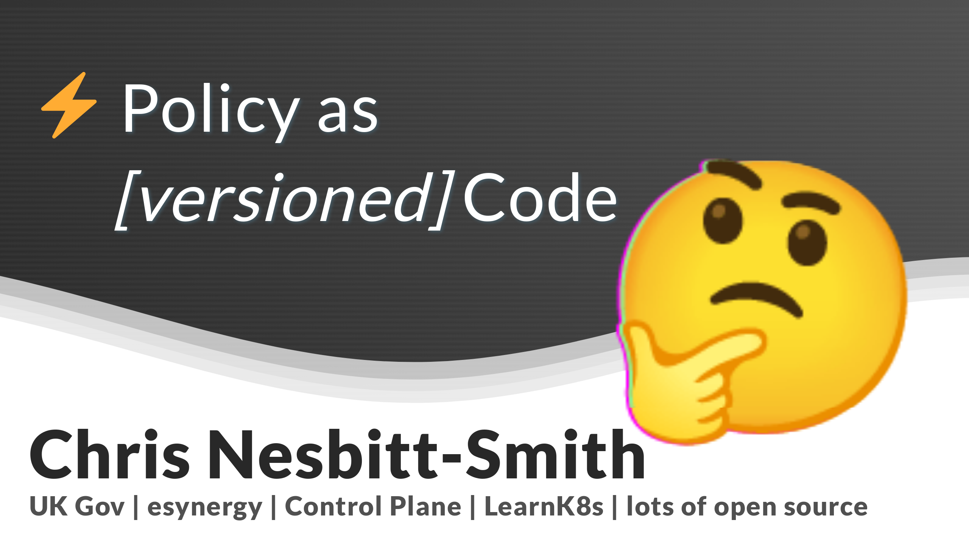

Slide 2

Notes:
This is a lightning version of a longer talk, of a longer blog, of a longer thesis.
Strap in, I've only got ten minutes for about a hundred slides

Slide 3

Notes:
Elephant in the room, policy is not sexy, but I'm going to try and get your attention.

Slide 4
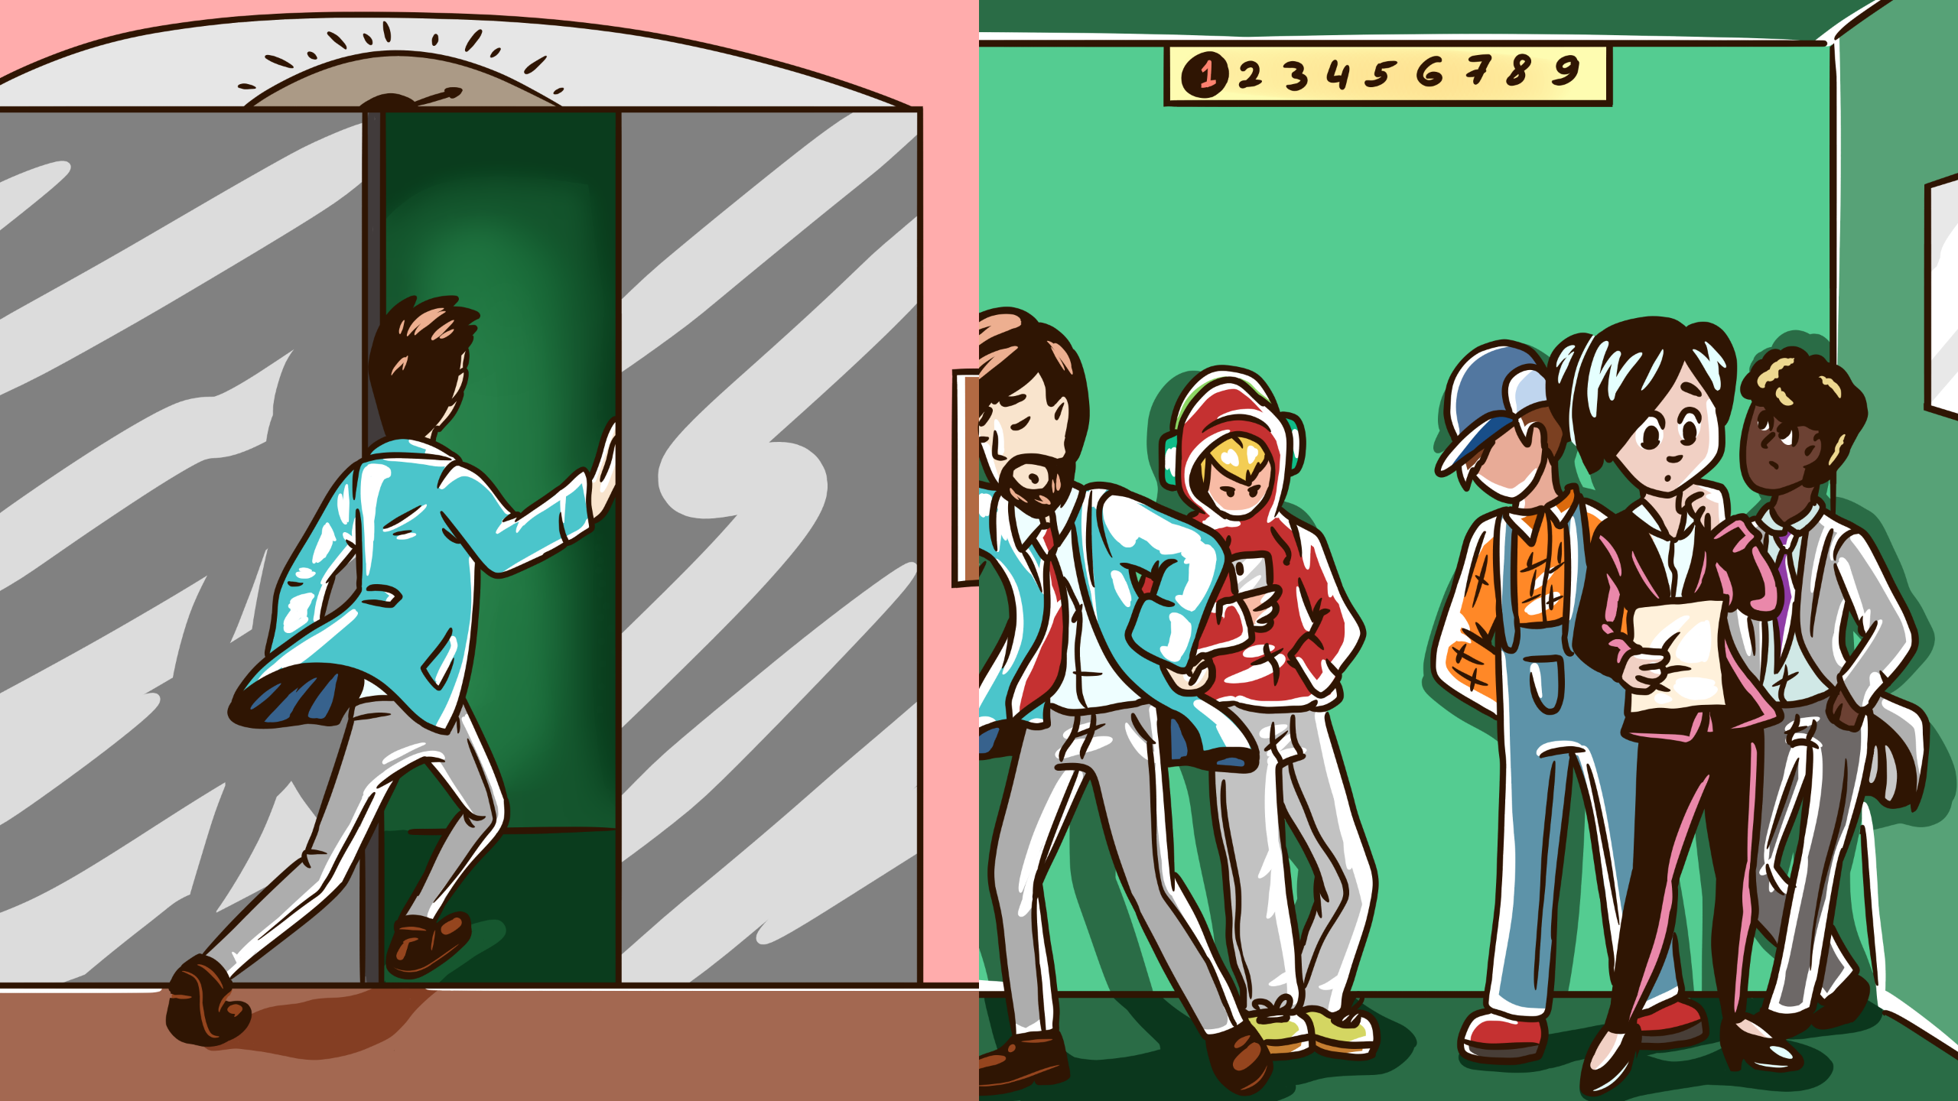
Notes:
So to set the scene I'm in the lift (yes, American friends we really do call them lifts) four people walk in.
Chris! this is your moment, a captive audience. I hear the doors seal shut behind me, I take a breath.

Slide 5
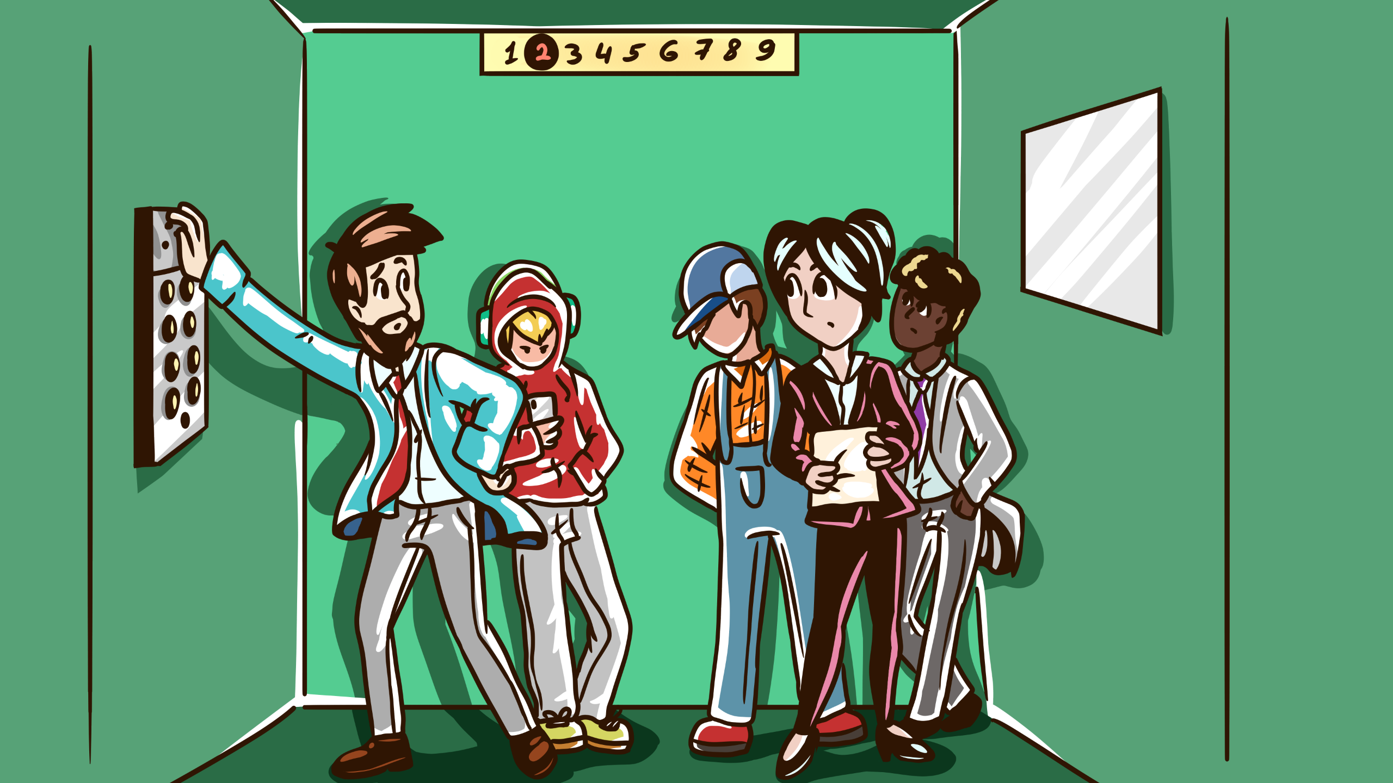
Notes:
I look at the first person, CIO the policy maker, the one who's neck is on the block, what are the chances of finding you in my imaginary lift today?
I ask her, what keeps you up at night?

Slide 6
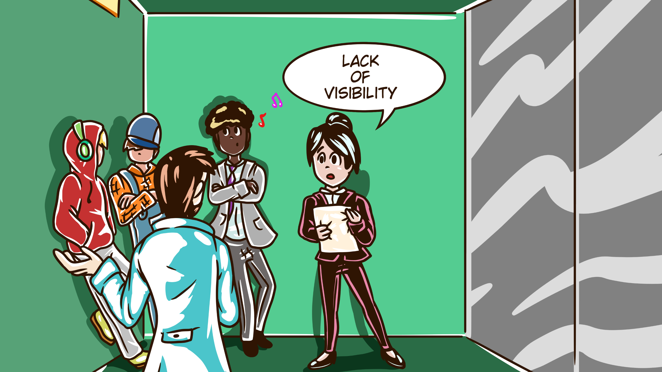
Notes:
Don't know what teams are doing.

Slide 7
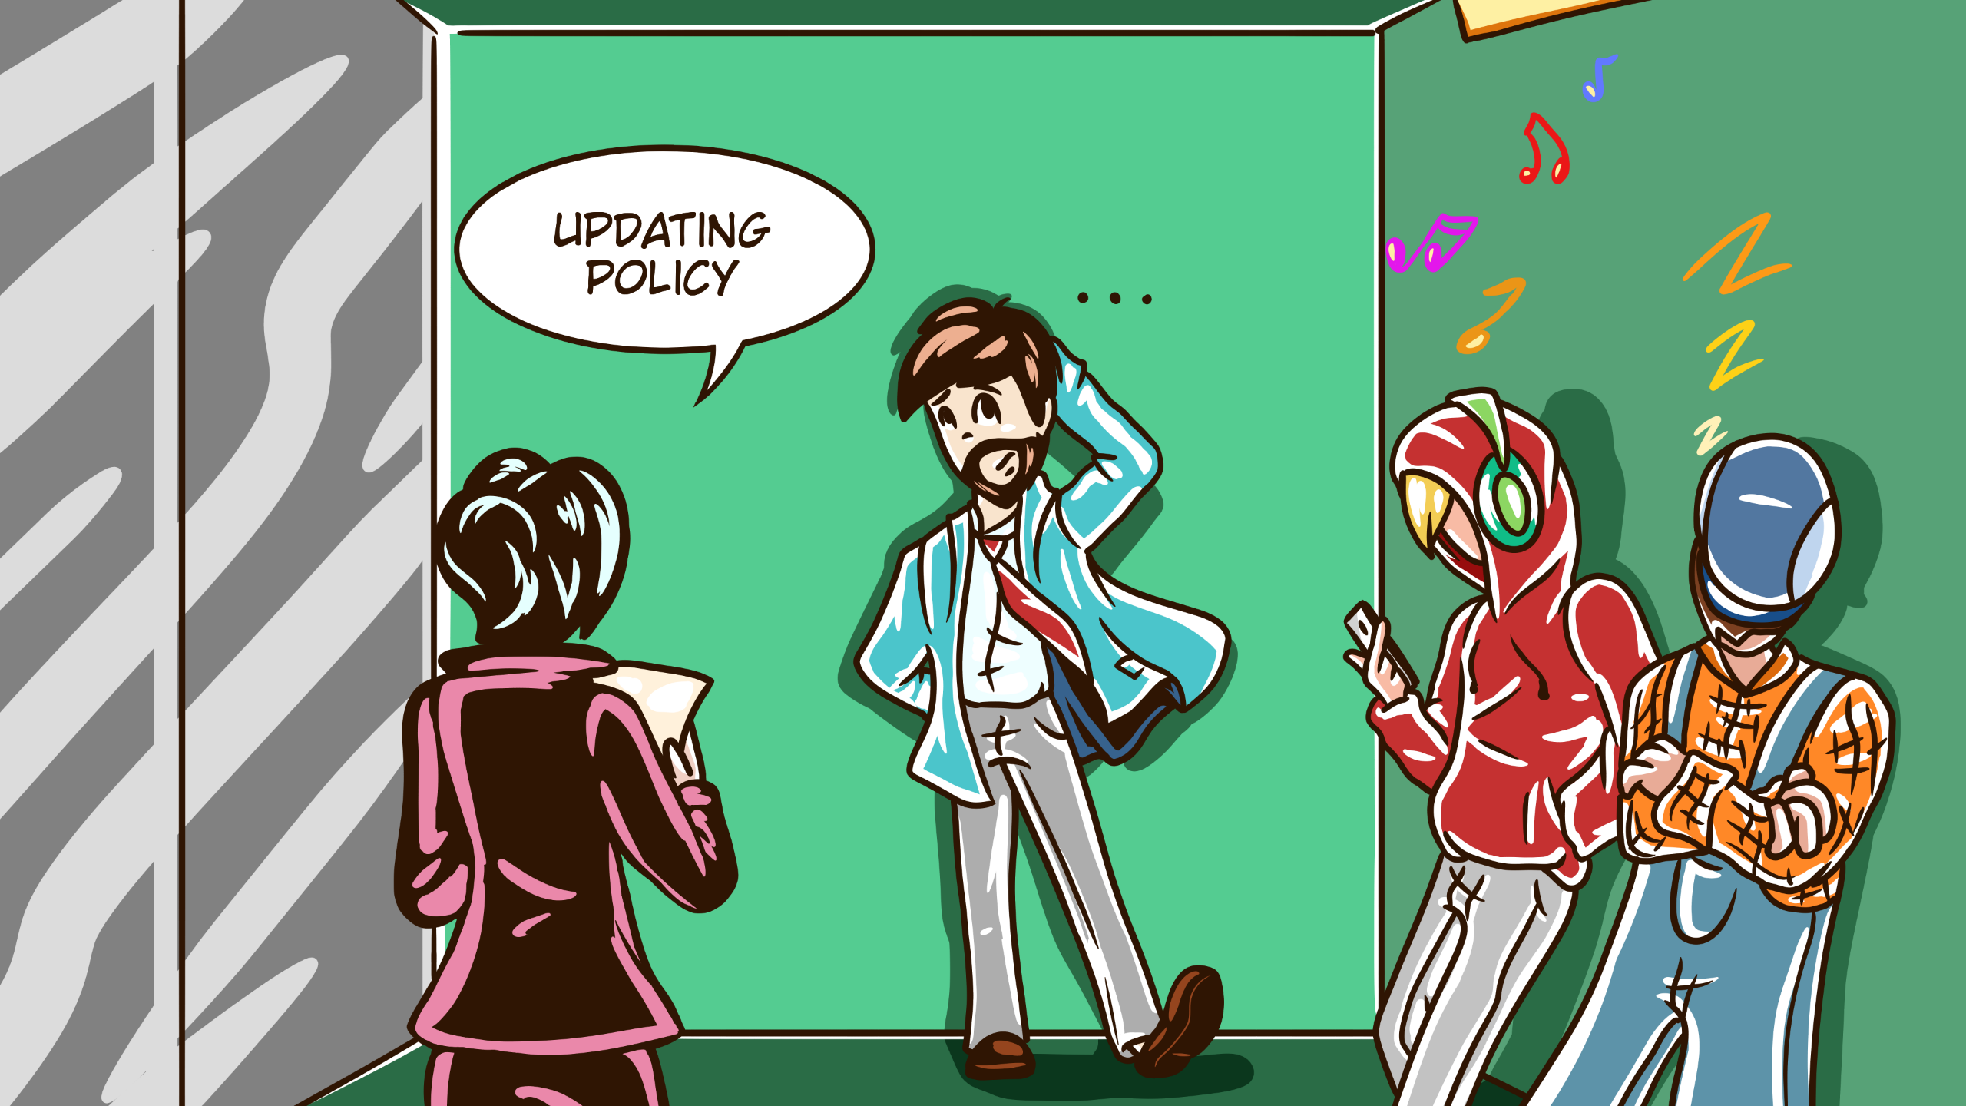
Notes:
Setting and changing policy is slow and hard to communicate

Slide 8
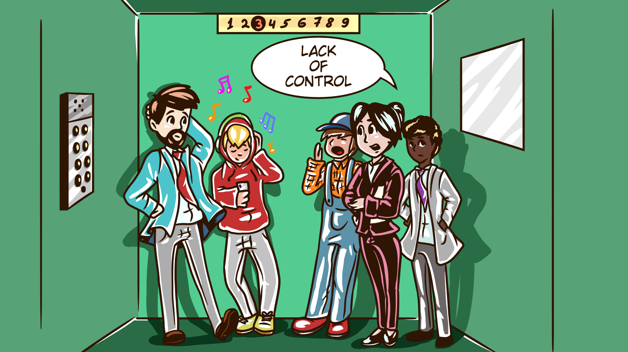
Notes:
People go off and do their own thing, they do know better, but I'm left playing catchup with the risk they've signed me up to

Slide 9
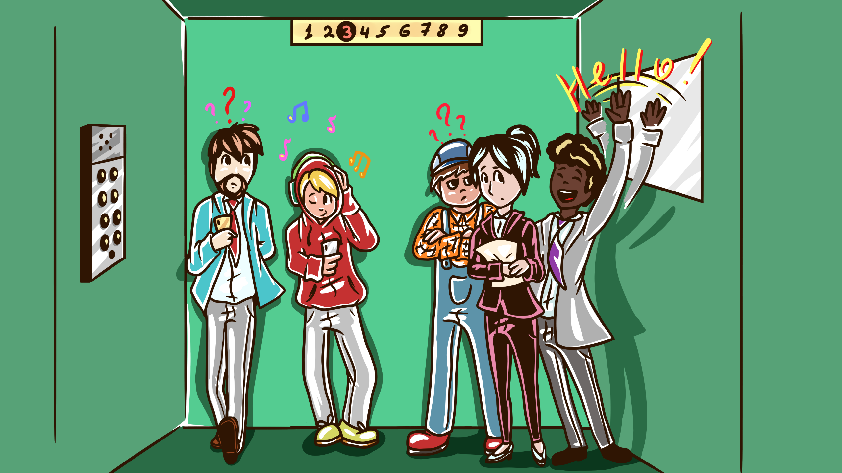
Notes:
Second person, Product manager - the whip cracker. What's important to you?

Slide 10
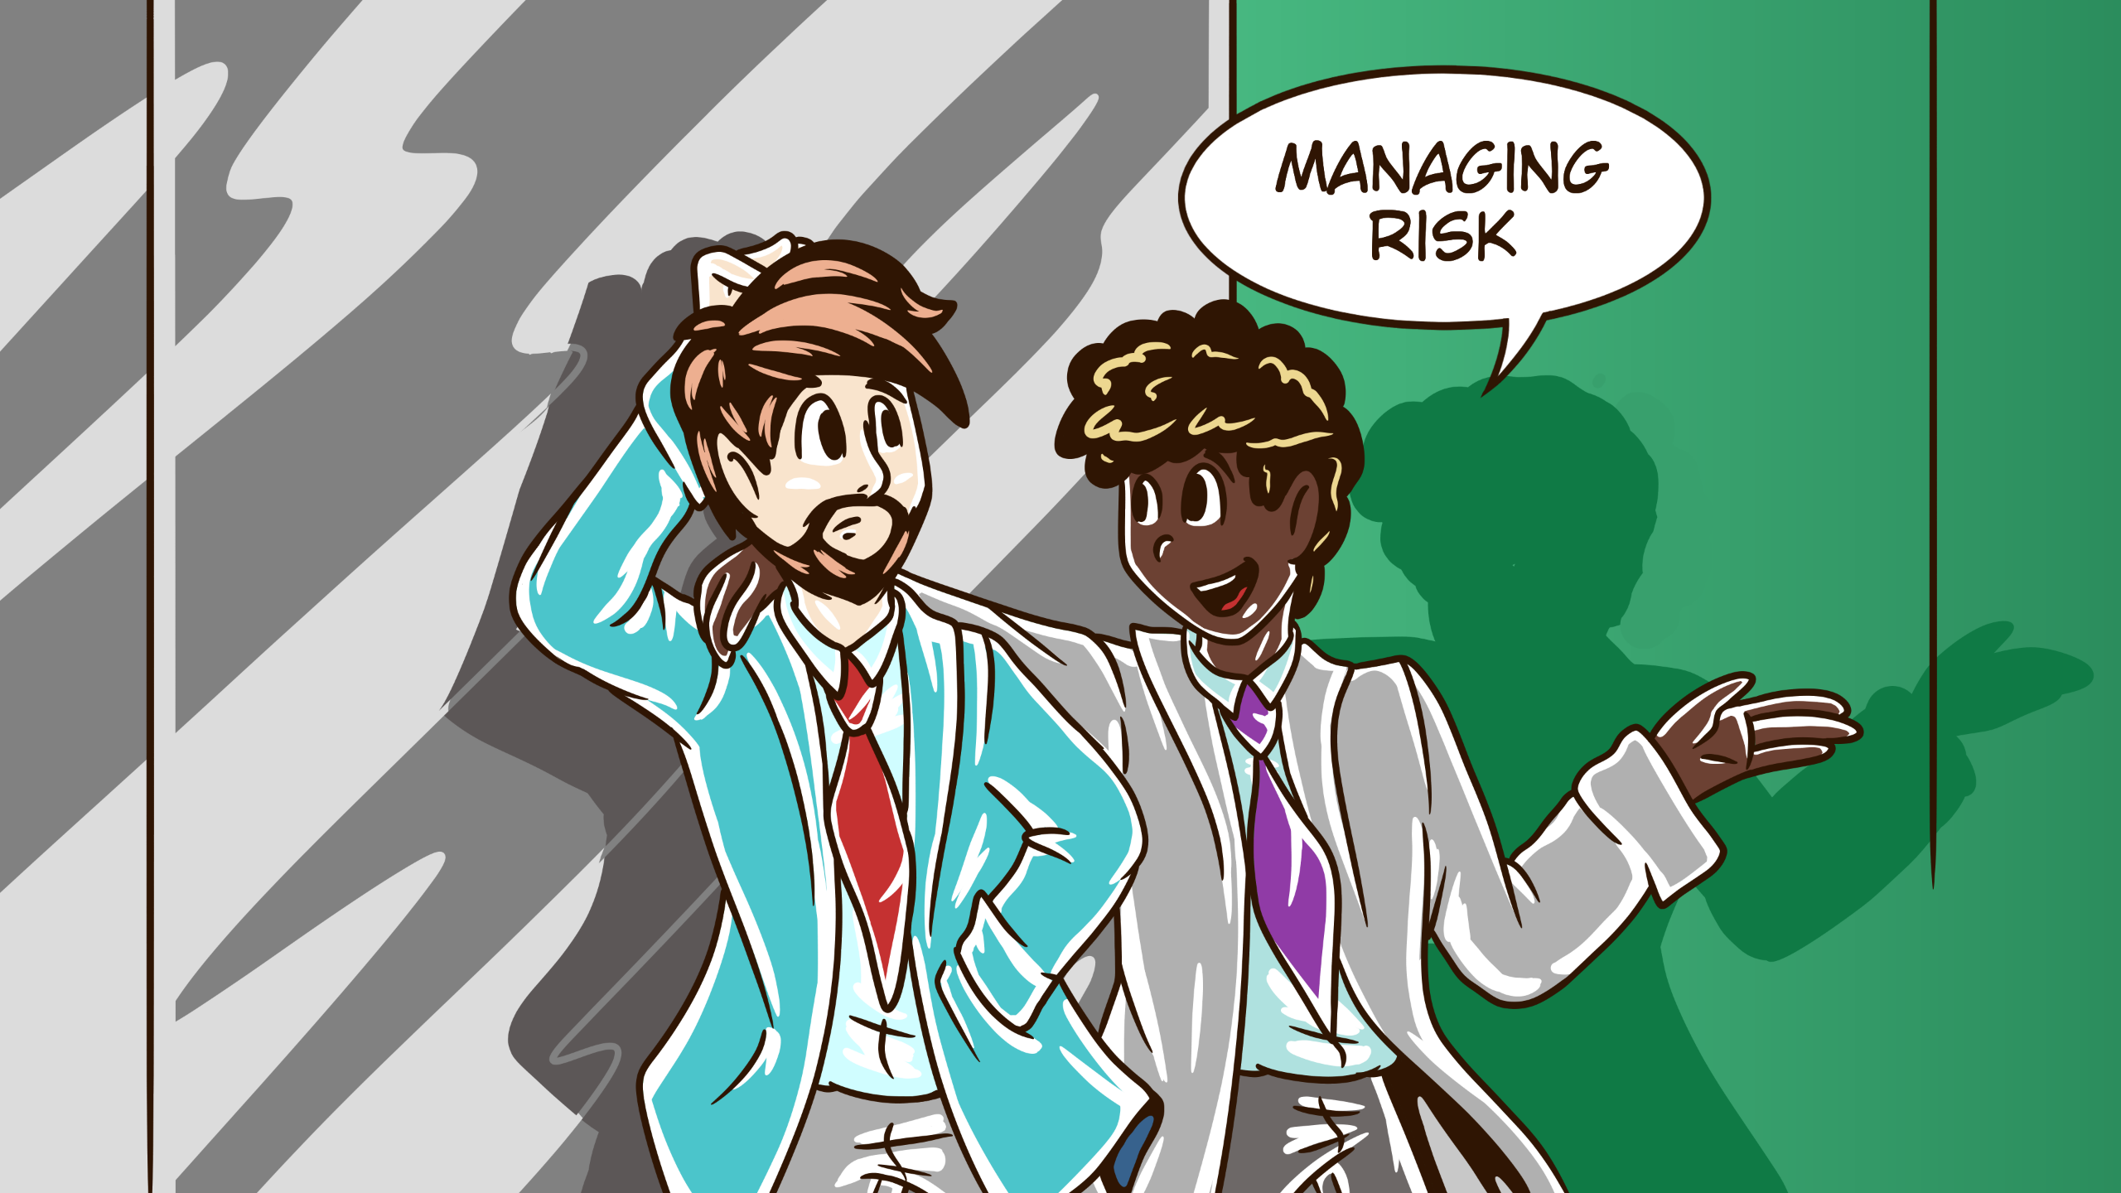
Notes:
Managing risk, mostly opportunity risk, the fear of missing out. getting features out the door, avoiding getting bogged down with

Slide 11
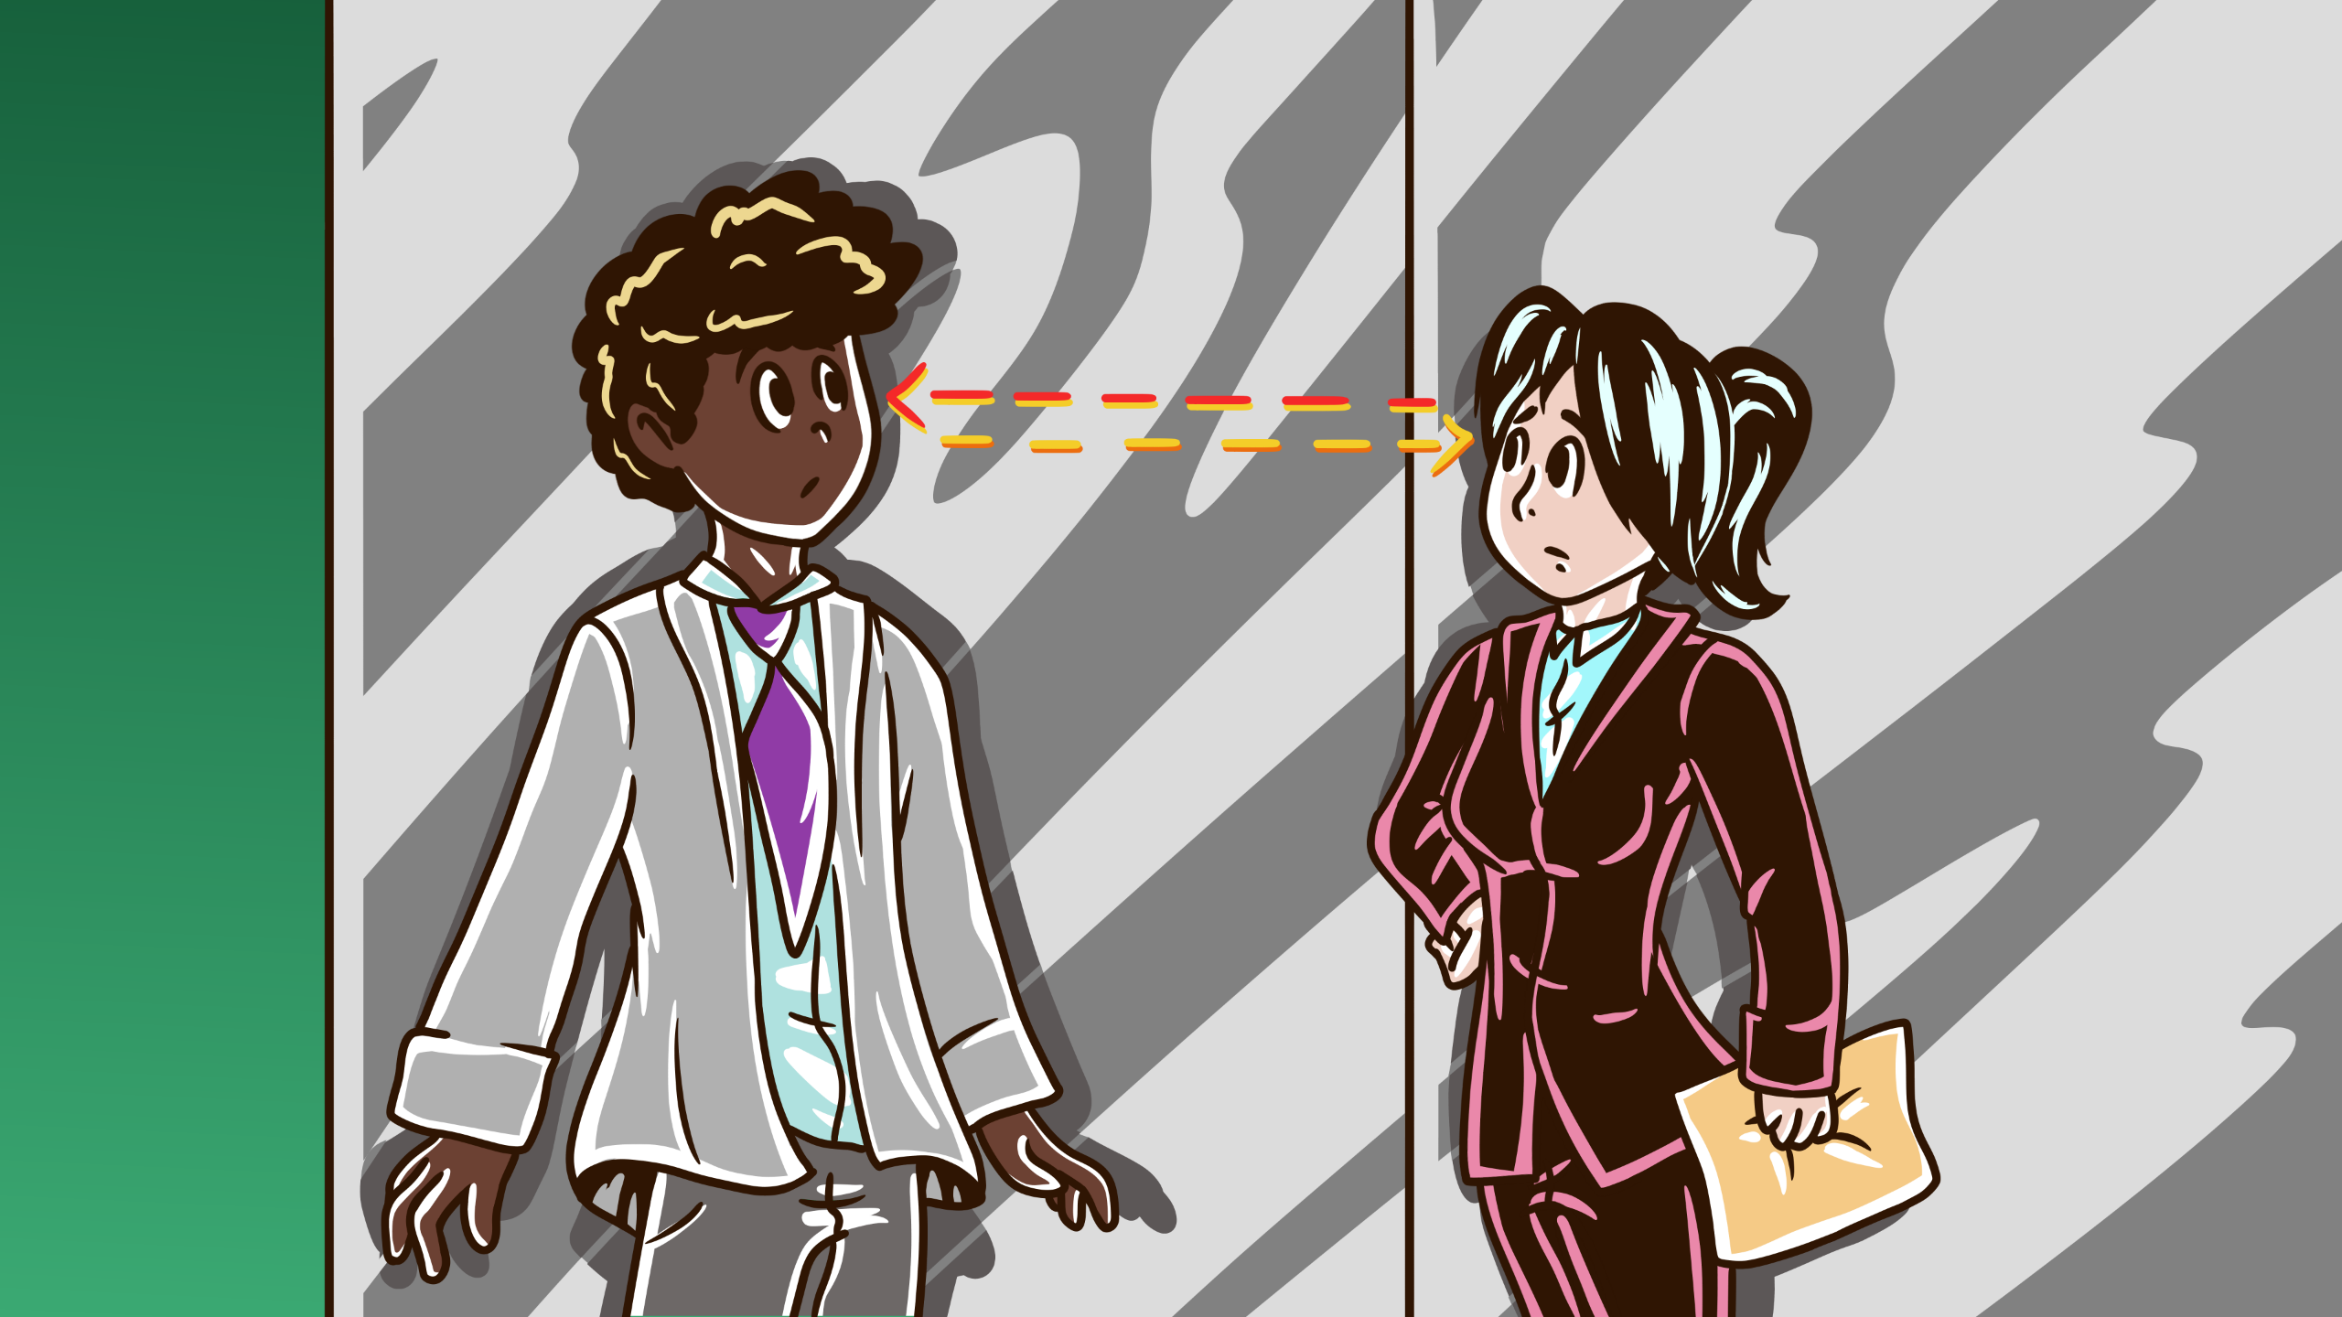
Notes:
bureaucracy that seems designed to slow me down.

Slide 12
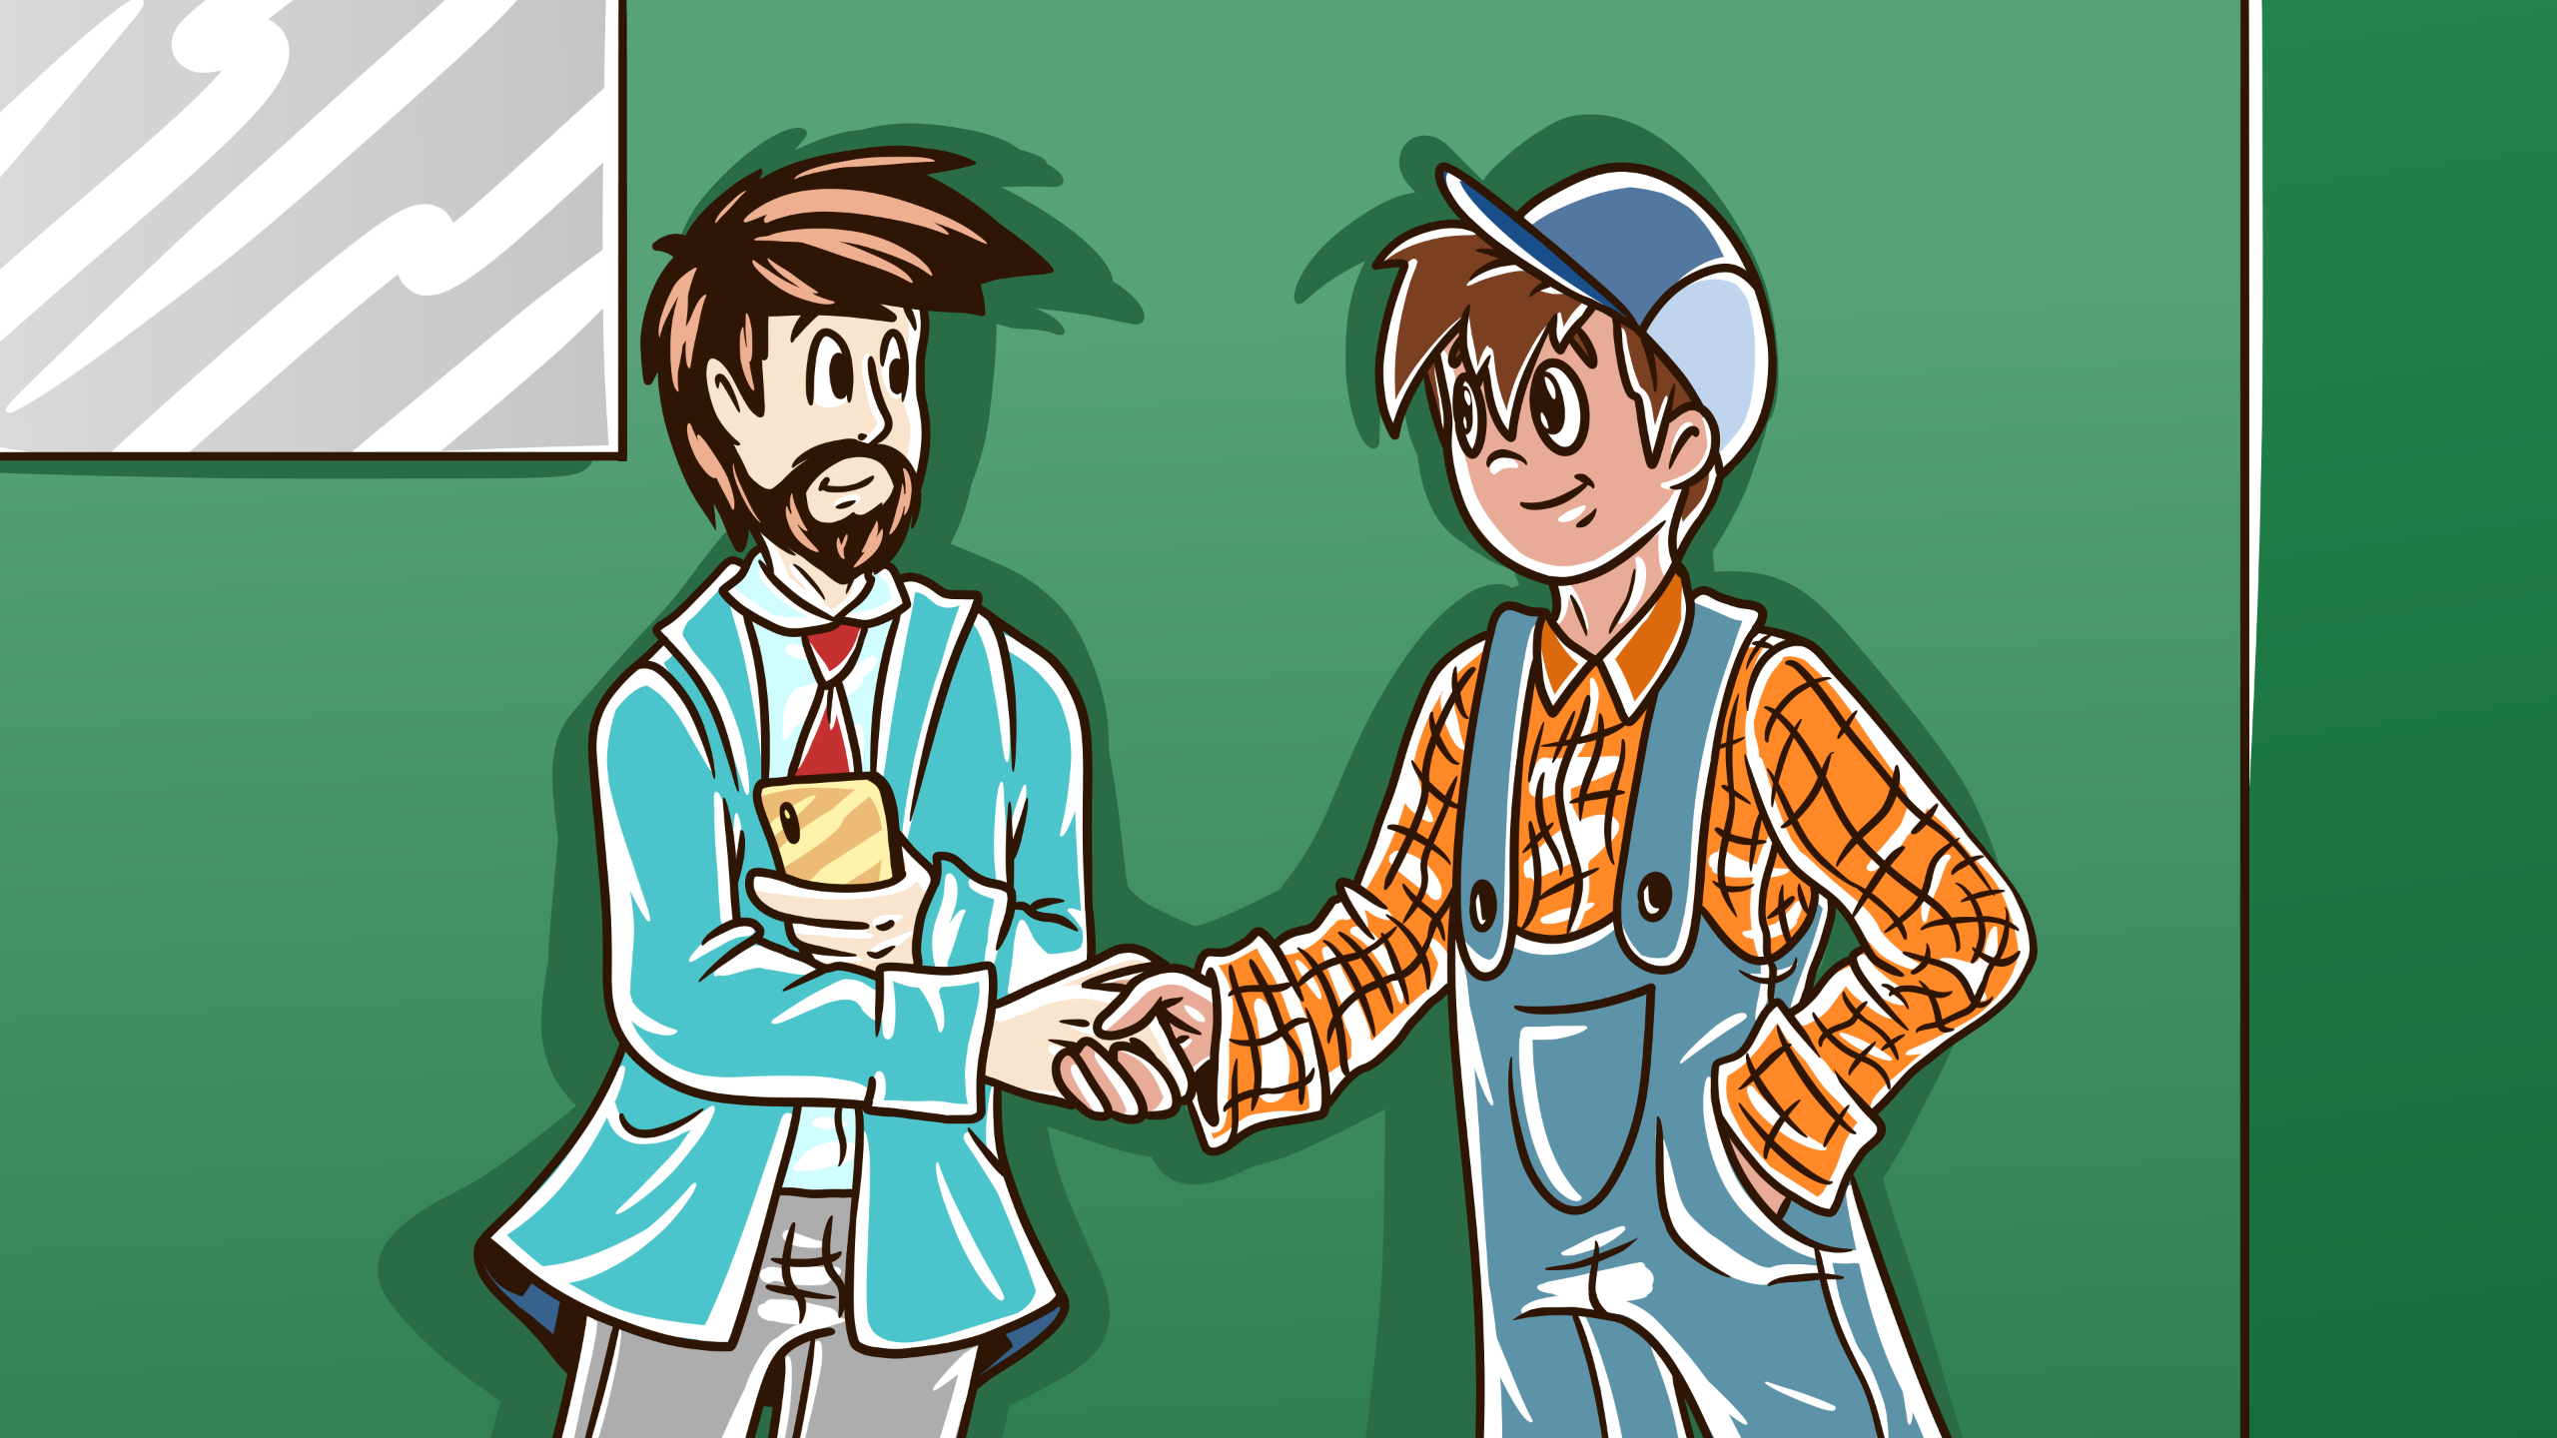
Notes:
Next person, dressed in overalls, they could be the CTO, before I ask,

Slide 13
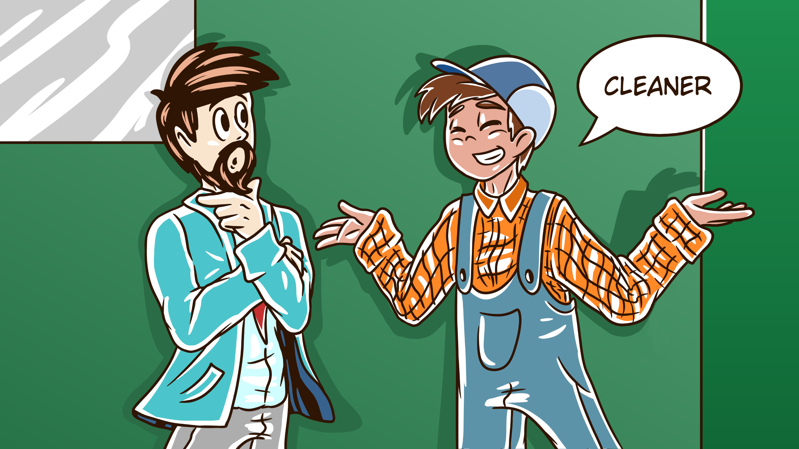
Notes:
Cleaner they say, errr ok how did you get in my imagination, I'll come back to you.

Slide 14
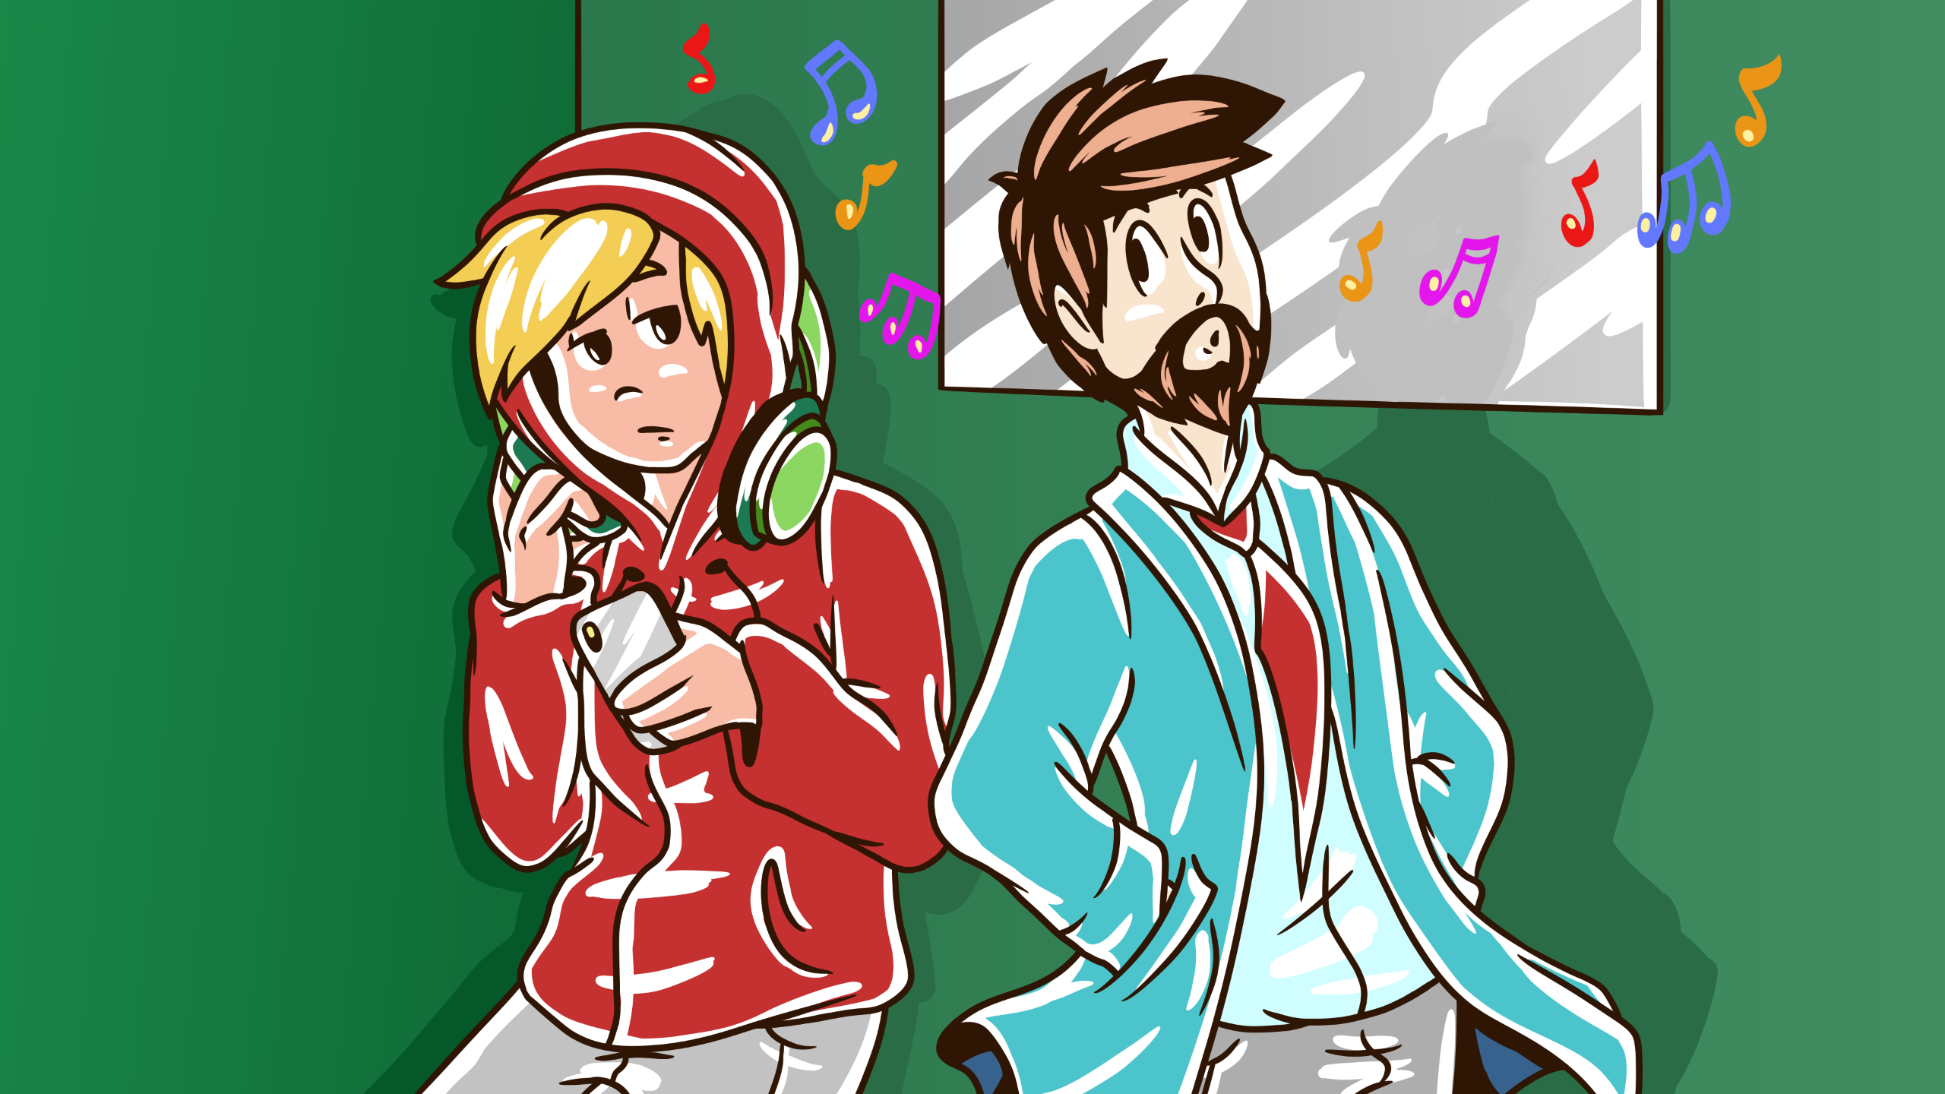
Notes:
My attention goes to the last person, hoodie, headphones. Ah my stereotypical developer, I know you well.

Slide 15
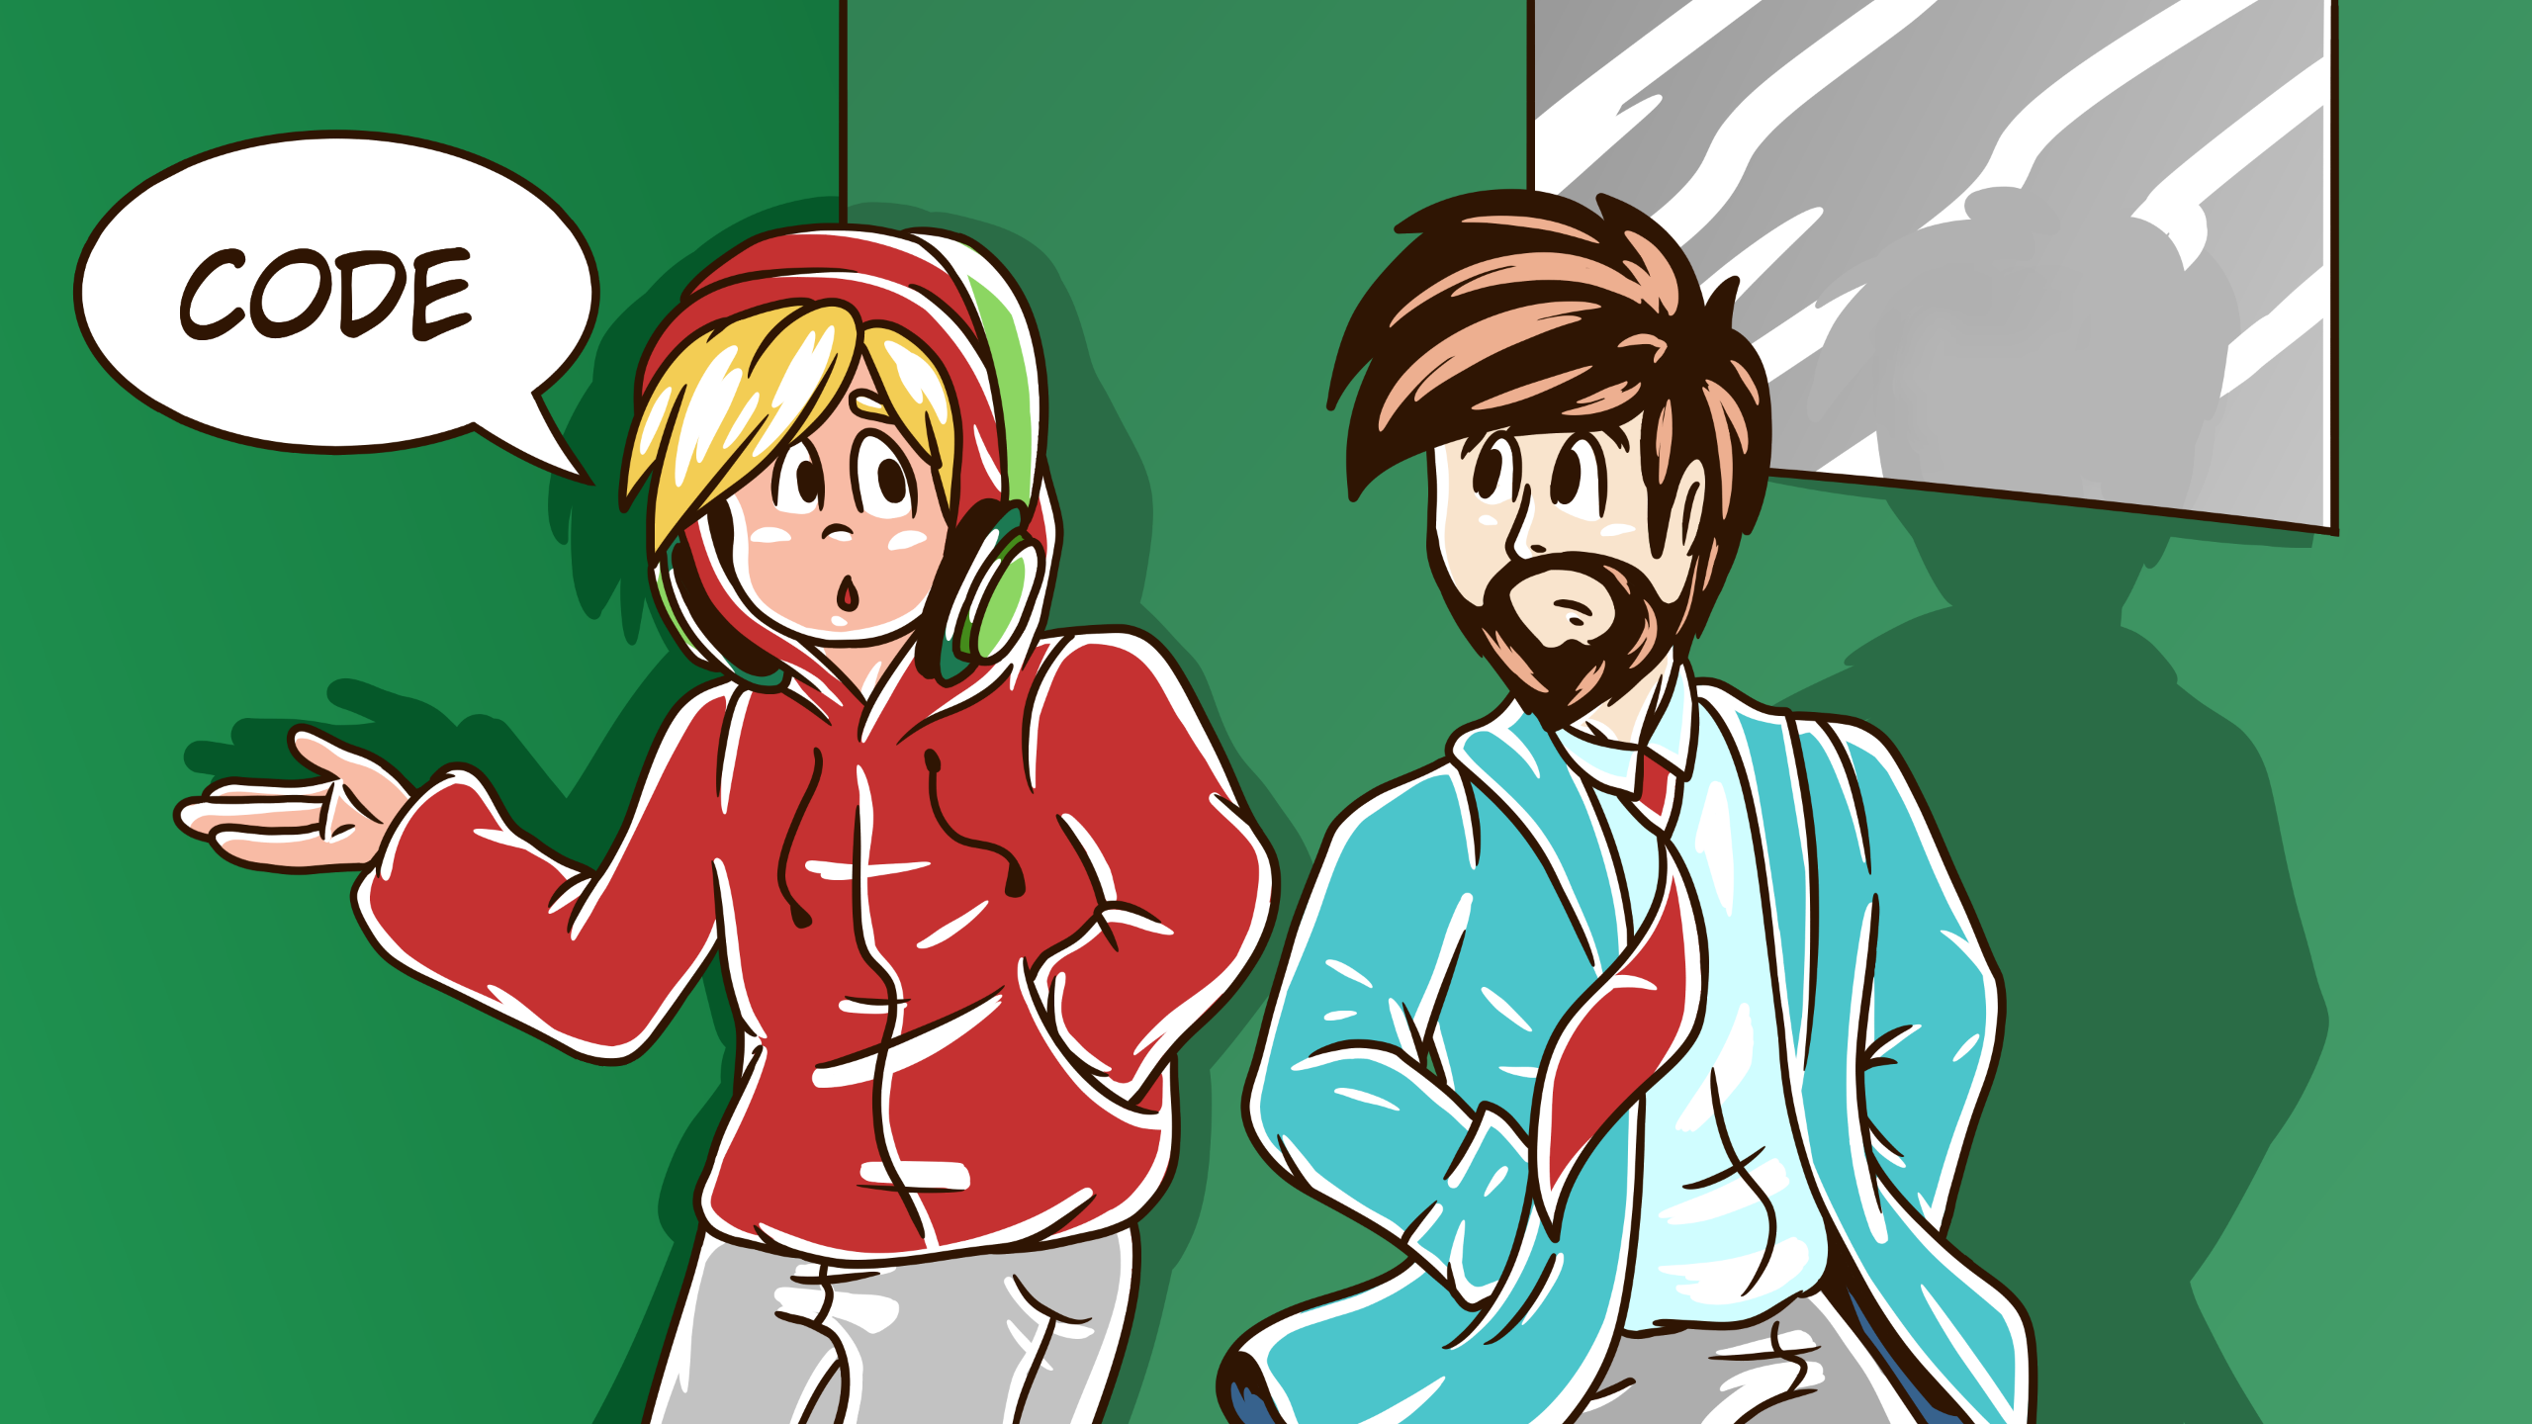
Notes:
Whats important to you?

Slide 16
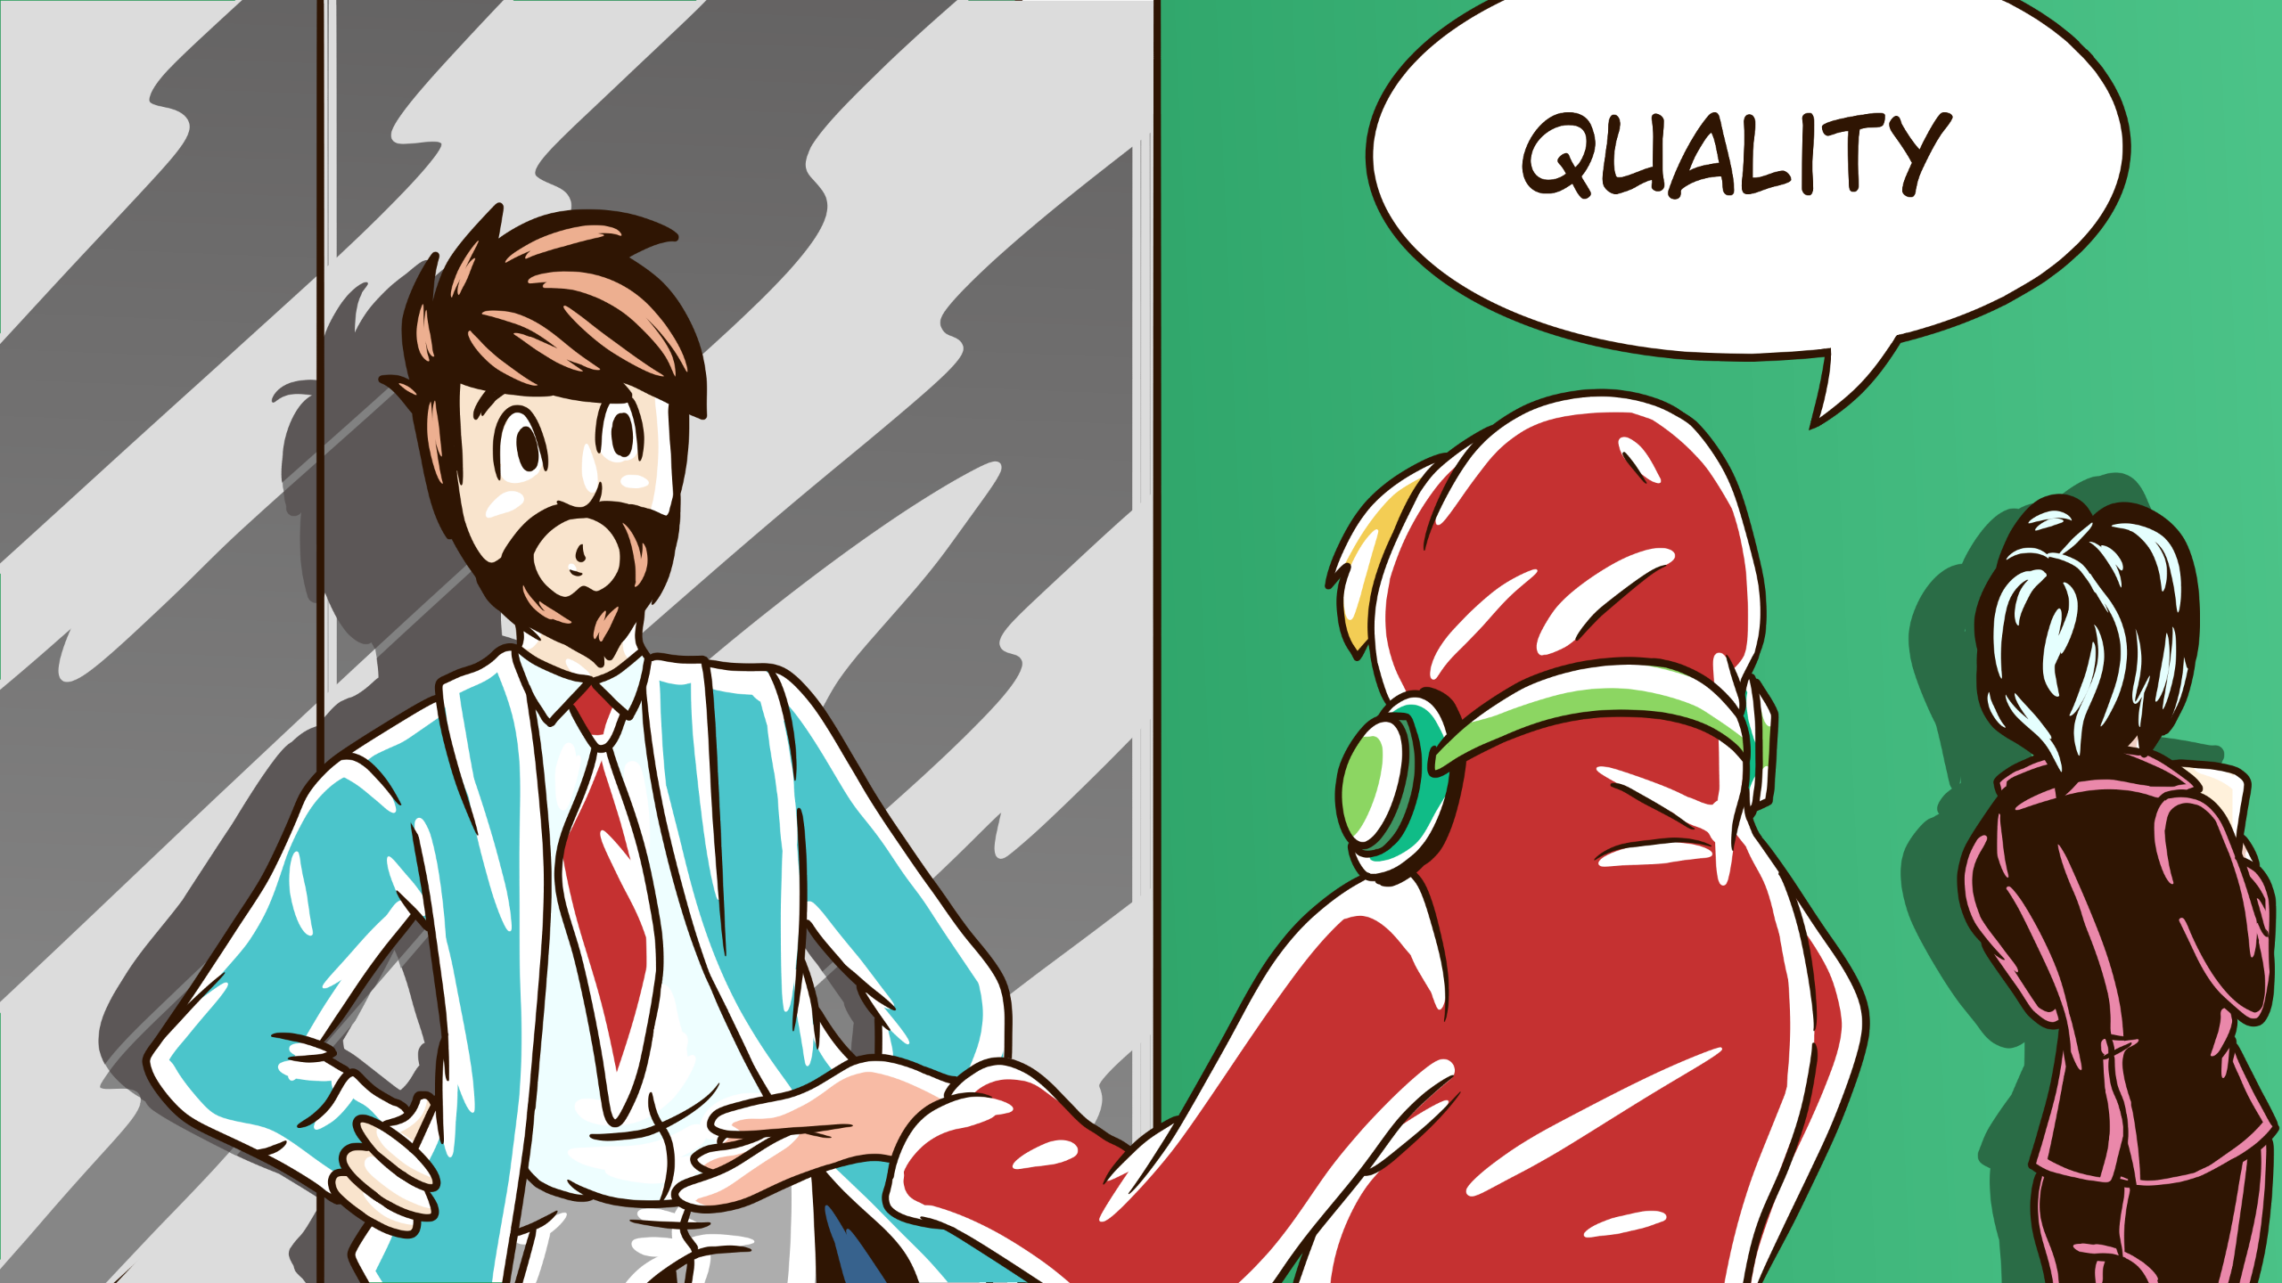
Notes:
Writing consistent quality code, avoiding technical debt, the rest of my team being able to cohesively work as one.

Slide 17
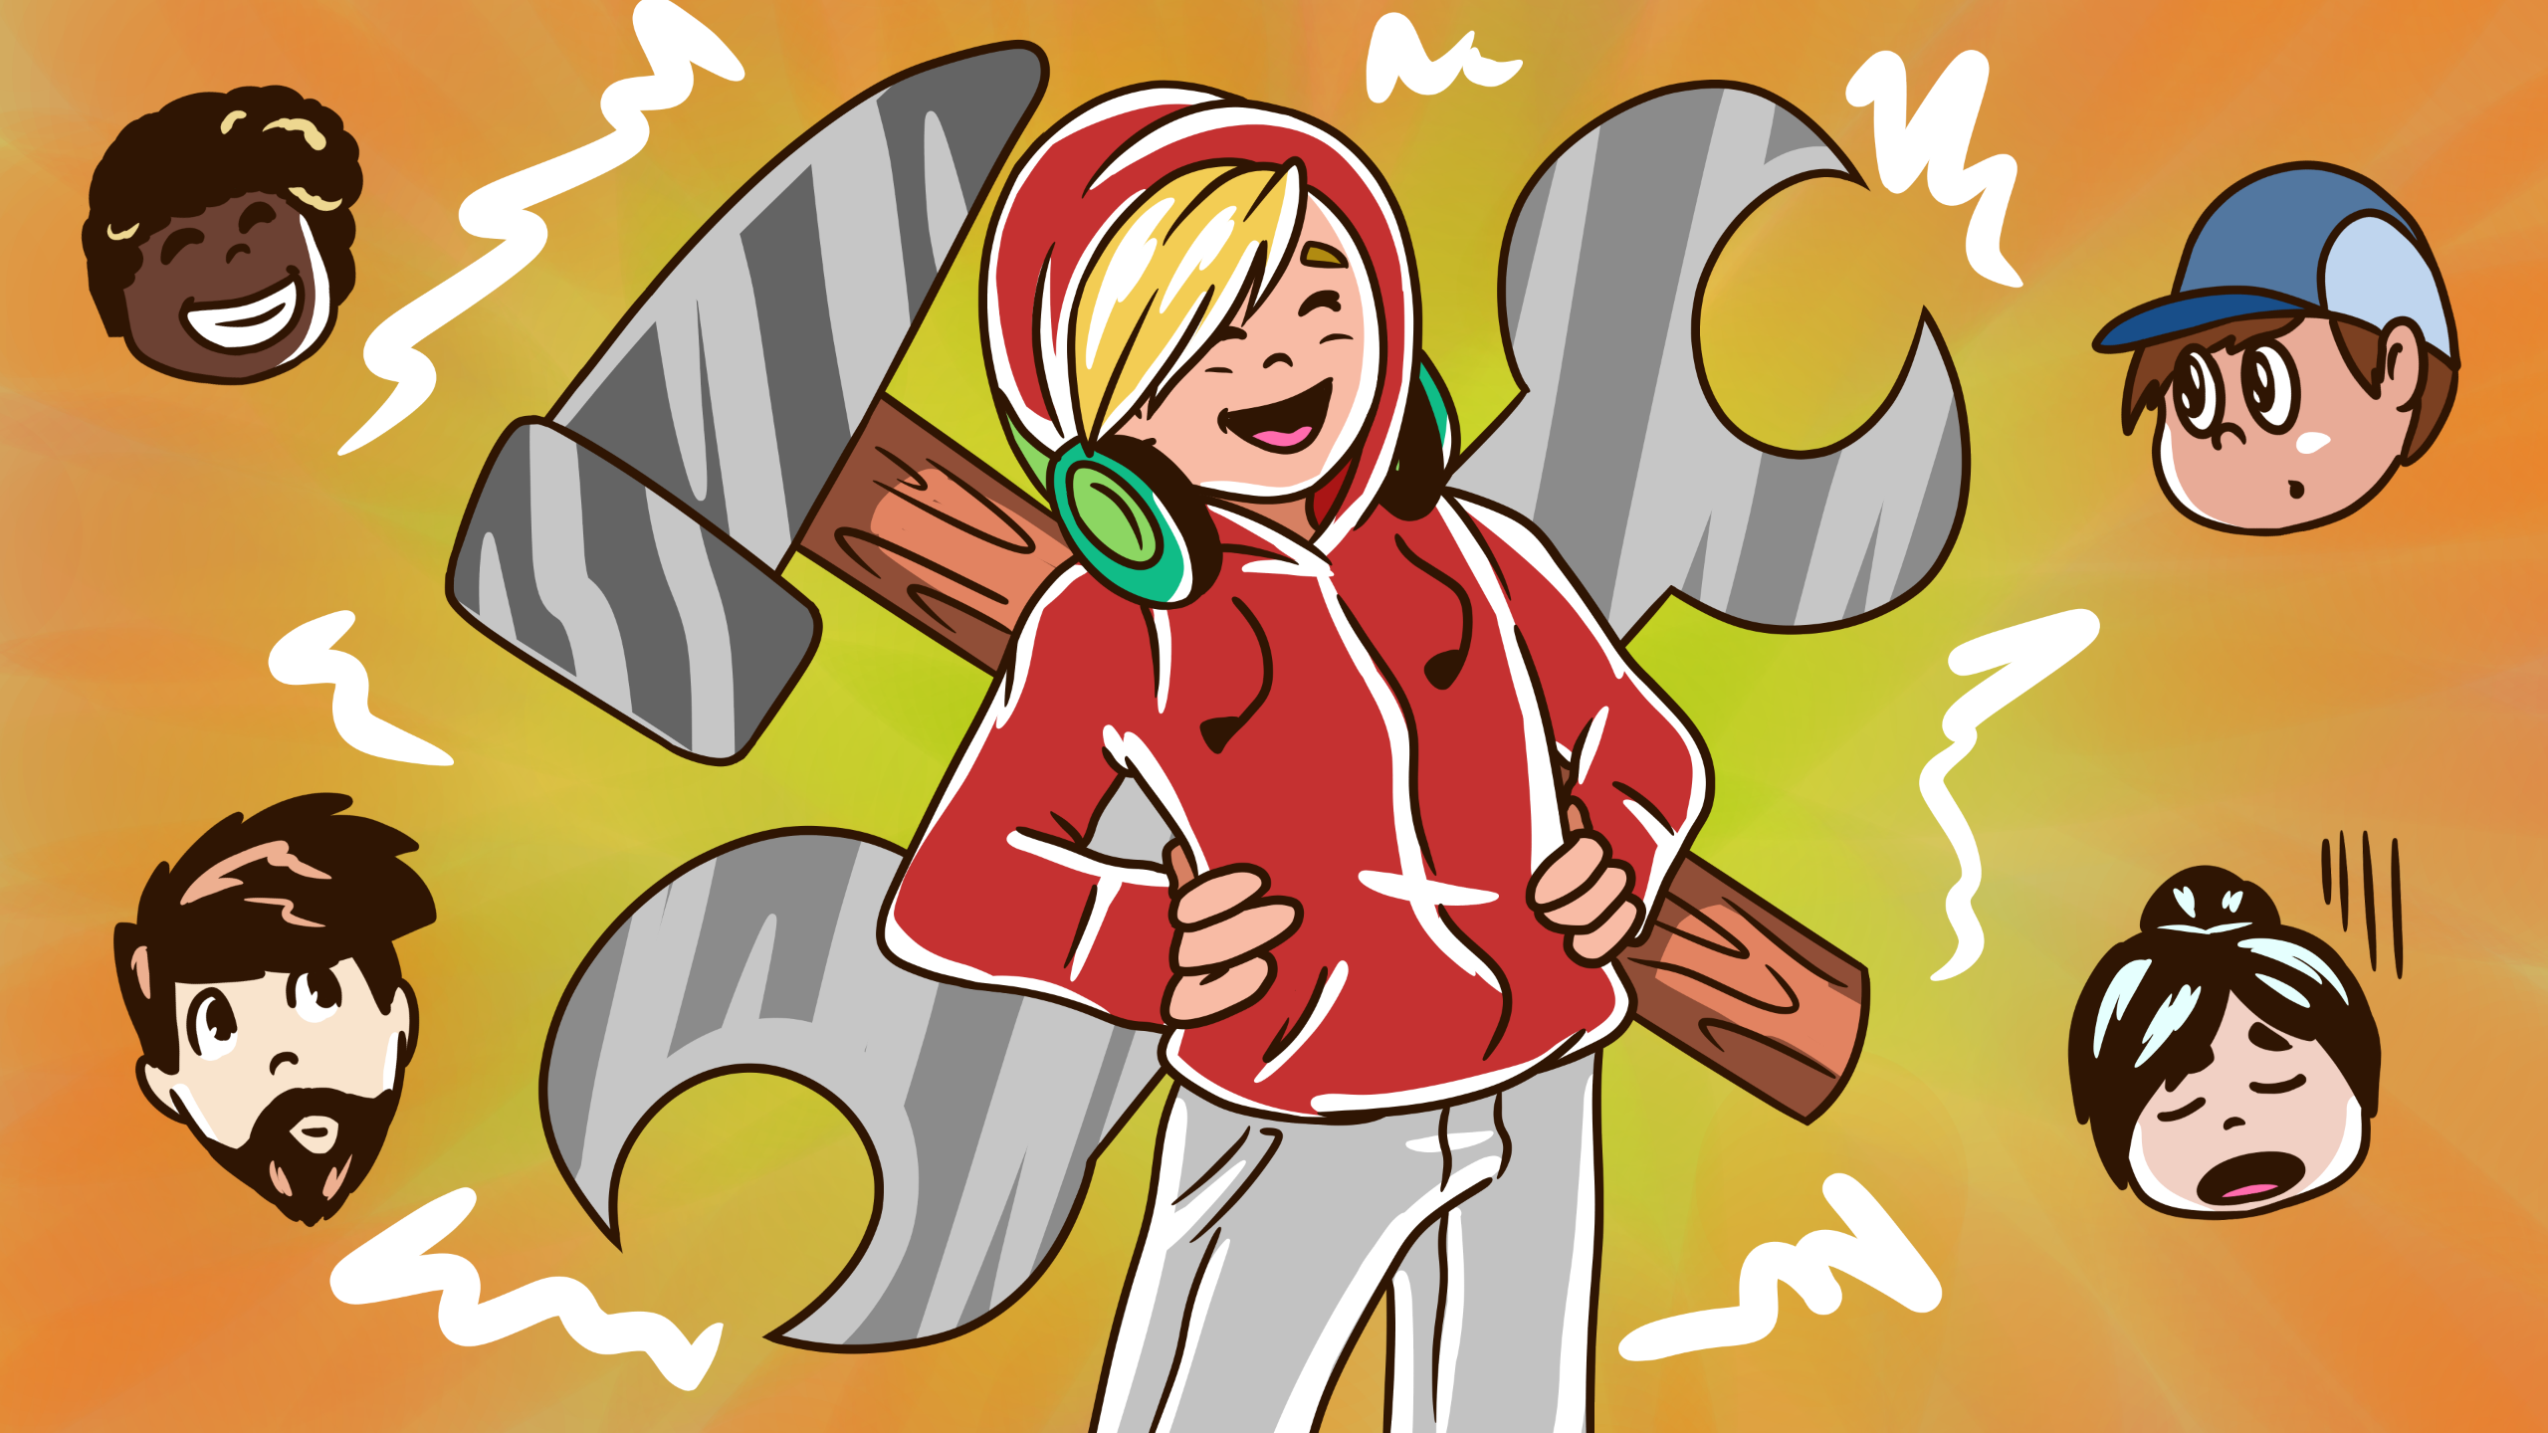
Notes:
linters, code quality, test coverage tools, the usual help with that.

Slide 18
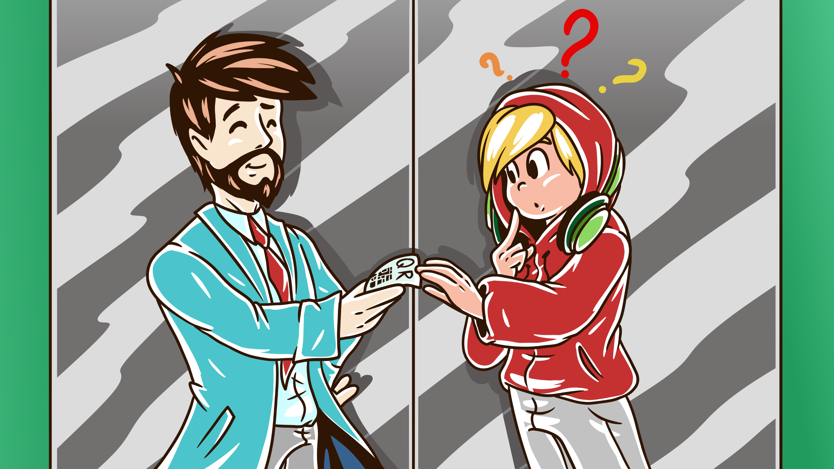
Notes:
Great I say, I write code too, lets be friends, and hand them a printed QR code of my public gpg key, so they can trust me.

Slide 19
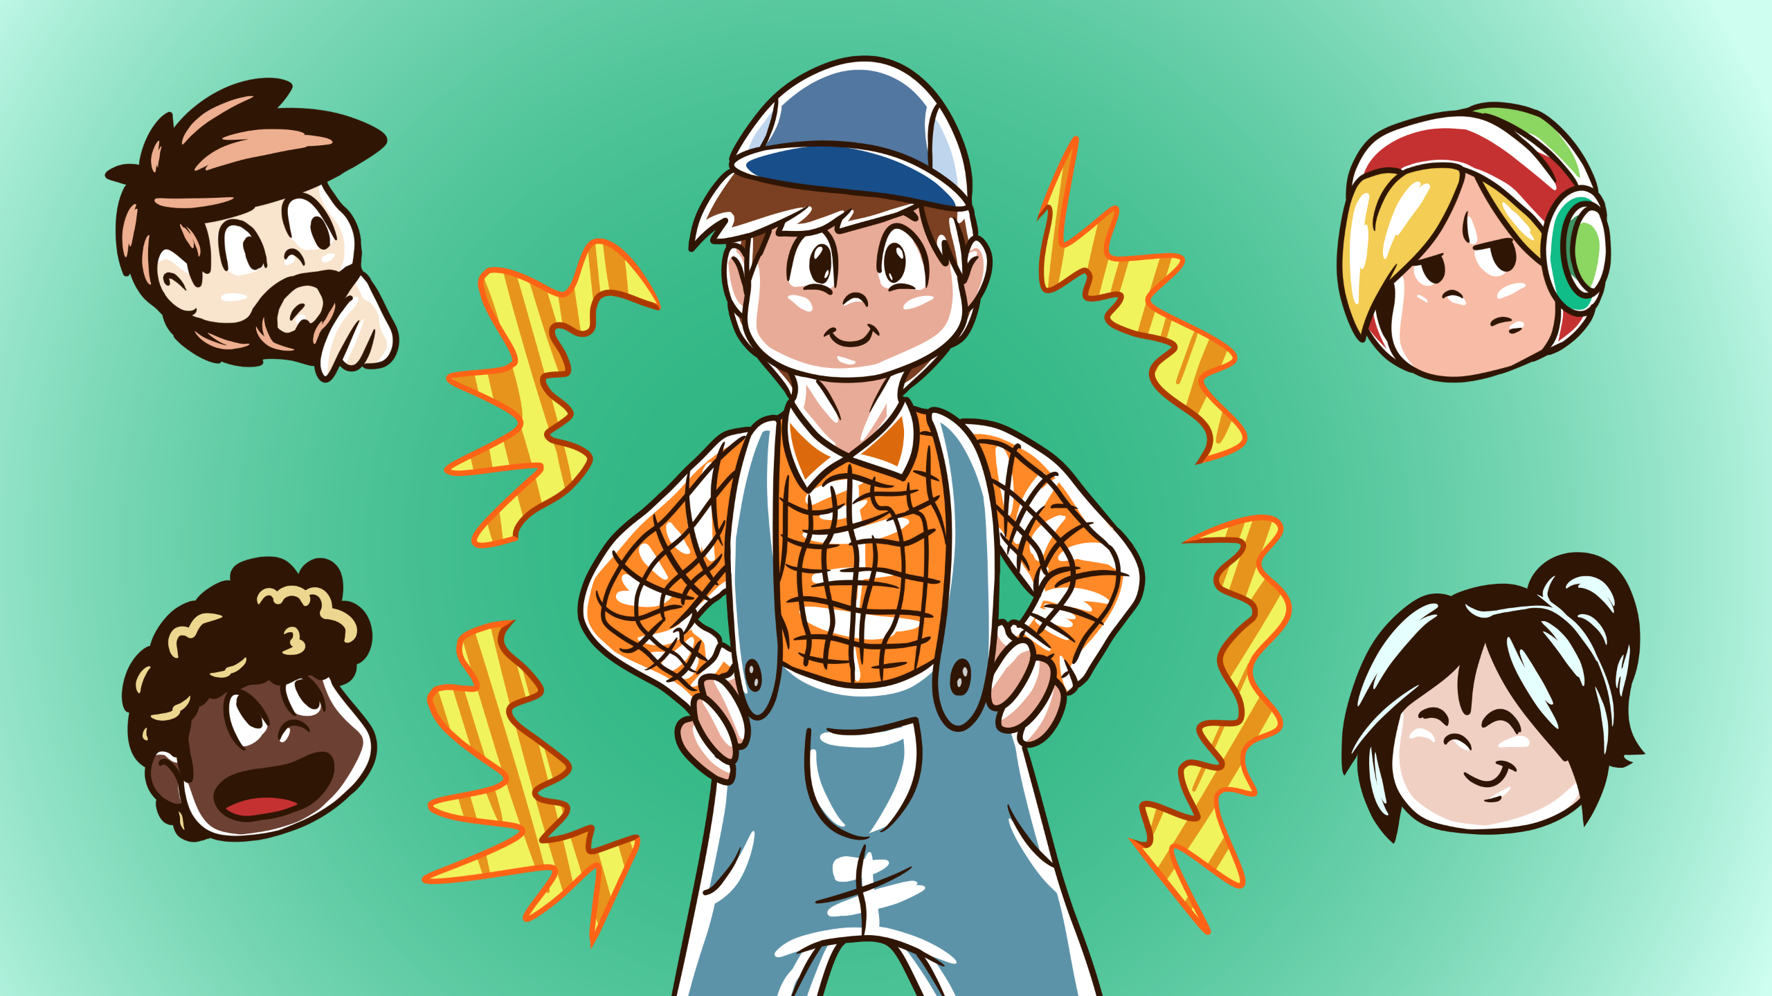
Notes:
Back to the cleaner, How do you get told what to do, and when it changes.

Slide 20
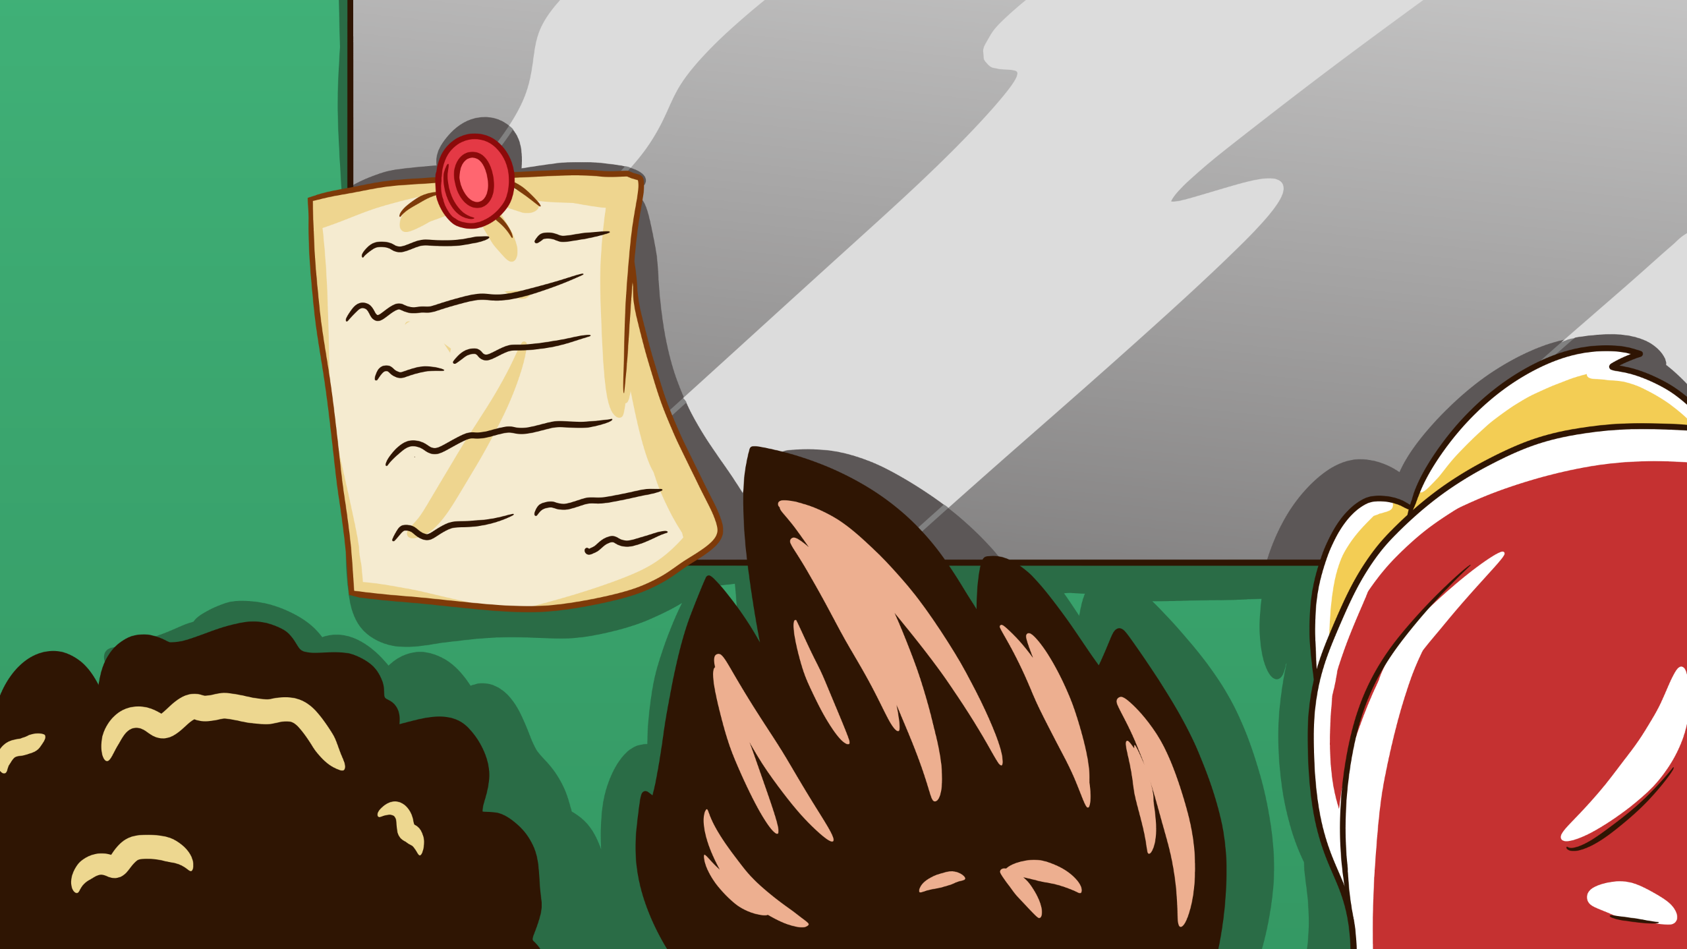
Notes:
Something stuck to the notice board, last week we were told all the meeting room whiteboards need to be cleaned every night.

Slide 21

Notes:
It's then up to us to keep everything in sequence.

Slide 22
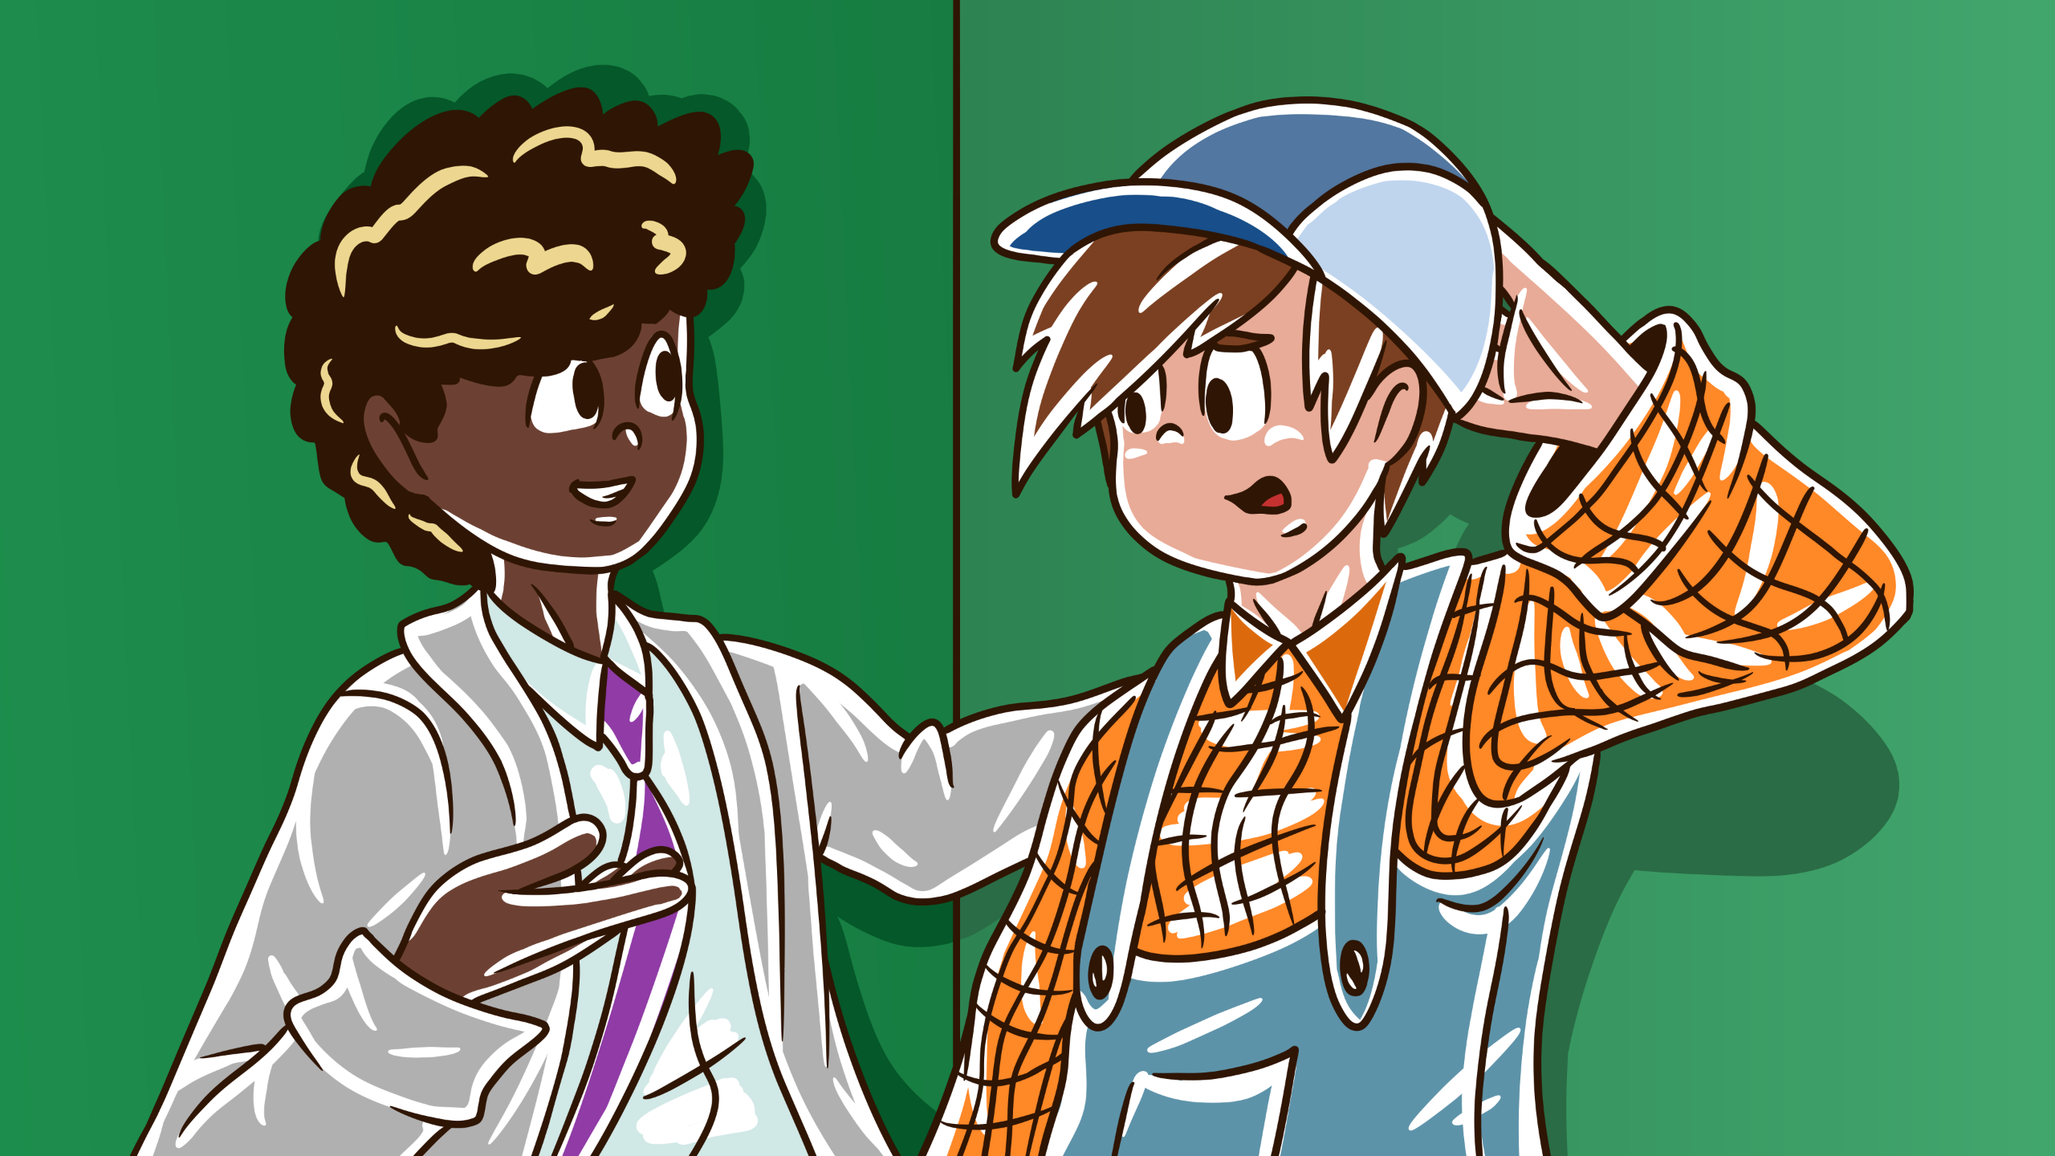
Notes:
Like when we hadn't updated the meeting room on the 3rd floor was being used as a dedicated war room, and we wiped their boards down.

Slide 23
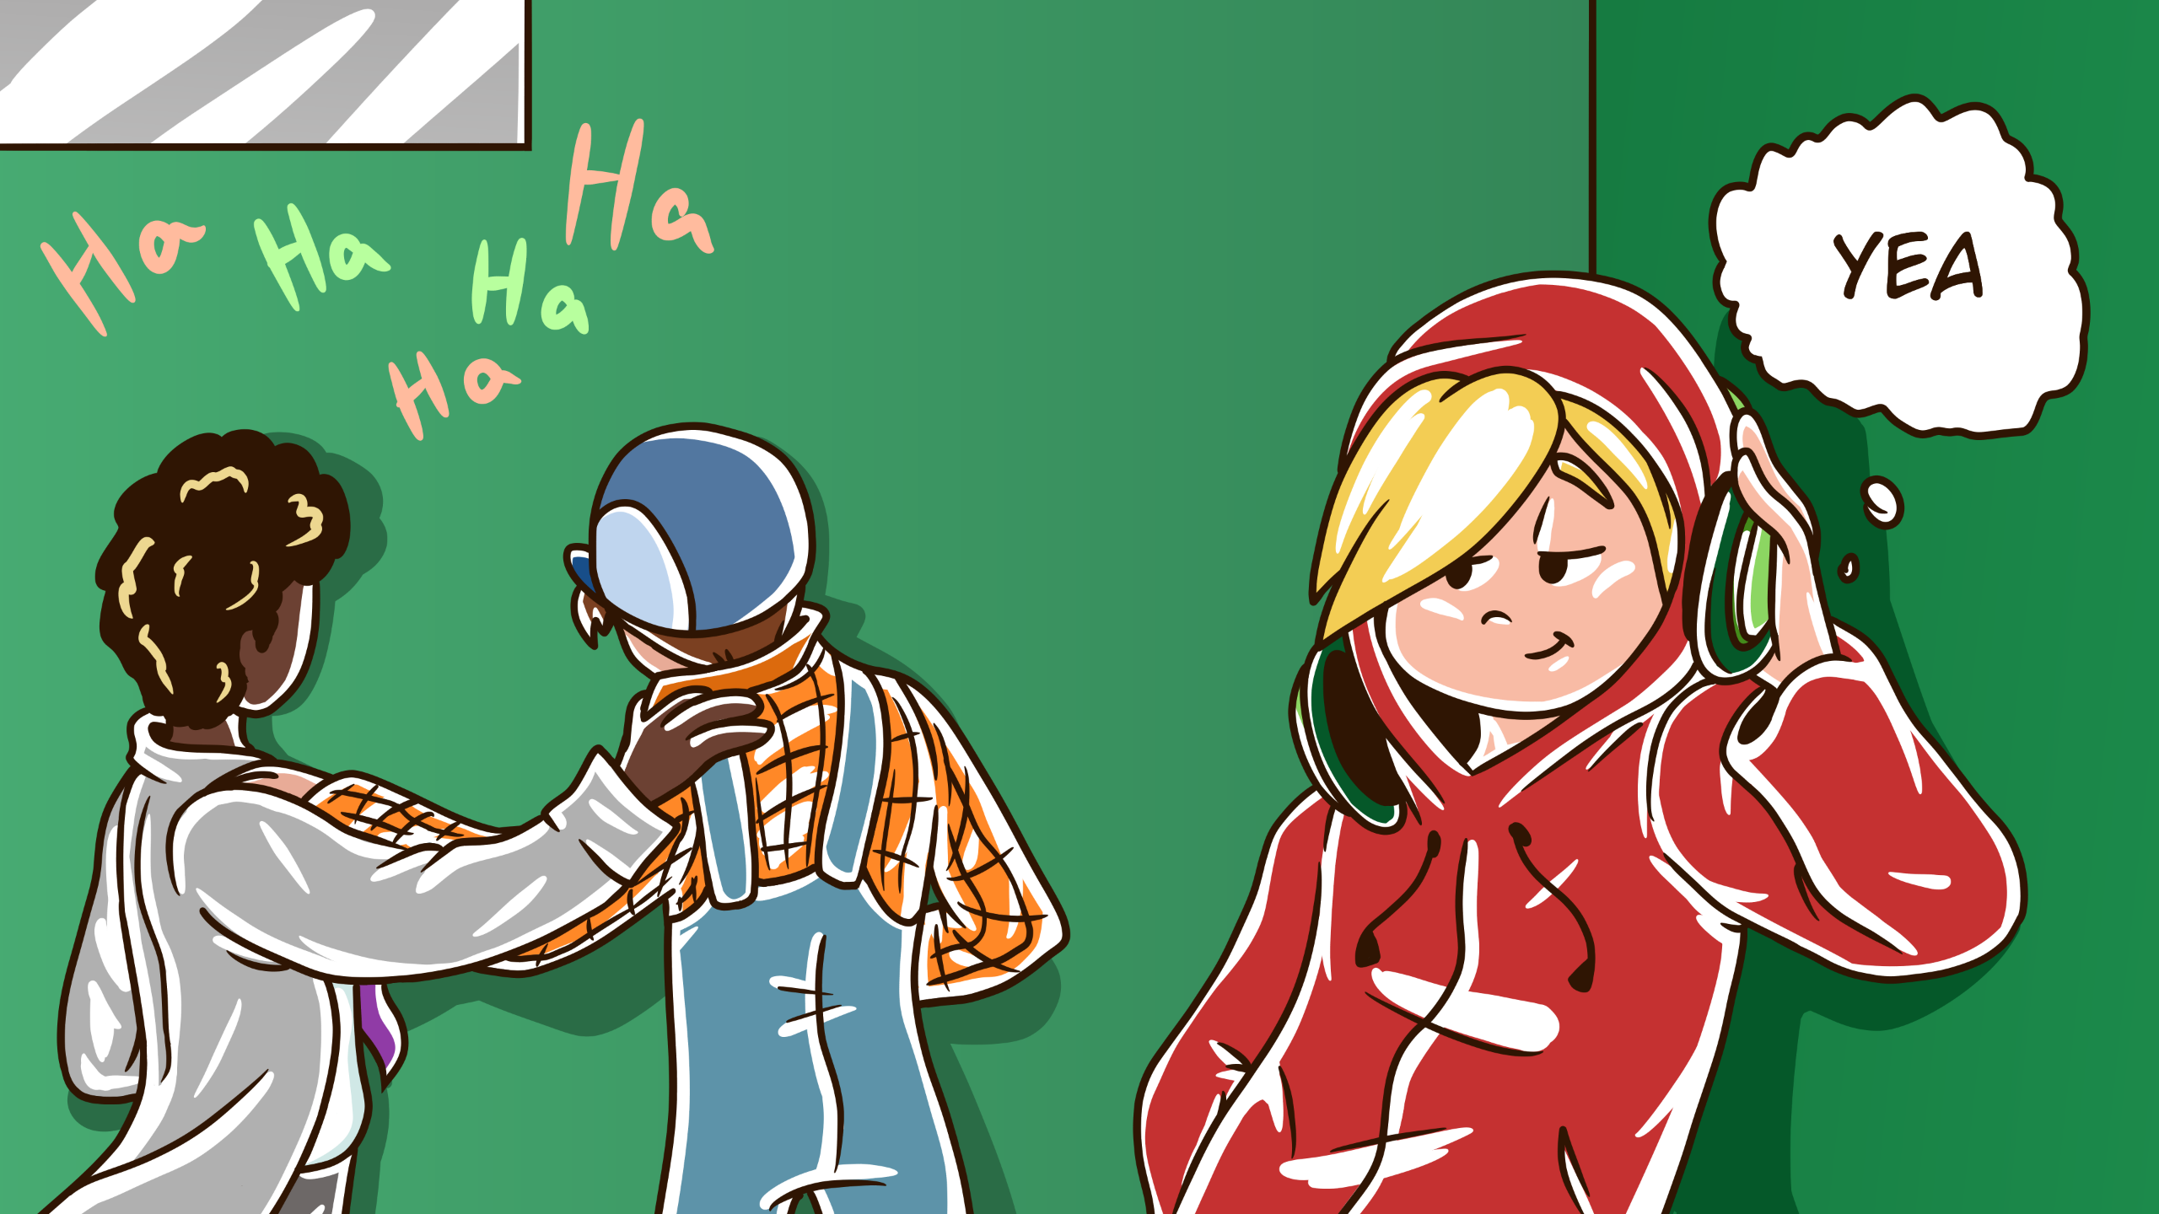
Notes:
I look to the dev, sound familiar? they nod.

Slide 24
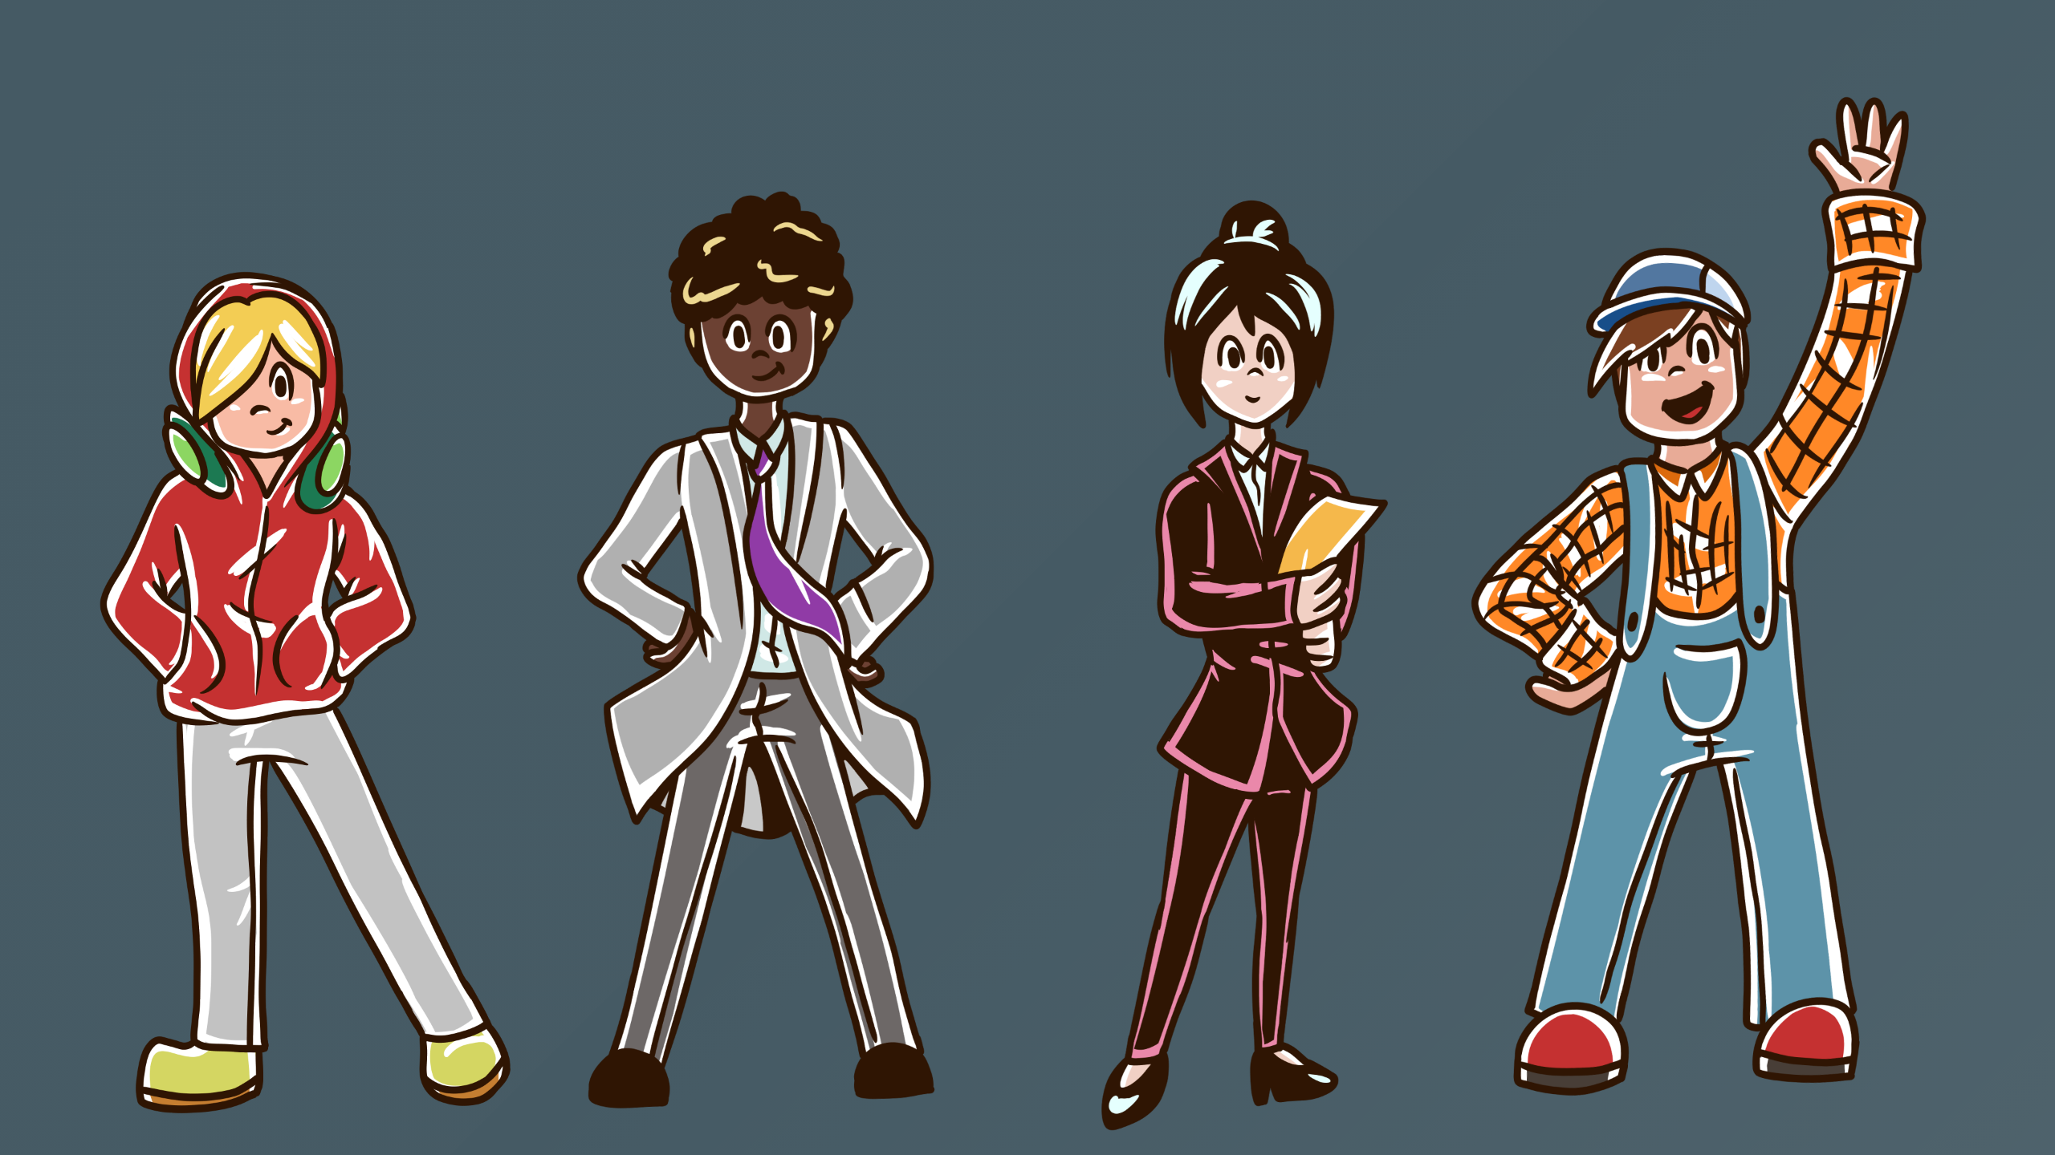
Notes:
Ok so if any of that sounds familiar, and you relate to my imaginary friends then I've got the answers for you.

Slide 25

Notes:
What if I said:

Slide 26
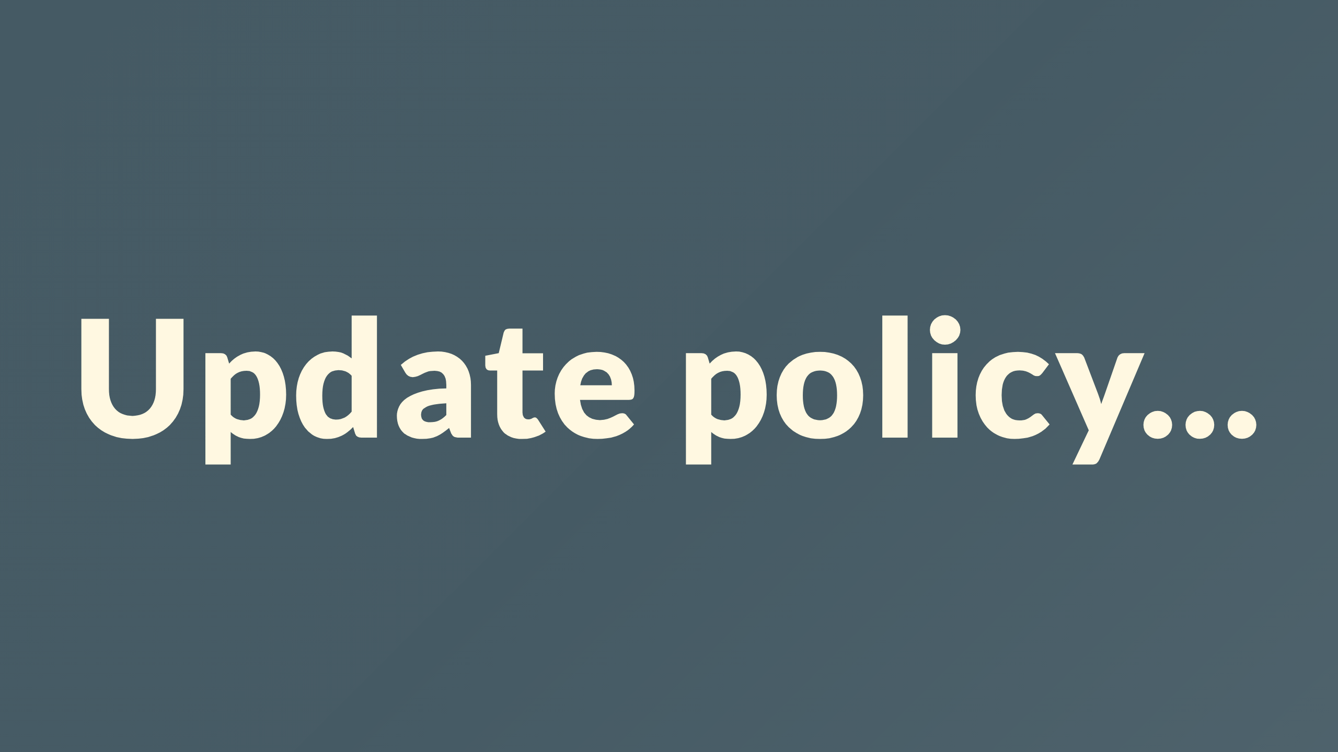
Notes:
You could update policy easily, even releasing several version updates

Slide 27
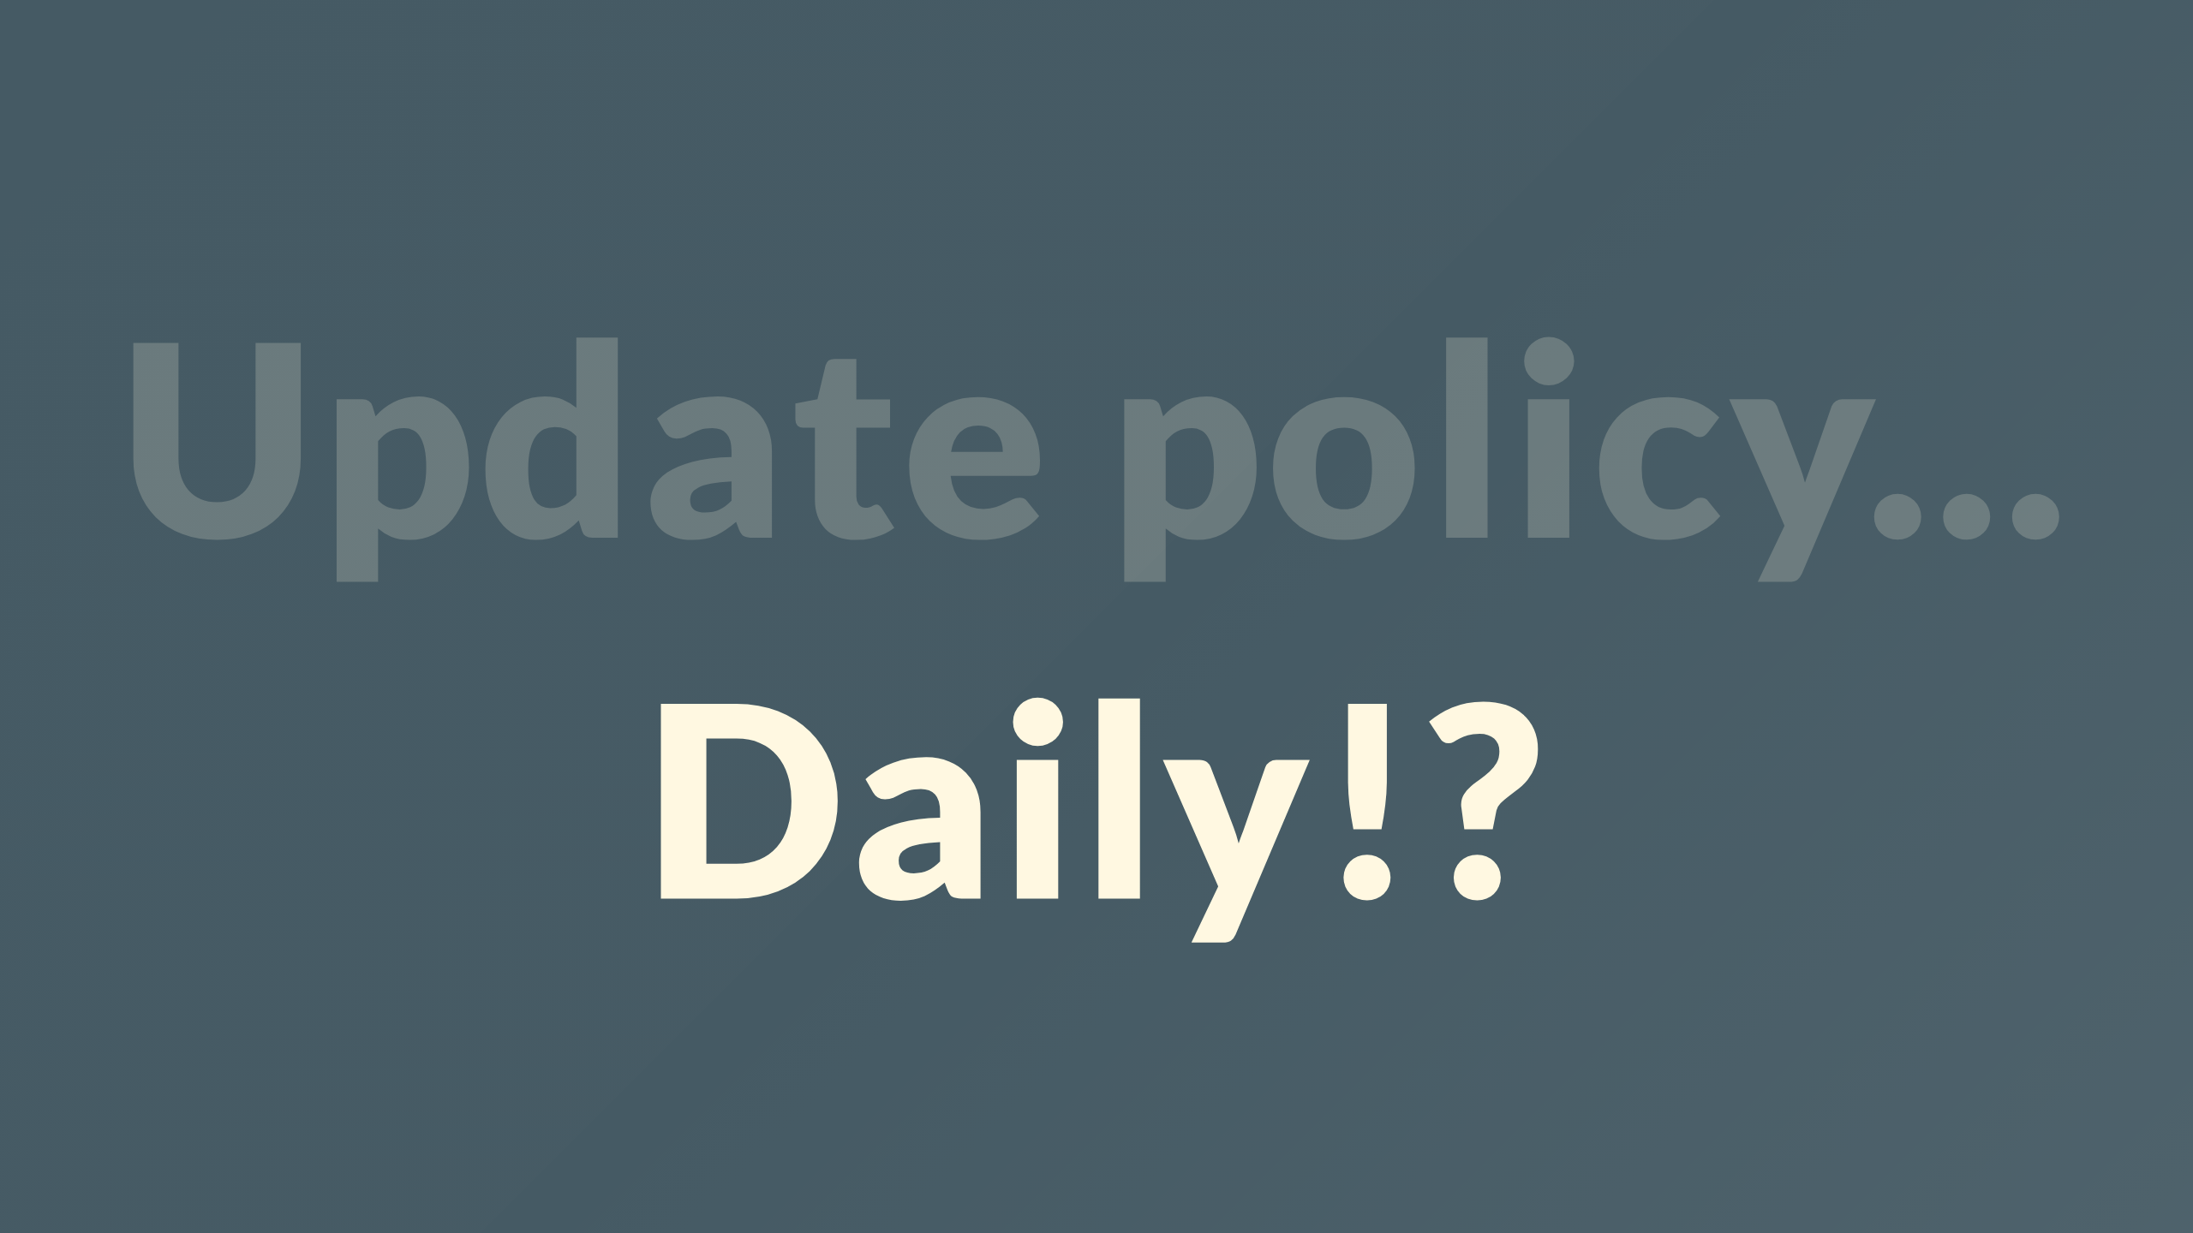
Notes:
in a single day, seamlessly communicated without derailing anyone?

Slide 28

Notes:
visibility on compliance using tools you already use?

Slide 29

Notes:
Multiple concurrent versions of policy are supported

Slide 30
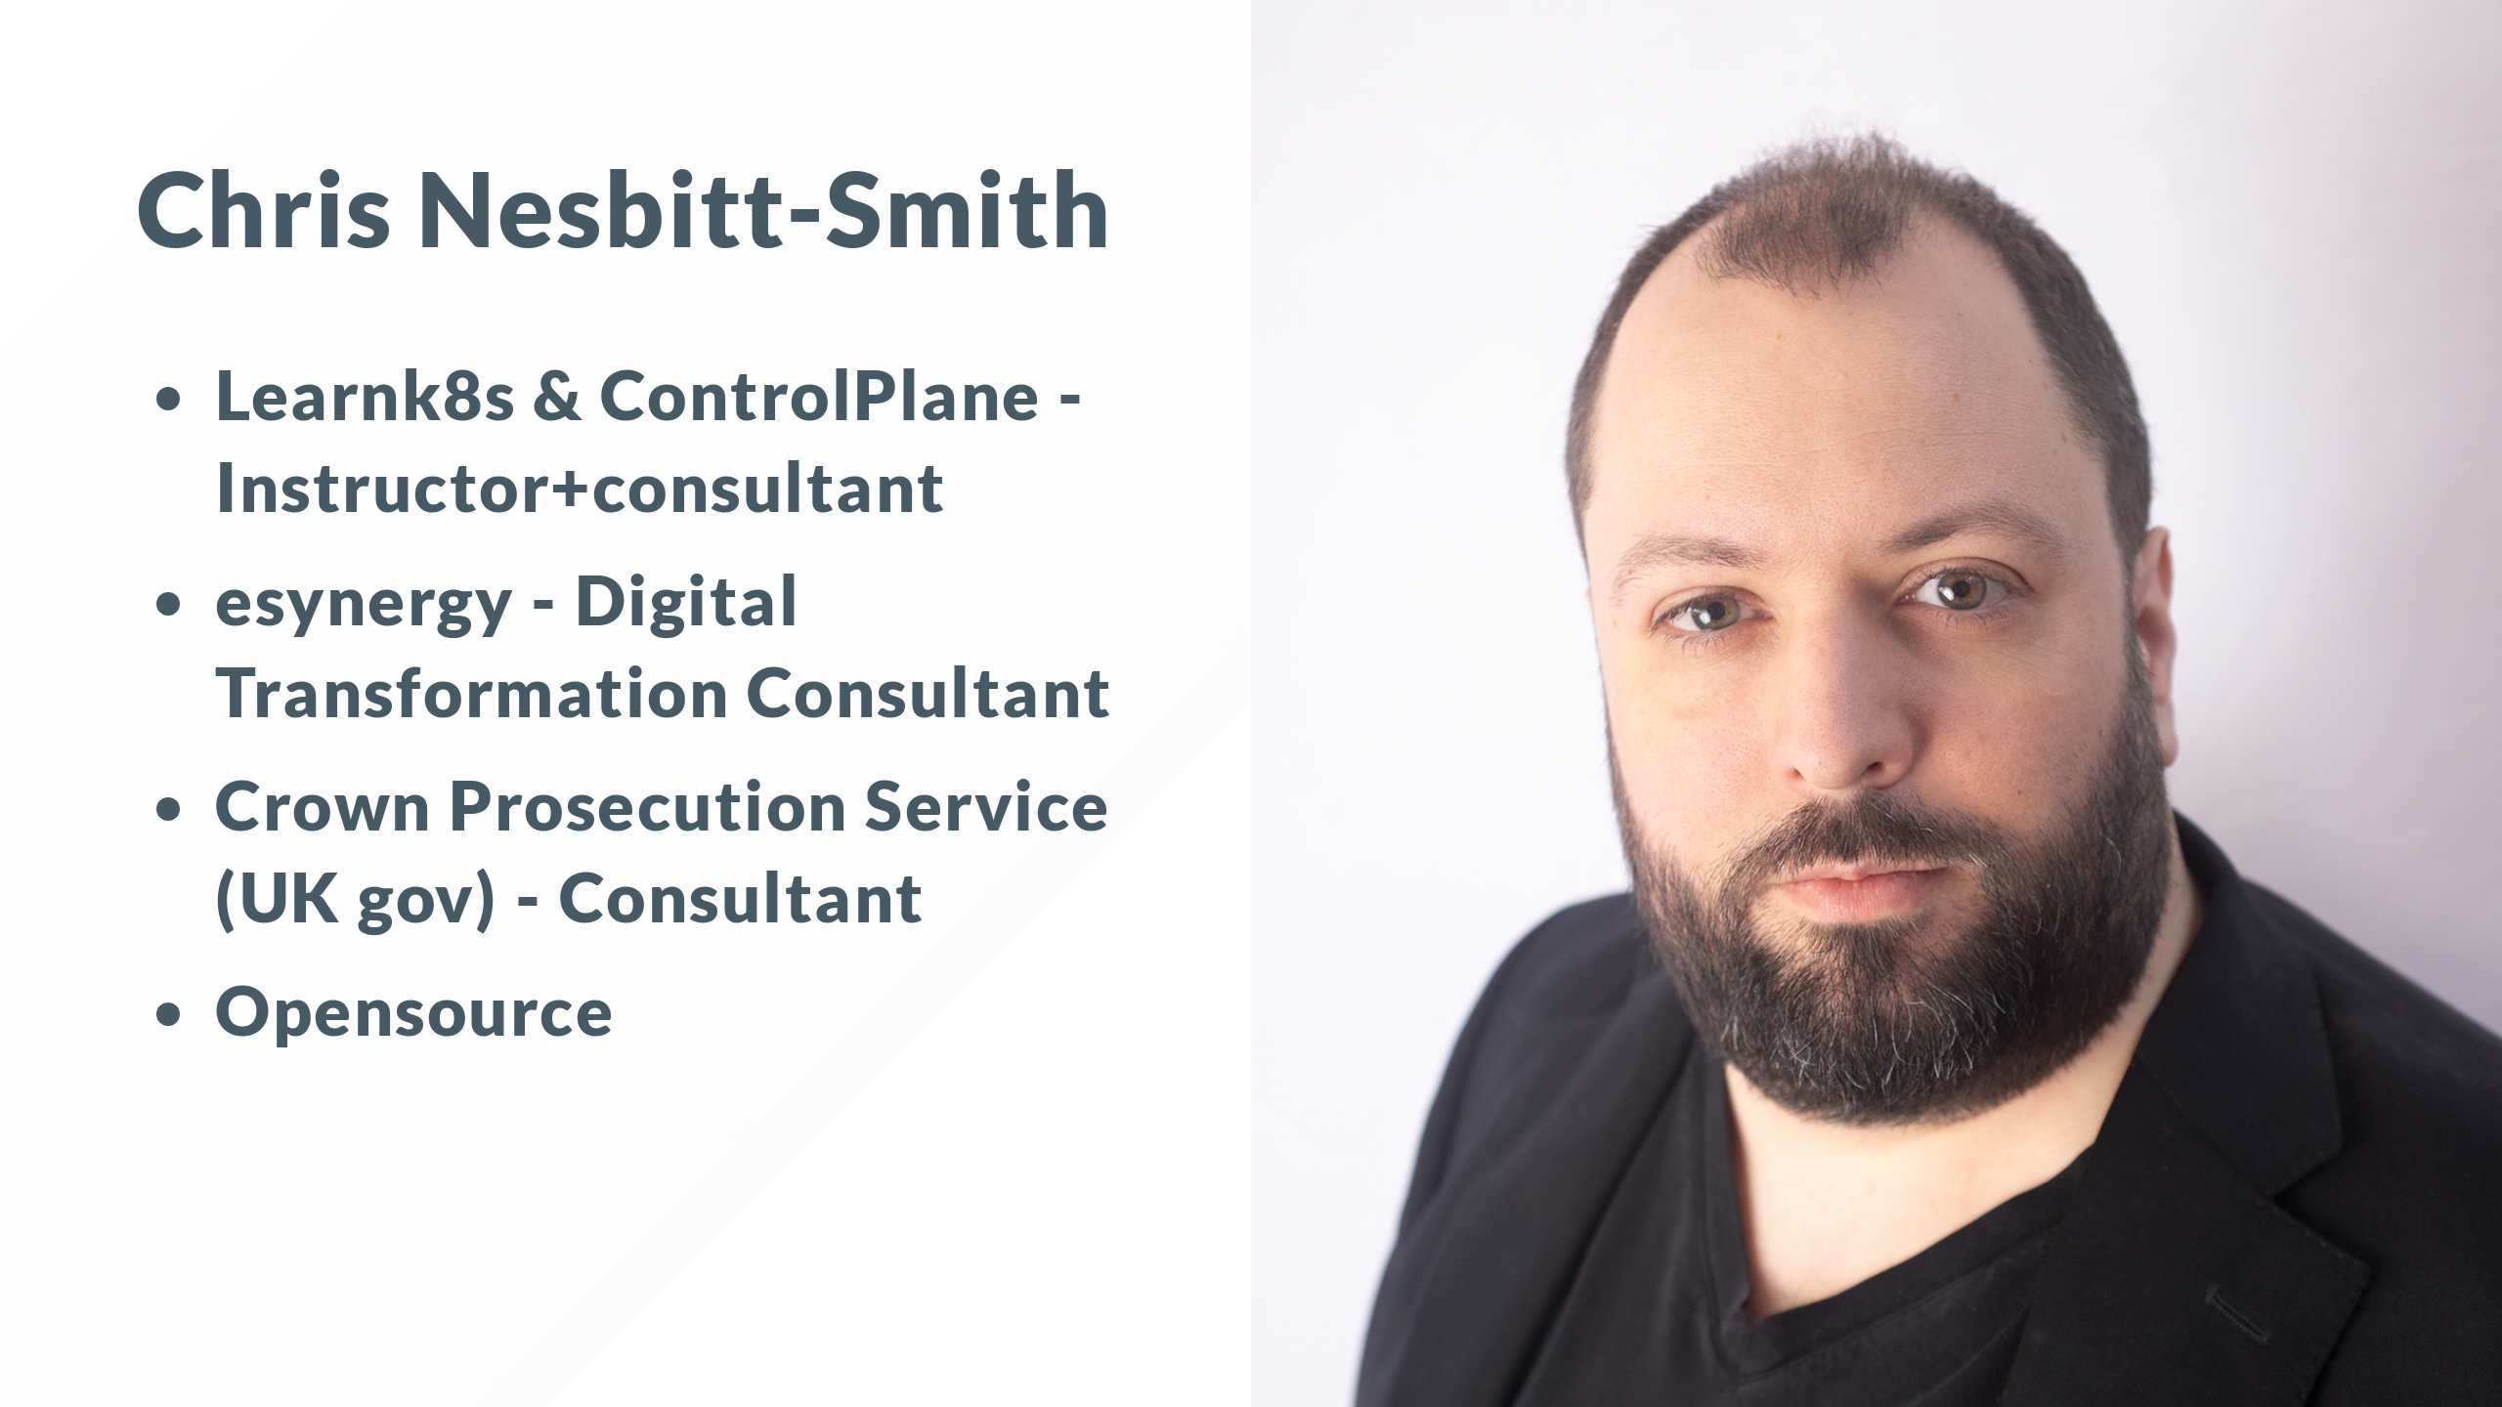
Notes:
I'm Chris Nesbitt-Smith, I'm an instructor for Learnk8s and Control Plane, consultant to UK Government and tinkerer of open source.
I've spent a fair chunk of my professional career now working in Government and large organizations where problems like these are rife.
This is a lightning speech, so you'll have to come find me after if you've got questions

Slide 31

Notes:
By show of hands who's with my CIO and set, written, or applied policy before?

Slide 32

Notes:
Next round who's sought exemption or consciously bent, broken, circumvented, ignored, bypassed, whatever a policy with at least good intentions?

Slide 33

Notes:
HA, you fell for it.

Slide 34

Notes:
We've got all your names and employers details, so put your phones down, lend me your ears, the stakes just got raised.

Slide 35
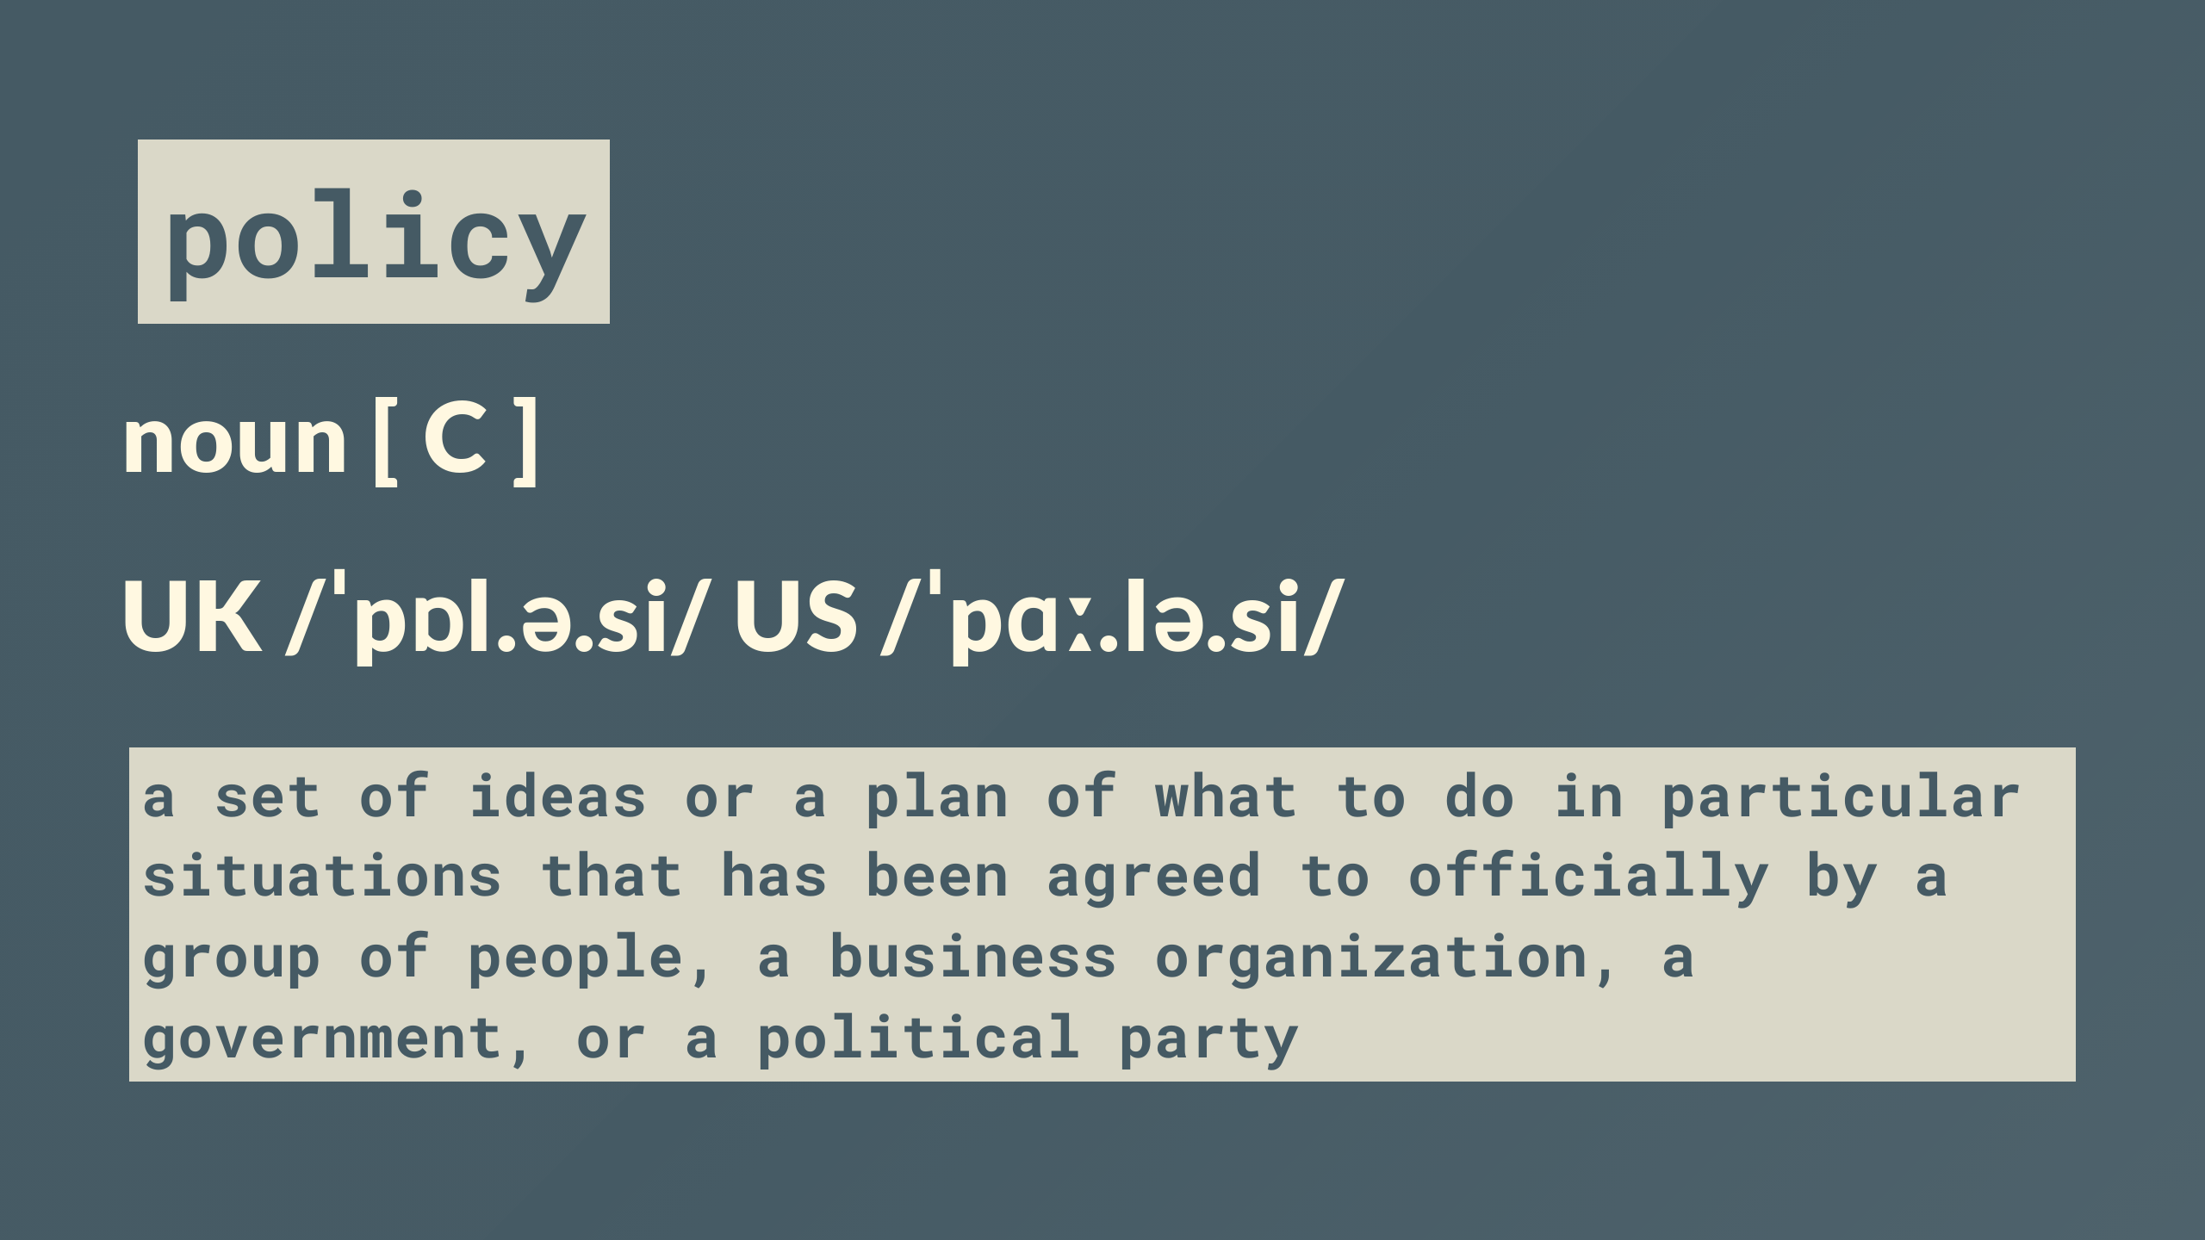
Notes:
Policy usually comes in one of two forms

Slide 36

Notes:
Security, like data at rest being encrypted

Slide 37

Notes:
Consistency such as code style

Slide 38

Notes:
Both are intended to mitigate a risk of some sort

Slide 39
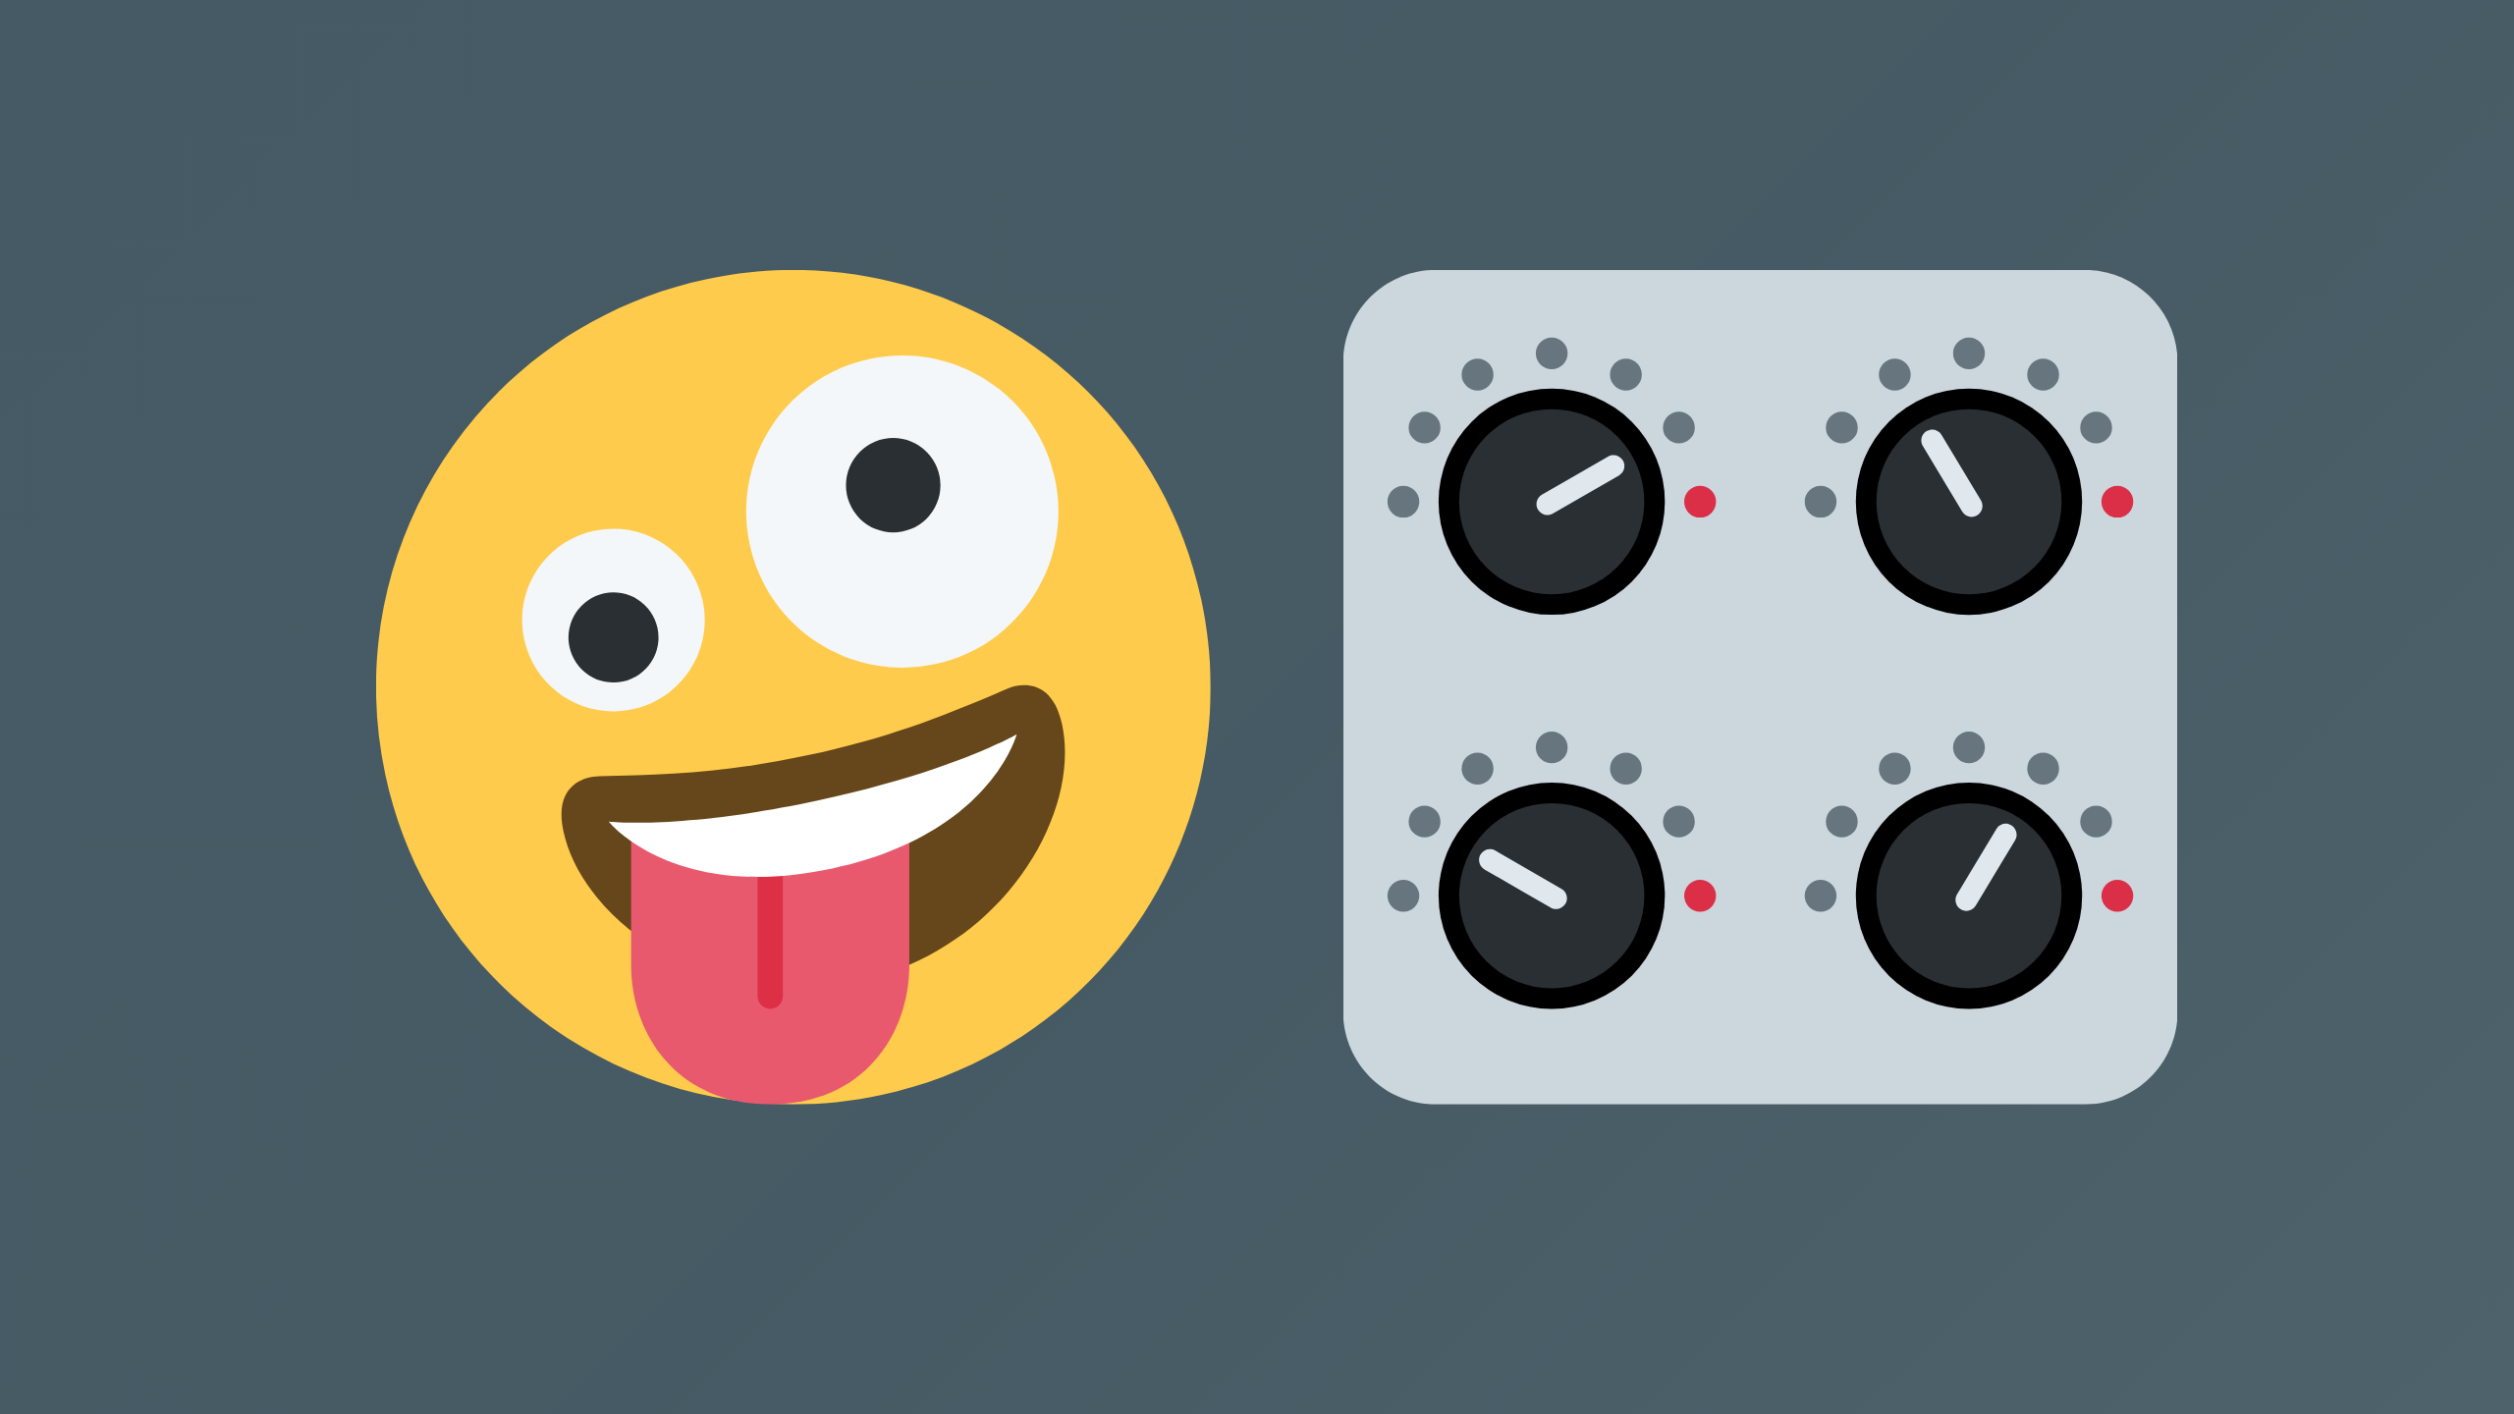
Notes:
However with the best of intentions these are often emotionally led rather than being grounded in a proportionate control which is the open door to case-by-case exemptions being required when you come against a situation you weren't anticipating

Slide 40
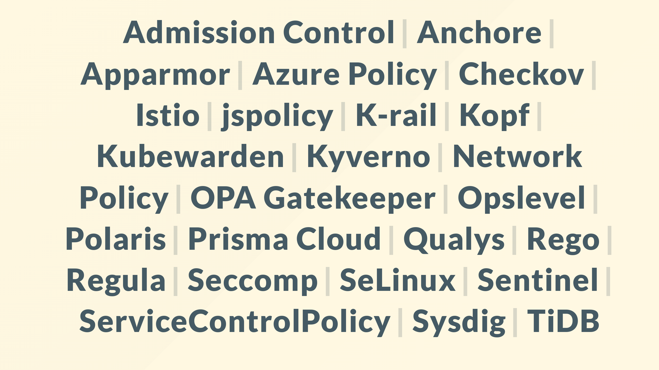
Notes:
Theres plenty of policy as code products out there to help

Slide 41

Notes:
Devil in the detail though

Slide 42

Notes:
Throwing some curly braces or yaml at something doesn't inherently fix things.

Slide 43
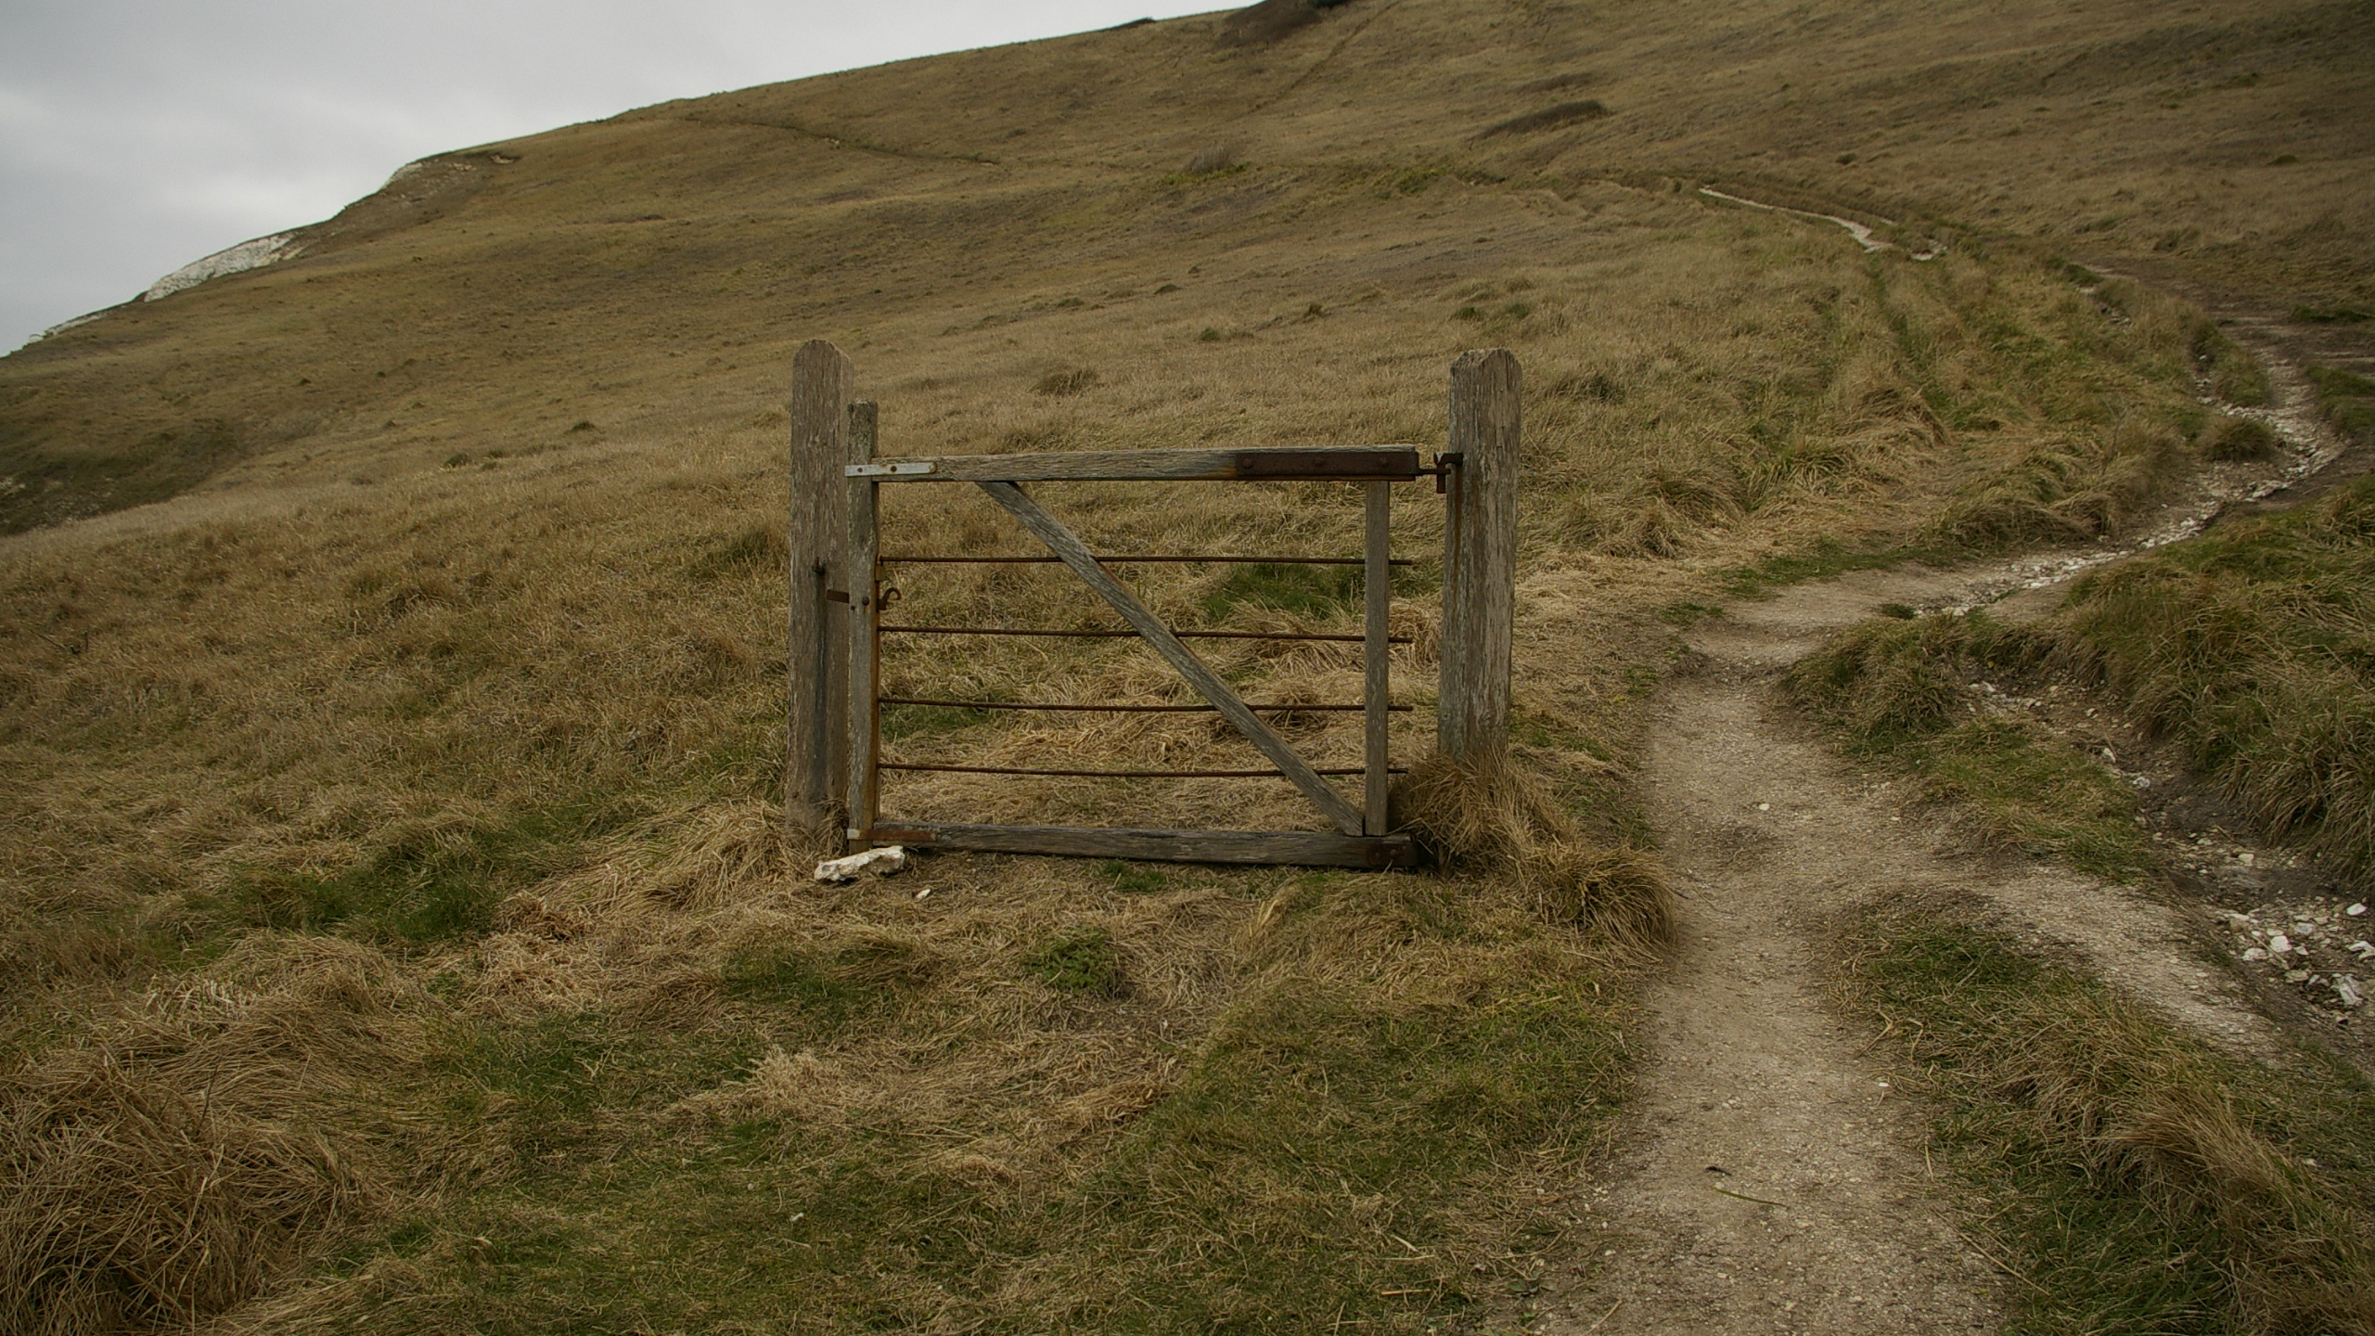
Notes:
Especially if it leads your engineers who are hopefully all plenty smart finding 'inventive' ways around the

Slide 44

Notes:
computer says no response they got.

Slide 45
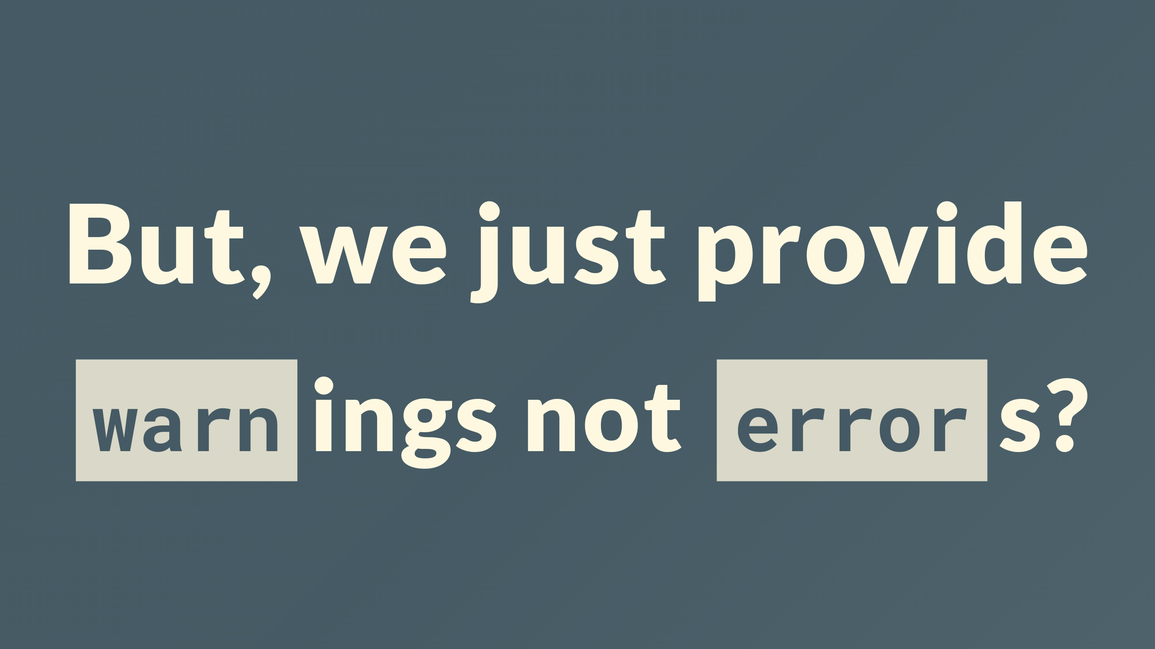
Notes:
sure you might say that you provide warnings, on less important issues or new emerging policy, but only useful if someone sees them

Slide 46
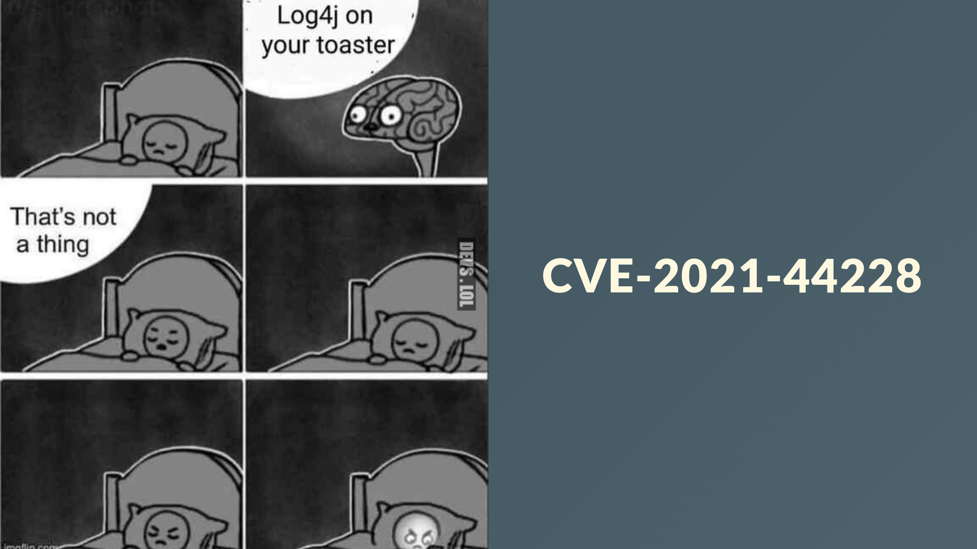
Notes:
yup, as you know all presentations this year are contractually required to reference log4j

Slide 47
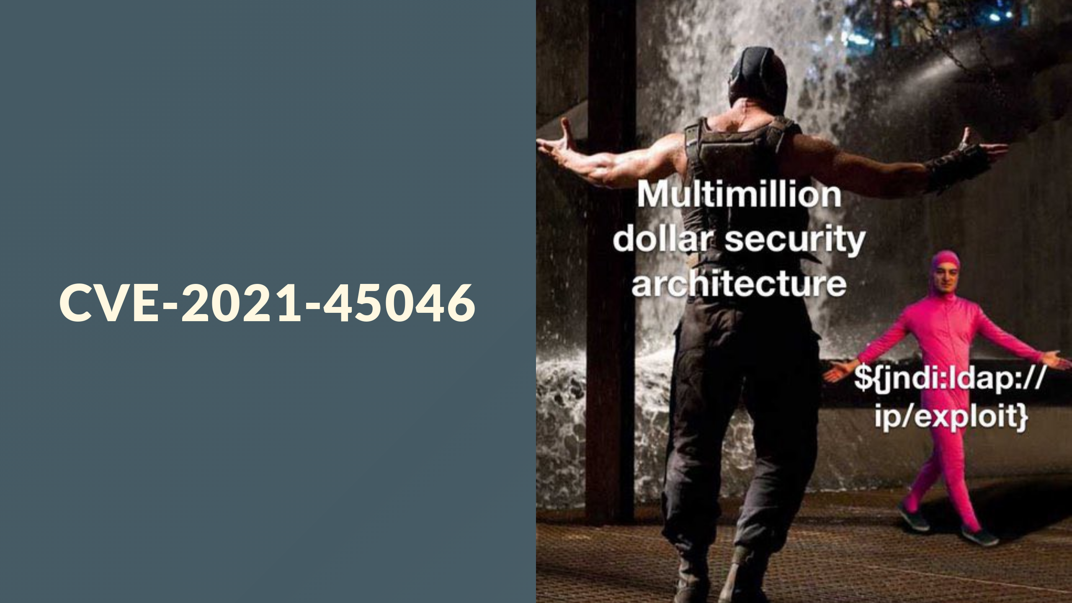
Notes:
even when its entirely out of context

Slide 48
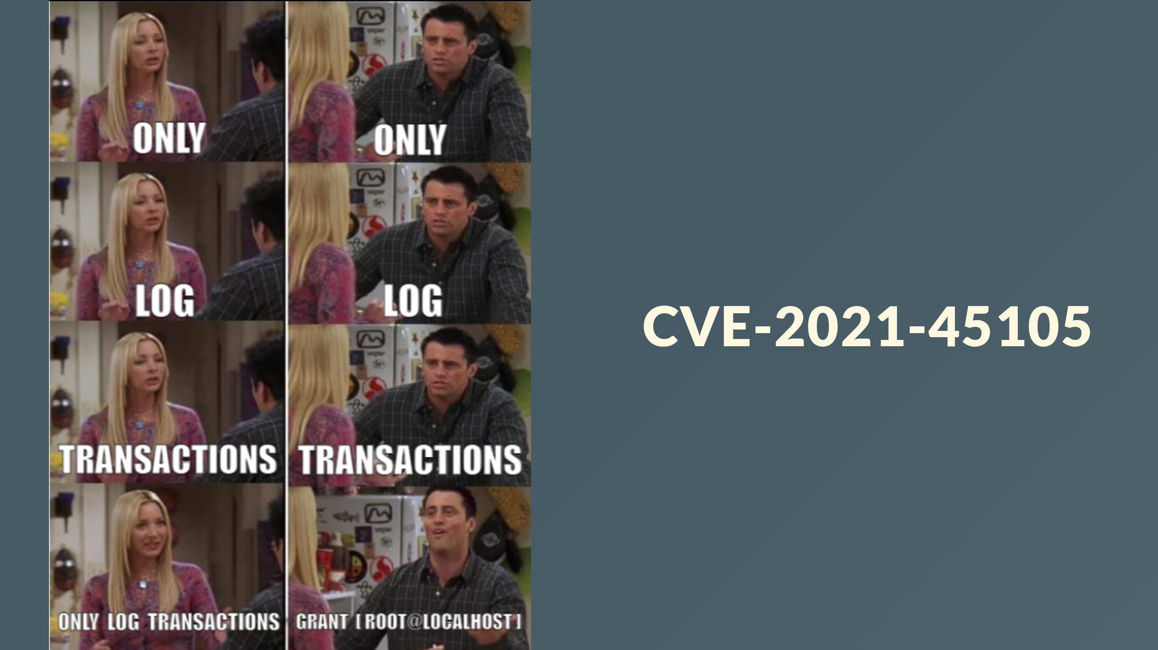
Notes:
and include some memes.
in just a few short months I can remove these

Slide 49

Notes:
I've just covered a lot of ground, and hopefully sounded convincing, and not just a fictional utopia painted in powerpoint

Slide 50

Notes:
I know you really came here wanting to see a million words on a slide not just an emoji or two

Slide 51

Notes:
I'm going to talk about two things, to prove its not just one tech, or tool.

Slide 52
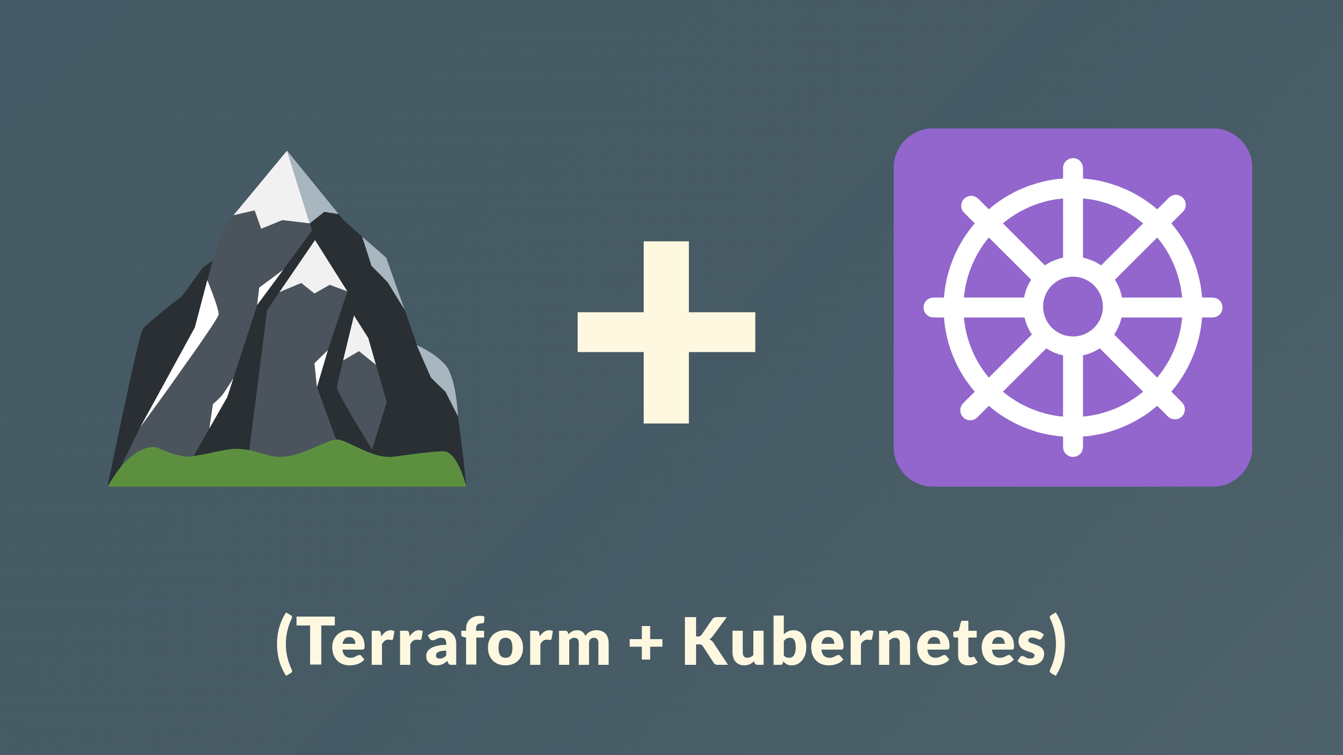
Notes:
I've picked terraform and Kubernetes

Slide 53

Notes:
but I could have picked anything

Slide 54
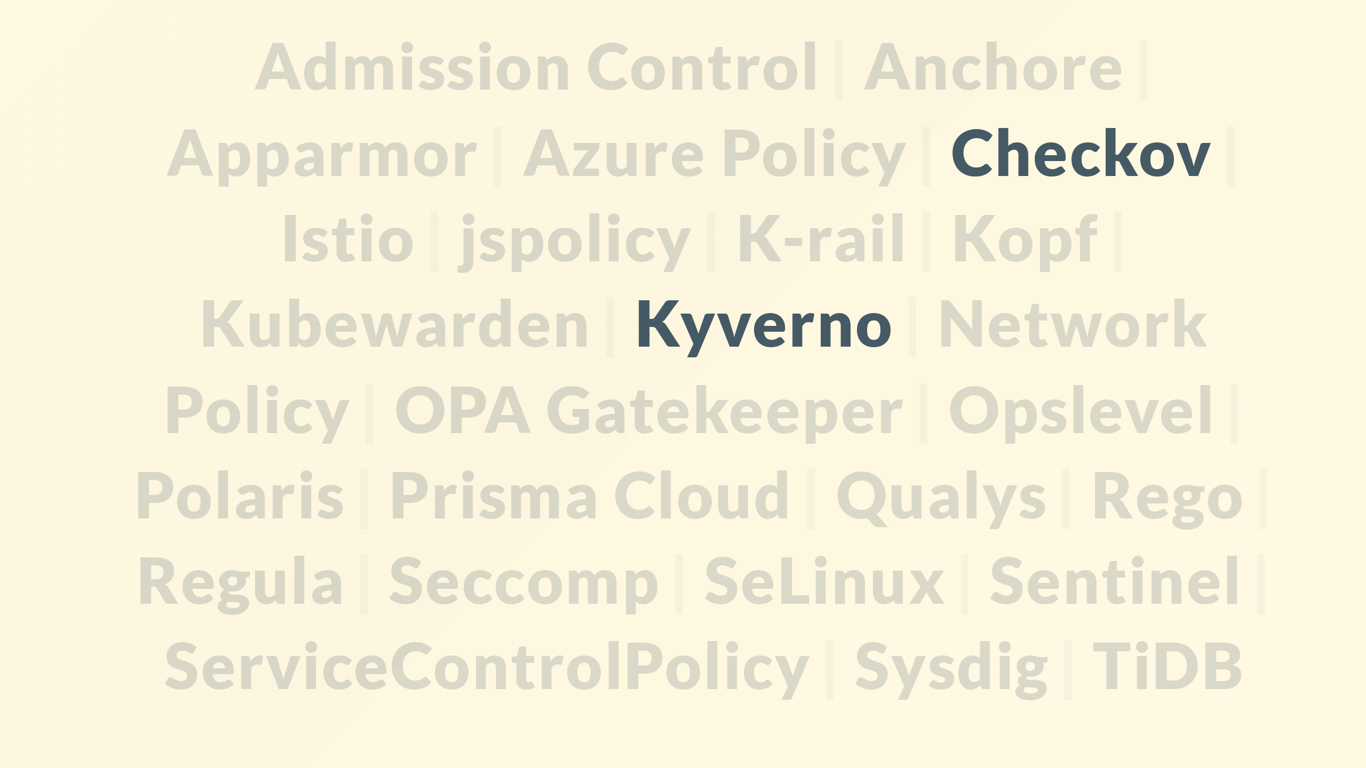
Notes:
likewise, two tools, but again I could use any, some, or even all, probably. Checkov will do my terraform, kyverno will to my kube.

Slide 55
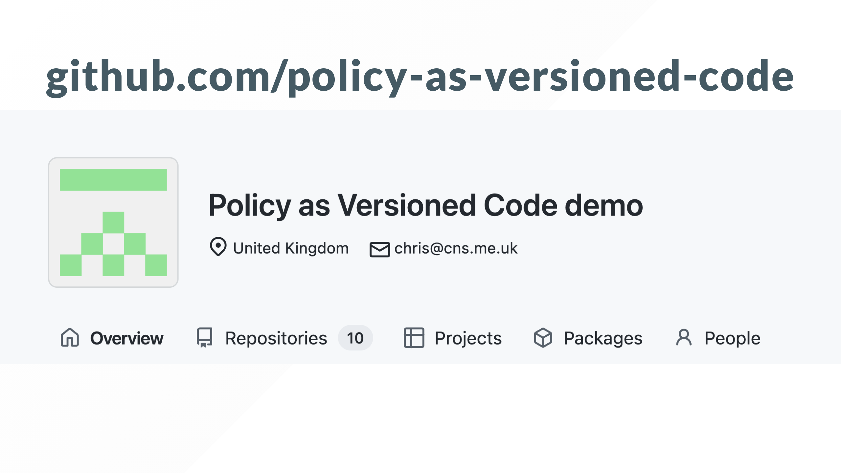
Notes:
I've created a example git hub organization here, I'm not expecting you to read or grok the code on screen, its just to prove its a real thing.

Slide 56
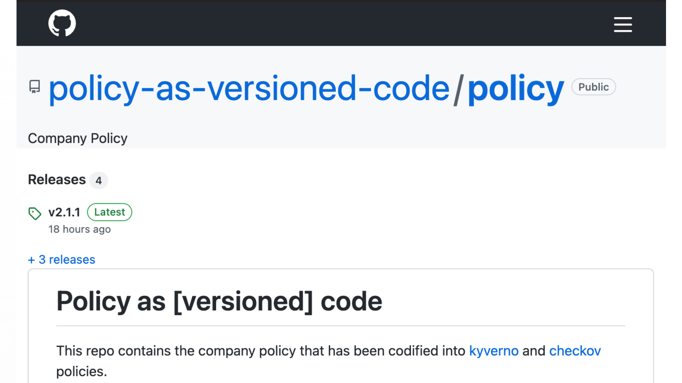
Notes:
The policy is stored here

Slide 57
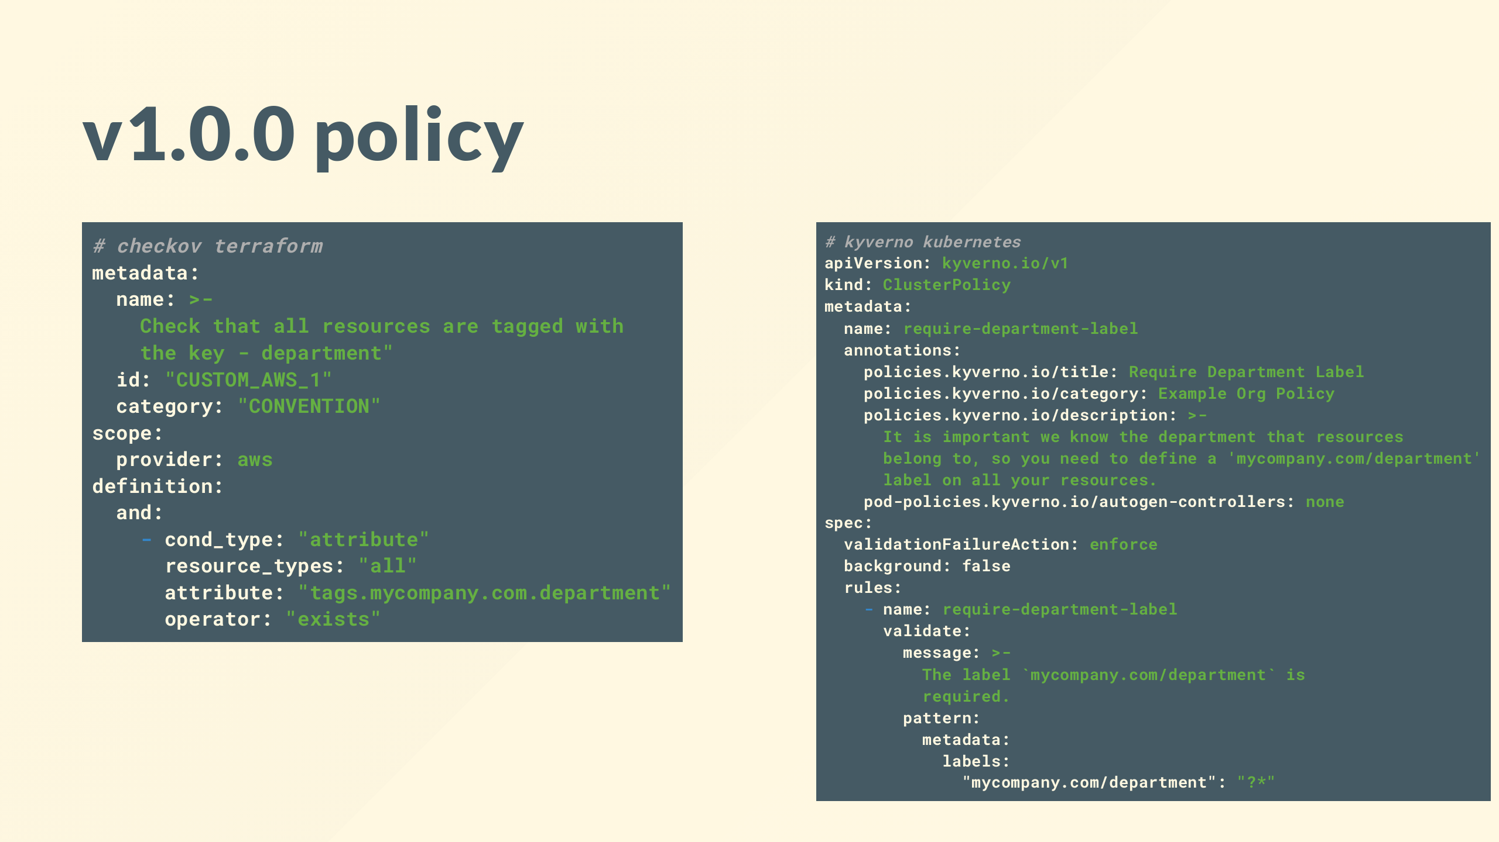
Notes:
so heres where my policy starts at v1.0.0 I've got policy that requires a department label on all resources, so long as its set, doesn't matter what it is

Slide 58
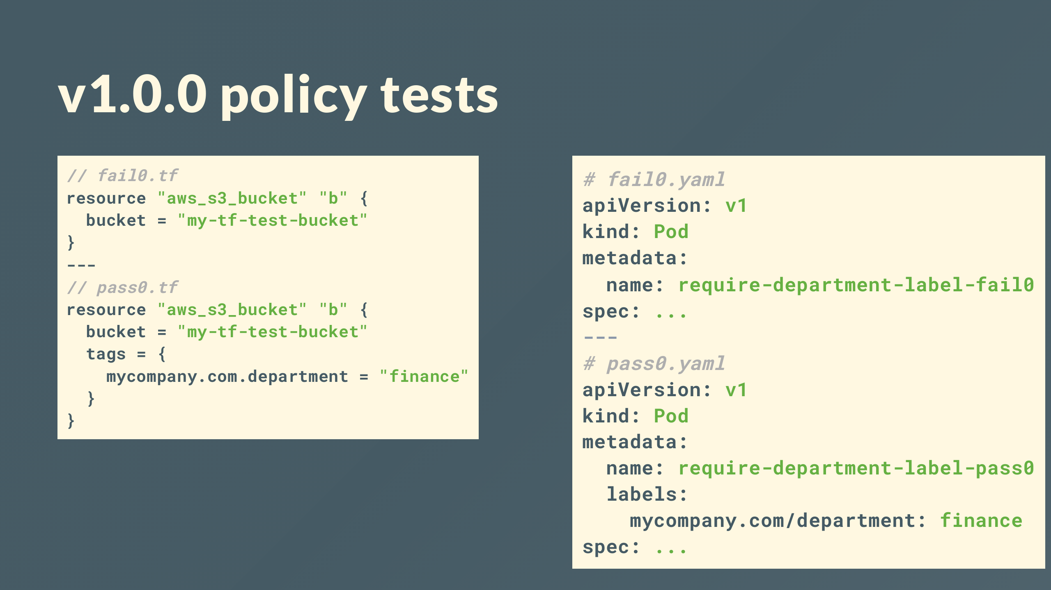
Notes:
I've written tests for this, passing test cases become great examples of what good and bad looks like

Slide 59
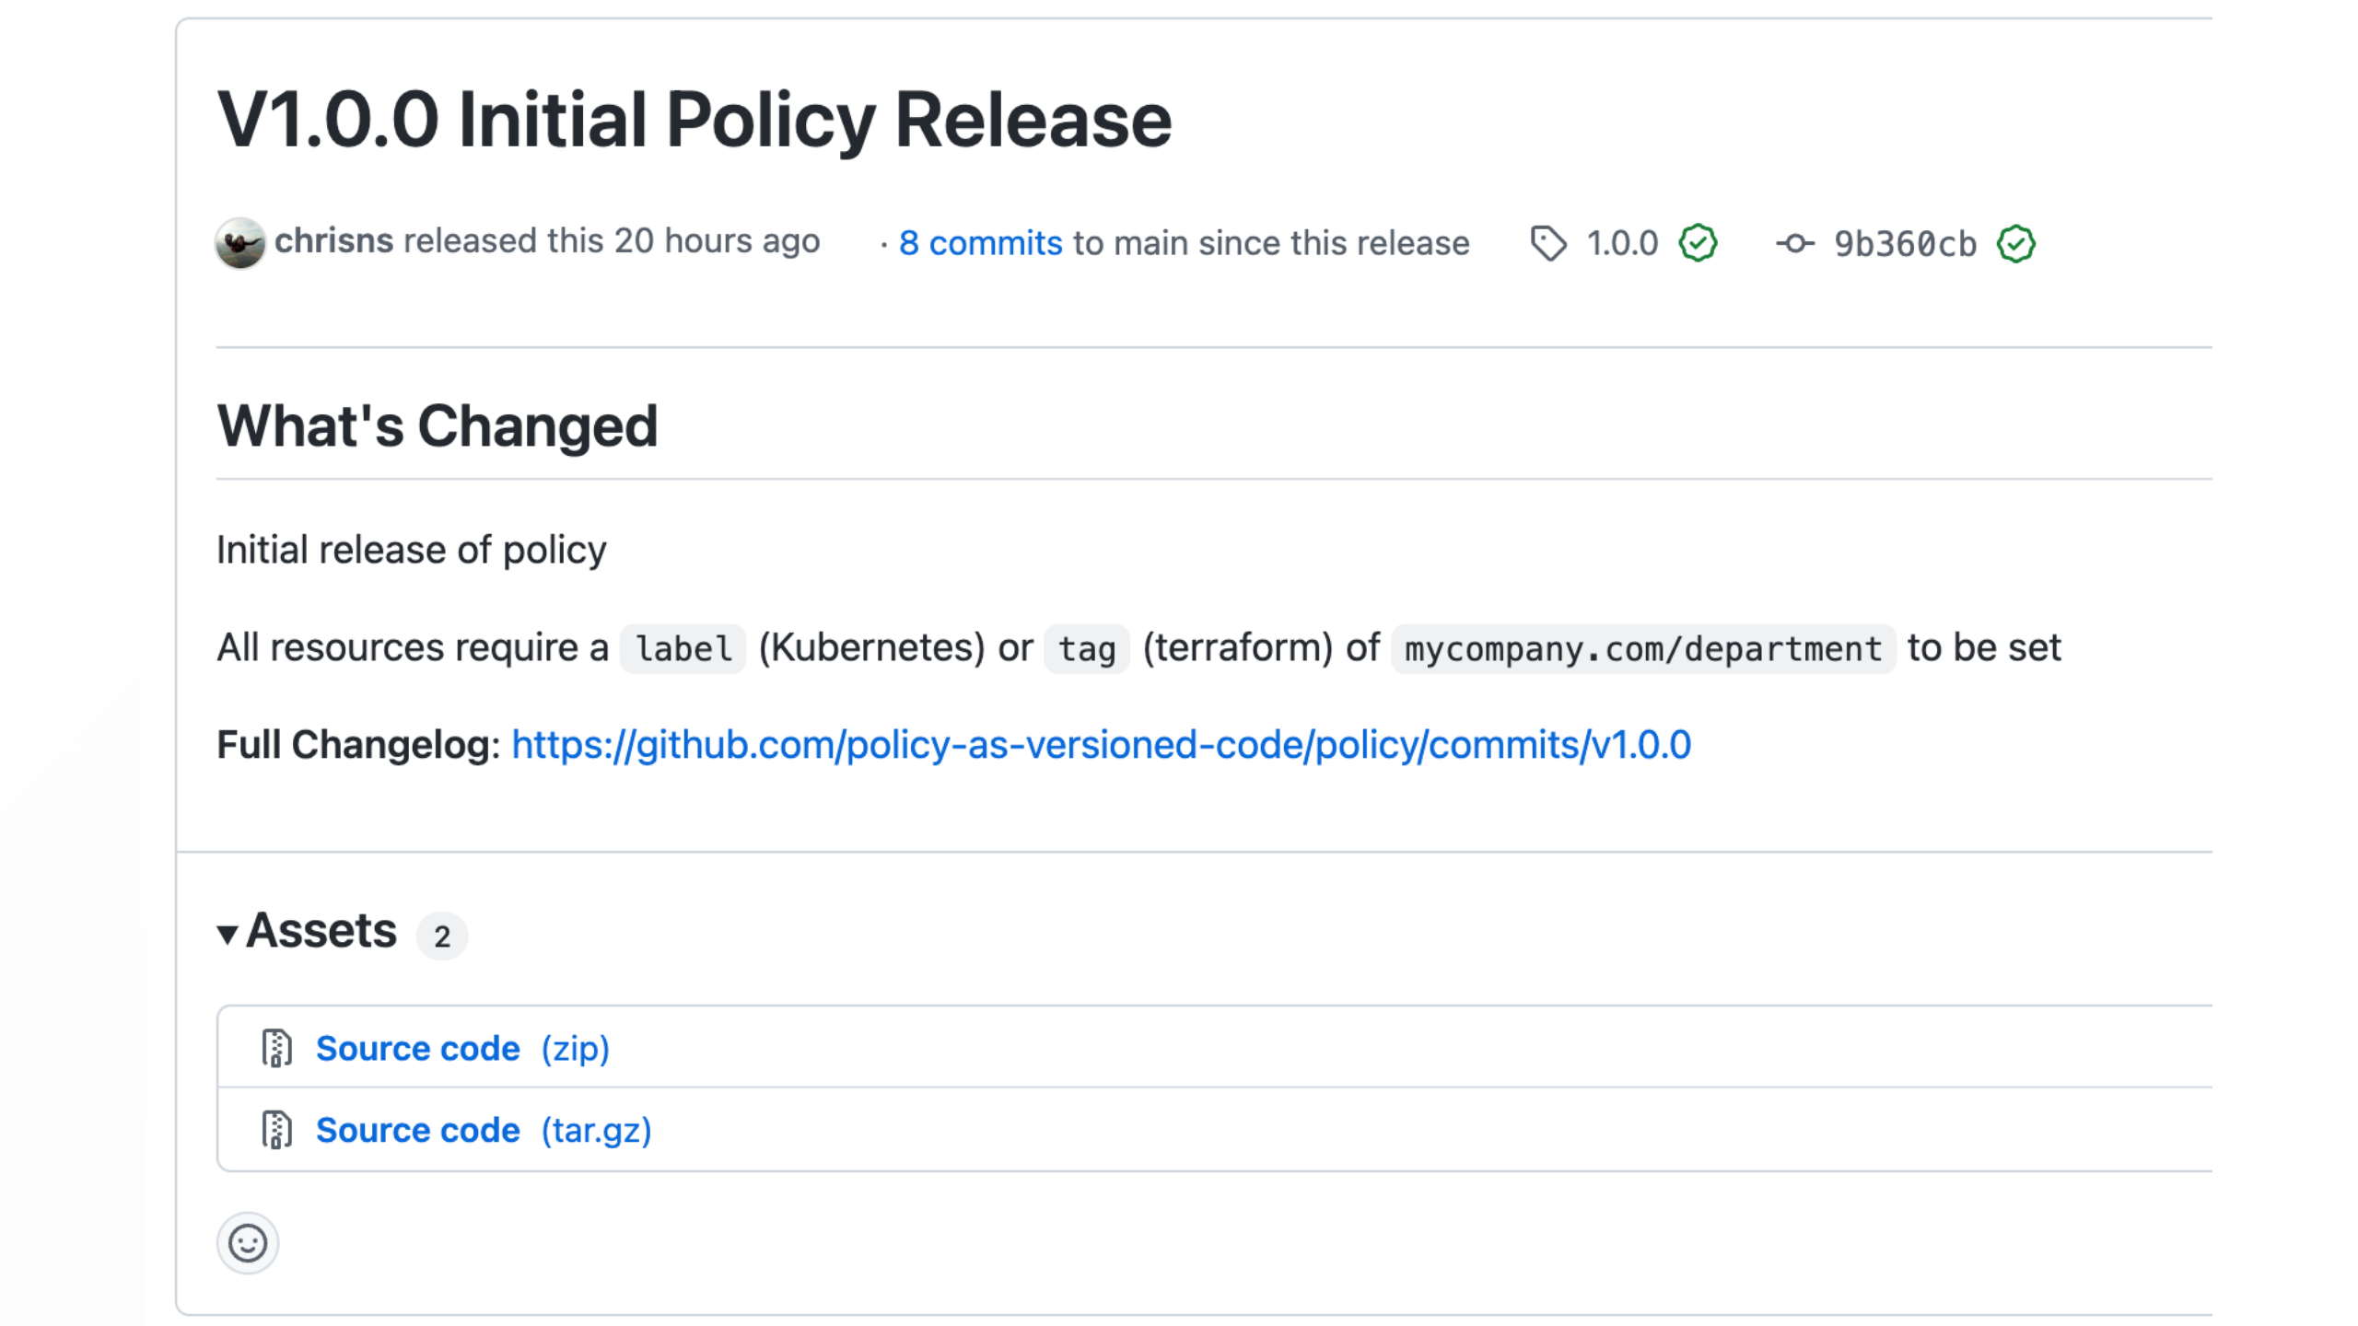
Notes:
pushed a tag in git, we've added release notes

Slide 60
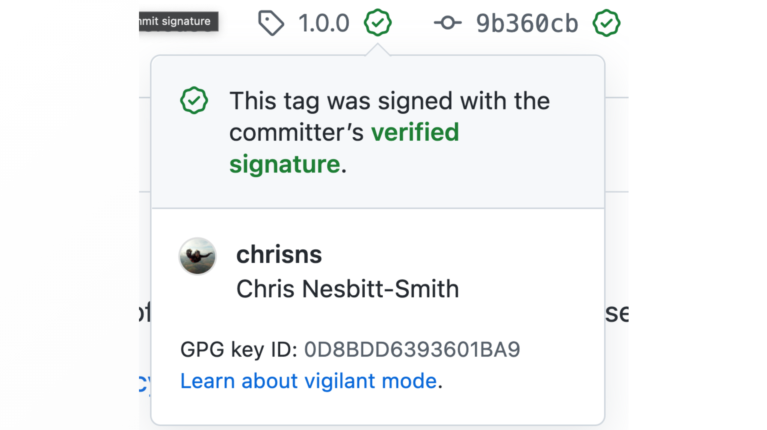
Notes:
and signed it

Slide 61
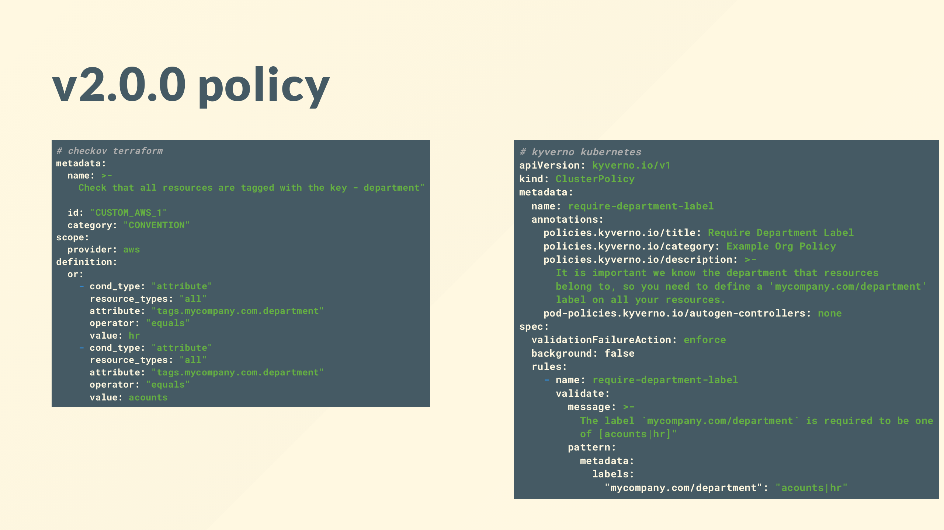
Notes:
version 2.0.0 looks similar, only now that field has to be from a predetermined list, like before, tests, release notes, tags, signed

Slide 62
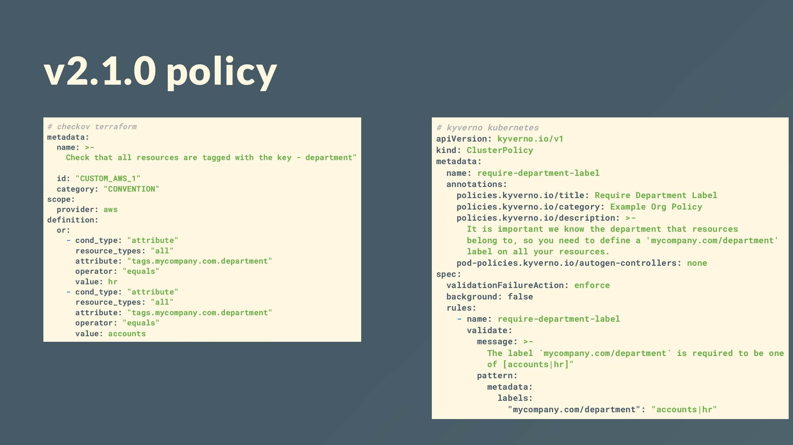
Notes:
2.1.0 is where we correct a spelling mistake in that list of departments

Slide 63
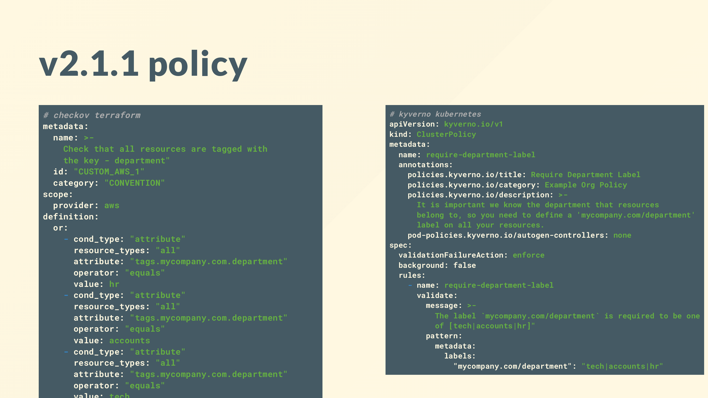
Notes:
2.1.1 added a new department to the list.

Slide 64
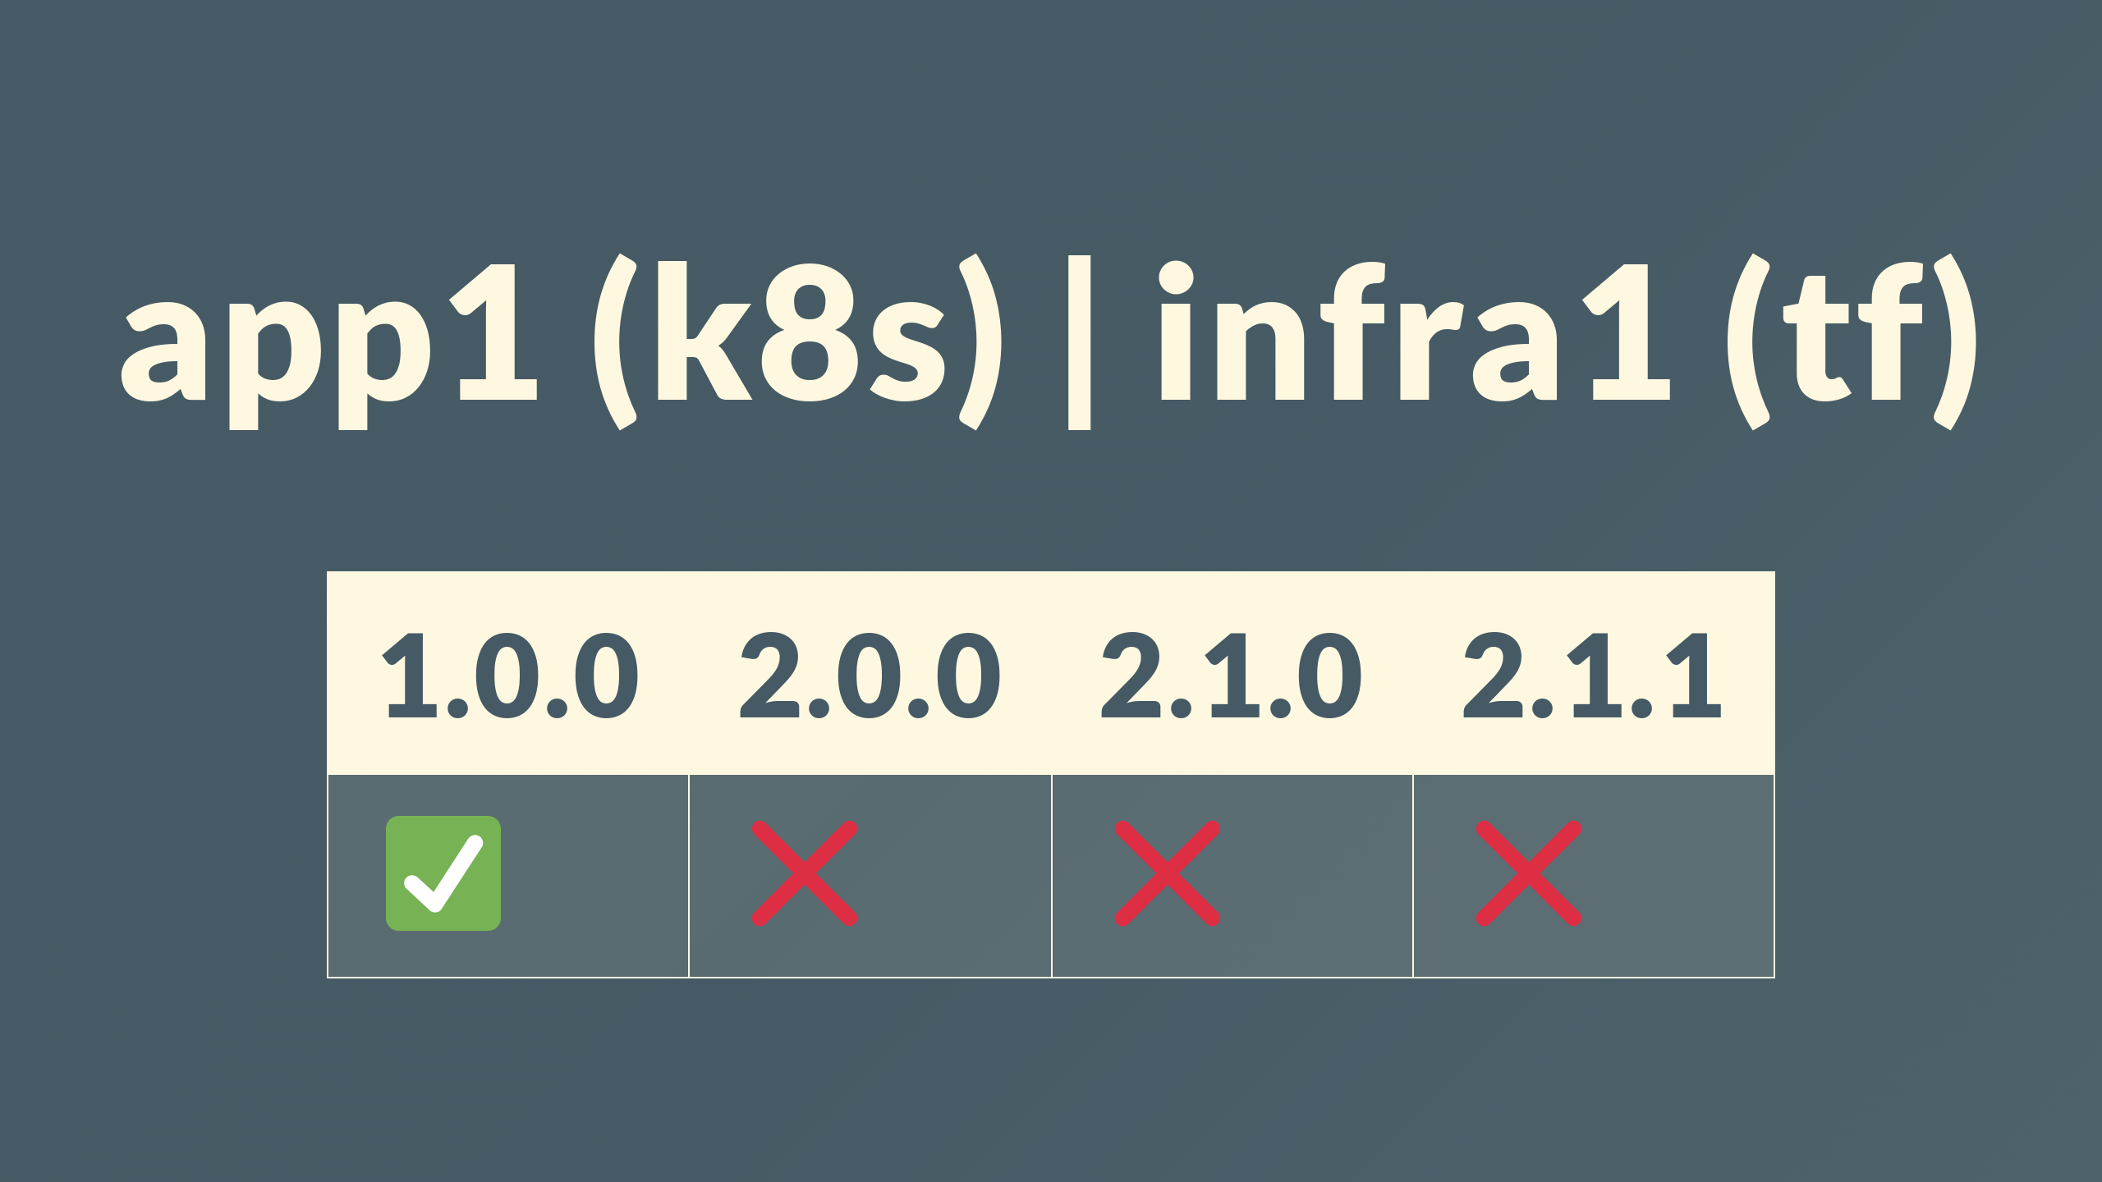
Notes:
couple more repos in the org, app1 and infra1 depend on version 1, and not compliant with 2 or beyond, but how do I know that?

Slide 65
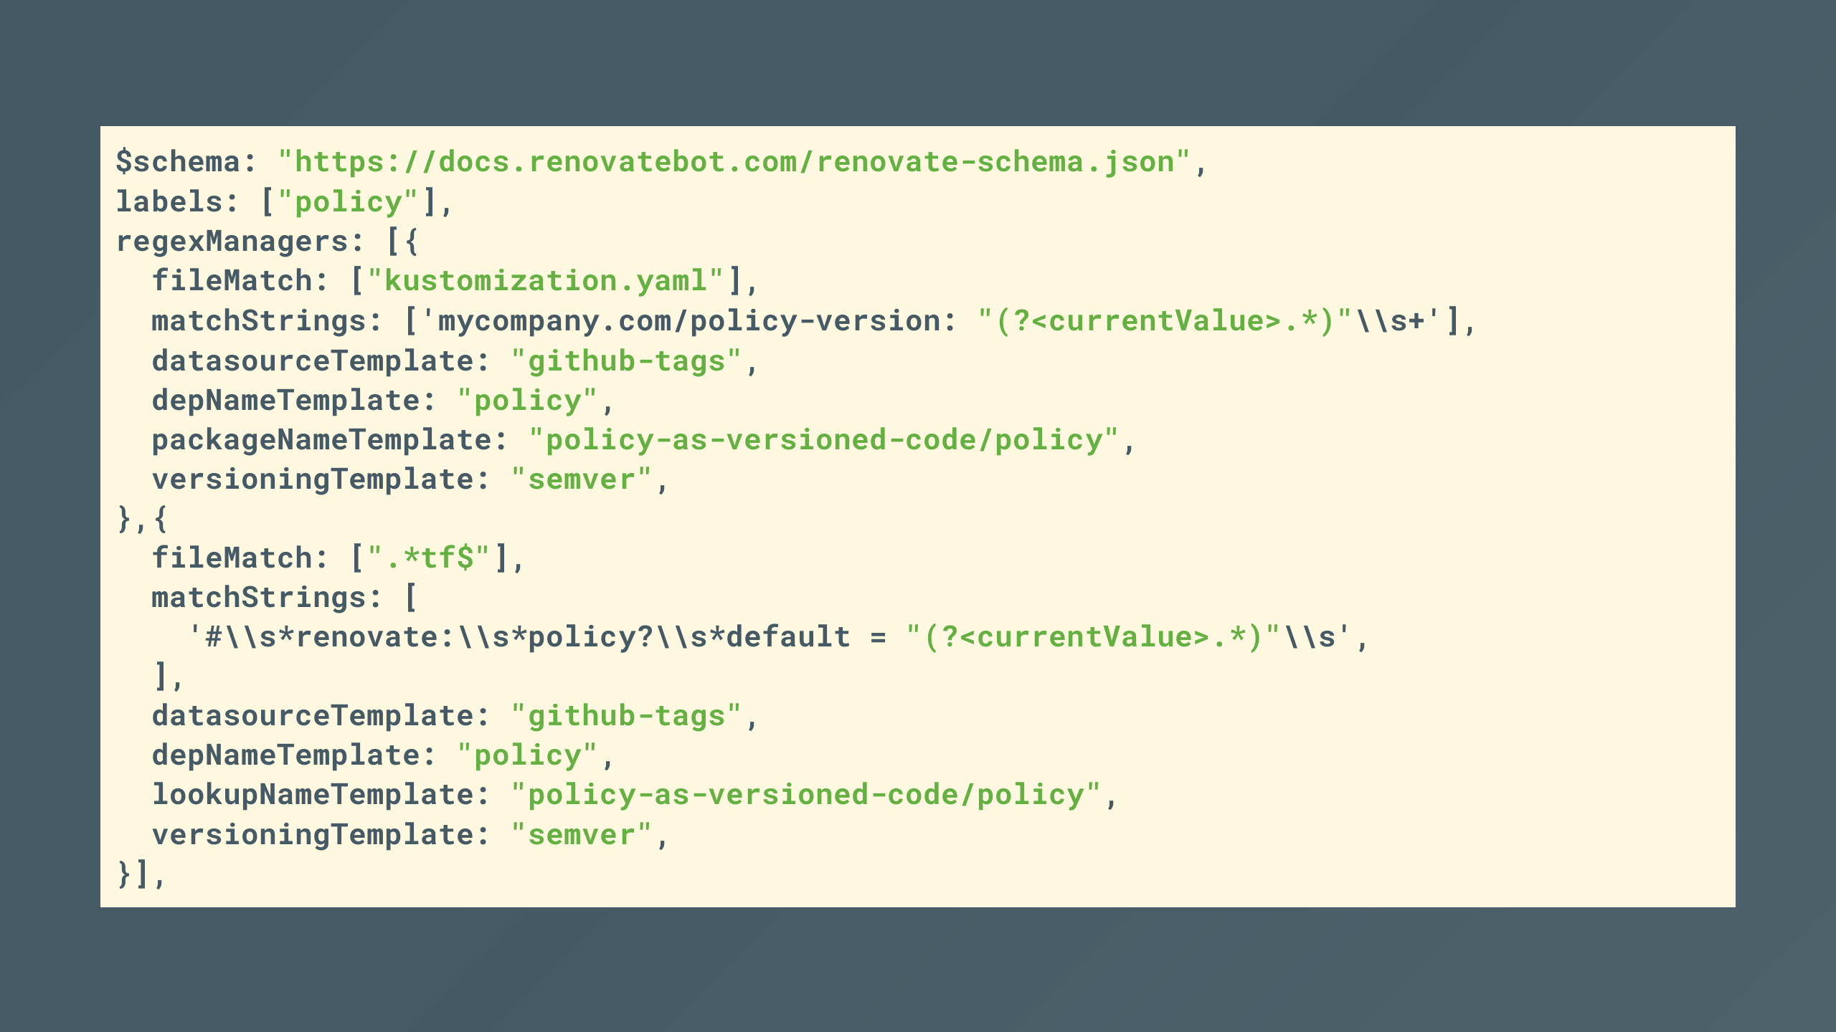
Notes:
Renovate is automatically making pull requests

Slide 66
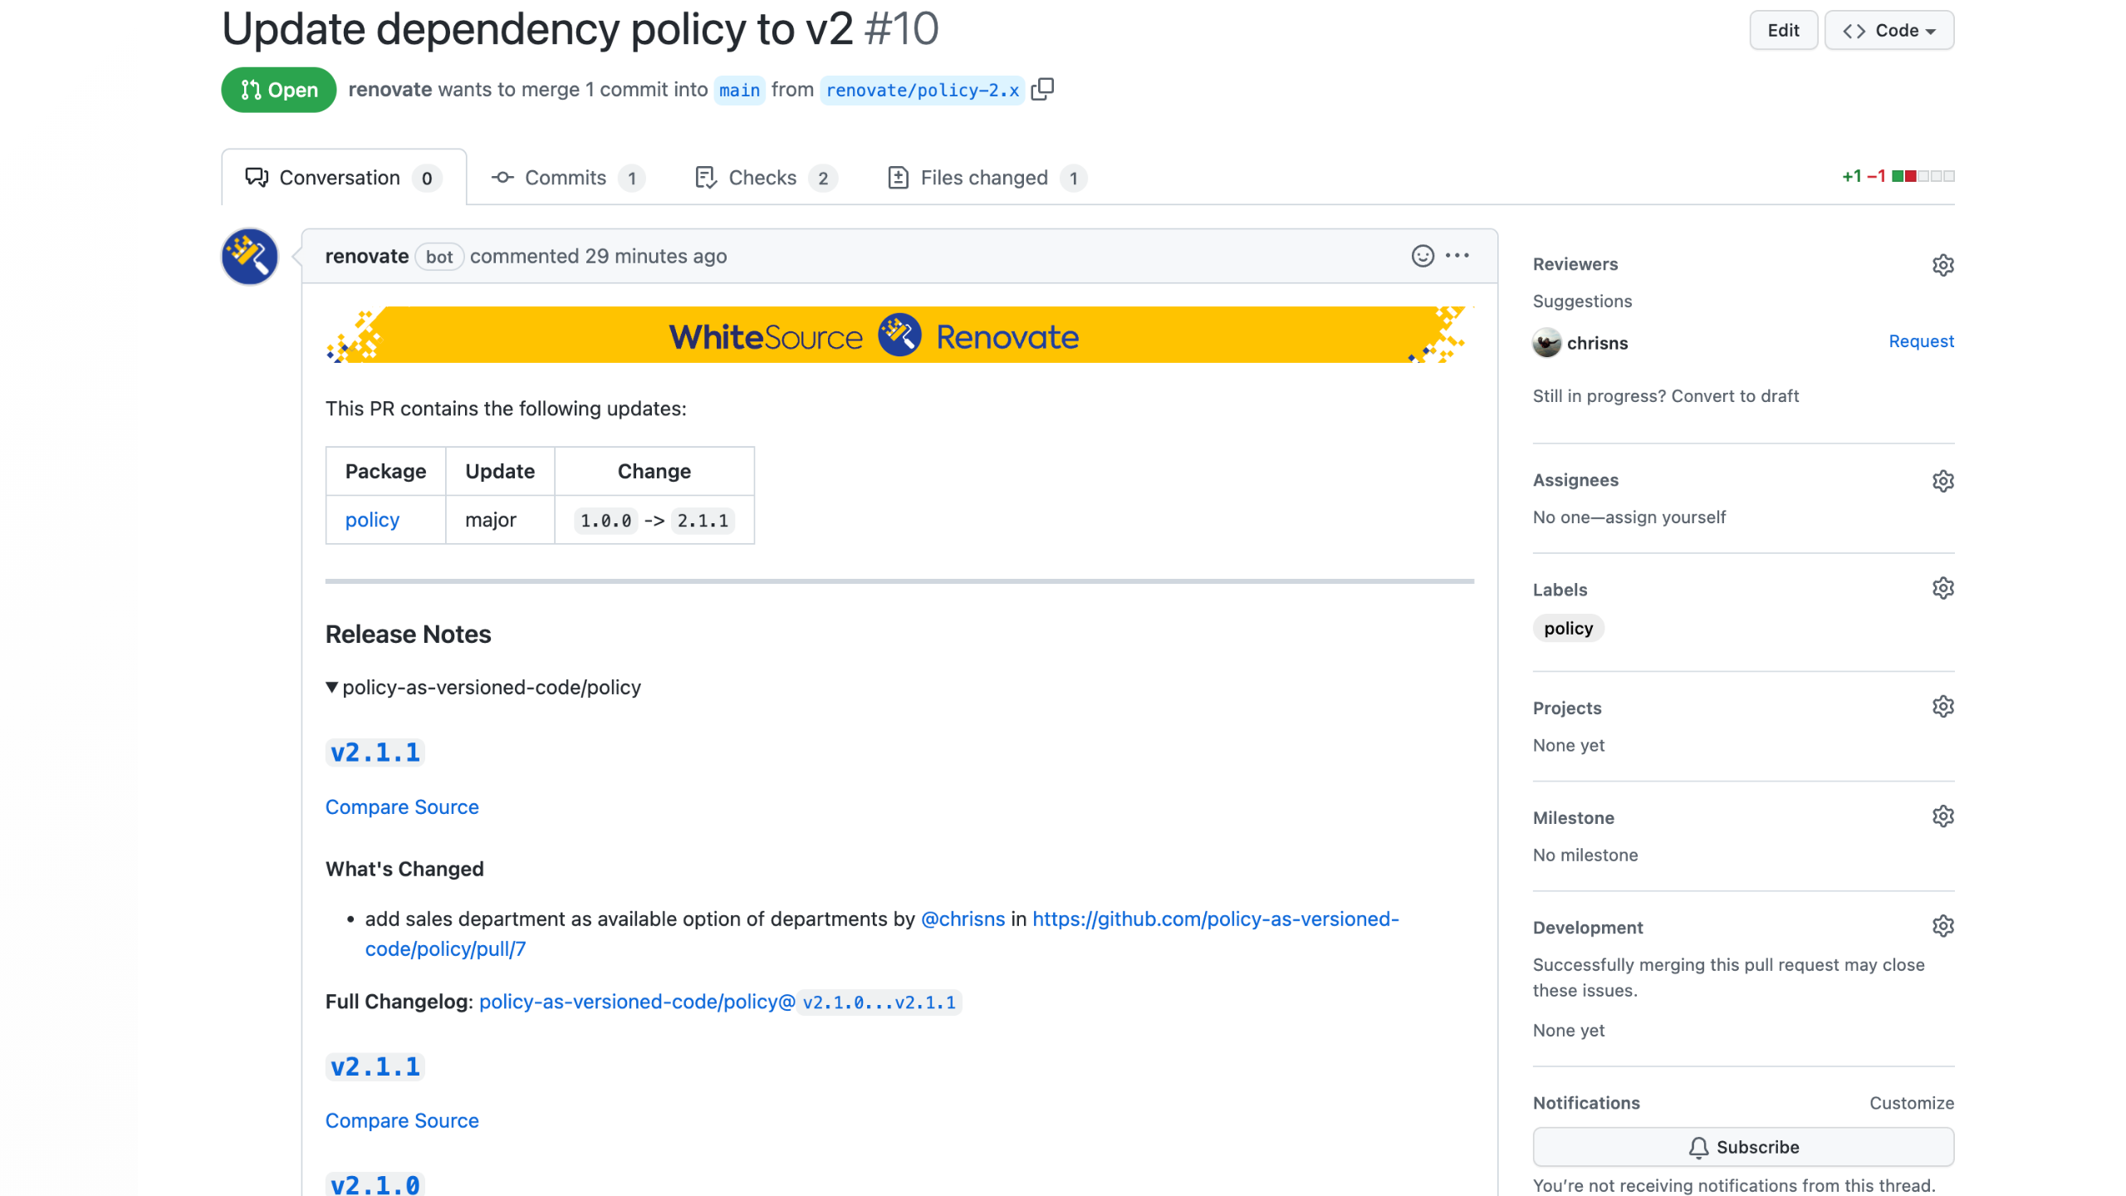
Notes:
with new versions of the policy, so I can update my dependency

Slide 67
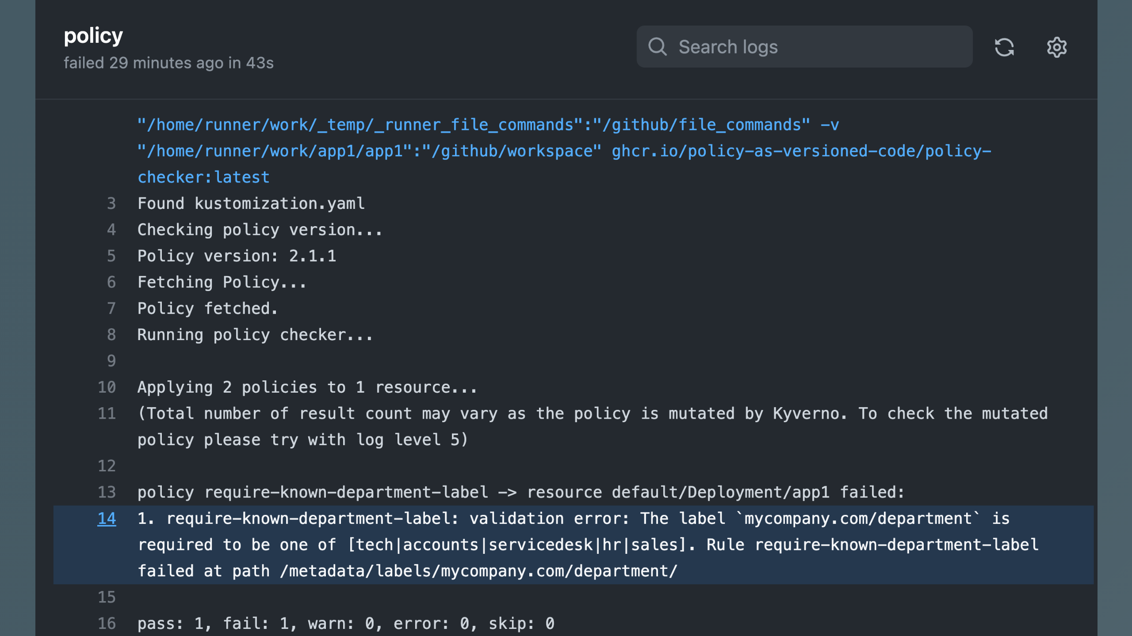
Notes:
and get feedback when I'm not compliant

Slide 68
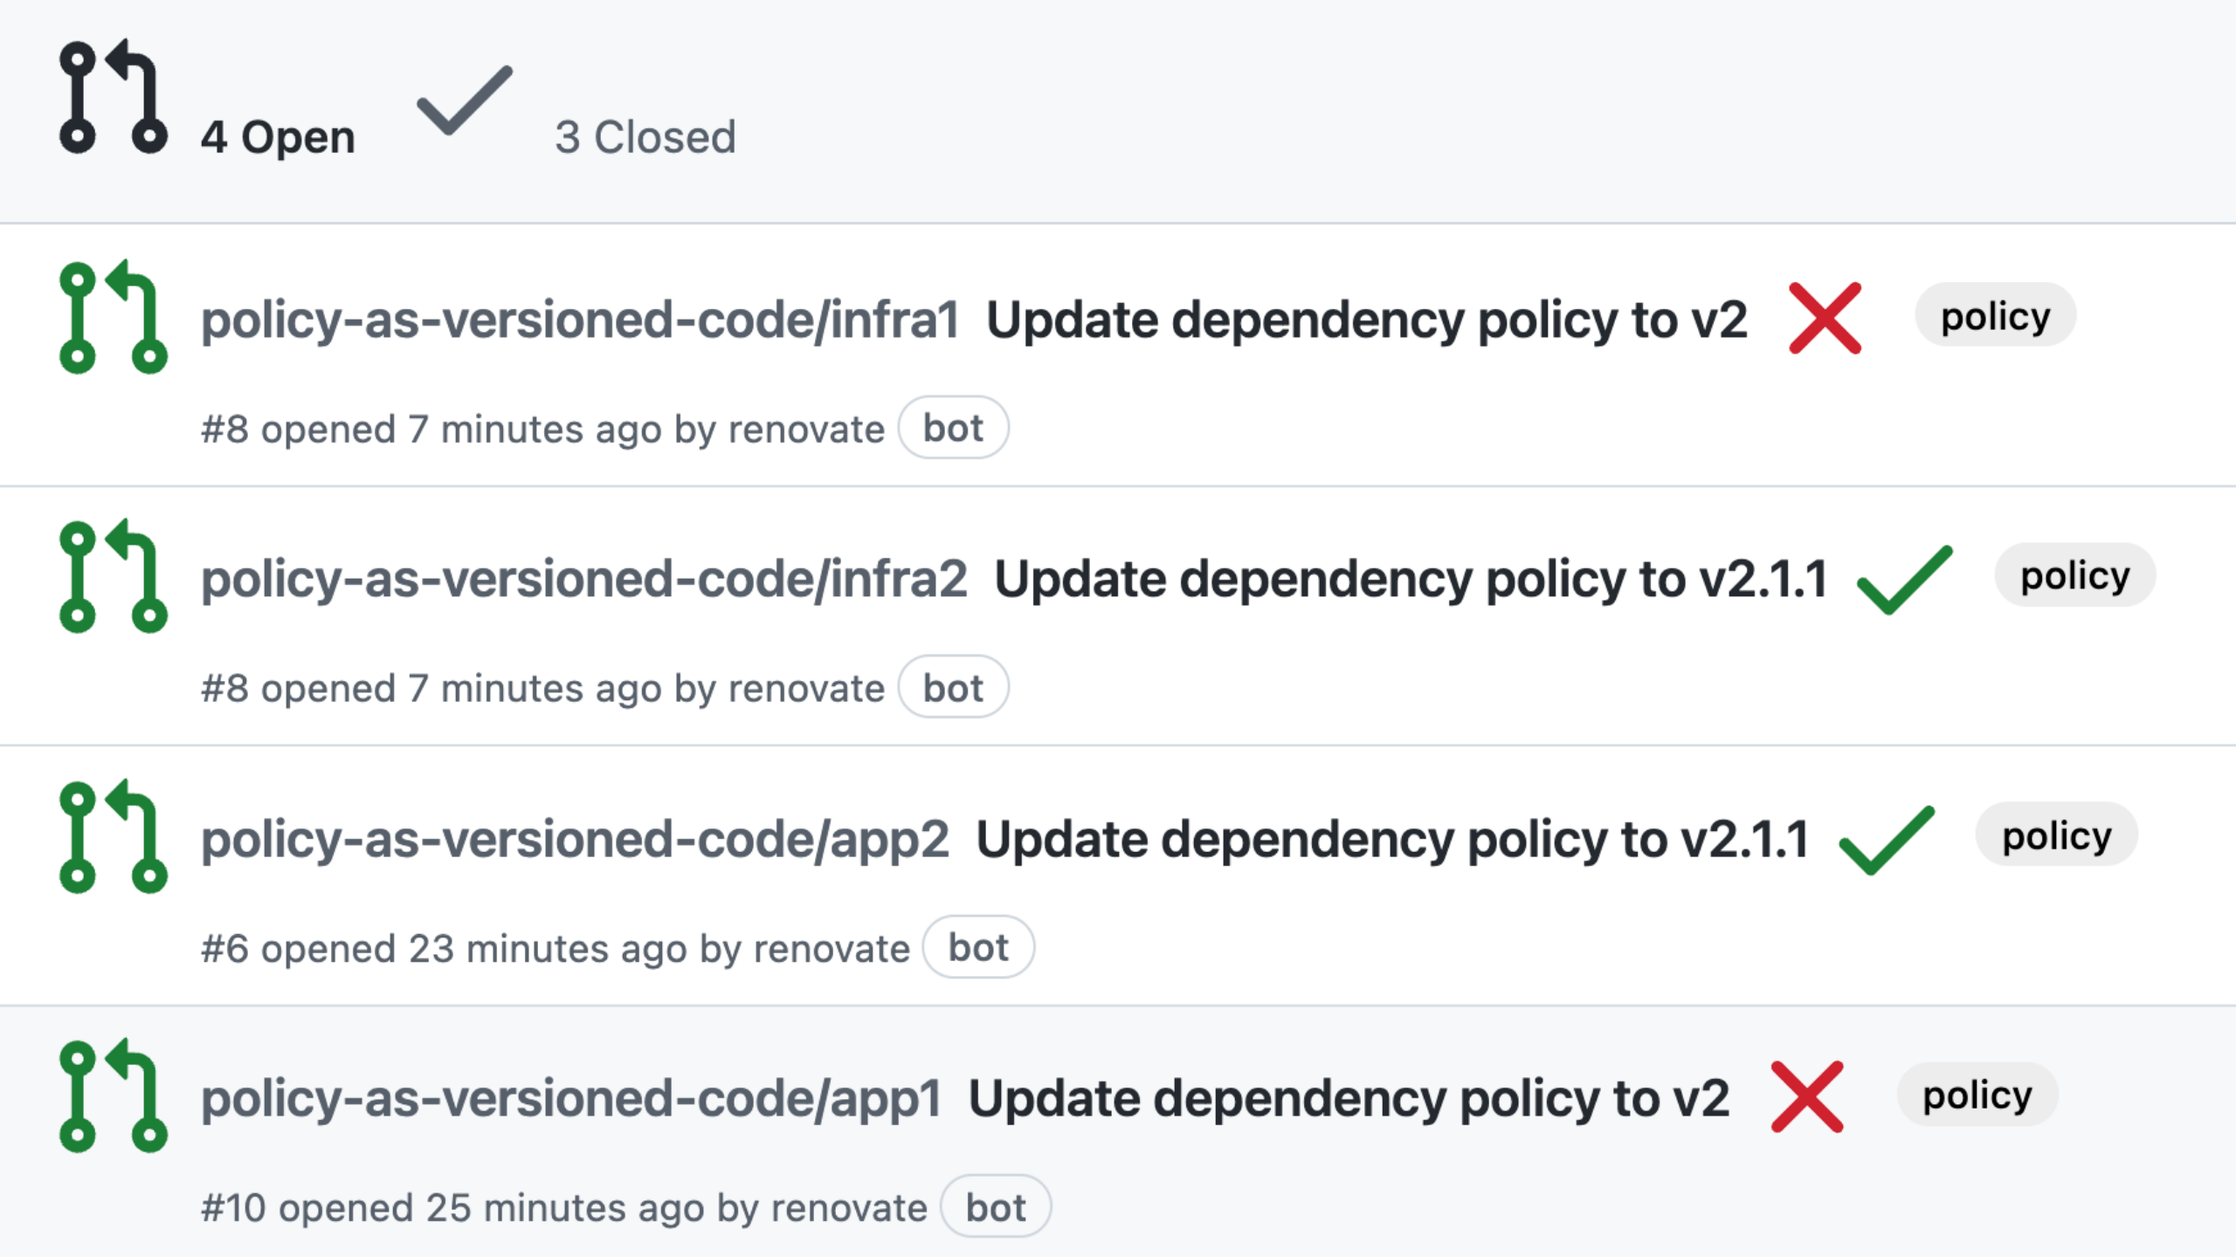
Notes:
I can also see the pull requests over the org, so I can measure the compliance of my policy
https://github.com/pulls?q=is%3Aopen+is%3Apr+archived%3Afalse+user%3Apolicy-as-versioned-code

Slide 69
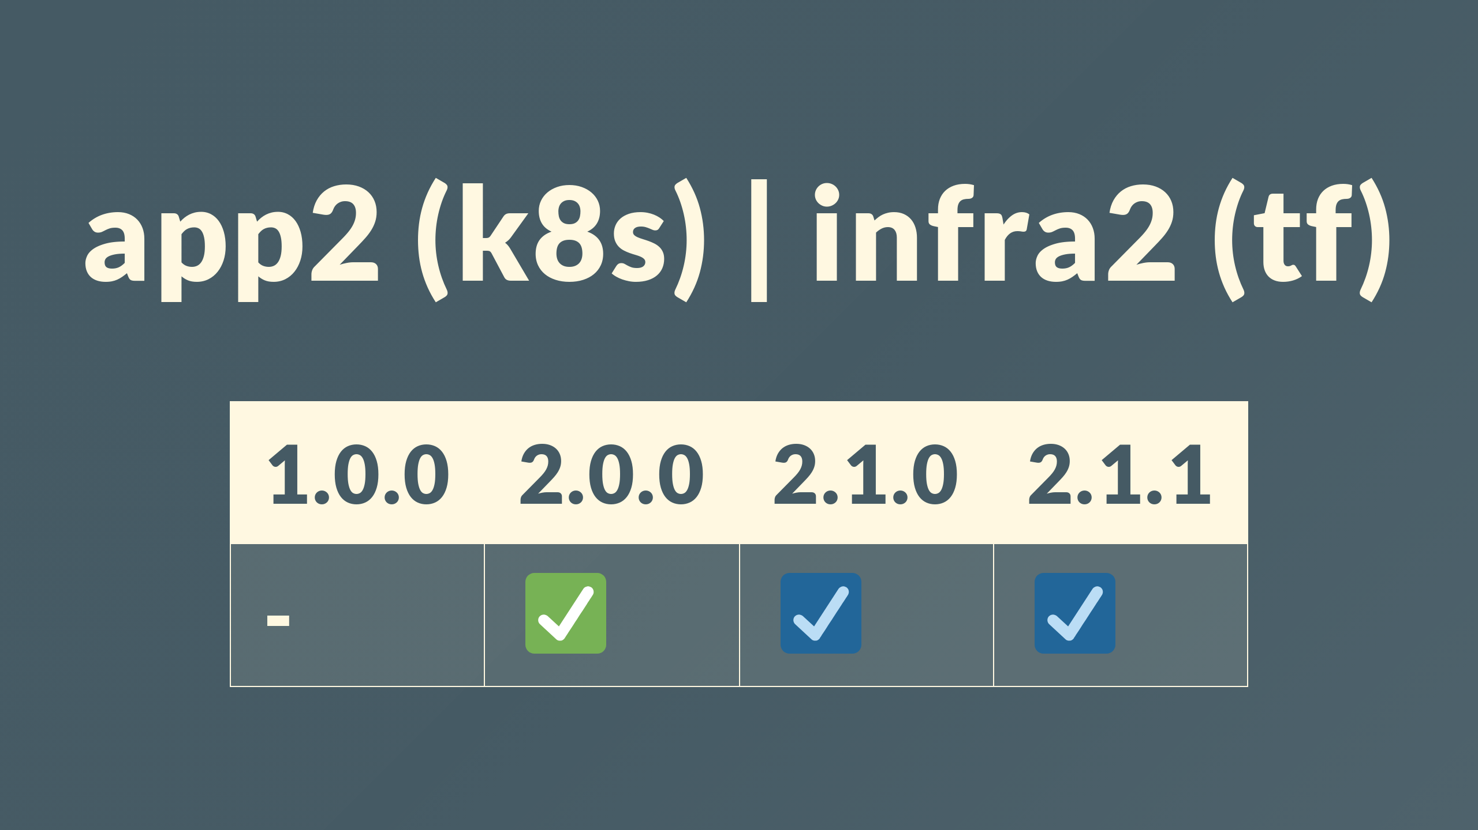
Notes:
couple more repos, app2 and infra2 depend on version 2 of the policy

Slide 70
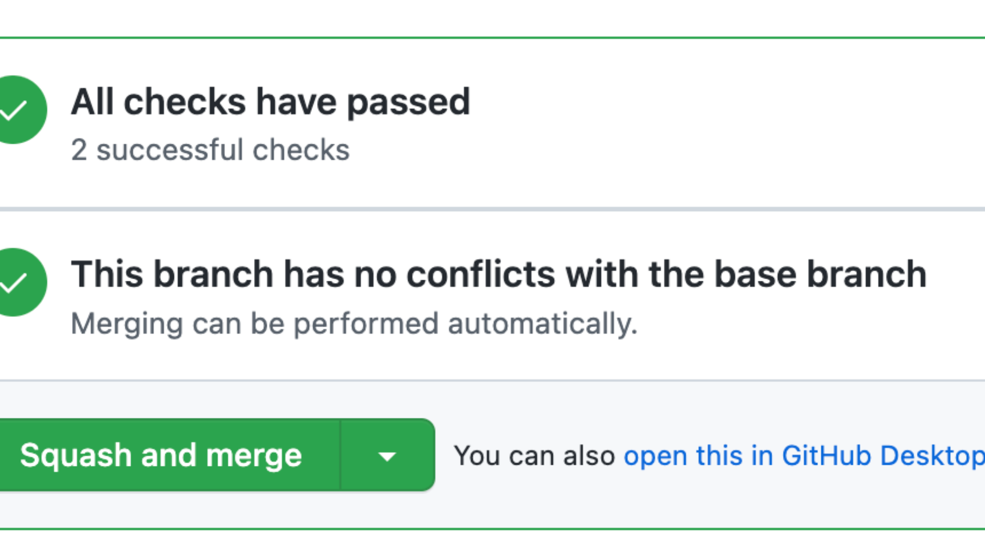
Notes:
however we could merge the open pull request up to 2.1.1

Slide 71

Notes:
app3 and infra3 are dependent on 2.1.1

Slide 72

Notes:
I've written some bash, sorry

Slide 73

Notes:
now from my laptop or in CI can evaluate my code against the right policy version

Slide 74

Notes:
and the last puzzle piece is managing the lifecycle of the policies, and allowing multiple versions of policy to be accepted and evaluated within a single runtime

Slide 75

Notes:
I've cheated, kube gives you admission controllers,
I haven't found a sane way to evaluate against Azure, GCP or AWS policy without doing it for real

Slide 76

Notes:
The way the policy is designed and distributed lends it self well to co-exist with previous and future versions of itself in a Kubernetes cluster

Slide 77

Notes:
cluster1 describes a cluster that accepts all the versions we've described so far

Slide 78

Notes:
likewise cluster2, only accepts 2.0.0 and greater

Slide 79

Notes:
to demo used KiND to deploy the apps

Slide 80

Notes:
and there we have it full org all done, all compliant, policy all versioned, CIO all aware of whats going on.
So this is great,

Slide 81

Notes:
when some new privacy regulation comes out, or you acquire more data, the risks and the appetite stand still for no one and now neither does our policy

Slide 82

Notes:
But the most important thing I want you to remember from our time together is that.
And feel free to say it out loud with me

Slide 83

Notes:
Purposeless

Slide 84

Notes:
policy is

Slide 85

Notes:
potentially

Slide 86

Notes:
practically

Slide 87

Notes:
pointless

Slide 88

Notes:
policy.

Slide 89

Notes:
I've been practicing saying that far too many times.

Slide 90

Notes:
I've been Chris Nesbitt-Smith, thanks for your time, you're now free to leave, I'll try destroy the evidence of your guilt admissions earlier.
Like subscribe whatever the kids do these days on LinkedIn, Github whatever. cns.me points at my LinkedIn.
talks.cns.me contains this and other talks, they're all open source.

Slide 91


