Slide 1
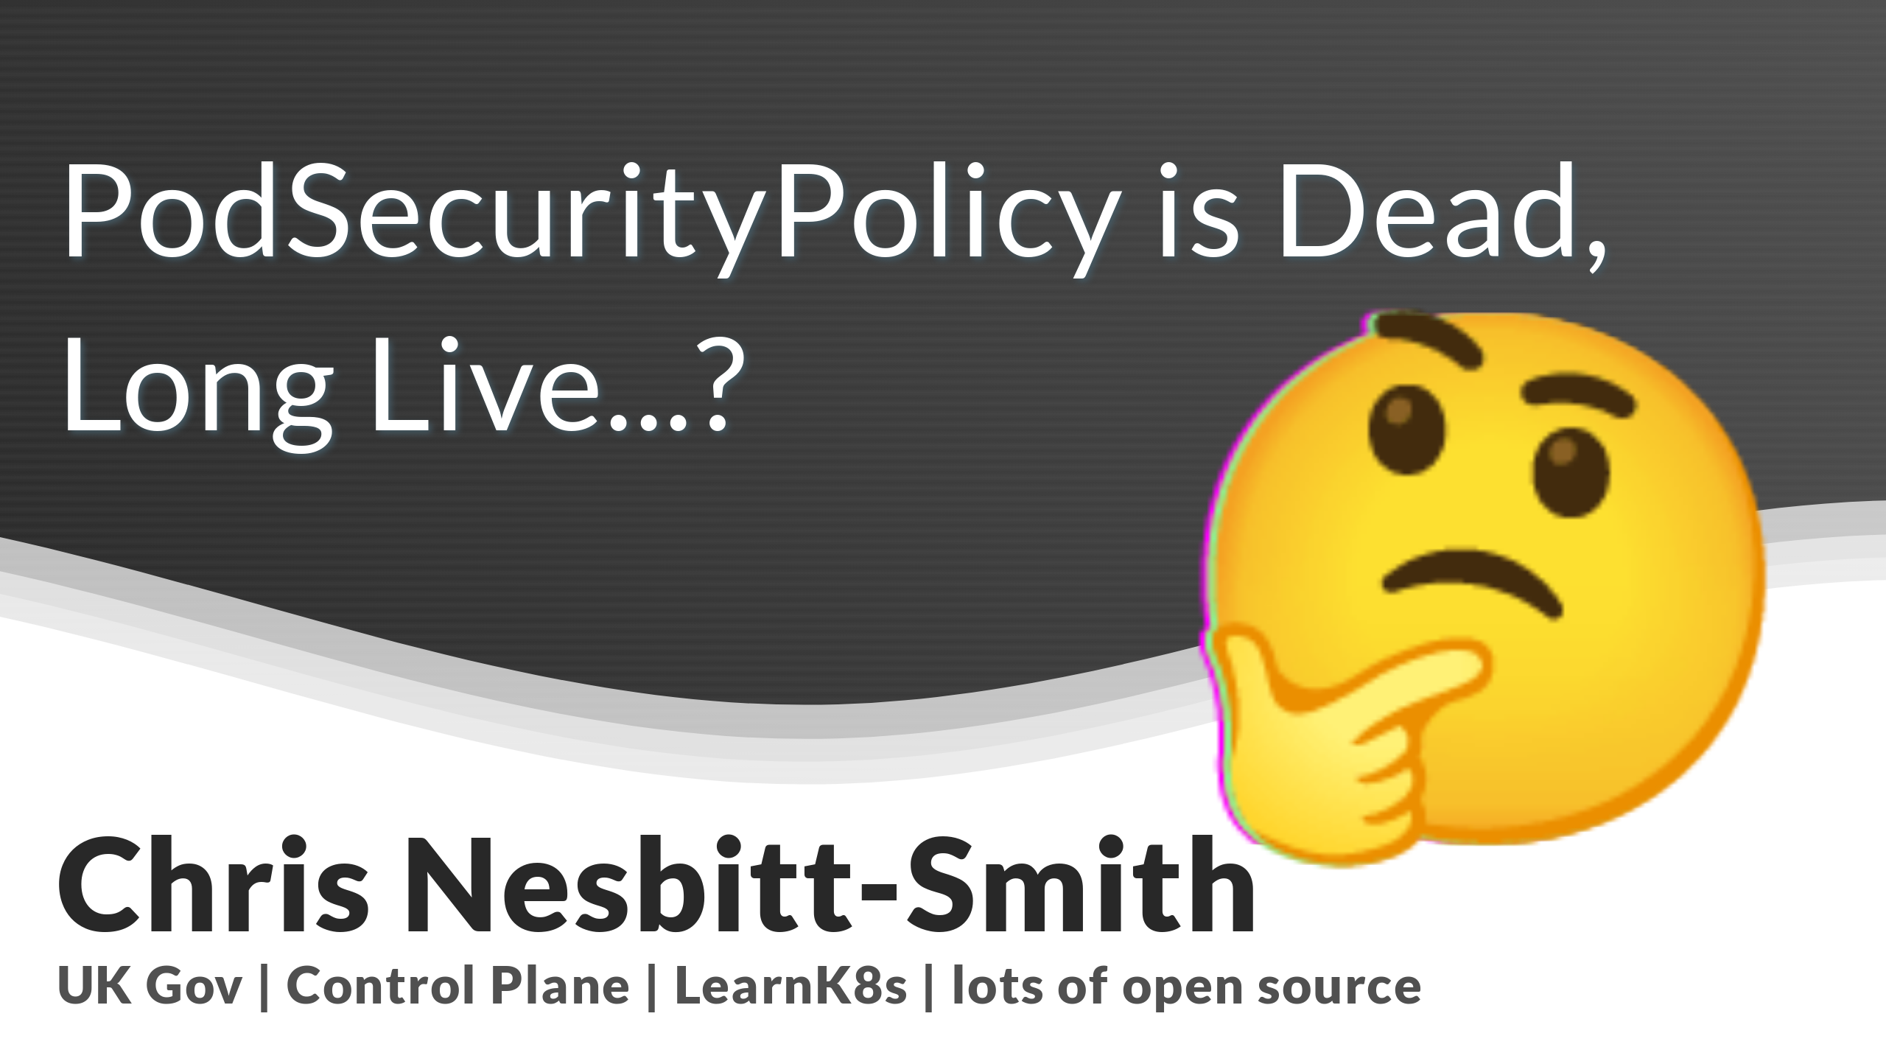

Slide 2

Notes:
Hello! Imagine a thing with human faces, what a treat, I get to stand not worry about being on mute, use my clicker and everything!
My name is Chris, and I've been trying, with some success to use Kubernetes since 0.4 and I've got opinions on it, so strap in.
I'm Solution Architect at Appvia, instructor at LearnK8s, and tinkerer of open source including maintaining some high profile projects in the home automation space.
I'm often talk too fast when doing these, please shout at me when this happens, and jump in with questions though there will also hopefully be time at the end.
--- ONLINE ---
Hello! Thank you so much for joining me here today.
So, to kick things off my name is Chris Nesbitt-Smith, I'm based in London and currently work with some well known brands like learnk8s, control plane, esynergy and various bits of UK Government I'm also a tinkerer of open source stuff.
I've using and abusing Kubernetes in production since it was 0.4, believe me when I say its been a journey!
I've definitely got the scars to show for it.
It'd be great to hear where you're joining from today so if you could drop a comment in the chat and let me know where you are that'd be great.
We'll have time for any questions at the end if you want to drop them into the comments.

Slide 3
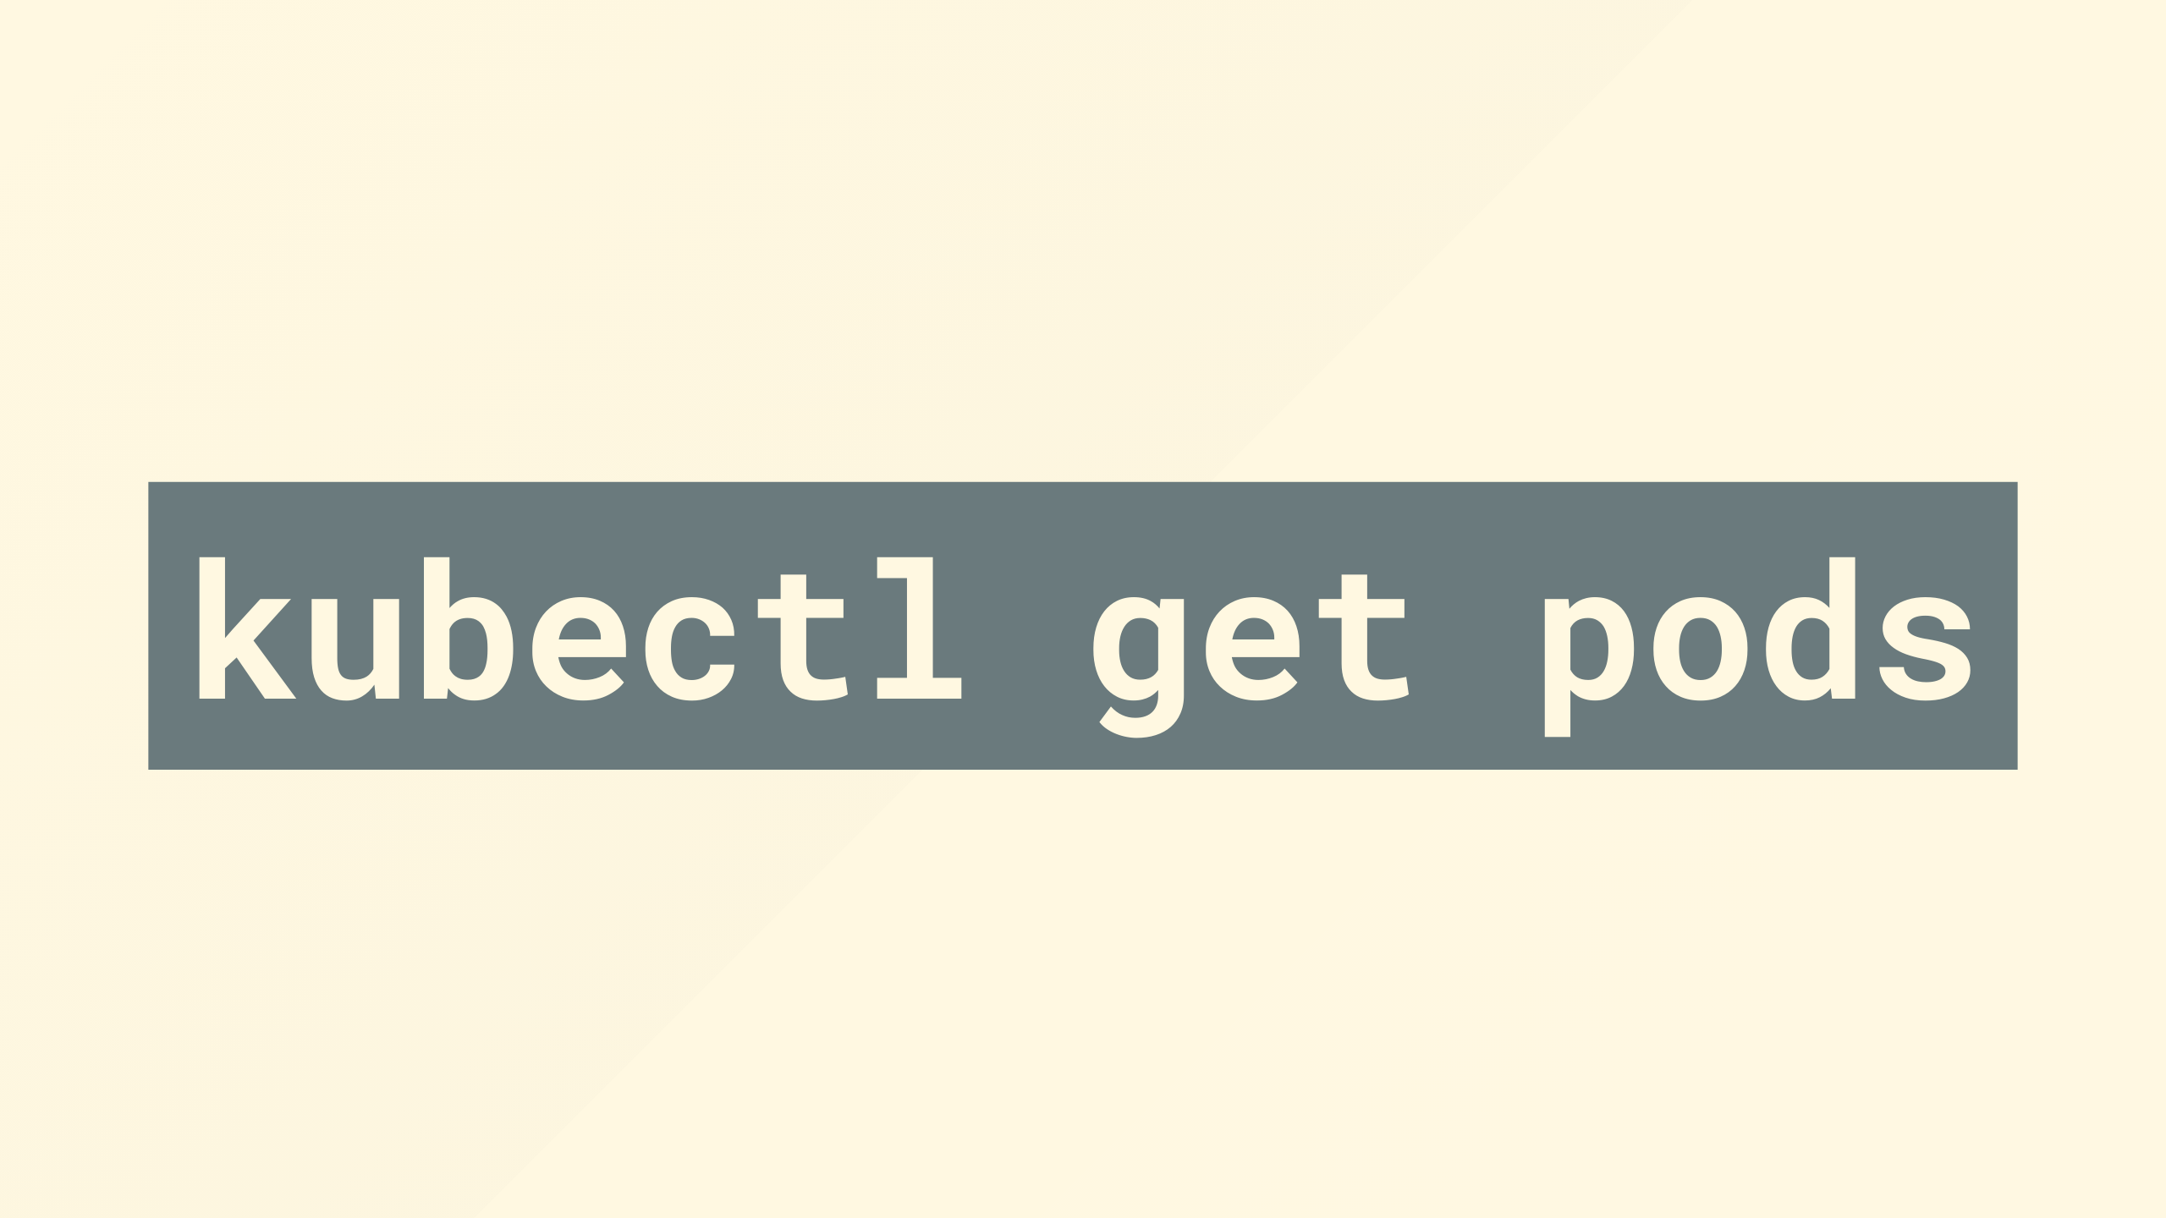
Notes:
By show of hands who's worked with pods before?
--- ONLINE ---
In a virtual, bit offline, by show of hands (or dropping off the stream) who's worked with pods before?

Slide 4


Slide 5
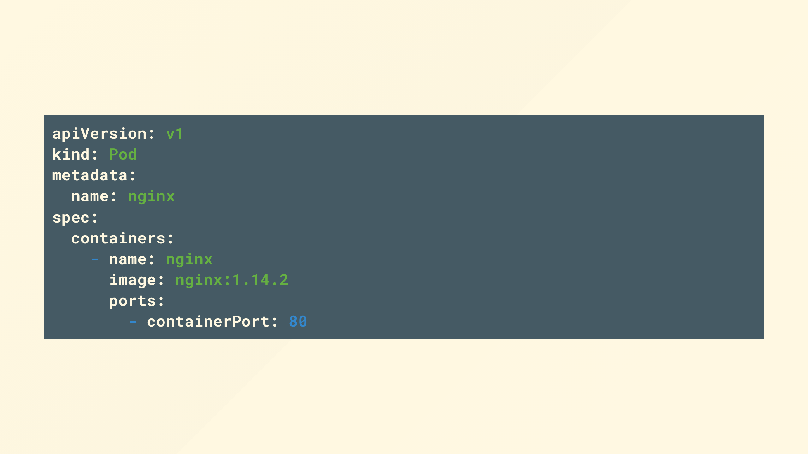
Notes:
Cool, and for anyone that didn't raise their hand, welcome to the party you almost missed it!
Pods are the smallest deployable units of computing that you can create and manage in Kubernetes, they represent a single instance of a containerized application running in your cluster.

Slide 6
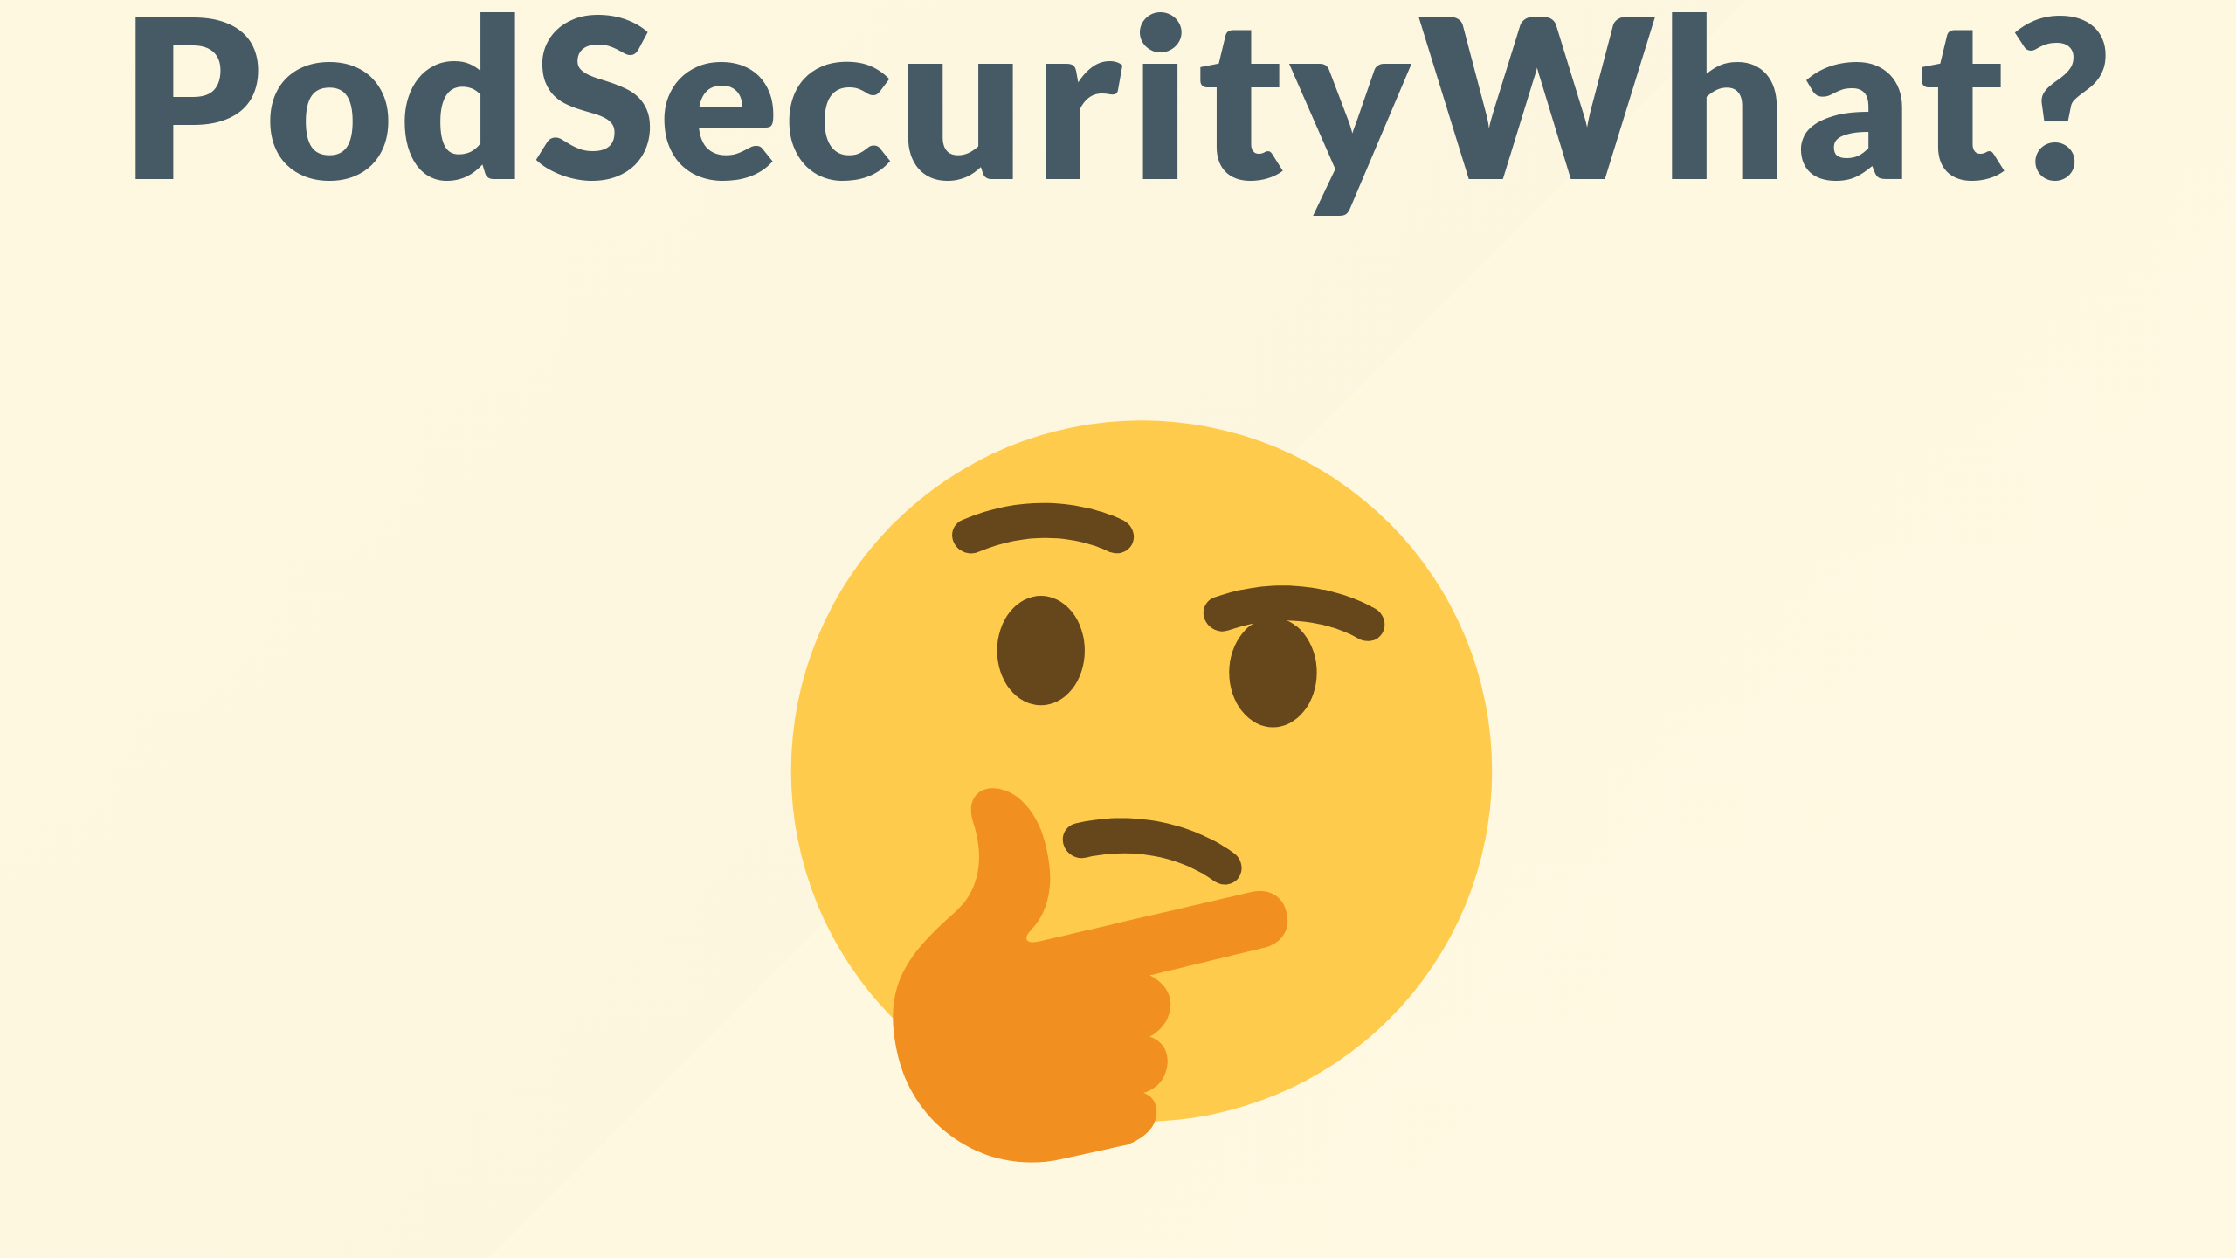
Notes:
Ok so now for the topic of this talk, pod security policies

Slide 7
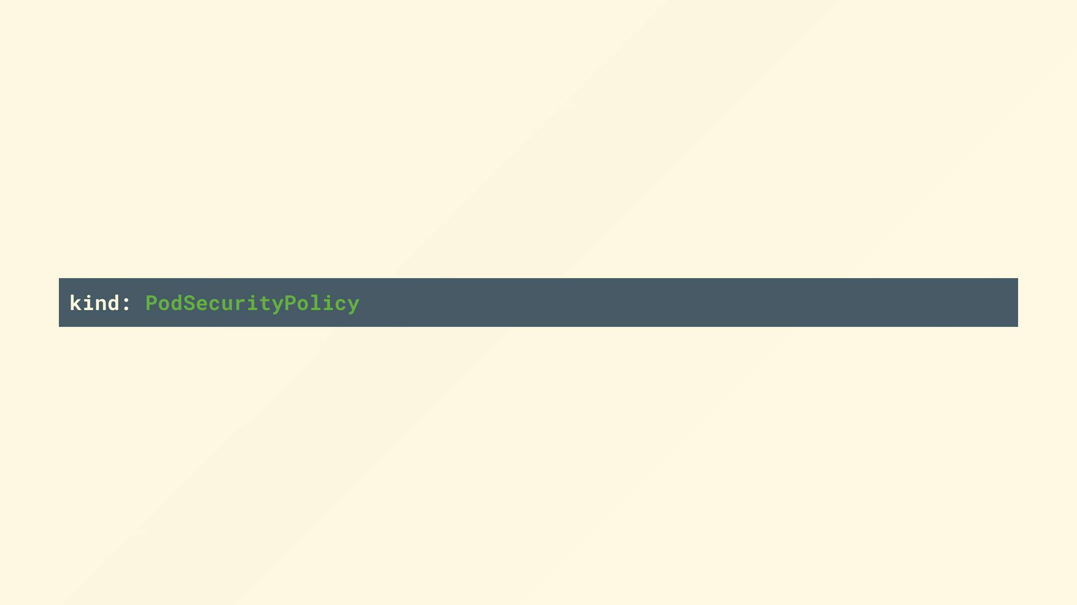
Notes:
They've been around since 1.0, which is about a million Kubernetes years.

Slide 8
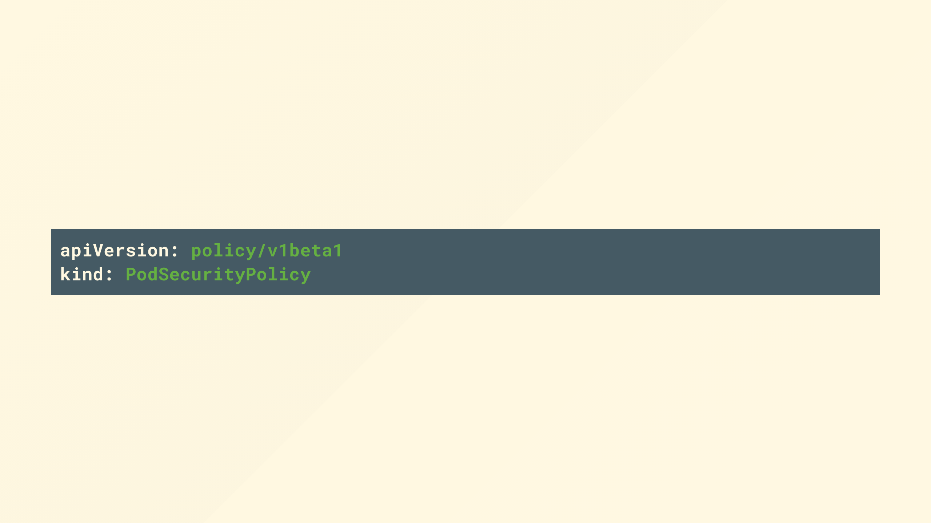
Notes:
and in that time has never made it past the beta classification, and I believe may be last v1beta1 resource that is routinely used in production, that is after ingress left beta not long ago.

Slide 9

Notes:
Sadly that's not the case for PSPs, they were deprecated in 1.21, and was removed entirely in 1.25.

Slide 10
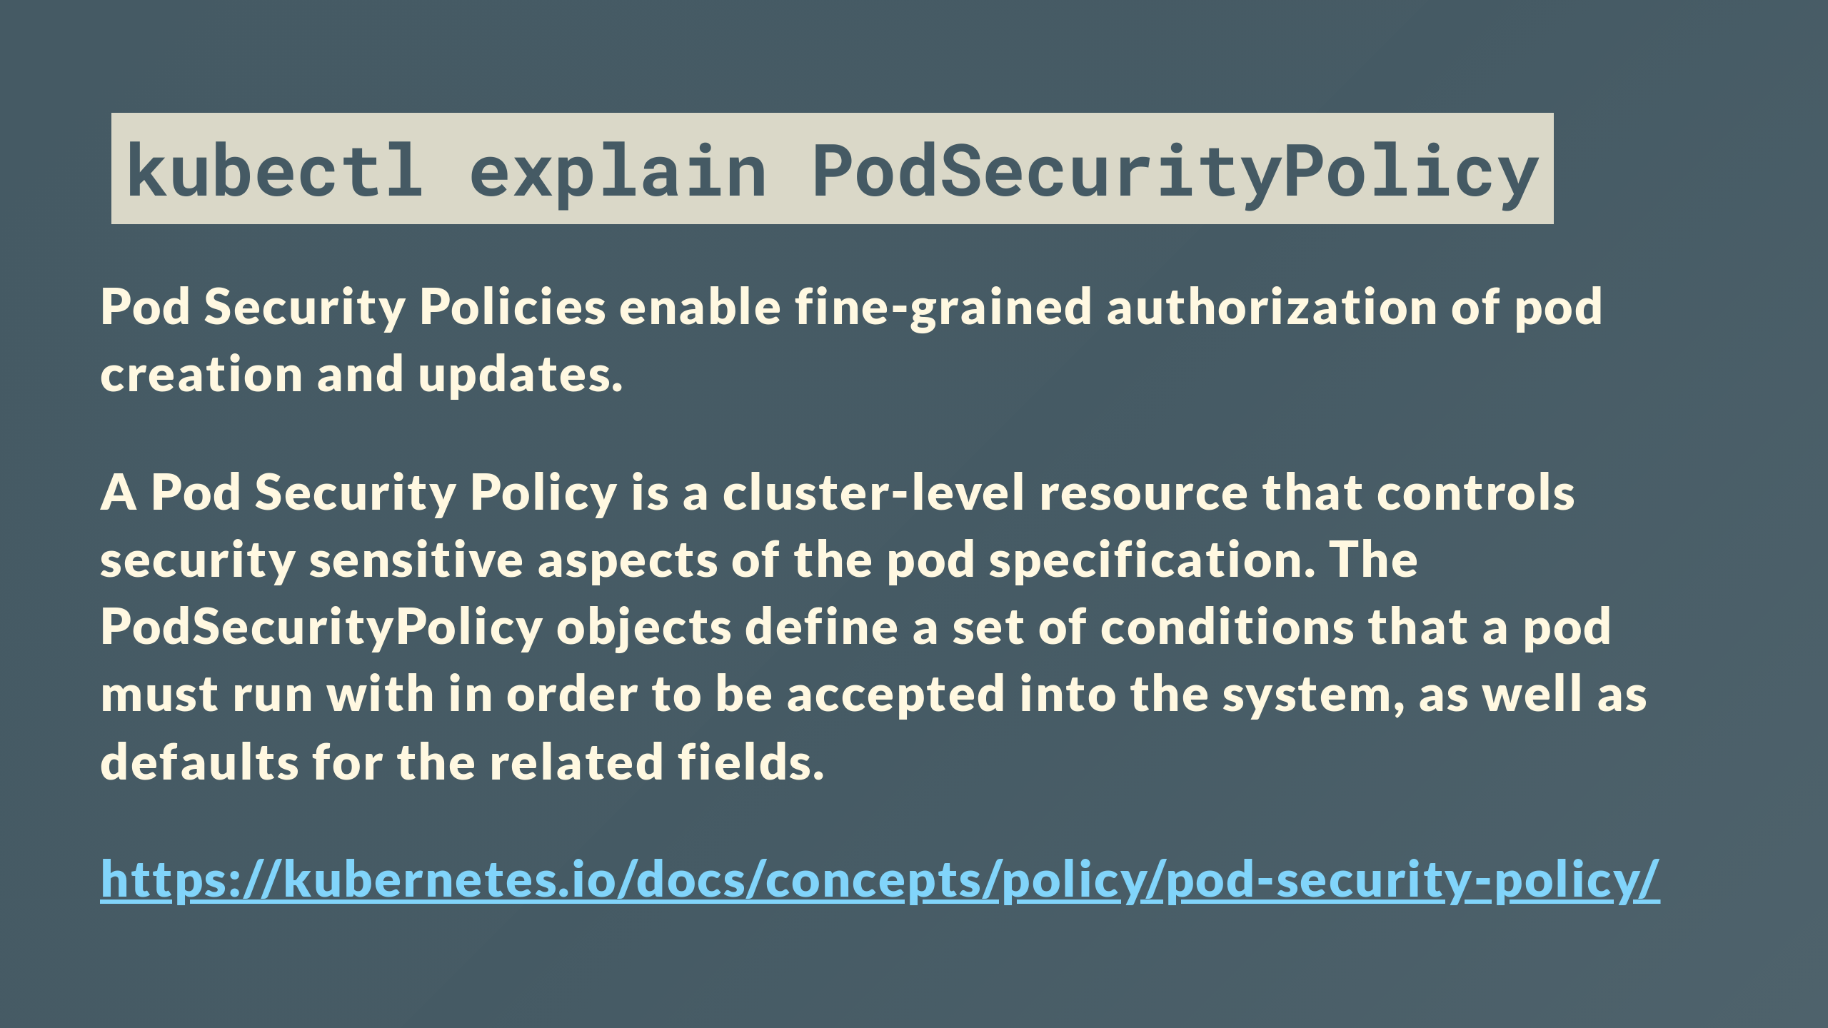
Notes:
What is a PSP apart from more words than should ever be on a slide?

Slide 11
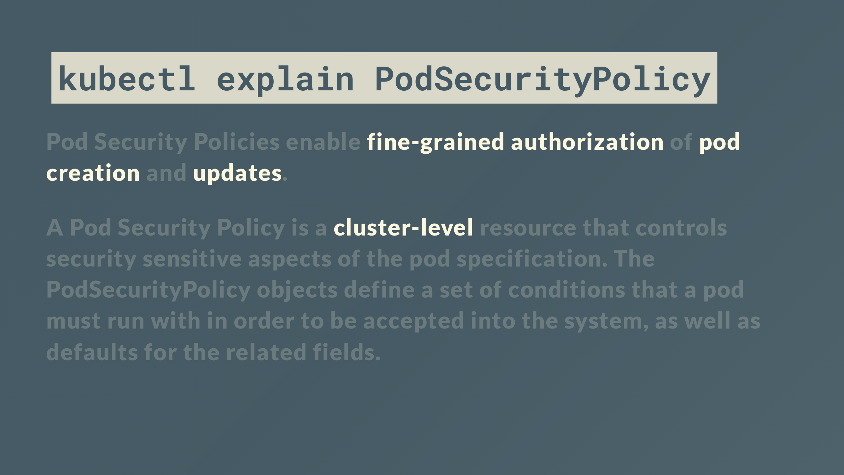
Notes:
Thats better
PSPs give cluster admins an ability to impose limits over things like running as root, opening ports on the host, types of volume you can use etc

Slide 12
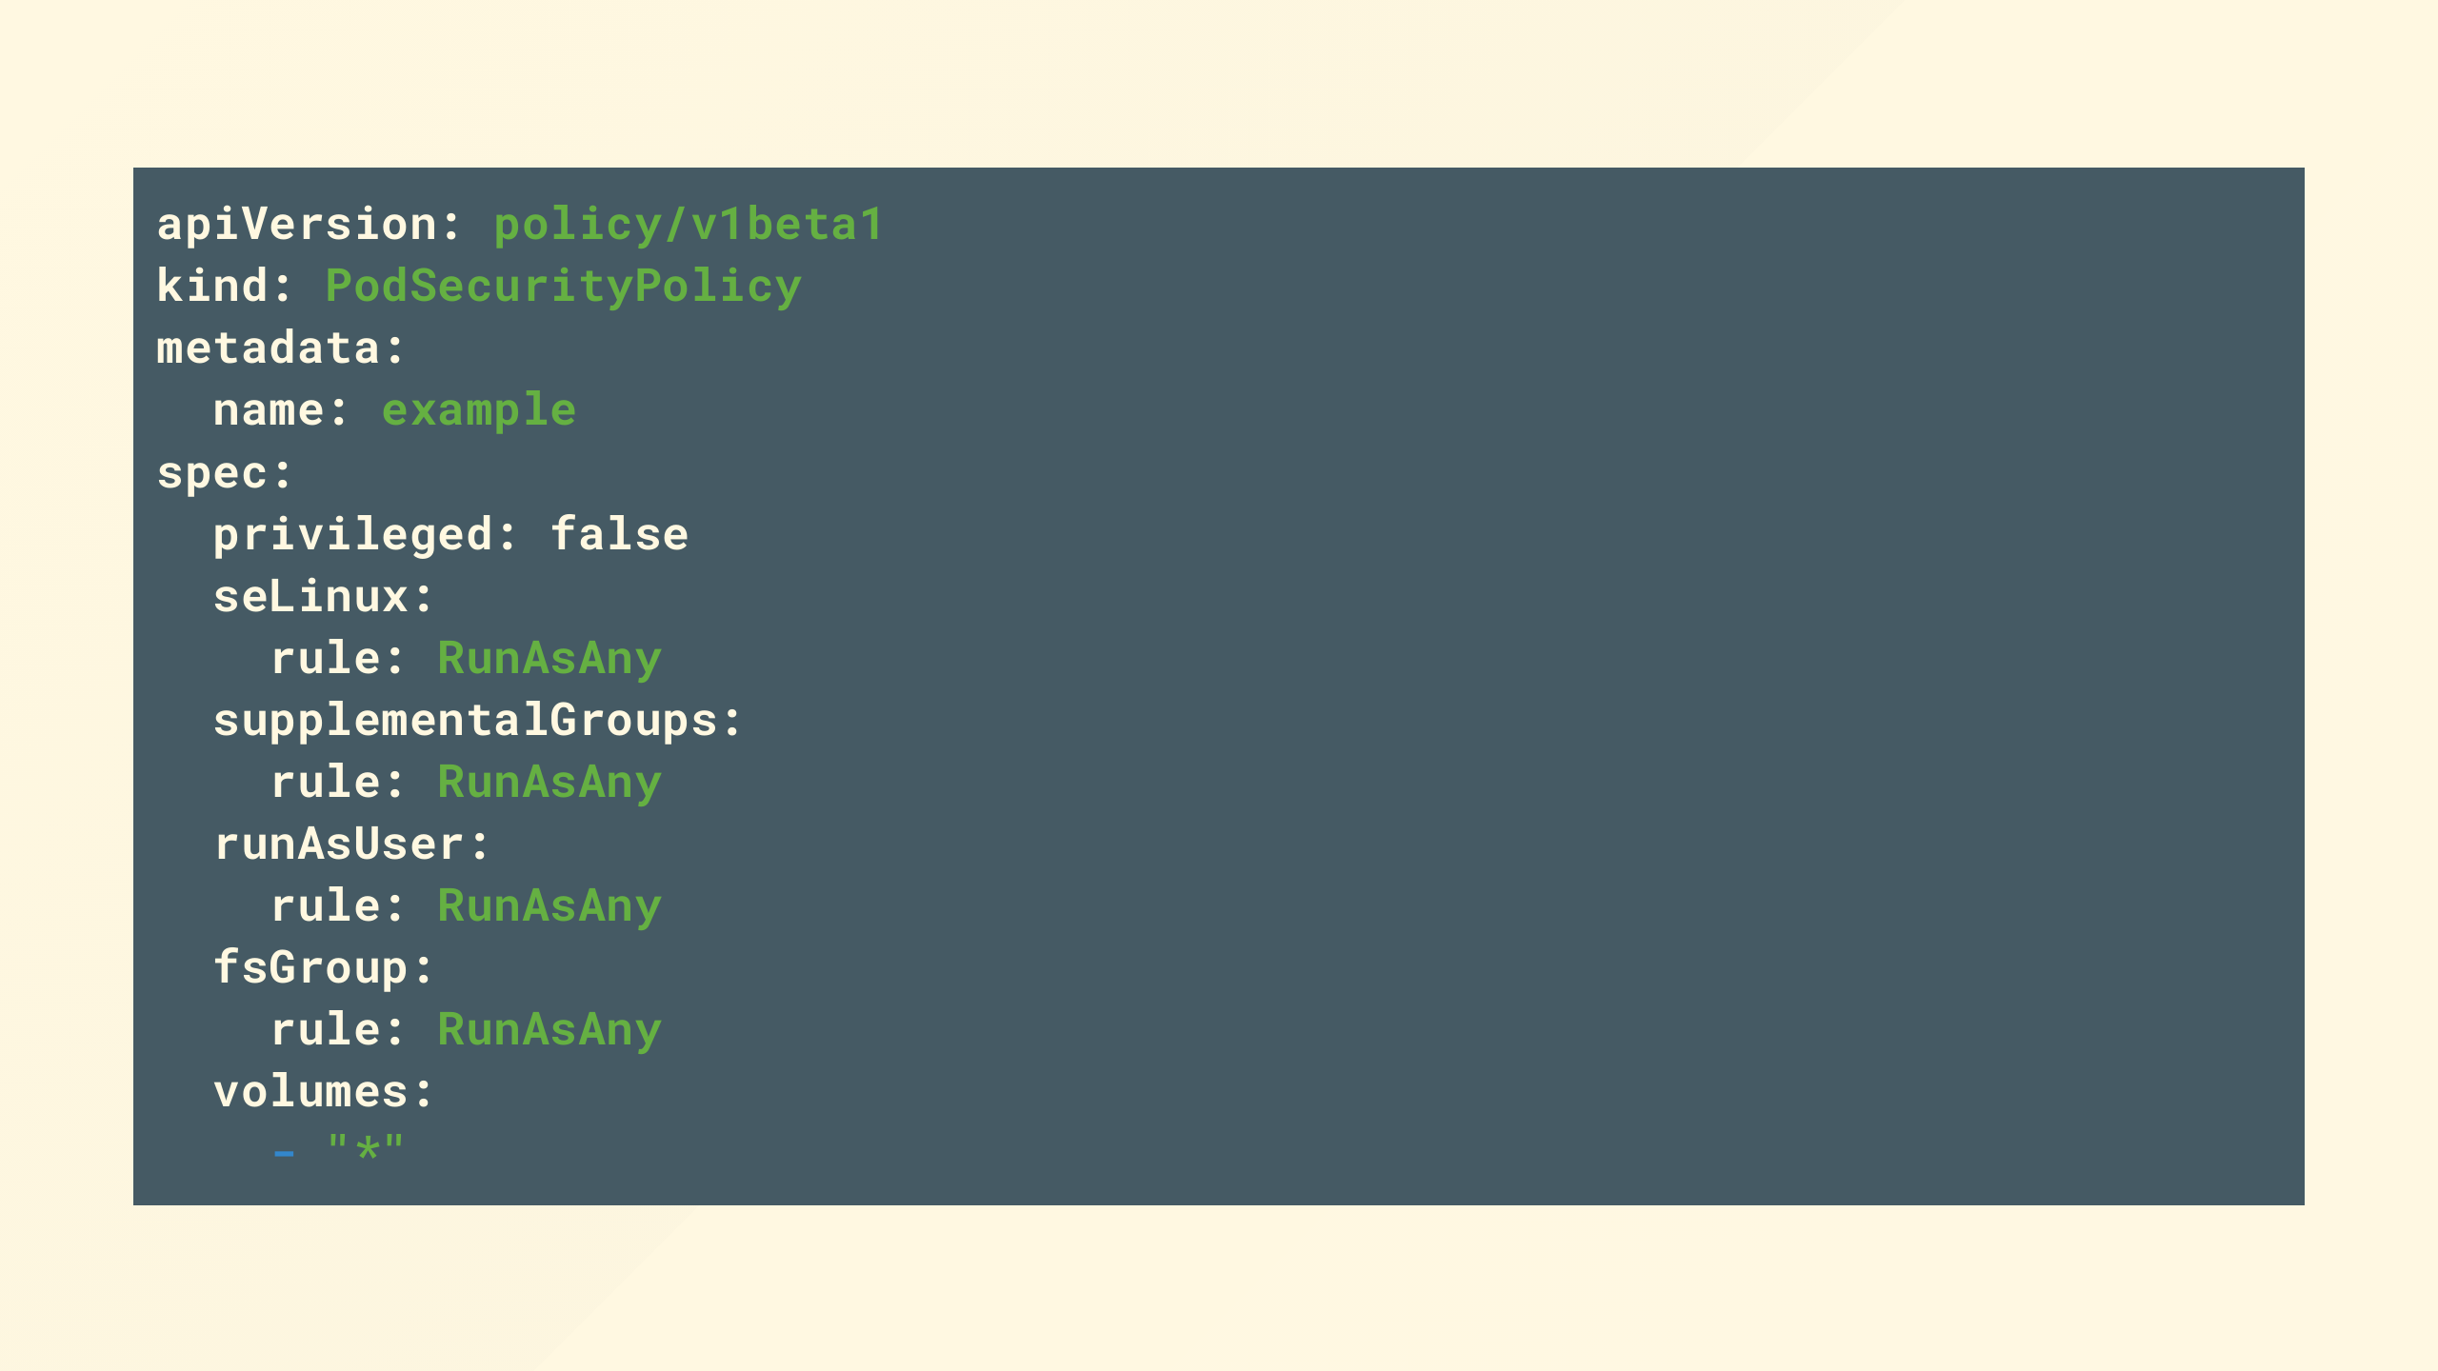
Notes:
If you've not seen one before it looks something like this [pause]

Slide 13
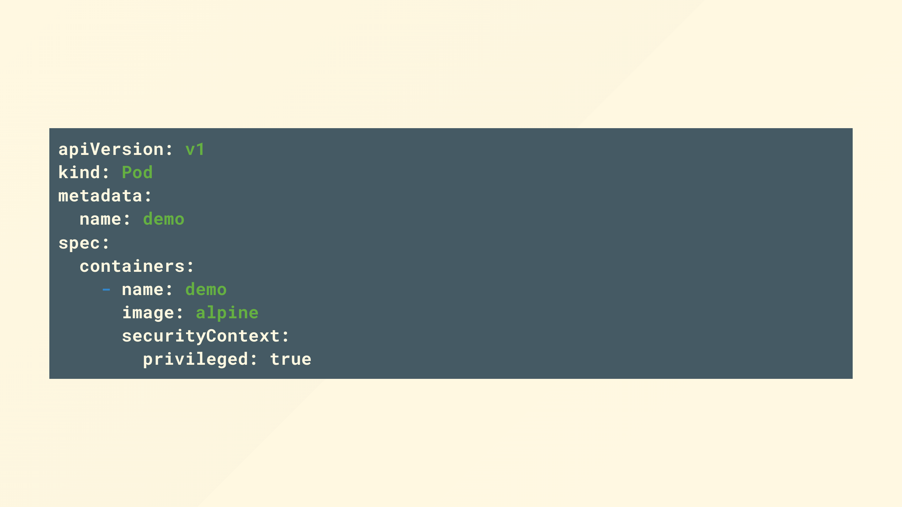
Notes:
Who can give me an example of what this container can actually do, say if a remote code exploit is found, or your code is bad?
--- ONLINE ---
Looking at this pod, can anyone give me an example of what this container can actually do, say if a remote code exploit is found, or your code is bad?
If you can get ahead of me and leave a comment in the comments.

Slide 14

Notes:
Lets have a quick explore and find out:
set +o history
kind create cluster --image=kindest/node:v1.23.0
kubectl run --image debian -ti unpriv
kubectl run --rm --privileged --image debian -ti priv
ls /dev
mkdir /foo && mount /dev/vda1 /foo
export PATH=$PATH:$(find /foo/ -type f -name kubectl | head -n 1 | sed -r 's|/[^/]+$||')
ln -s $(find /foo -type l -name kubelet-client-current.pem | sed -r 's|/[^/]+$||'| sed -r 's|/[^/]+$||') /var/lib/
export KUBECONFIG=$(find /foo/ -type f -name kubelet.conf -print -quit)
kubectl get pods -A
kubectl get nodes
---
- repartition disks
- eBPF interception of kernel wide activity including network intercept
- mount the root or any other file system which is a bad day, you've then got root on the node complete with the kubelet, which with a couple of get requests to the api server gives you admin and service account credentials on the api server.
- Put simply, game over, real fast, everything on your cluster and everything your cluster connects to is at breach.

Slide 15
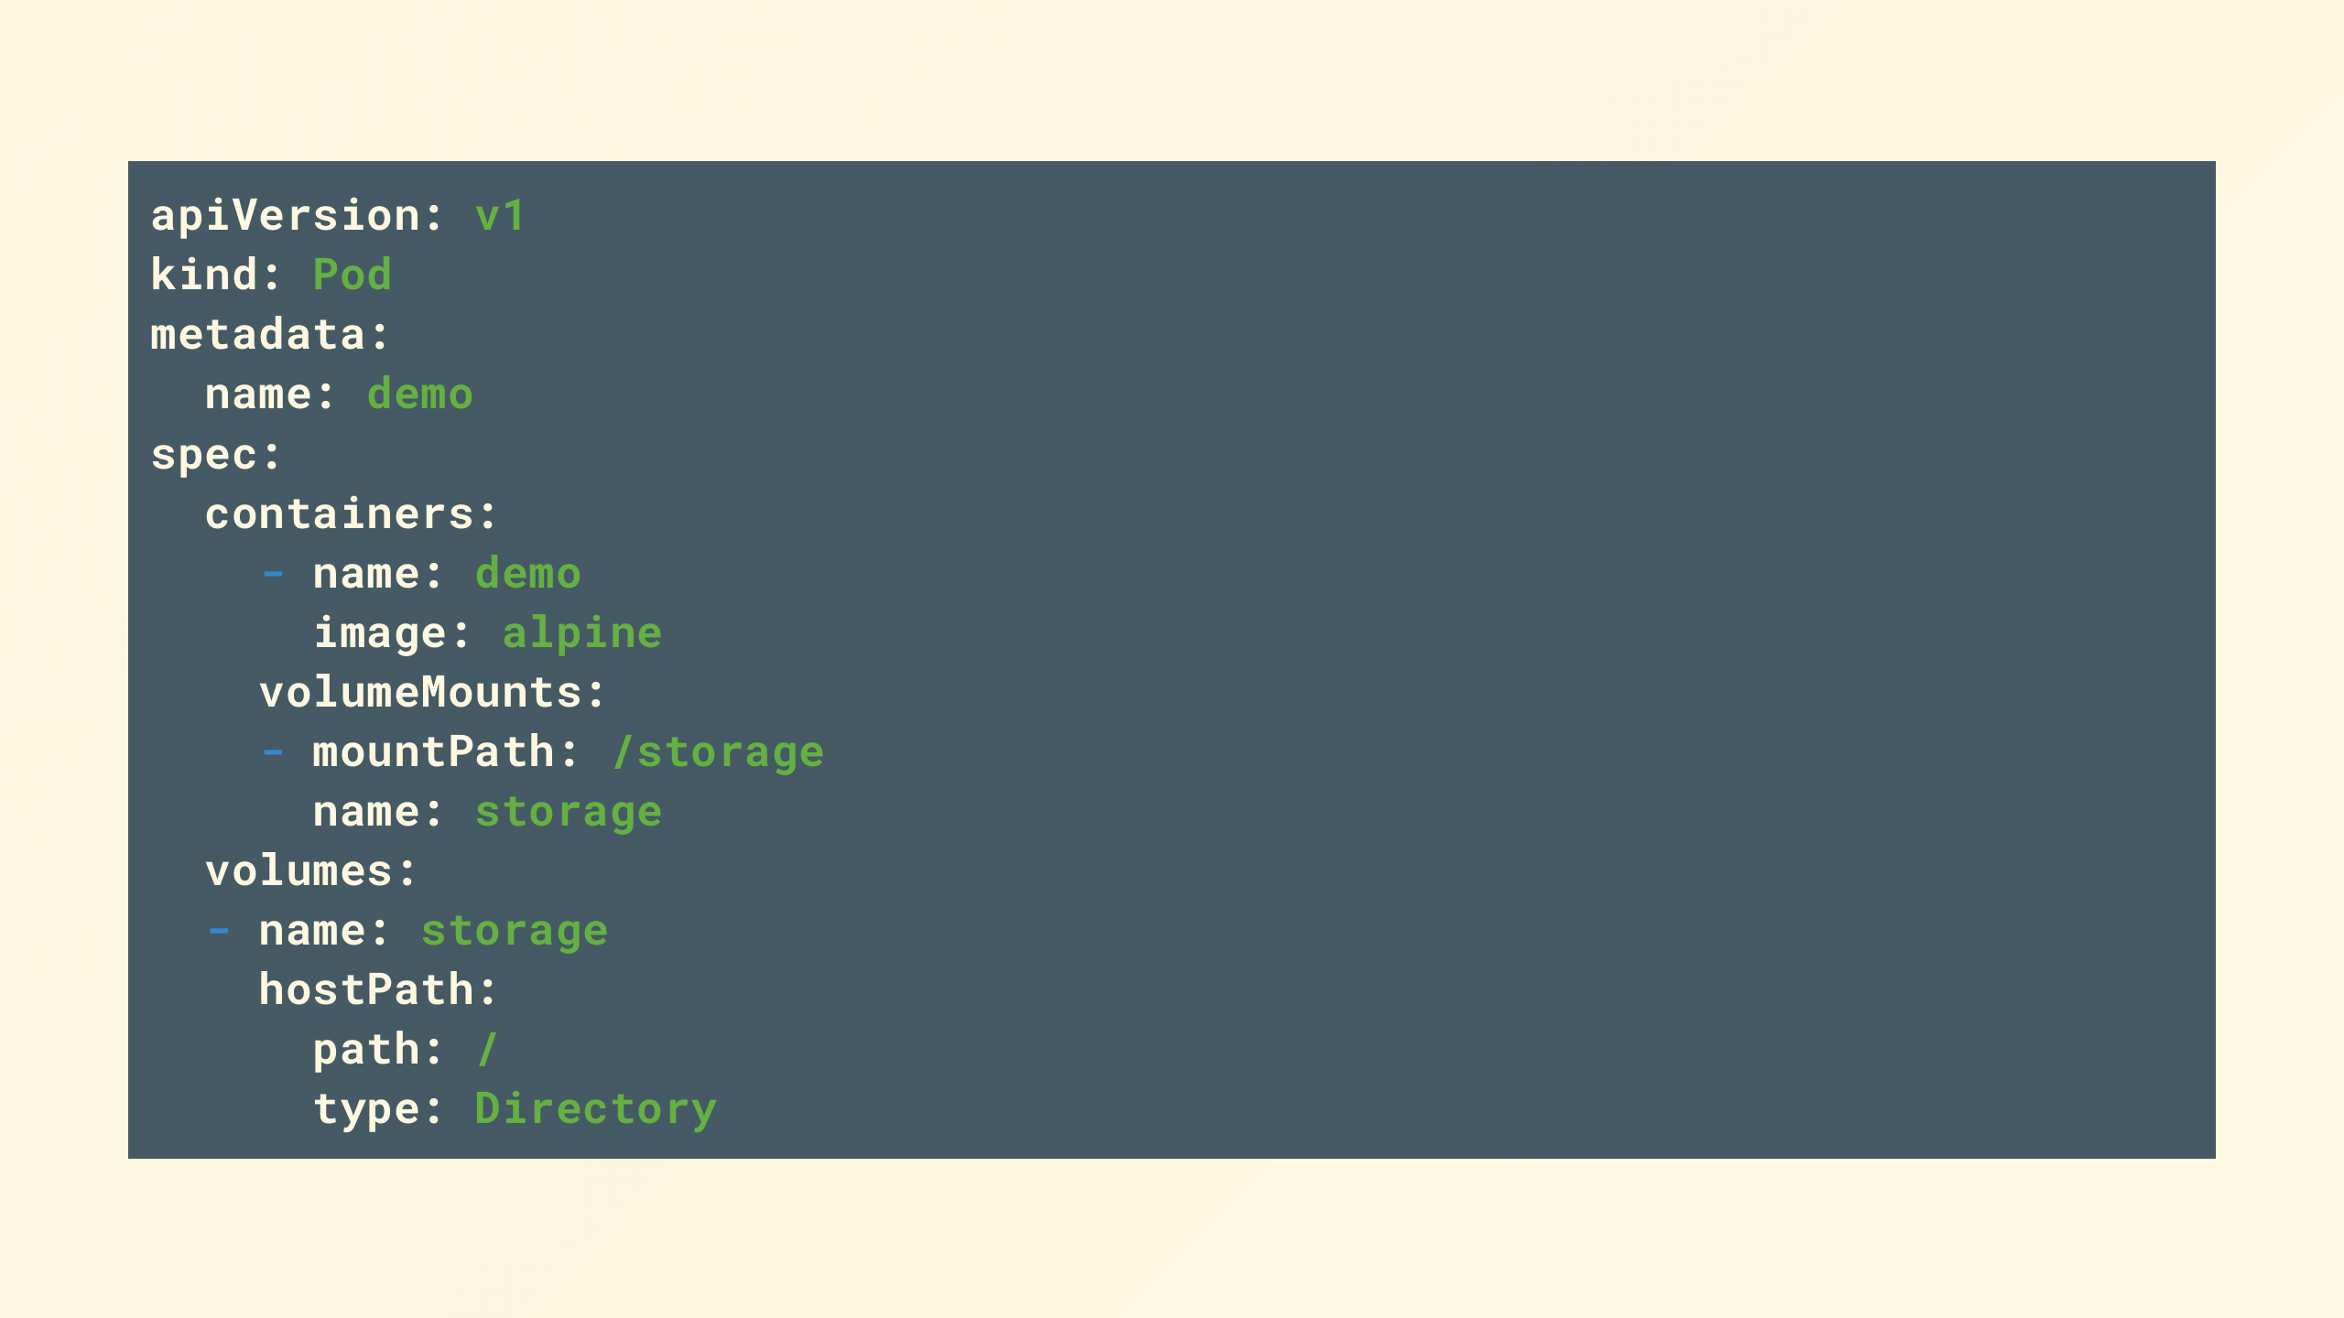
Notes:
Ok bit more obvious, again game over under the same terms as before

Slide 16
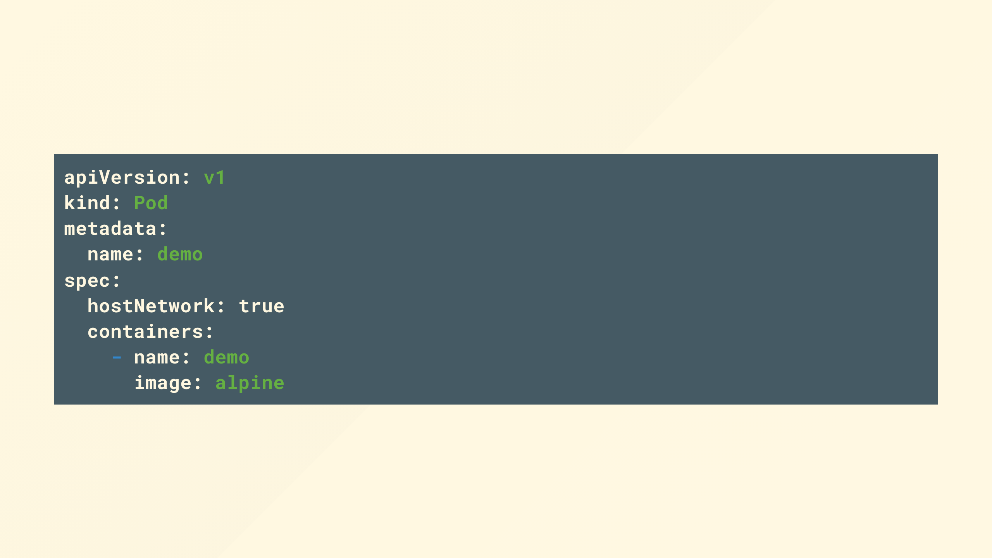
Notes:
How about this, can anyone help me out?
- masquerade as other things to the network, maybe get 443 or 80 and get traffic that was intended for cluster wide ingress
- talk to and masquerade with all sorts of local systems to the host, like X, dbus, iscsi, the container runtimes
Bit more involved but game over after you've jumped through a few hoops to get root

Slide 17

Notes:
Basically leave any one of the controls in the PSP open and you can be one bad pod away from loosing absolutely everything.

Slide 18

Notes:
So PSPs sound like a great idea right?

Slide 19

Notes:
Not so fast bucko!
Theres a whole heap of usability issues you might have encountered if you'd tried to use them in anger.

Slide 20

Notes:
The policy is based on the user that created the pod, not the workload.
If you're creating pods with CI for example that might require you to have multiple identities to authenticate to the API server with
But when was the last time you created a pod and not a deployment, statefulset or whatever else, well in that case the identity creating the pod is the service account for that controller

Slide 21

Notes:
Some of the parameters aren't simply admission controllers that accept or reject but mutating, this is not clear

Slide 22

Notes:
The of order of evaluation can be confusing and unpredictable with multiple policies with overlapping scope especially if some are mutating

Slide 23

Notes:
Only applies to new pods, not to anything already running in the cluster, which means you might not know when you update the policy that it breaks your production apps, that is until they happen to try to reschedule and fail, maybe on a scale event or node fail.

Slide 24

Notes:
So what are the alternatives, what should we do, the clock is ticking, august is only another lockdown or two away!

Slide 25
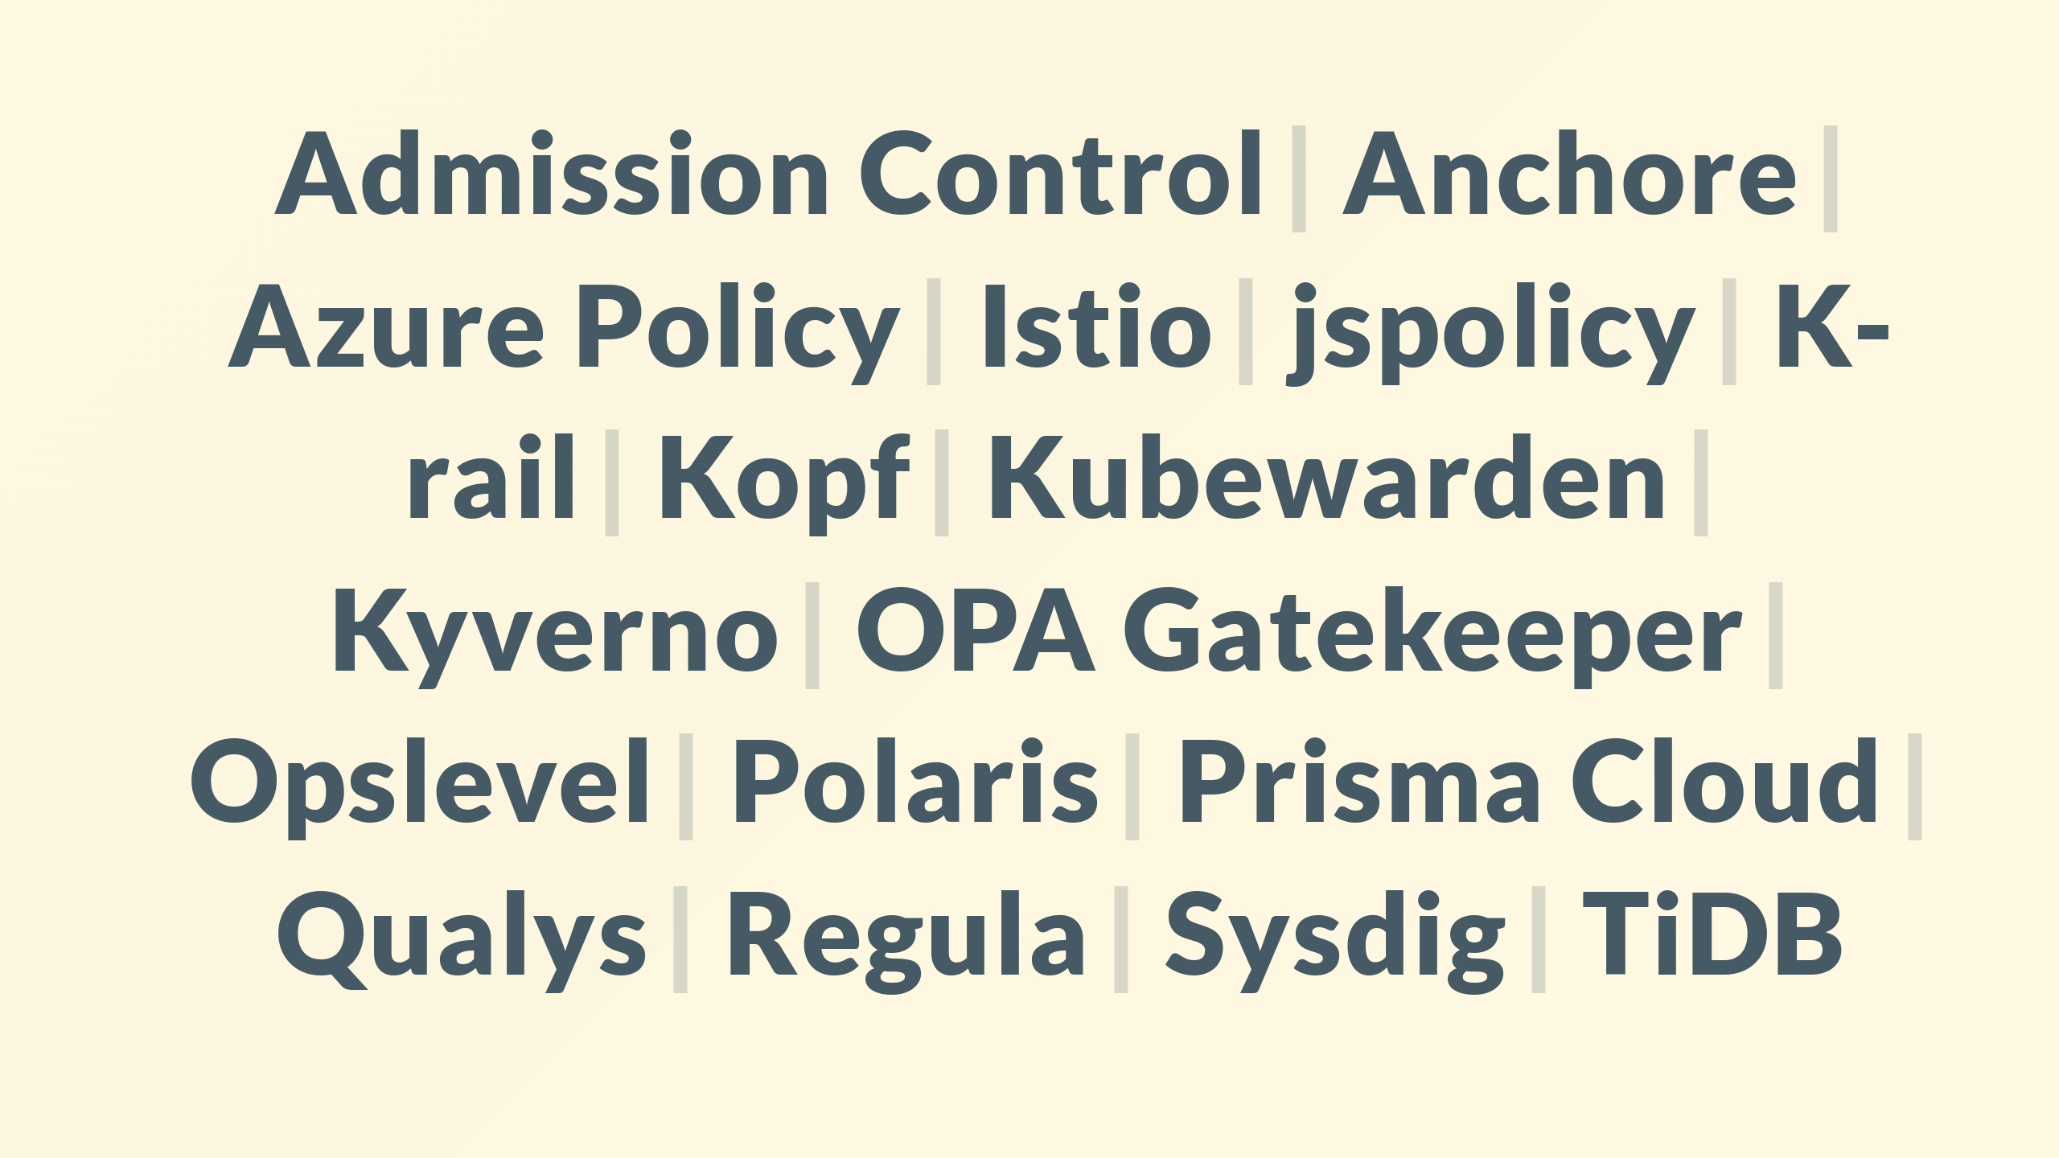
Notes:
Theres a fair amount of choice, here's just a few, you can of course write your own, it is just a webhook.

Slide 26
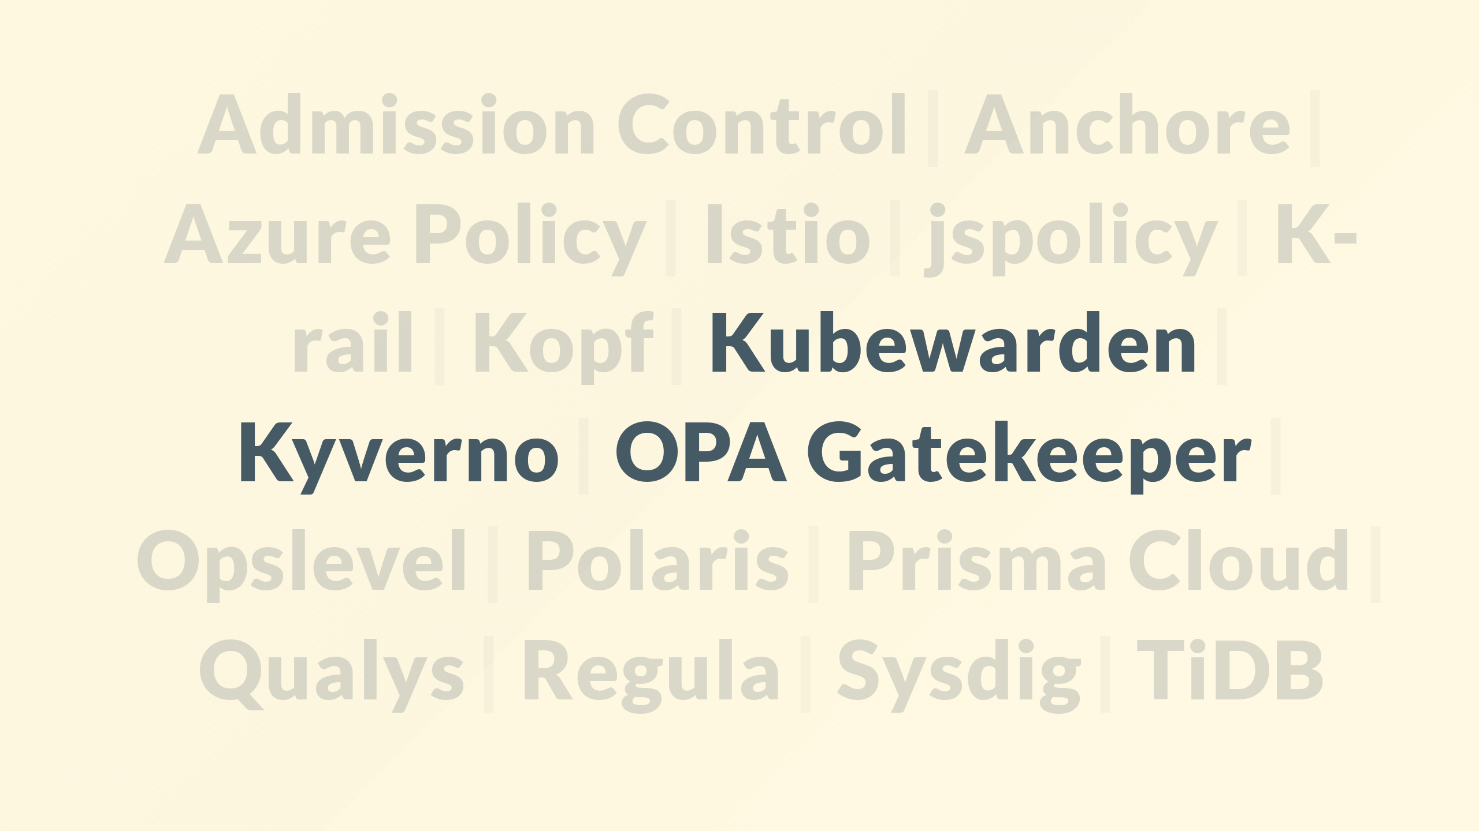
Notes:
I'm going to focus on a few, because with a little help they provide a straight forward-ish migration journey

Slide 27
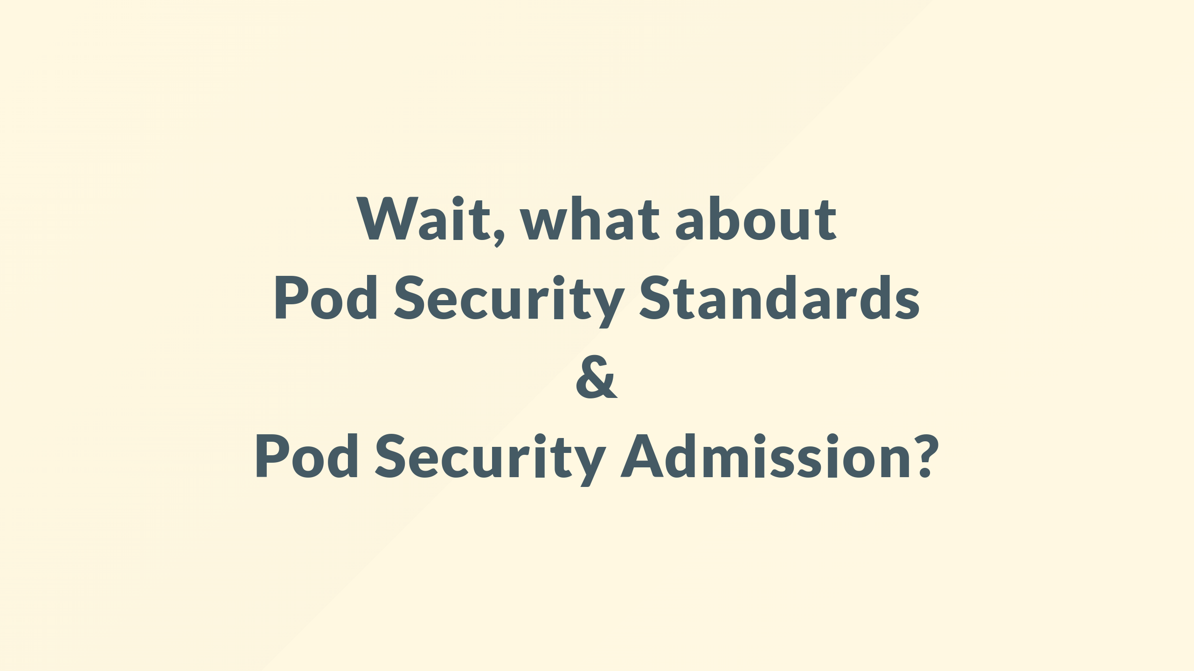
Notes:
There is an 'in tree' answer i.e. built in to Kubernetes, so why am I not pointing at that, grabbing my drink and walk off?
Pod Security Standards are most easily thought of as three rigidly defined predefined Pod Security Policies

Slide 28
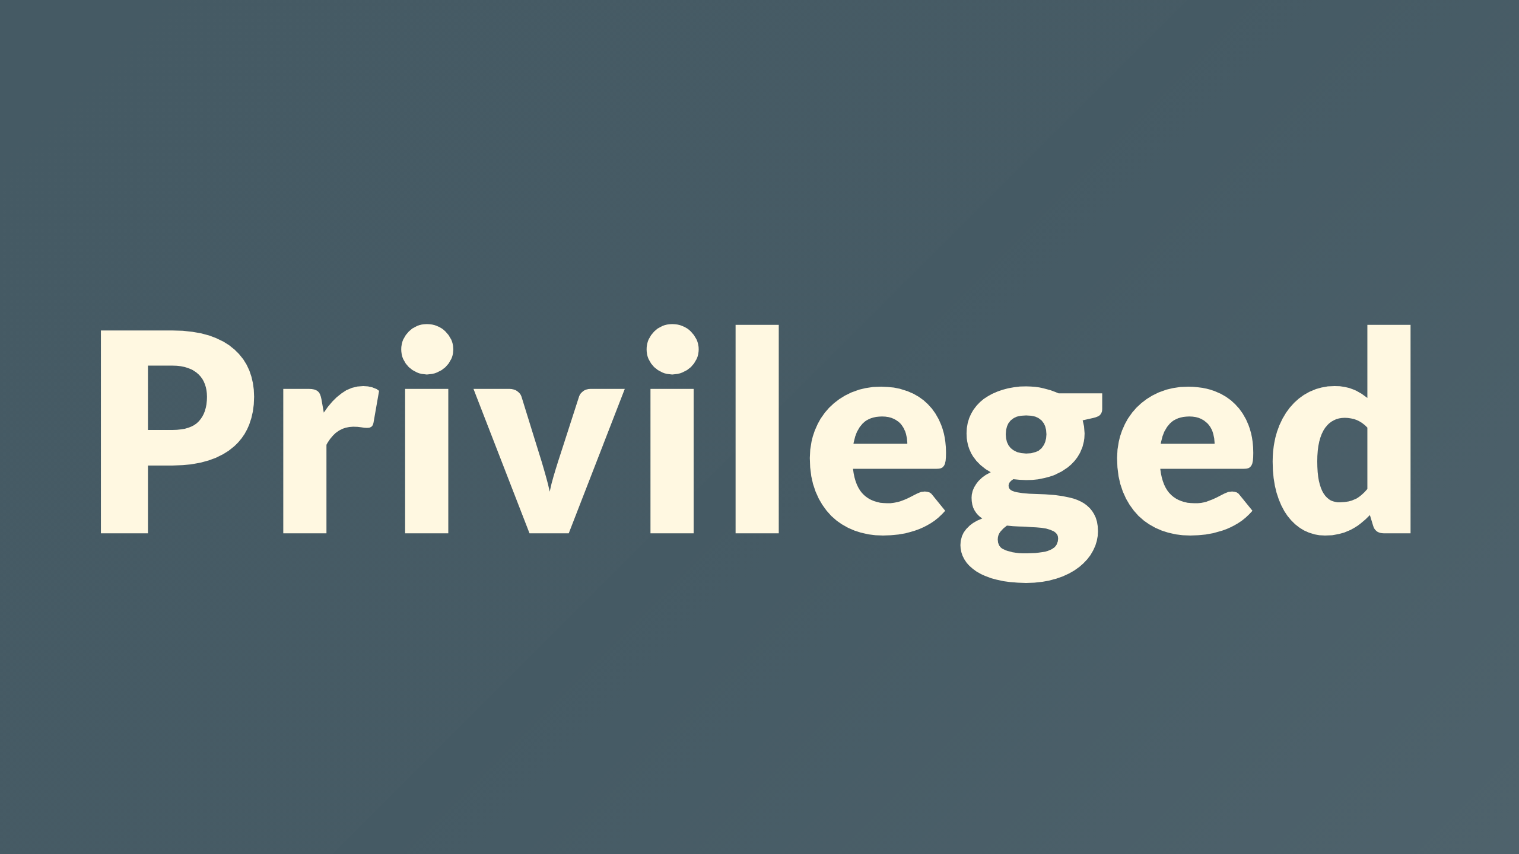
Notes:
Those are privileged, basically anything goes, and is the same as not defining a policy

Slide 29
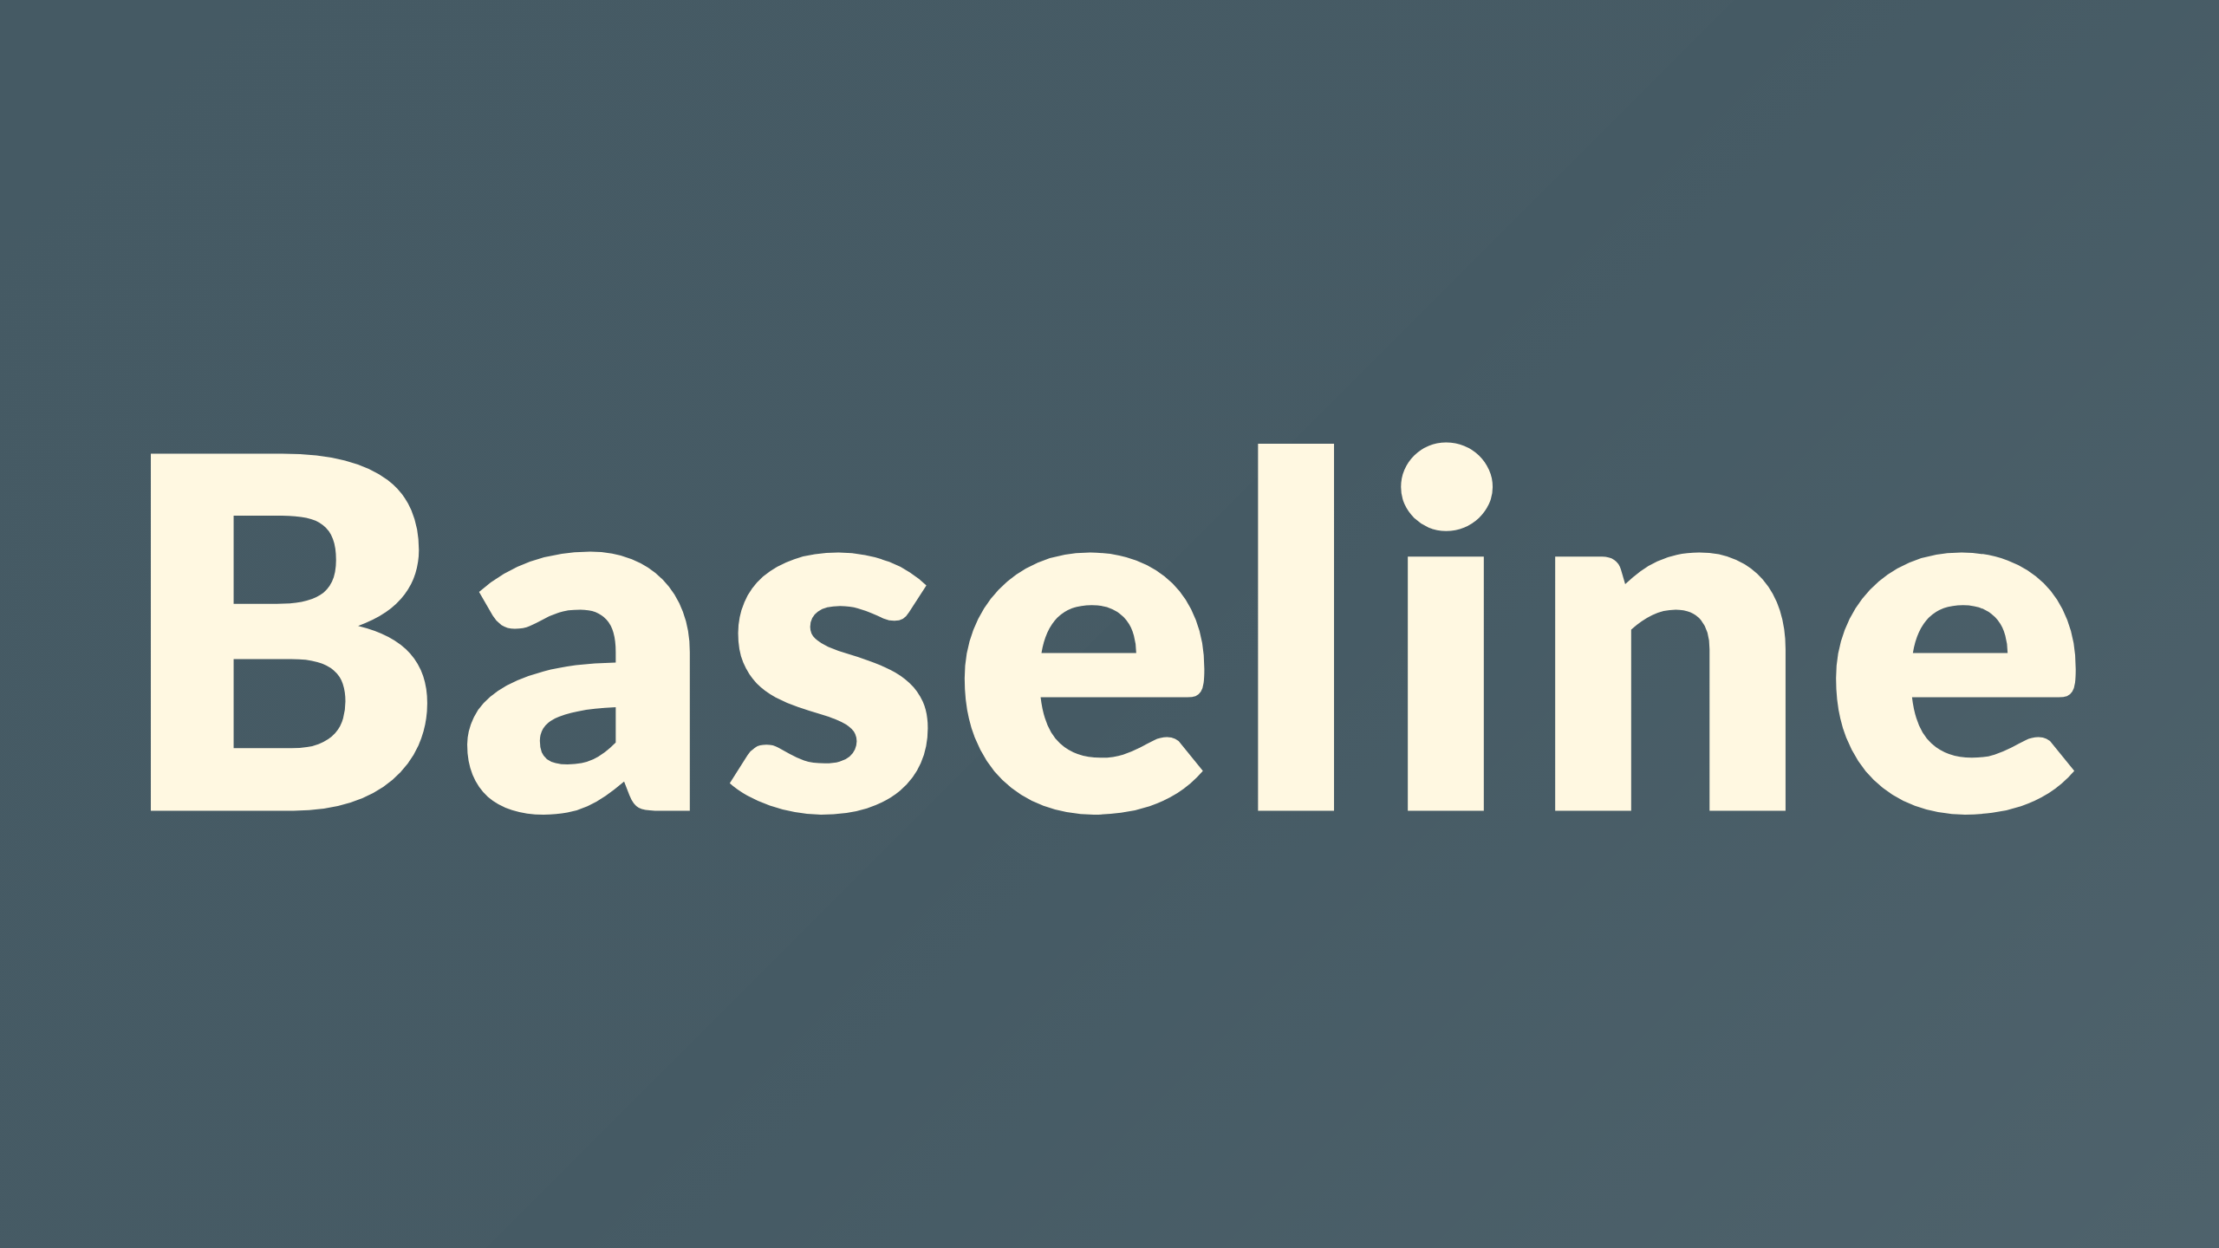
Notes:
Baseline, middle ground, stops some of the super obvious stuff, most your stuff should run at this tier without change

Slide 30
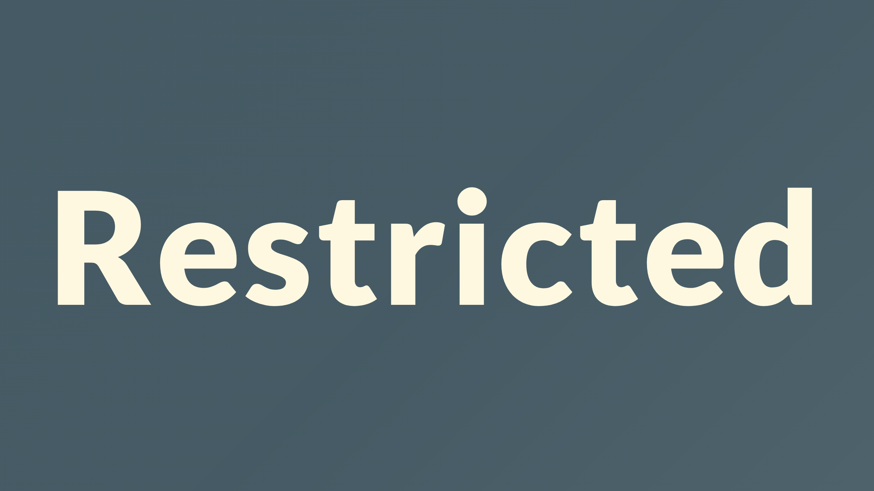
Notes:
Restricted, The most restrictive policy, stops most things.
You should aspire to run stuff here, but realistically you'll probably have issues

Slide 31

Notes:
Rigid universal policies sounds great, its super easy to communicate these between teams, test against them and no confusion when deploying between different clusters, happy days right?

Slide 32

Notes:
Sadly not, for a few reasons
Ideally you'd run all your workload at restricted, but inevitably there'll be some things that can't quite fit that
Well restrictions are applied on a namespace level
And theres no way to grant fine grained exemptions, so your only option is to take a massive step down, and not for just the container but whole namespace

Slide 33

Notes:
Oh, and its applied with a label on the namespace, not even an annotation
WTF guys?!
So what's it good for, well the only thing I can see this as possibly good for is if you're a Software Vendor building products to run on Kubernetes.

Slide 34

Notes:
And if you're mad enough to be in that business

Slide 35

Notes:
Then if you can make your product run in restricted then it'll give you a good head start for whatever unique configuration your customers have implemented and demonstrate that you have considered the security implications of your product

Slide 36

Notes:
Ok so how do we migrate all our old legacy PSPs to something new
Well there is unfortunately no simple like-for-like mapping, PodSecurityPolicy and any of the replacements behave slightly differently, and for good reason too.
If you’ve been using PodSecurityPolicy for a while, you’ve likely developed some quite complex rules which have become entangled with the usability issues, so I would encourage you to take the opportunity to refactor and simplify over trying to continue what you’ve always done.
That said, there has been some work to ease the transition by reproducing the key capabilities and even calling them the same things in some cases.

Slide 37

Notes:
The short answer is...

Slide 38

Notes:
use a whizz-bang-super-duper tool that I made

Slide 39
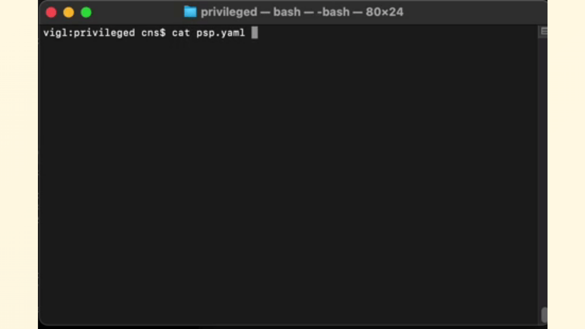
Notes:
Simply provide your existing PSP and take your pick of policy engine from Kyverno, Kubewarden, or Gatekeeper.

Slide 40
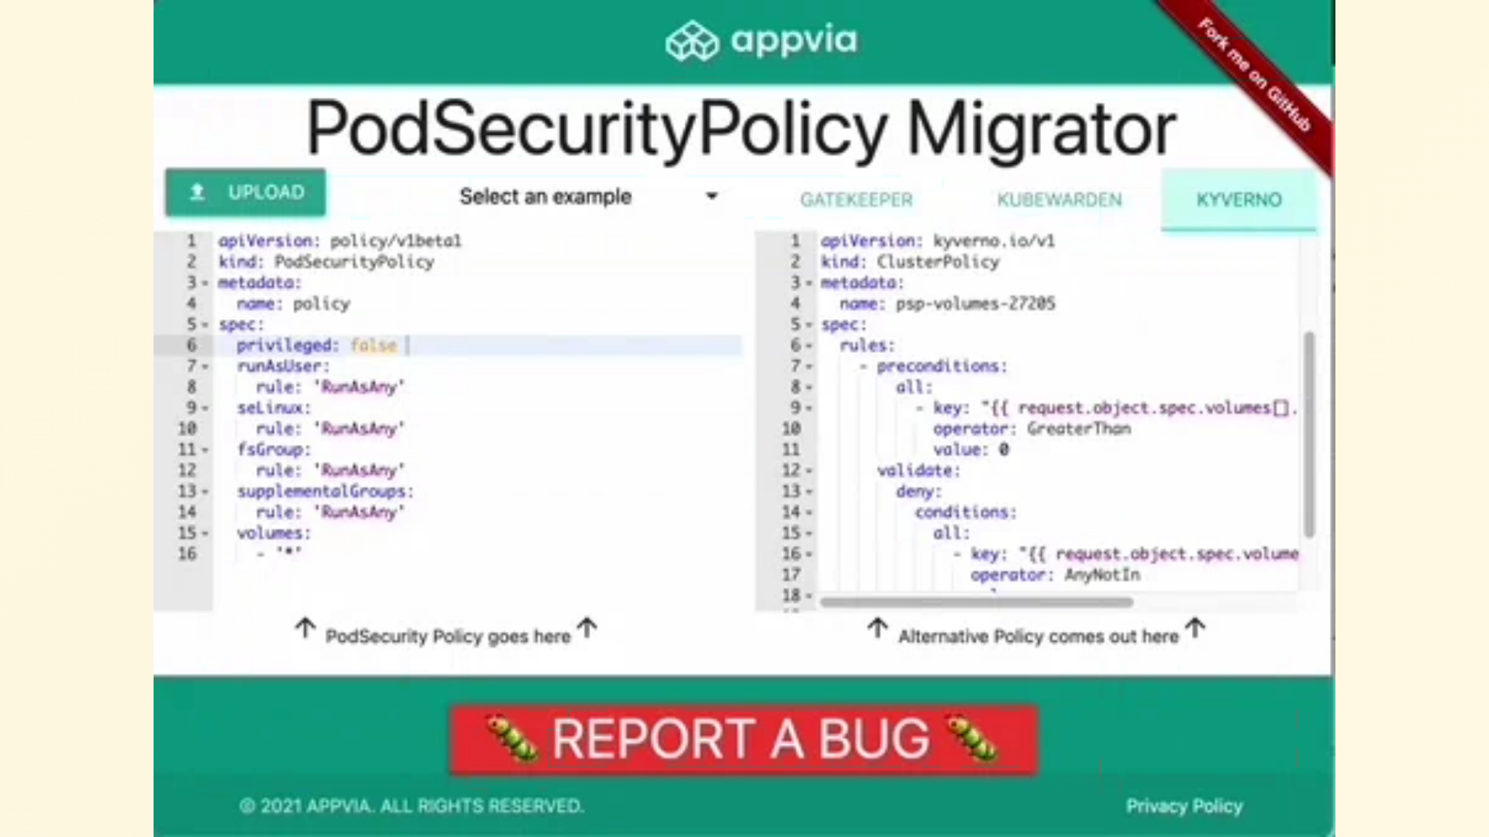
Notes:
Or just paste it into our simple web app and let your browser do the work

Slide 41

Notes:
Live demo time!

Slide 42
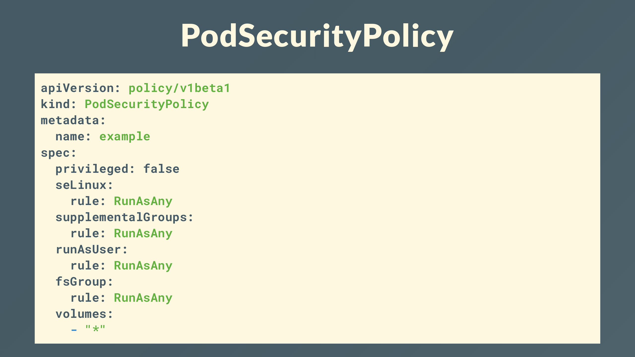
Notes:
Your PSP just converted seamlessly to

Slide 43
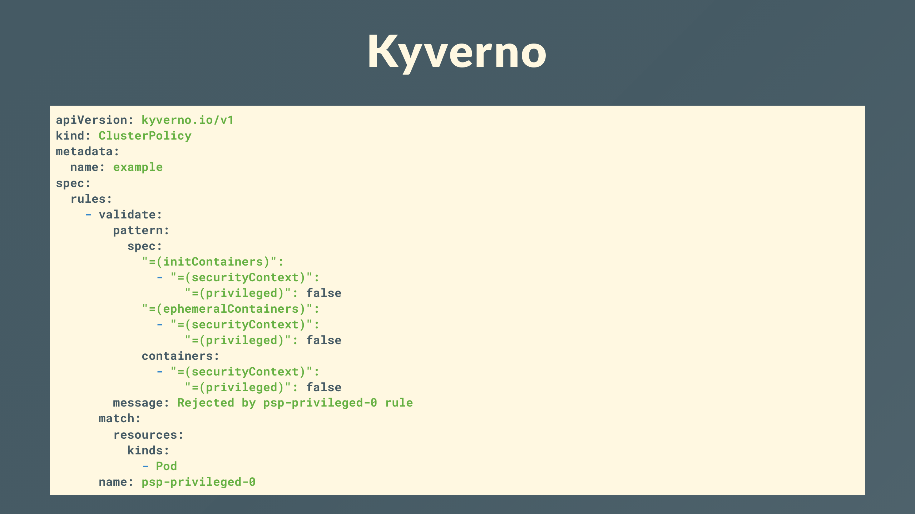
Notes:
Kyverno . .

Slide 44
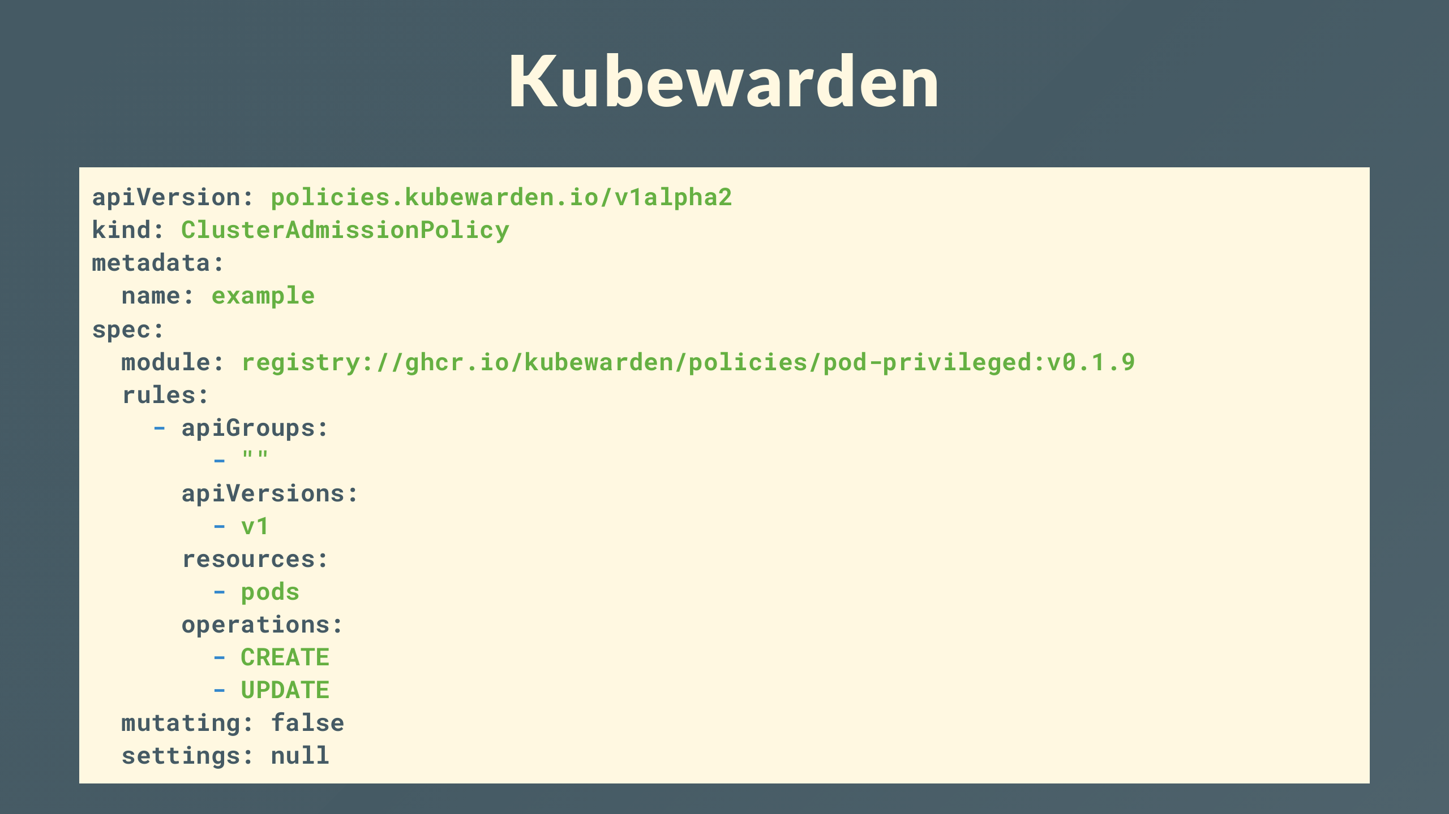
Notes:
Kubewarden . .

Slide 45
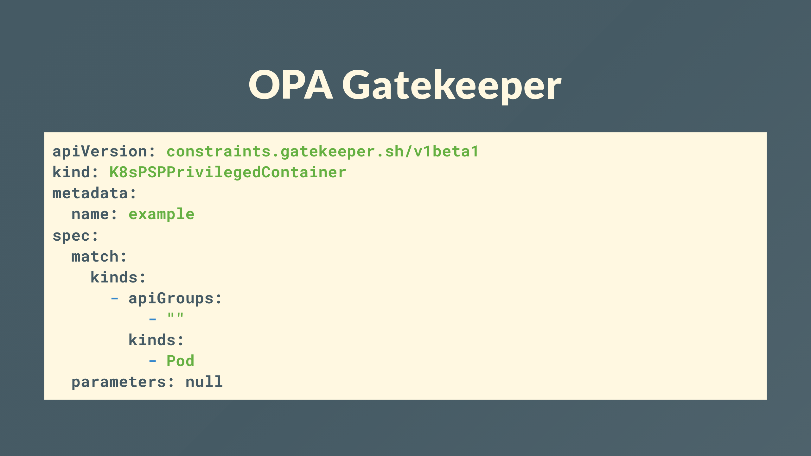
Notes:
or Gatekeeper . .

Slide 46

Notes:
That was easy

Slide 47
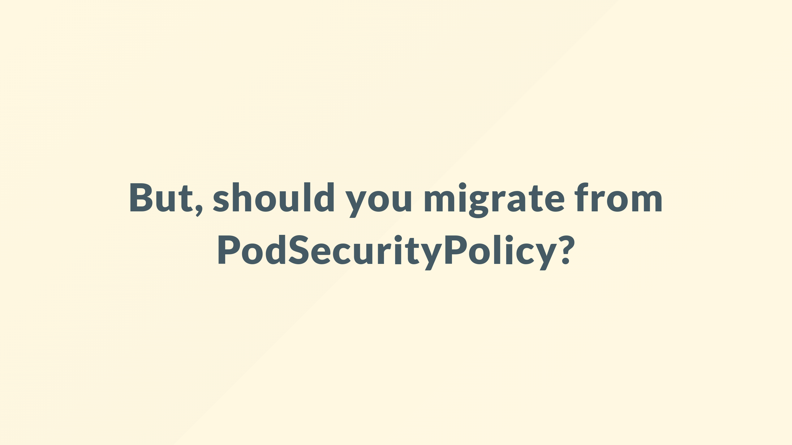
Notes:
But should you?
Don't be fooled, just because I wrote a tool to help does not mean I think any of this is even remotely a good idea for the vast majority of use cases.
But it got your attention.

Slide 48

Notes:
Using a cluster enforced policy does not guaranty any real security, you may well find as a cure, its worse than the disease.

Slide 49
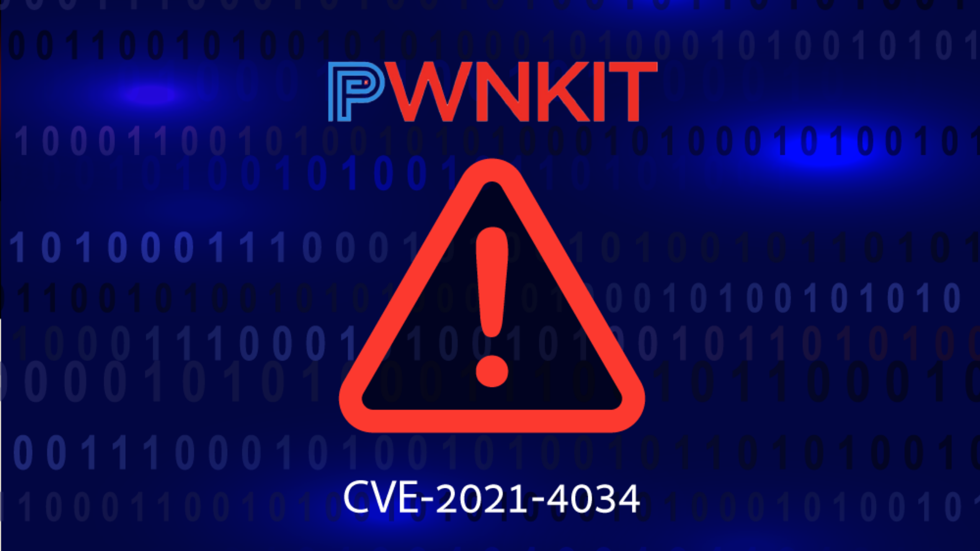
Notes:
We're seeing more and more vulnerabilities and in the wild attacks that cluster enforced policy would not protect against.

Slide 50
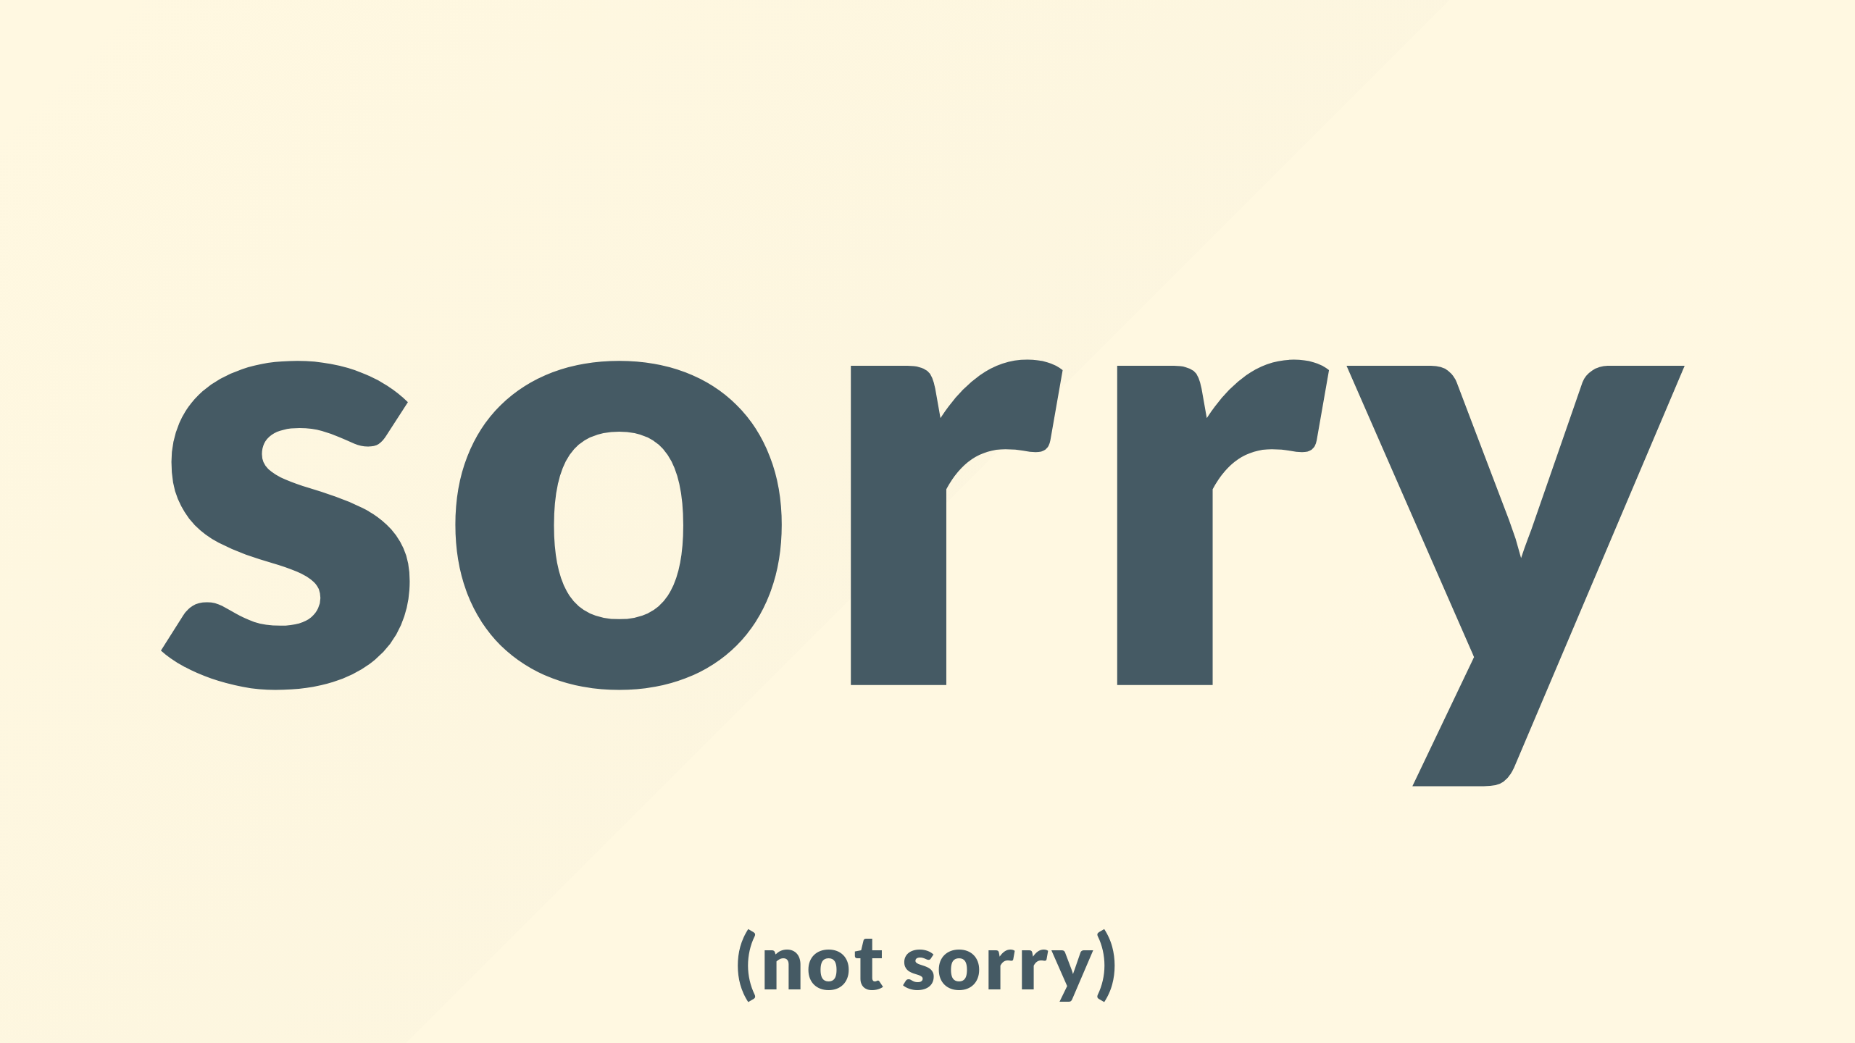
Notes:
If you've been keeping up you'll have realized I've taken you on a roller coaster of explaining a problem with security in Kubernetes, a solution of PSP, another problem of PSPs going away, another solution of a tool that I've built and yet another problem that undermines everything I've just told you.

Slide 51

Notes:
The good news is there are answers, they are simple but not easy

Slide 52
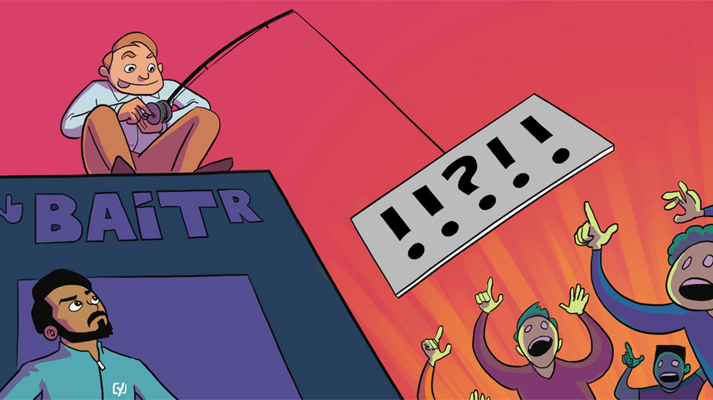
Notes:
but I'm out of time, so you'll have to come back and find out in my next talk

Slide 53

Notes:
As a sign of good faith though

Slide 54
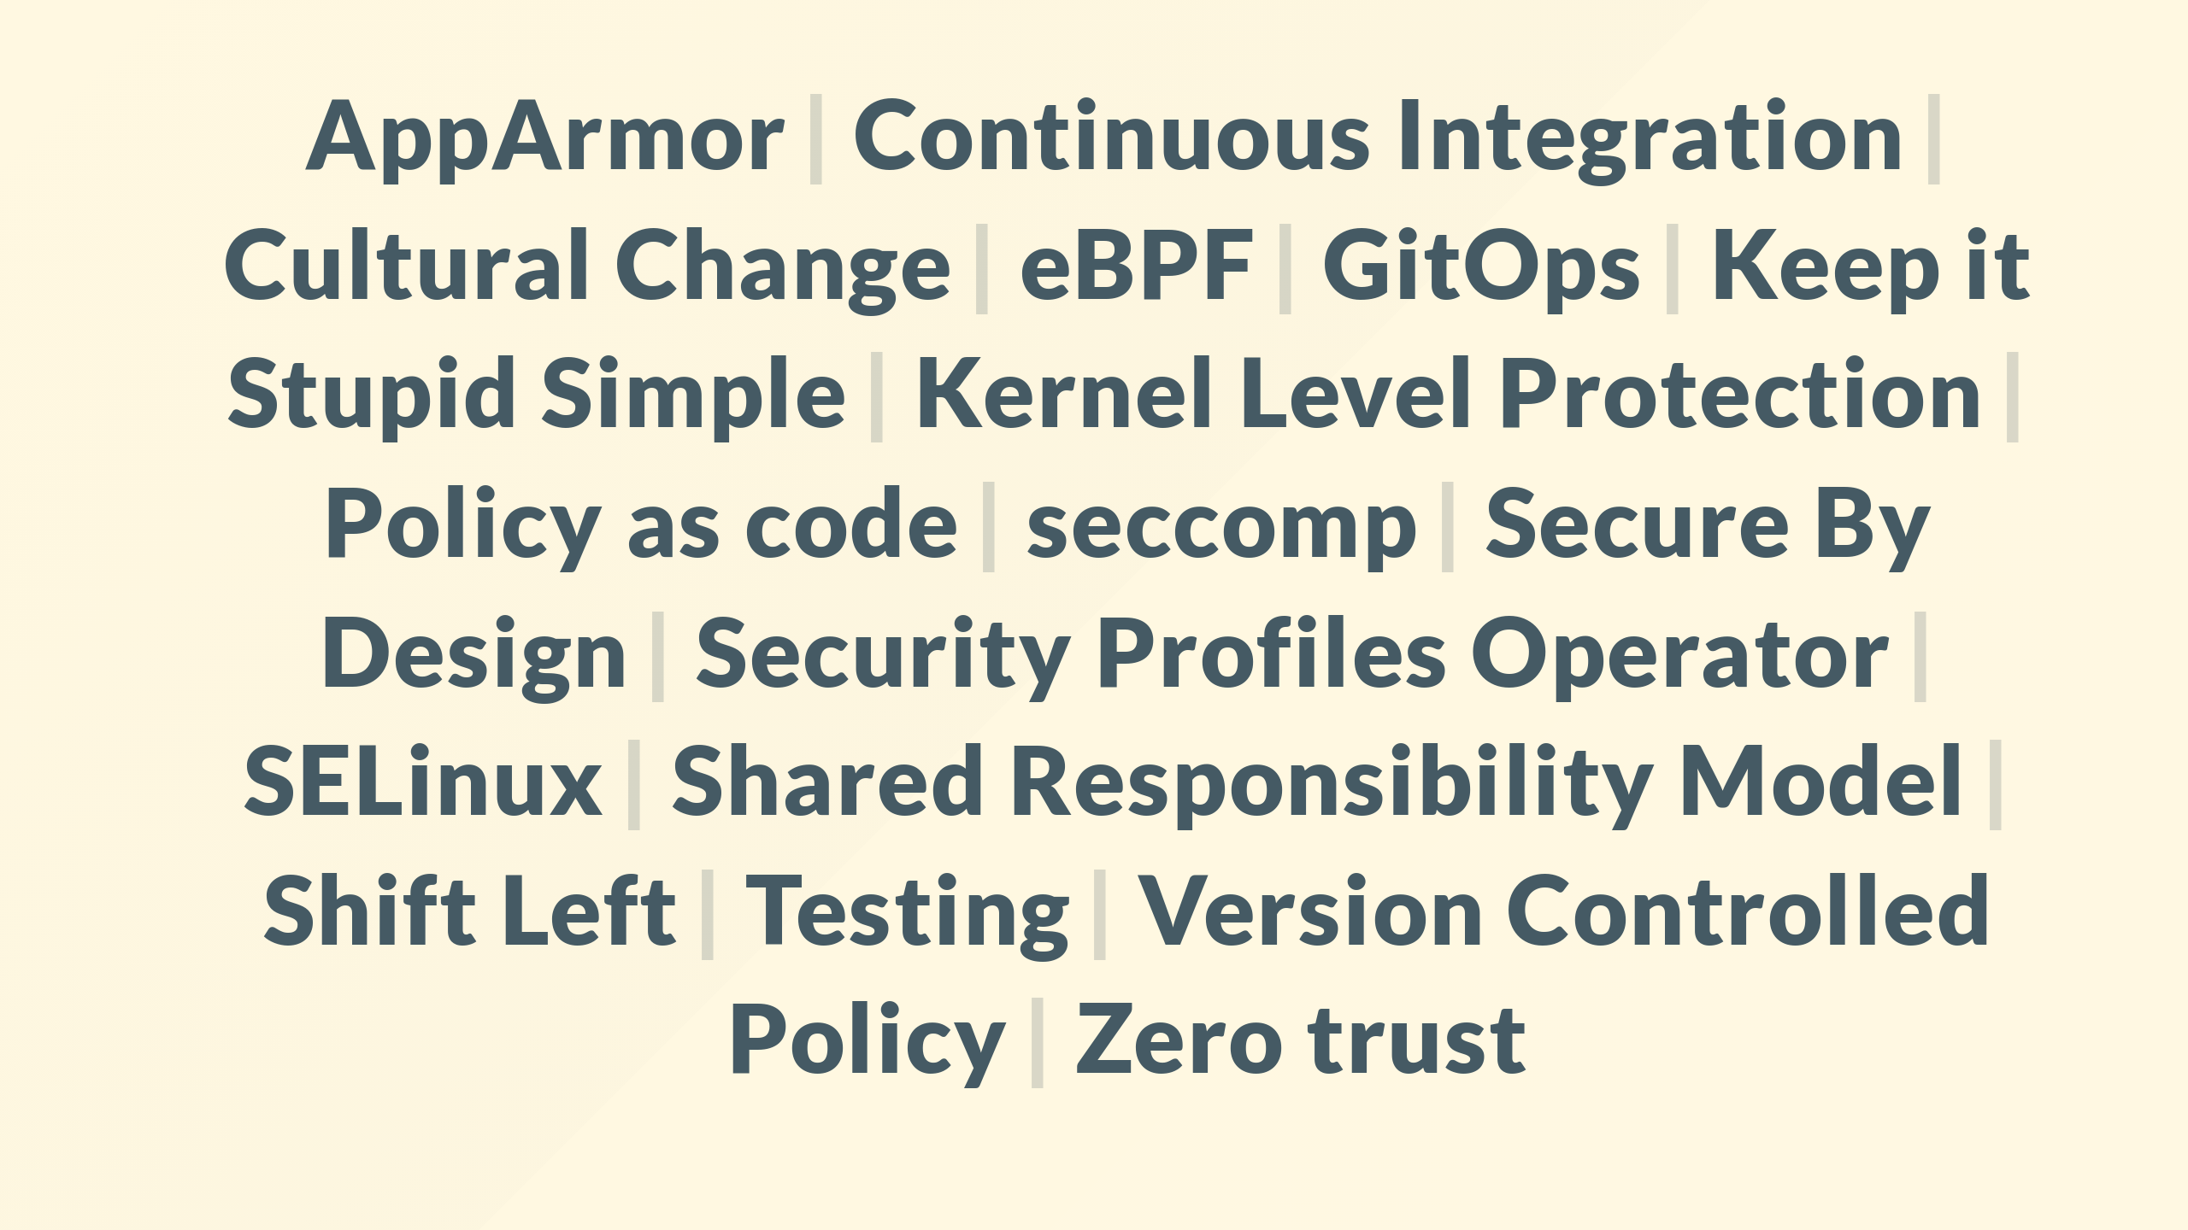
Notes:
You can expect a scenic walk through buzzwords like these and I'm excited to be able to share some hard but simple solutions that can provide a robust level of coverage and also advice on how to tackle the cultural change that needs to go hand in hand with the tech.

Slide 55
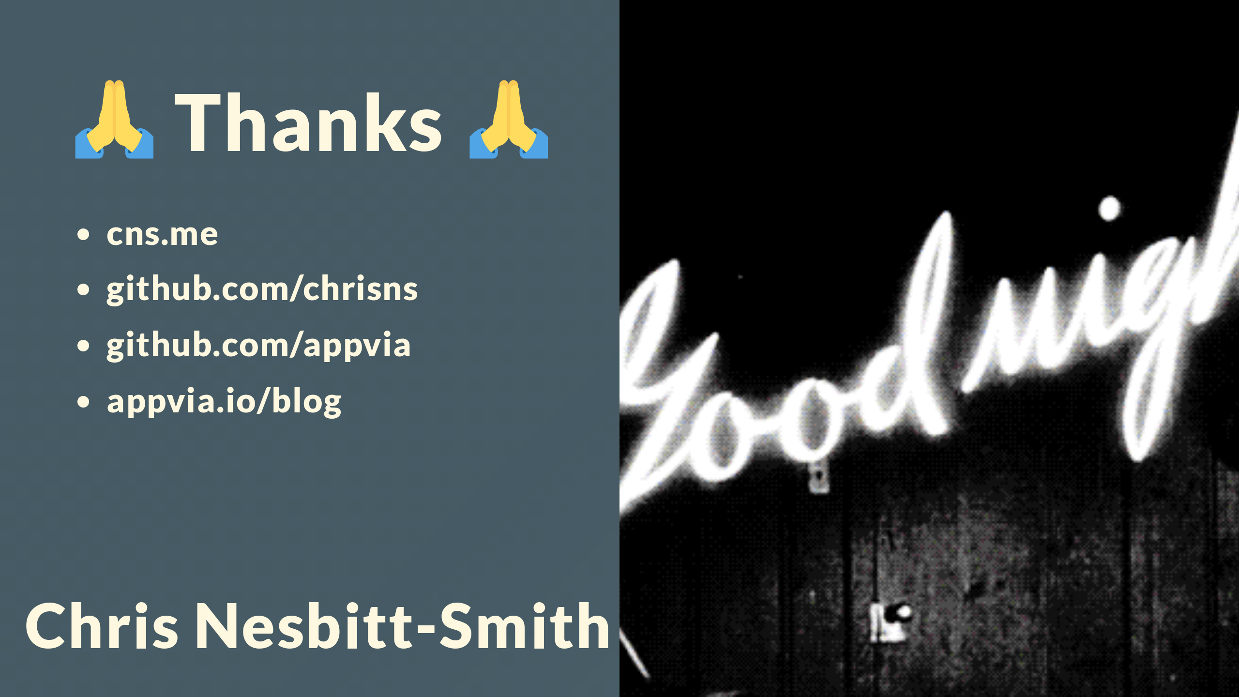
Notes:
Thanks for your time, hopefully this has been interesting if a tease.
Please do follow me on LinkedIn, Twitter, Github and you can be assured there'll be no spam since I'm awful at self promotion especially on social media. cns.me just points at my linkedin
The original content for this talk and some of the solutions I've alluded to including how to do Policy as Versioned Code are on the appvia.io blog.
Questions are very welcome on this or anything else, If I miss you or you're not watching this live I'll try and keep an eye on the comments, or find me on the DevSecCon discord or LinkedIn.

