Slide 1
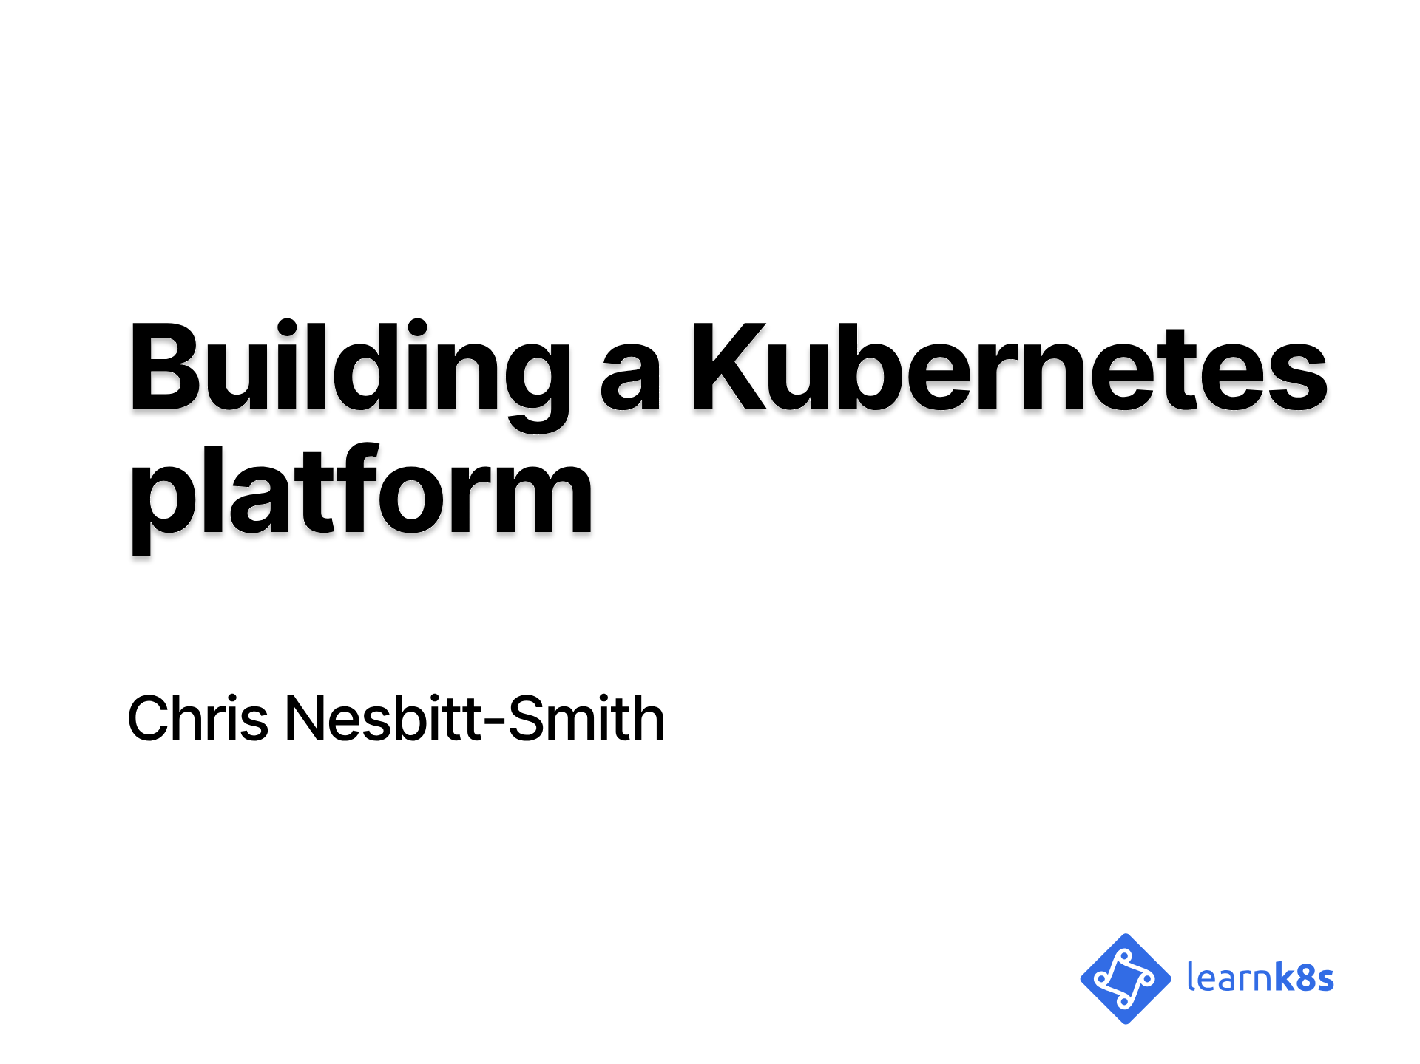
Notes:
hello!

Slide 2
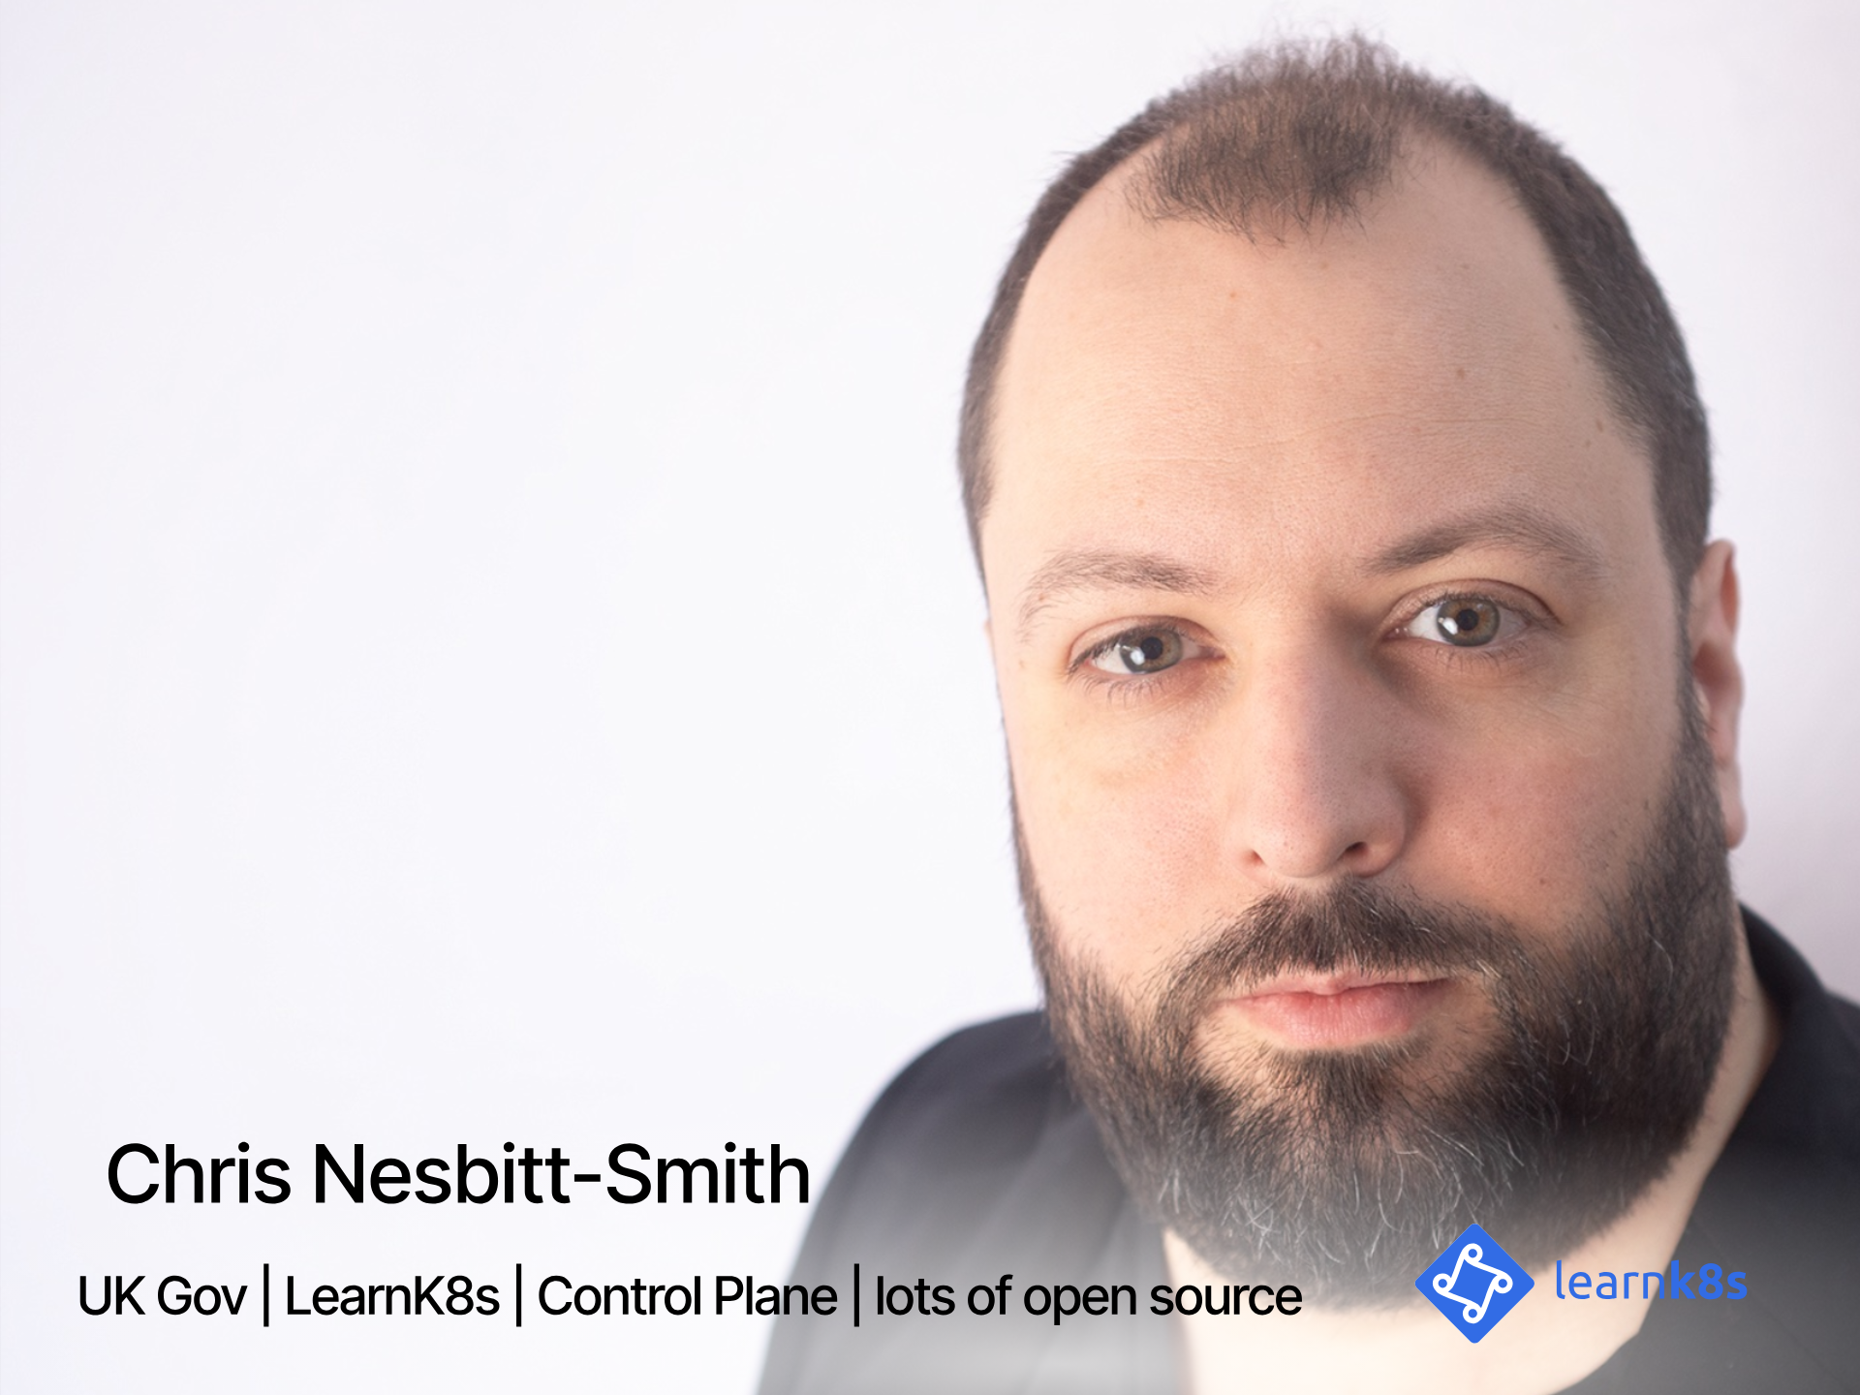
Notes:
So, to kick things off my name is Chris Nesbitt-Smith, I'm based in London and currently work with some well known brands like learnk8s, control plane, and various bits of UK Government I'm also a tinkerer of open source stuff.
I've using and abusing Kubernetes in production since it was 0.4, believe me when I say its been a journey!
I've definitely got the war wounds to show for it.
We should have time for questions and your best heckles at the end, but if we run out of time or you're not watching this live, then please find me on LinkedIn or in the loft labs slack.
Right lets get going

Slide 3
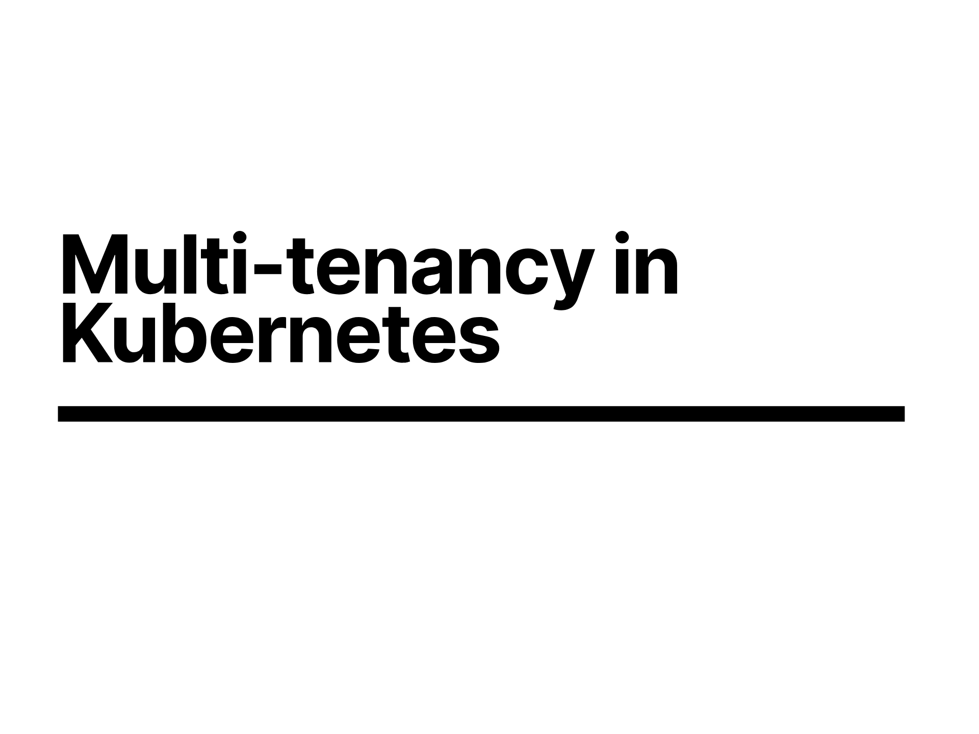
Notes:
We all came here in search of minimizing wasted overheads in our compute estate, right?
Well, lets go with that, and pretend it wasn't just an exercise in technical naval gazing and CV enhancement

Slide 4
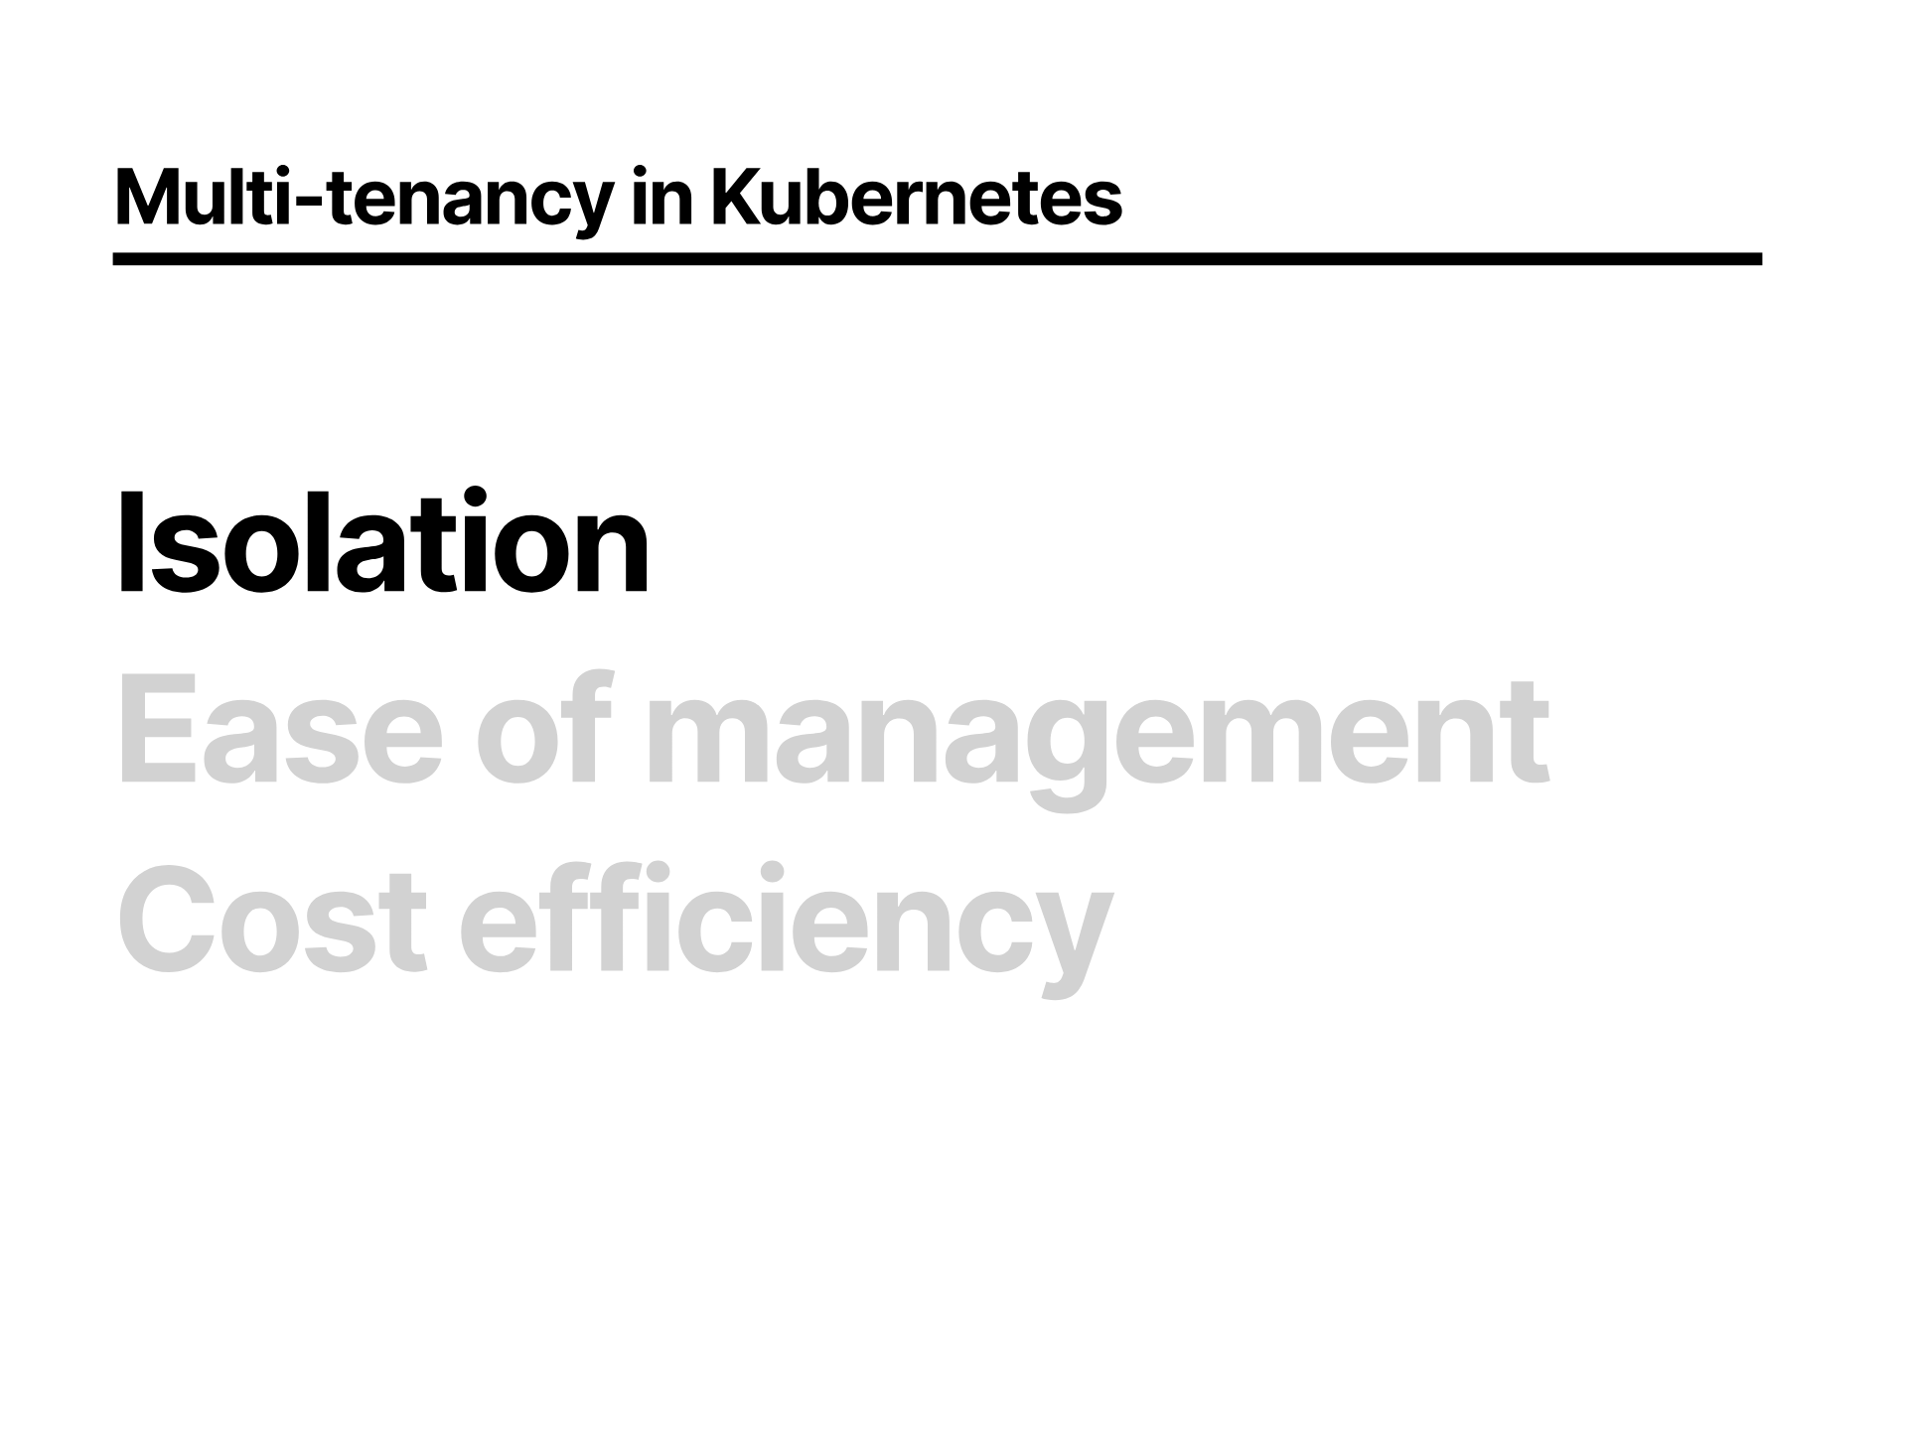
Notes:
So Ideally we'll want to isolate one workload from another

Slide 5
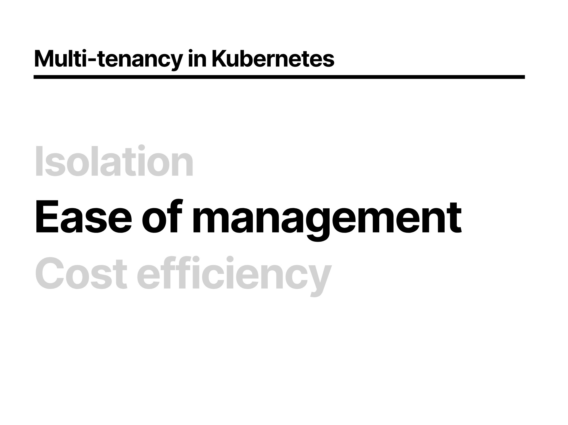
Notes:
We'll want super ease of managing all of those isolated things, because we need that collective spare time to think up new exciting abstractions of running processes on computers or a new job title? Shout out to my DevSecOps, SREs, and Platform Engineers!

Slide 6
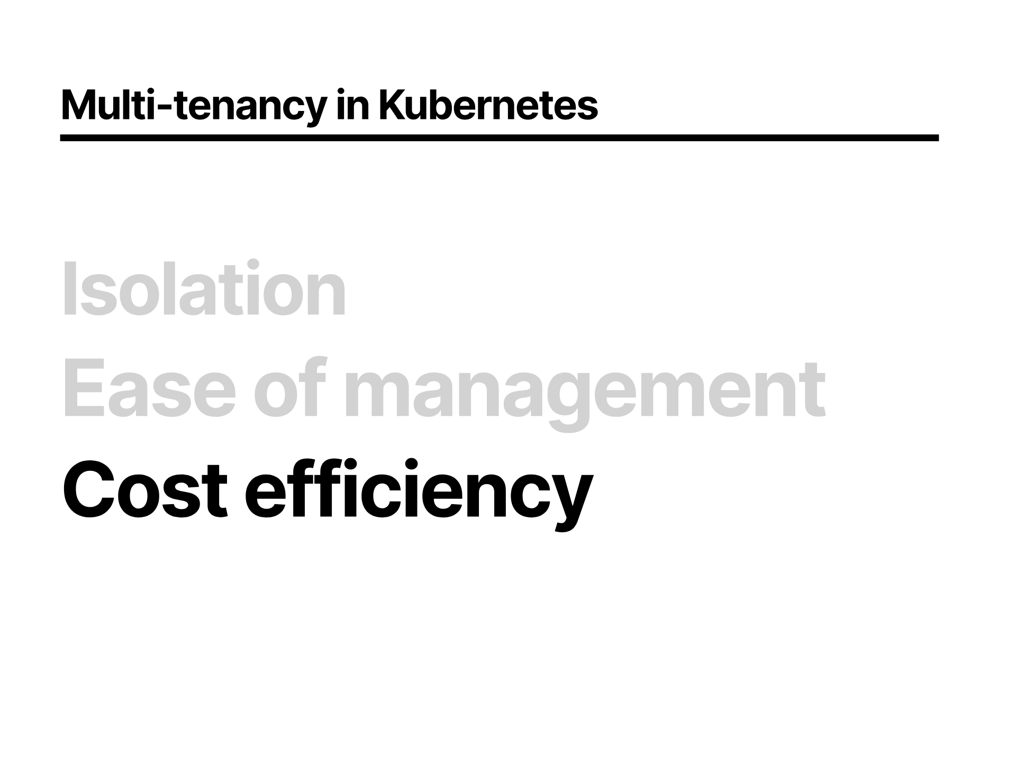
Notes:
And our ability to reduce waste on the hardware should give us some cost savings, which we'll all need to buy the Apple Vision Pro for some DevAROps.
So how do we realize those dreams

Slide 7
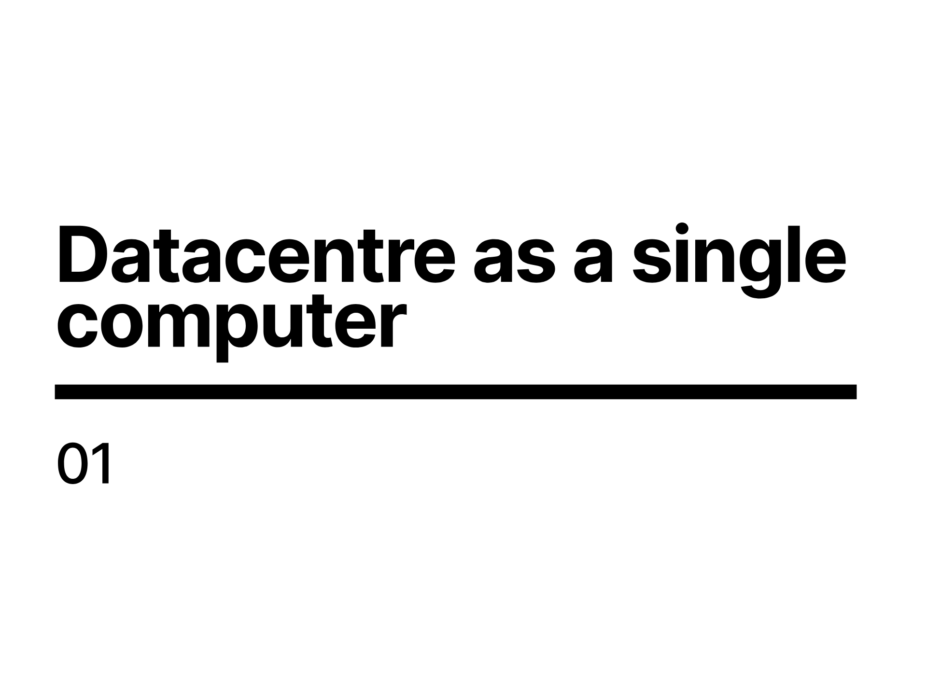
Notes:
Here comes the science bit.
Kubernetes embraces the idea of treating your servers as a single unit and abstracts away how individual computer resources operate.

Slide 8
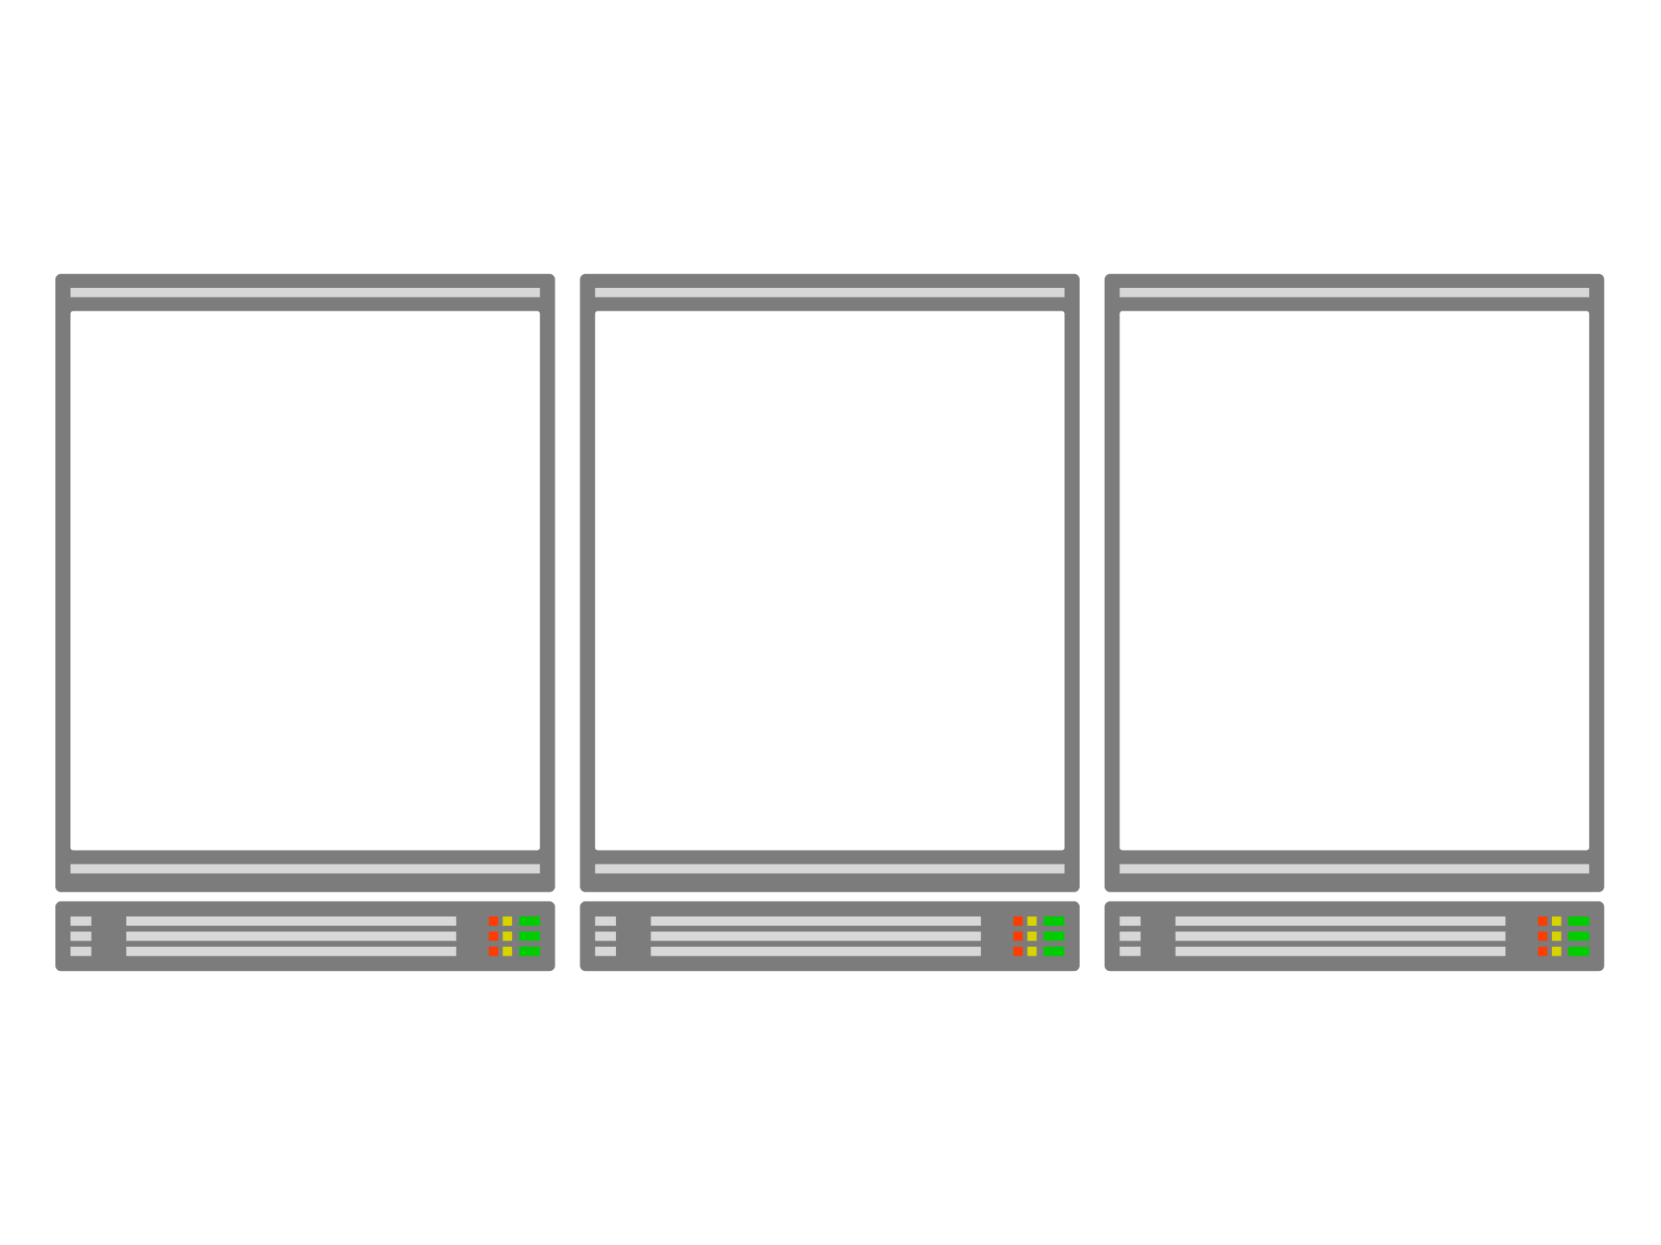
Notes:
Imagine having three servers.

Slide 9
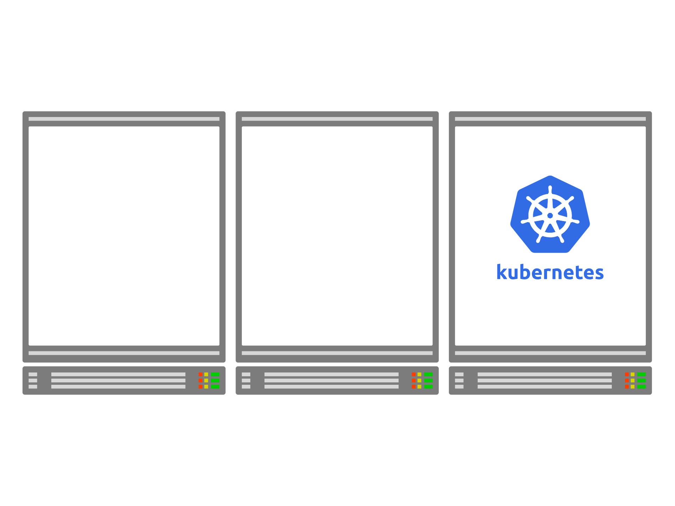
Notes:
You can use one of those to install the Kubernetes control plane.

Slide 10
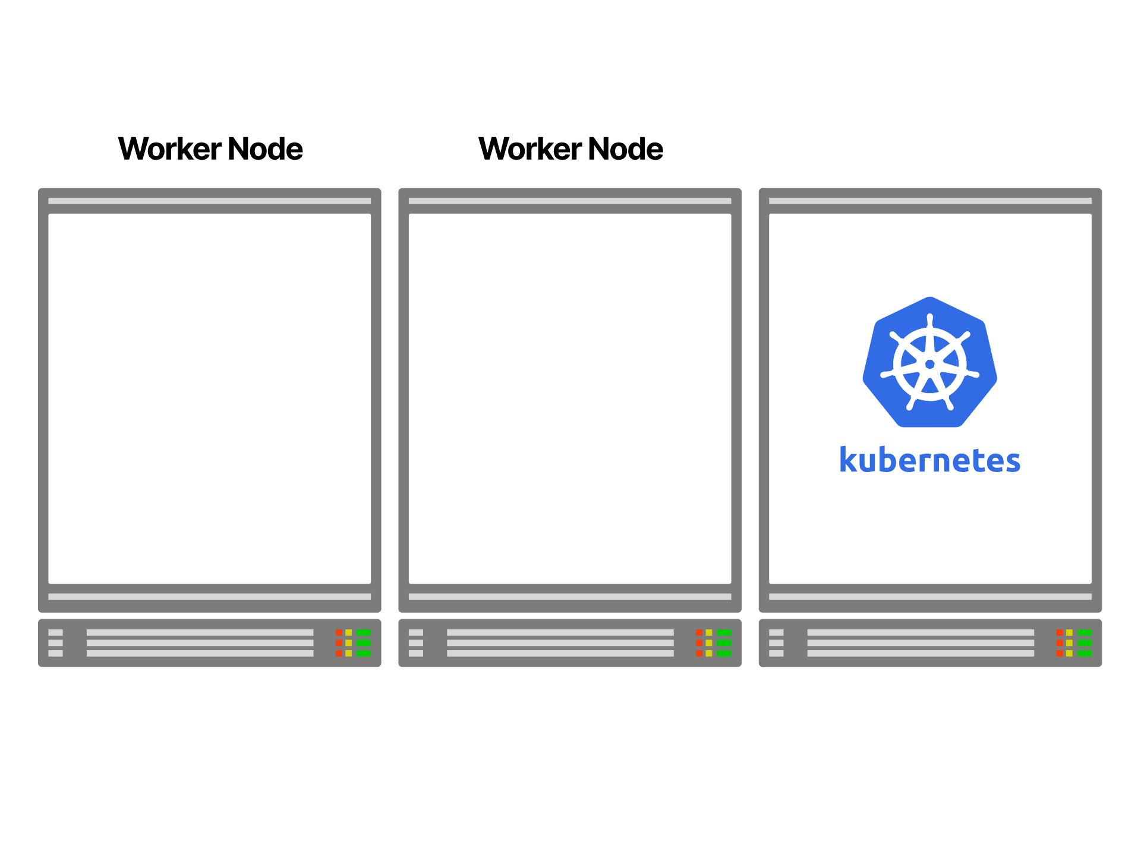
Notes:
The remaining can join the cluster as worker nodes.

Slide 11
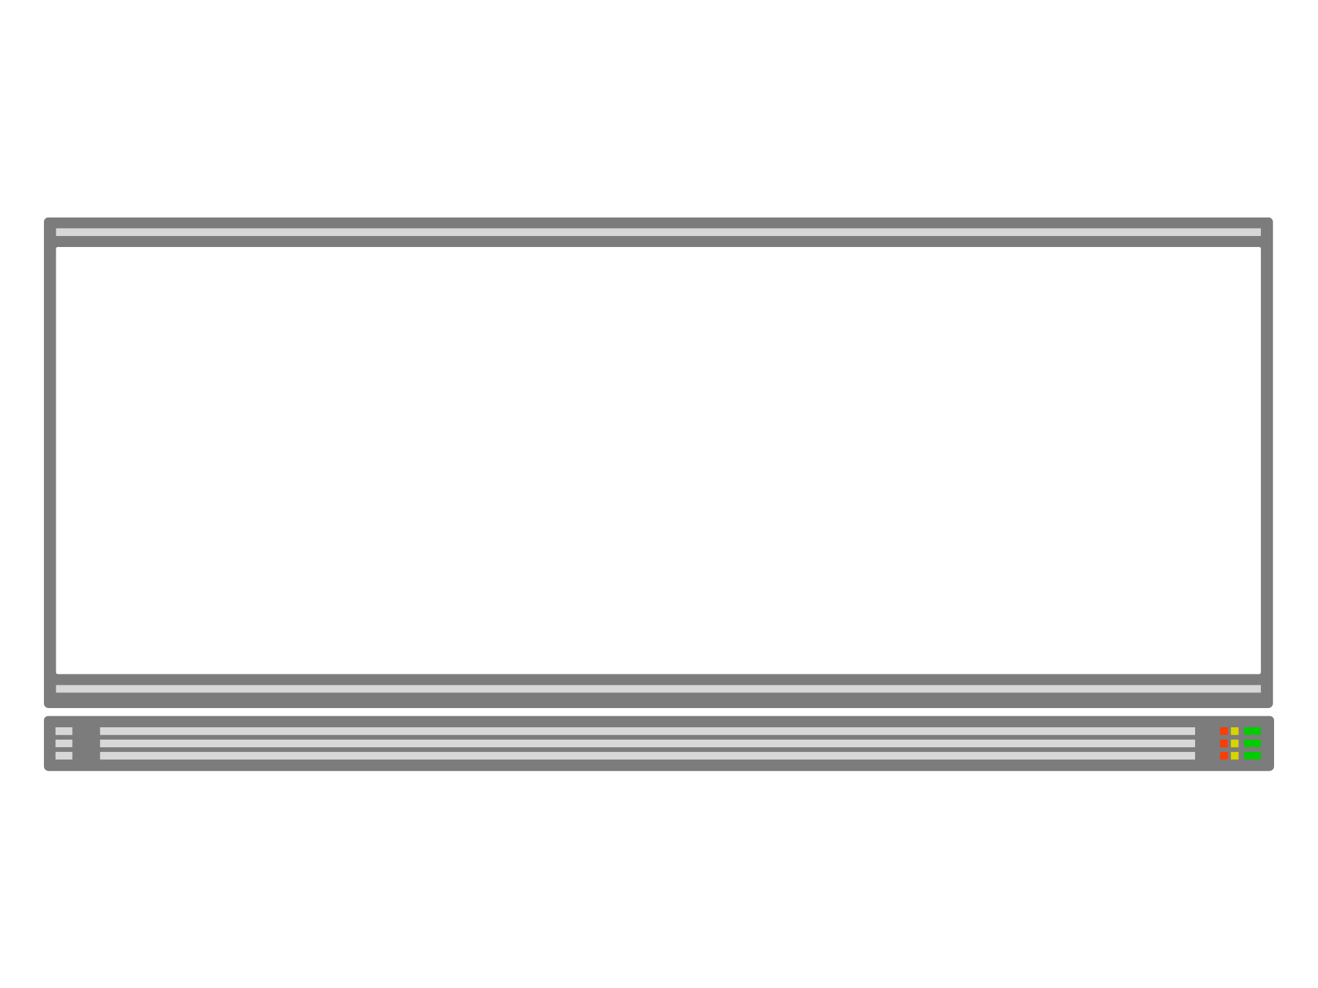
Notes:
Once the setup is completed, the physical servers are mostly abstracted from you. You deal with Kubernetes as a single unit.

Slide 12
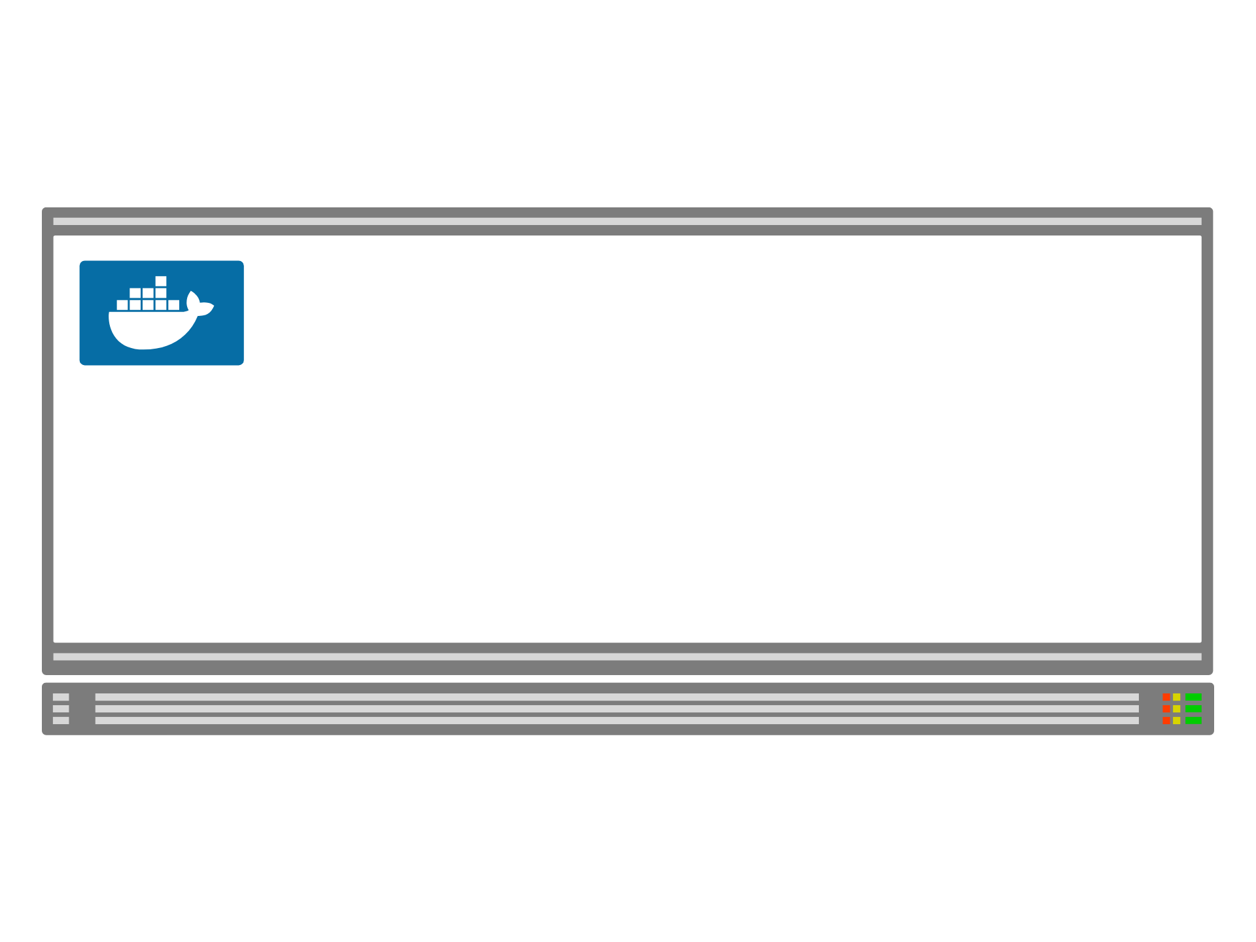
Notes:
When you want to deploy a container, you submit your request to the cluster.
Kubernetes takes care of executing `docker run` and selecting the best server for the job.

Slide 13
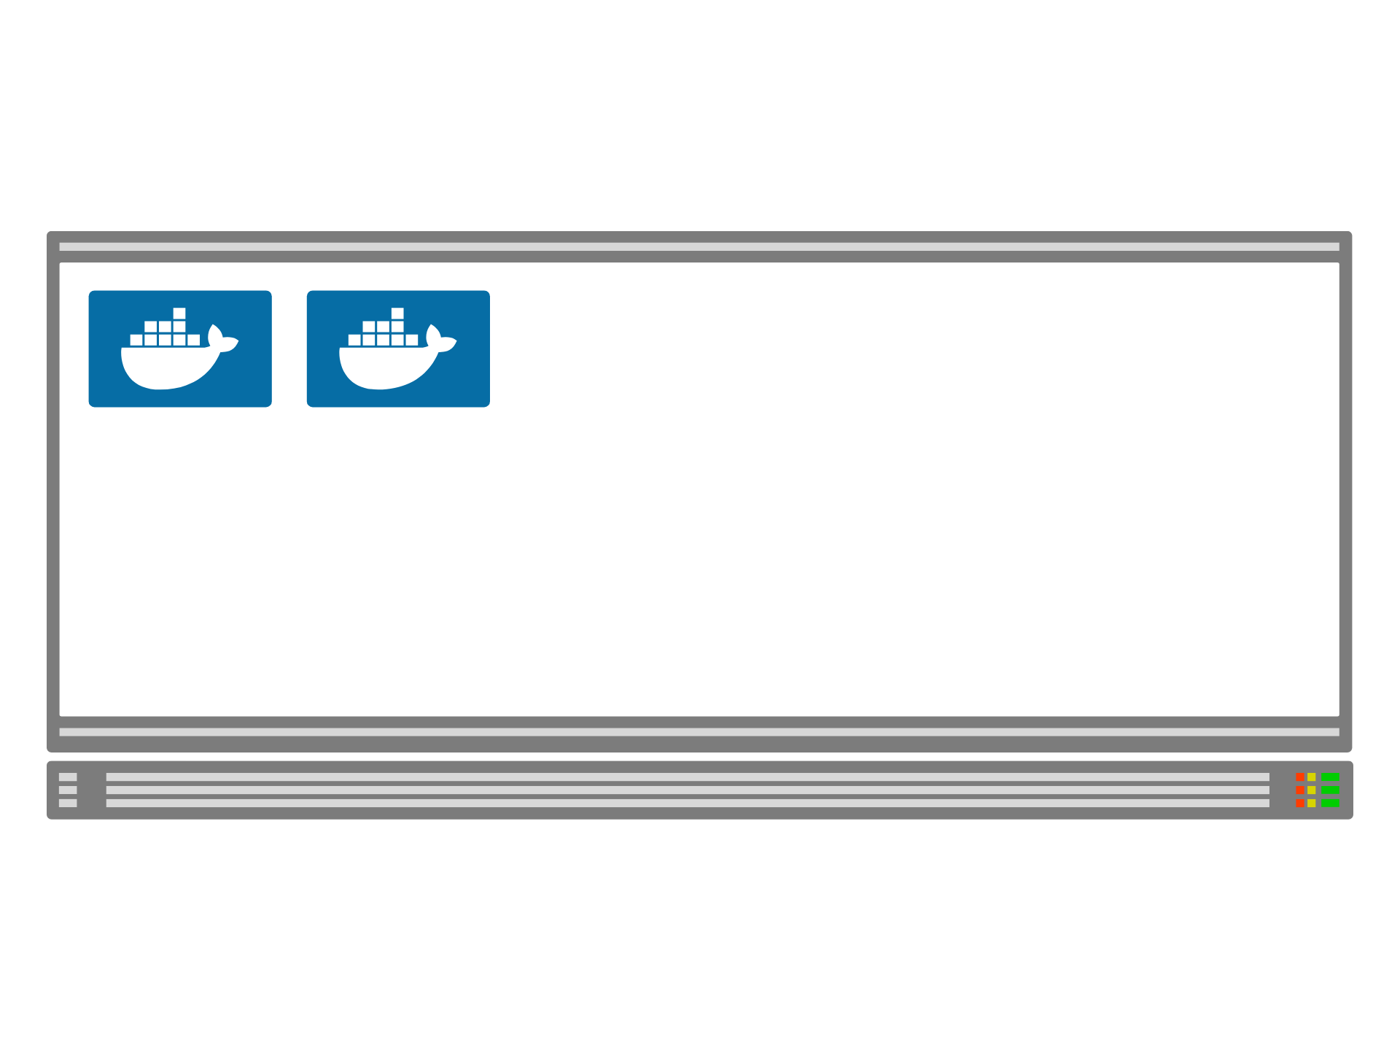
Notes:
The same happens for

Slide 14
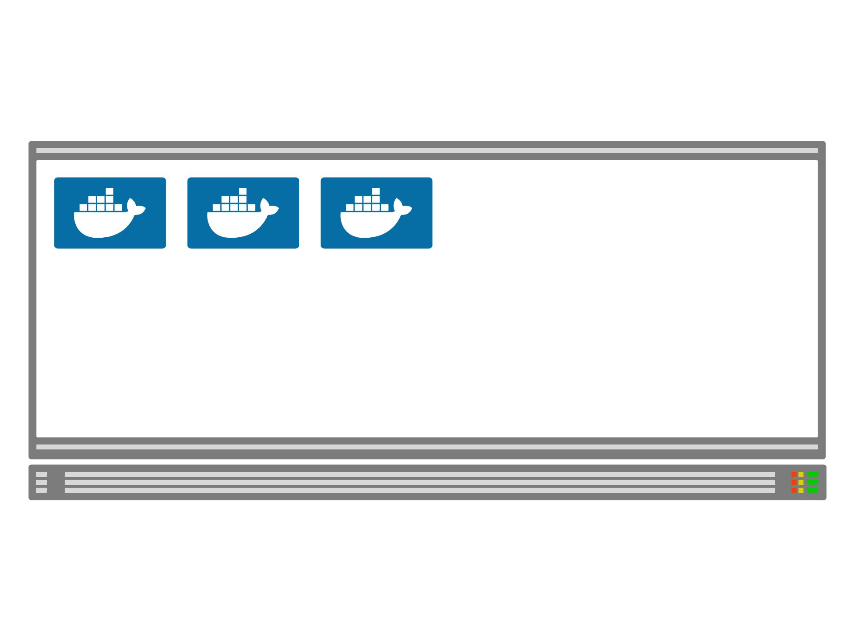
Notes:
all other containers.

Slide 15
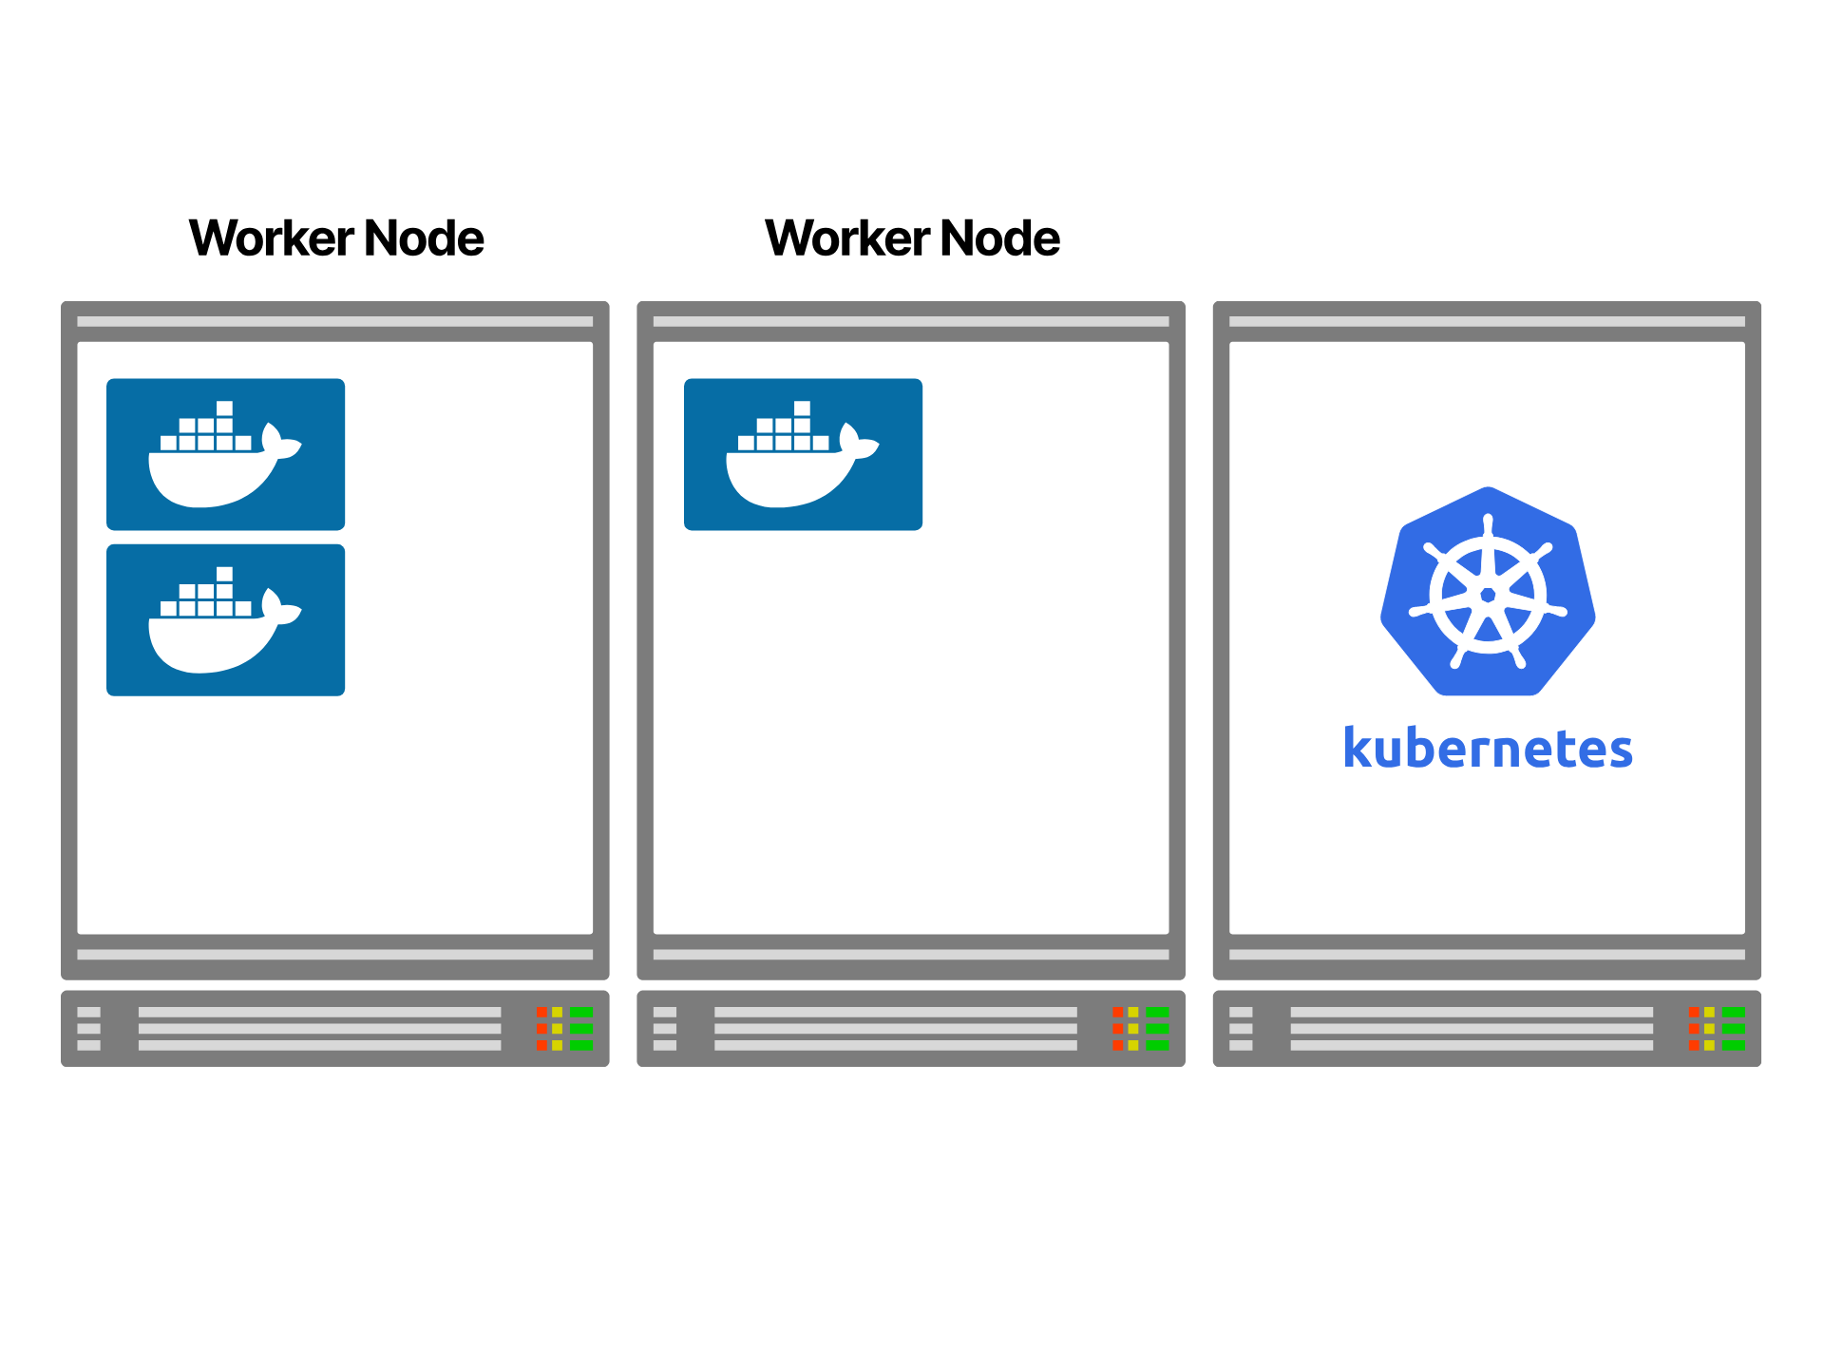
Notes:
For every deployment, Kubernetes finds the best place to run the application.

Slide 16
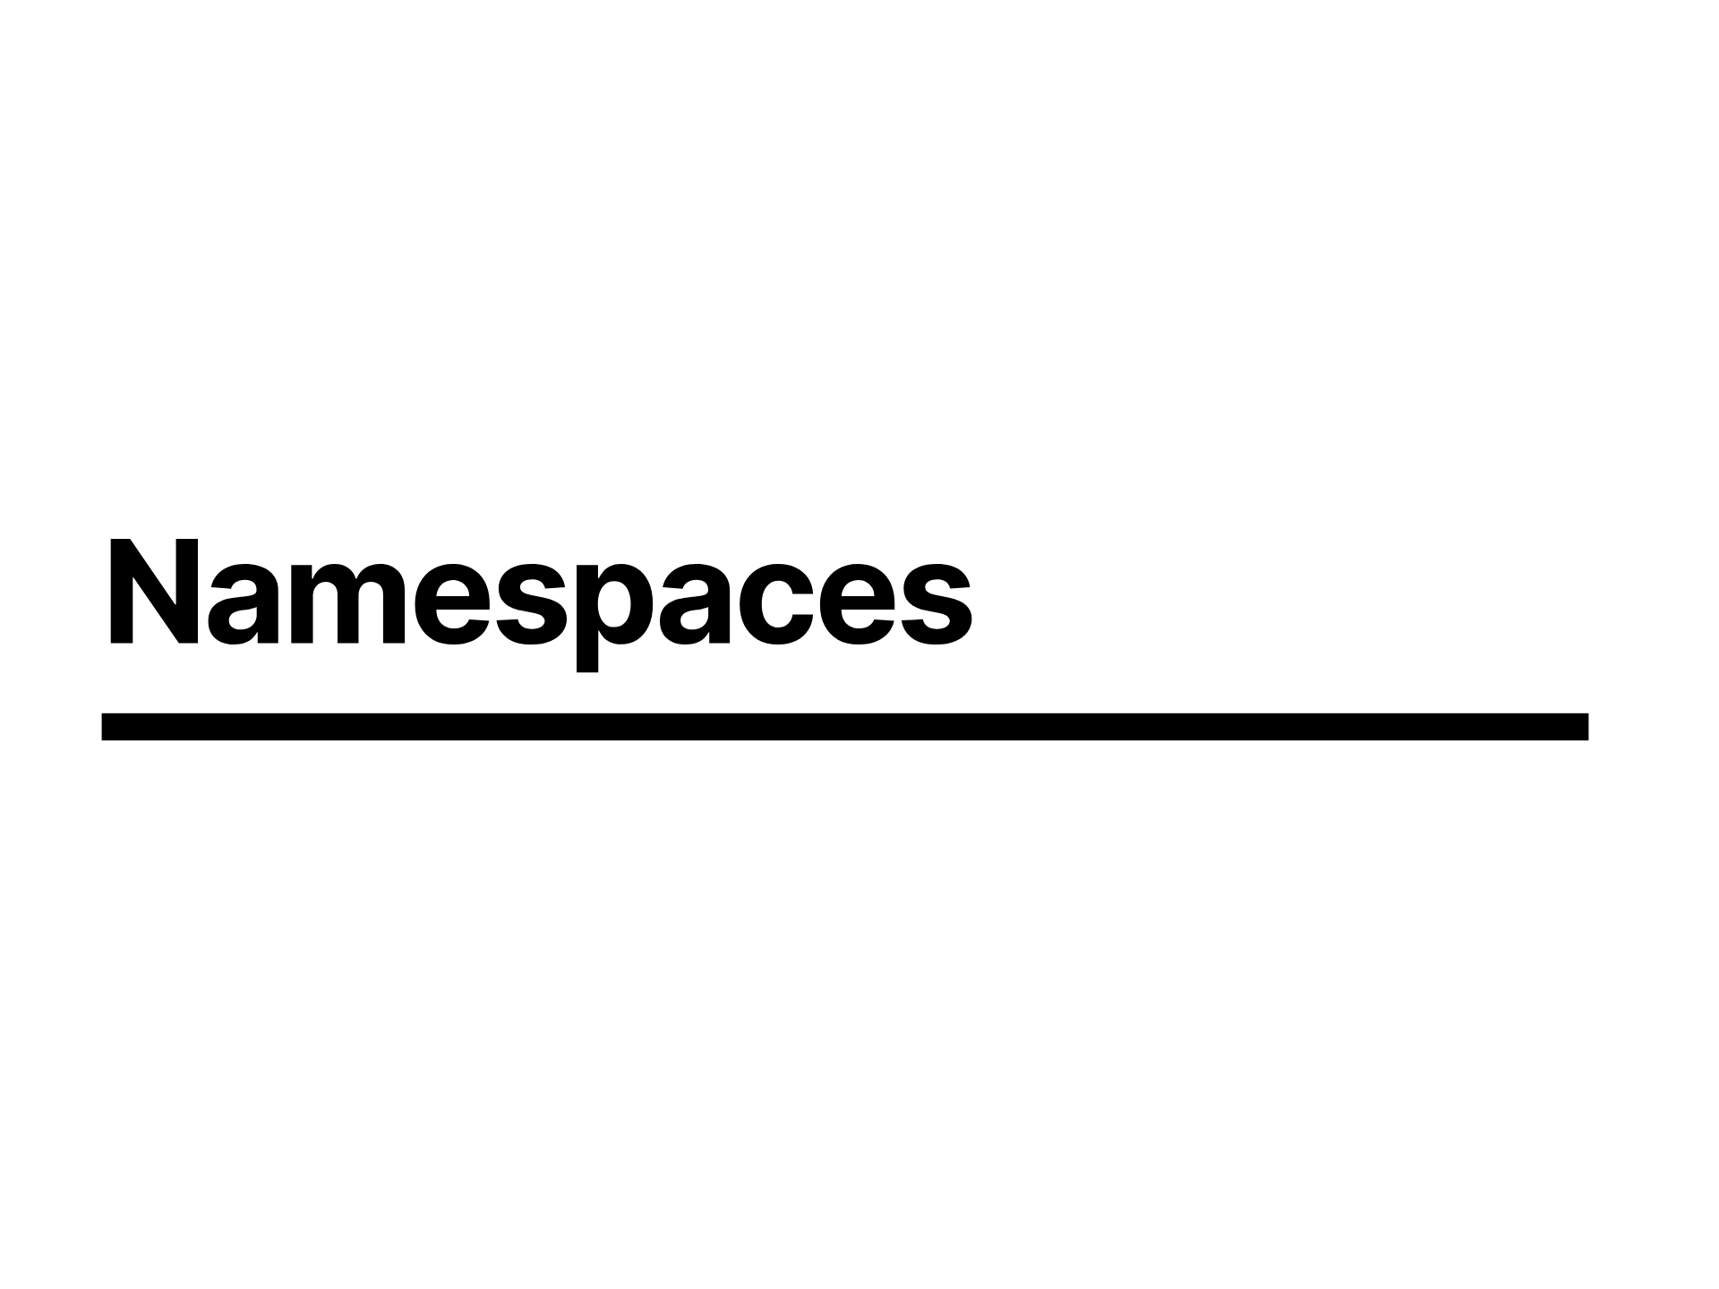
Notes:
Out the box Kubernetes does give you namespaces

Slide 17
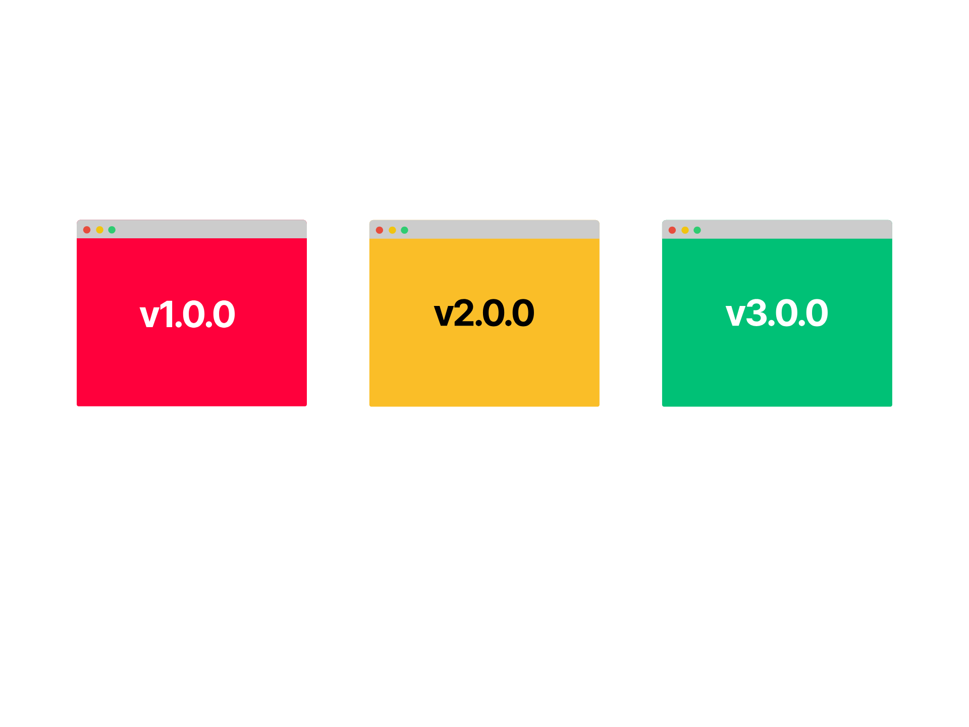
Notes:
So if you have three applications or teams

Slide 18
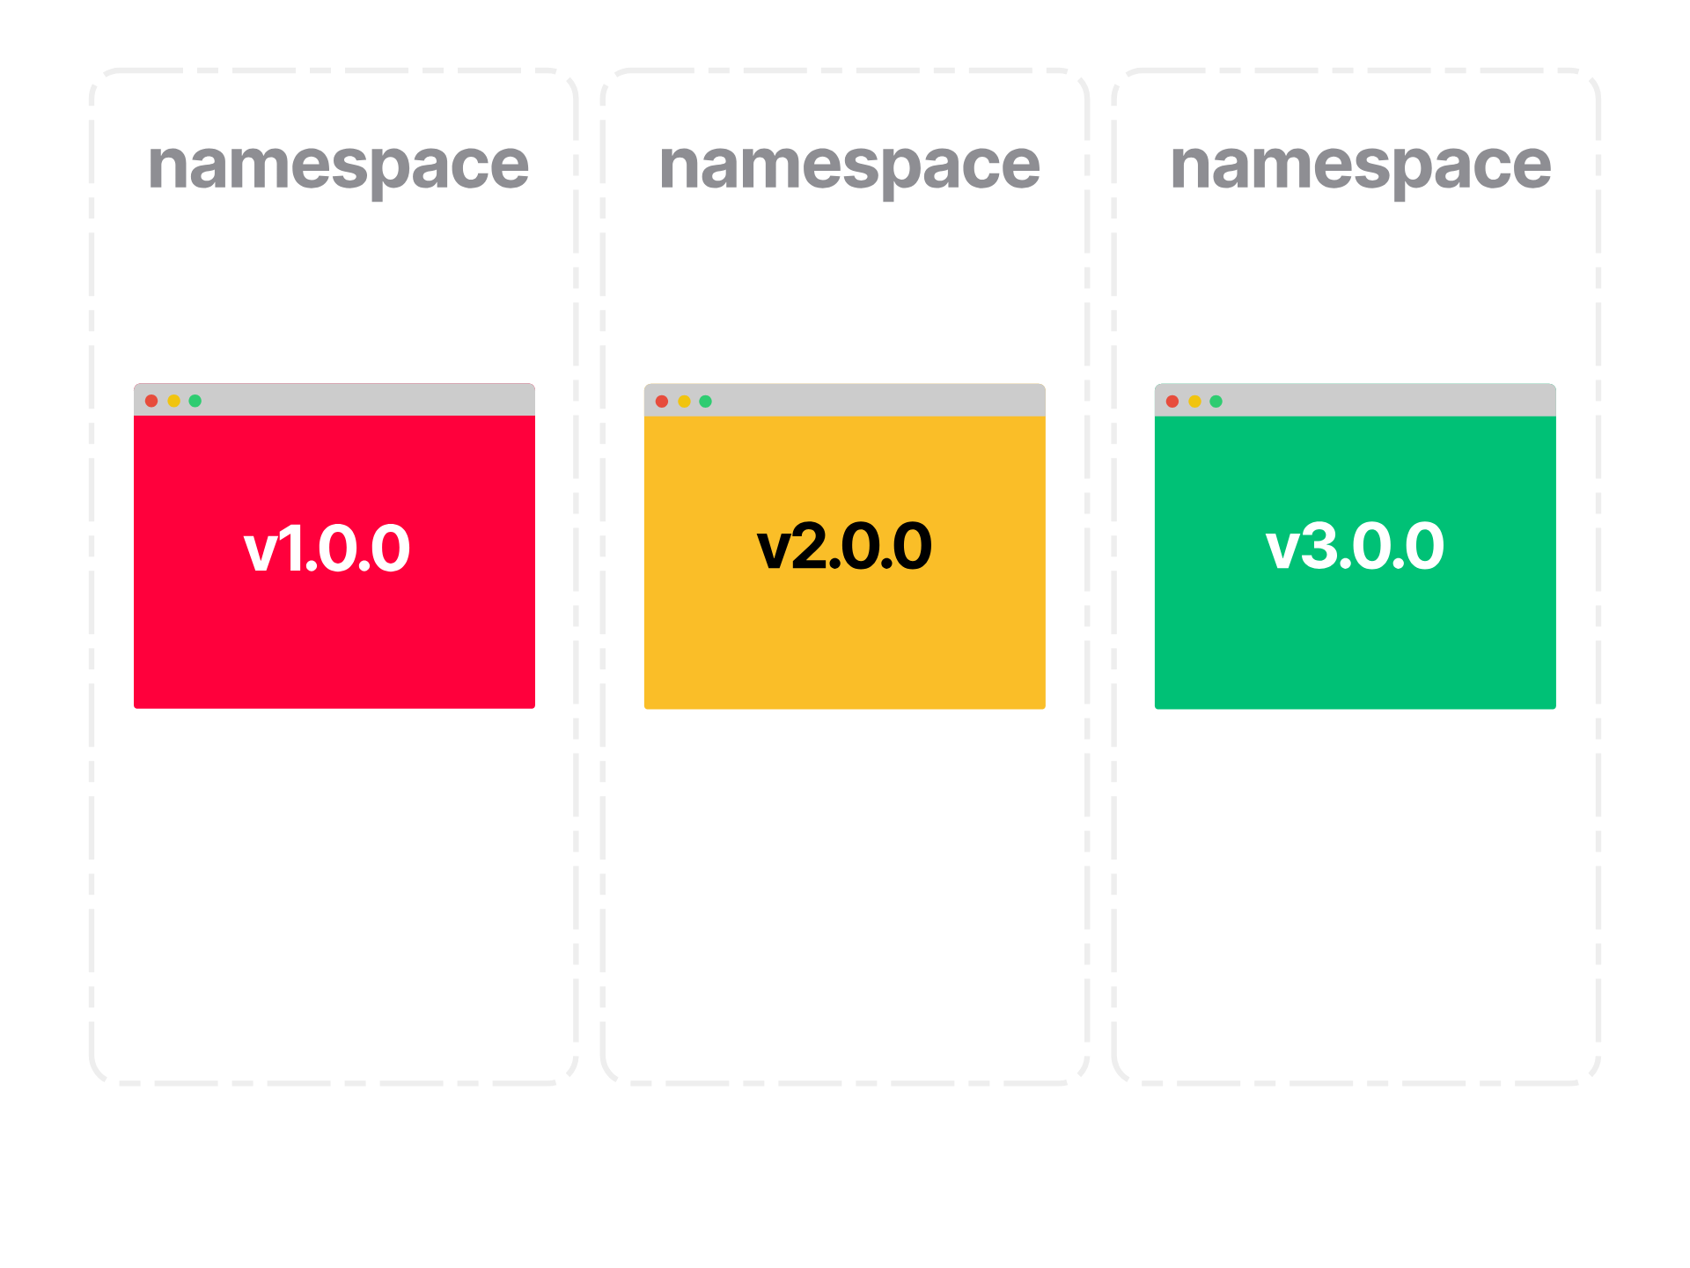
Notes:
you could create three Kubernetes namespaces and place one in each. and you'd be forgiven for thinking that namespaces might refer to a lower level implementation kernel capability that would provide you some isolation

Slide 19
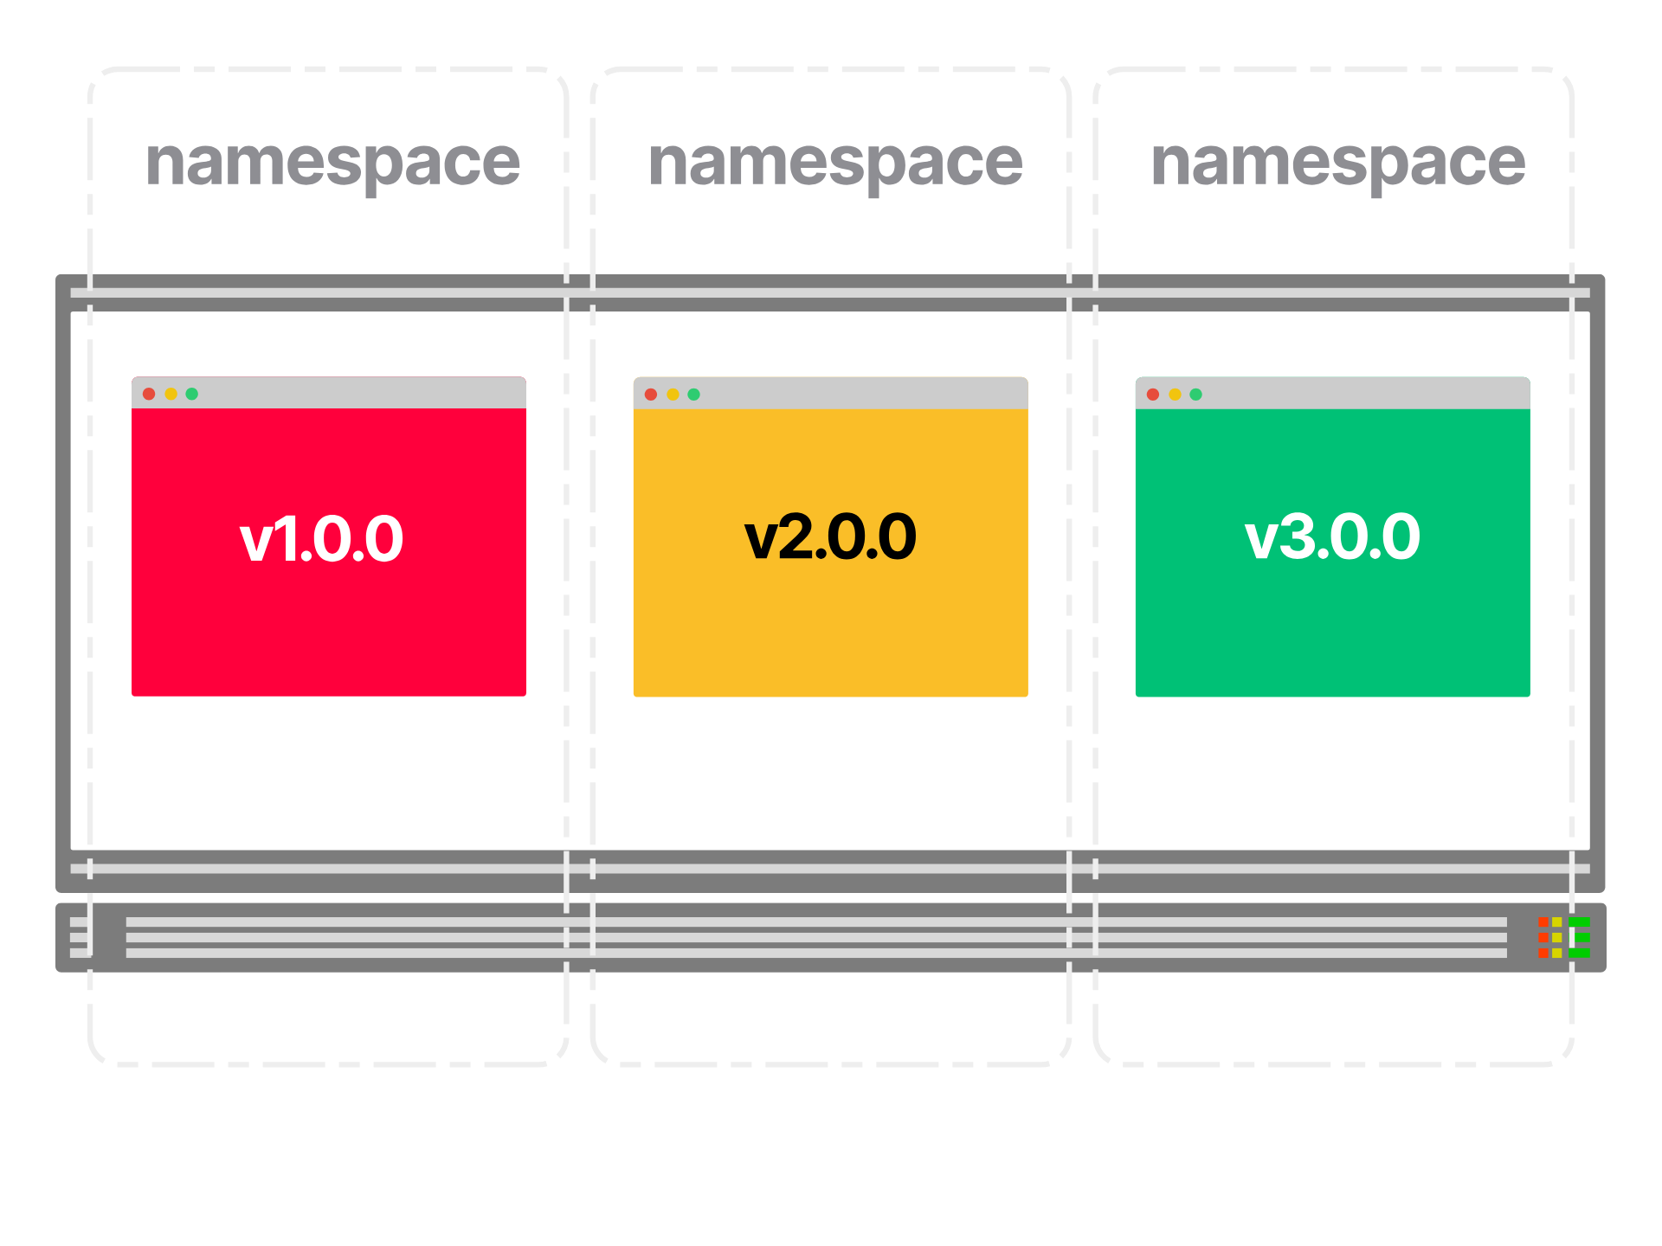
Notes:
However a Kubernetes namespace is just a logical partition of the cluster that is used to group Kubernetes objects together. It doesn't offer any isolation, it's just a convenient way to categorize and compartmentalize objects, and has some performance benefits in scheduling by limiting the scope.

Slide 20
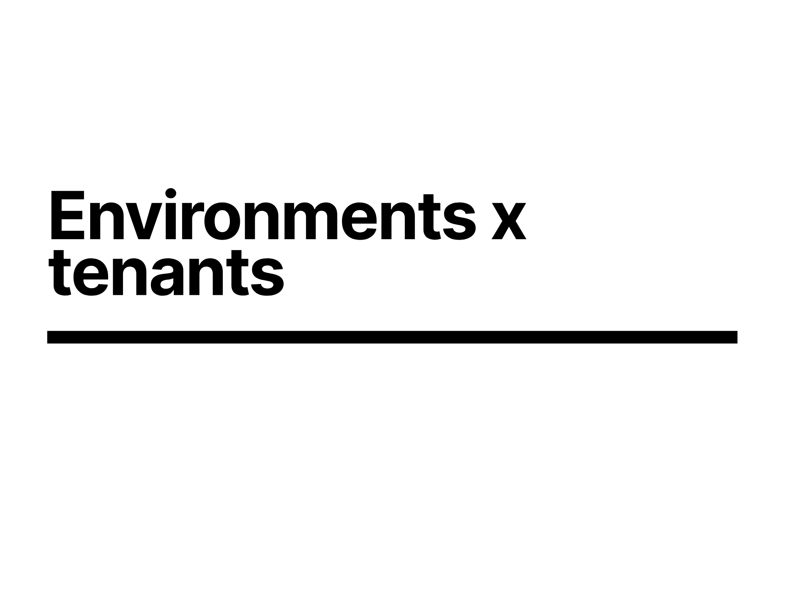
Notes:
Lets explore how we can apply namespaces to start with, since its a useful baseline, and how many folk have done it in the past, at least before managing multiple clusters became a thing when we put down Kubernetes the hard way (thanks Kelsey) and remembered we can at the very least script things

Slide 21
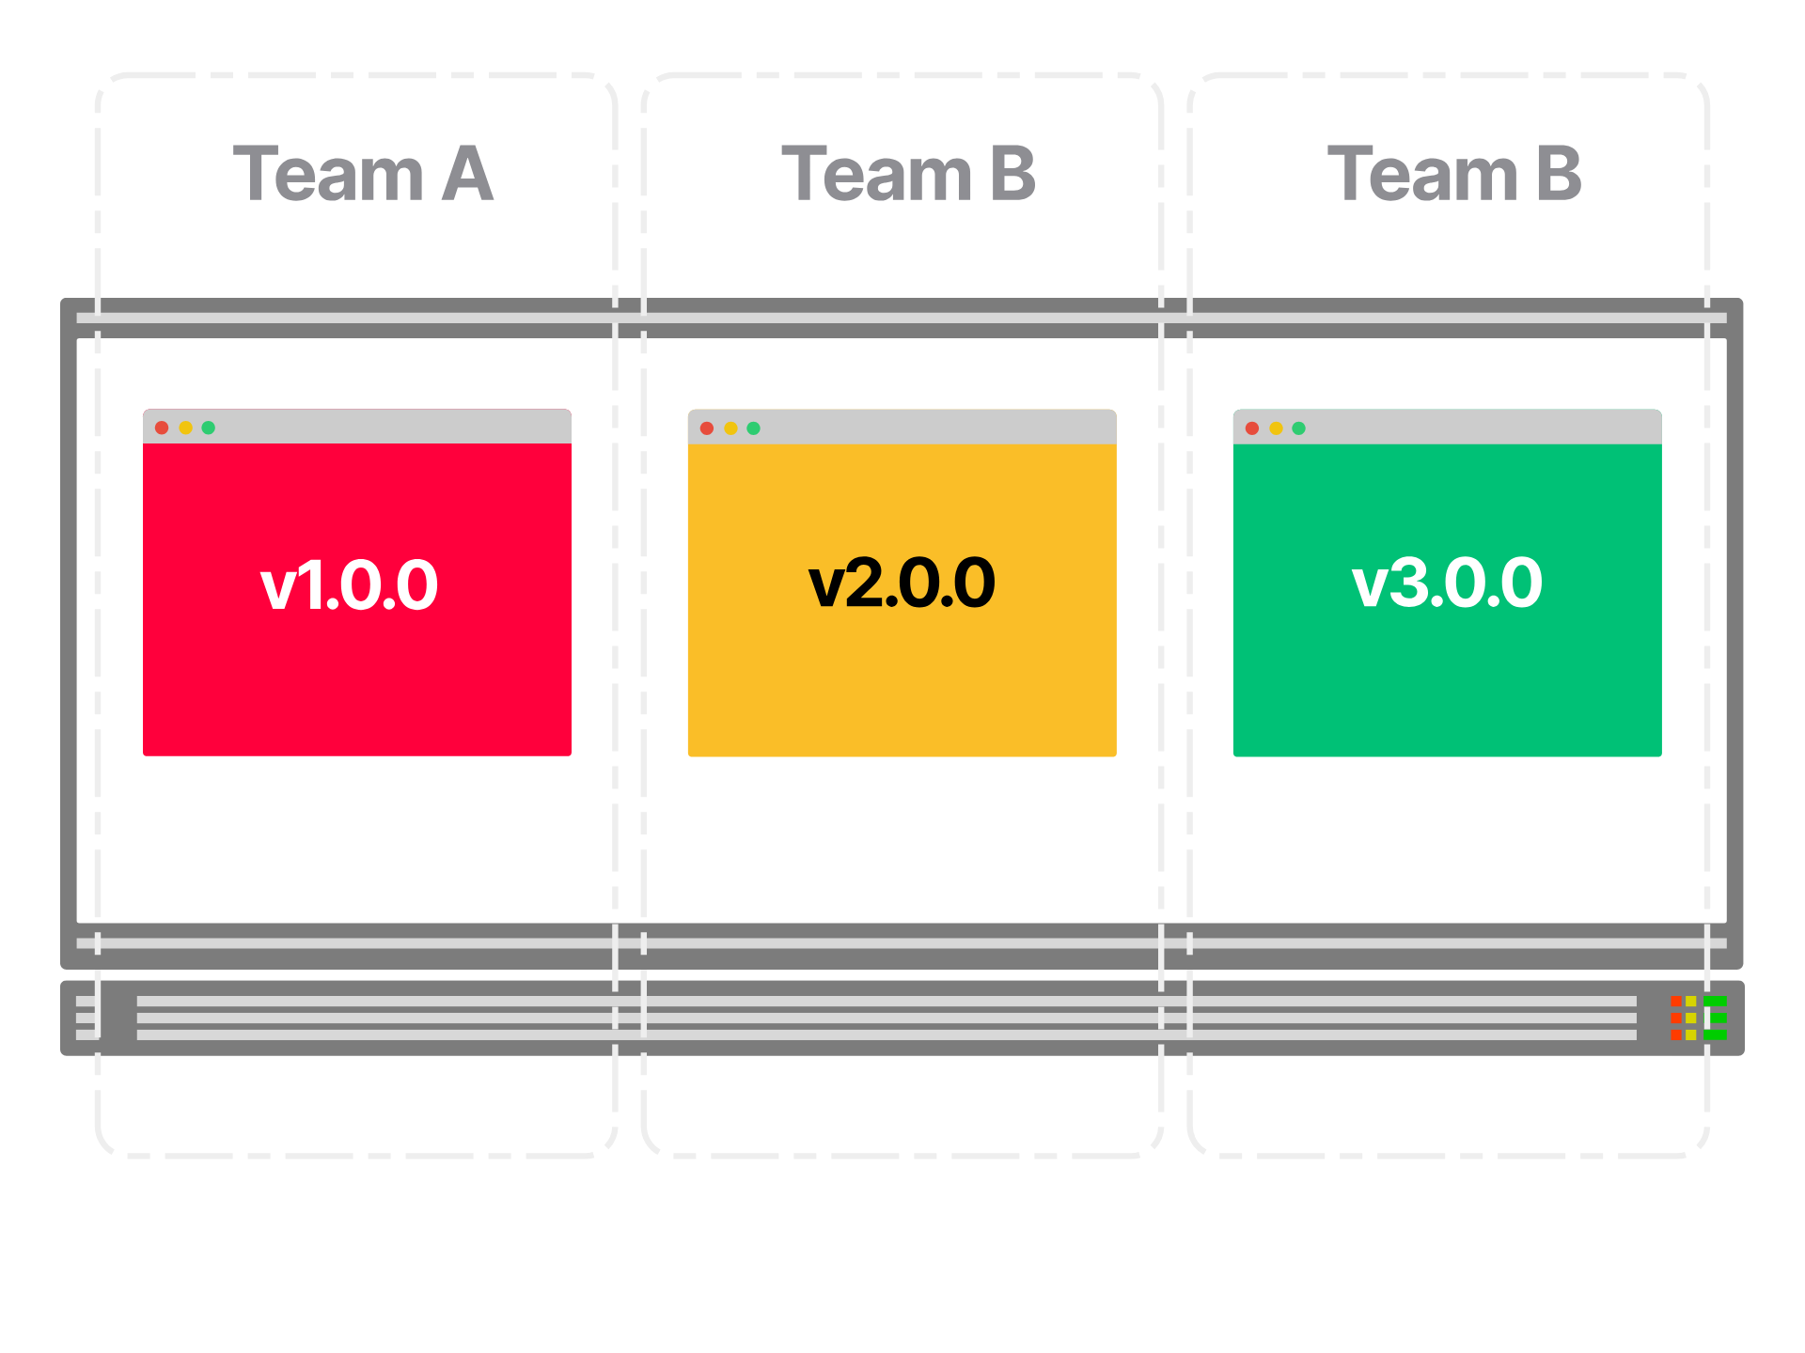
Notes:
but how do we carve up estate.
You could split it up by your three teams

Slide 22

Notes:
Or perhaps by lifecycle stage, say dev, test prod

Slide 23
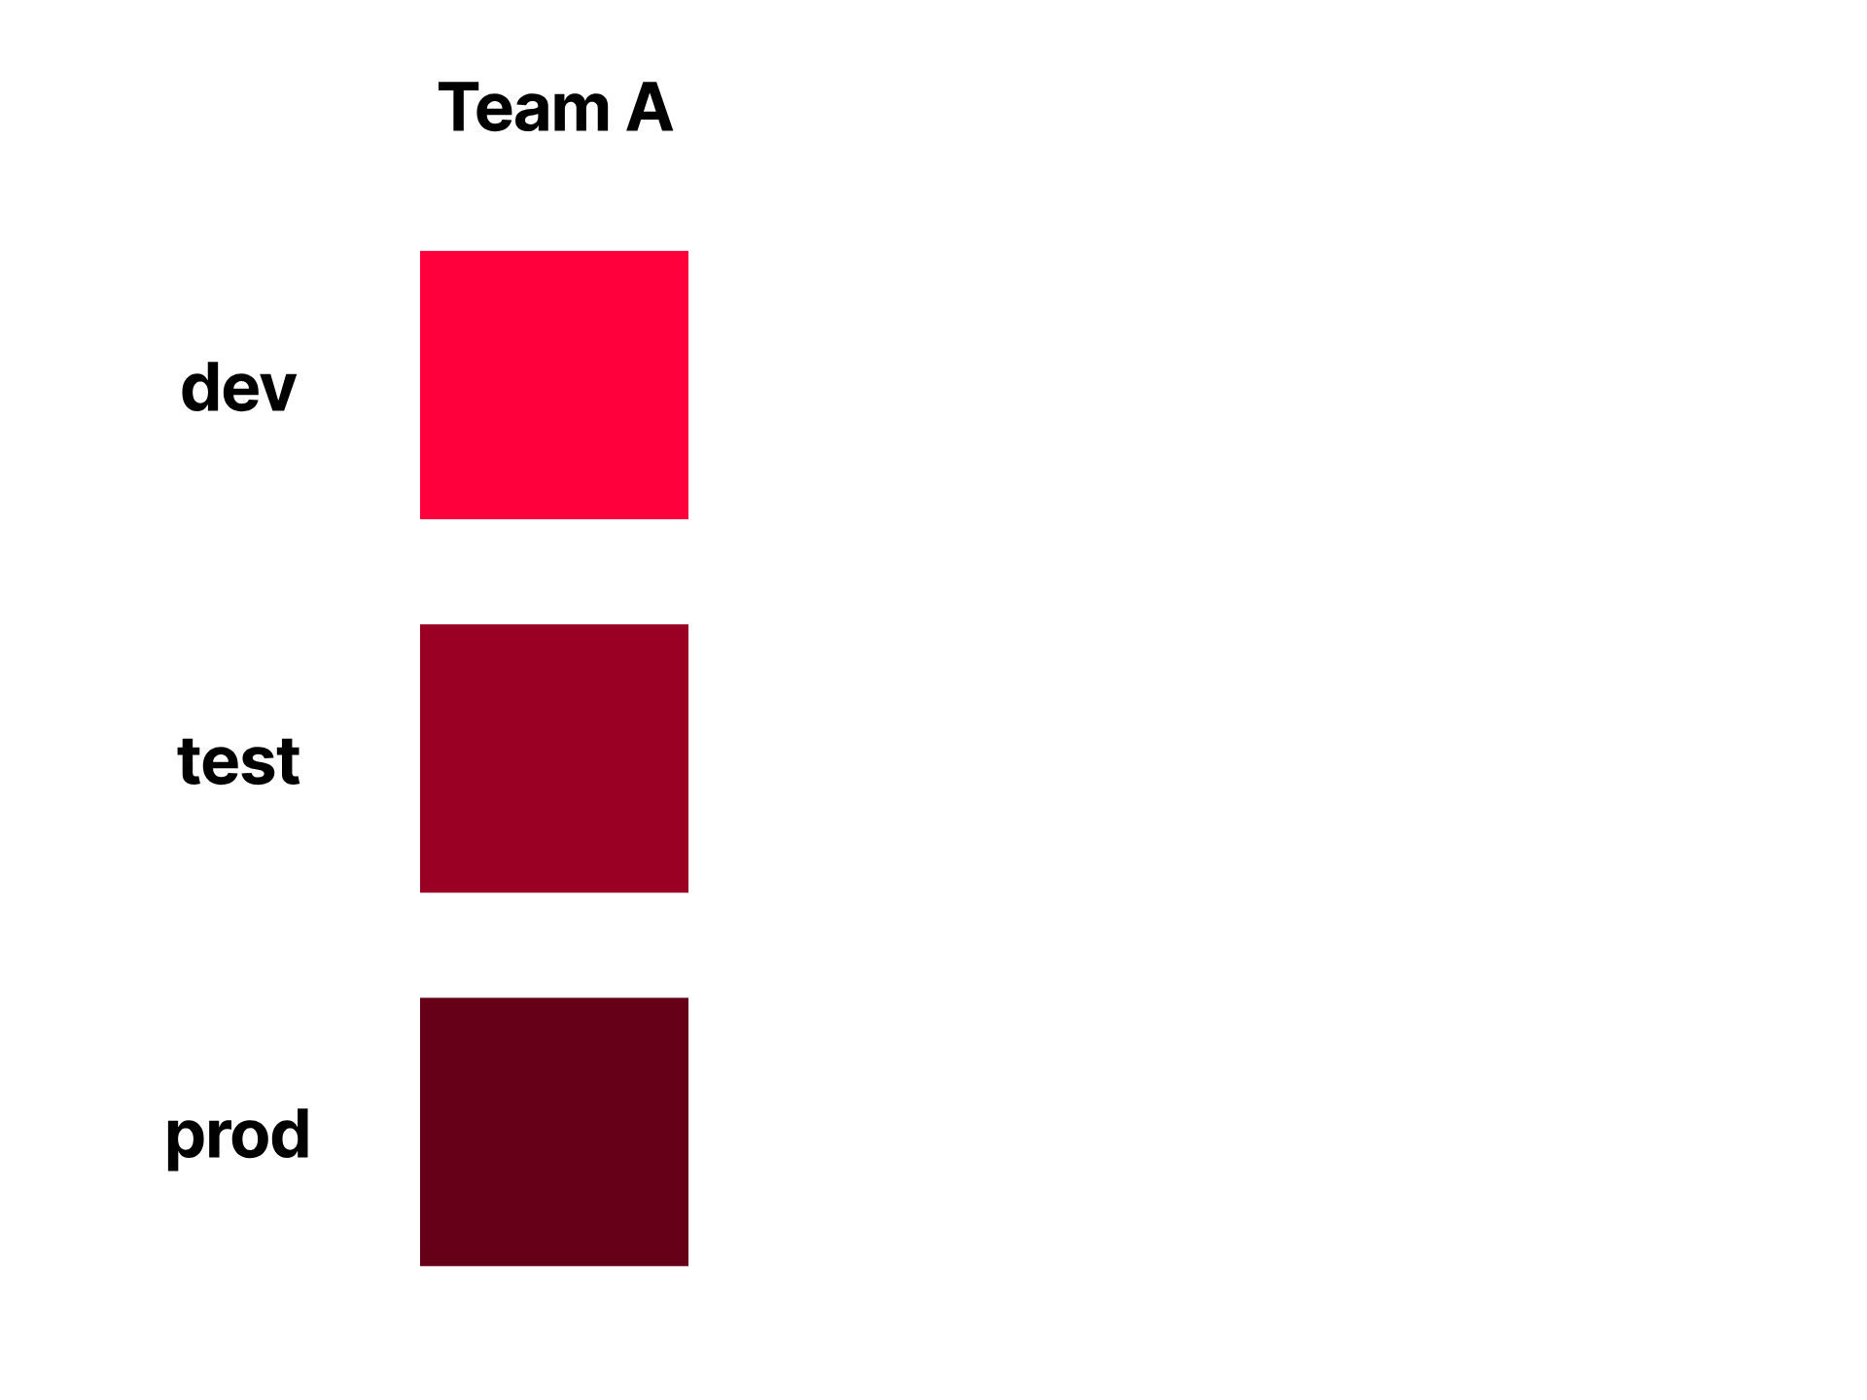
Notes:
but what about when your teams need multiple lifecycle stages

Slide 24
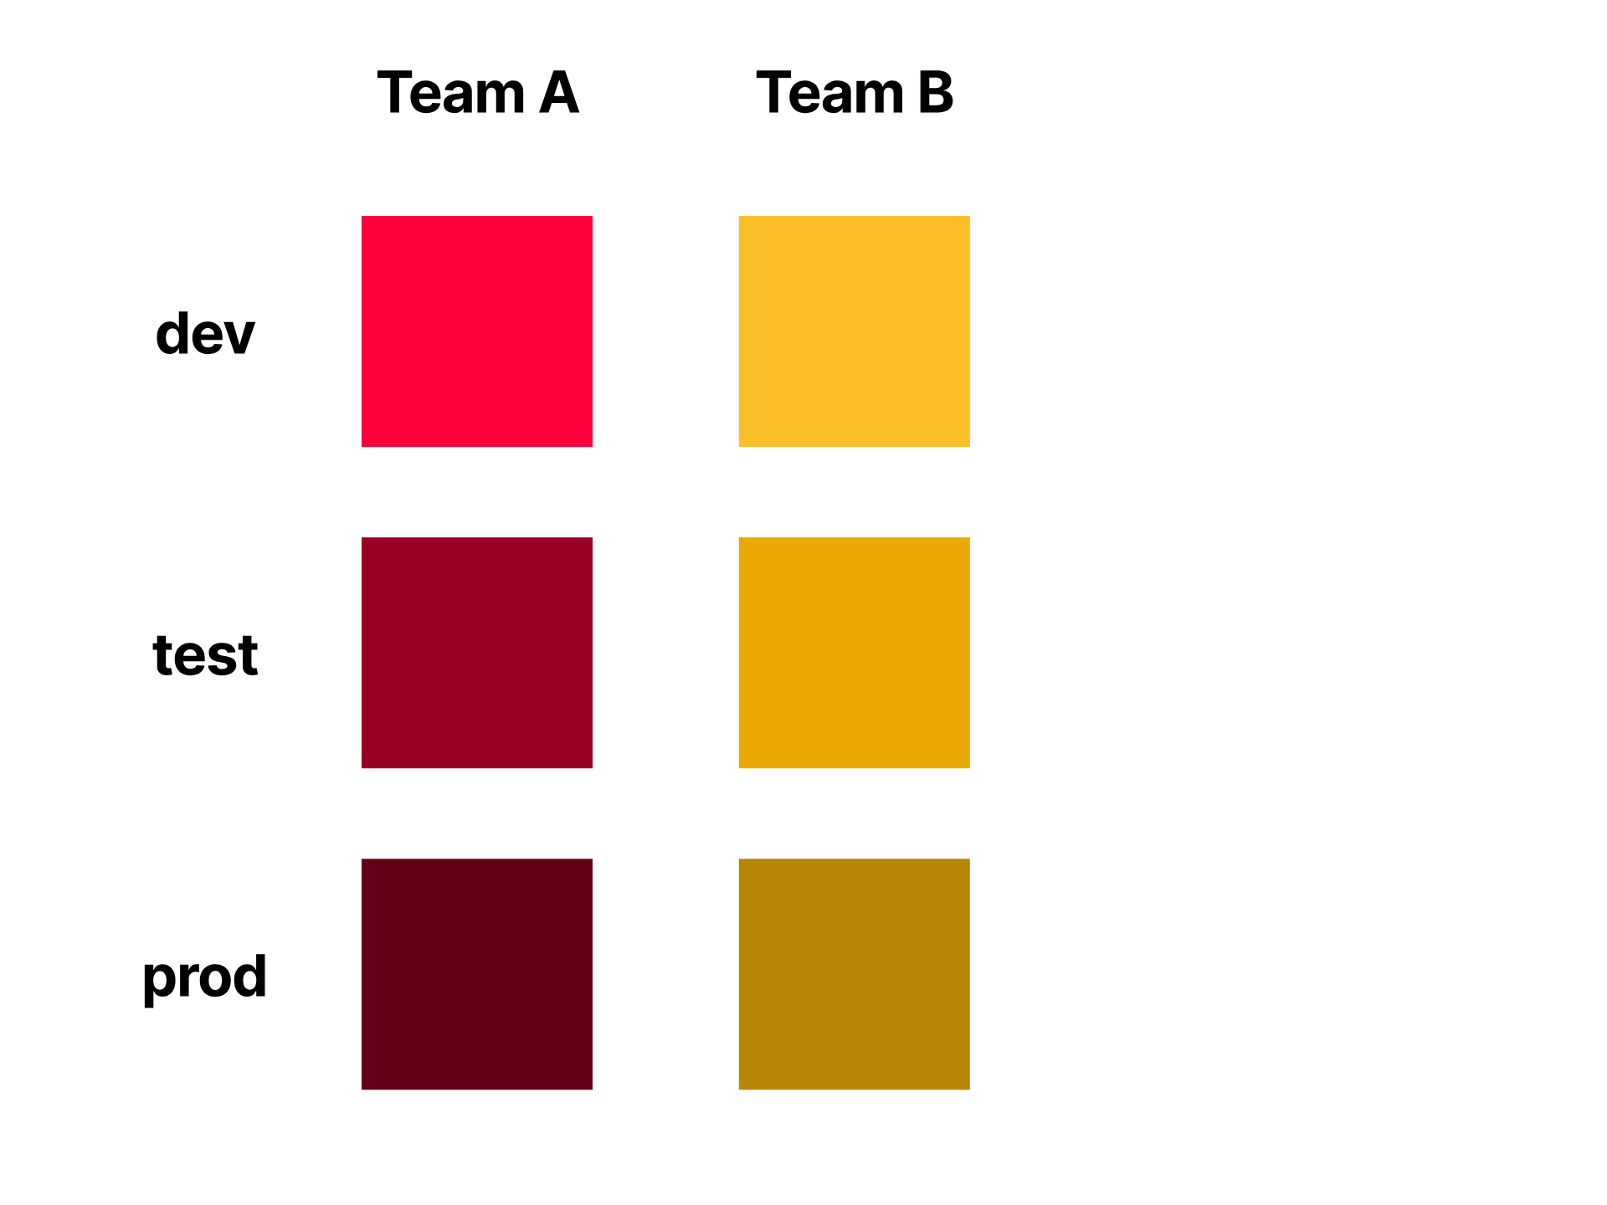
Notes:
you start to see

Slide 25
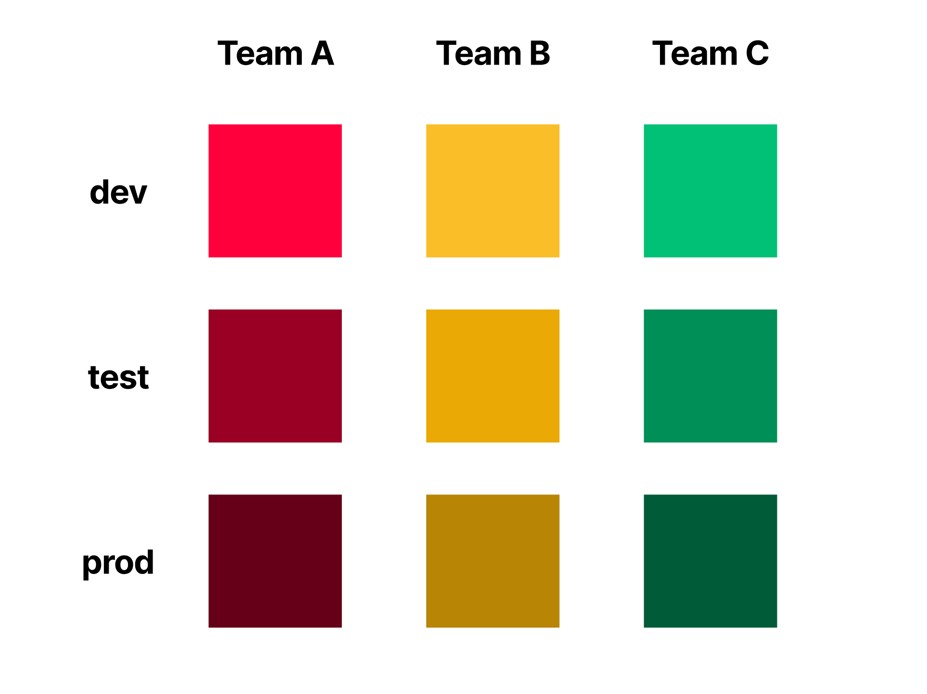
Notes:
this getting quite busy

Slide 26
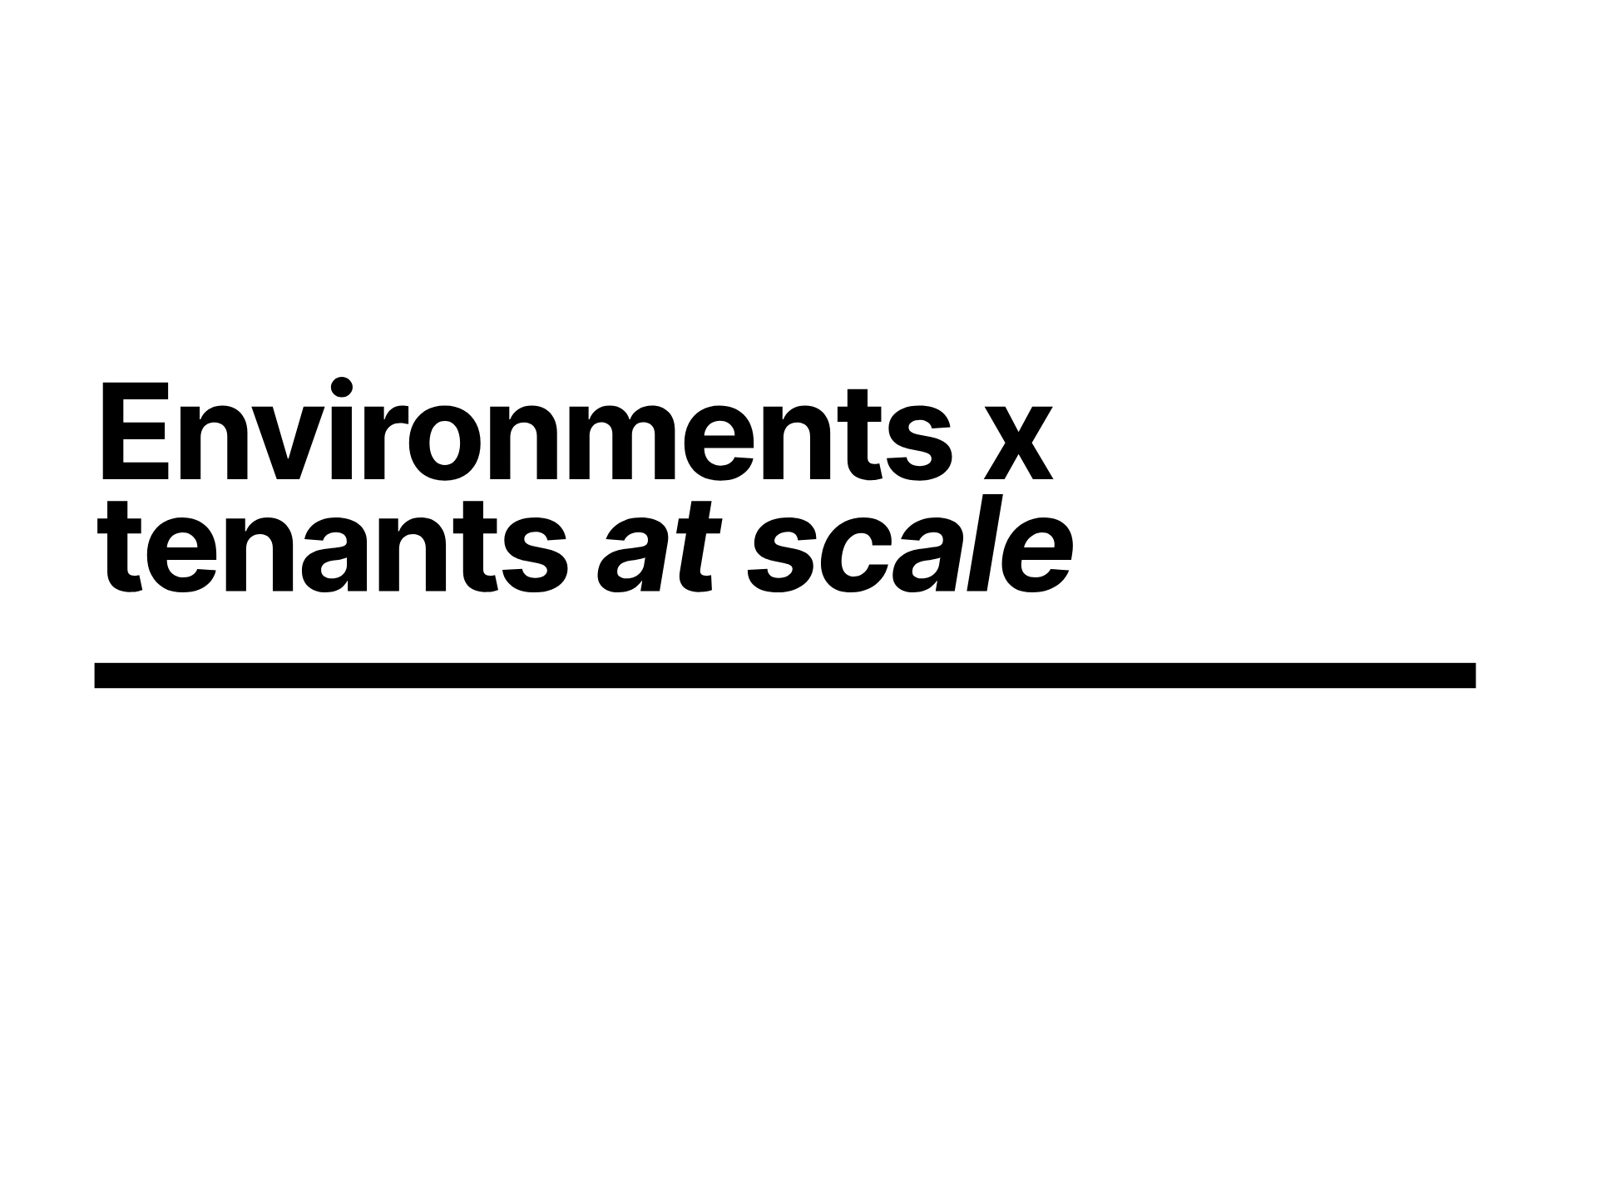
Notes:
so how big can this get

Slide 27
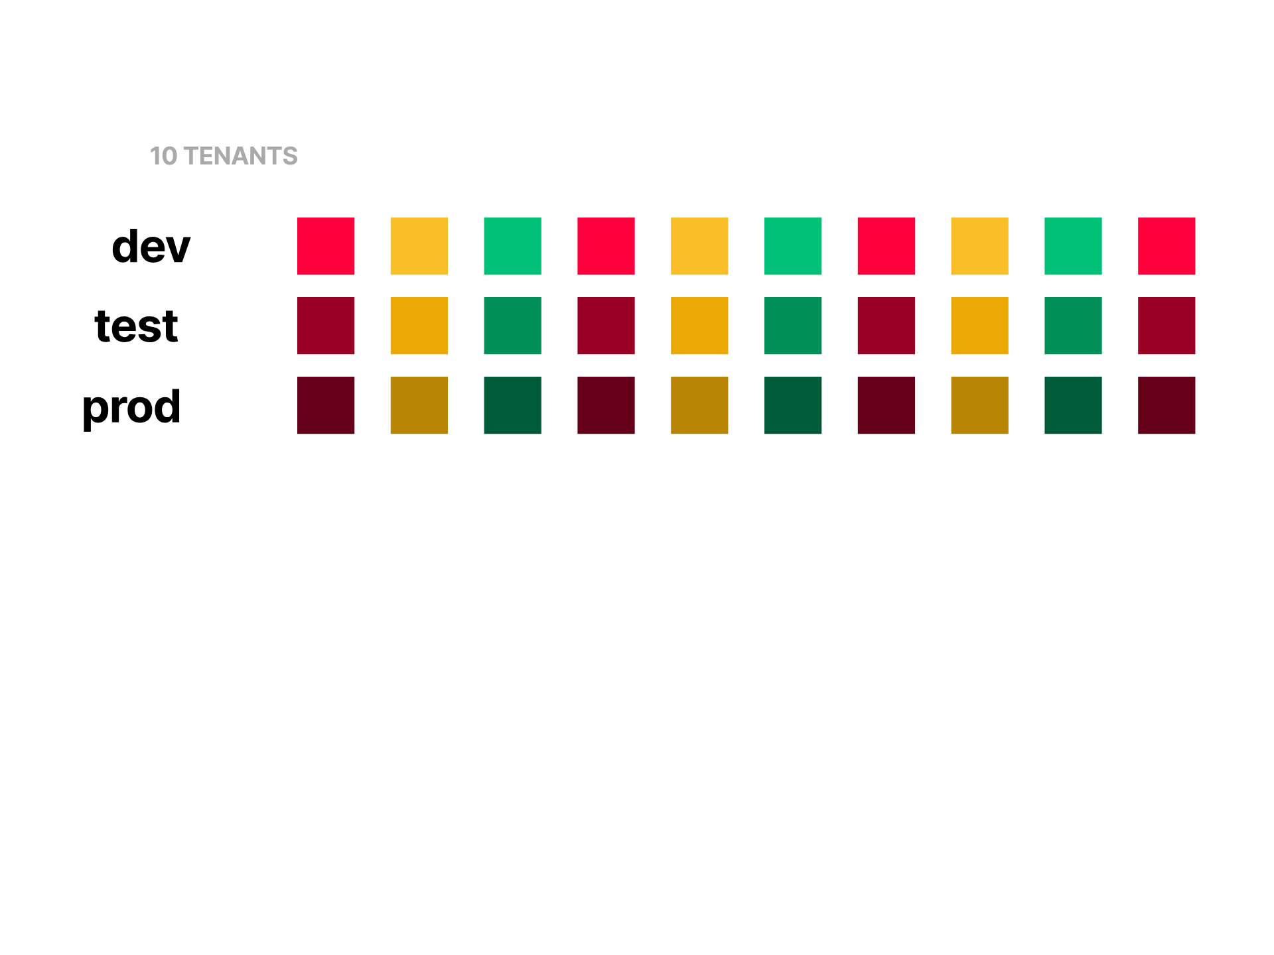

Slide 28
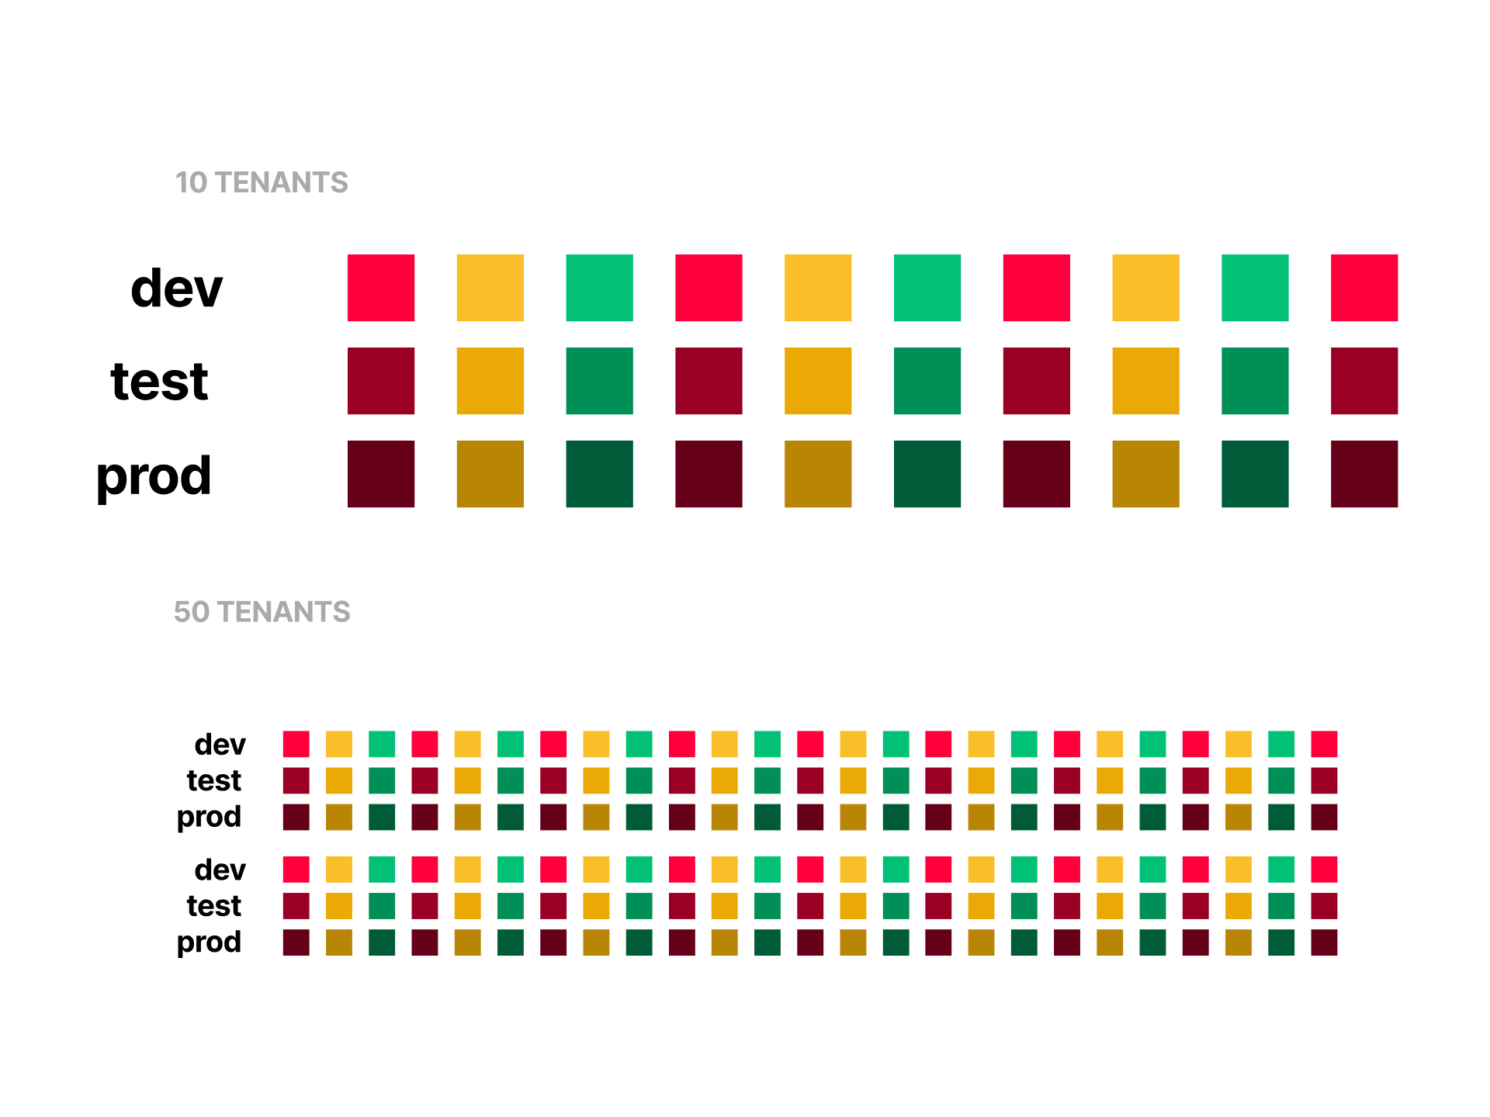
Notes:
and another with 50 tenants

Slide 29
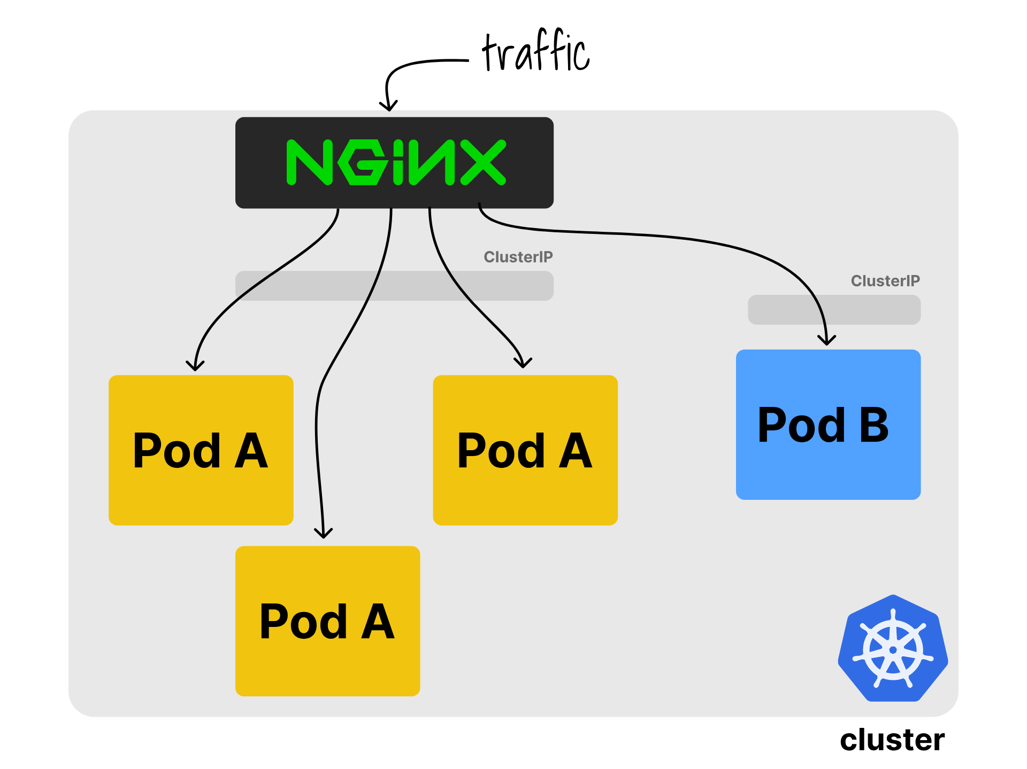
Notes:
assuming they're all serving some http traffic, you'll probably use an ingress controller like nginx

Slide 30
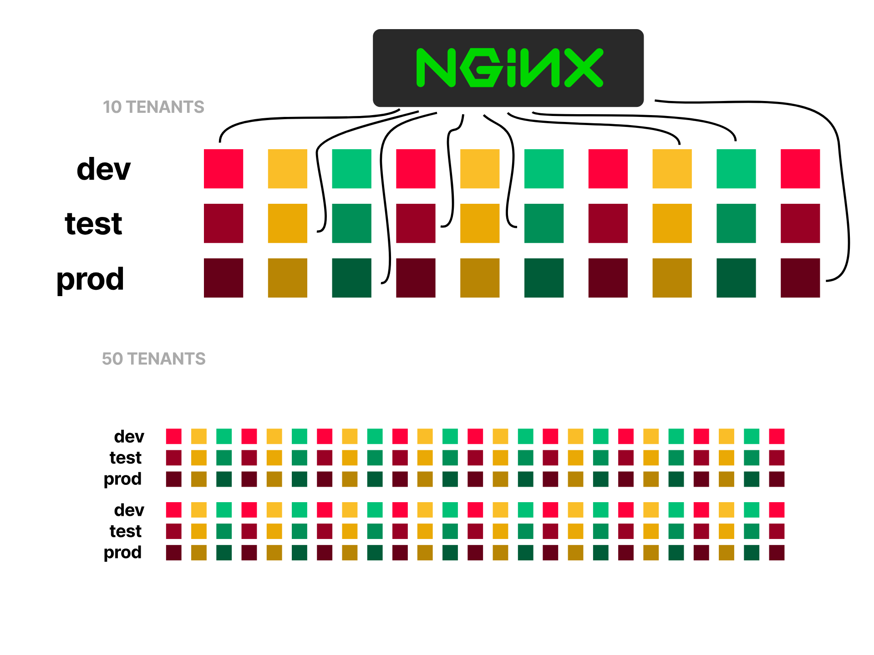
Notes:
which is a single pod that can serve your 10 tenants

Slide 31
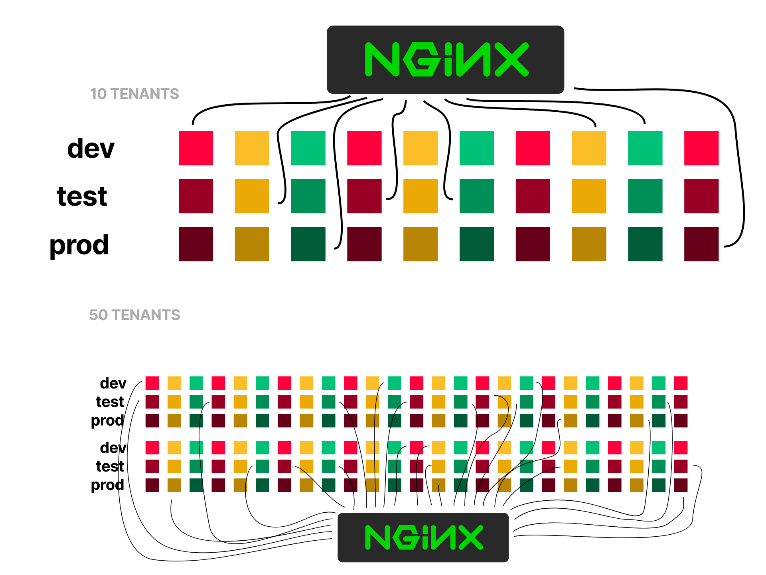
Notes:
just as easily as your 50

Slide 32
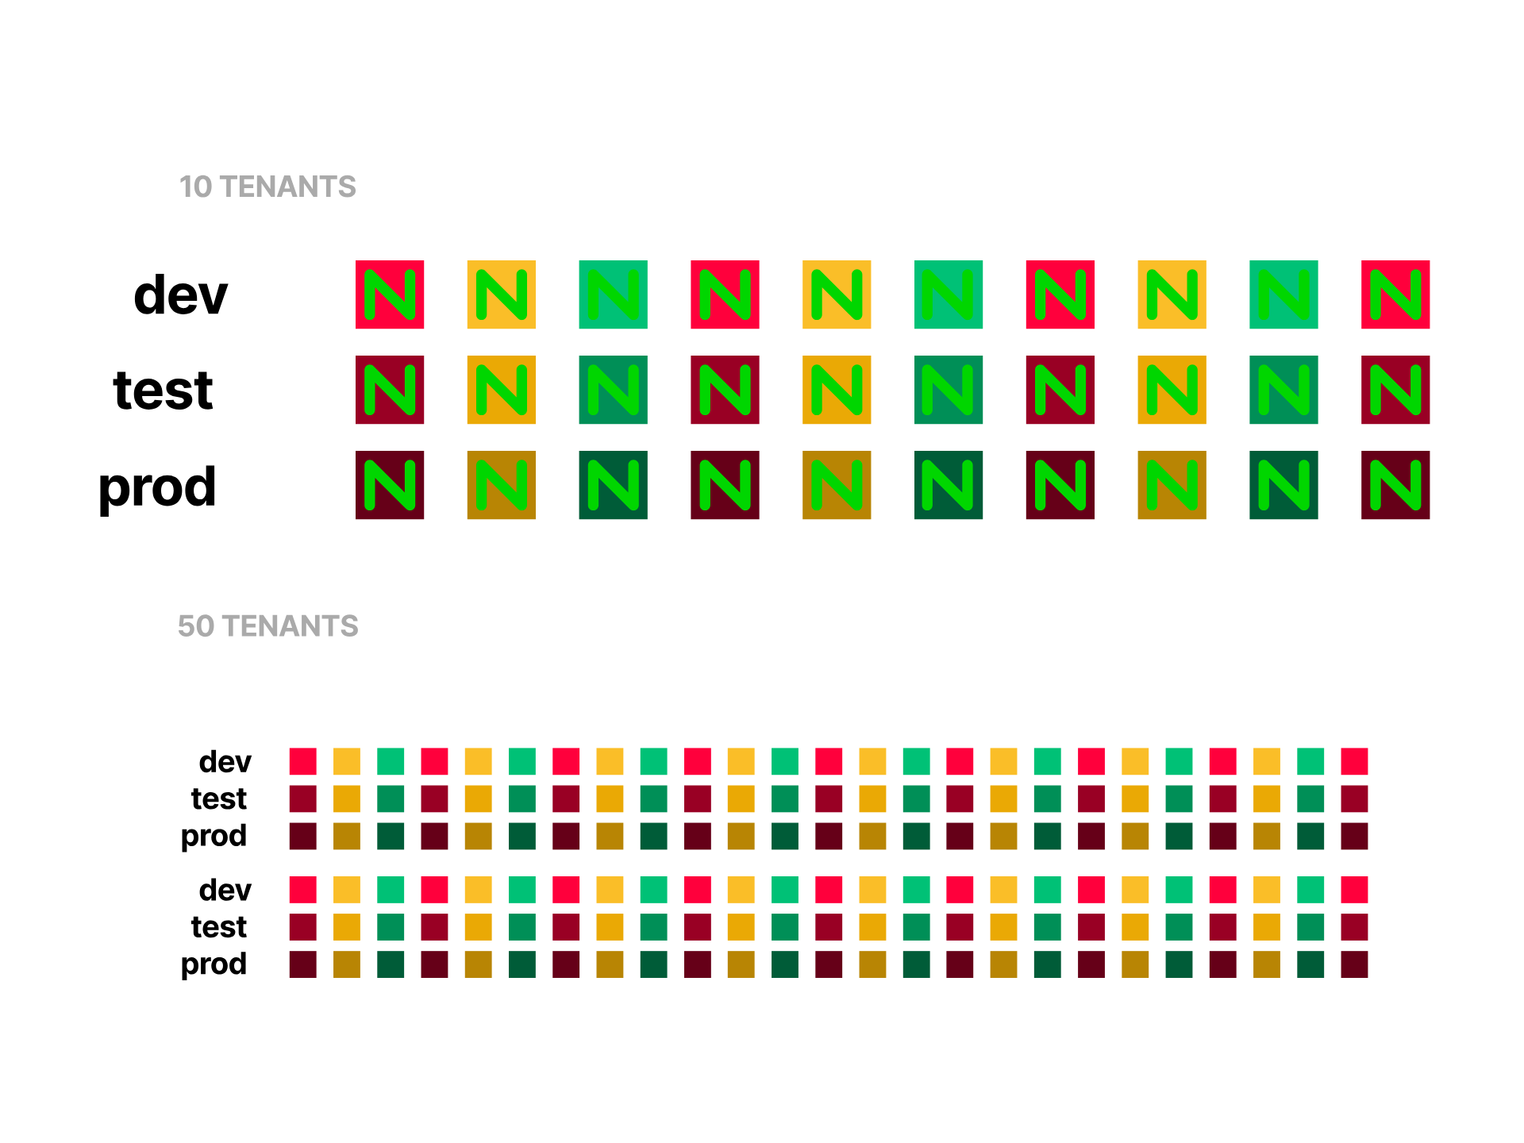
Notes:
Notice how that didn't mean we needed to scale to have 30 nginx ingress for our 10 tenant cluster

Slide 33
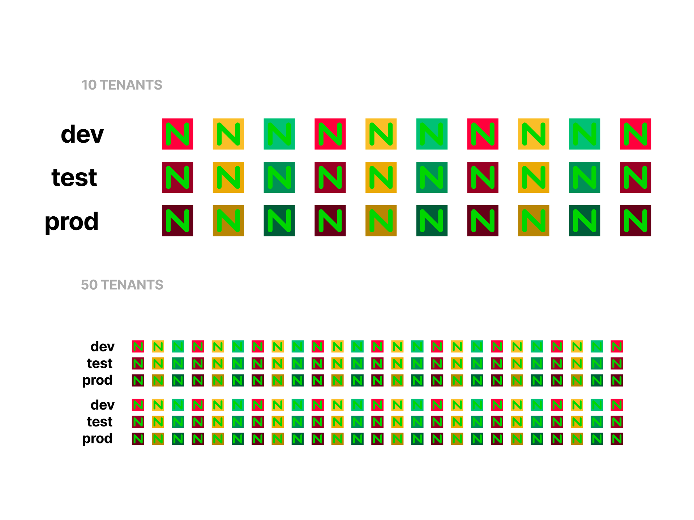
Notes:
or worse, 150 for our 50 tenant cluster

Slide 34
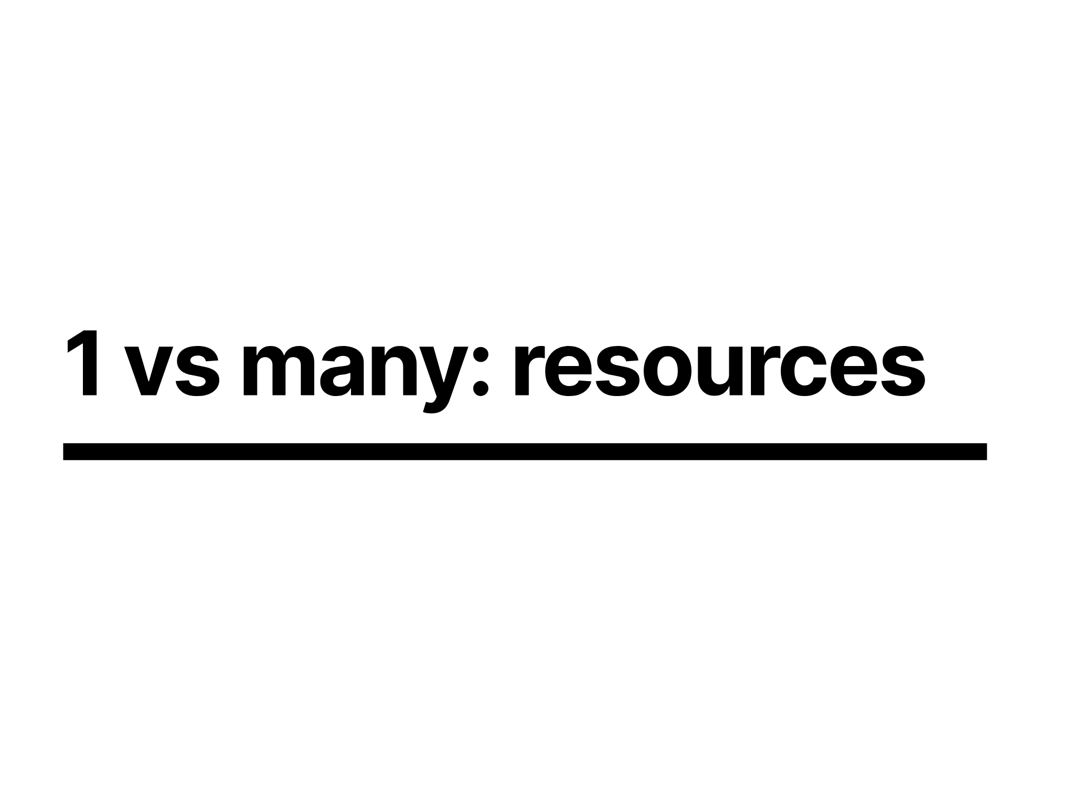
Notes:
so what are the cost implications of this choice

Slide 35
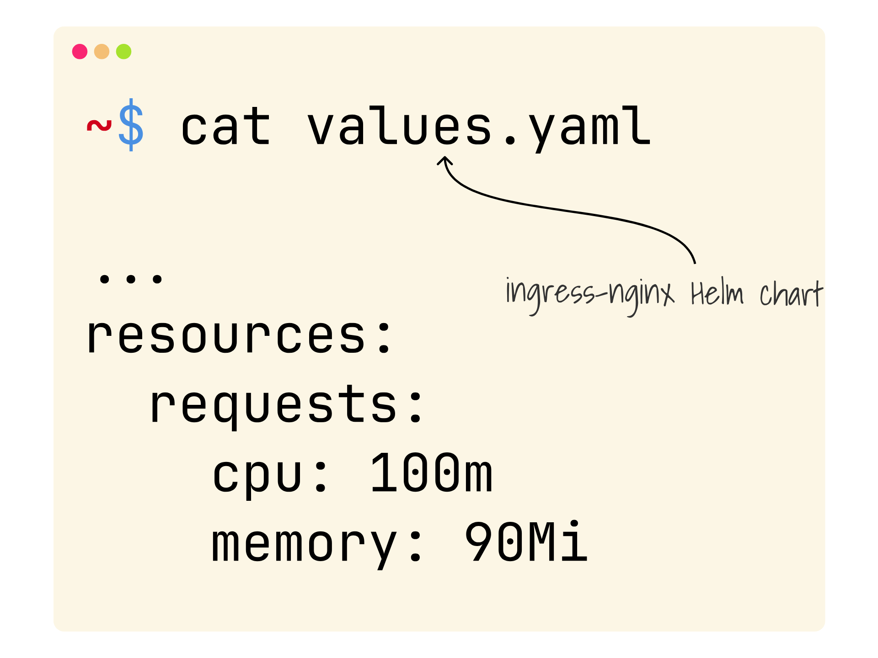
Notes:
If we look at the ingress-nginx helm chart config, you'll see we've got a resource request of 100 millicores and 90mb of ram

Slide 36
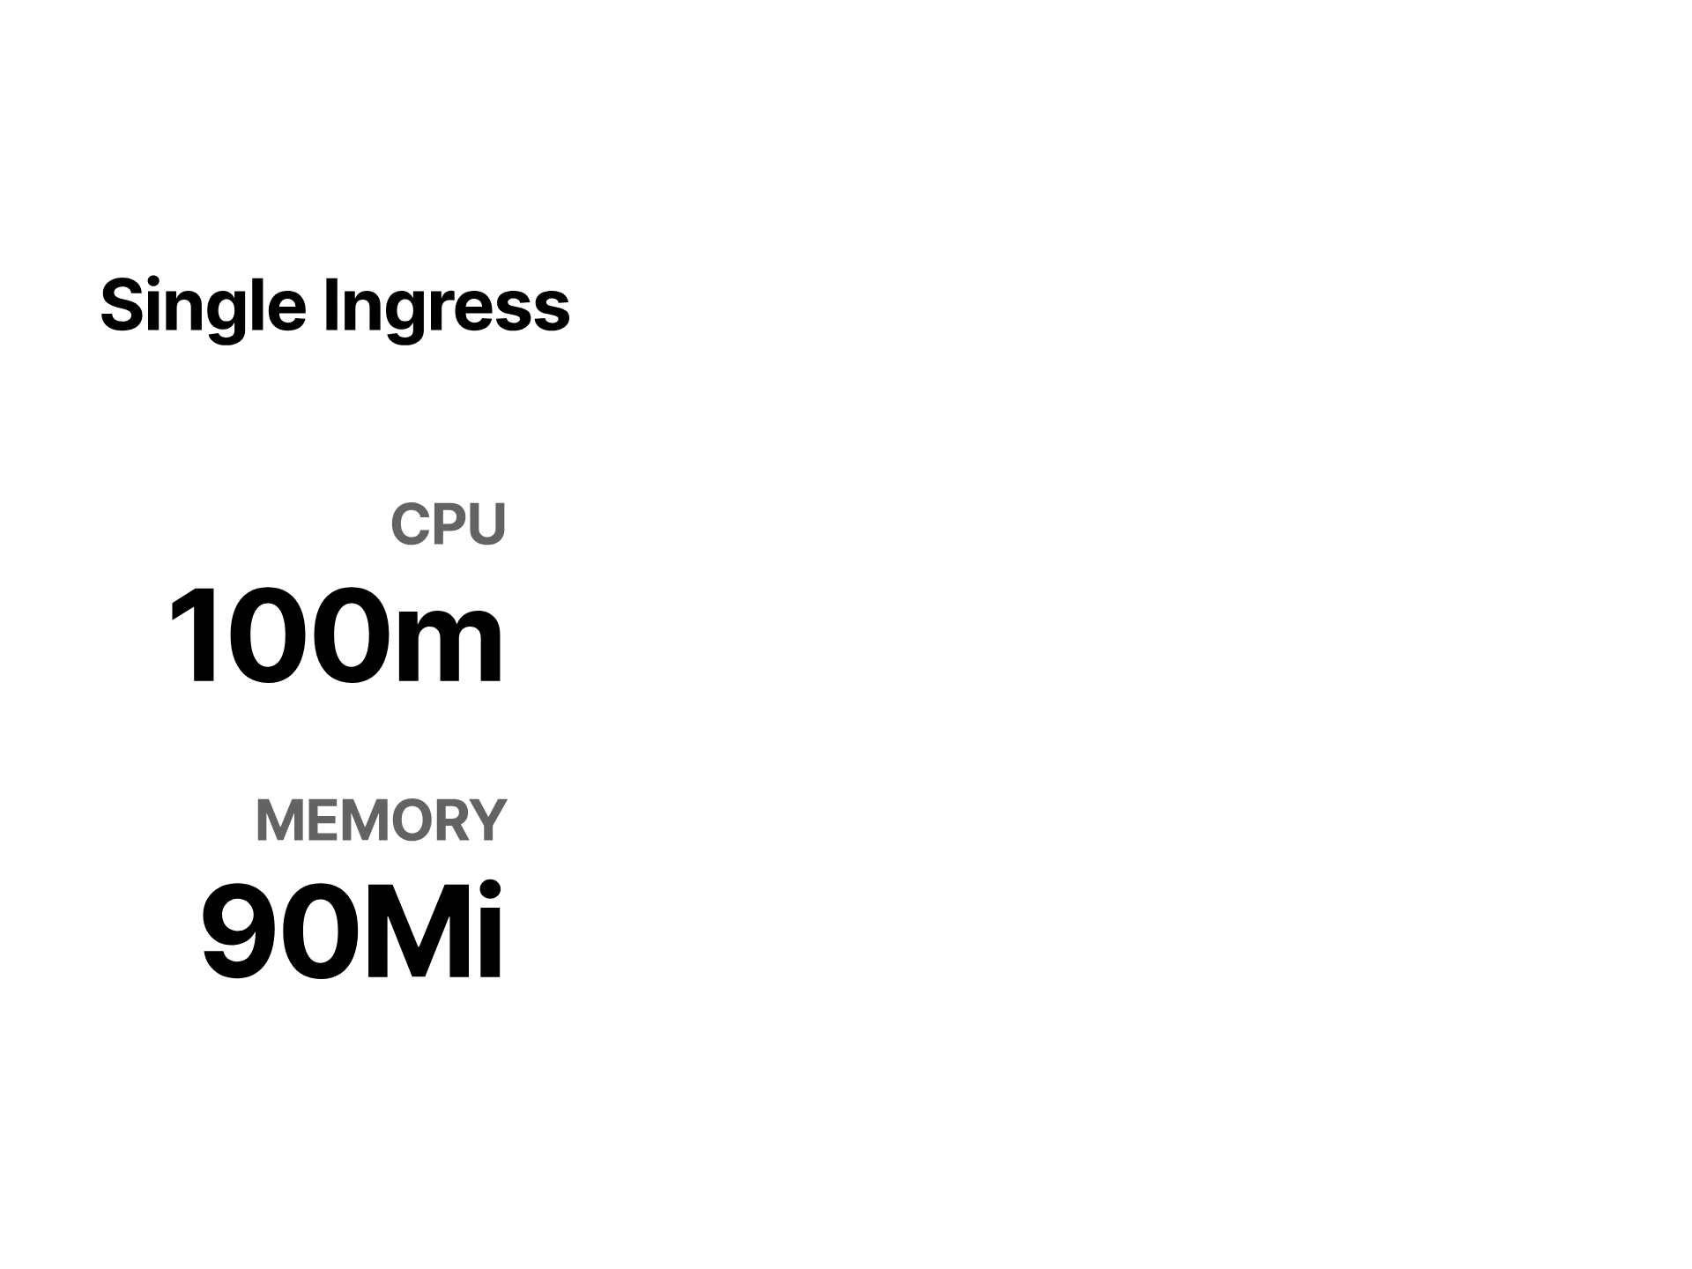
Notes:
Lets put scaling for the volume of traffic aside for a minute and assume we're just looking at the standing still cost. while the numbers might seem low in isolation they are likely going to turn into papercuts

Slide 37
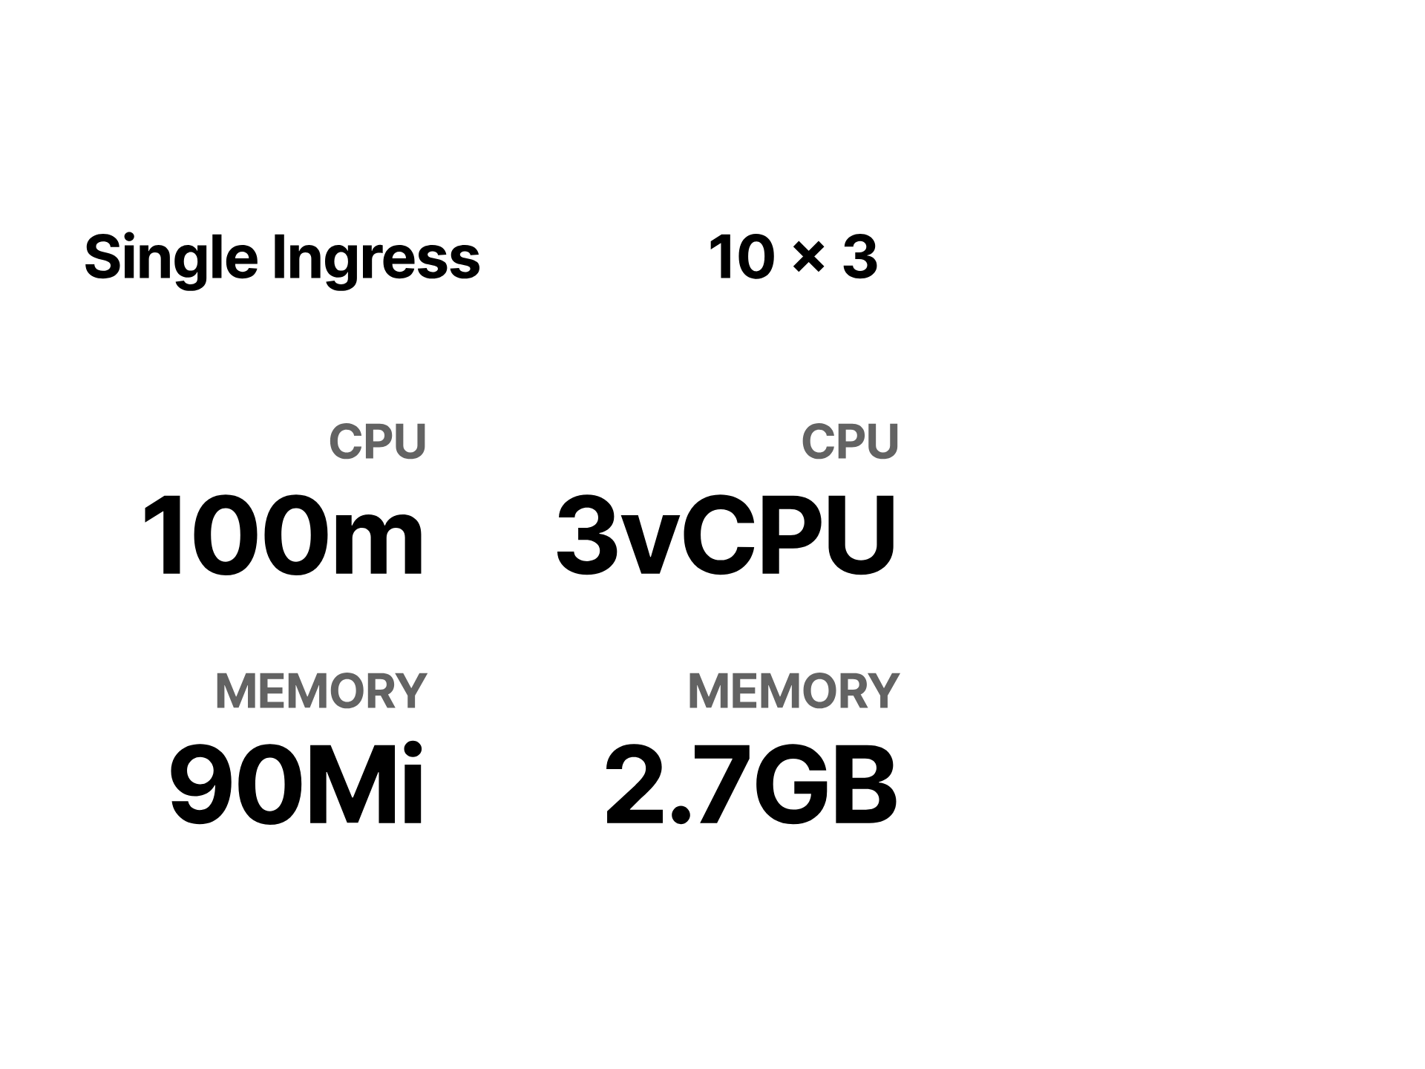
Notes:
so our 10 tenant 3 lifecycle stage cluster looks like this

Slide 38
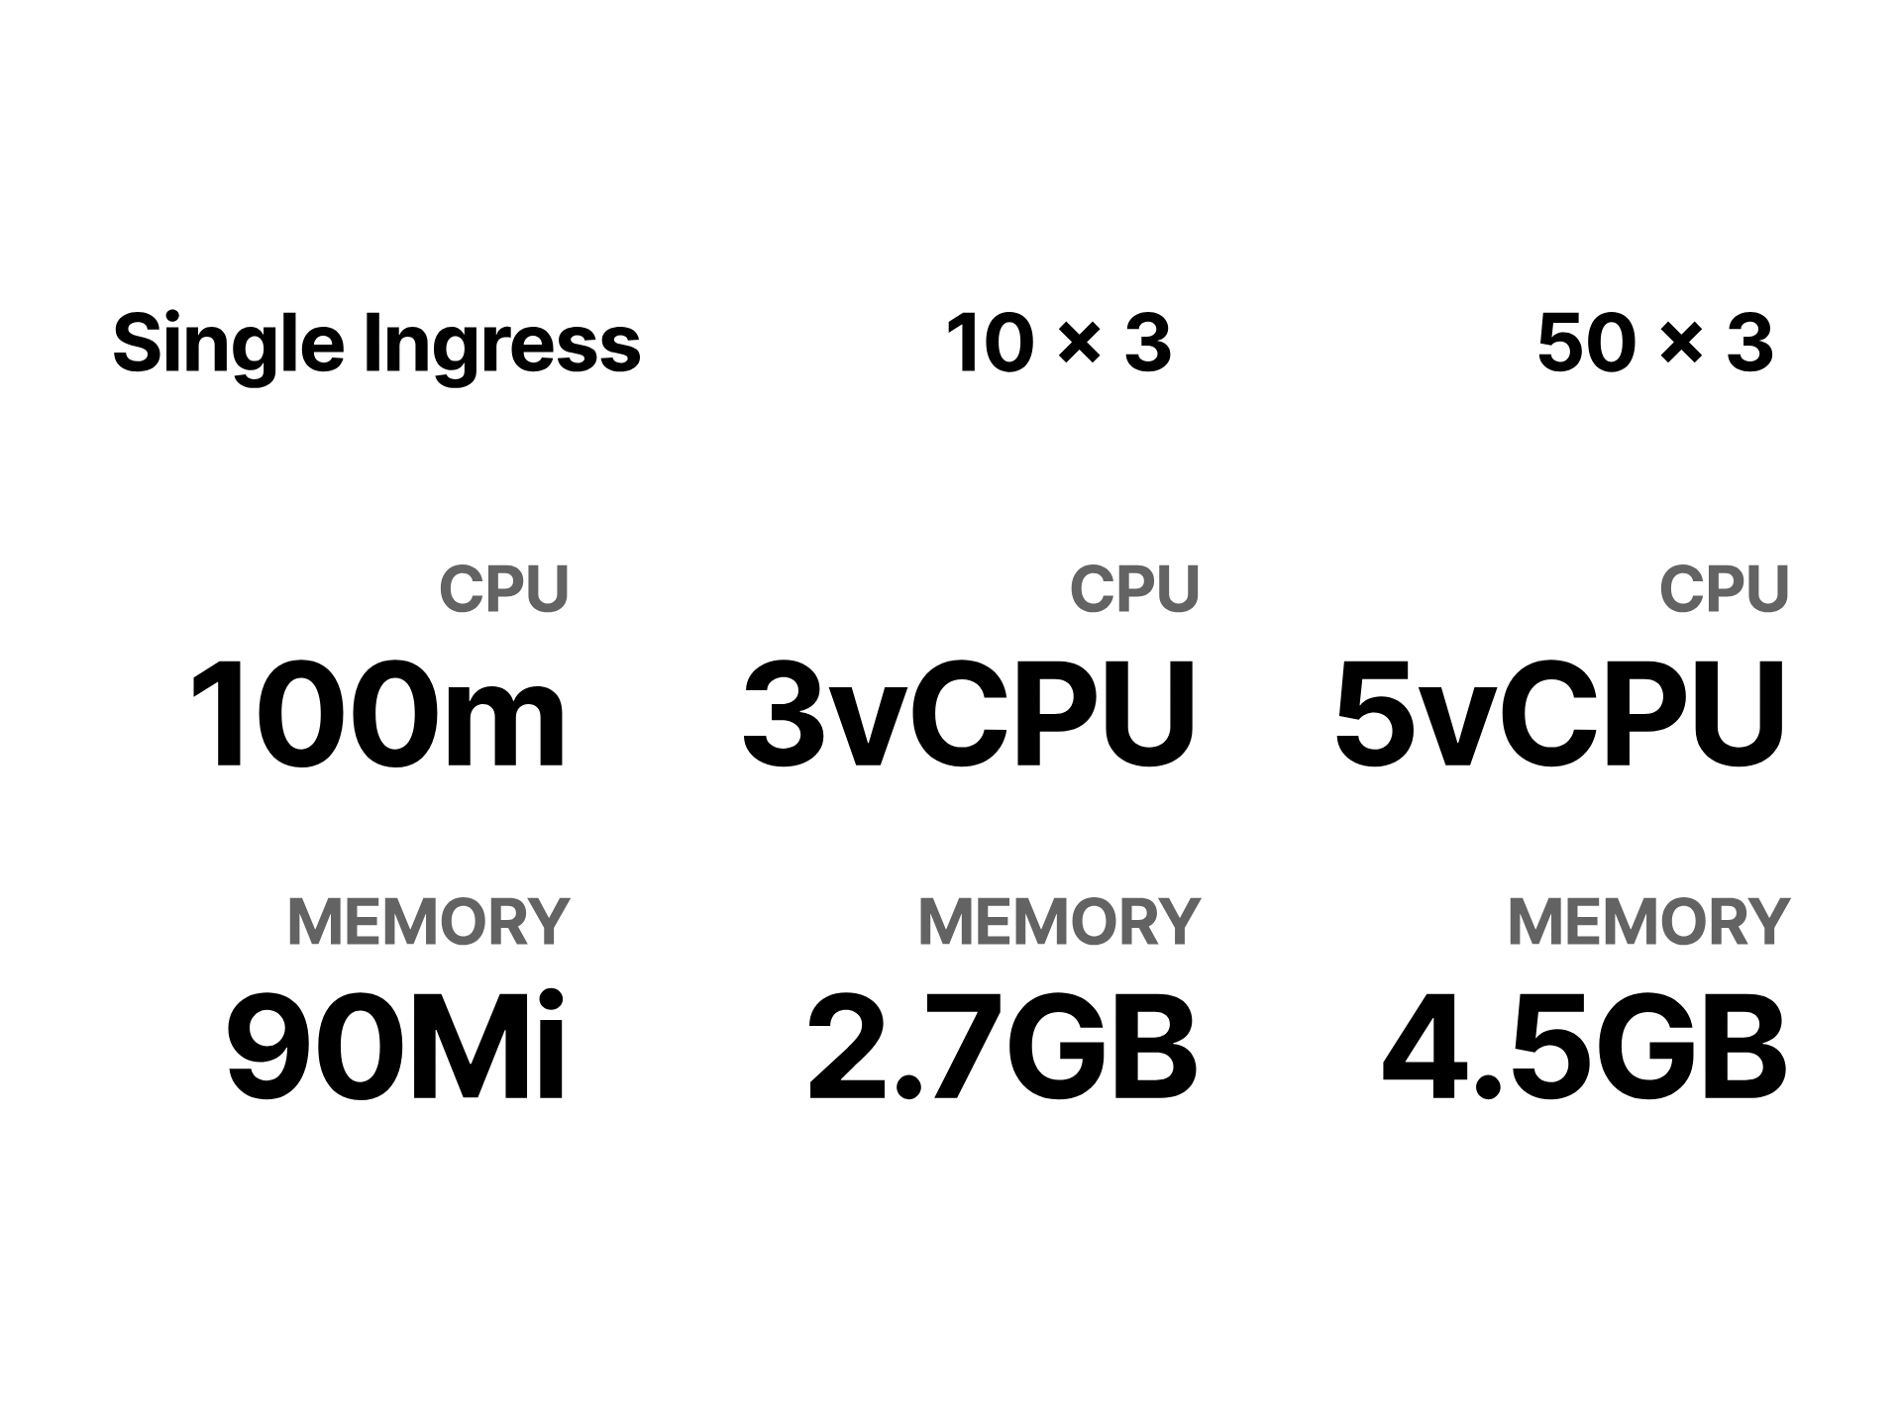
Notes:
and our 50 tenant one looks even worse
thats just math, and compute is cheap so who cares

Slide 39
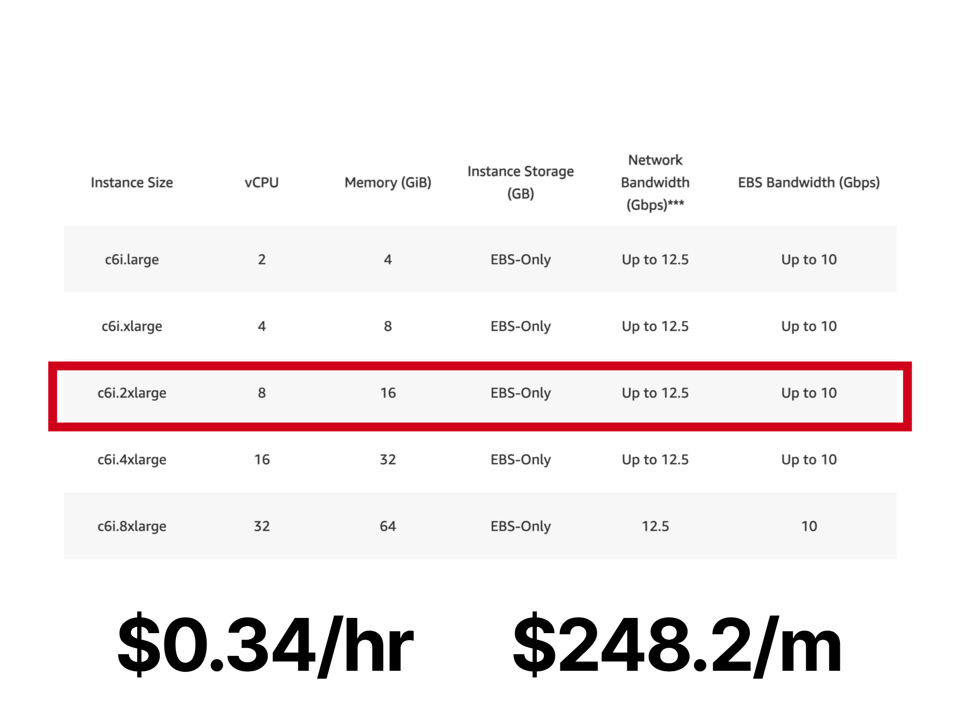
Notes:
Well someone might when get the bill for your ingress node requirement without it actually doing anything real. 248 bucks a month, just to stand still, before you add monitoring and logging and other stuff.

Slide 40
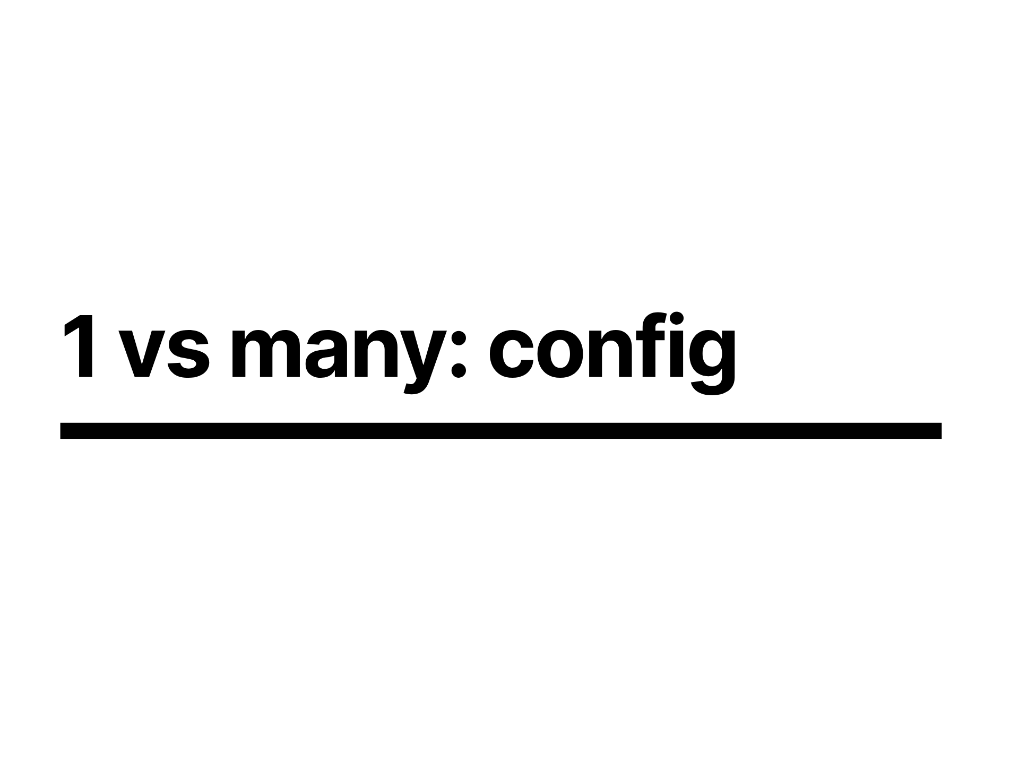
Notes:
So a single ingress might look like a good idea

Slide 41
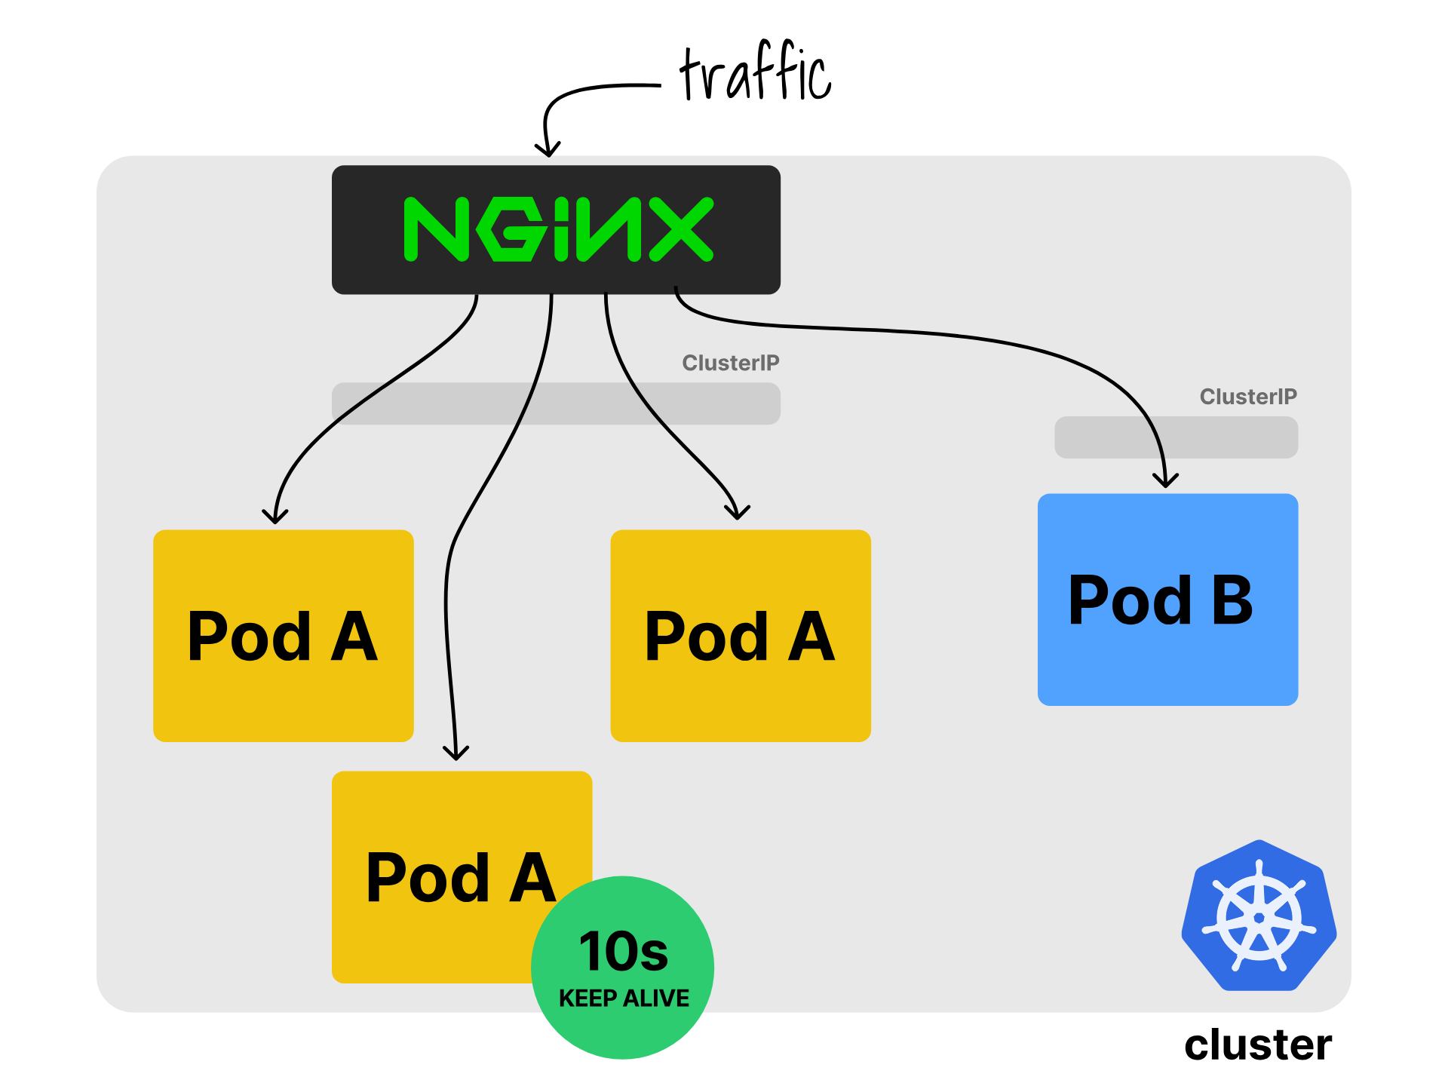
Notes:
but what happens when one of your snowflake teams wants a configuration option that isn't readily made available by the ingress annotations configuration such as tweaking the keep alive.

Slide 42
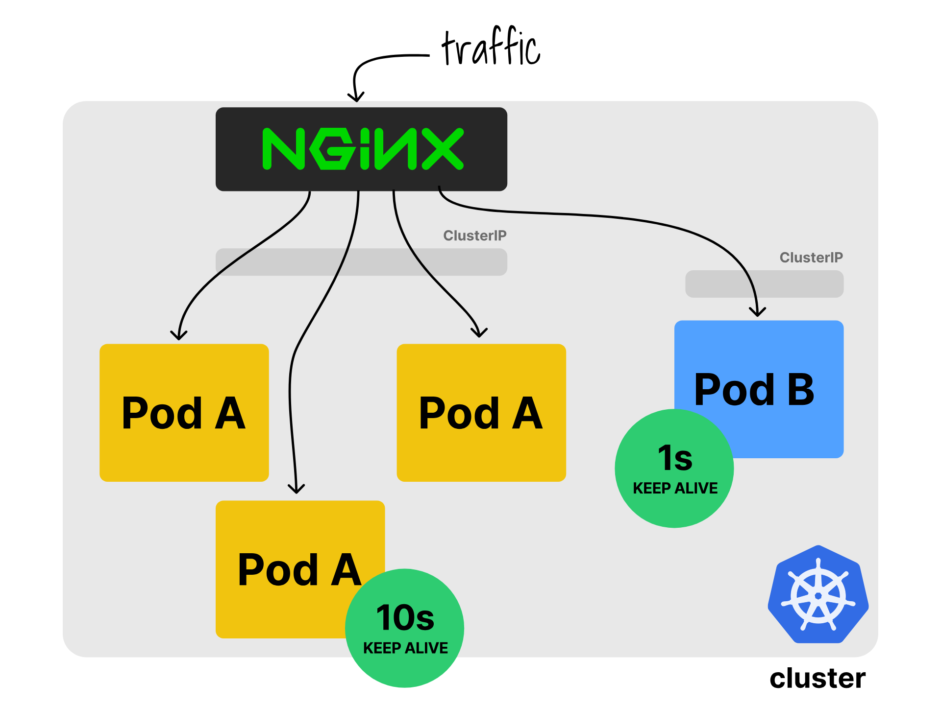
Notes:
But others don't, sure you could use the configuration snippet annotation to tweak this, but thats quite a blunt instrument you shouldn't really give all your teams since it allows any one of them to break ingress for everyone

Slide 43
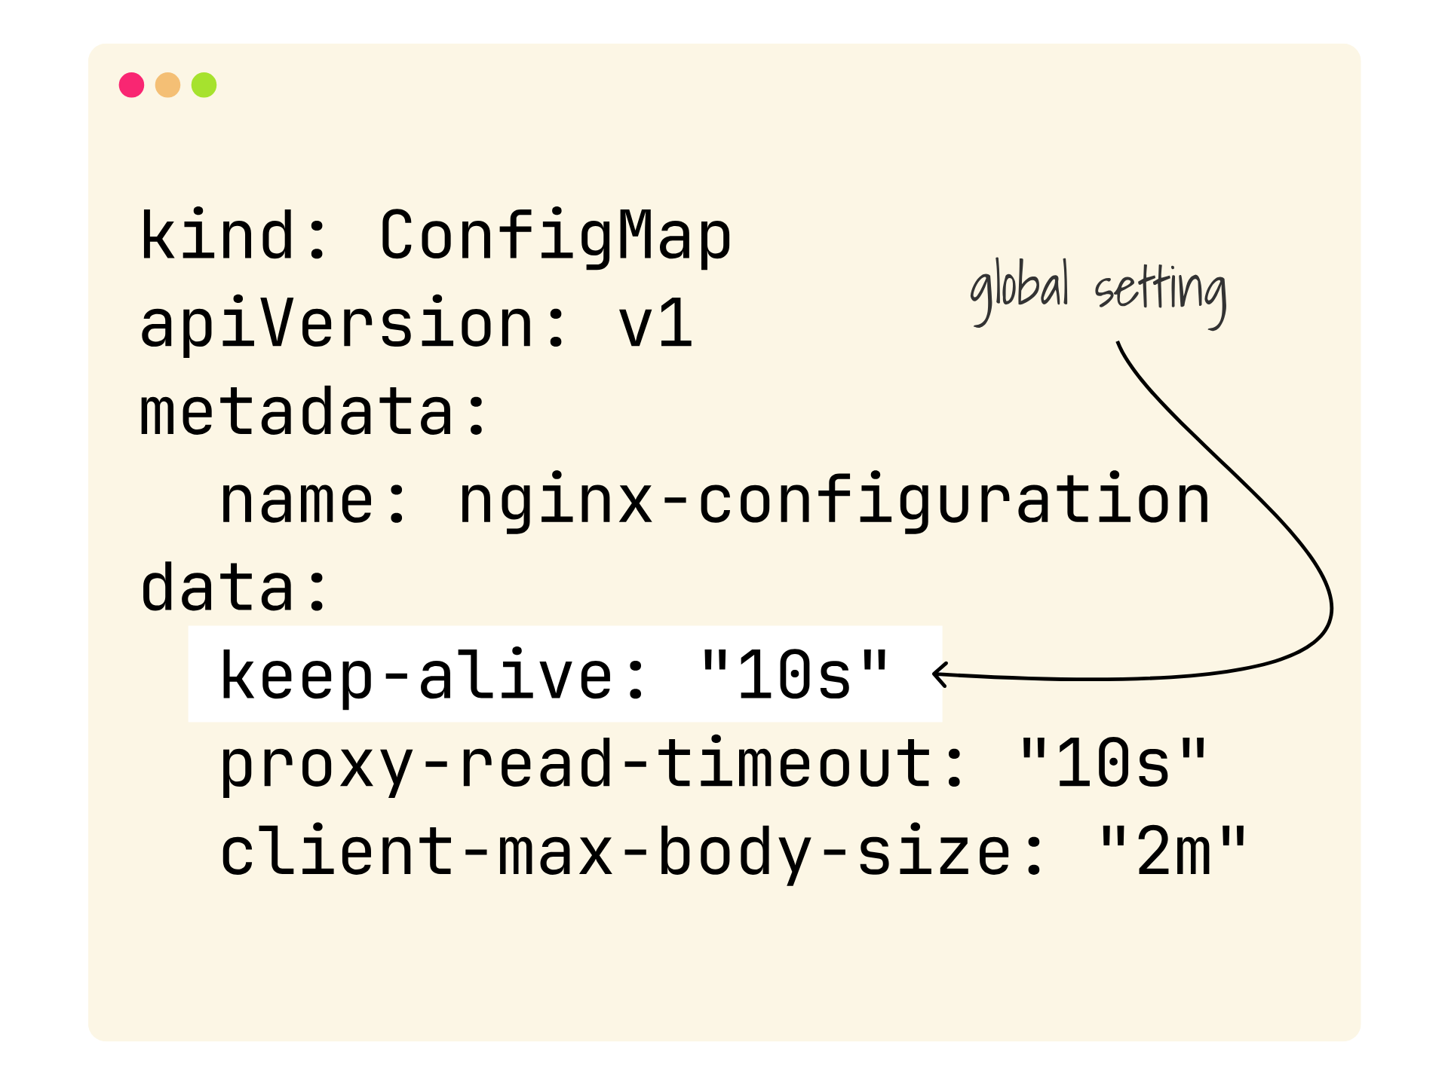
Notes:
So you're stuck having to define that configuration option at a full cluster level

Slide 44

Notes:
consequently, those that didn't want that configuration have it forced upon them

Slide 45
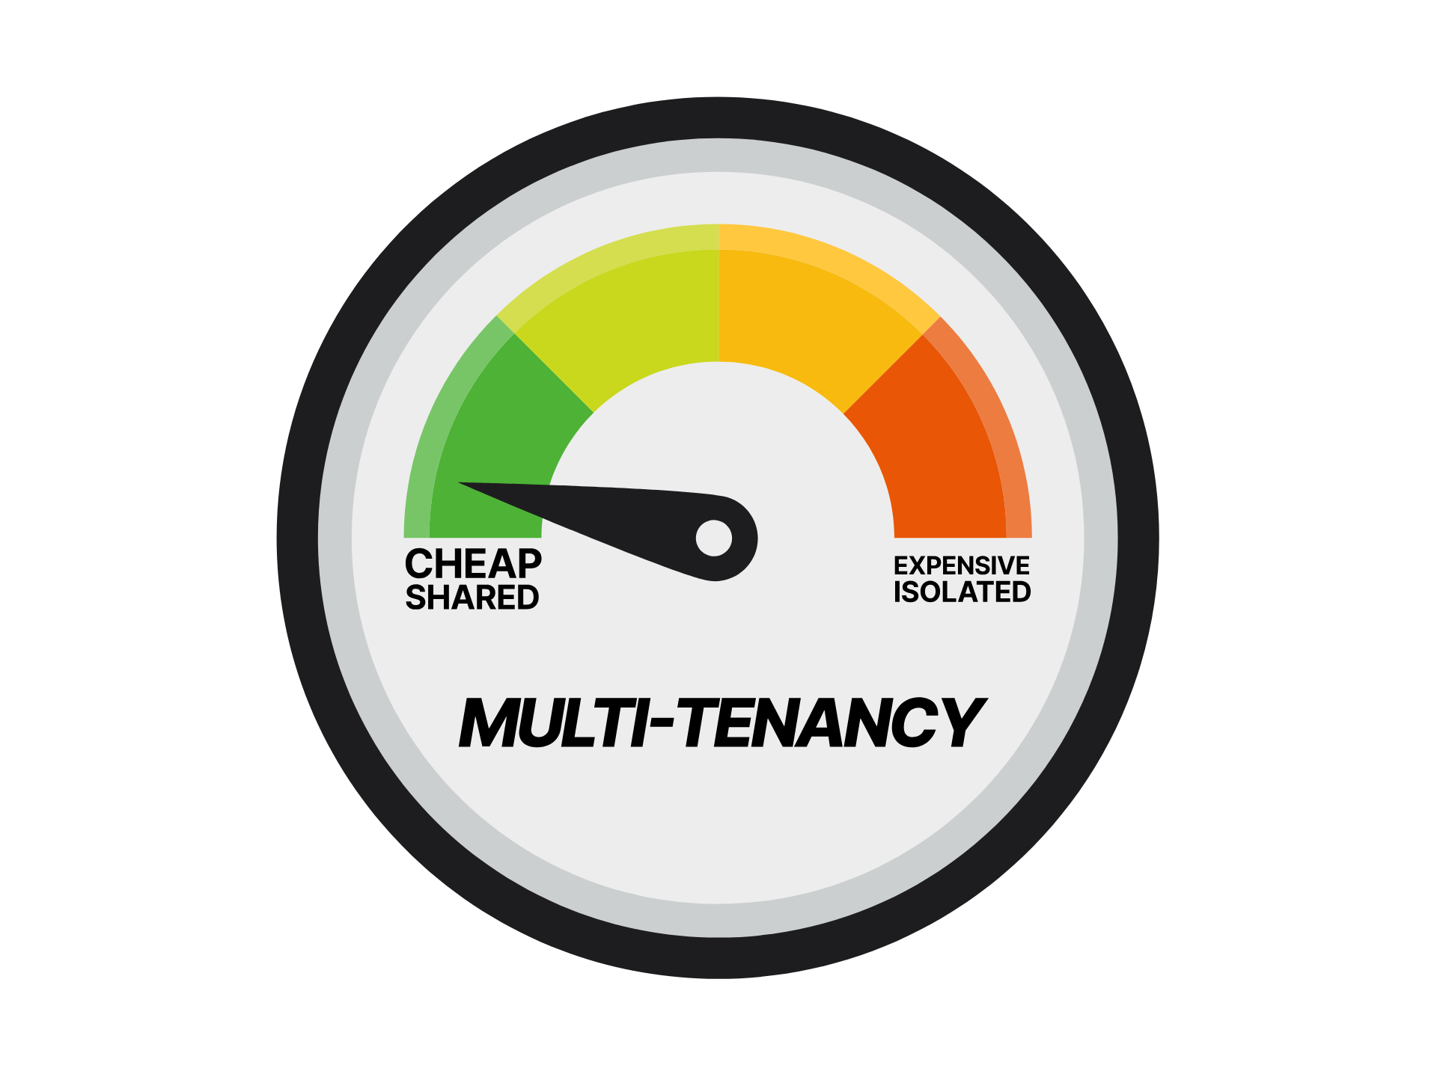
Notes:
If we look at our patent pending multi-tenancy o'meter you'll see that the configuration of a single shared ingress is tracking nice and cheap

Slide 46
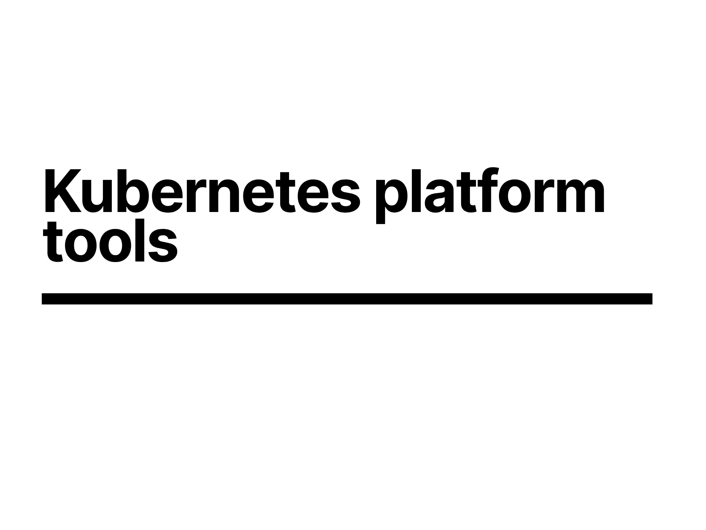
Notes:
but lets face it, when was the last time ingress was the only thing you installed in a cluster, those Custom Resources won't define themselves after all

Slide 47
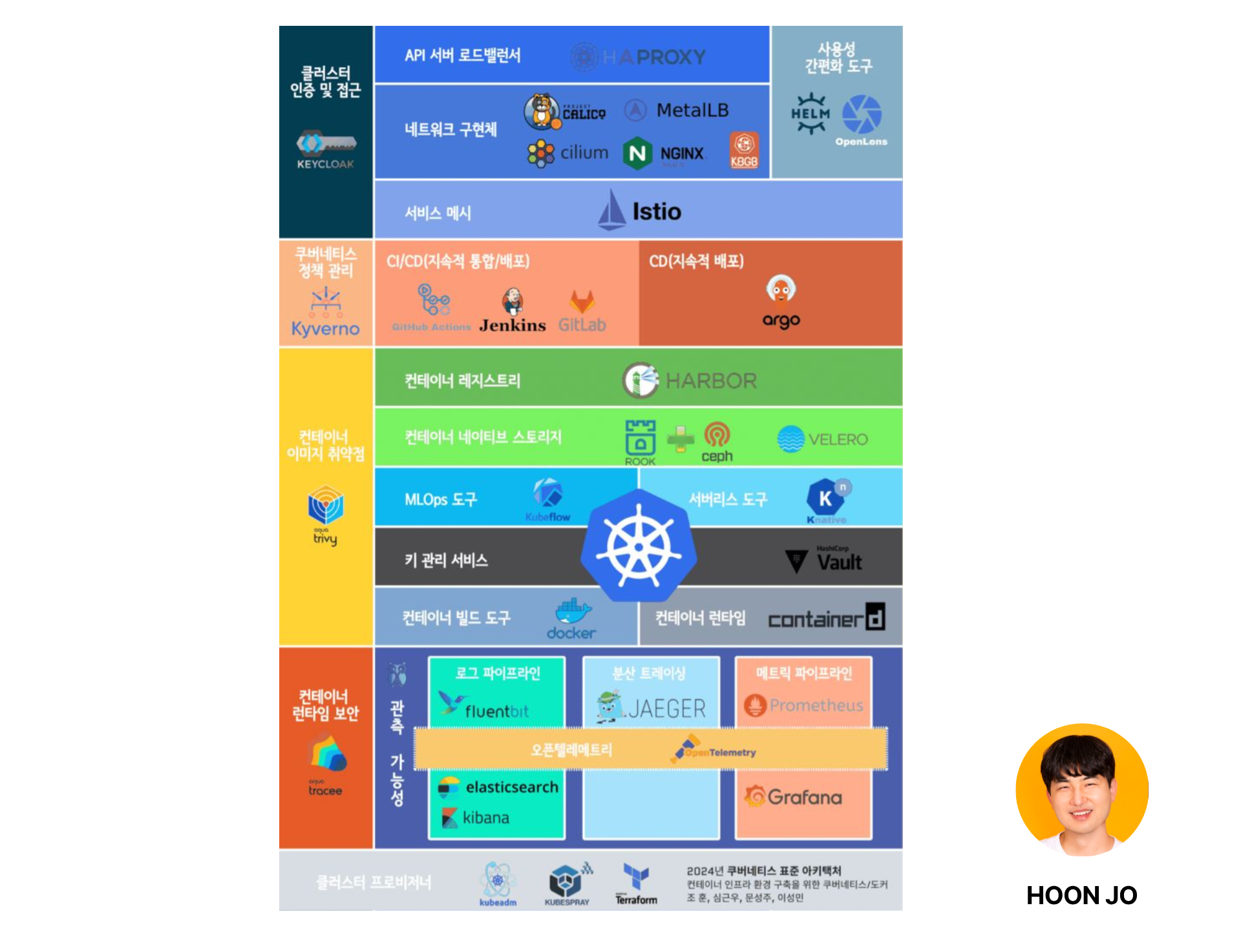
Notes:
Something like this likely looks familiar, logos as far as the eye can see. After all, our DevSecFinOps CV needed something new and shiny added to it.

Slide 48
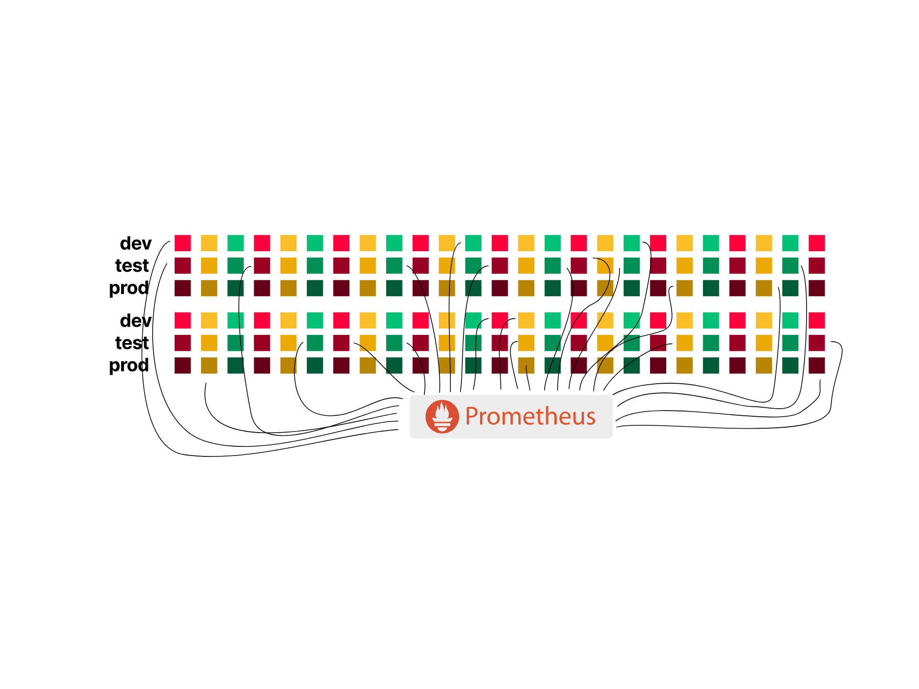
Notes:
Lets take prometheus for example, well you don't normally run it like this where you have a shared one for every application workload

Slide 49
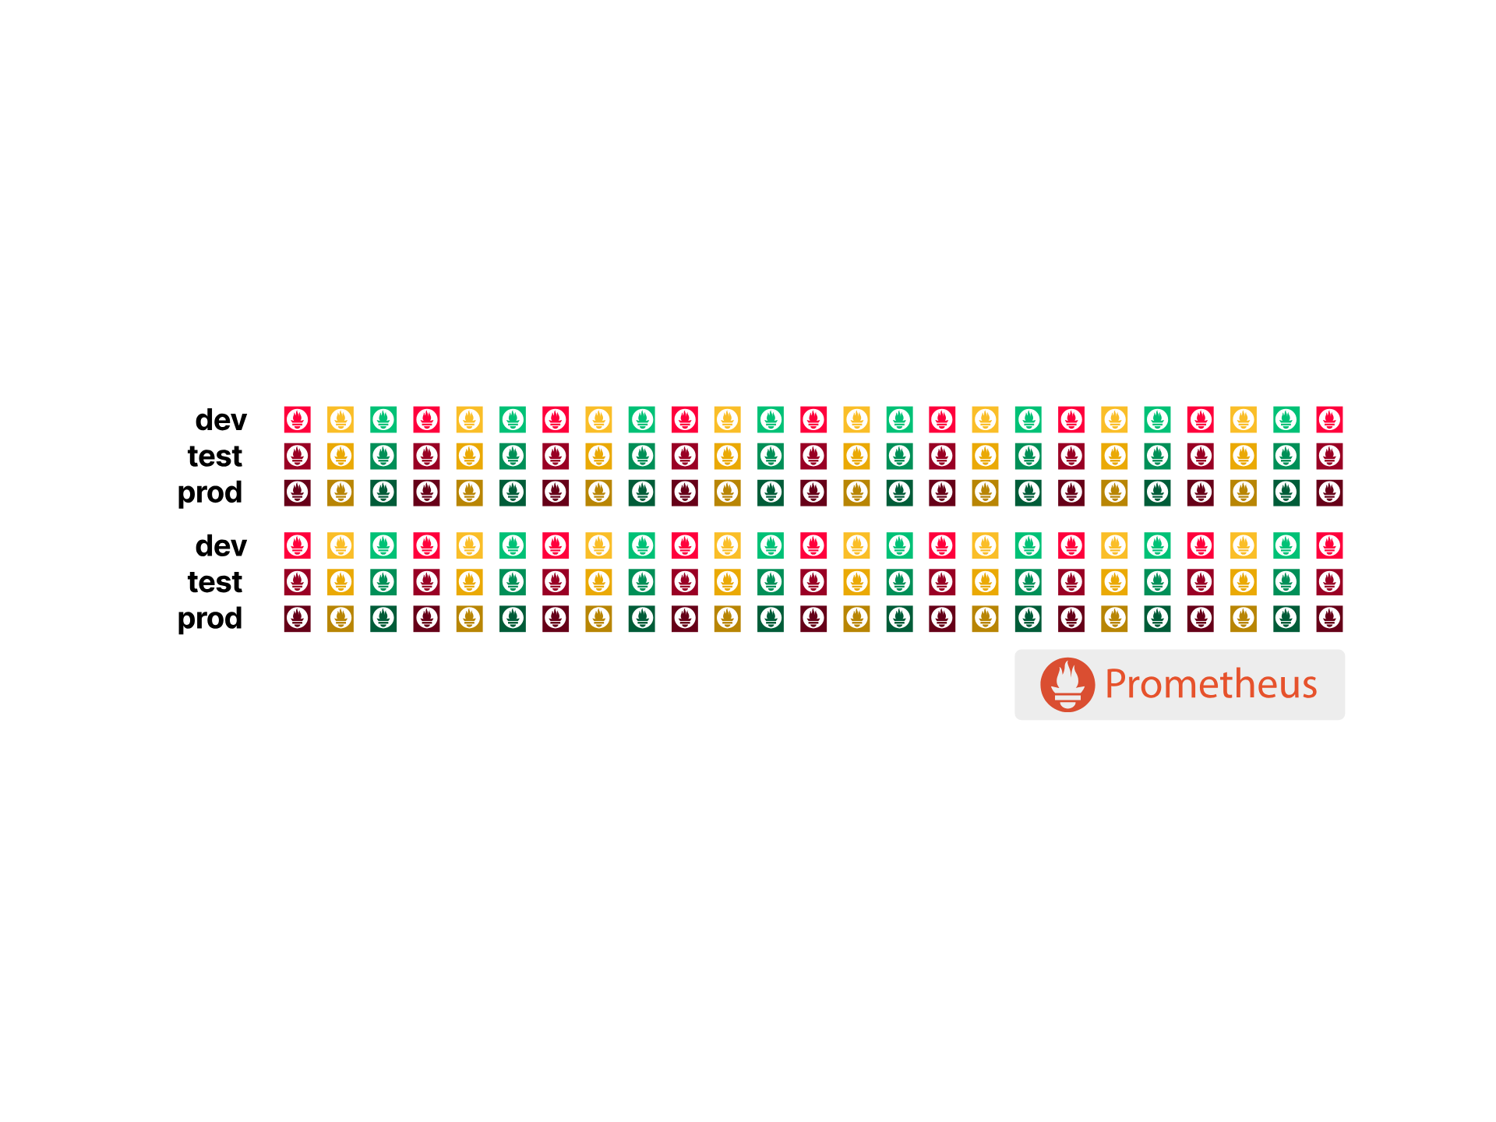
Notes:
So you're cluster is going to be looking something more like this

Slide 50
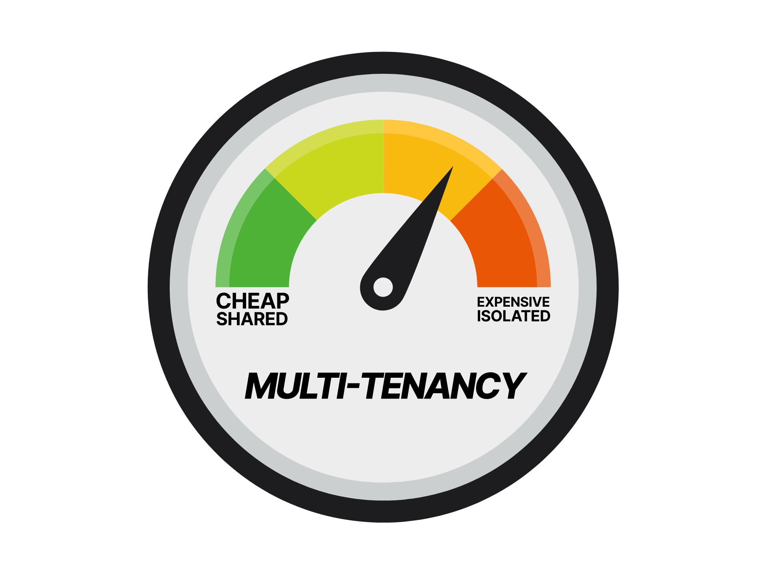
Notes:
taking a look at our multi-tenancy-o-meter, we can see the costs of this sort of practice accruing

Slide 51
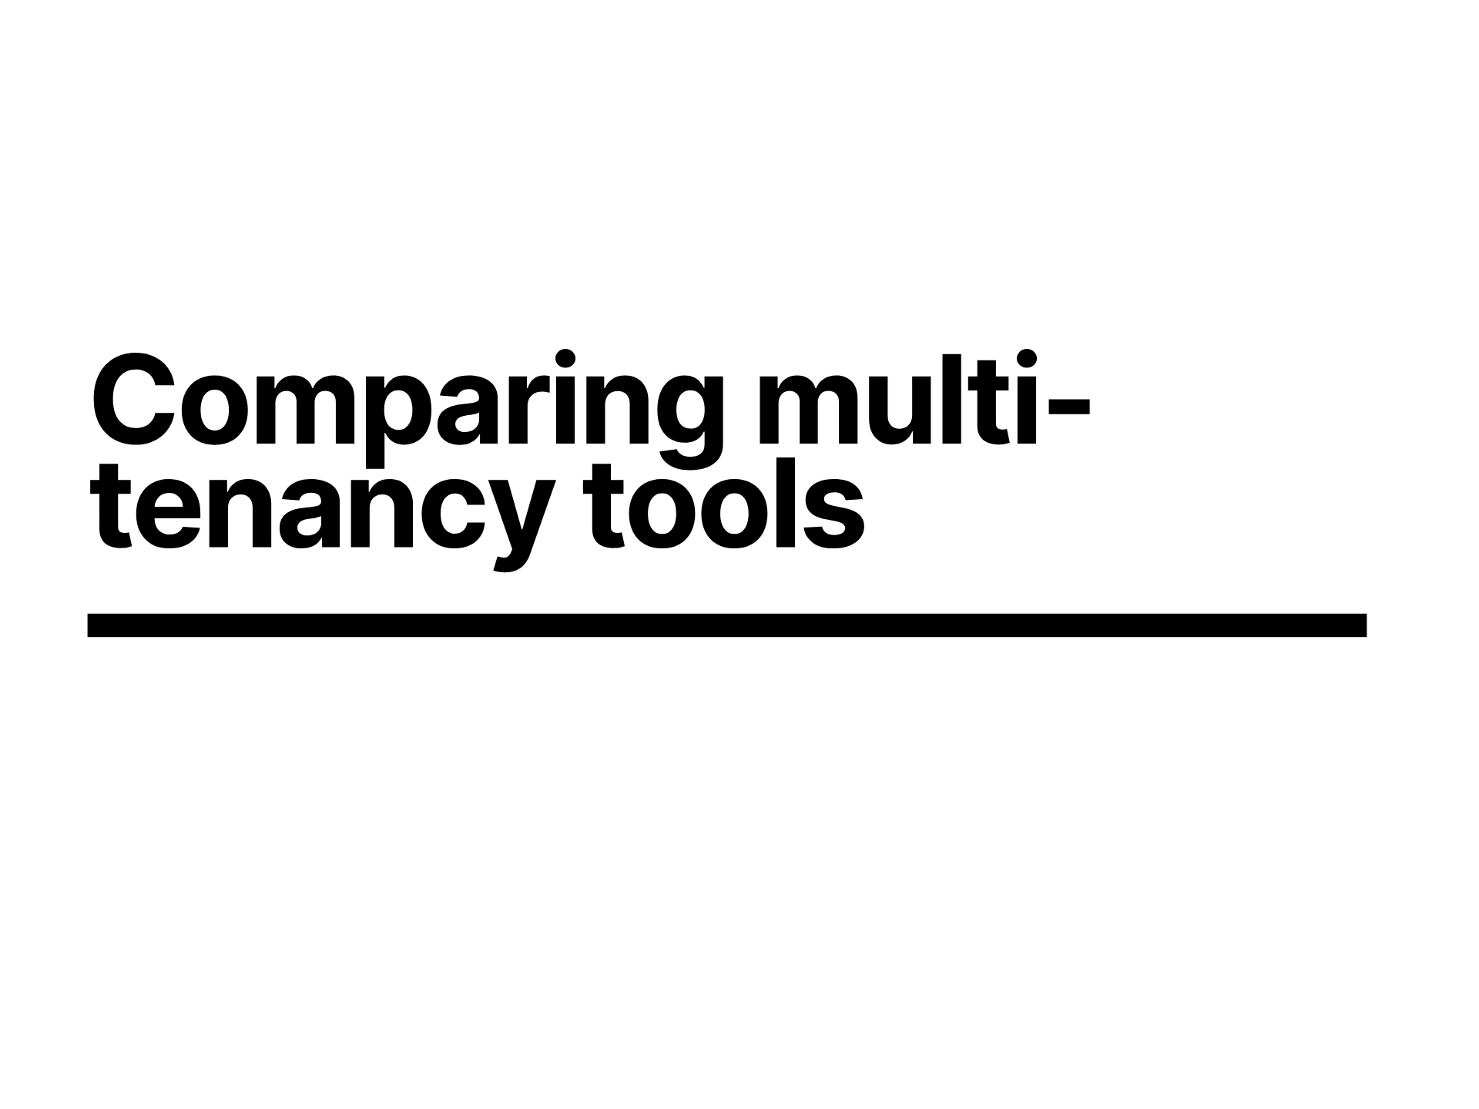
Notes:
So, since we're logo loving devops, lets see what more complexity we can add to manage it more easily and give ourselves enough time to anxiously refresh the CNCF landscape for new logos to find what we need to install next.

Slide 52
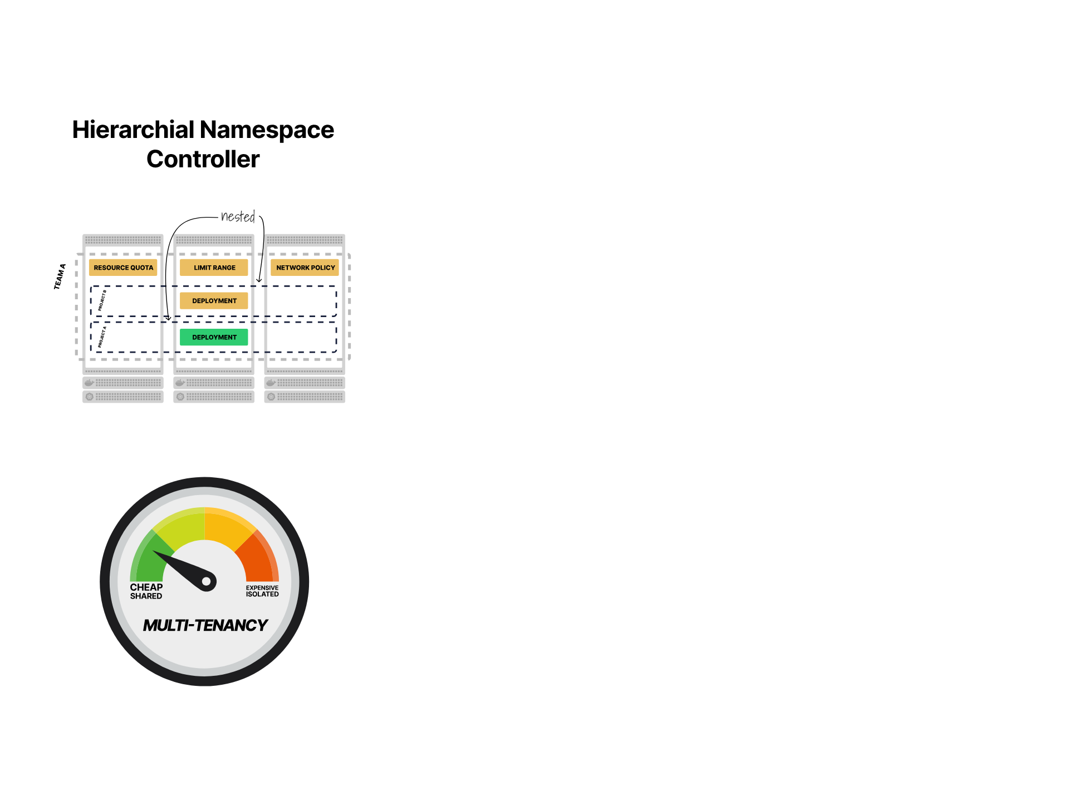
Notes:
first tool we'll look at is the hierarchical namespace controller

Slide 53

Notes:
We'll then look at vCluster from our kind friends loft labs, the v stands for virtual, we'll look at what that means in reality since while novel doesn't really align with the word virtual in other computing senses.

Slide 54

Notes:
And lastly we'll look at karmada as a means of managing many clusters

Slide 55

Notes:
hierarchical Namespace Controller as the name suggests is a controller

Slide 56

Notes:
that allows you to define a root, or parent namespace

Slide 57

Notes:
and then define a child tree off the back of that

Slide 58

Notes:
the rabbit hole can go as deep as you like

Slide 59

Notes:
This is the first of my three demos today, because Daniele and Salman who did the previous two talks thought it'd be really funny if I demoed all the hard stuff.
So join me in prayers to the demo gods while I try not to mess this up.
cd /Users/cns/httpdocs/learnk8s_loft
export PATH=$PATH:${PWD}
kind create cluster
kubectl apply -f https://github.com/kubernetes-sigs/hierarchical-namespaces/releases/download/v1.1.0/default.yaml # setup
kubectl -n hnc-system patch deployments.apps hnc-controller-manager --patch-file hnc-patch.yaml # setup
kubectl create ns parent
kubectl hns create tenant-1 -n parent
kubectl hns config describe
kubectl hns config set-resource resourcequota --mode Propagate
kubectl hns config describe
cat resource-quota.yaml
kubectl apply -f resource-quota.yaml
kubectl get resourcequotas -A
cat hnc-50.sh
./hnc-50.sh
kubectl get resourcequotas -A
kubectl hns set parent --allowCascadingDeletion
kubectl delete ns parent
kubectl delete -f https://github.com/kubernetes-sigs/hierarchical-namespaces/releases/download/v1.1.0/default.yaml # setup

Slide 60

Notes:
As you can see the namespaces aren't truly nested, its all smoke and mirrors

Slide 61

Notes:
theres a single controller doing the templating work for you

Slide 62

Notes:
but at the end of the day its just regular namespaces

Slide 63

Notes:
Our multi-tenancy-o-meter shows its cheap since the standing still cost of the tenants is zero since theres no workload in them.

Slide 64

Notes:
in fact, since these are just empty namespaces, a construct stored in etcd theres absolutely no inherent cost associated with it

Slide 65

Notes:
So what practical use are these namespaces

Slide 66

Notes:
lets have a look at roles
so if our team has some roles that they can read and write pods and pvs in the root namespace

Slide 67

Notes:
we could cascade those role bindings to all the children

Slide 68

Notes:
and we could do the same for many teams

Slide 69

Notes:
all allowing them access to the pv

Slide 70

Notes:
Our next approach of isolating the control plane

Slide 71

Notes:
which is what vCluster does, where by a namespace is created

Slide 72

Notes:
And inside that we run a small k3s instance.
Those that aren't familiar with k3s, its a lightweight Kubernetes distribution that by default uses sql lite as it's database backend instead of etcd and can lend itself to working very well running as a single binary

Slide 73

Notes:
so we can hit the api server with kubectl, and create a pod
but this is just an api server, theres no nodes to run the workload

Slide 74

Notes:
whats more its the wrong database for the real scheduler to pick it up, so what can we do?

Slide 75

Notes:
We could copy the pod spec

Slide 76

Notes:
which would magically cause the pod to be scheduled somewhere on the parent cluster

Slide 77

Notes:
and thats exactly what the vcluster syncer does, you select the resources and direction to sync them in between the clusters

Slide 78

Notes:
and with global resources like an ingress controller, crds, I can just sync the primitive resources like pods, configmaps, secrets, pvs and so on

Slide 79

Notes:
so if I apply my pv to the tenant cluster

Slide 80

Notes:
it'll get stored in the tenant control plane

Slide 81

Notes:
and then sync'd to the parent

Slide 82

Notes:
and allow the pvc to bind to that pv and the pods to connect to it

Slide 83
Notes:
DEMO
cat pv-values.yaml
vcluster create tenant1 --upgrade -f pv-values.yaml
cat pv.yaml
kubectl apply -f pv.yaml
vcluster disconnect
kubectl get pv
vcluster create tenant2 --upgrade -f pv-values.yaml
kubectl apply -f pv.yaml
kubectl get pv
vcluster disconnect
kubectl get pv
vcluster delete tenant1
vcluster delete tenant2
kubectl delete pv --all
cat vcluster-50.sh
./vcluster-50.sh
kubectl get ns
kubectl get pod -A

Slide 84

Notes:
so this gives us a kinda nested control plane

Slide 85

Notes:
with a sense that we can give what feels like cluster admin out selectively to tenants, if you squint its a virtual cluster

Slide 86

Notes:
but theres a single parent cluster that exists, and can have controls and configuration set there, and we don't have heaps of fully independent clusters, many highly available.

Slide 87

Notes:
our multi-tenancy-o-meter is twitching but its still reasonably cheap

Slide 88

Notes:
We'll need around an extra 17 nodes to handle our 50 tenants controlplane pods

Slide 89

Notes:
and 50 pvs for all the databases

Slide 90

Notes:
totalling out around 254 bucks, or $5 per tenant a month

Slide 91

Notes:
what does that mean for your workloads though when you apply a pod

Slide 92

Notes:
well the pods will share nodes with other tenants

Slide 93

Notes:
which introduces a noisy neighbor concern

Slide 94

Notes:
but we could create node pools to separate that, so a single control plane could operate multiple pools
vcluster makes this a bit easier with the node selector and enforce node selector options

Slide 95

Notes:
so that all sounds great, but what about network

Slide 96

Notes:
well the inherent rules of Kubernetes networking still exist that any pod can talk to any pod, and that overarching cluster is a flat network.

Slide 97

Notes:
depending on your network, you may be able to apply network policy in order to limit what is permitted to talk to what

Slide 98

Notes:
in effect giving us an isolated network boundary
vcluster makes this easy with the --isolate parameter

Slide 99

Notes:
so thats the network isolated

Slide 100

Notes:
but if any one of the containers escapes to the host, perhaps through a kernel vulnerability

Slide 101

Notes:
well if you've got to the node, then its not a big leap to then take the kubelet

Slide 102

Notes:
and in turn take the control plane, at which point your entire multi tenant cluster and everything it connects to has been compromised. its a bad day

Slide 103

Notes:
what alternatives do we have left

Slide 104

Notes:
Well, we could run a bunch of different clusters

Slide 105

Notes:
Enter Karmada to make some sense of that

Slide 106

Notes:
which abstracts some of the things you might be used to seeing in Kubernetes with

Slide 107

Notes:
some karmada equivalents

Slide 108

Notes:
to dig in to the architecture of that

Slide 109

Notes:
so our master cluster can command the child clusters agent

Slide 110

Notes:
which in turn communicates with the agent's cluster api server

Slide 111

Notes:
so a kubectl apply to the master

Slide 112

Notes:
will cascade into the child cluster

Slide 113

Notes:
This effectively gives us independent clusters with an overarching central management

Slide 114

Notes:
with calls made to the manager

Slide 115

Notes:
being passed on to child clusters giving me both standard fixed workloads, perhaps some logging and policy engine and config

Slide 116

Notes:
along with workloads

Slide 117

Notes:
that are individual to

Slide 118

Notes:
each team or environment
and the child clusters could be anywhere, from all being in the same physical data centre, all the way through to geographically disparate multi cloud vendors and some hybrid cloud thrown in for good measure because fun times

Slide 119

Notes:
Last demo god prayer to make, wish me luck
DEMO
export KUBECONFIG=karmada-apiserver.config
kubectl get cluster
#deploy something on a worker
cat deploy.yaml
KUBECONFIG=worker-1-kubeconfig.yaml kubectl apply -f deploy.yaml
kubectl get --raw /apis/search.karmada.io/v1alpha1/search/cache/apis/apps/v1/deployments | jq '.items[] | (.metadata.annotations["resource.karmada.io/cached-from-cluster"] + " " + .metadata.name)'
## demo propagating a deploy
cat propagating-deploy.yaml
kubectl apply -f propagating-deploy.yaml
KUBECONFIG=worker-1-kubeconfig.yaml kubectl get pods -A
KUBECONFIG=worker-2-kubeconfig.yaml kubectl get pods -A
KUBECONFIG=worker-1-kubeconfig.yaml kubectl delete -f deploy.yaml
kubectl delete -f propagating-deploy.yaml
unset KUBECONFIG

Slide 120

Notes:
So we saw a cluster of clusters

Slide 121

Notes:
with administrative control being carried down to the tenant clusters

Slide 122

Notes:
and we saw there was no sharing of any network, worker nodes. but still some consolidation
ultimately a strong isolation

Slide 123

Notes:
our multi-tenancy-o-meter is well into the red however

Slide 124

Notes:
but what is that in dollars
so we need 51 clusters, well the control plane node don't cost us anything with our cloud vendor

Slide 125

Notes:
there'll need to be at least 1 node per cluster in order to support the agent

Slide 126

Notes:
so that totals out at 612 bucks or 12 per tenant per month

Slide 127

Notes:
so by means of a review

Slide 128

Notes:
we started with basic Kubernetes, and added some multi-tenancy through namespaces

Slide 129

Notes:
we then added in some isolation with node pools giving us runtime isolation

Slide 130

Notes:
we saw what happened when we added in some common things like monitoring

Slide 131

Notes:
logging

Slide 132

Notes:
storage

Slide 133

Notes:
ci/cd

Slide 134

Notes:
and ingress

Slide 135

Notes:
and of course we saw the cost implications of those choices

Slide 136

Notes:
We saw the costs ranging from 0 for the Hierarchical namespace controller, vCluster in at 252, and karmada at 612 dollars/month

Slide 137

Notes:
on top of that, theres the cost of a dedicated ingress for each of those 50 tenants

Slide 138

Notes:
bringing our totals to this

Slide 139

Notes:
now add on some monitoring and logging

Slide 140

Notes:
and any other tooling and you can see the exponential costs mounting

Slide 141

Notes:
some caveats to the costs

Slide 142

Notes:
so thats dedicated ingress

Slide 143

Notes:
what if we dropped that requirement, and had a single ingress controller
well karmada obviously needs one per real cluster, but we can share one with vcluster and hnc

Slide 144

Notes:
which gives us a slightly more balanced result on our multi-tenancy-o-meter

Slide 145

Notes:
so a full recap on everything we've covered today

Slide 146

Notes:
we saw that isolation comes at a cost, only you can be the judge of where you want to shoot for on the multi-tenancy-o-meter.
hopefully we've covered some detail that will allow you to make a more informed decision

Slide 147

Notes:
we looked at some of the common things folk tend to run in clusters and want to be different such as ingress controllers

Slide 148

Notes:
we saw how theres some baseline costs, some linearly increasing costs and ultimately some exponentially increasing costs that can really be a gotcha

Slide 149

Notes:
we looked at some tools along the journey of how to manage something that has something resembling the ergonomics of multi cluster, but fundamentally has the limitations of a single cluster under the hood

Slide 150

Notes:
and then we covered karmada which is one many products in the space of supporting you wrangling multiple clusters

Slide 151

Notes:
Finally a quick thank you to loft labs, for hosting these three sessions with us.
If you've not seen them, then I'd consider Daniele and Salman's talks as essential watching, so absolutely go feast on those.
Special big thanks to Salman who's hopefully been furiously working in the background to support this session by hopefully giving me some well researched hints to any of your questions; so I'll also use that as an opportunity to blame him for any misinformation I pedal.

Slide 152

Notes:
Thank you so much for your time, we've hopefully got some time for questions, if you don't get a chance to ask it, or you're not watching this live then please do drop a line in the loftlabs slack, or hunt me down on linkedin

Slide 153


Slide 154


Slide 155


Slide 156


Slide 157


