Slide 1
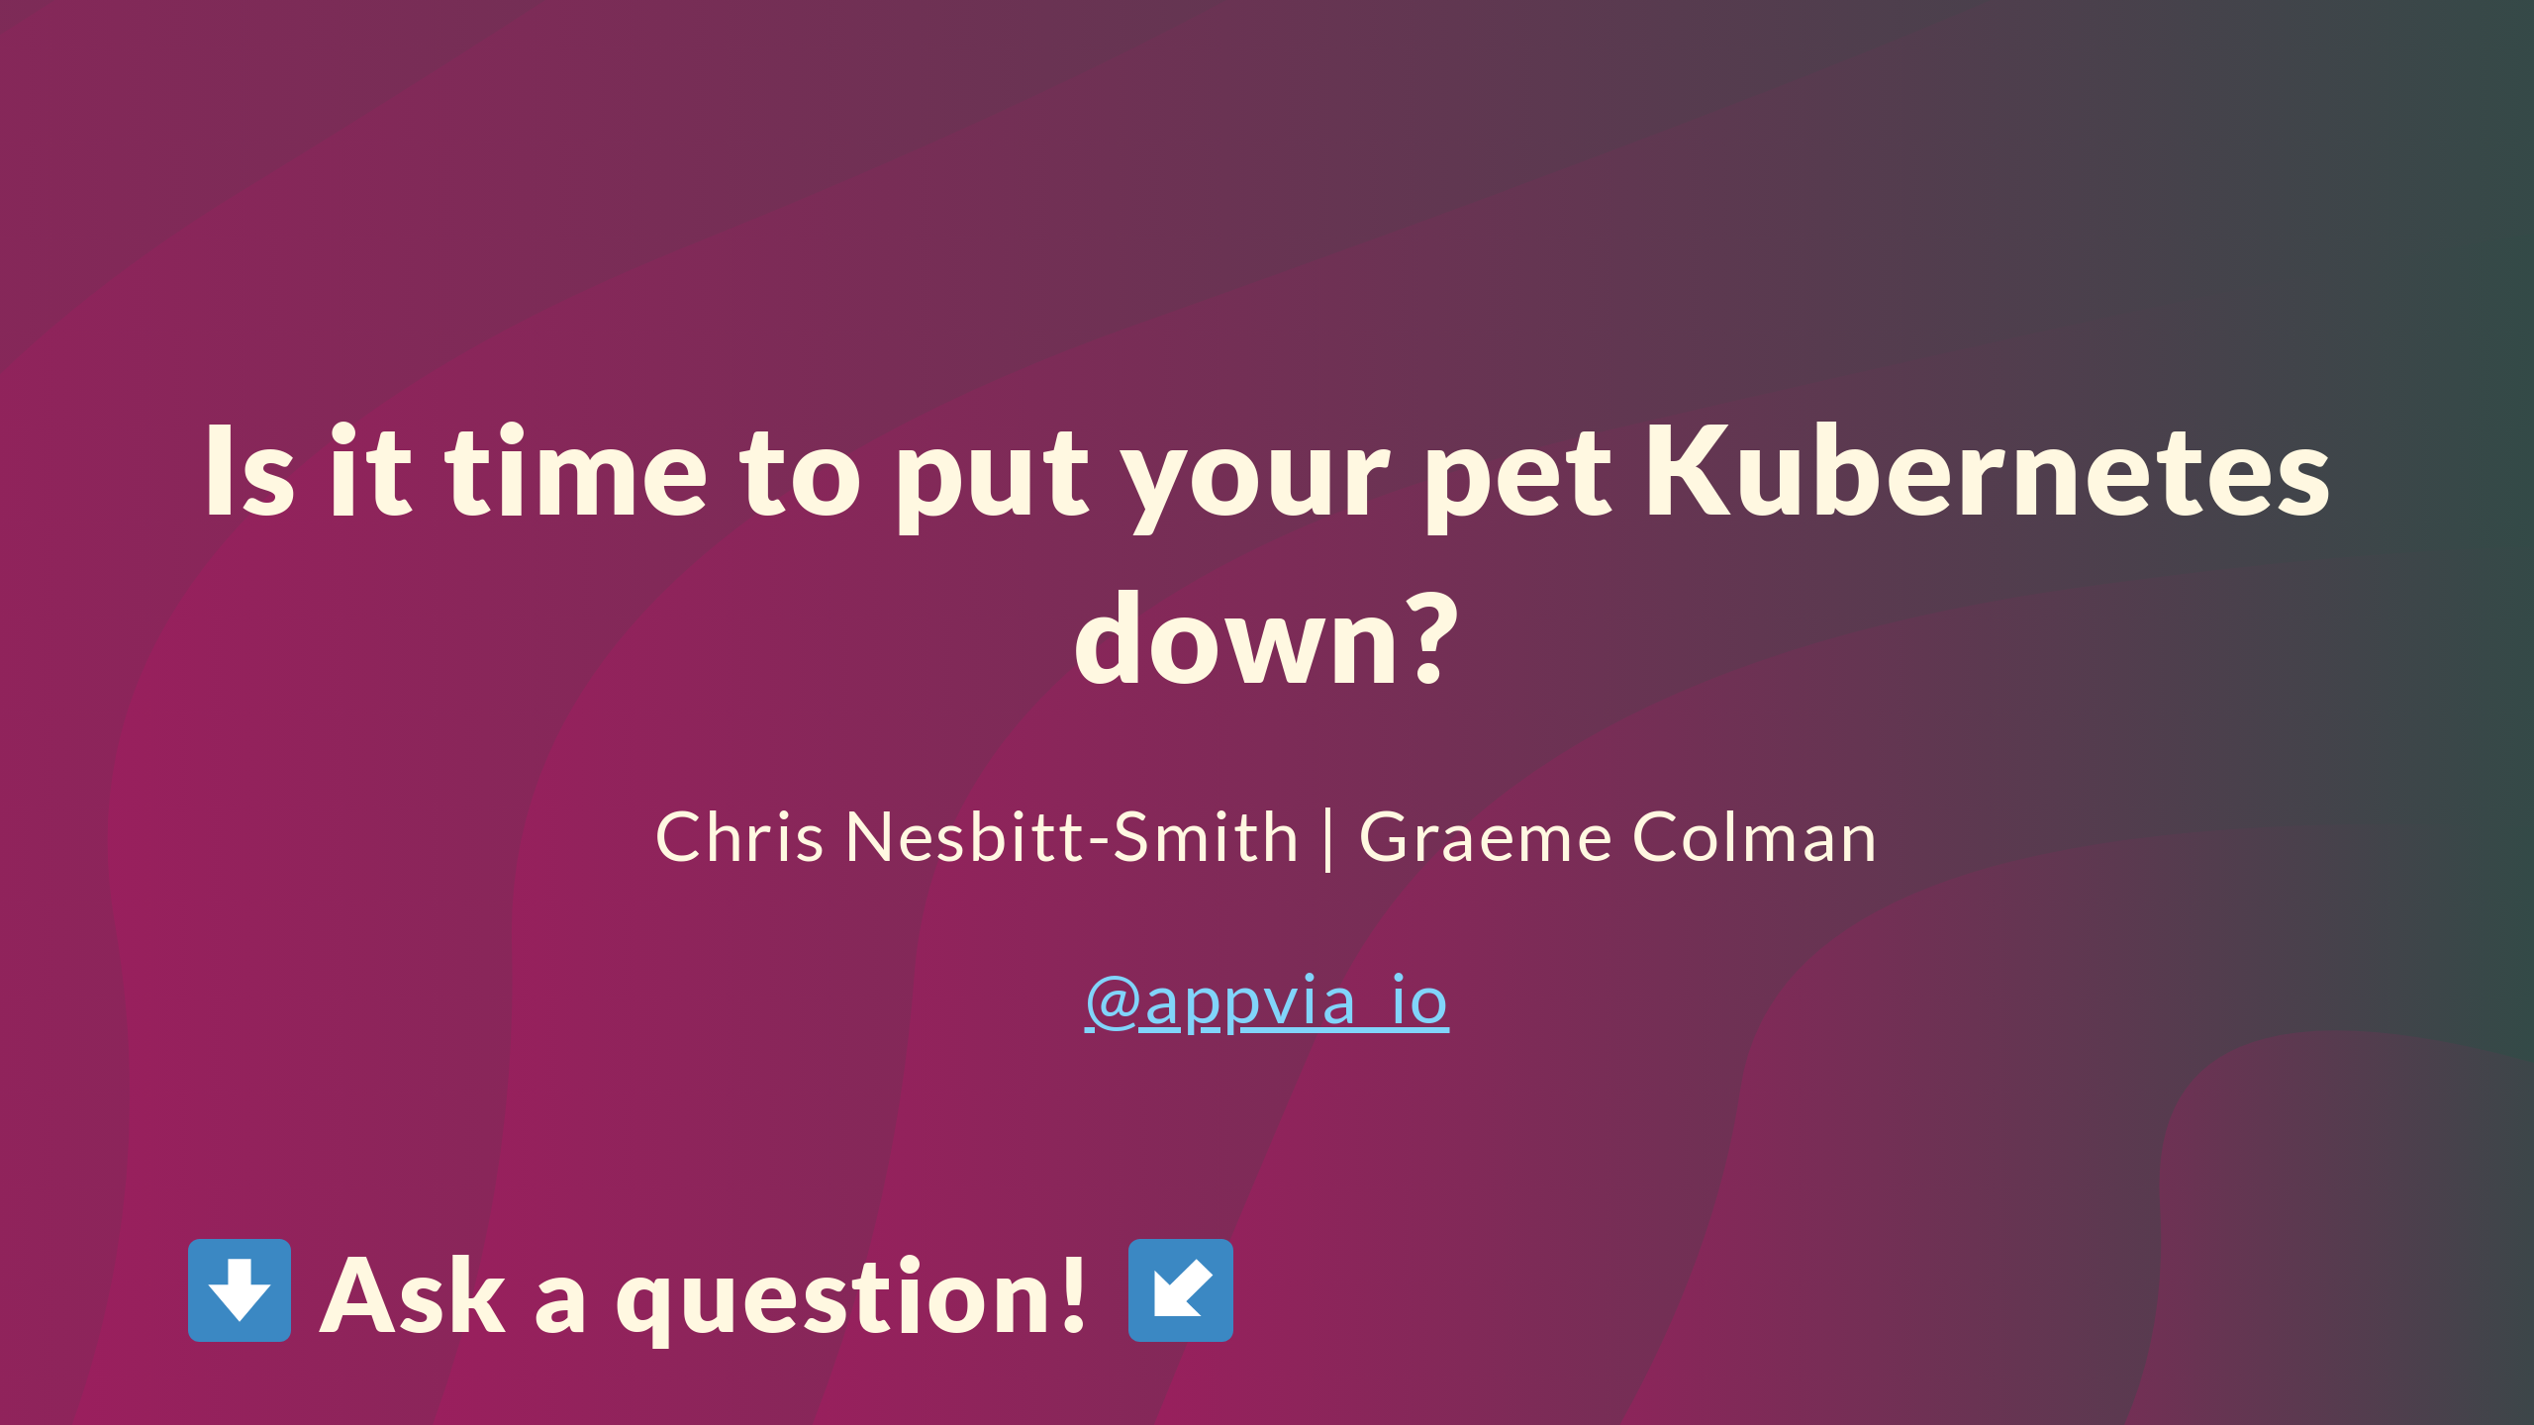

Slide 2


Slide 3
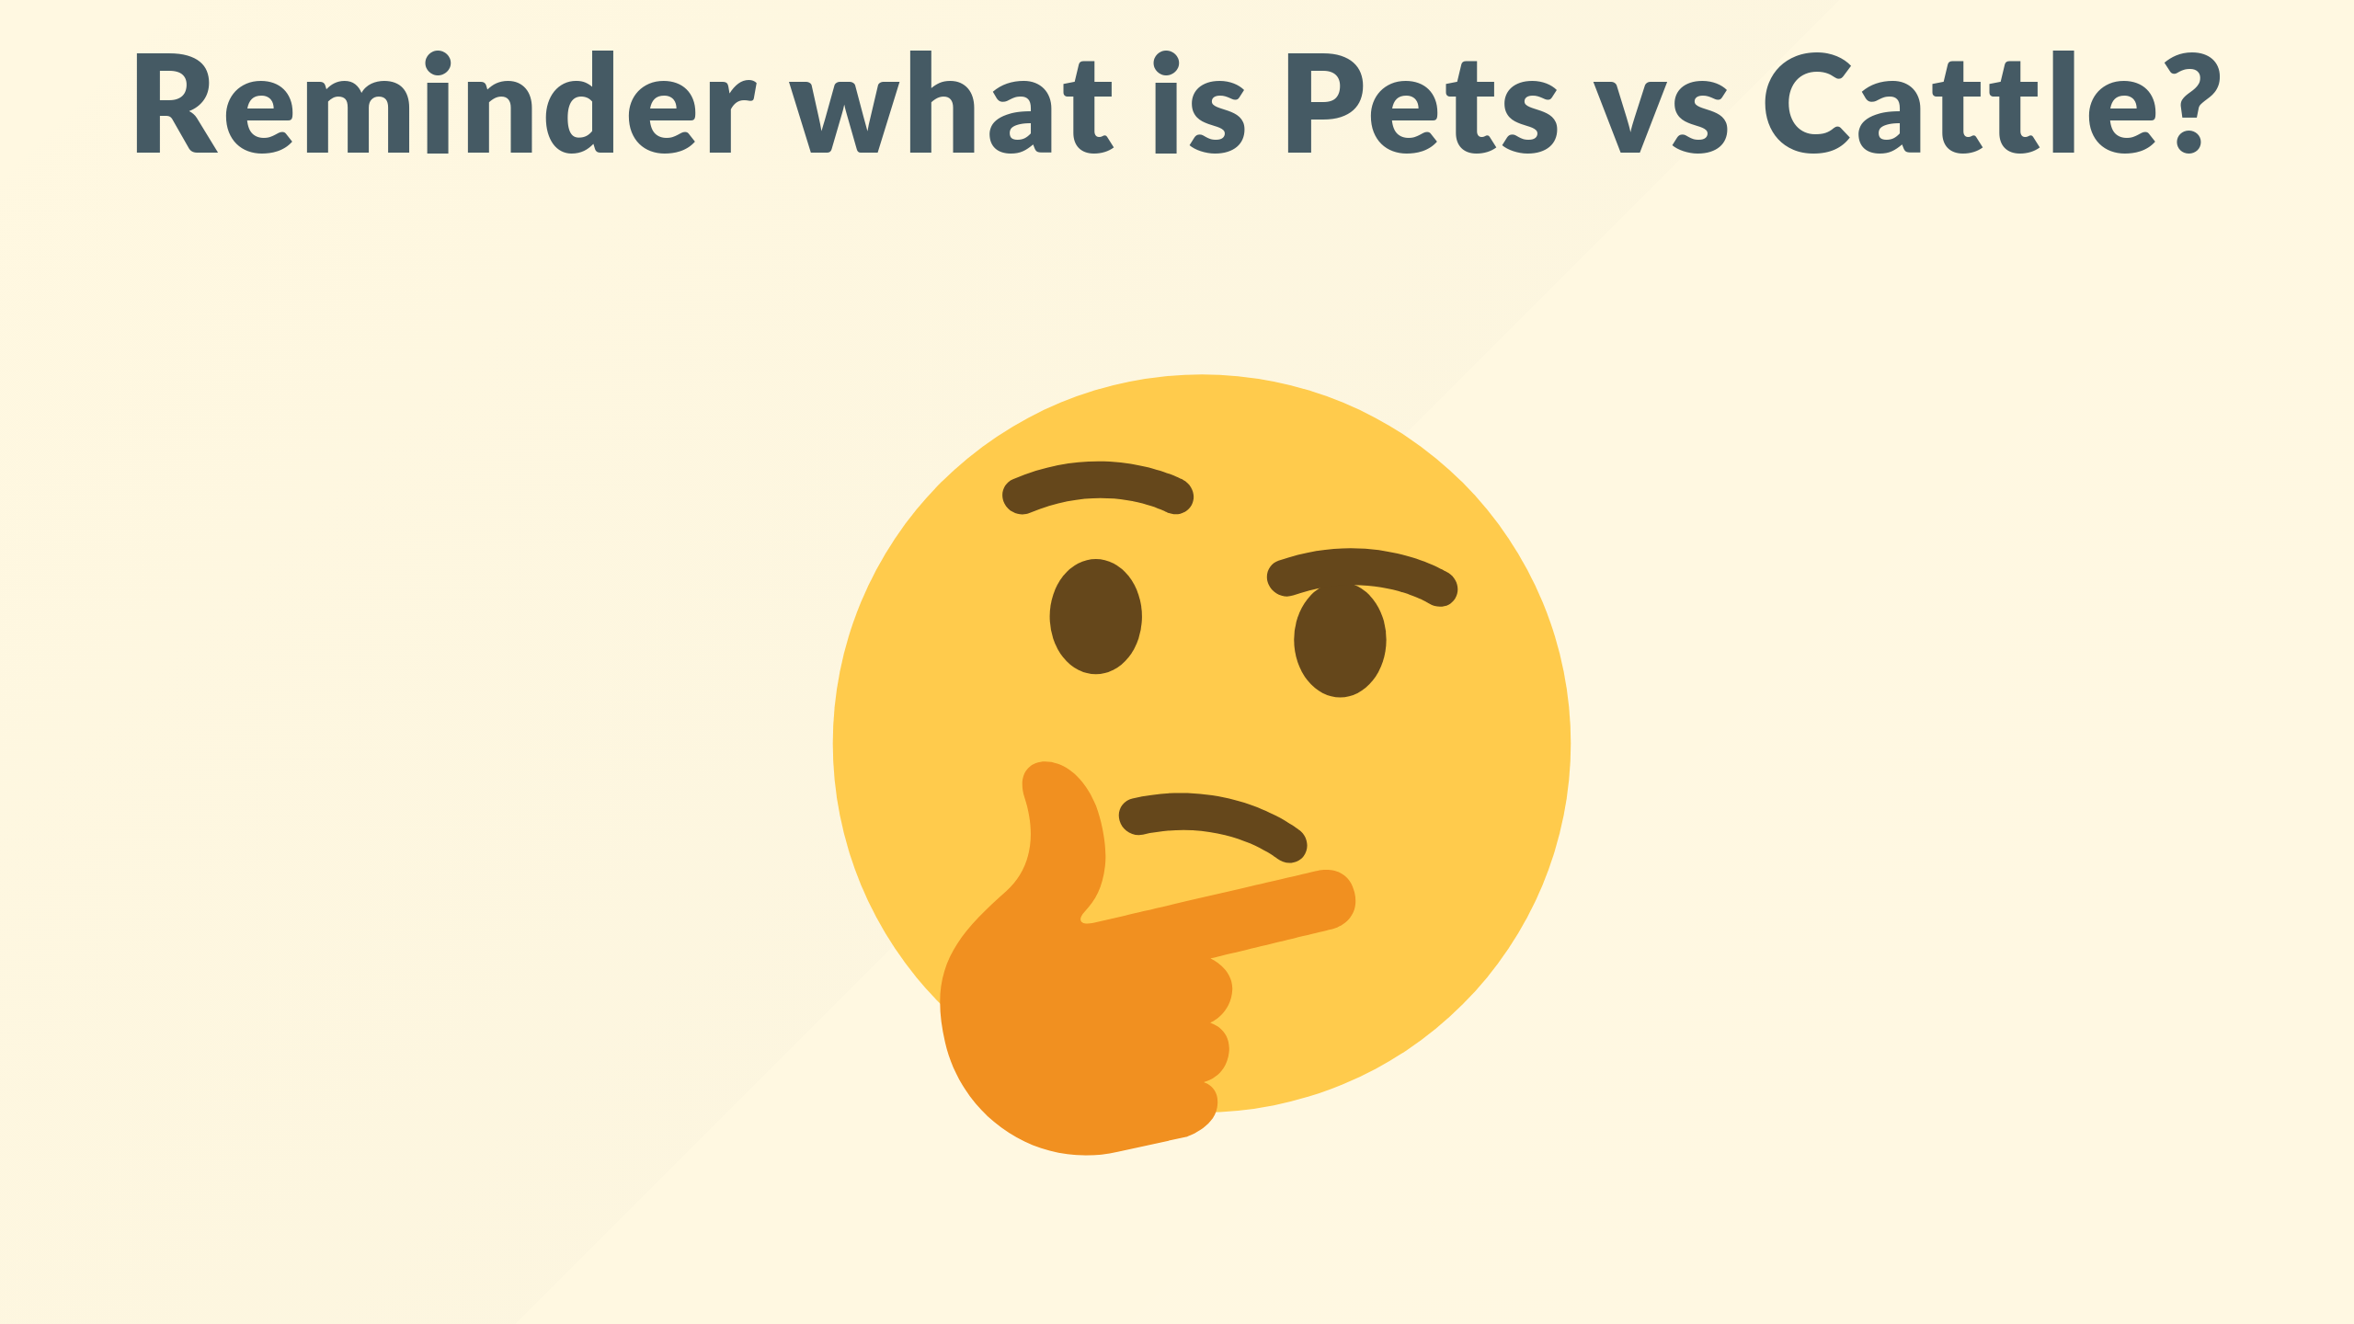
Notes:
The history of the pets vs cattle terminology is muddy, most link to a presentation Bill Baker from Microsoft made in 2006 around scaling SQL server.

Slide 4
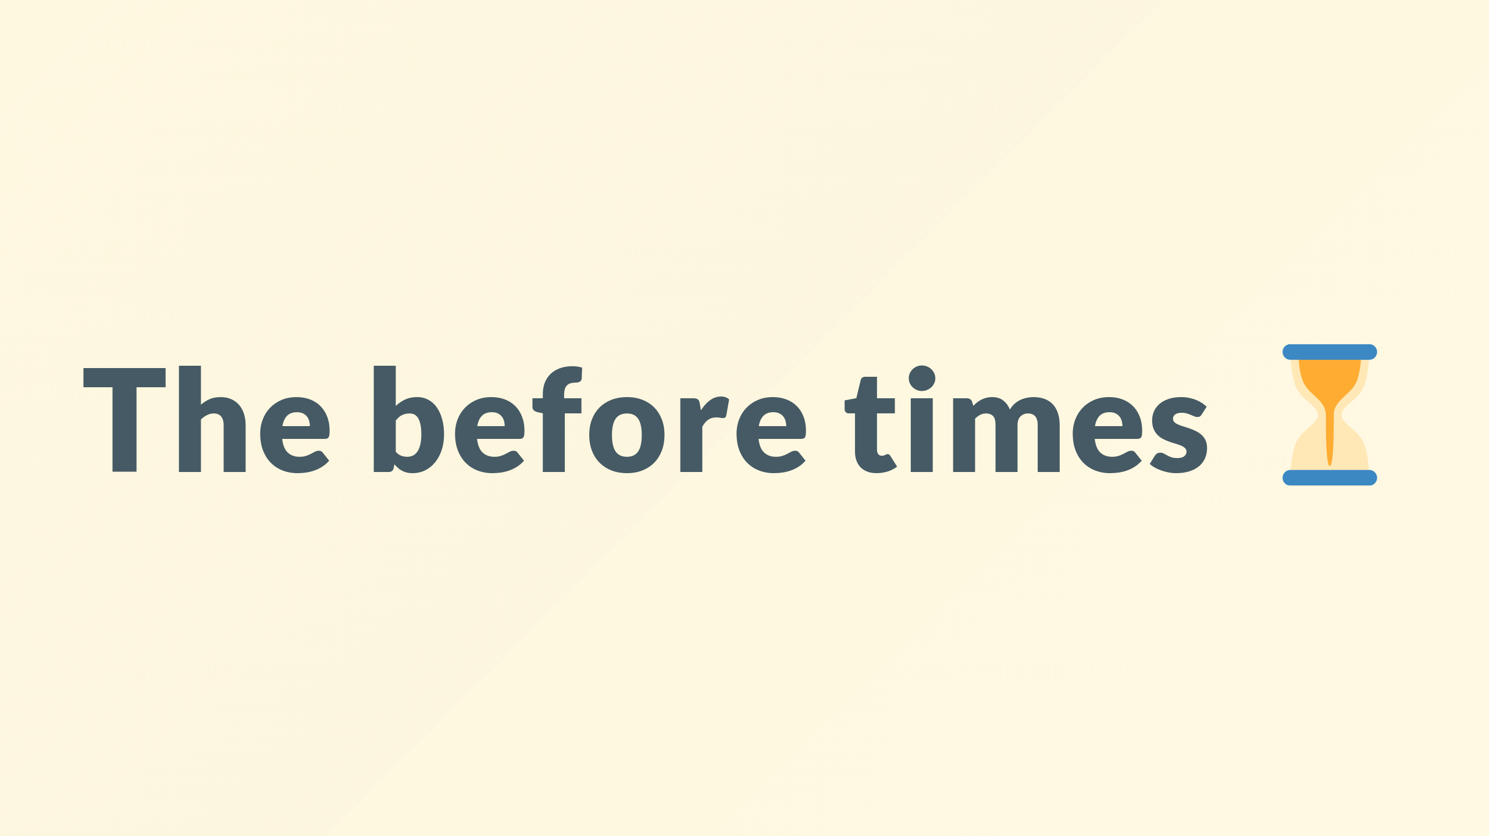
Notes:
Way back then in the before times, we called ourselves sysadmins and treat our servers like pets

Slide 5
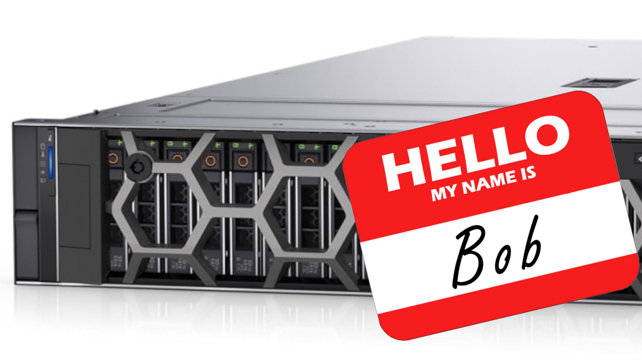
Notes:
For example Bob the mail server. If Bob goes down, it’s all hands on deck. The CEO can’t get his email and it’s the end of the world.

Slide 6
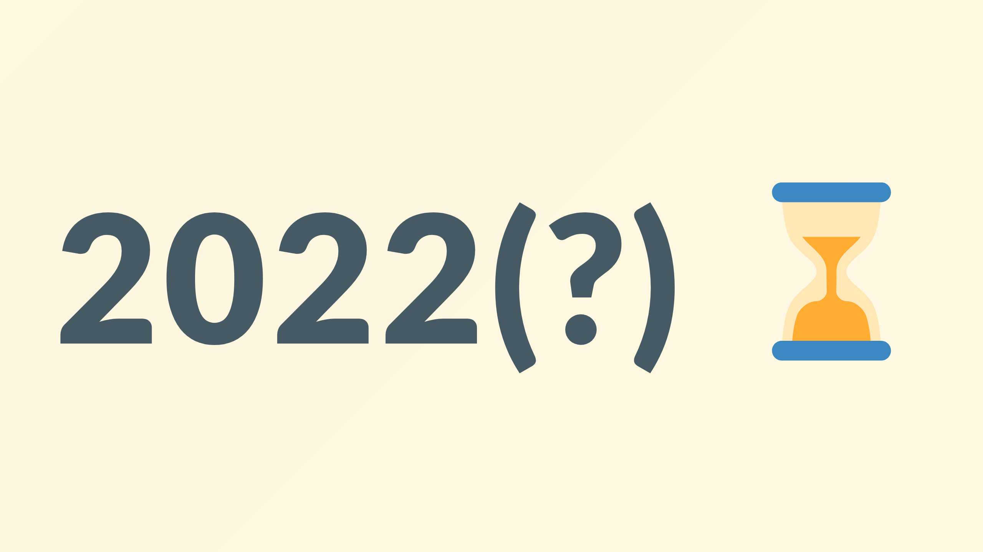
Notes:
In the new world, servers are numbered or maybe uuids, like cattle in a herd.

Slide 7
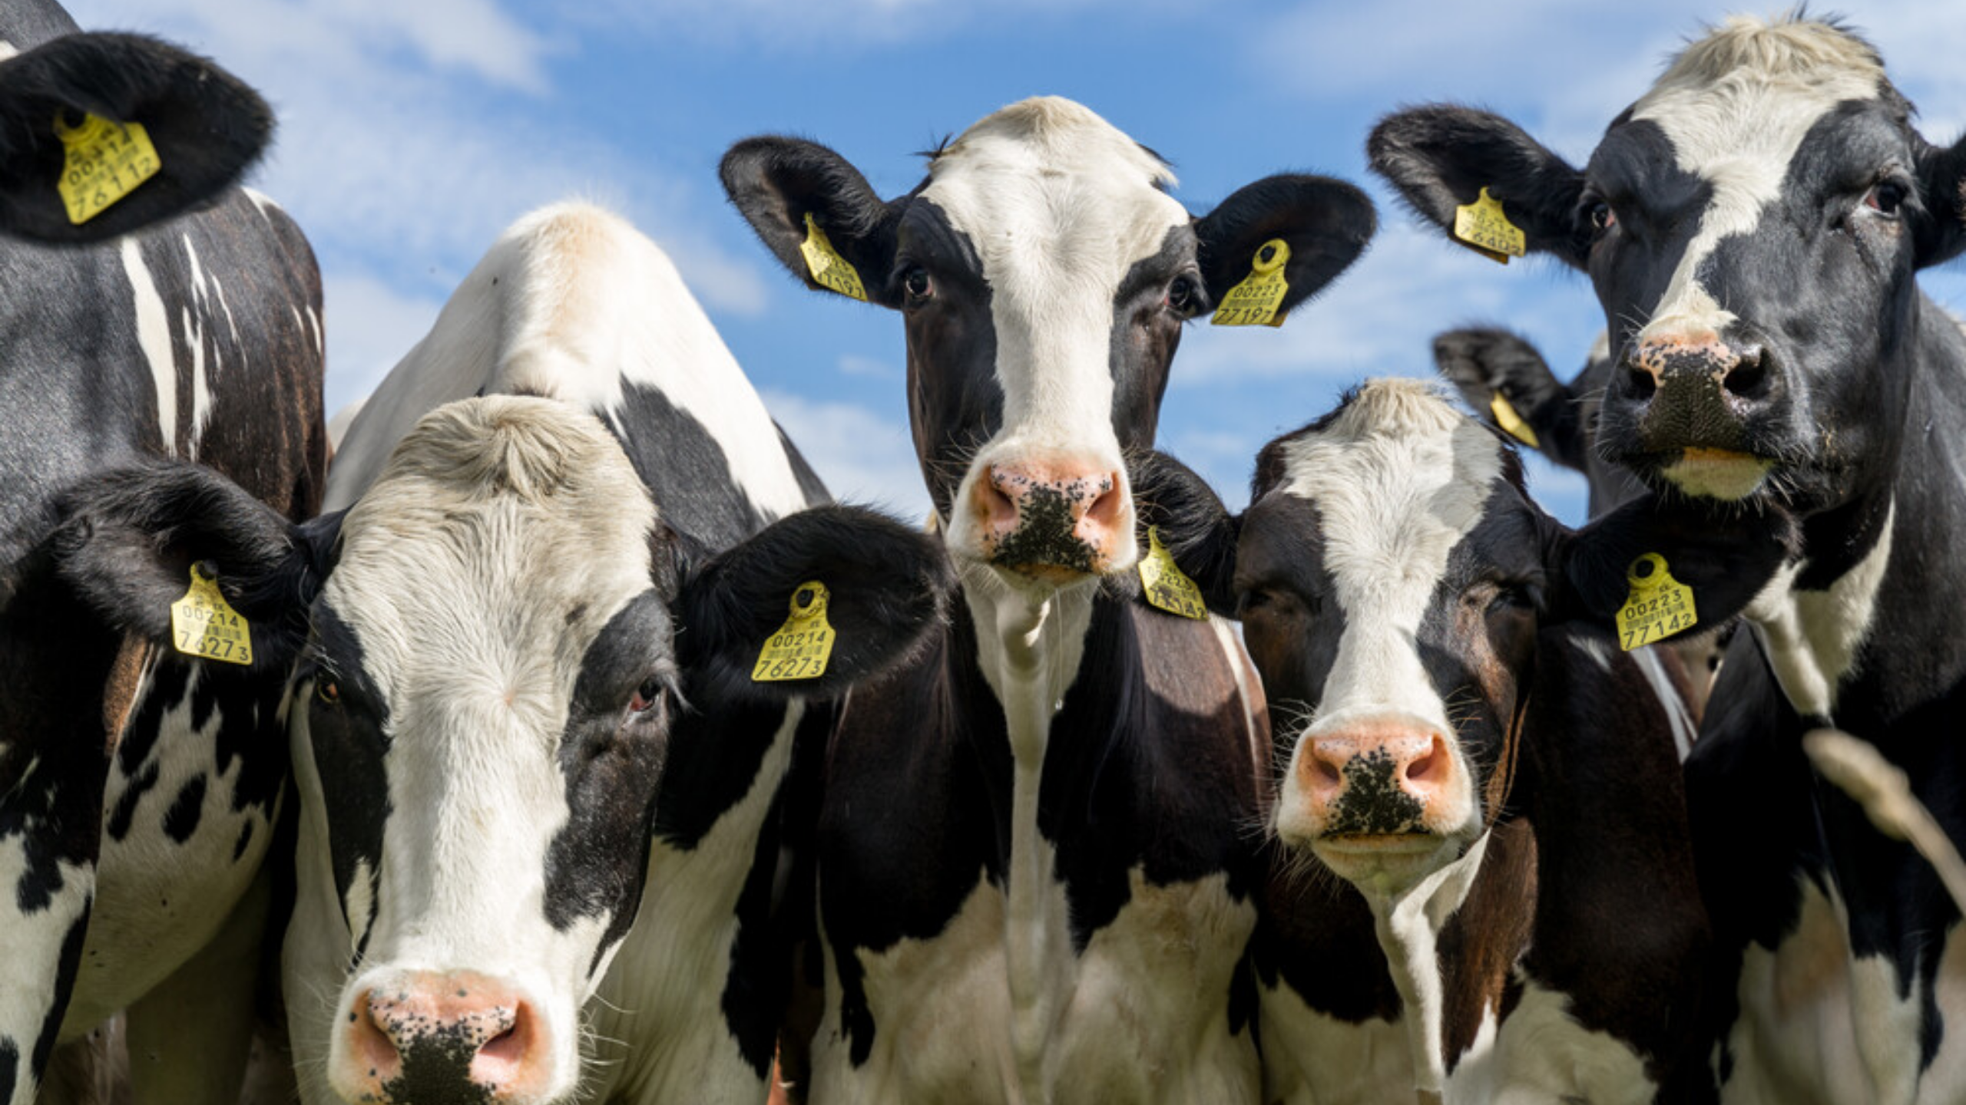
Notes:
For example, www001 to www100. When one server goes down, it’s taken out back, shot, and replaced on the line.

Slide 8
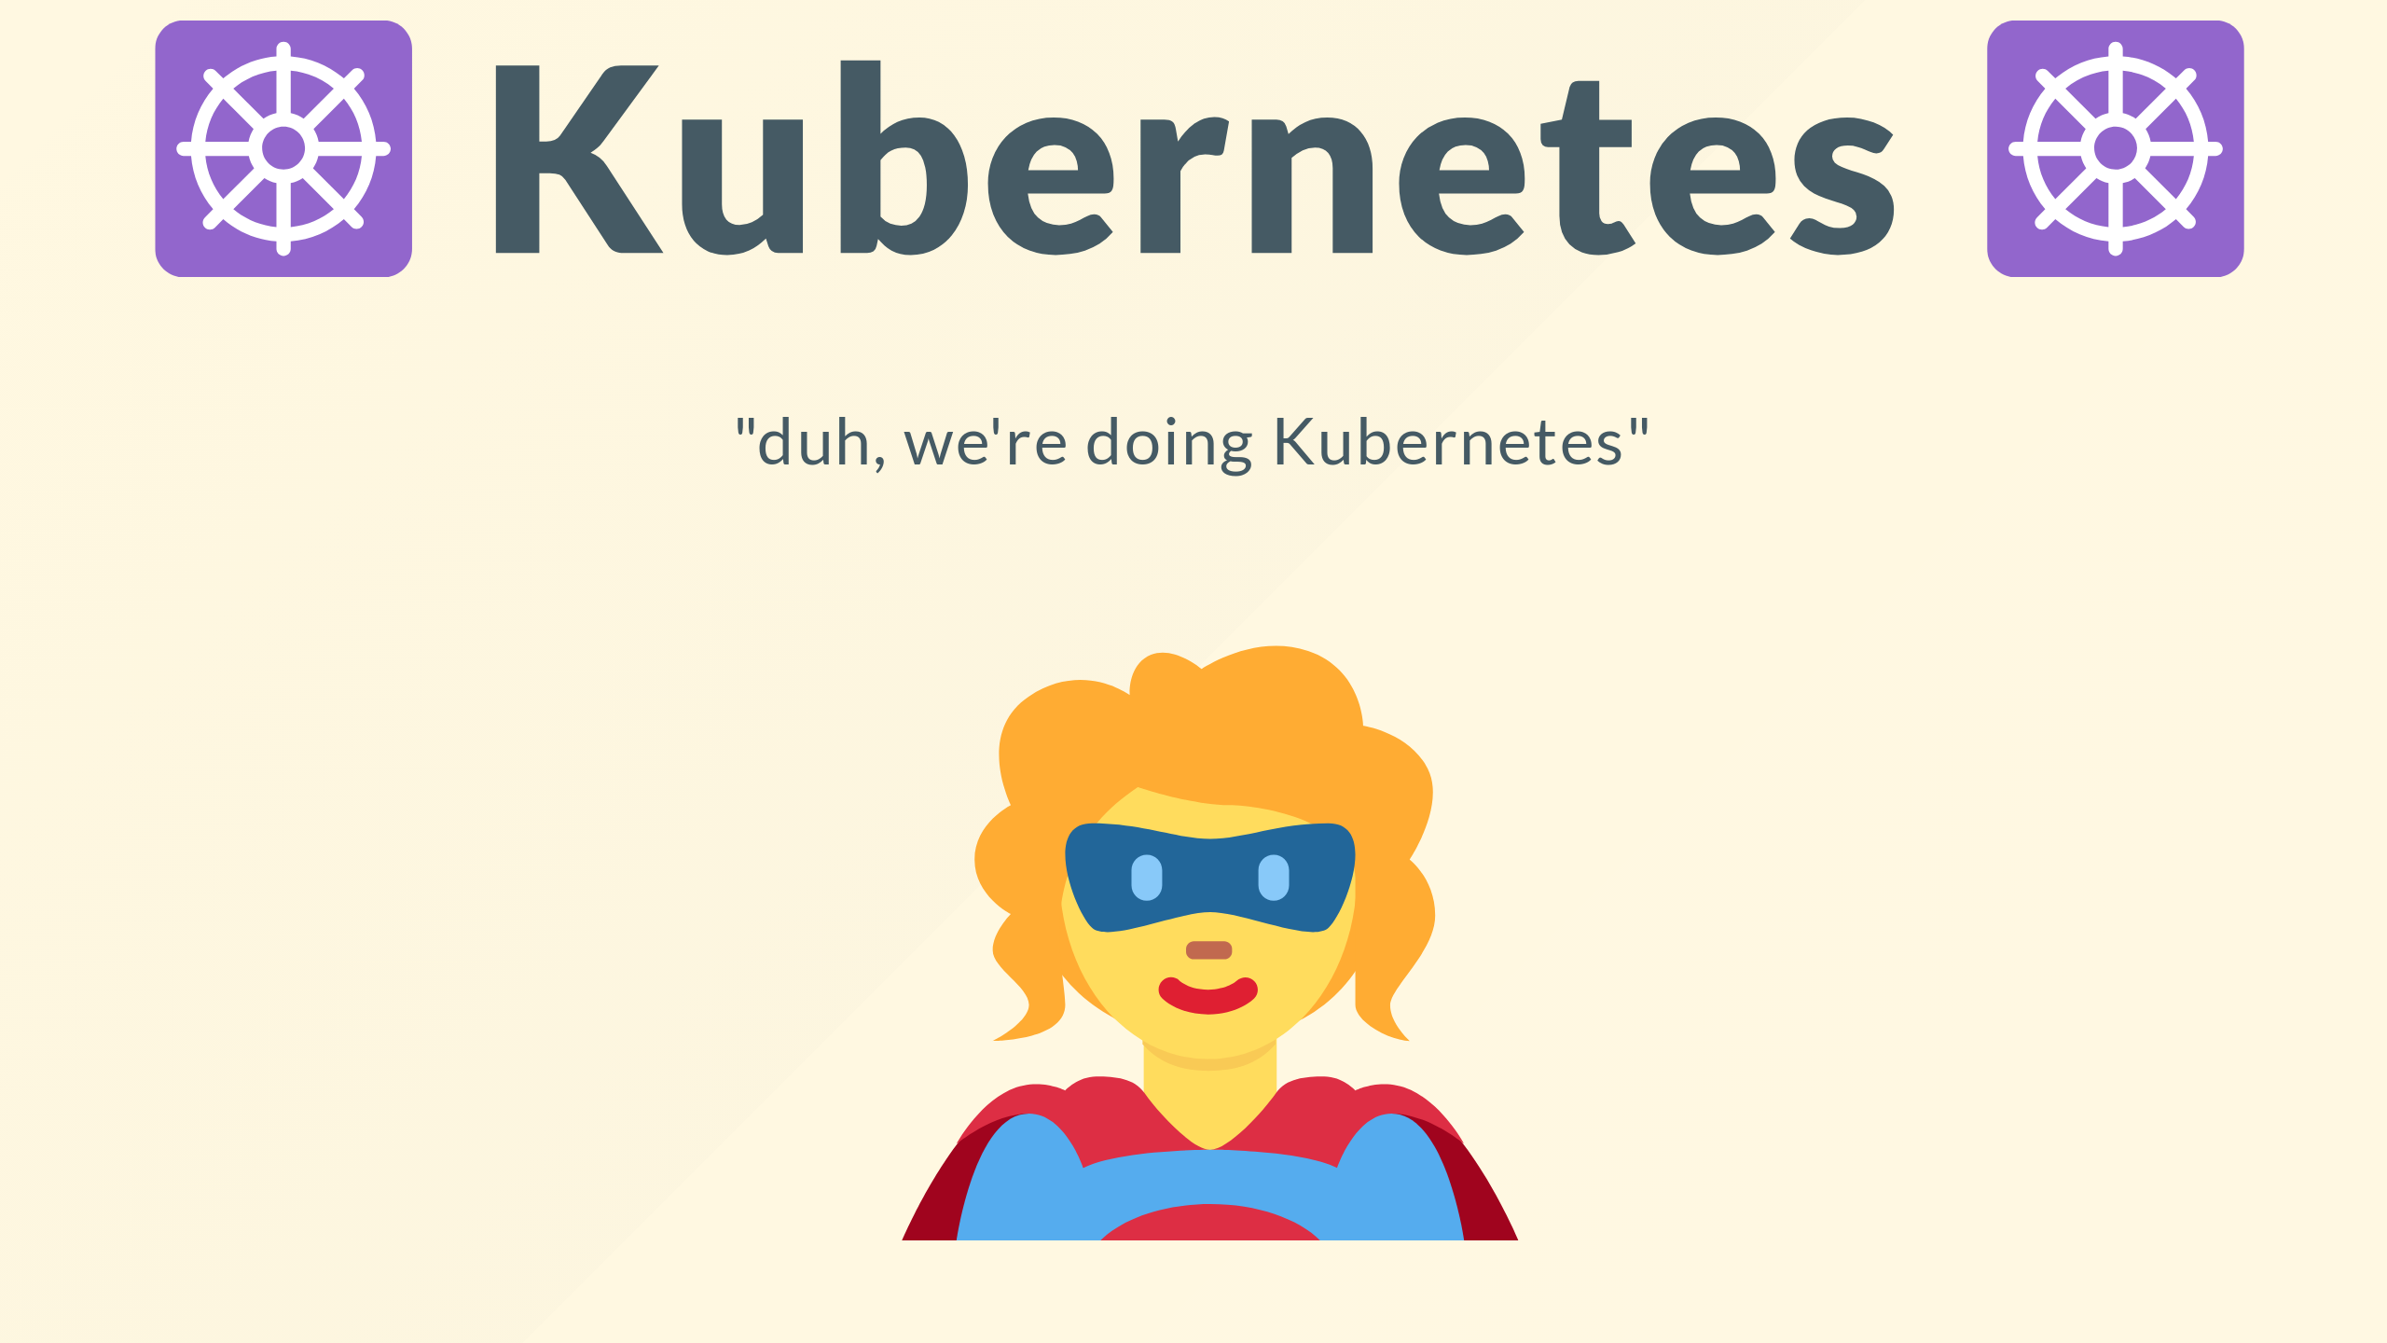
Notes:
Why am I telling you this rather gruesome story? Kubernetes deals with that right? and saves us from the tyranny

Slide 9
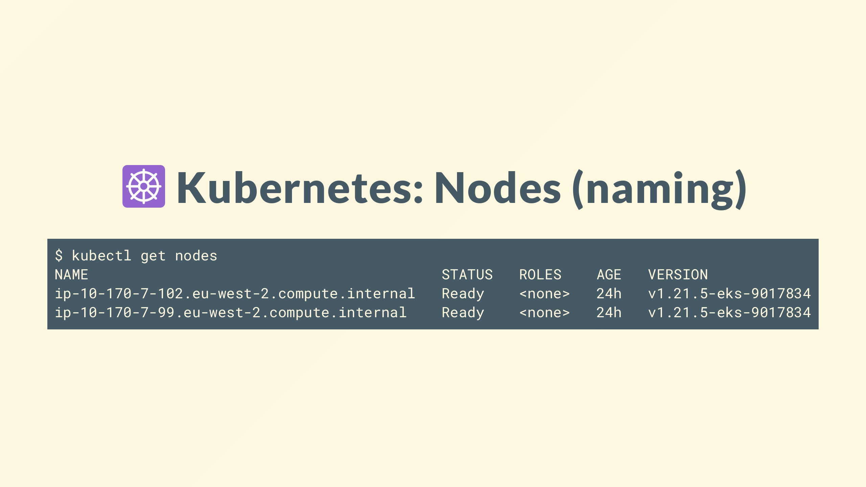
Notes:
And you're right, it does.
All you're computers are called nodes and abstracted and given arbitrary names, autoscaling groups and such will automatically detect the sick in your flock, take them out, and bring a replacement in.
all while seamlessly (ish) rescheduling the workload that was on the failed computer

Slide 10
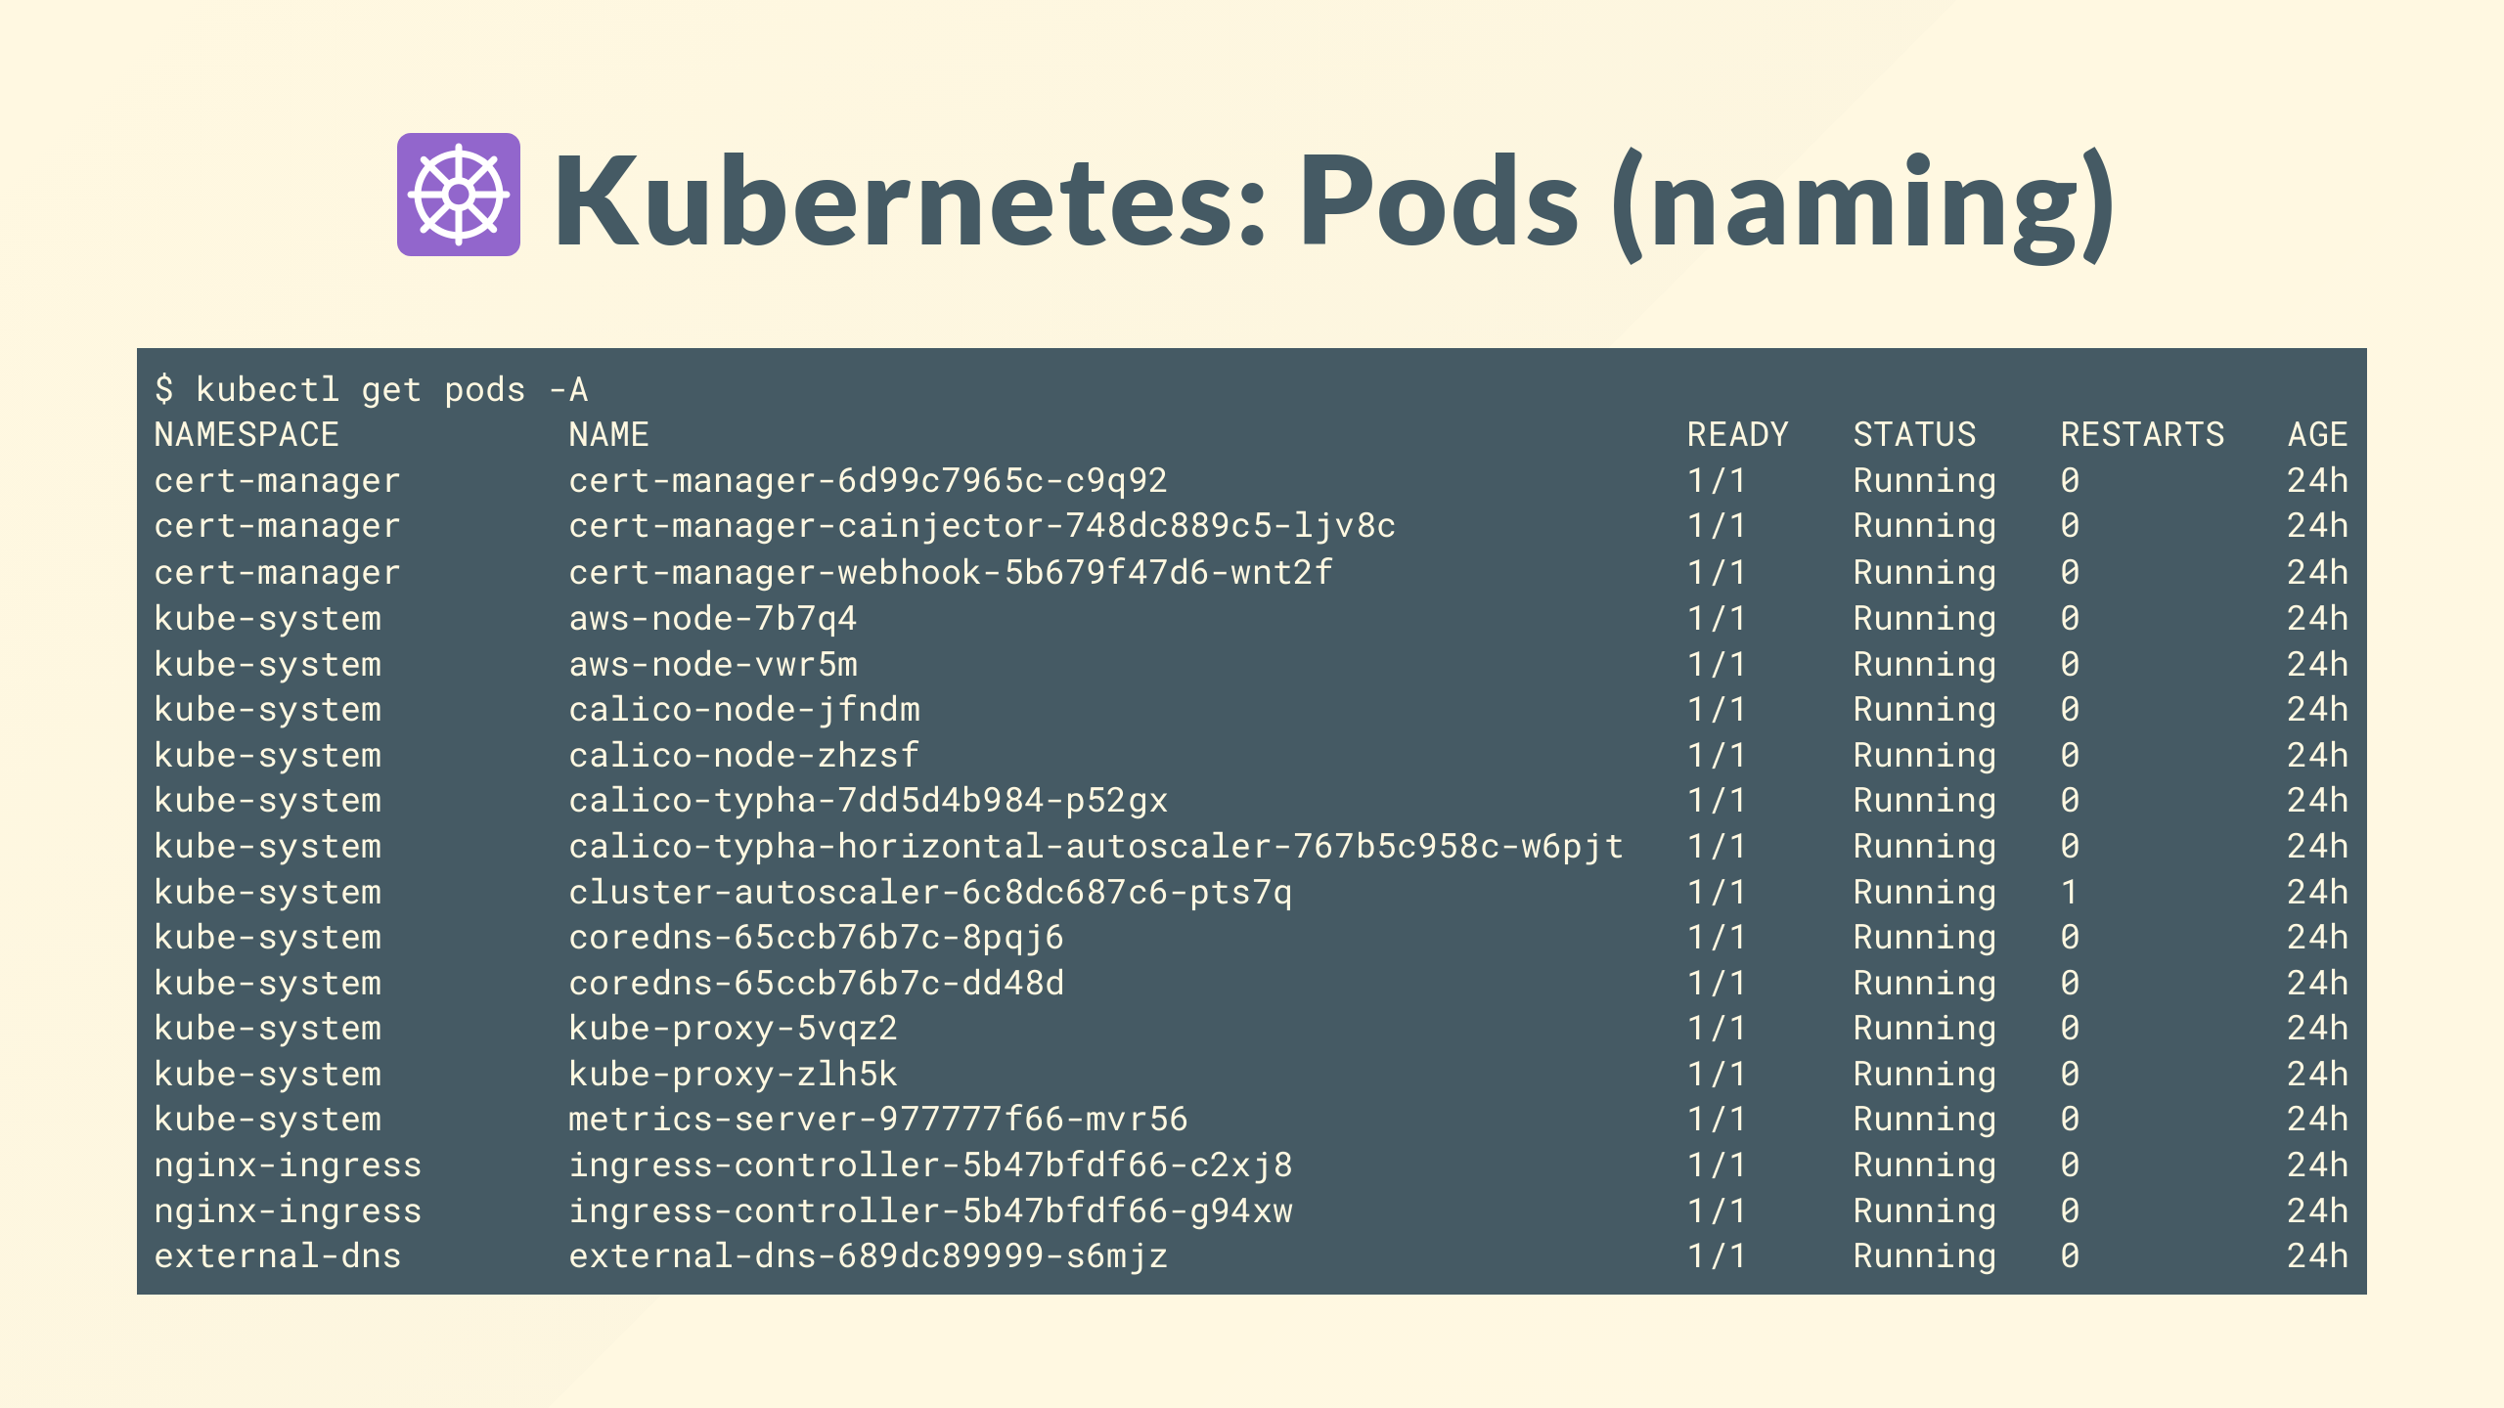
Notes:
And Kubernetes takes that a step further, your workload also has unique names

Slide 11
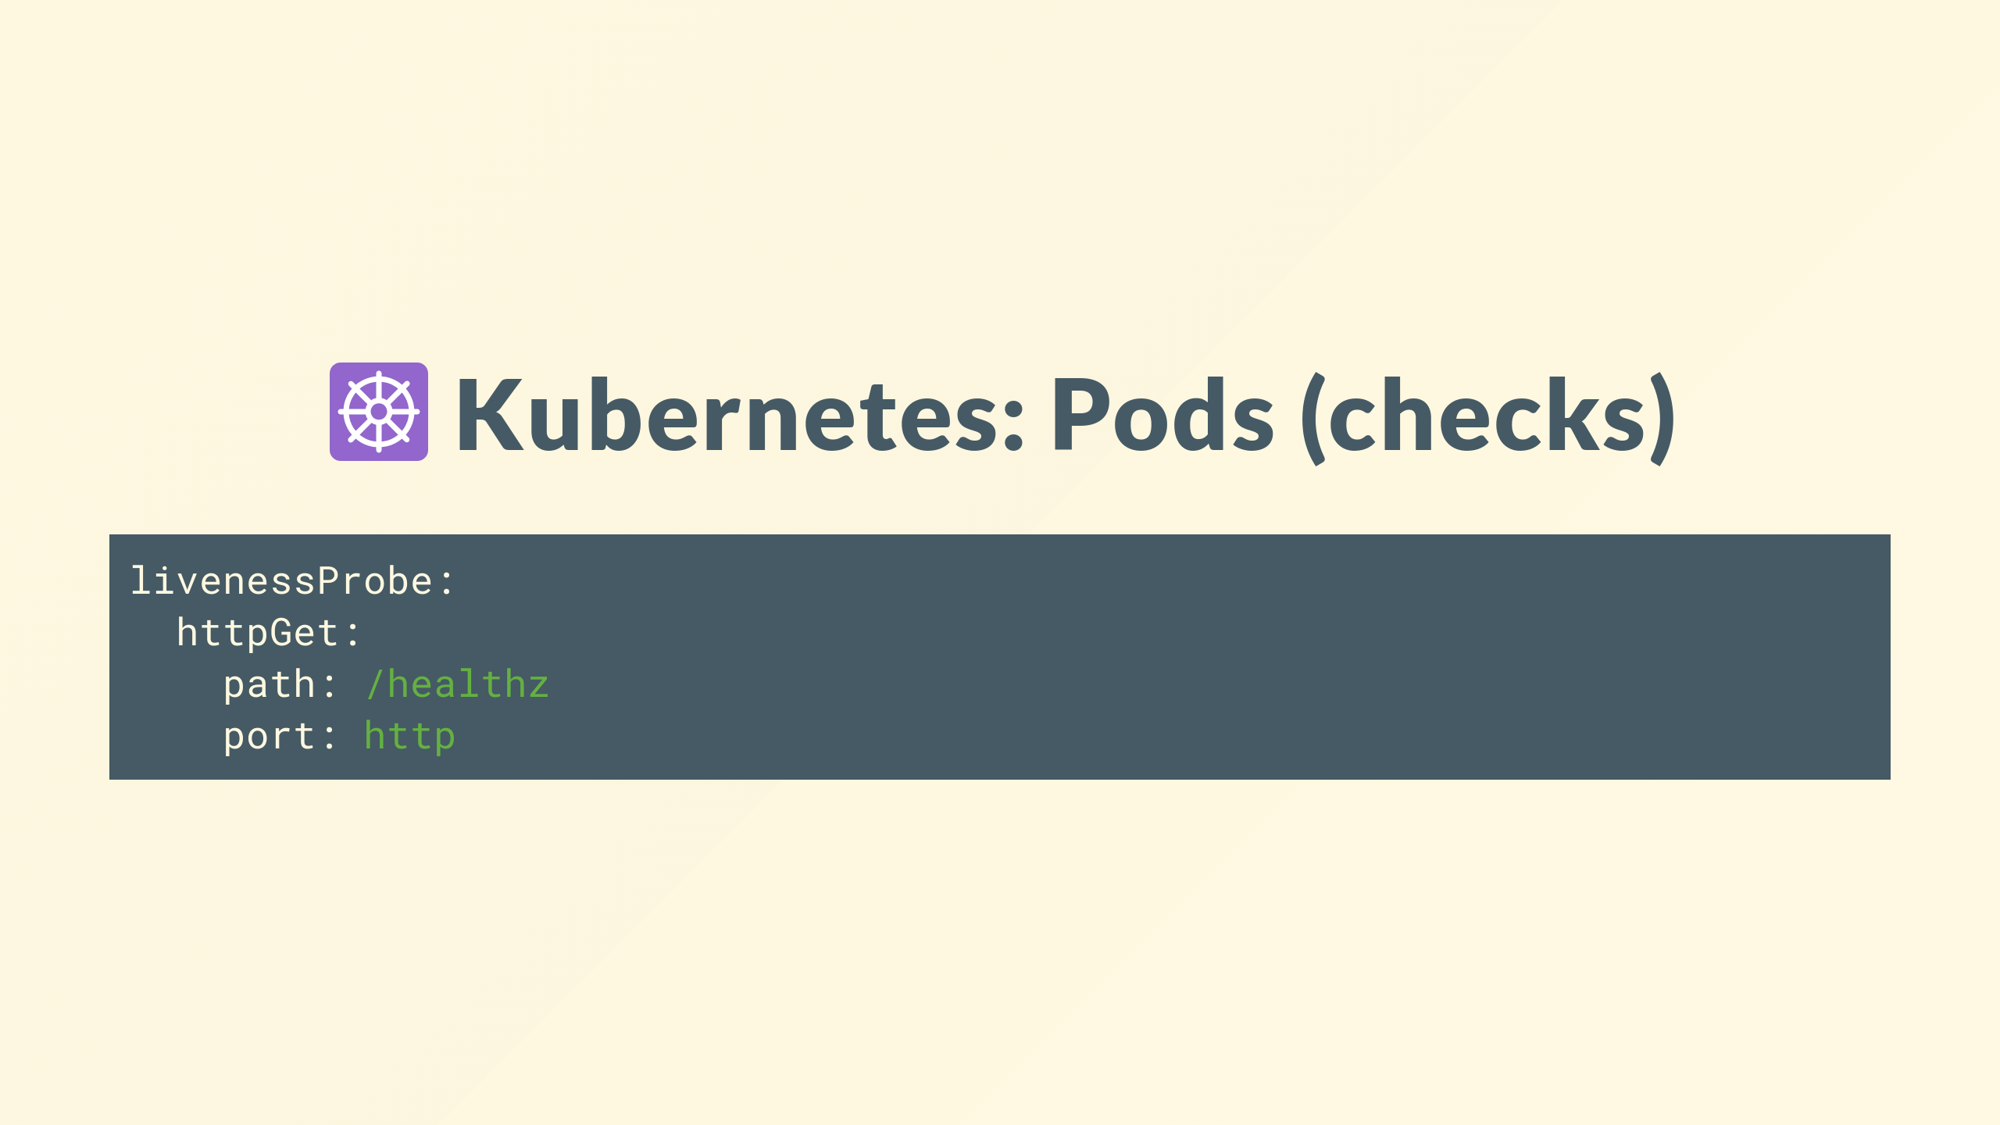
Notes:
Like the physical servers your workload failures can be detected, and replaced seamlessly

Slide 12
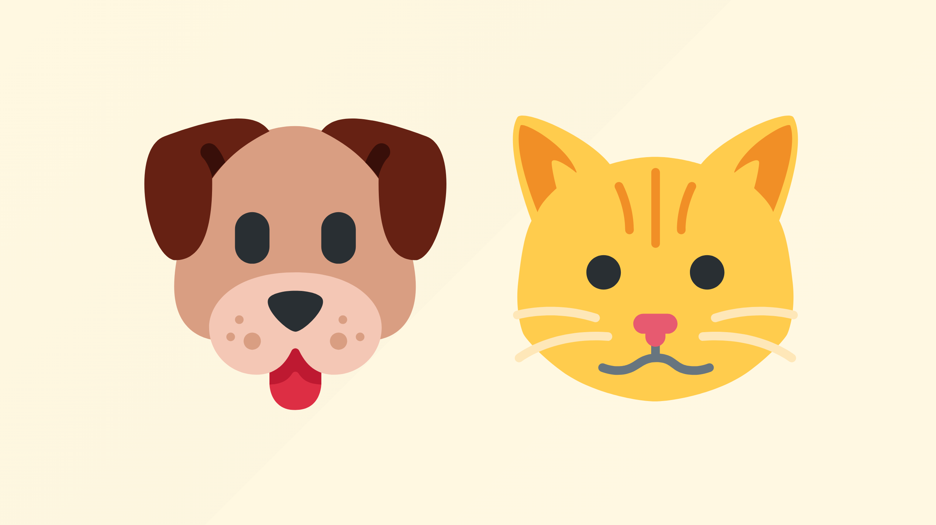
Notes:
So wheres the pet?

Slide 13

Notes:
well..

Slide 14
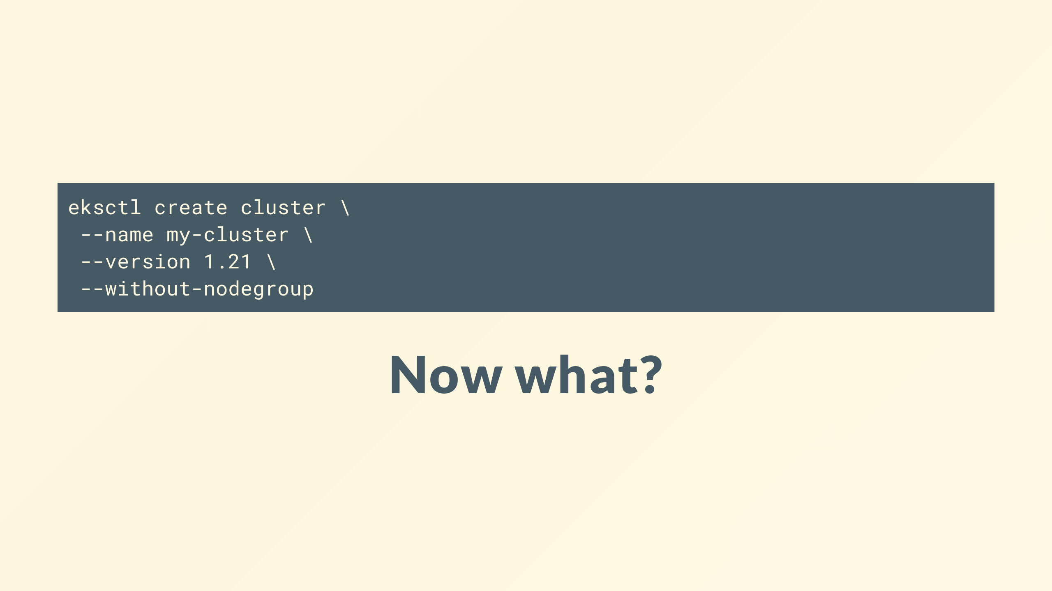
Notes:
Whats the first thing we do with a brand new Kubernetes cluster?

Slide 15

Notes:
Hint: it's not deploying your application

Slide 16
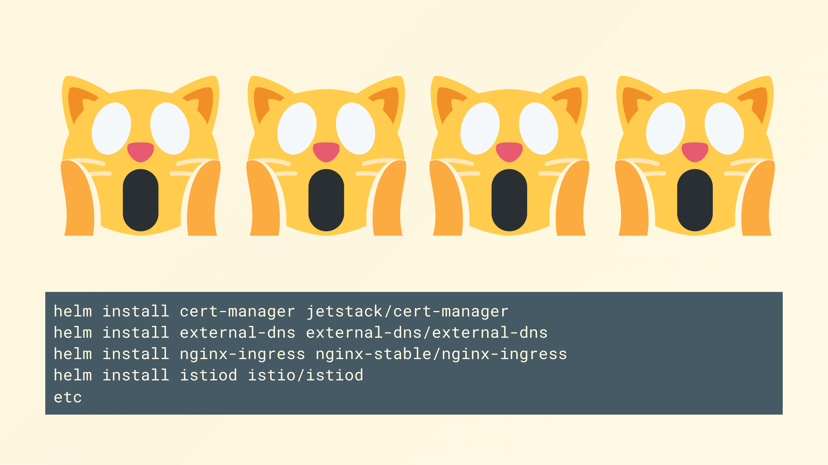
Notes:
Look familiar?
yeah, we had to do a load of 'things' just to make this cluster able to start running our workloads

Slide 17

Notes:
And it's worth noting that with a trend towards more and more features being being 'out of tree' that is to say they're optional add-ons and don't ship with core Kubernetes, examples of this are things like flex volumes, and basically all the Kubernetes sig projects that many find essential is only exasperating this issue

Slide 18
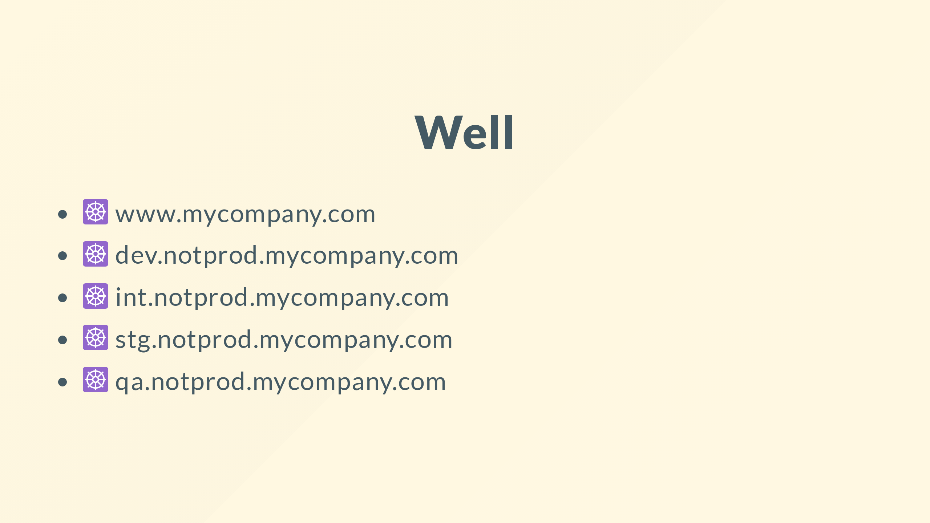
Notes:
<click>
That might work for when you've got a single cluster, but what about when you've got a single cluster <click>
But what about when you've got dev <click> integration <click> staging <click> qa that your app needs to run on

Slide 19
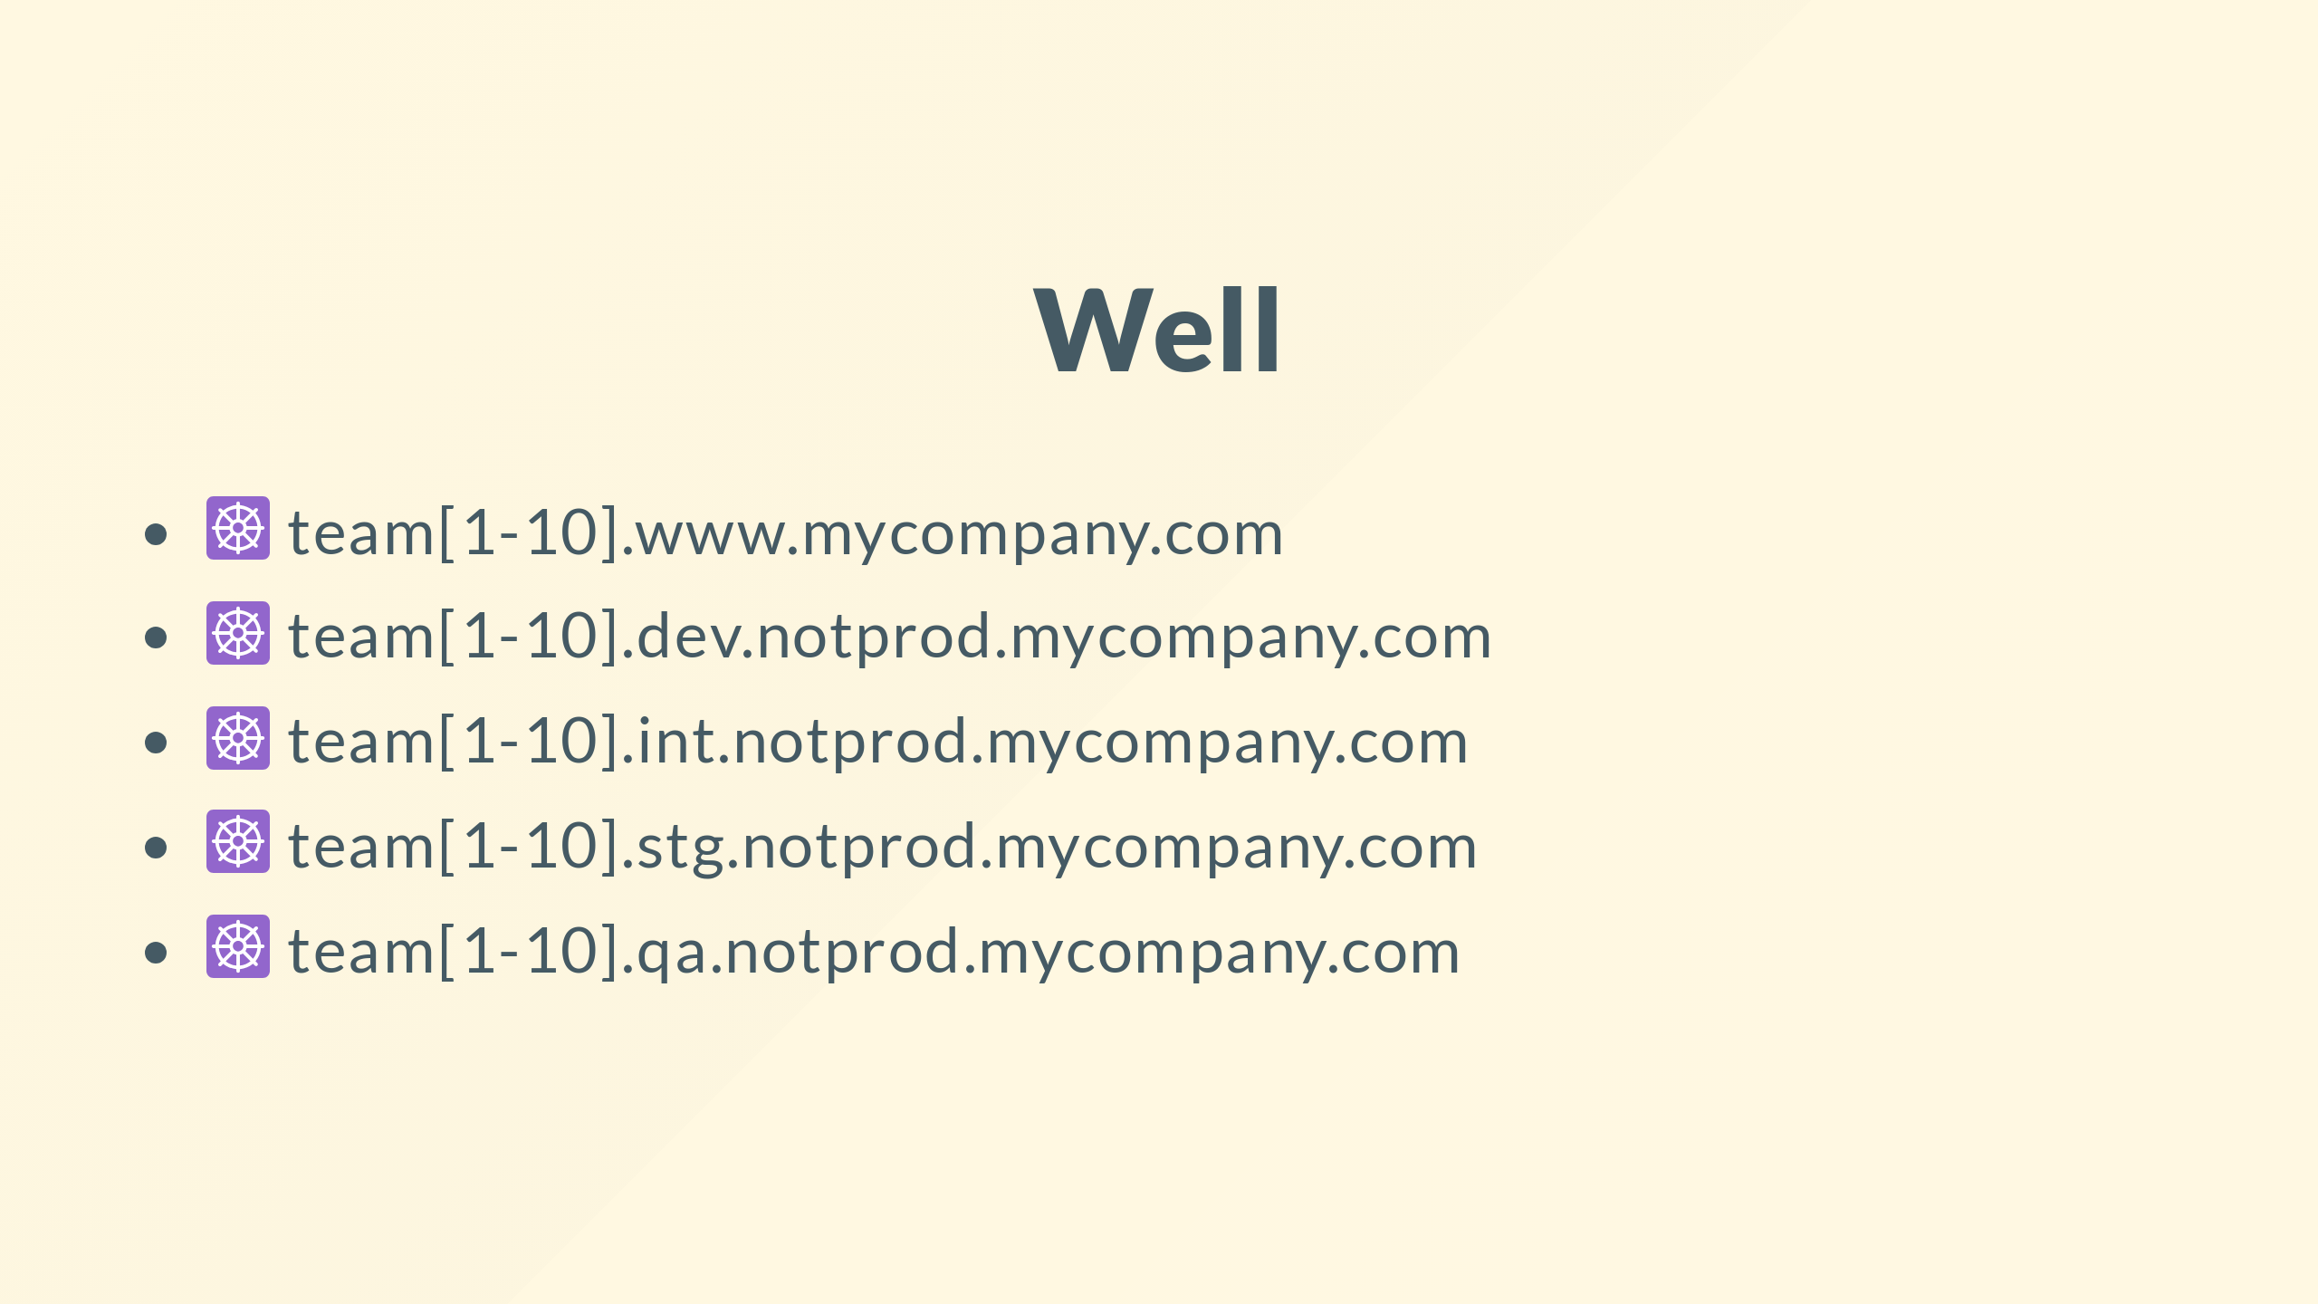
Notes:
Or worse, when you need separation between your teams or products

Slide 20
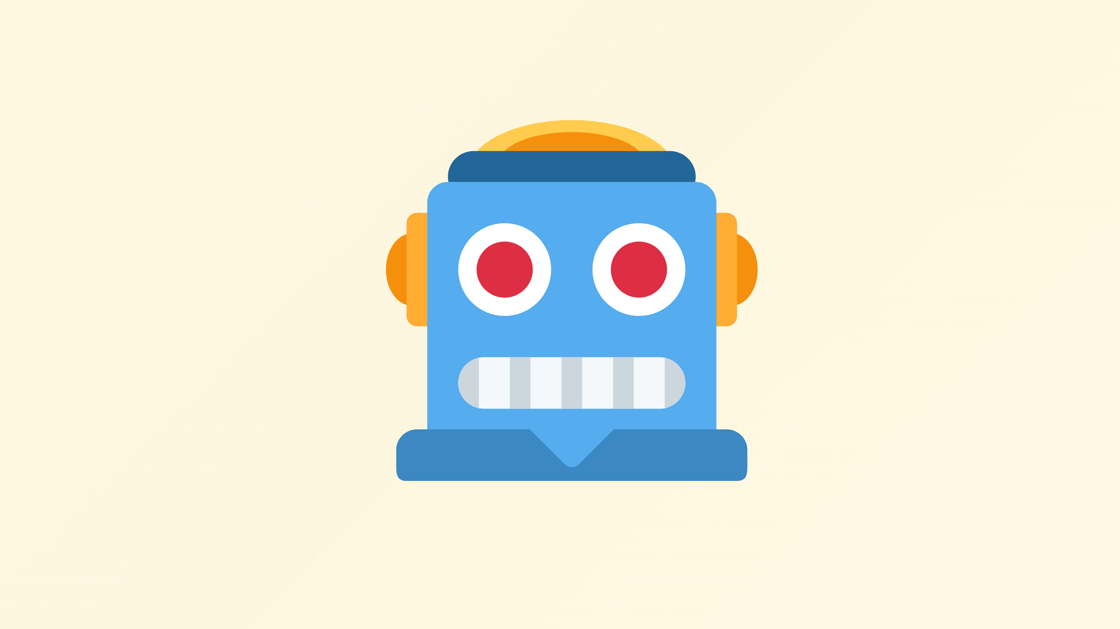
Notes:
Maybe you've automated that, bash, ansible, terraform, whatever you like, cool good on you

Slide 21

Notes:
However you'll find it won't be long before theres an updated version perhaps patching a vulnerability you care about and you may be stuck trying to test every single app across your estate

Slide 22
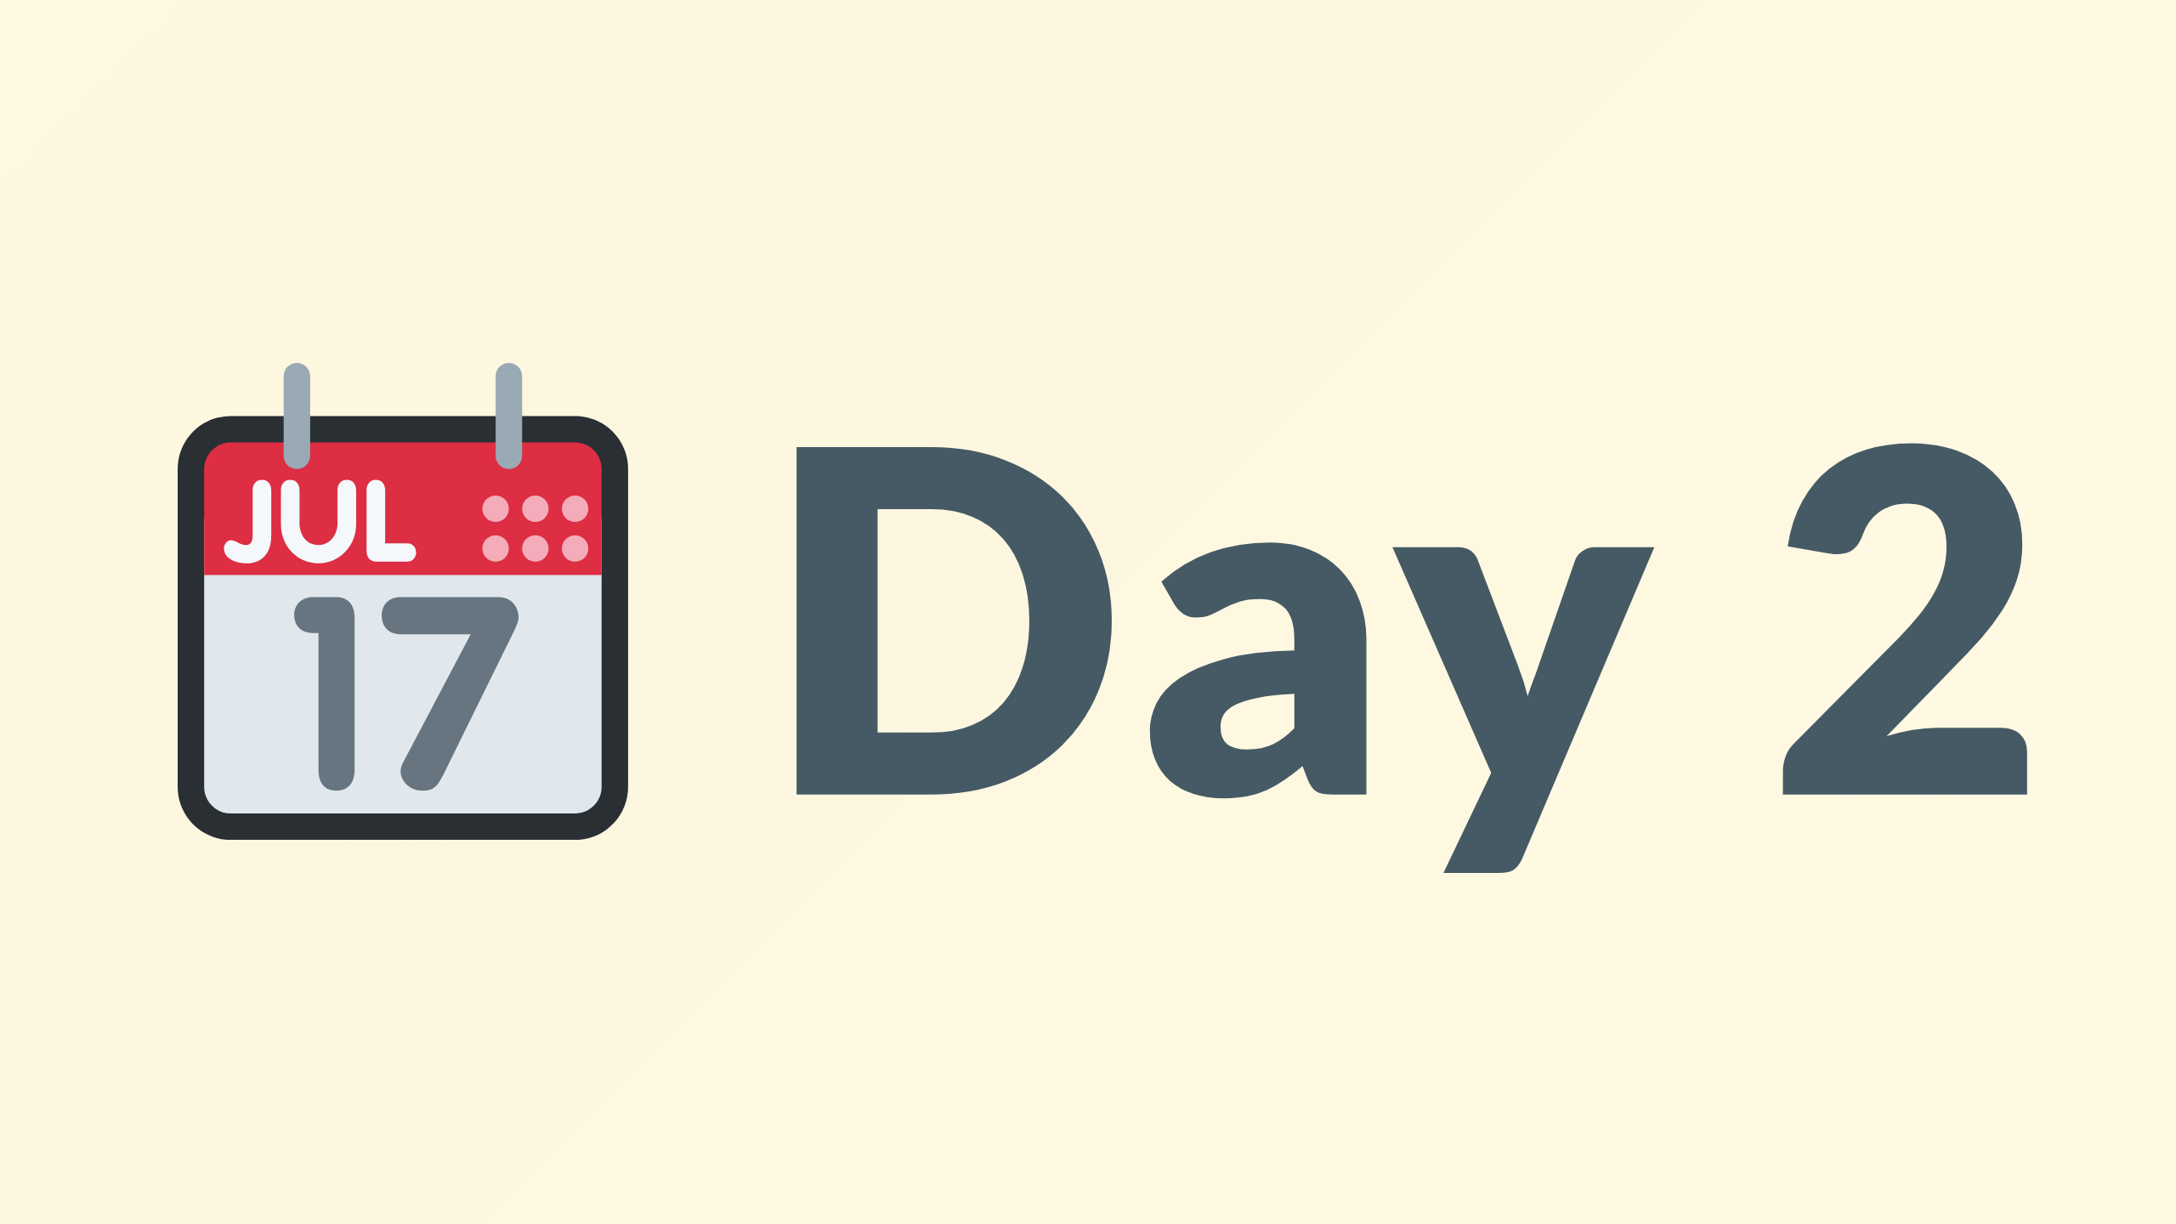
Notes:
This is what we're used to calling day 2 operations, we used to call it BAU or business as usual, and it's where reality catches up with our idealistic good intentions

Slide 23

Notes:
You'll quickly find that clusters are running various versions, given the rate of change in the community its unrealistically to run :latest everywhere confidently without breaking production and disrupting your operational teams.

Slide 24
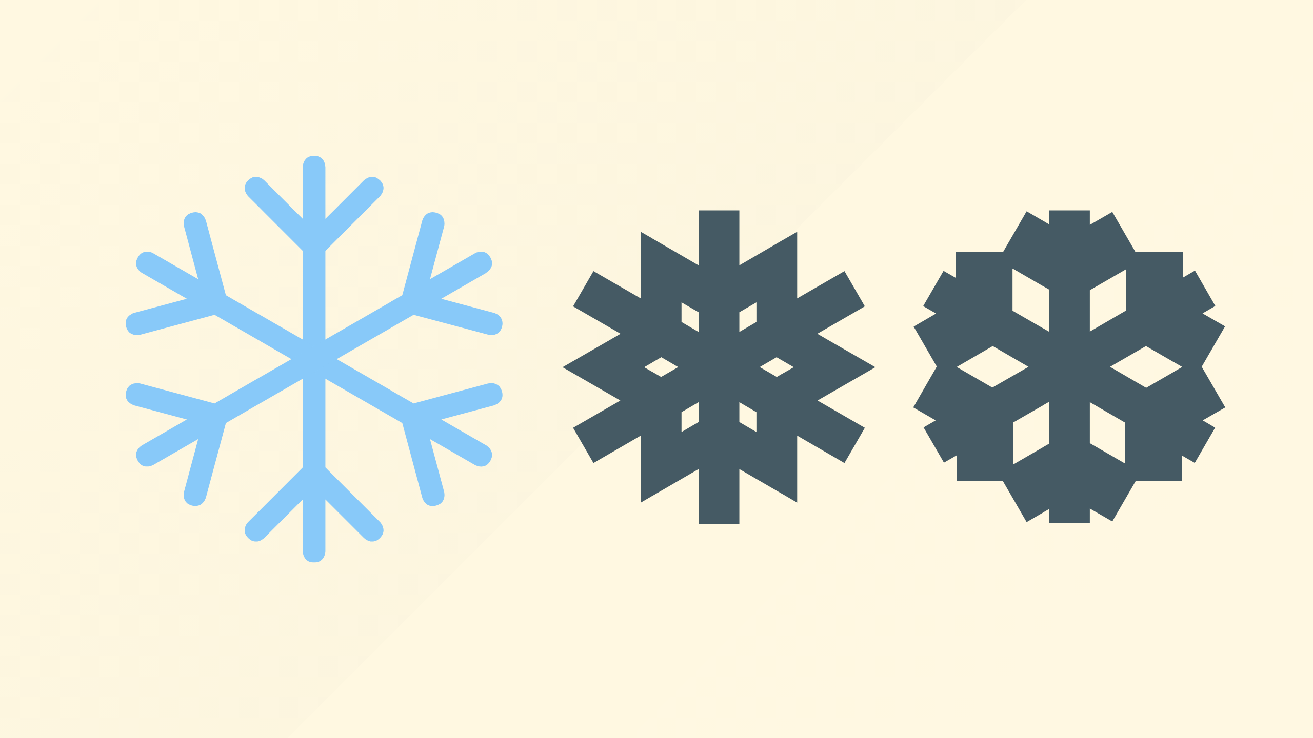
Notes:
Permutations of seemingly common tool choices, some teams might use kong, others nginx, another apache, all for good reasons I'm sure

Slide 25

Notes:
Seemingly infinite possibilities appear across the estate

Slide 26

Notes:
Sad times

Slide 27
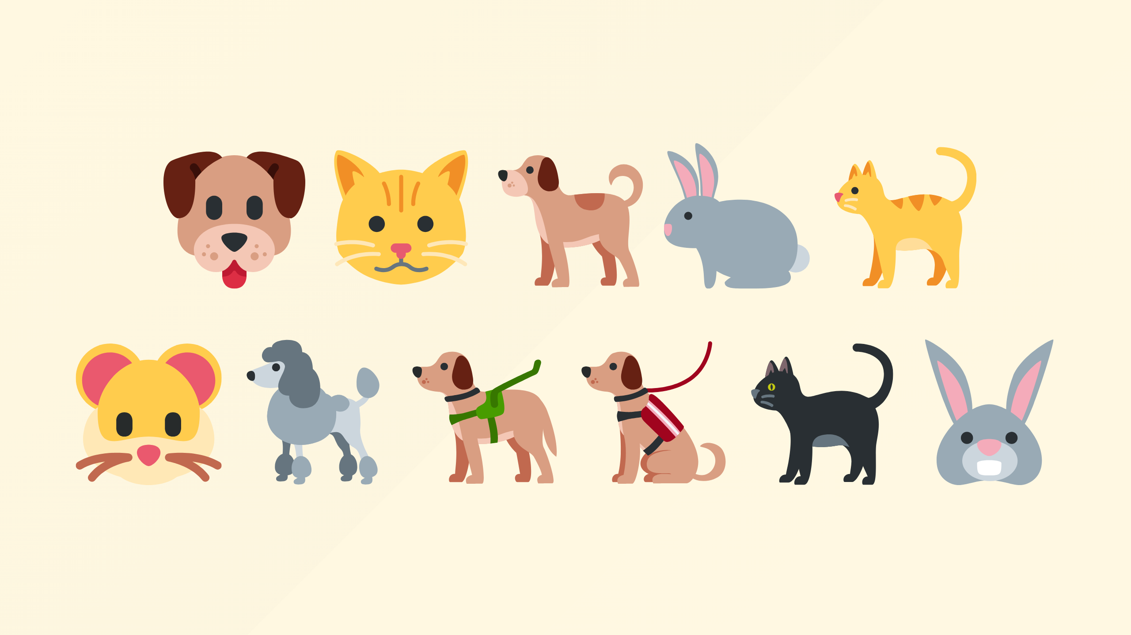
Notes:
Congratulations, you're now the proud owner of a pet shop, or if you managed to automate the creation

Slide 28
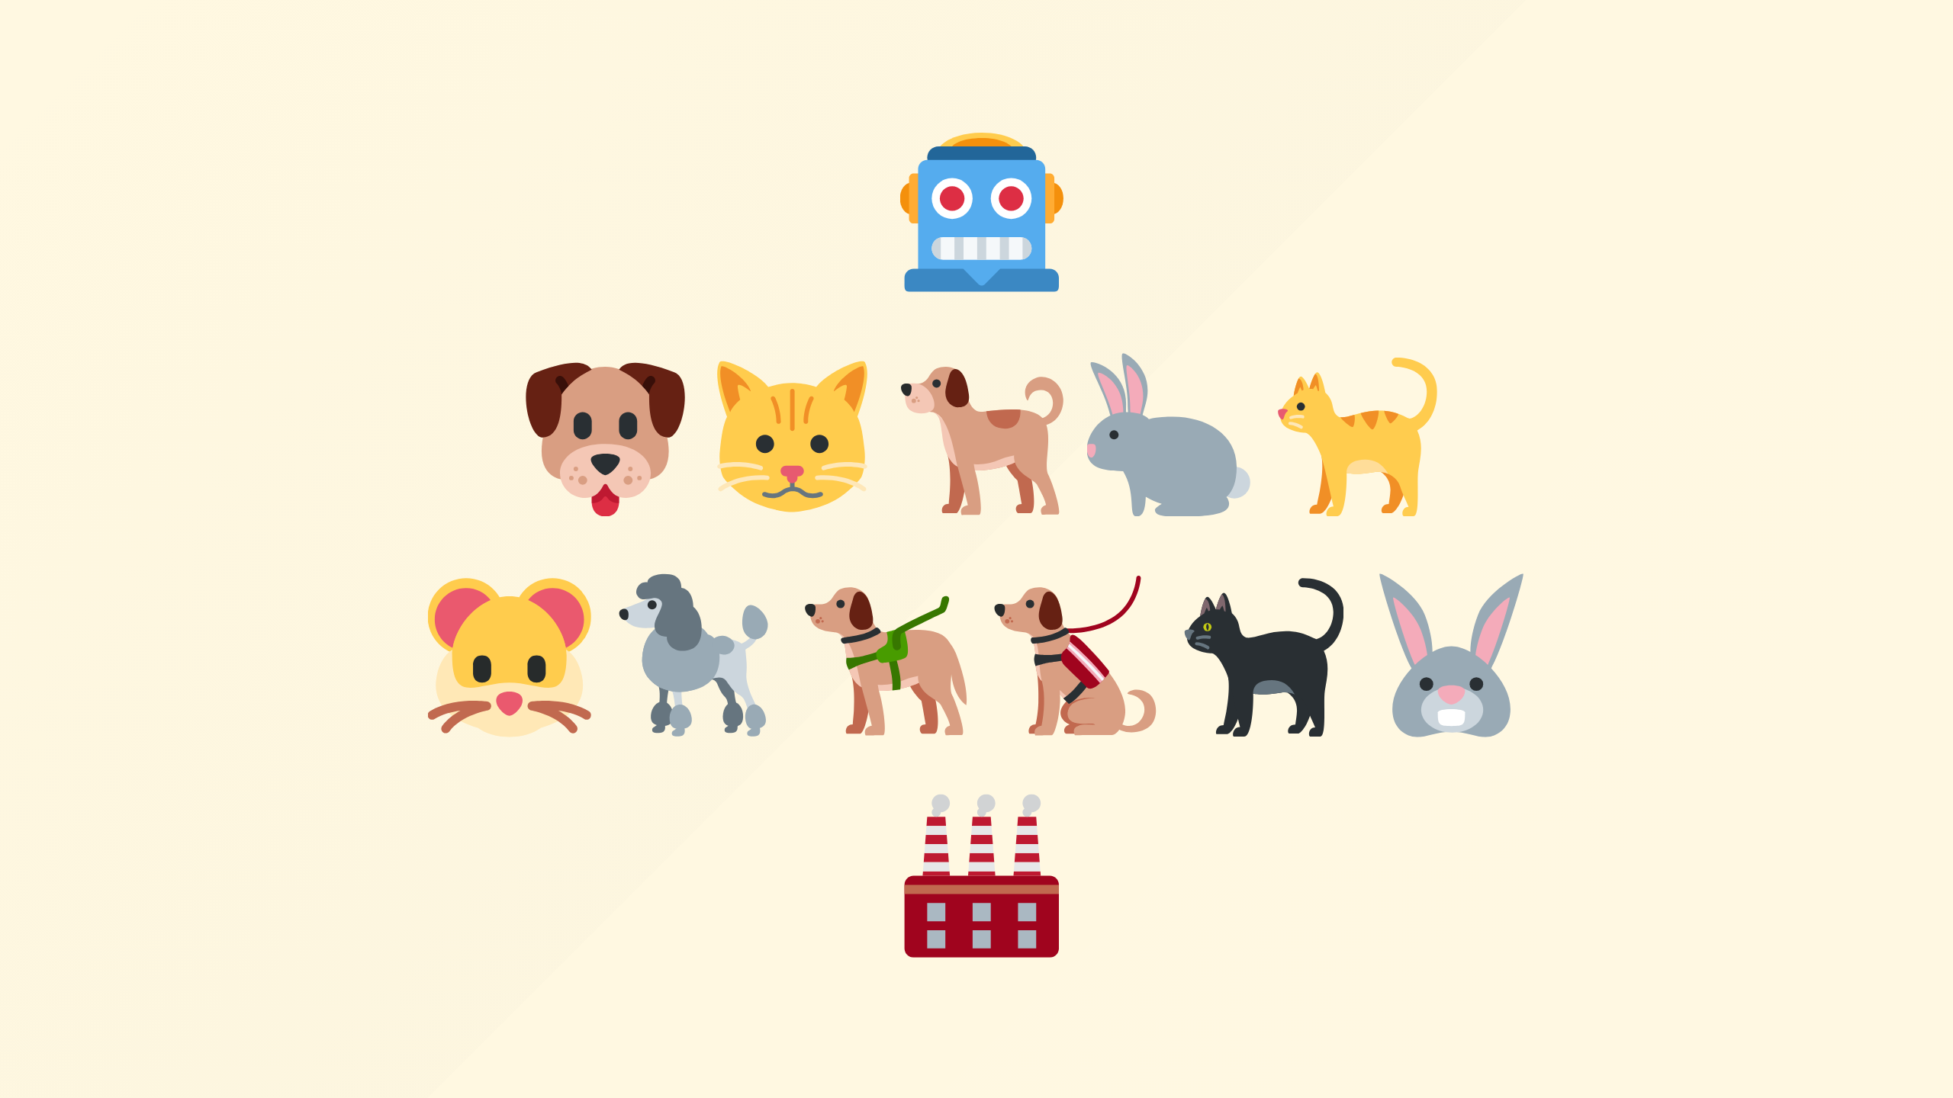
Notes:
You can call it a pet factory, but it's a headache

Slide 29

Notes:
But so what, how does this hurt you might ask?

Slide 30
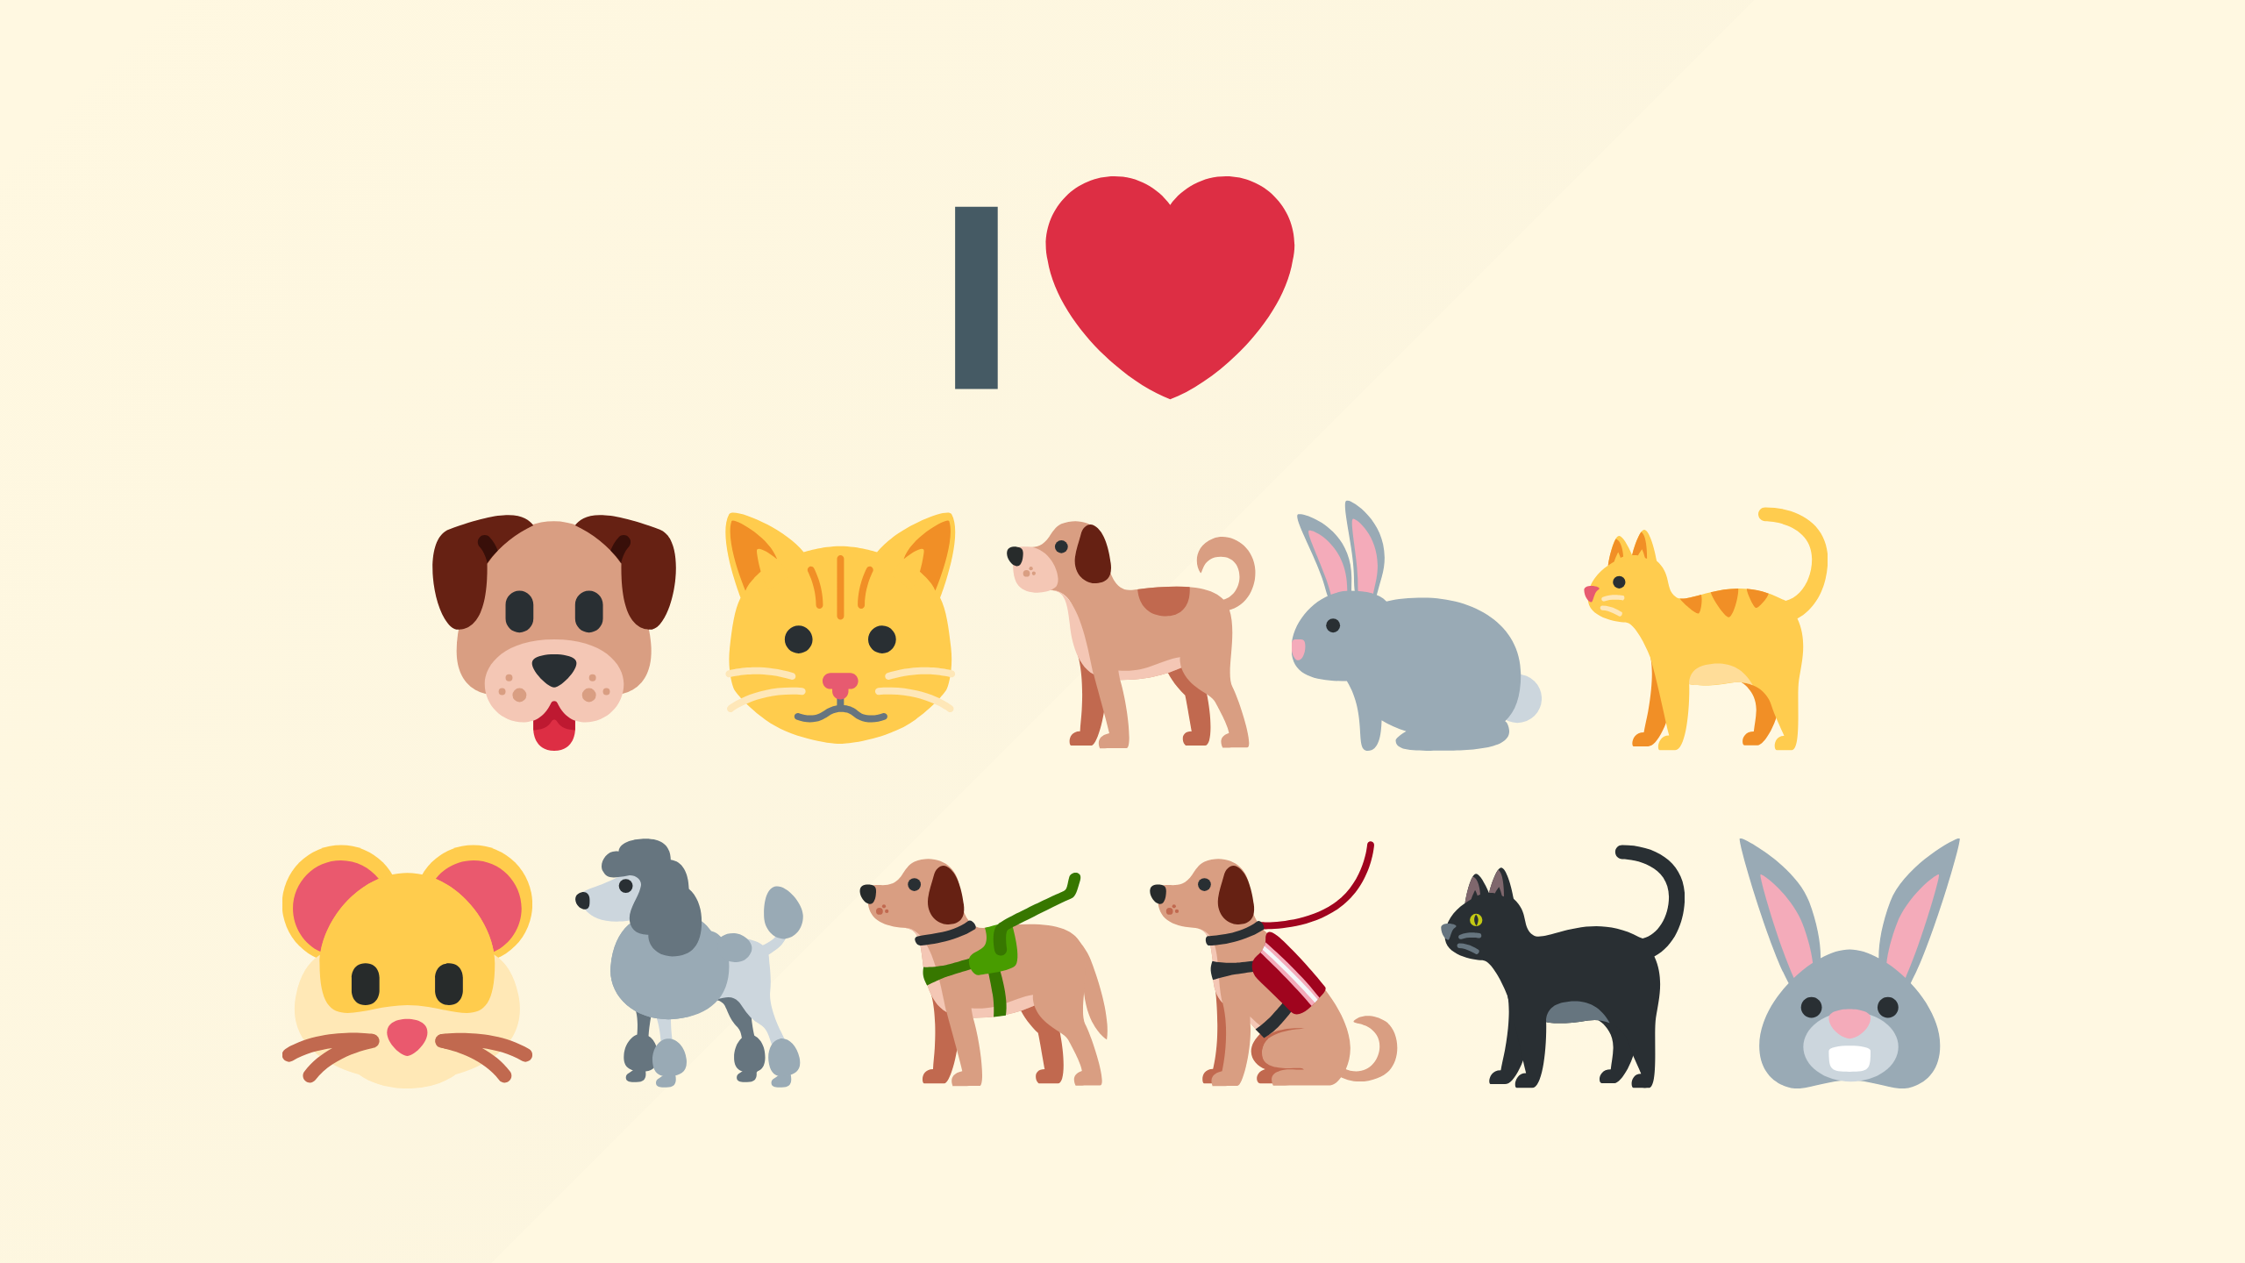
Notes:
Maybe you like pets?

Slide 31
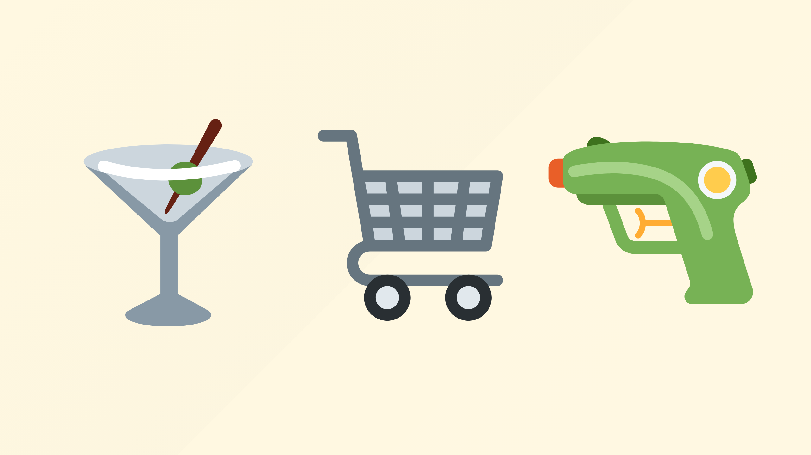
Notes:
Well, presuming of course you're in cloud, your world could roughly be summarized into tiers
Apps, well these are things that your board room know about, and can probably name, so think your public website, shopping cart system, customer service apps, online chat interfaces, email system etc. These are all implicitly providing some value in of themselves to your end customers.

Slide 32
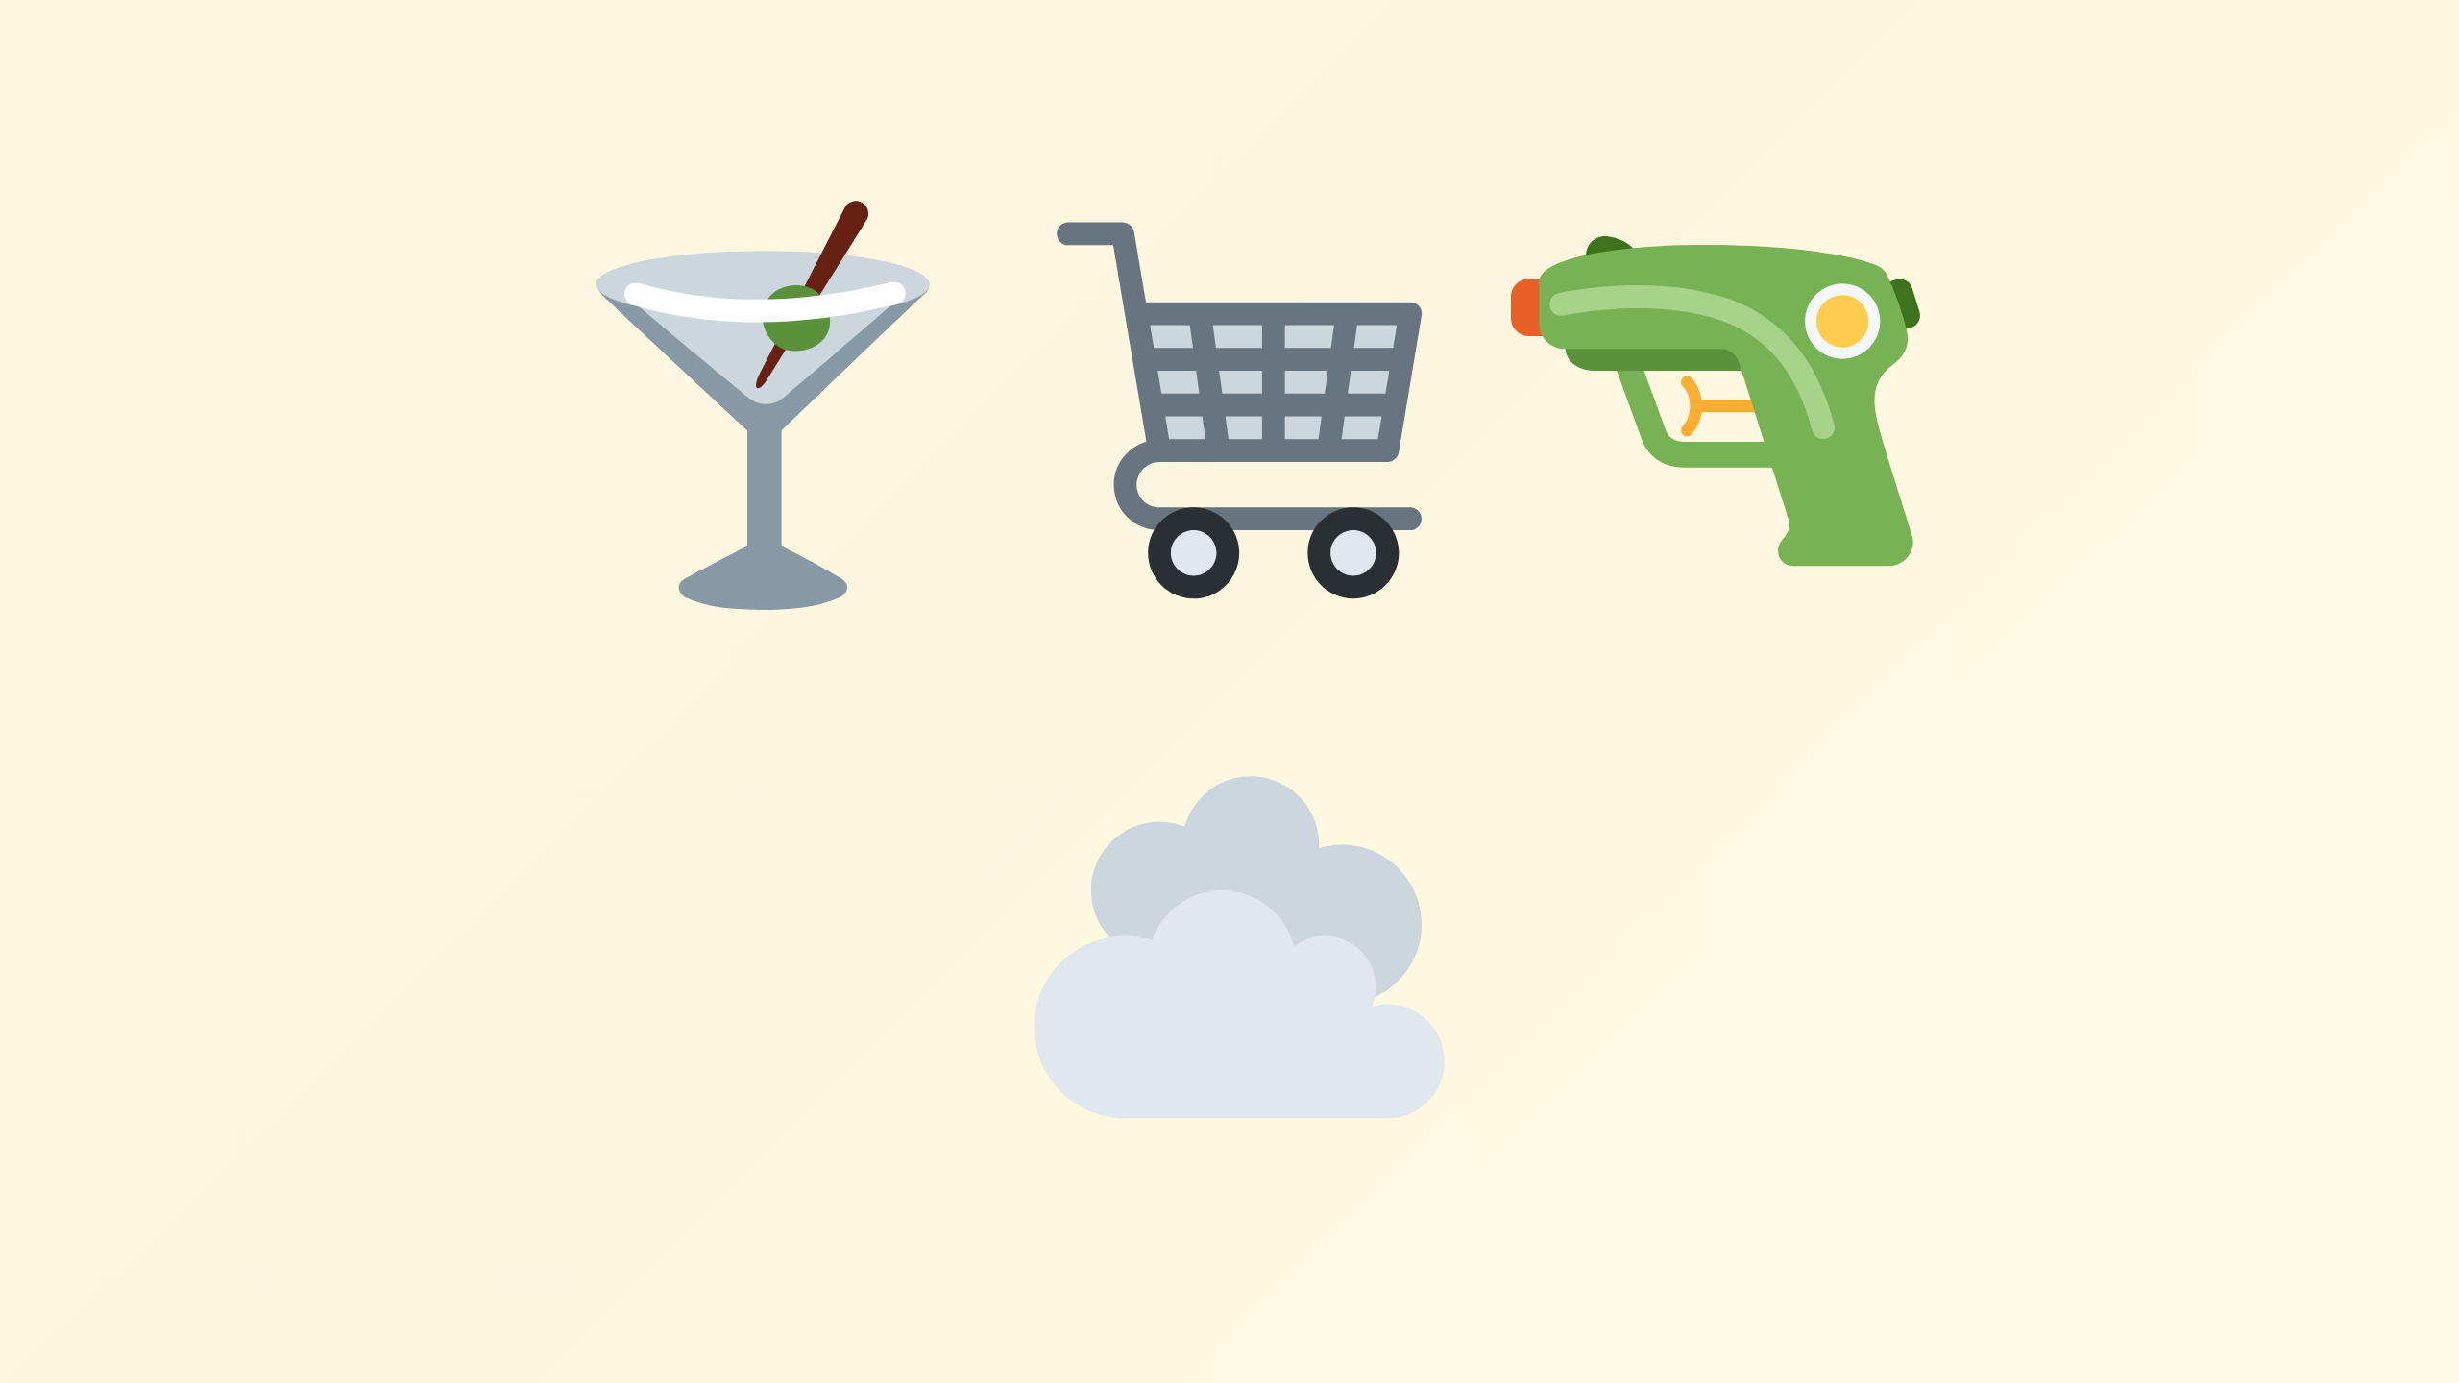
Notes:
Infrastructure, with cloud this is all commodity thankfully, the days where anyone in your business caring about the challenges of physically racking up hardware, not overloading the weight in the cabinet, taking pride in how well they've routed cables have hopefully passed;
and you're consuming infrastructure, hopefully you've codified this but even if you're in to ClickOps, making sure its running is not your problem. No one in your business is concerned with hardware failures, patching routers every-time theres a critical vulnerability, testing the UPS and the generators regularly, upgrading the HVAC when you add more servers.
"YAWN-orarma" as my 15 year old would say and curse me for repeating. Your interactions with any of this is a few clicks or lines of code and some infra is available to you with an SLA

Slide 33

Notes:
If only the story ended there

Slide 34
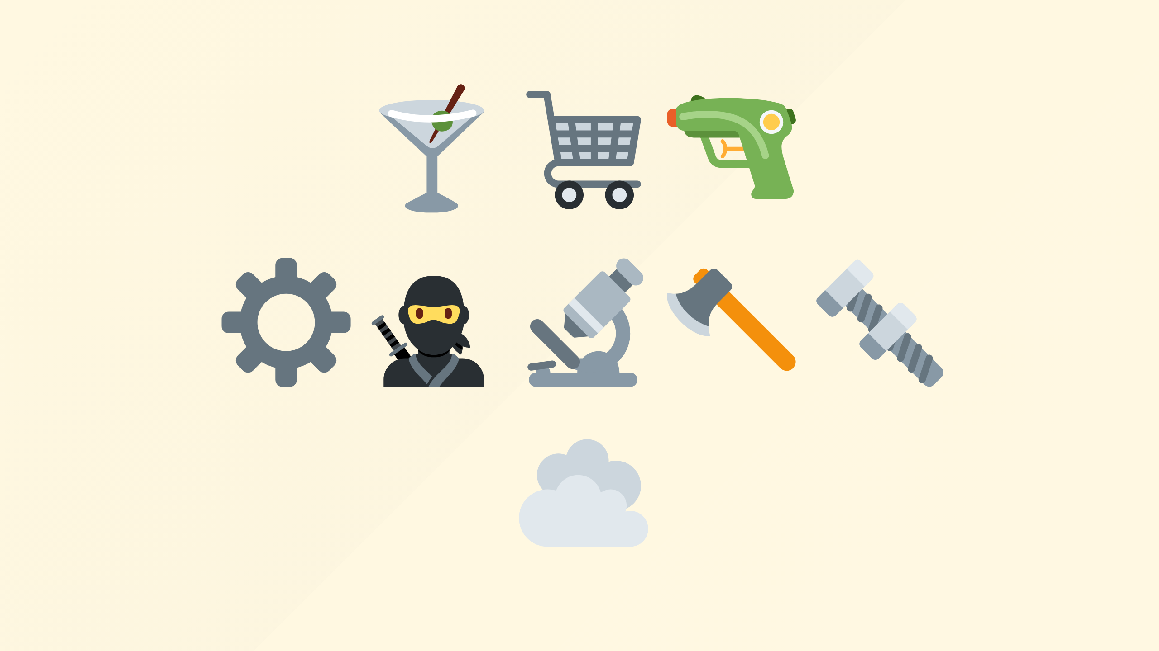
Notes:
But sandwiched between those is a grey layer, of all the operational enablers, its where your 'devops' or 'SRE' team live.
So think log aggregation, certificate issues, security policies, monitoring, service mesh and others.
These are things you do because of all sorts of reasons ranging from risk mitigation to emotion and technically unqualified opinion or just without foresight of what was round the corner in 6 months.
All of this while technically fascinating for people like me to stand and stroke my beard at they are delivering absolutely zero business value, unless of course your business is building those products.

Slide 35

Notes:
and who'd want to get into that business!

Slide 36
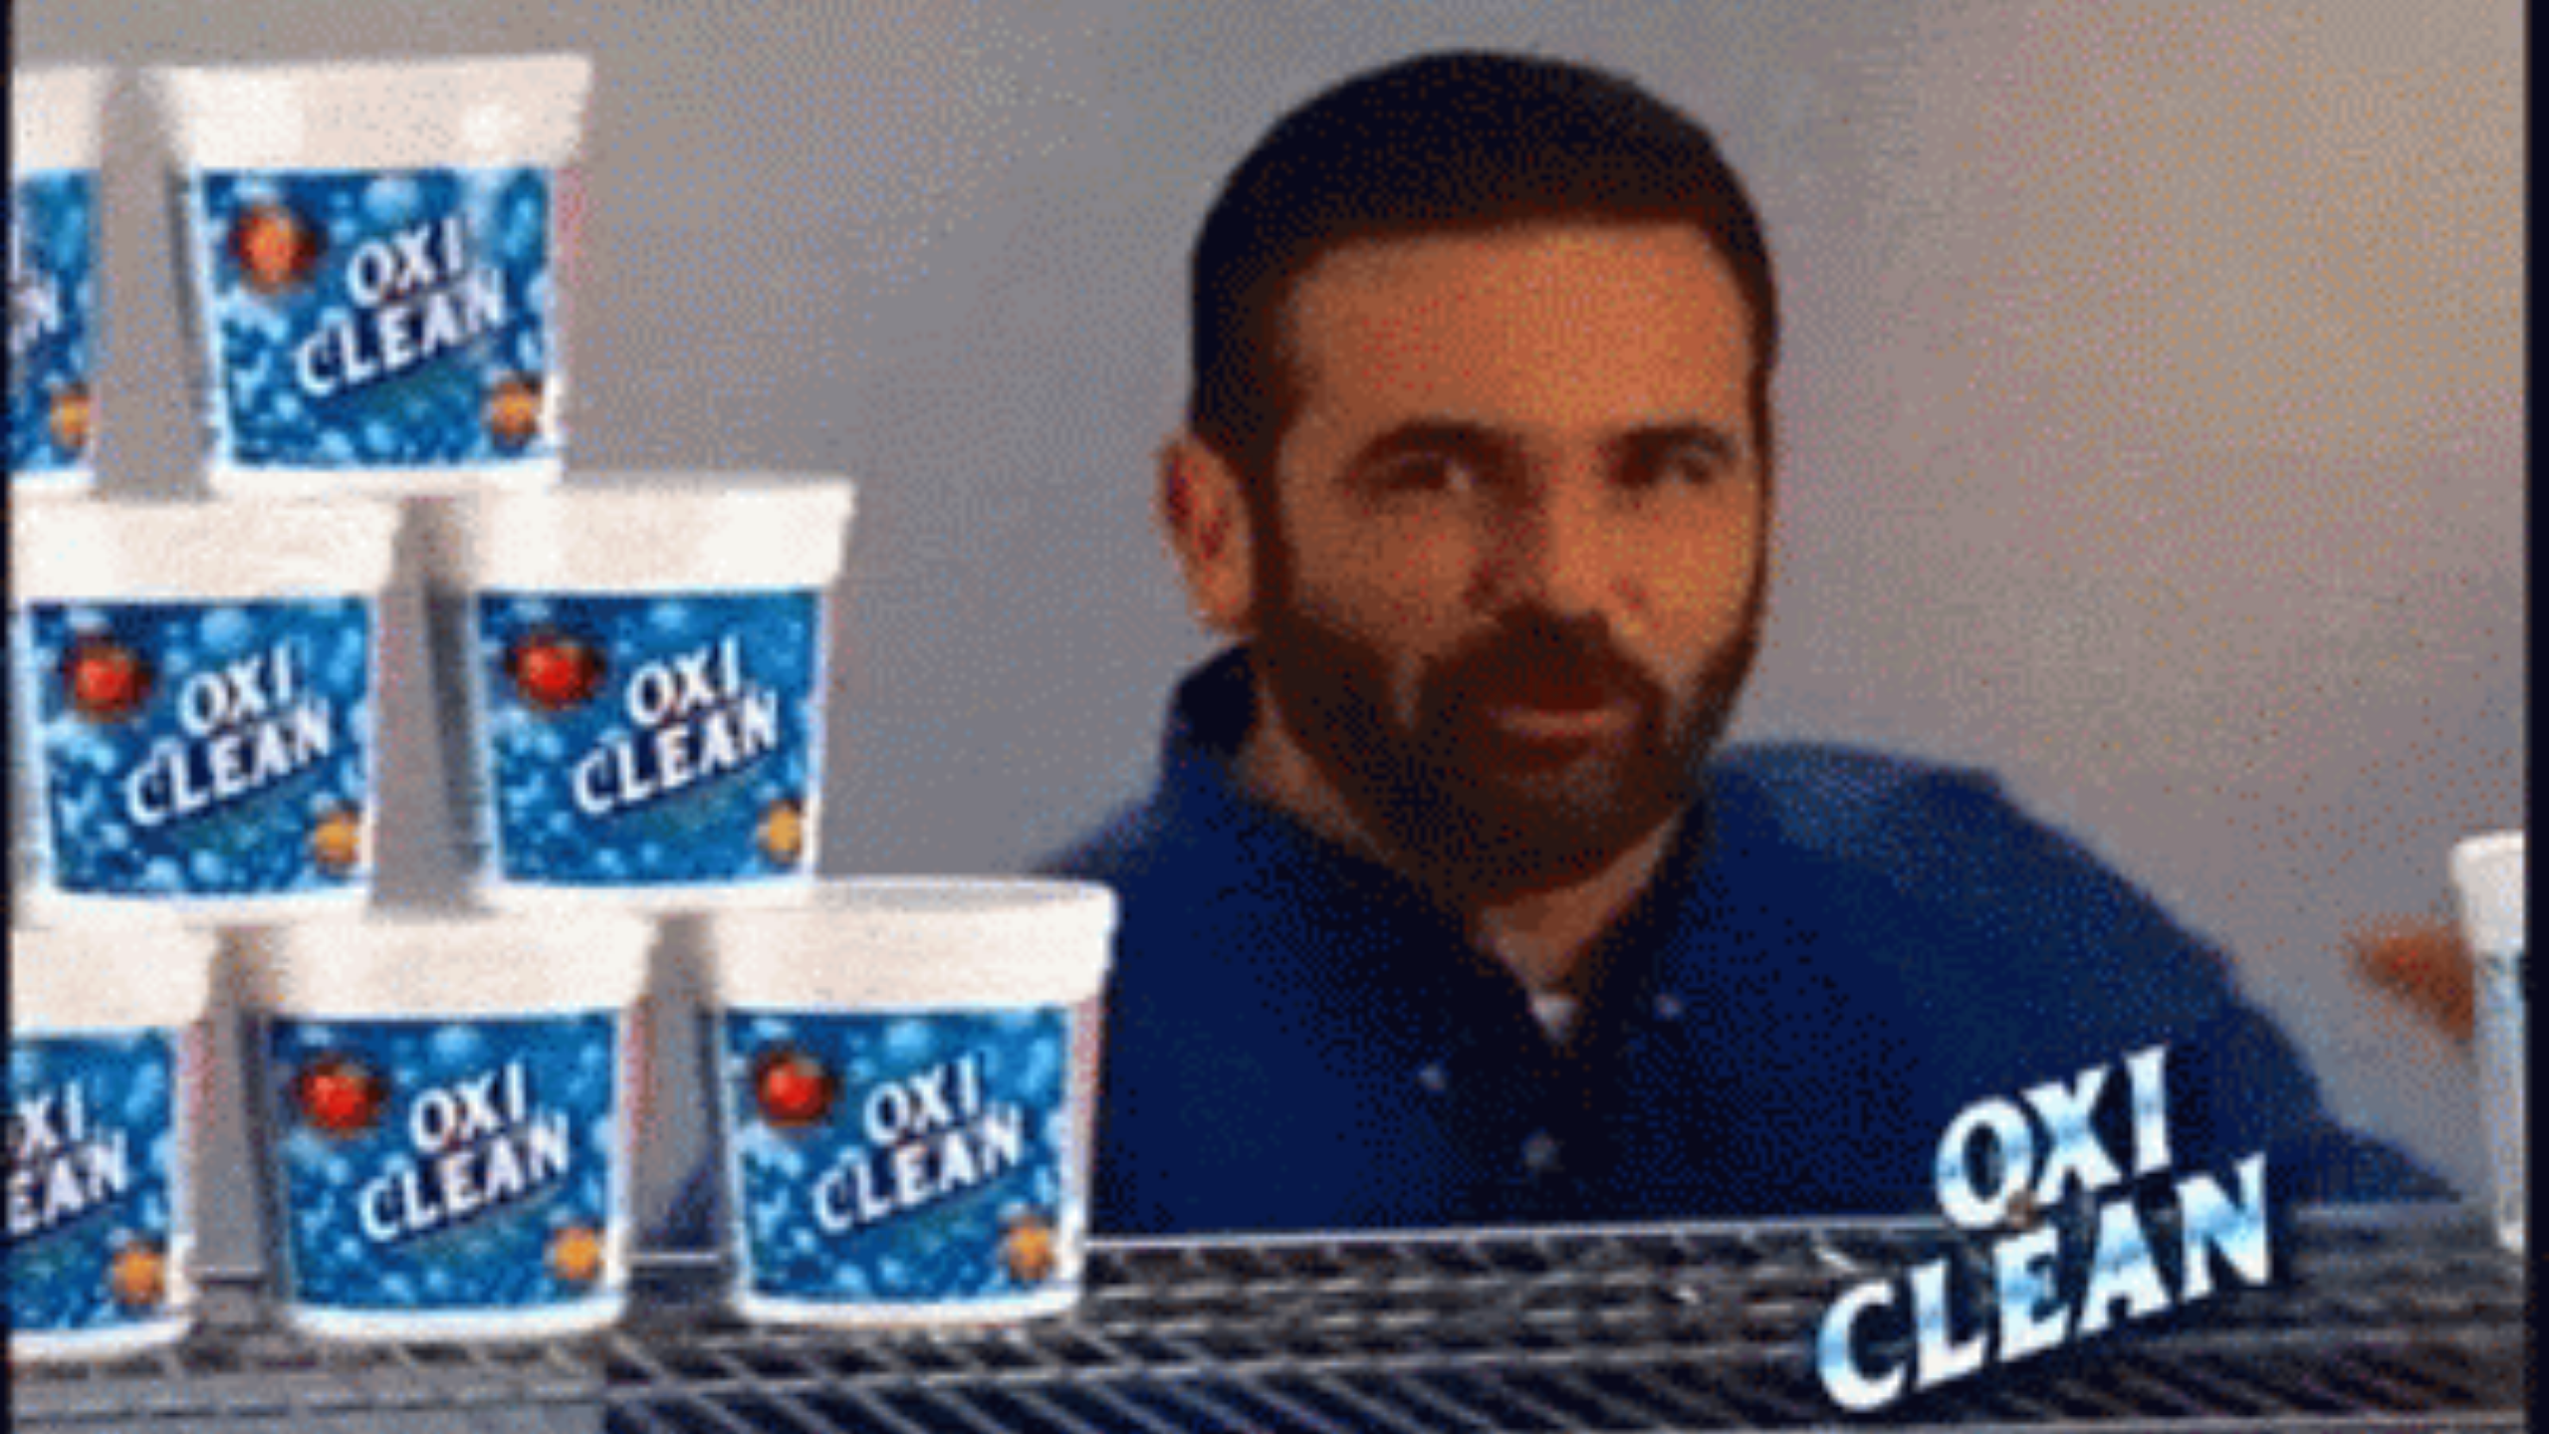
Notes:
And thats not all! Recruitment...

Slide 37
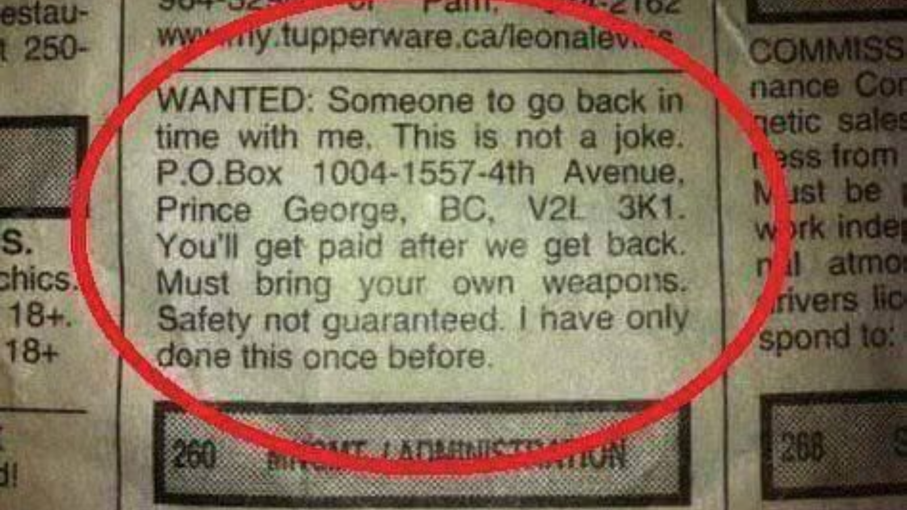
Notes:
You might think you want a devops right? oh no wait, devops with Kubernetes experience, maybe a CKA? oh yeah, its on AWS, and we use linkerd and in some places istio, no not the current version, or even the same version everywhere. a mix of pod security policy, kyverno and OPA for policy, some terraform, helm, jenkins, github action soup going on, all in a mono-repo apart from all that stuff that isn't.

Slide 38
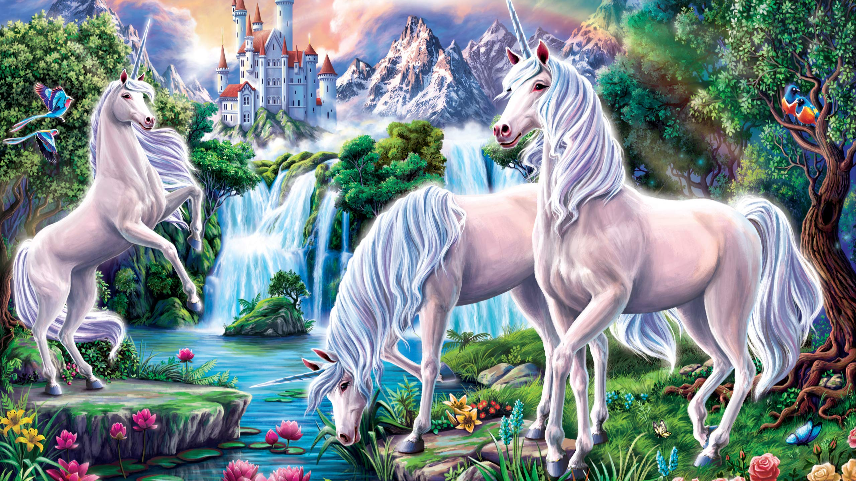
Notes:
We're well outside the remit of commodity skills and back to hunting unicorns.

Slide 39
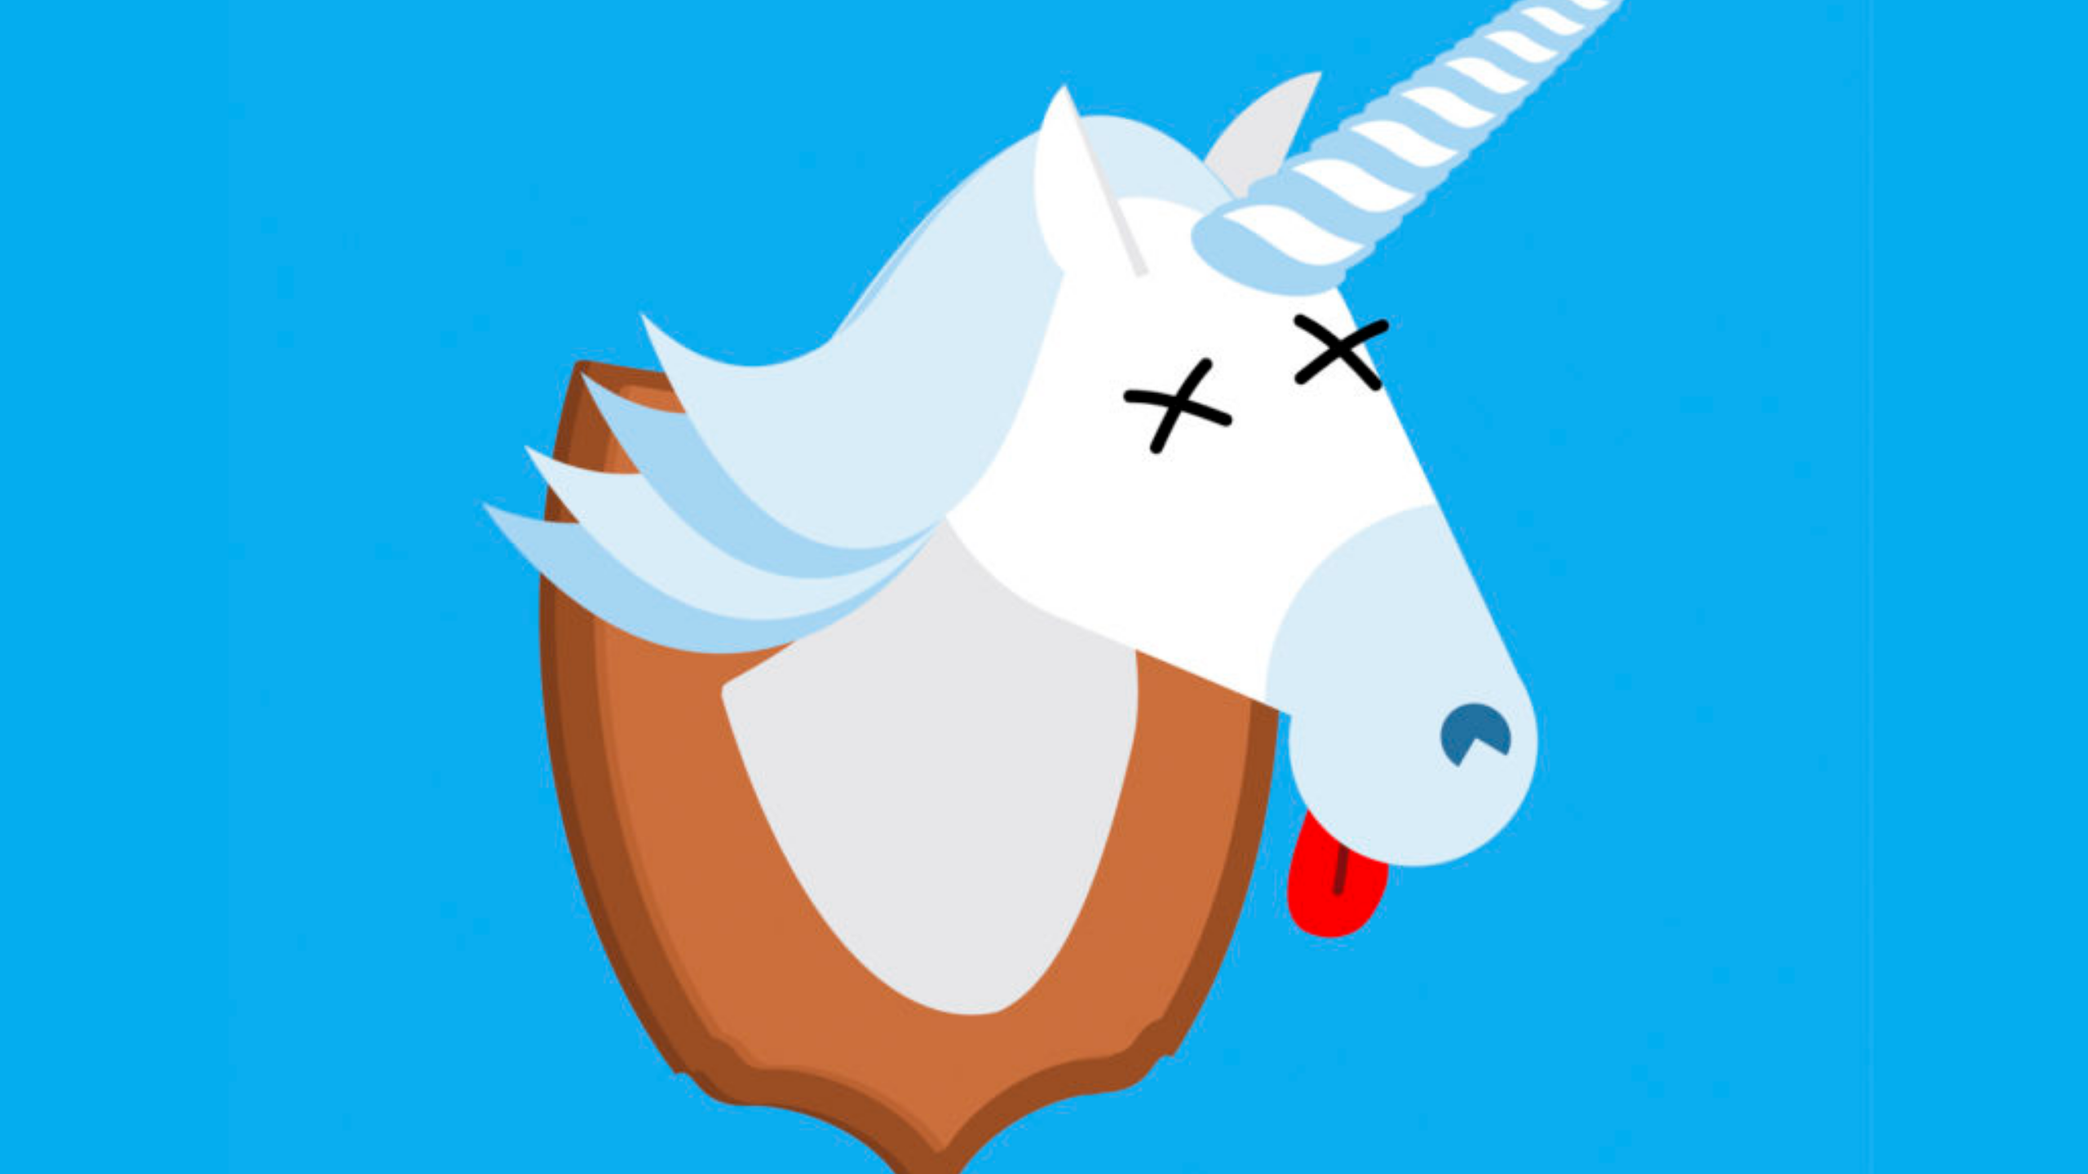
Notes:
Sure you'll find some victims. sorry...

Slide 40

Notes:
I mean candidates; that you'll hire, well now you've got one hell of an onboarding issue before they can do anything useful and help your business move forwards faster than it did without them.

Slide 41

Notes:
And if you hired smart people they'll come with experience and their own opinions of what worked for them before, so your landscape gets bigger and bigger and more complex

Slide 42
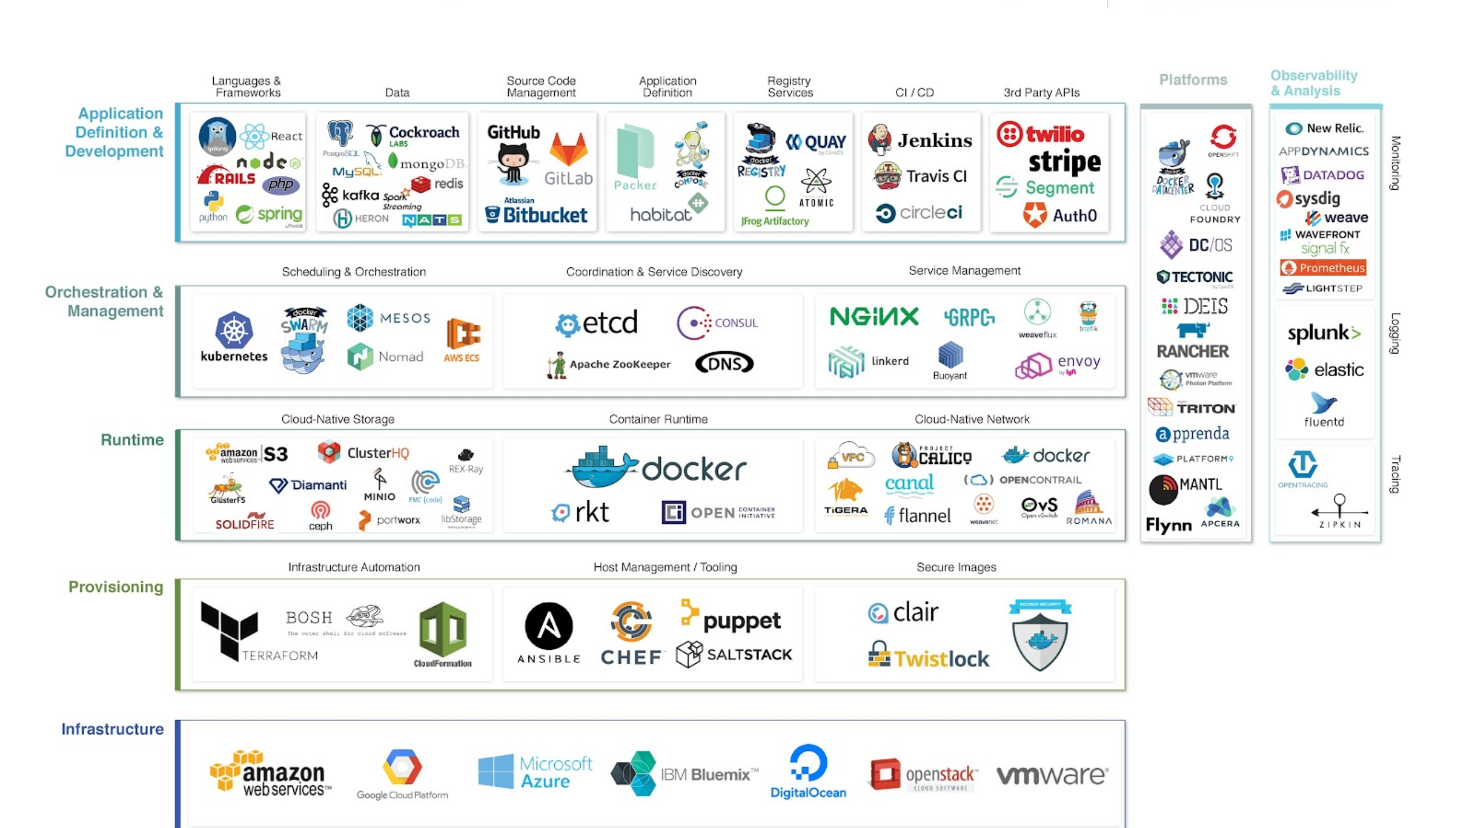
Notes:
I did some googling, this is what the CNCF landscape looked way back in 2017.

Slide 43

Notes:
Choices, choices as far as the eye can see.

Slide 44
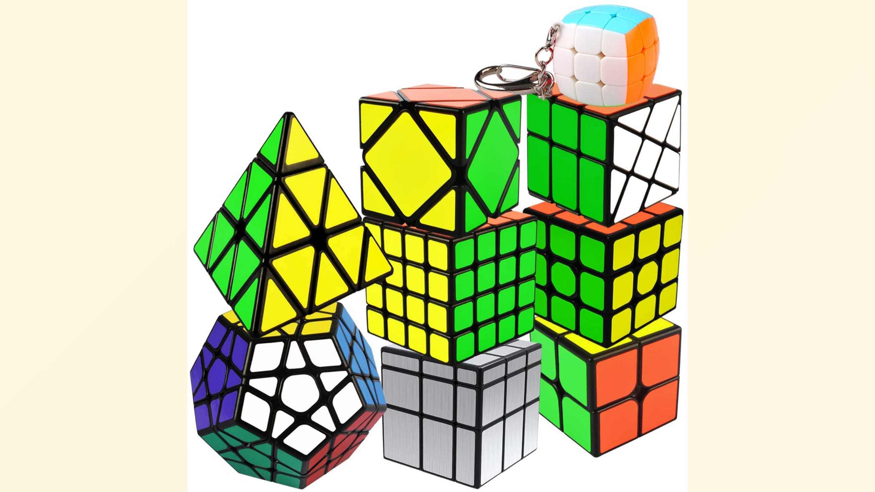
Notes:
Have you seen it recently?

Slide 45
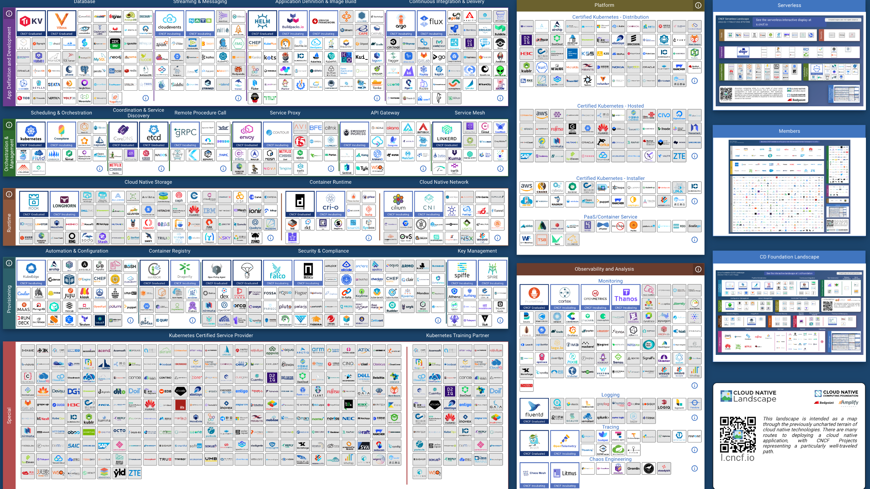
Notes:
This has got a bit out of hand, I'd say someone aught to have a word but I suspect that'd just make things worse by adding yet another thing

Slide 46
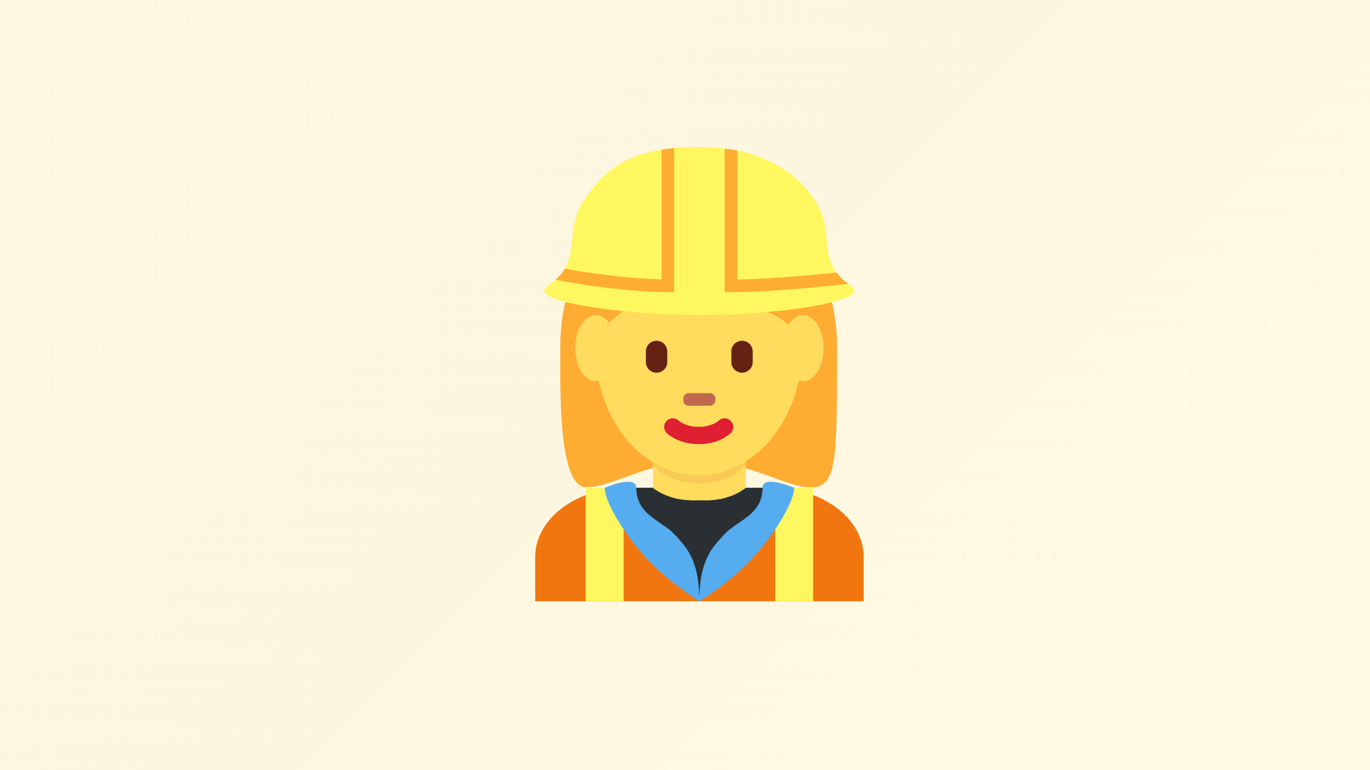
Notes:
I can't possibly think of a faster way to go from enthusiastic engineers playing with new exciting tech

Slide 47
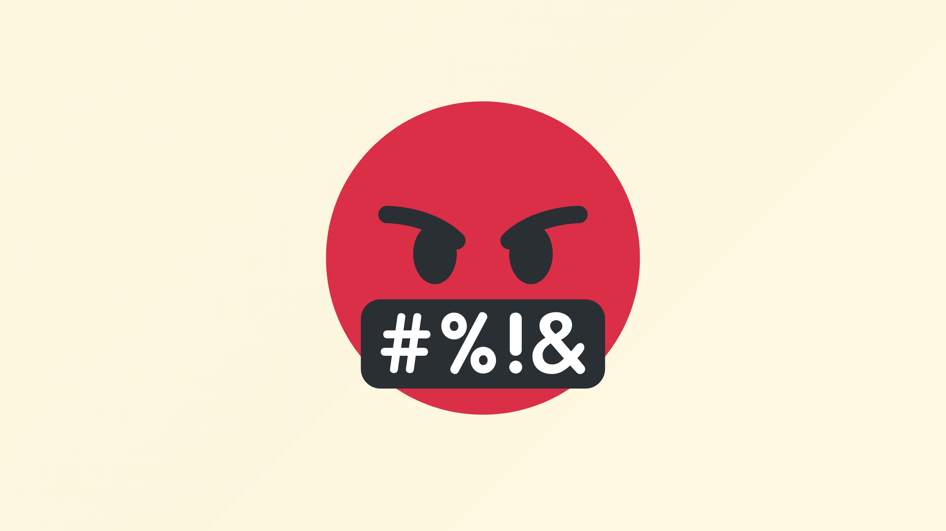
Notes:
To deeply unhappy ones trying to fix something at 4am

Slide 48
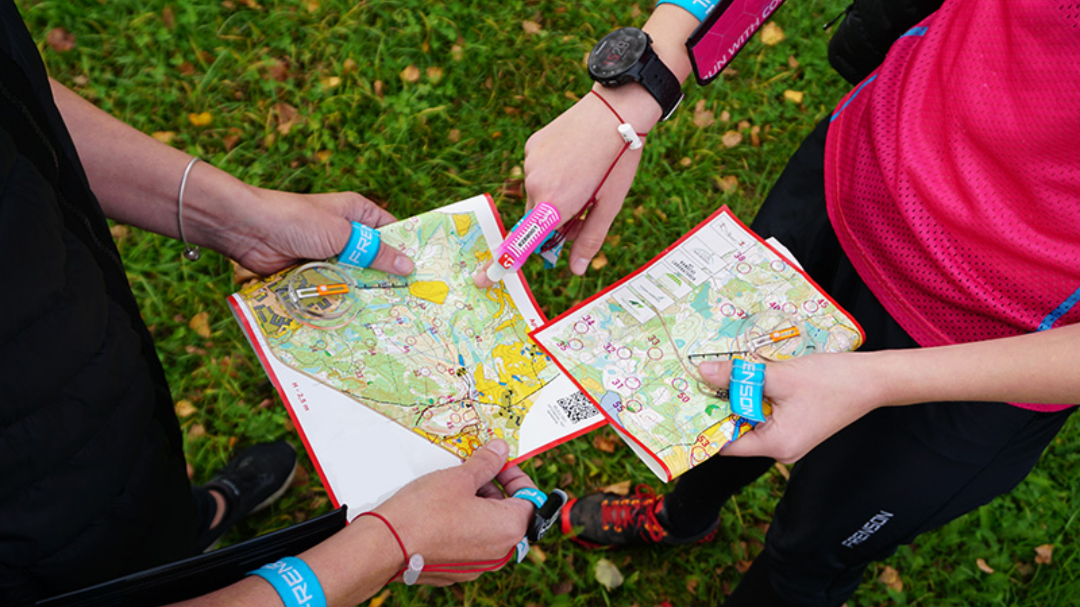
Notes:
and before they can do anything meaningful they've got an orienteering exercise to switch mental context to whatever the intended permutation of things it is they're looking at.

Slide 49
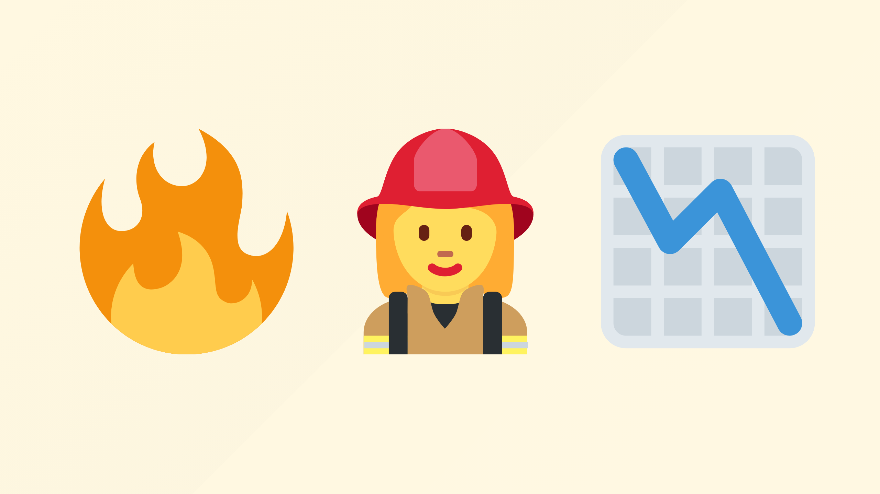
Notes:
Meanwhile your business value delivering apps are offline, or worse at breach

Slide 50

Notes:
Rewind a minute we didn't want any of these things, how did we get here?
What can we do about that?

Slide 51

Notes:
So with that I'd like to reintroduce Graeme who is surely going to fix all this mess

