Slide 1
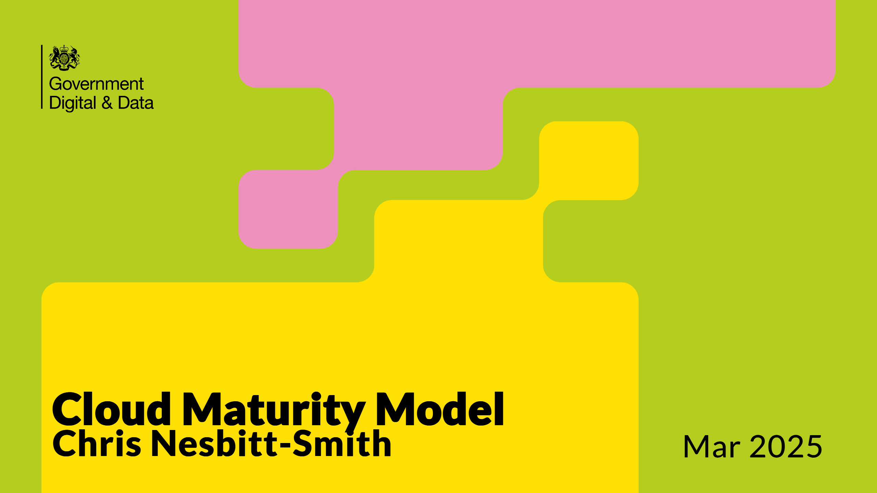
Notes:
Hello, I'm Chris, I'm a consultant at GDS, working with the cloud and platforms team.
I'm going to talk about a thing I've been working on for a few months, looking at cloud maturity.

Slide 2
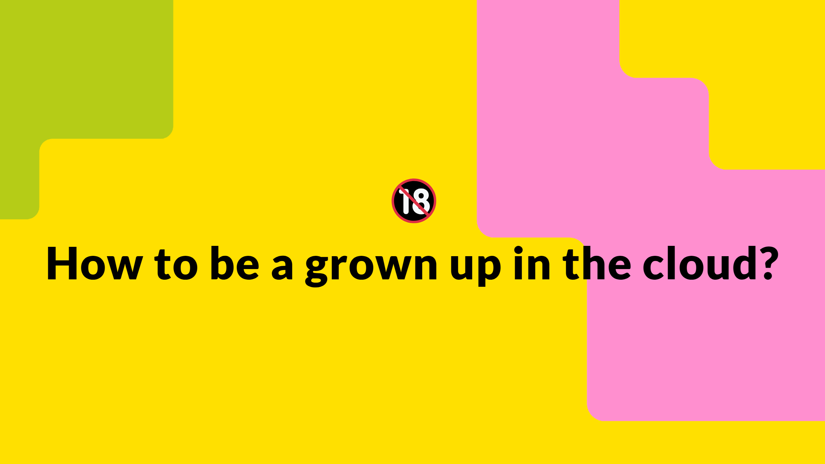
Notes:
The original title for this talk was:
How to be a grown up in the cloud
because clickbait.

Slide 3

Notes:
Before the grand reveal, theres some things to clarify and provide context

Slide 4
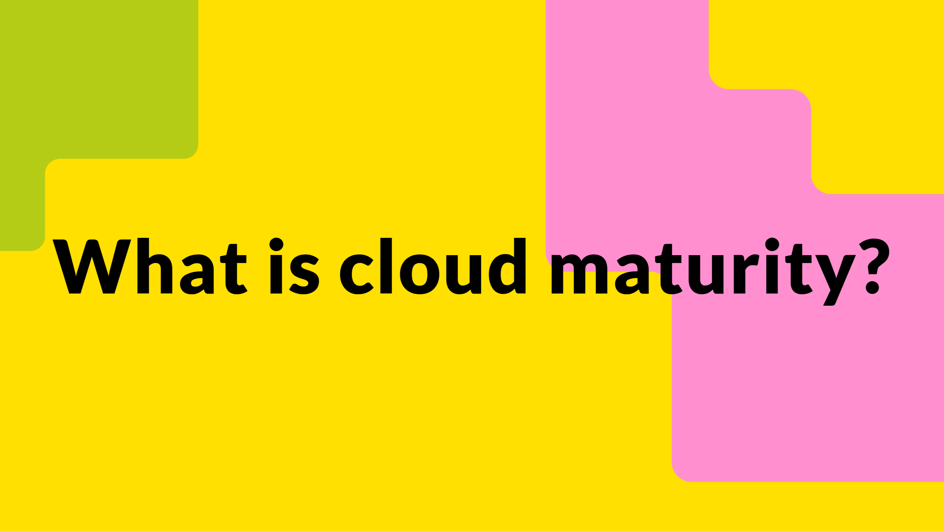
Notes:
What is cloud maturity anyway?
I did what everyone else has done for the past 12 months, and asked ChatGPT because every talk has to mention AI these days, anyone playing tech talk, bingo take a shot

Slide 5
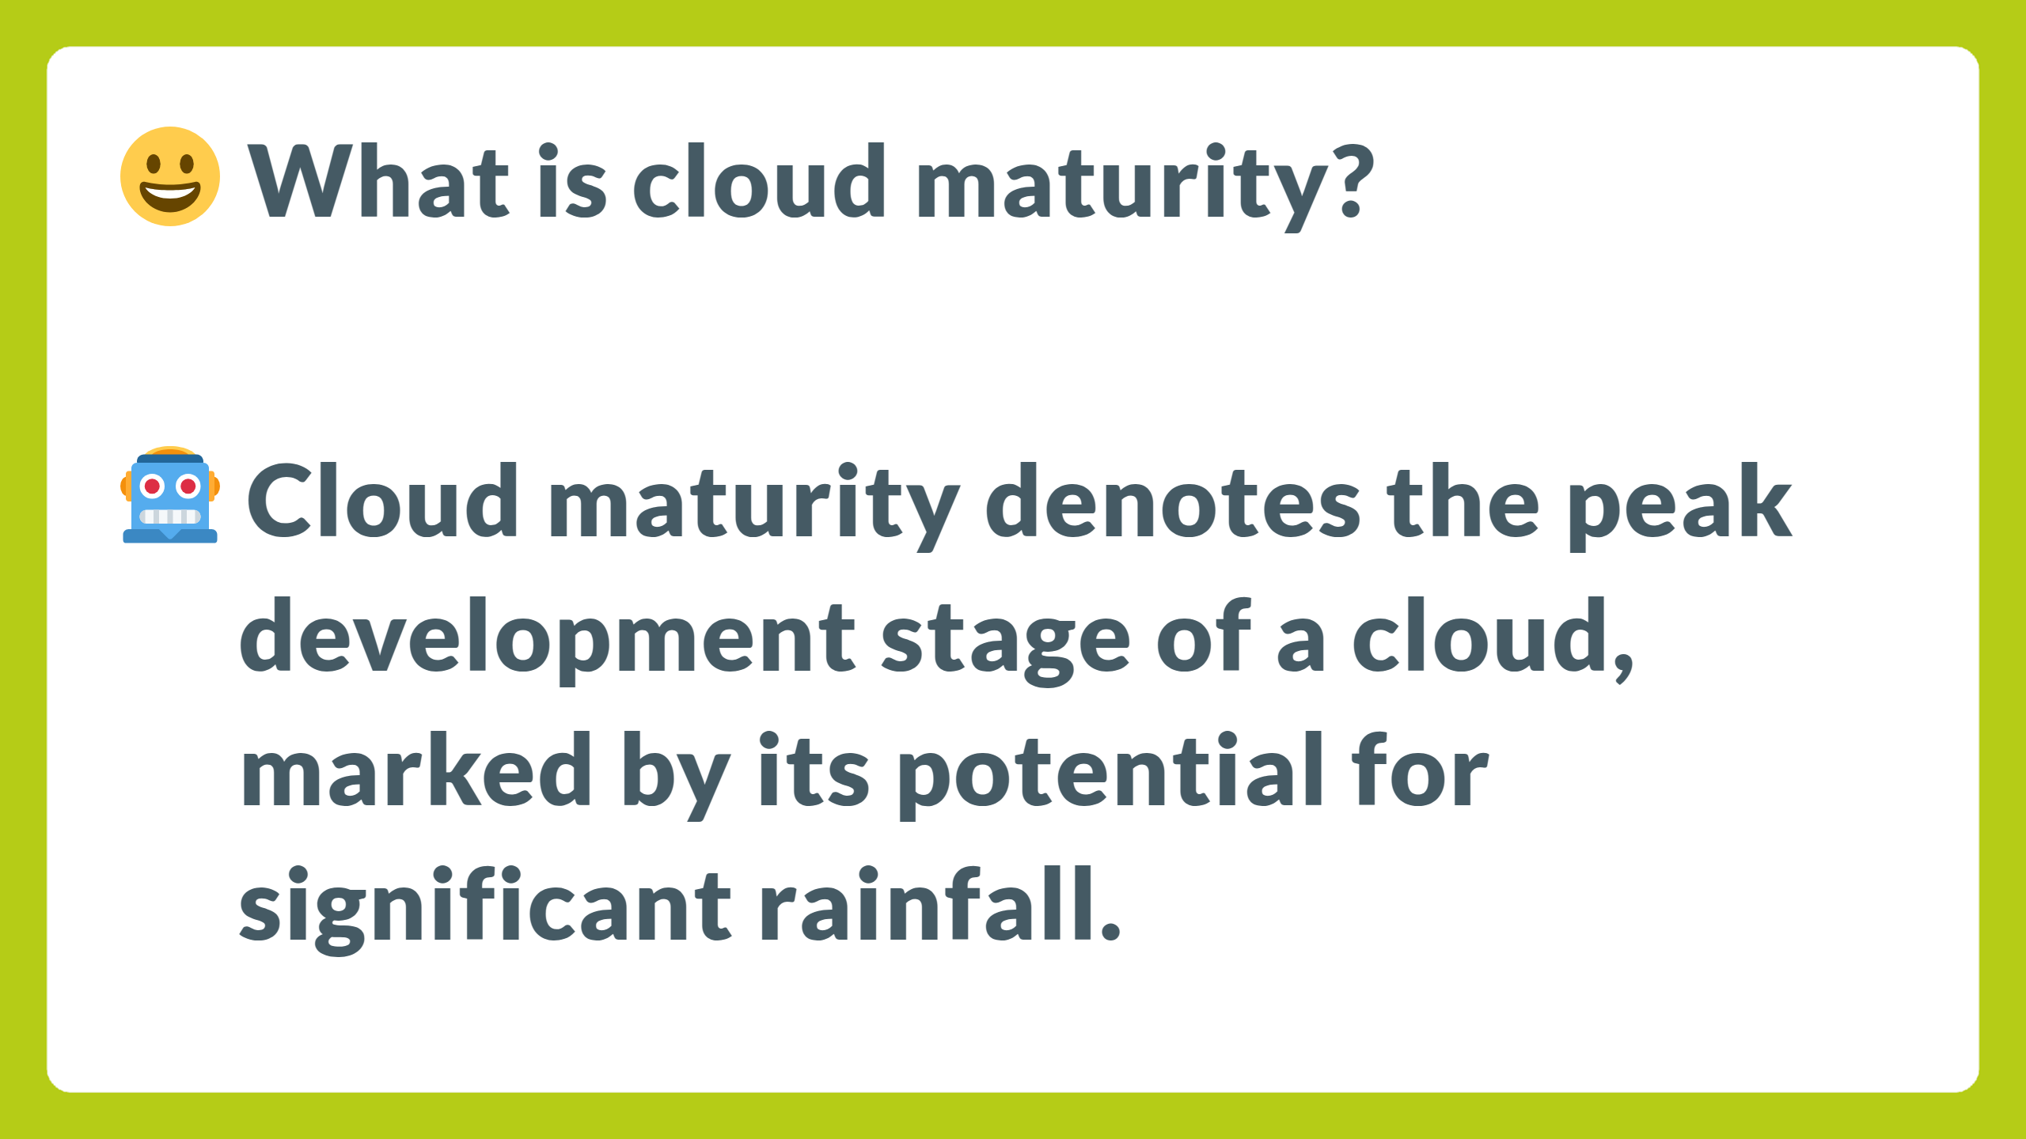
Notes:
Heres the response. That's another shot.
After some "prompt engineering" since we're not the Met Office:
Cloud maturity is the extent to which an organization can effectively leverage cloud technologies and practices to fulfill its business objectives and drive innovation, efficiency, and growth.

Slide 6
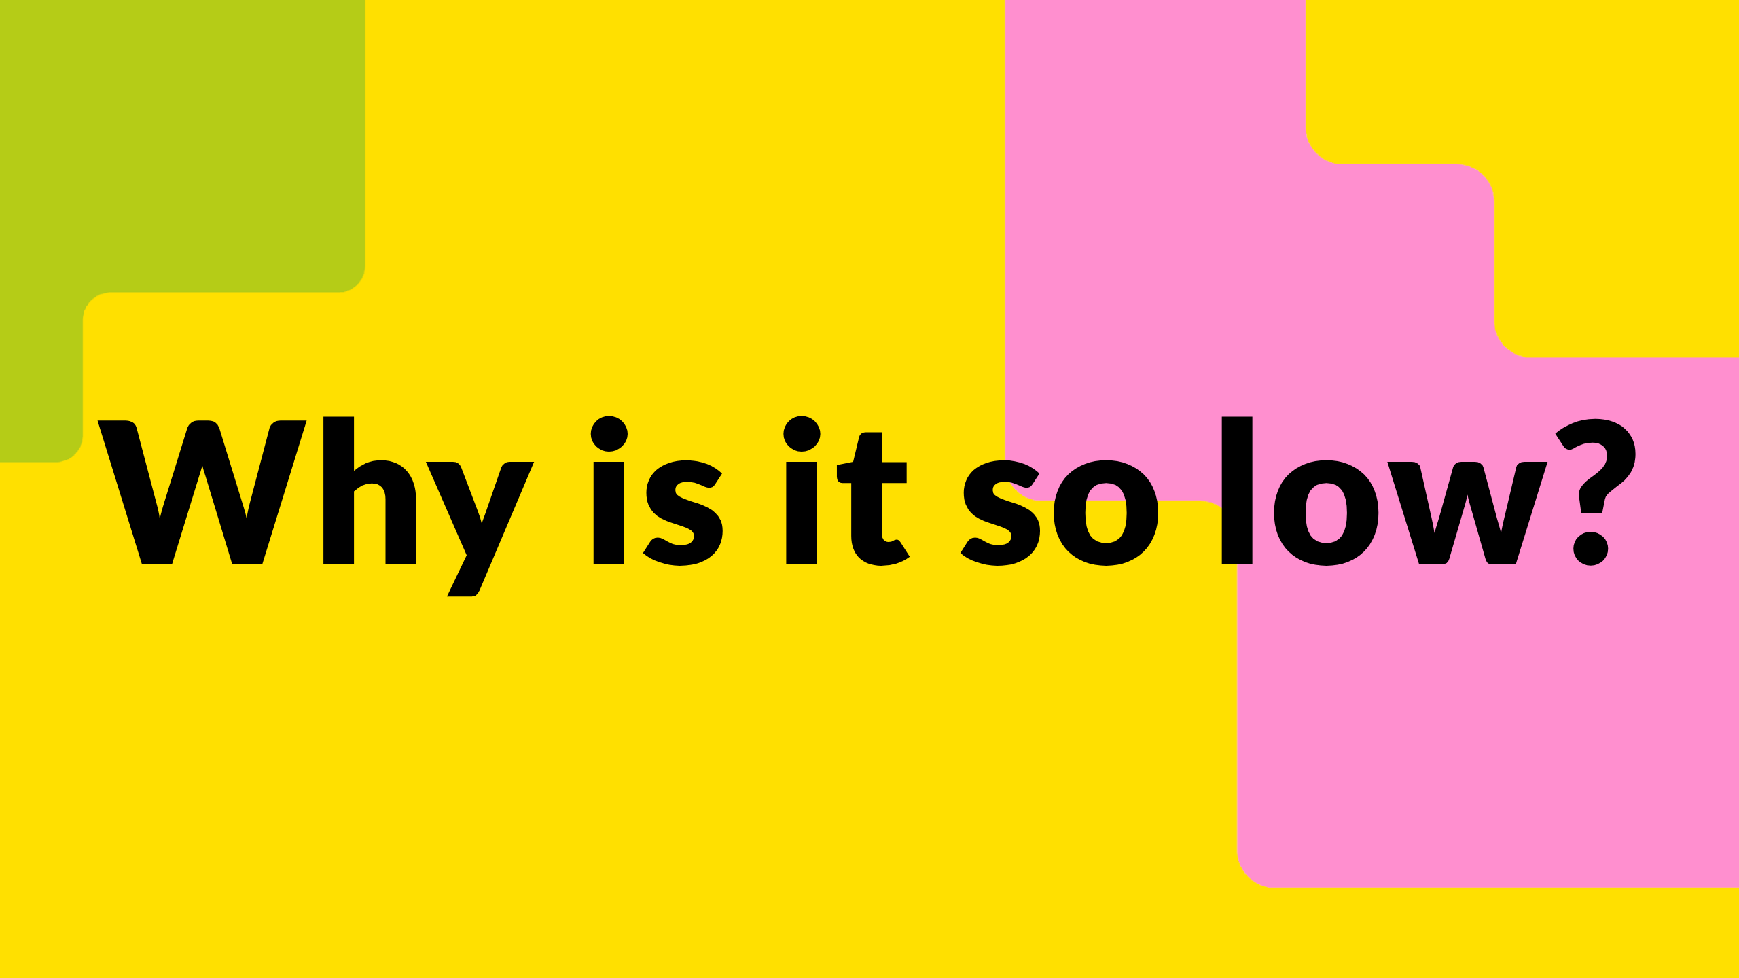
Notes:
Why is it so low? well thats easy, its hard
And usually any organization's use of cloud starts with something small, possibly incidental, and then it all snowballs from that, and no one goes back to burn it to the ground when you learn new things and start again.

Slide 7
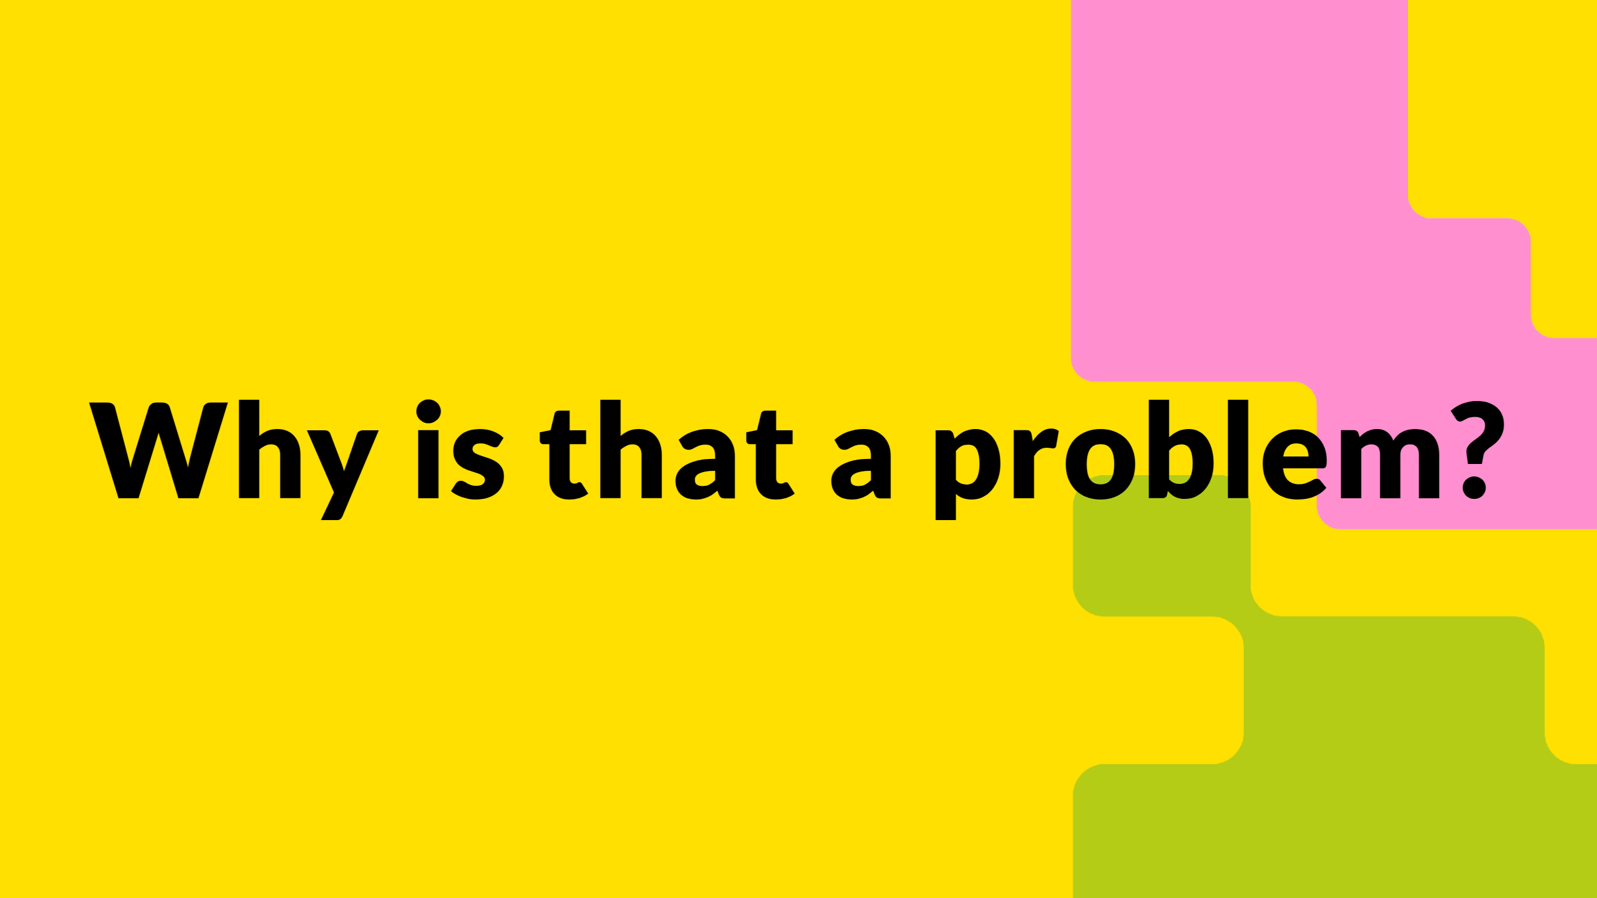
Notes:
Why is that a problem?
Well it's risk, everything from financial risk with spiraling costs to operational risk with growing complexity, security with lack of observability of what is going on to even know if you've been breached let alone mitigate against it.

Slide 8

Notes:
oh gosh that sounds bad right? well..

Slide 9
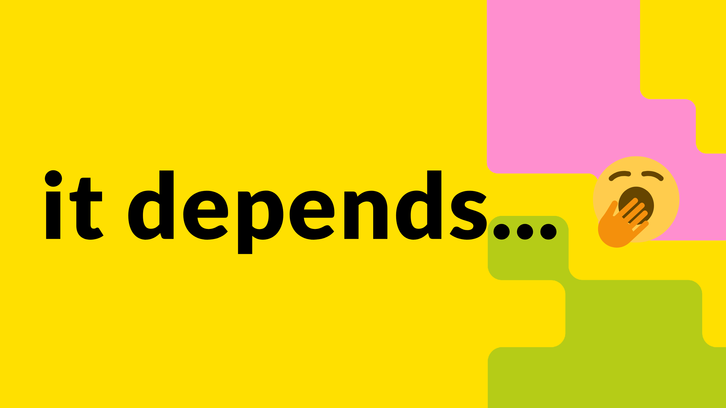
Notes:
it depends, and people usually mistake me for an architect and wander off when I say things like that

Slide 10
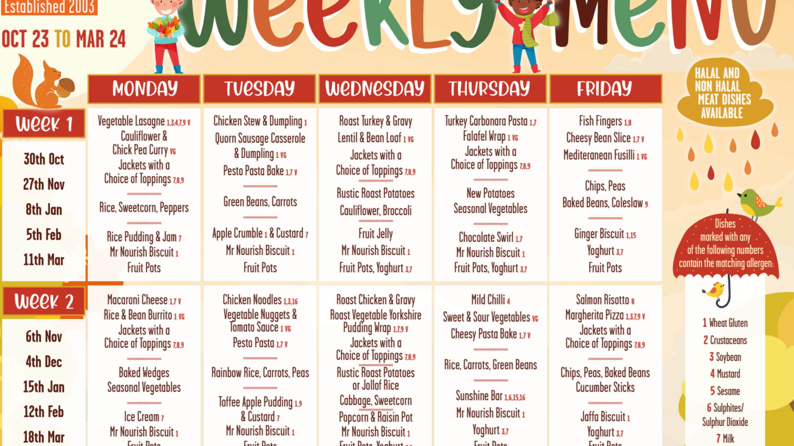
Notes:
take my kids school menu for example
I'd hope you'd agree that its probably not a proportionate answer to have the equal rigor of protective controls applied to this as you might find on say the personal data of the children showing who is eligible for free school meals and thus their parents financial state, which children have been referred to social services, ability to change who is on the list to collect them, and so on.
Or is it necessary to serve this from a multi-national content delivery network that ensures it's available with sub second latency delivered anywhere on the planet?

Slide 11

Notes:
or beyond

Slide 12

Notes:
So its hard, and it does depend, but thats not useful or actionable

Slide 13
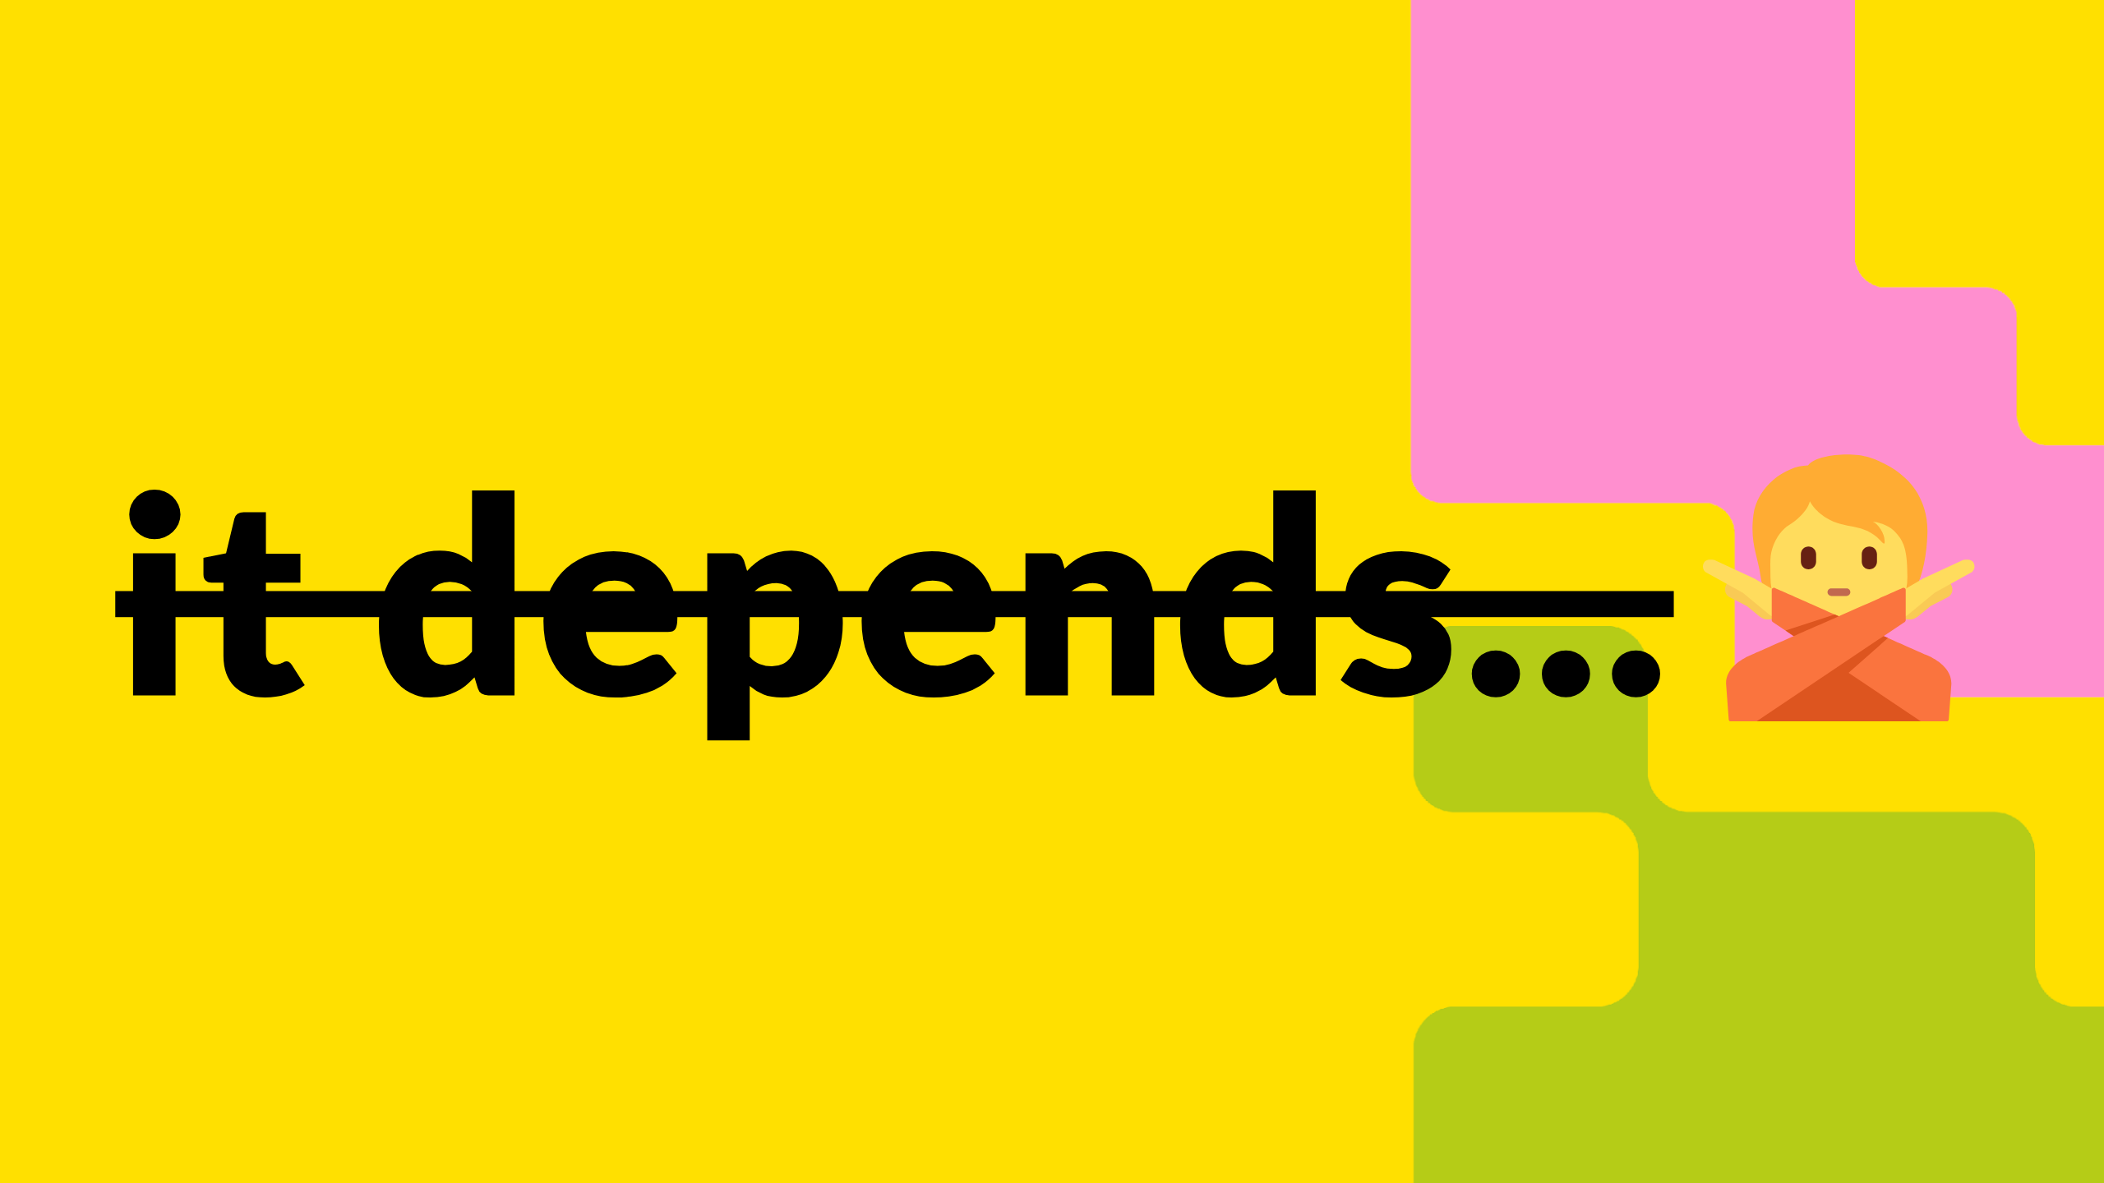
Notes:
lets have some opinions

Slide 14
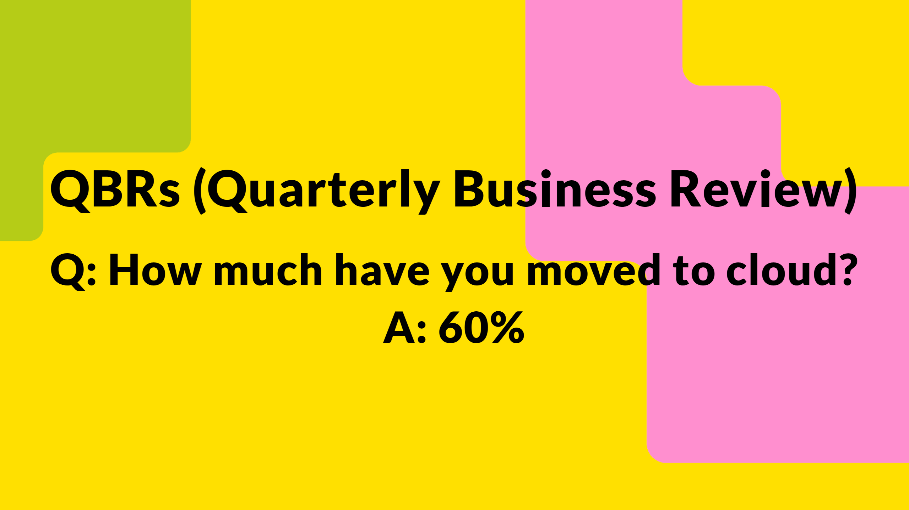
Notes:
Today we in the QBRs we ask departments how much have you moved to public cloud
and they'll respond with no greater context, say 70%. but what is that?

Slide 15

Notes:
maybe its servers, or virtual servers

Slide 16

Notes:
maybe its the amount of data
(thats a 3.5 inch floppy disk by the way, it pains me to have to explain that, the astute will notice the emoji is a 720 kilobyte read-write one, if you can explain why come find me in white chapel building and I'll buy you a coffee downstairs)
TANGENTS

Slide 17

Notes:
maybe its money?

Slide 18

Notes:
who knows, basically anything between zero and 100% is interesting to track for a single department, but its not a usable metric between departments, nor does it suggest good/bad/on track/behind, or any other context.
And indeed if they're full steam ahead into creating a future legacy in cloud

Slide 19

Notes:
We're well overdue some better questions.

Slide 20

Notes:
That we can take the answers from them to chastise the departments with, right?
Thats the nearest emoji I could find to a stick

Slide 21

Notes:
No, that's not helpful.

Slide 22

Notes:
OK I know you really came here wanting to see a million words on a slide not just an emoji or two

Slide 23

Notes:
so we've reached the point where I show you the thing and some code, hooray!

Slide 24

Notes:
- no state or database, you can save/extract, but we're GDS
- the report is actionable guidance, it is not a stick
- we're not the fun police
- pointing to the cloud vendors on how to do the things, not reinventing the world / duping docs

Slide 25

Notes:
- its markdown
- its static html

Slide 26
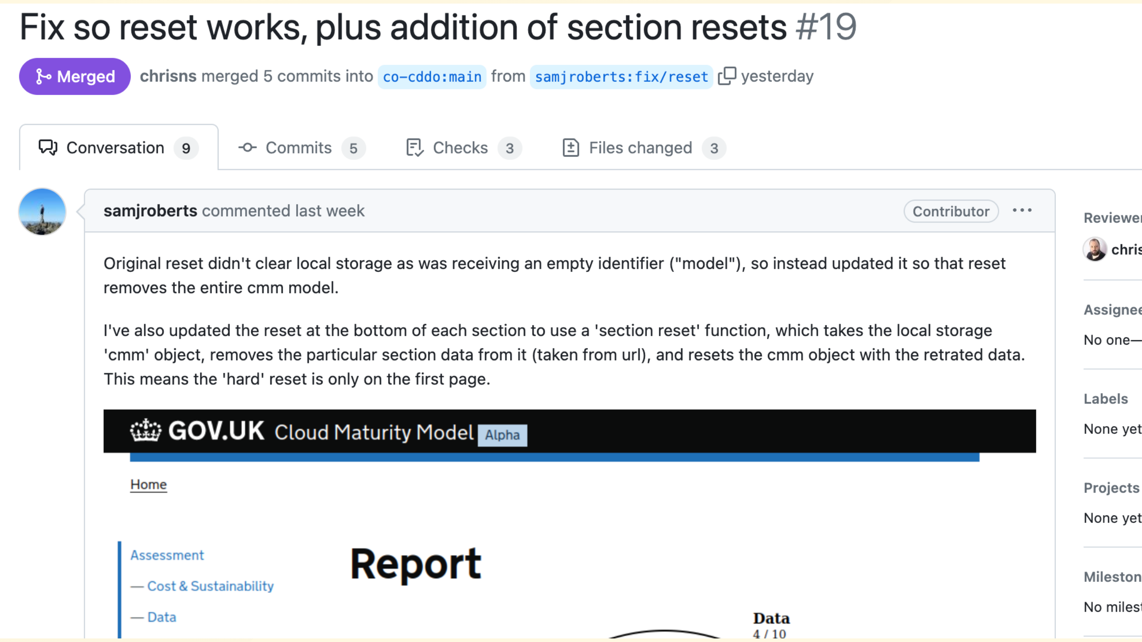
Notes:
Some neat things have happened, I'm developing this in the open, on github, and a few days ago I got my first out the blue pull request fixing a thing.

Slide 27

Notes:
Well thats lovely! horrah Open source for the win

Slide 28

Notes:
So where to now, well I'm working towards in the next week or so when I've got just enough guidance to test this with some real department teams as an alpha and see if this is useful and or helpful, if you know any friendly ones then let me know.

Slide 29

Notes:
What else, well theres maybe a thing in this that might be reusable, I'm aware lots of GDS folk are thinking about maturity models and how they're going to measure maturity in departments for their respective domains, so if this sort of approach is useful to you, then please ping me an email and lets chat.

Slide 30
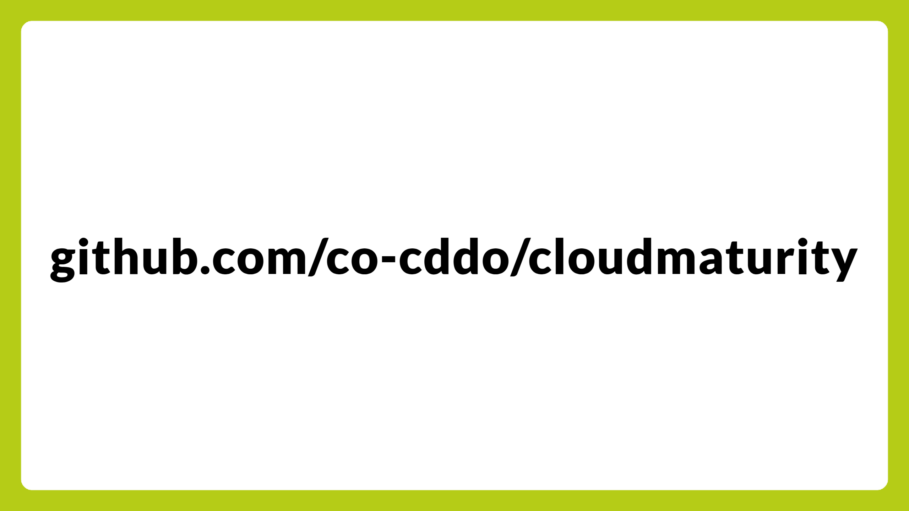
Notes:
the code is open source, so feel free to steal it, but I'd suggest its probably more sensible we extract the interesting bits into a reusable thing with a bit of guidance of how to set it up, in theory given the content is all markdown, it should be accessible for non-developers to add content to

Slide 31
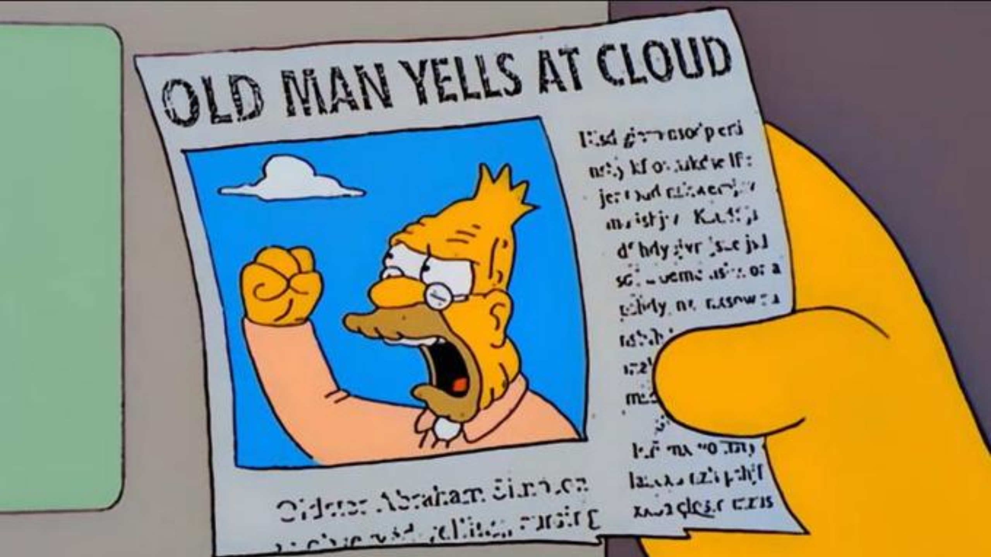
Notes:
Thank you for your time, if you don't get a chance to ask a question, or you're watching the recording of this, please do find me on google chat or email me

Slide 32

Notes:
You'll be pleased to know I've run out of slides, the best thing you could do right now is tell me I'm wrong, missing the point or for any other reason to stop.
I've hopefully not been on mute the whole time so I will now invite your very best heckles, failing that questions work too.

