Slide 1
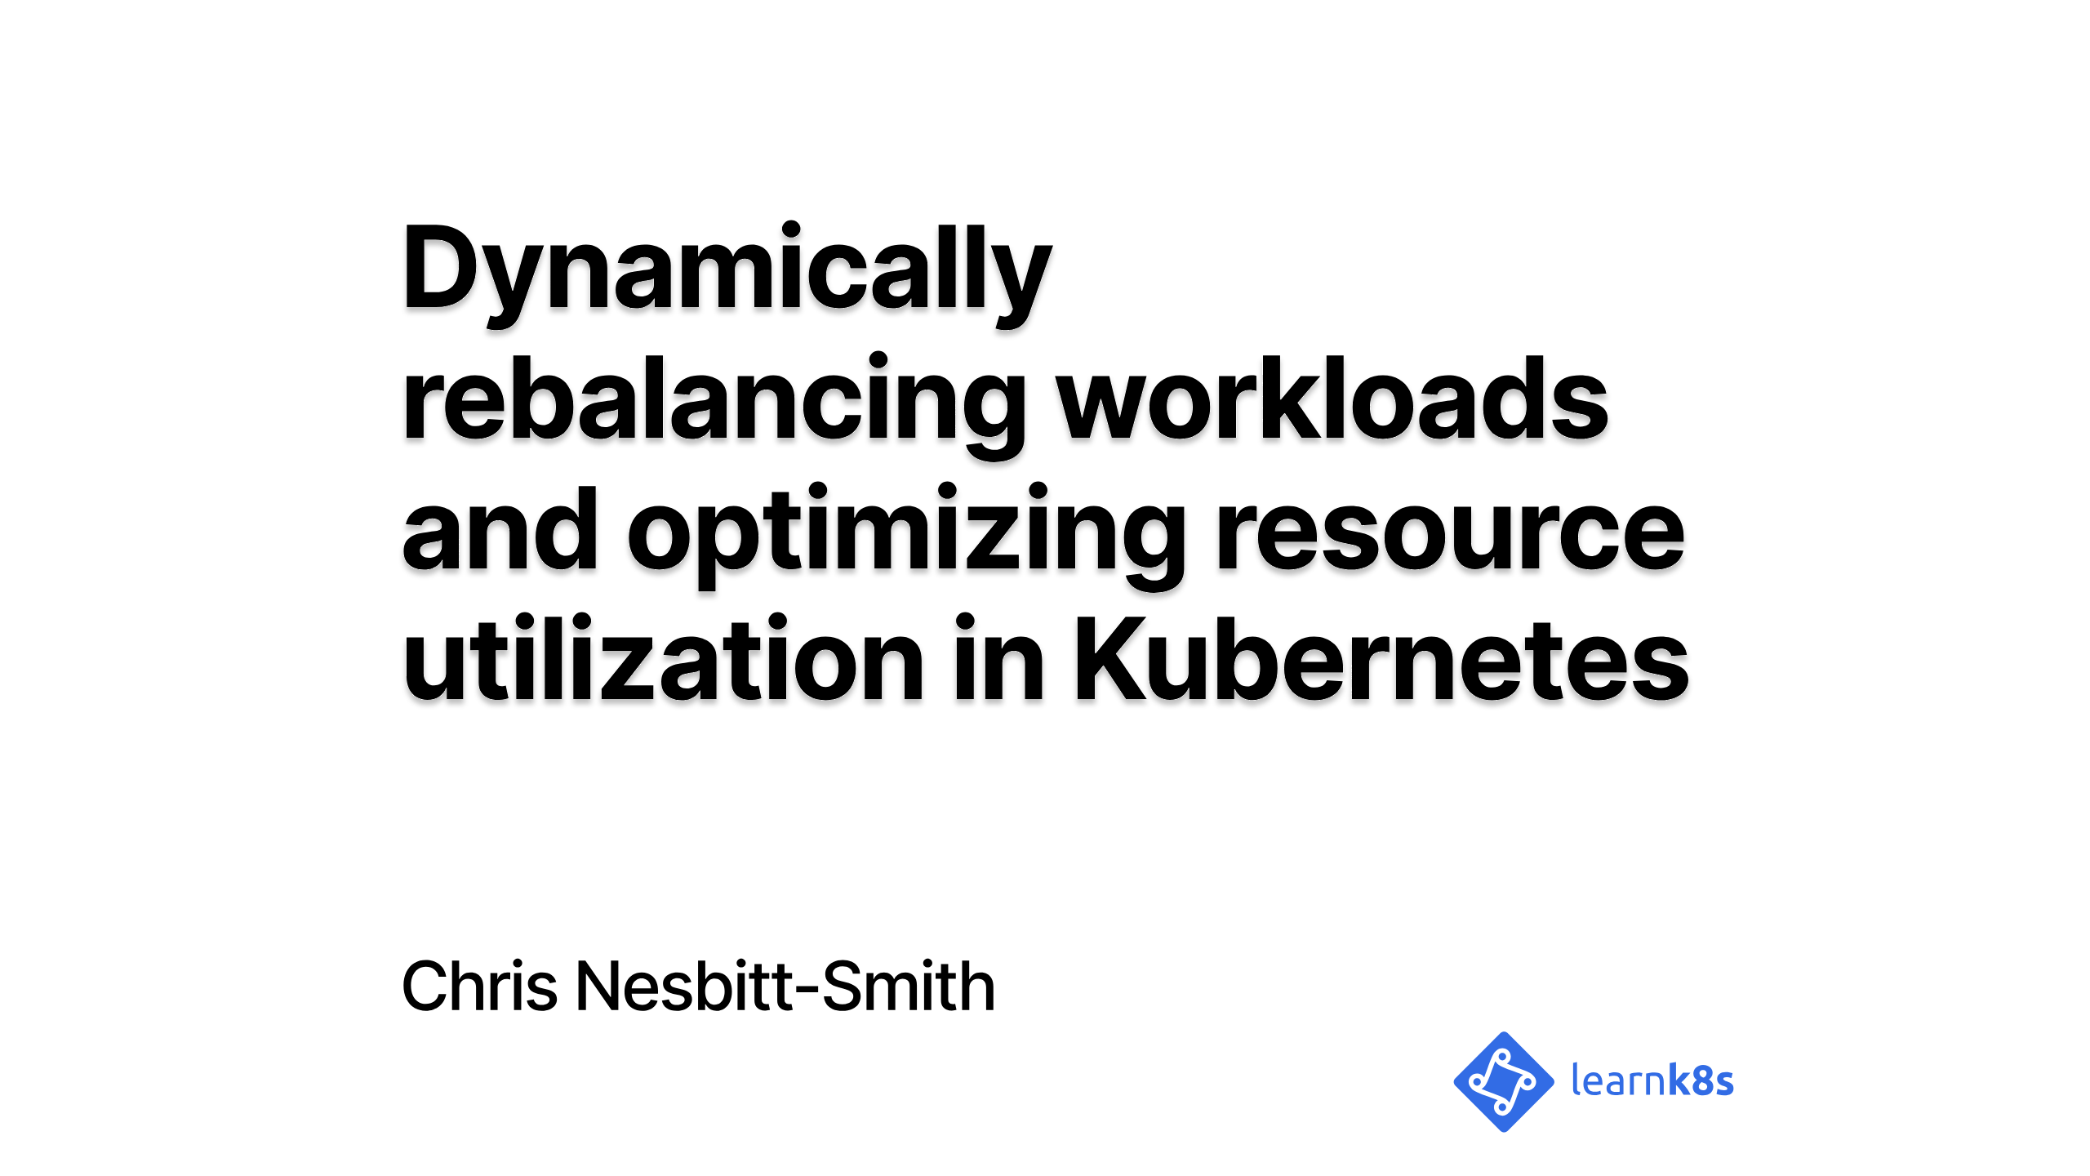
Notes:
Hi

Slide 2

Notes:
So, to kick things off my name is Chris Nesbitt-Smith, I'm based in London and currently work with some well known brands like learnk8s, control plane, and various bits of UK Government I'm also a tinkerer of open source stuff.
I've using and abusing Kubernetes in production since it was 0.4, believe me when I say its been a journey!
I've definitely got the war wounds to show for it.
We should have time for questions and heckles at the end, but if we run out of time or you're not watching this in realtime, then please find me on LinkedIn or in the linode slack

Slide 3

Notes:
Kubernetes embraces the idea of treating your servers as a single unit and abstracts away how individual computer resources operate.
From a collection of three servers, Kubernetes makes a single cluster that behaves like one.

Slide 4

Notes:
1/4
So if we Imagine having three servers.

Slide 5
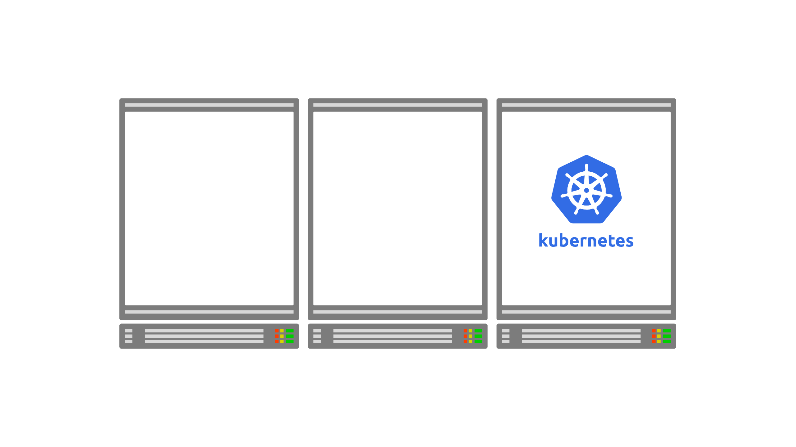
Notes:
2/4
You can use one of those servers to install the Kubernetes control plane.

Slide 6
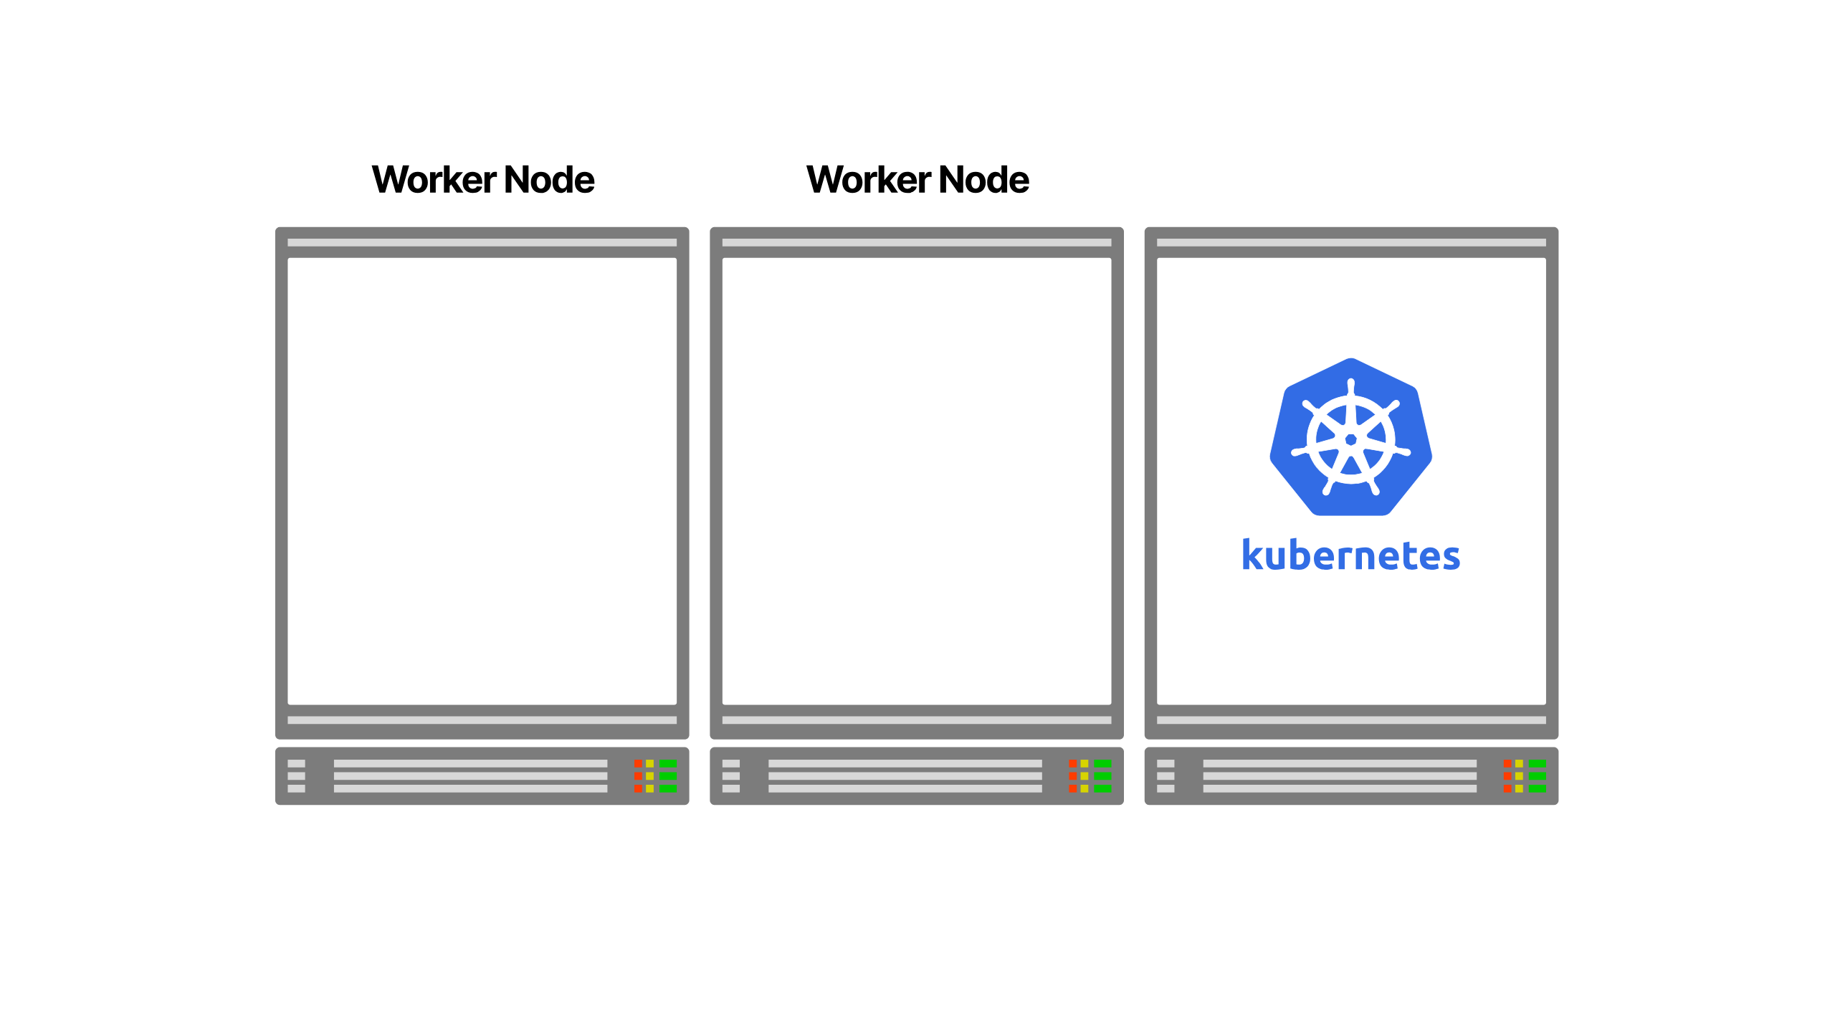
Notes:
3/4
The remaining servers can join the cluster as worker nodes.

Slide 7

Notes:
4/4
Once the setup is completed, the servers are abstracted from you. You deal with Kubernetes as a single unit.

Slide 8
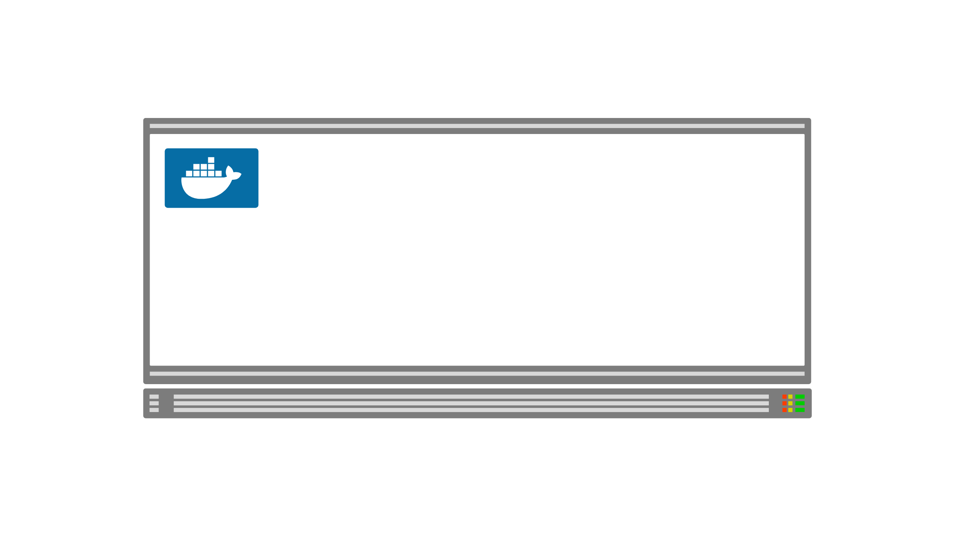
Notes:
1/4
When you want to deploy a container, you submit your request to the cluster.
Kubernetes takes care of executing `docker run` and scheduling the container in the right server.

Slide 9
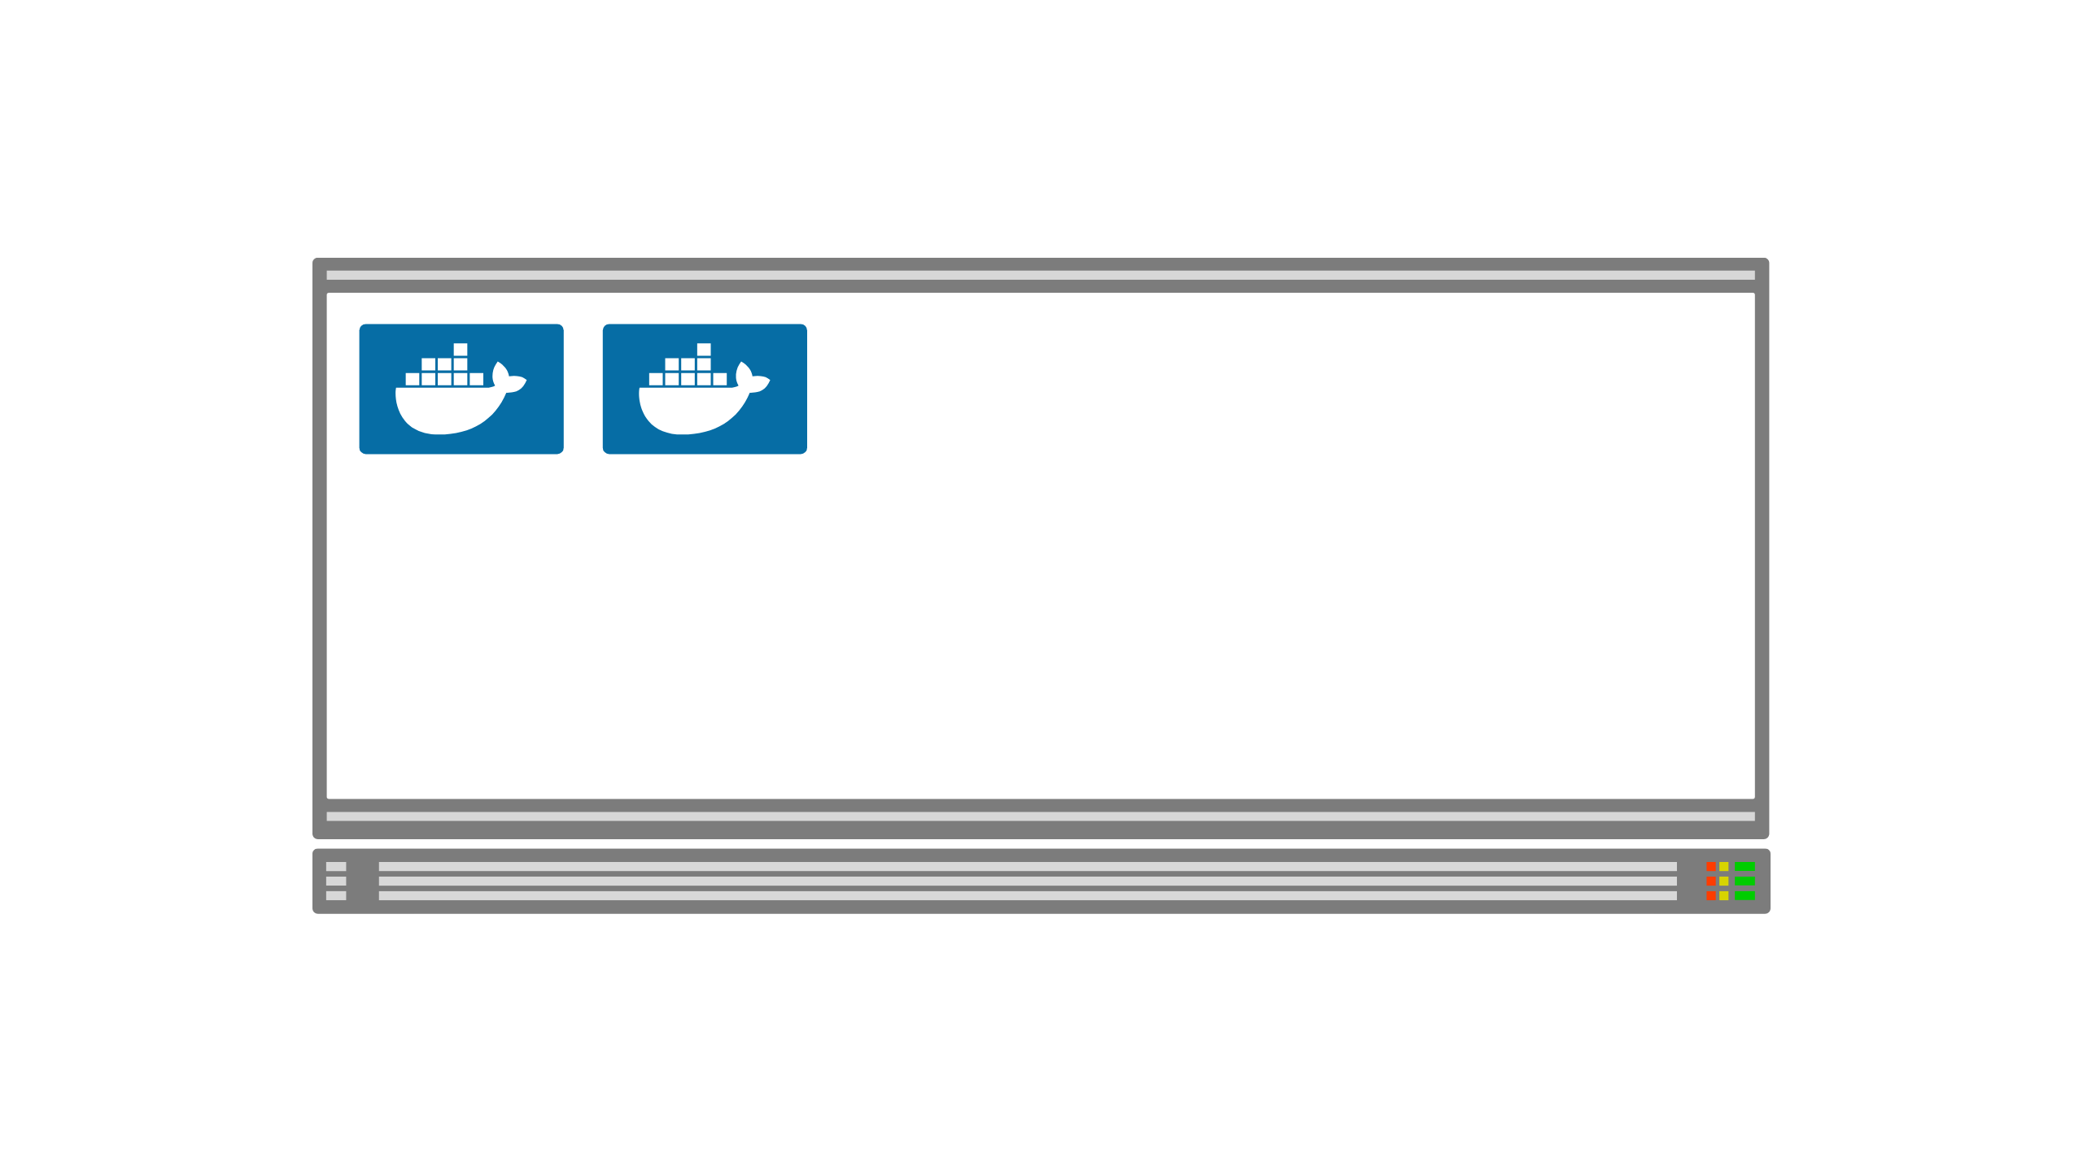
Notes:
2/4
The same happens for all other containers.

Slide 10
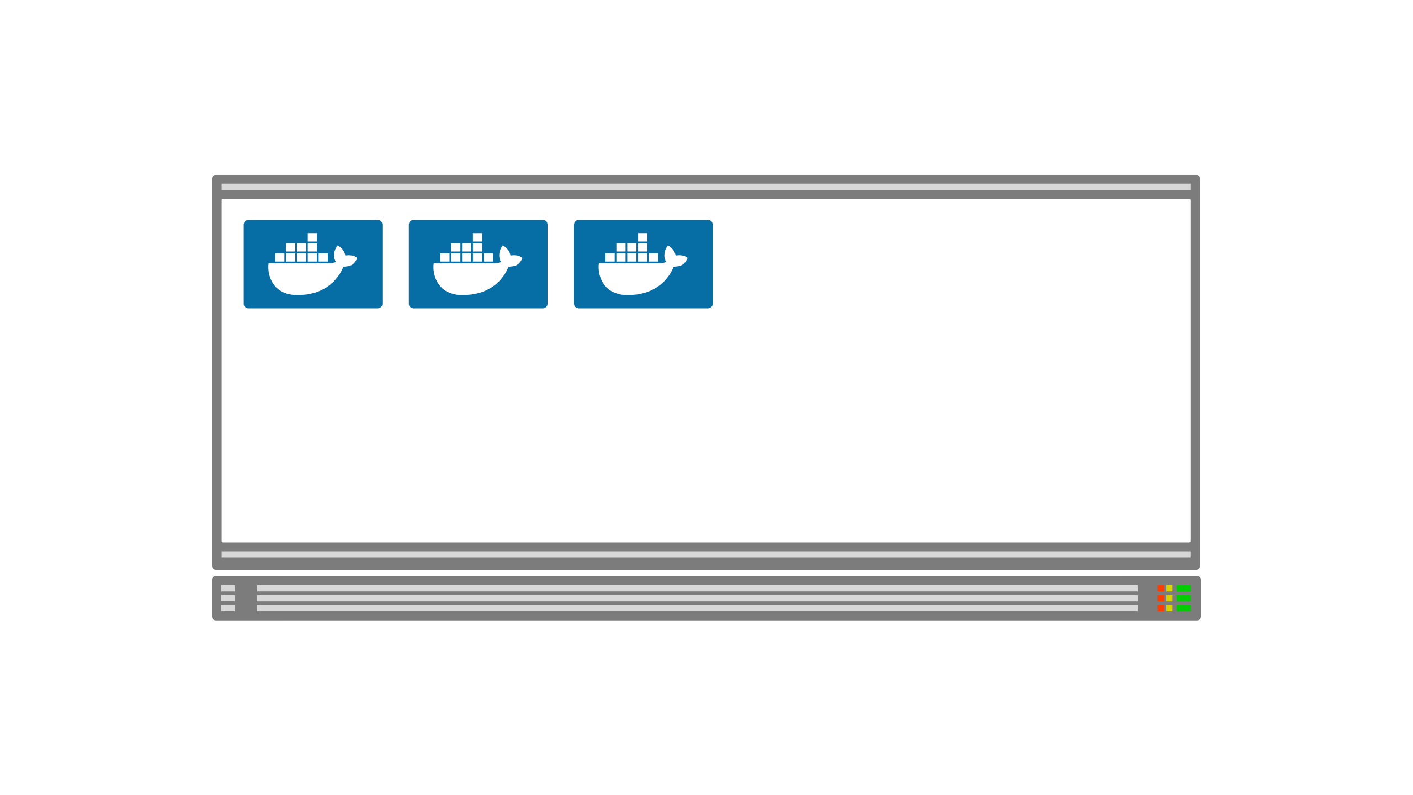
Notes:
3/4

Slide 11
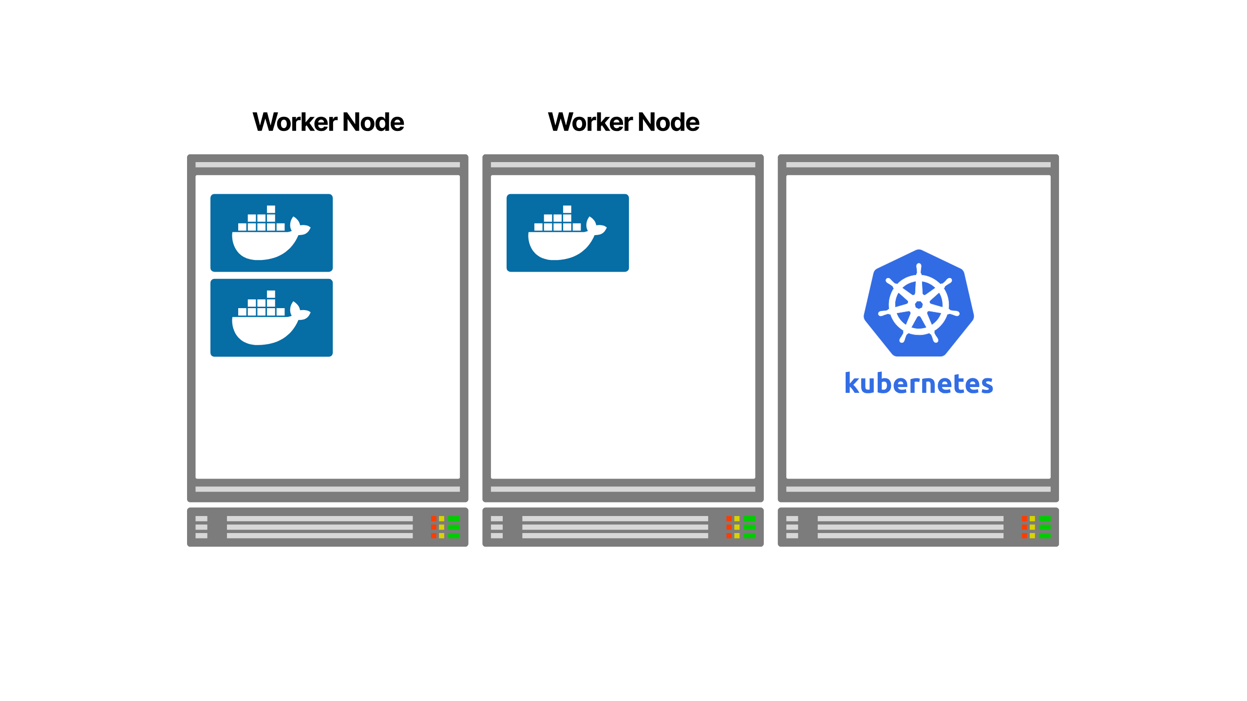
Notes:
4/4
For every deployment, Kubernetes finds the best place to run the application.

Slide 12

Notes:
Kubernetes can automatically scale your application for you

Slide 13

Notes:
But you'll likely find you run out of compute resource
but all is not lost, Kubernetes has yet another trick up its sleeve

Slide 14

Notes:
Given access to your underlying infrastructure when you run out

Slide 15
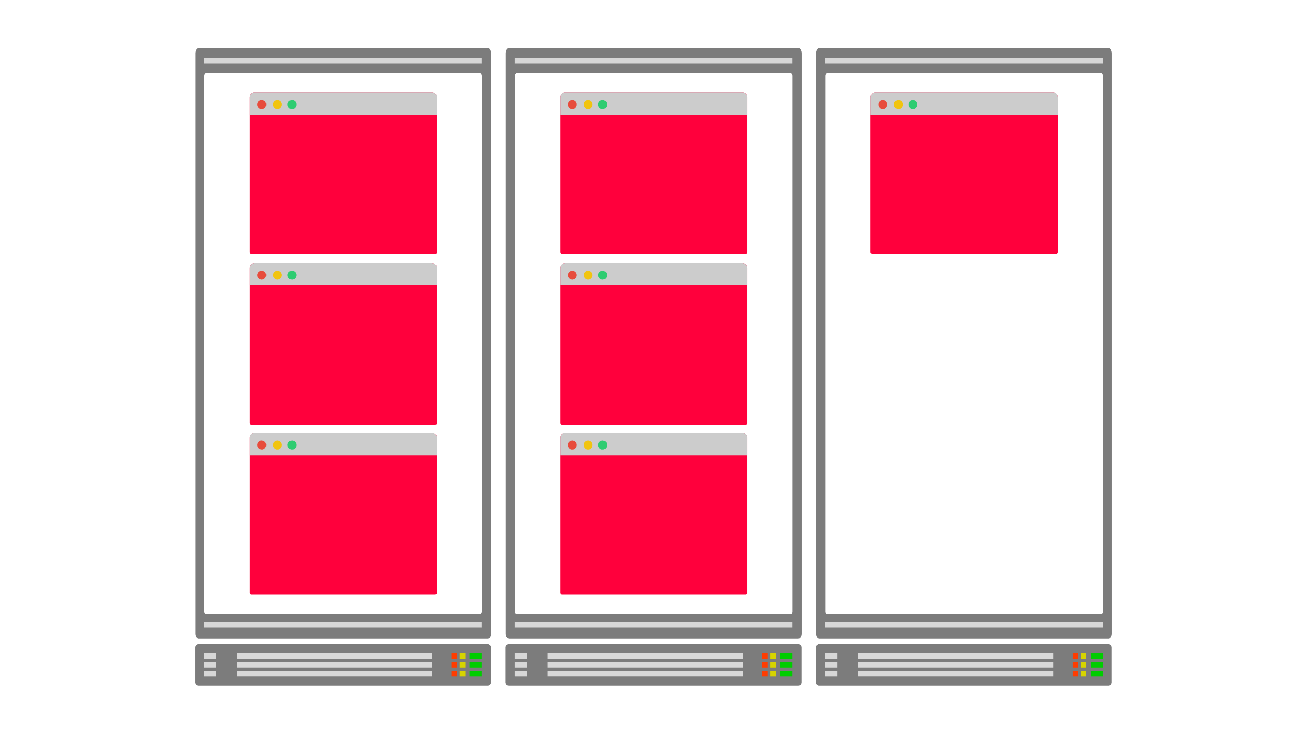
Notes:
it can even dynamically provision additional compute when you require it using the Cluster autoscaler

Slide 16

Notes:
If you didn't see Salman's fantastic talk on this a couple of weeks ago, I highly recommend watching that back for a really insightful walk through that

Slide 17

Notes:
So far this is all sounding great, clusters can scale up and down both in workload and compute resource, and scheduling is all working perfectly

Slide 18
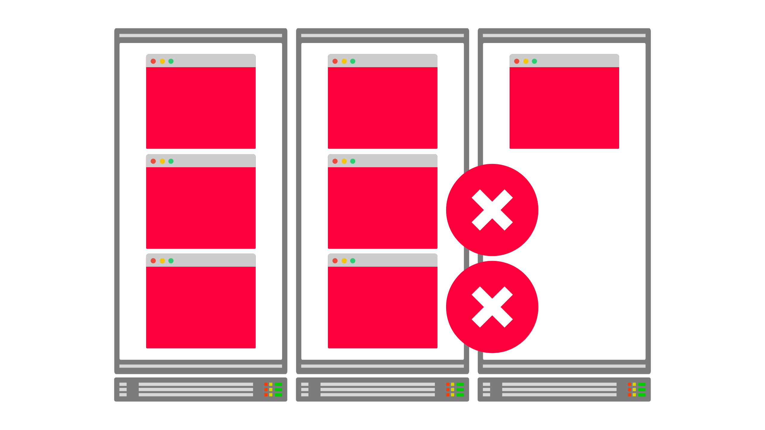
Notes:
but you'll quickly find when your workload scales down, it might not happen how you would anticipate it to

Slide 19
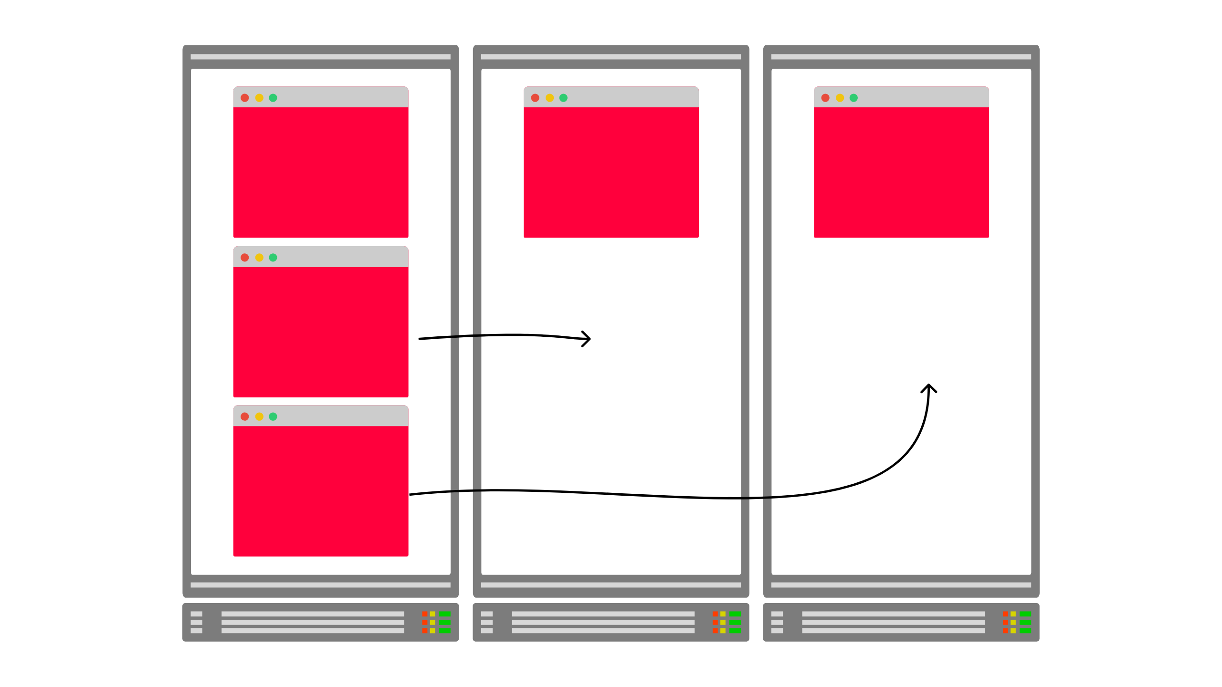
Notes:
which can lead you to undesirably loaded clusters, when what you'd really like is for things to rebalance

Slide 20
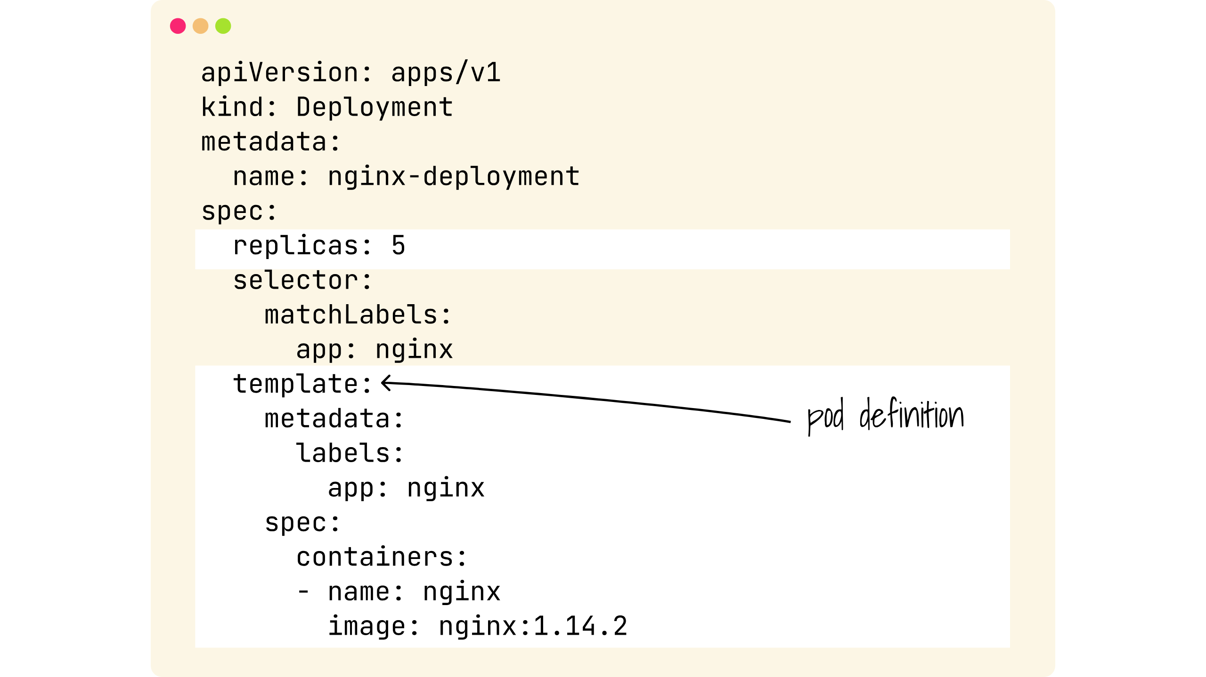
Notes:
So If we look at a deployment spec

Slide 21
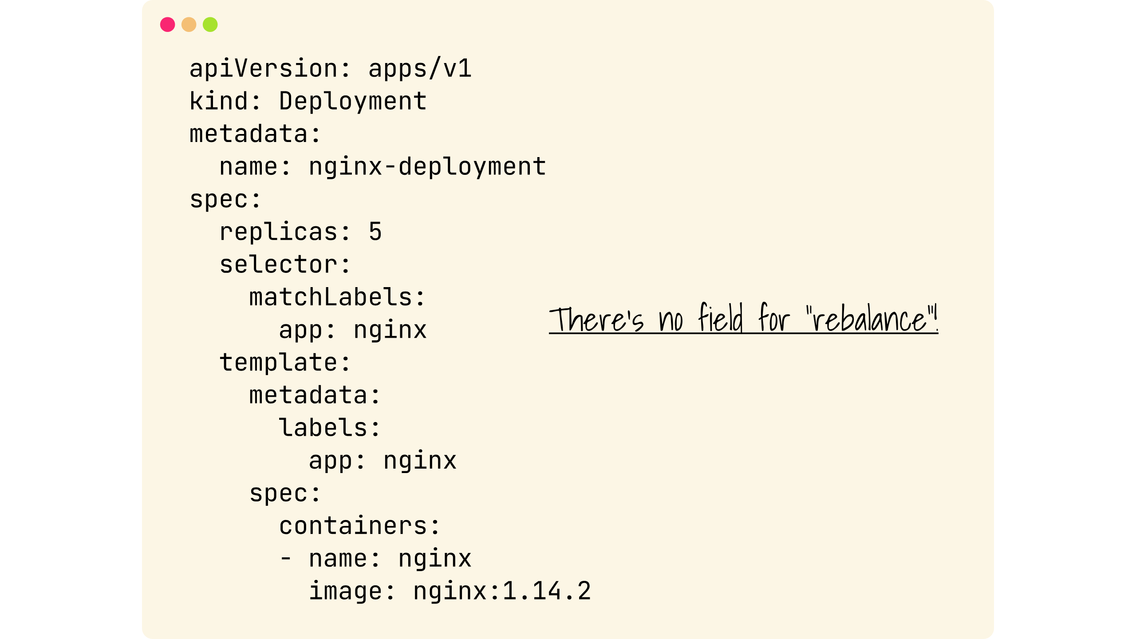
Notes:
You'll notice there is no field or instruction for Kubernetes on how you'd like your workload to be rebalanced.
Put simply once Kubernetes has scheduled the workload, it considers it's job done, thats the end, until something goes wrong.

Slide 22
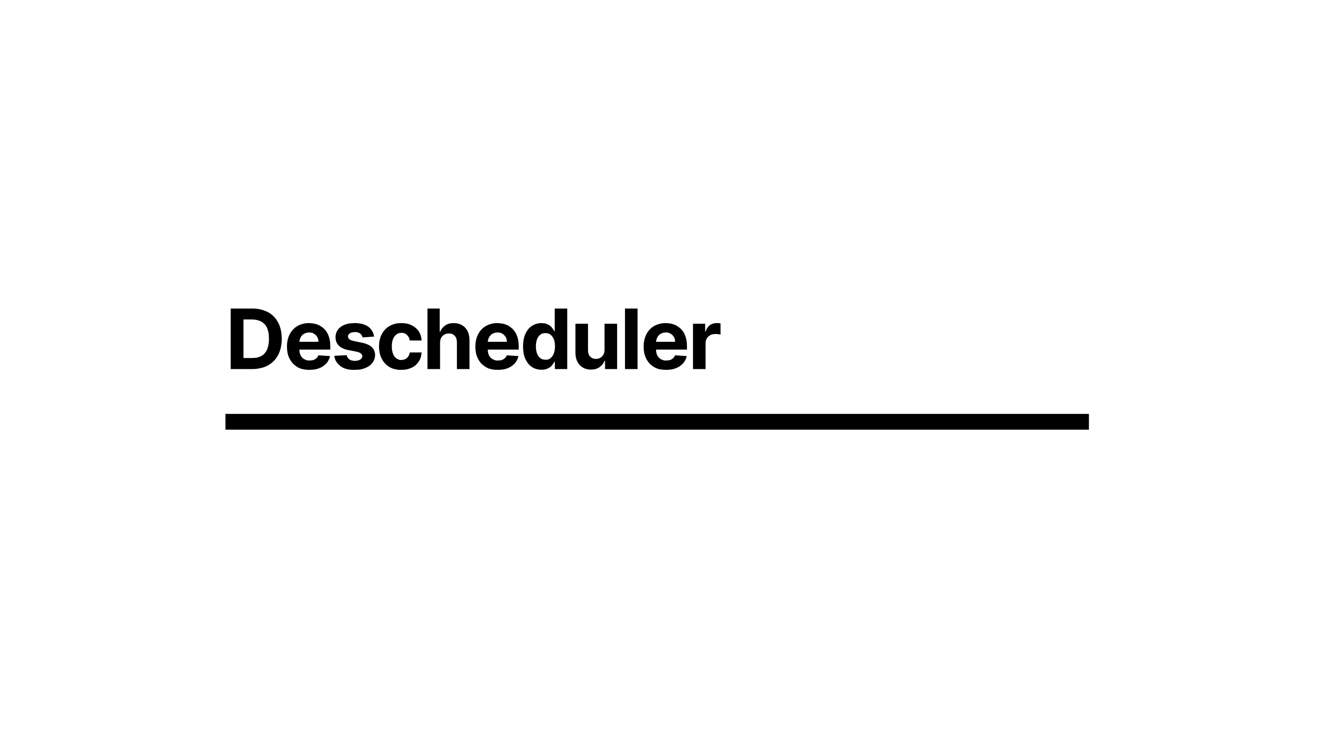
Notes:
This has been an issue that has played on many people's minds which has led to the desire for descheduling workload in order to let the scheduler readjust with new information

Slide 23

Notes:
I might be showing my age now, but I remember a time when I used to have to defragment my hard disk

Slide 24
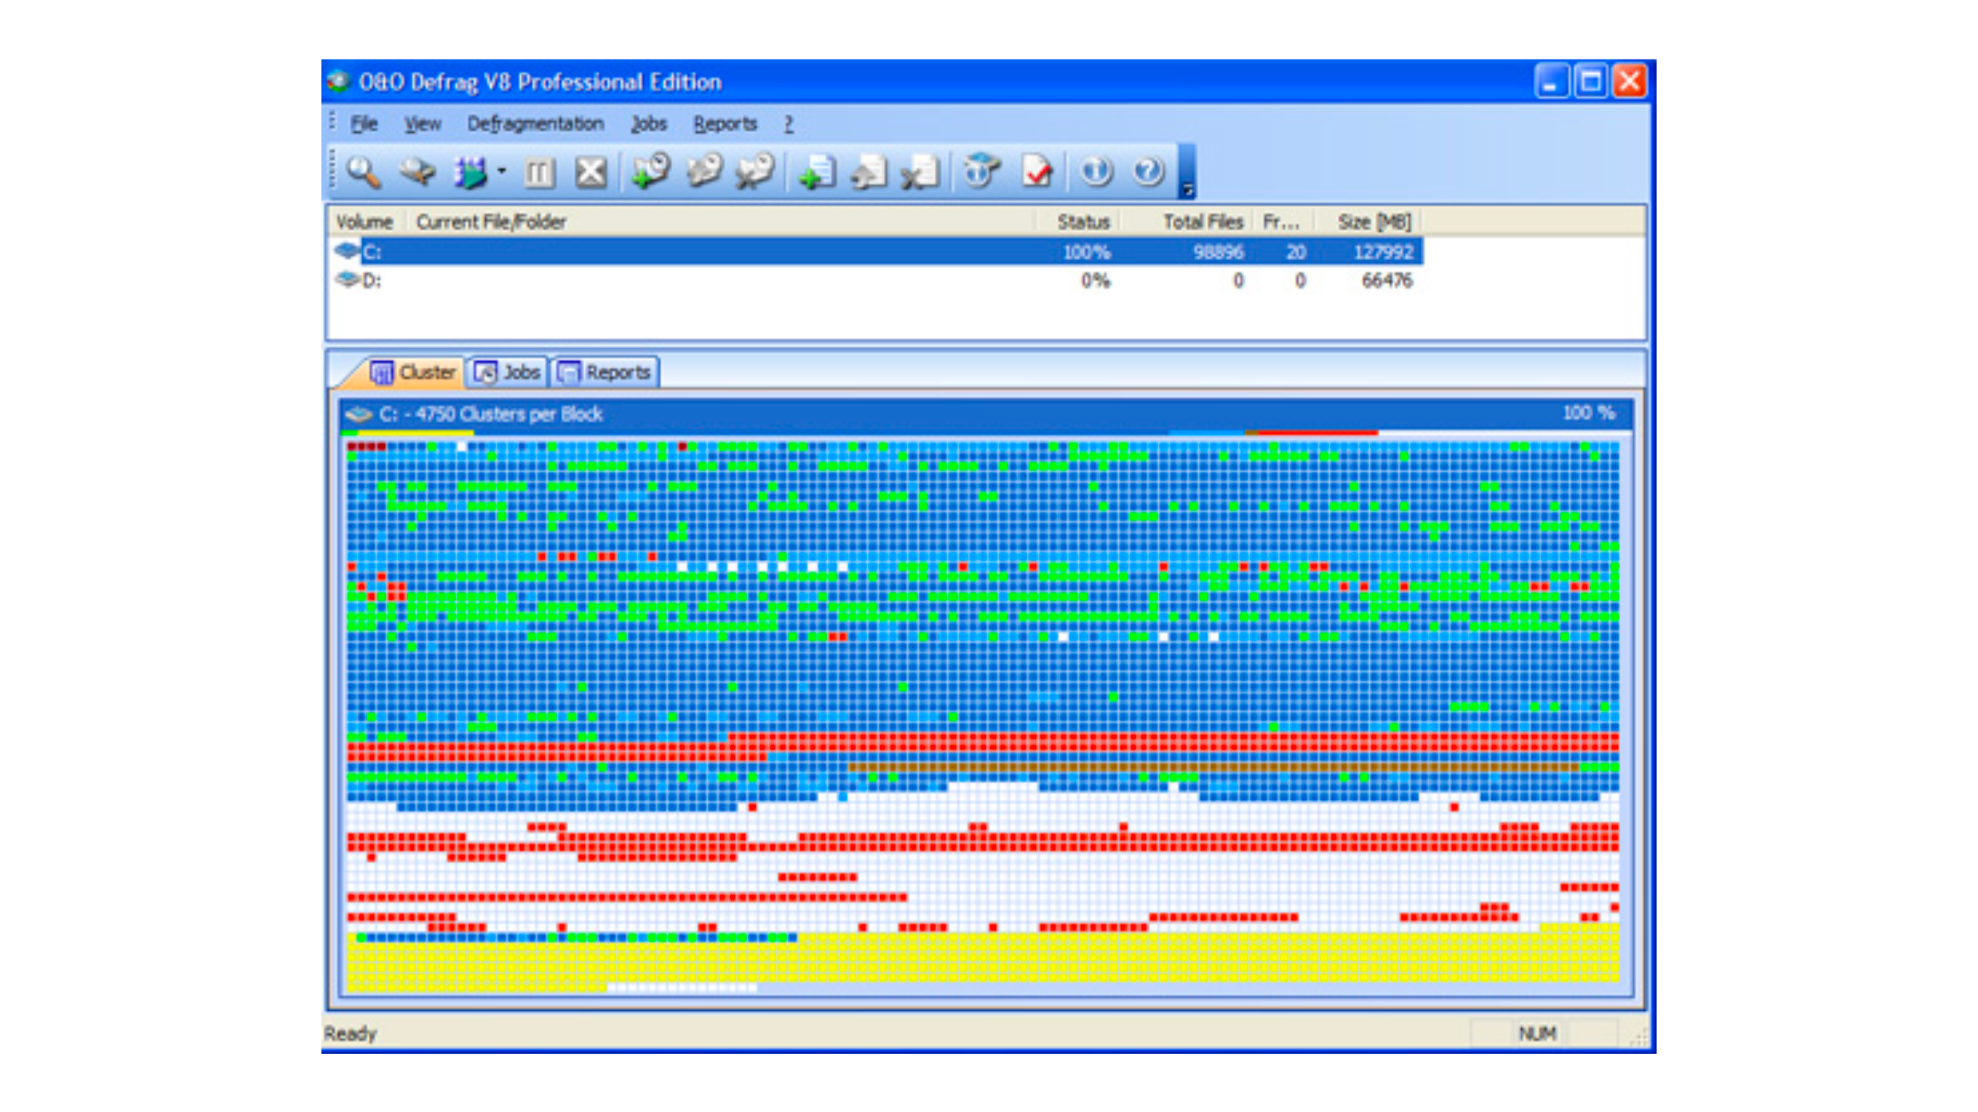
Notes:
Hours staring at a screen that looks like this because the way the file system works is data is written anywhere, then when its later deleted leaves gaps

Slide 25

Notes:
Not at all dissimilar to how the Kubernetes scheduler works

Slide 26
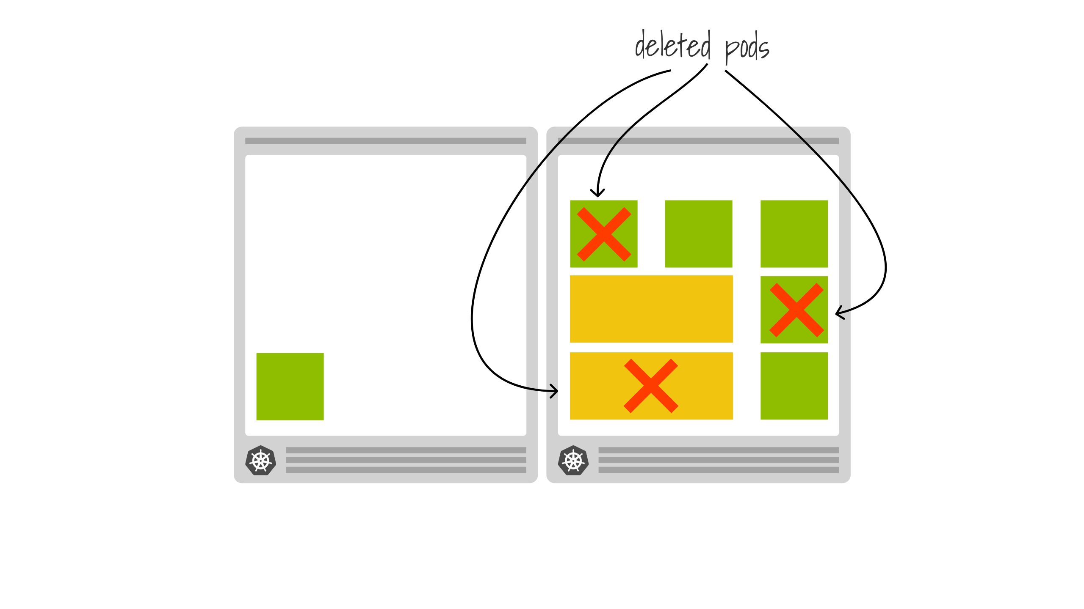
Notes:
When you delete workload you can find yourself with gaps, that if you were to reschedule everything from scratch wouldn't exist

Slide 27
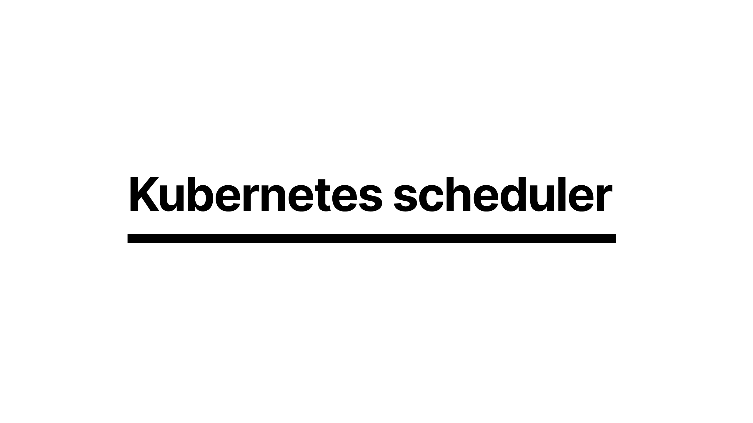
Notes:
The effect of descheduling then causes our old friend the Kubernetes scheduler

Slide 28
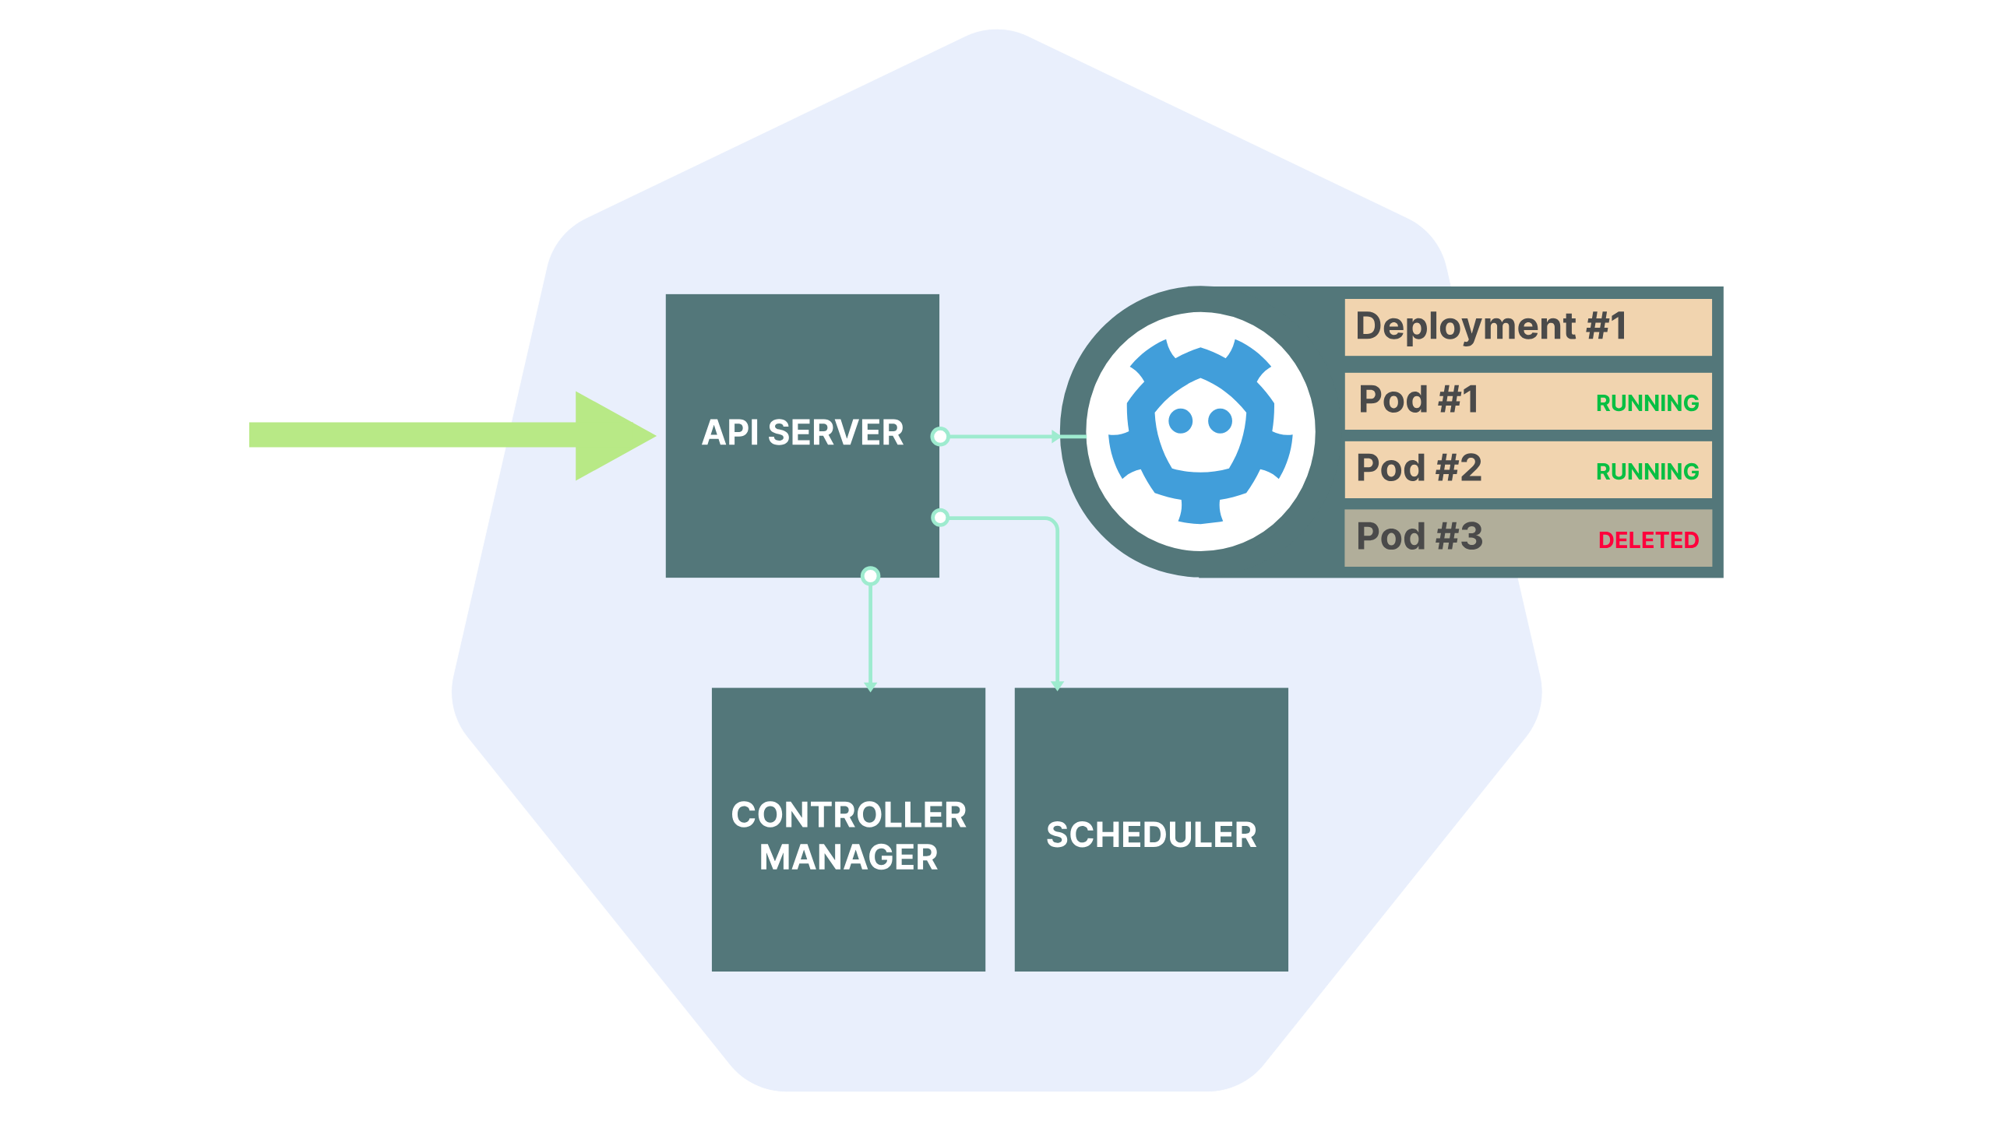
Notes:
to notice that a pod has been deleted from an undesirable location

Slide 29
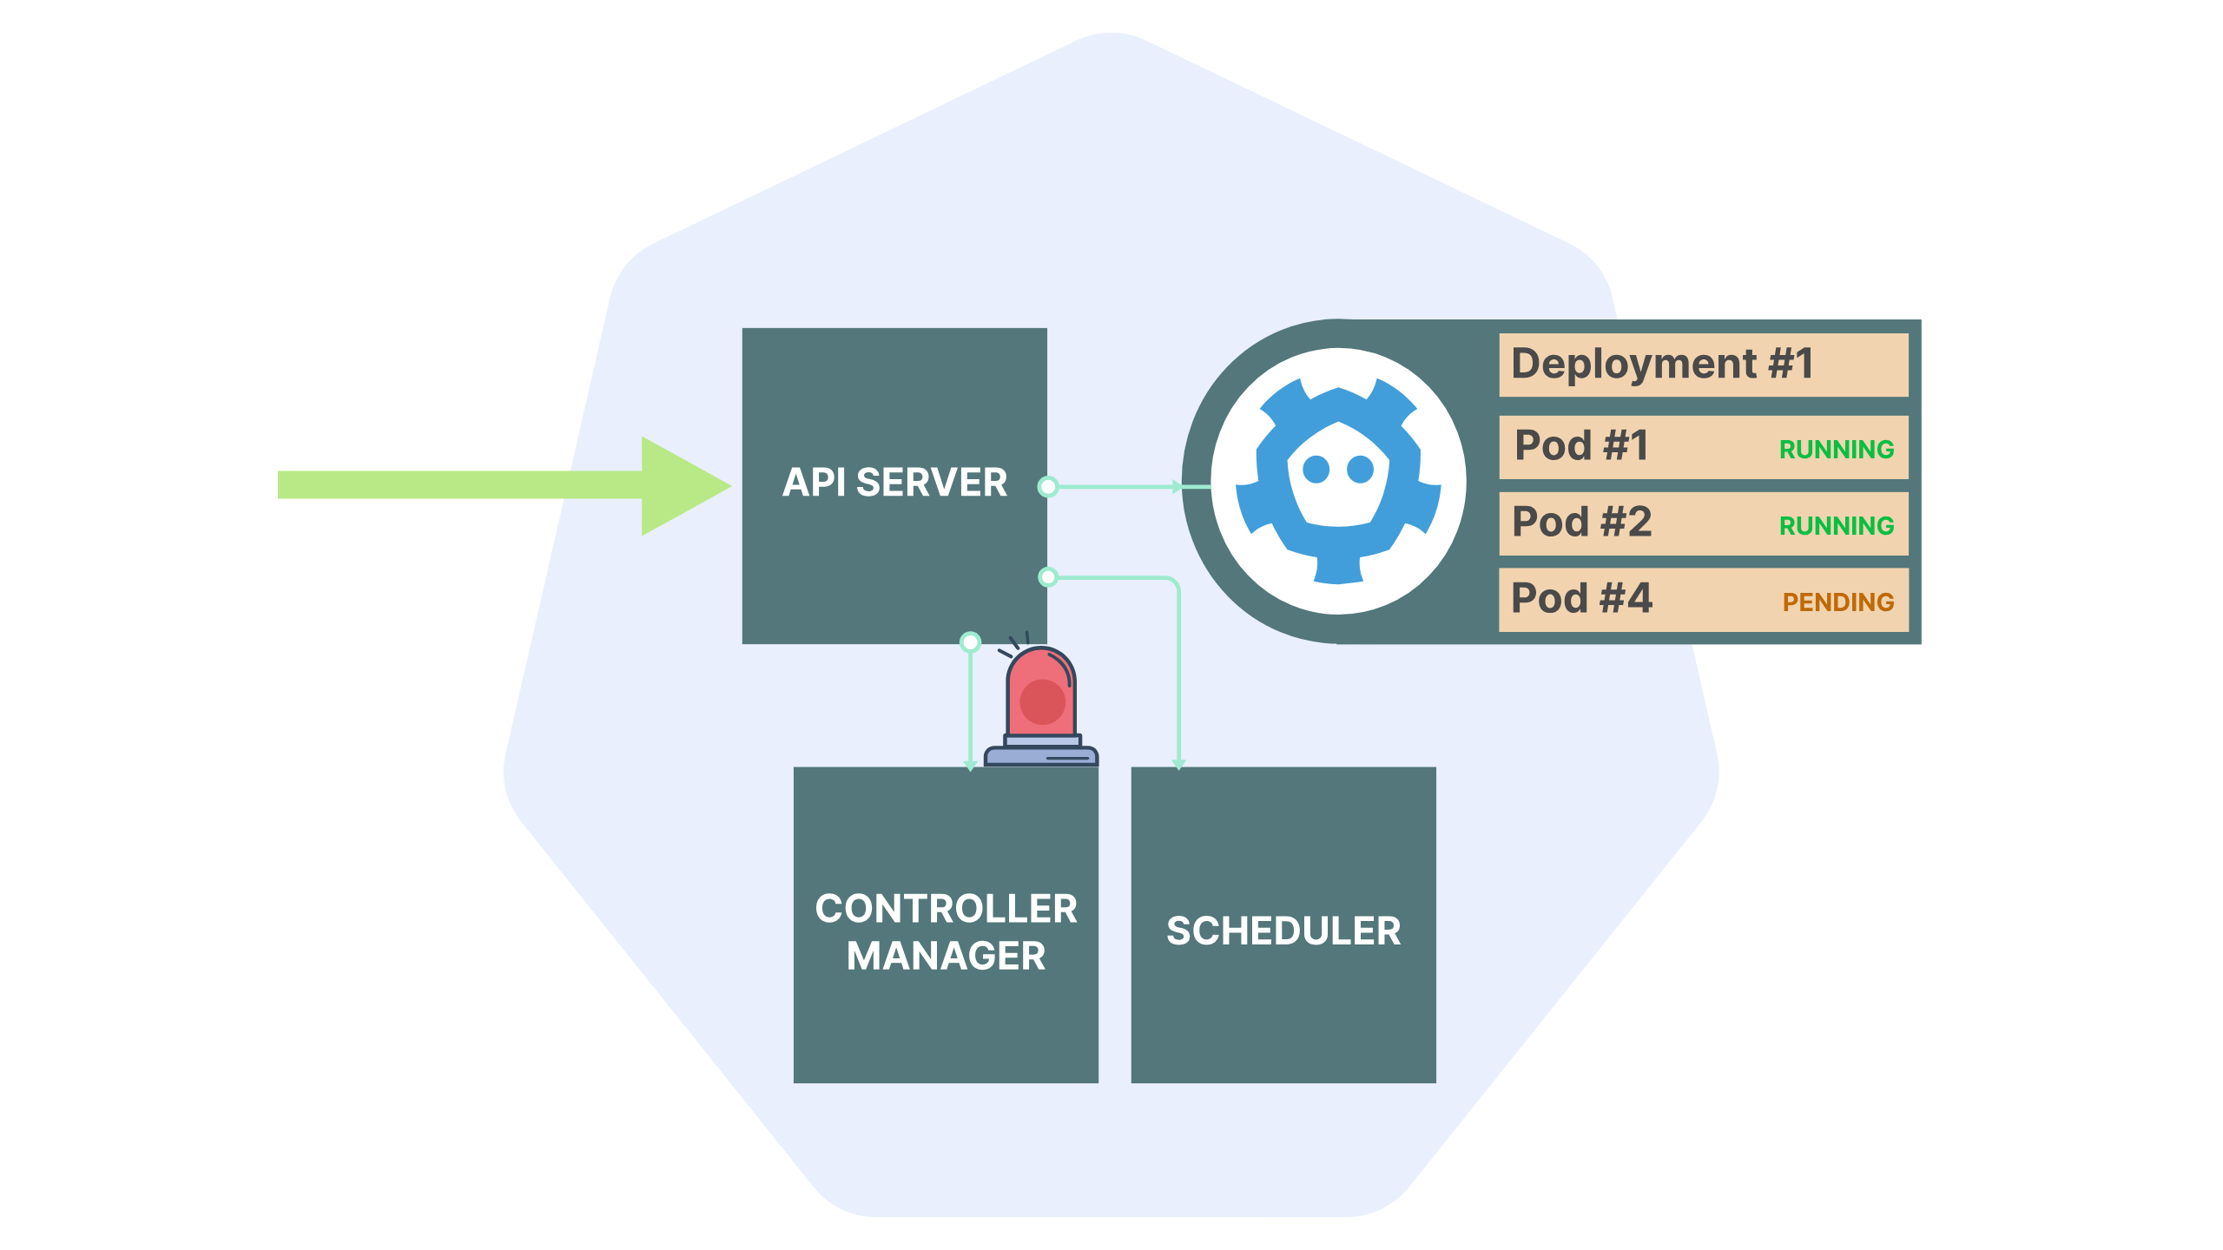
Notes:
create a new pod

Slide 30
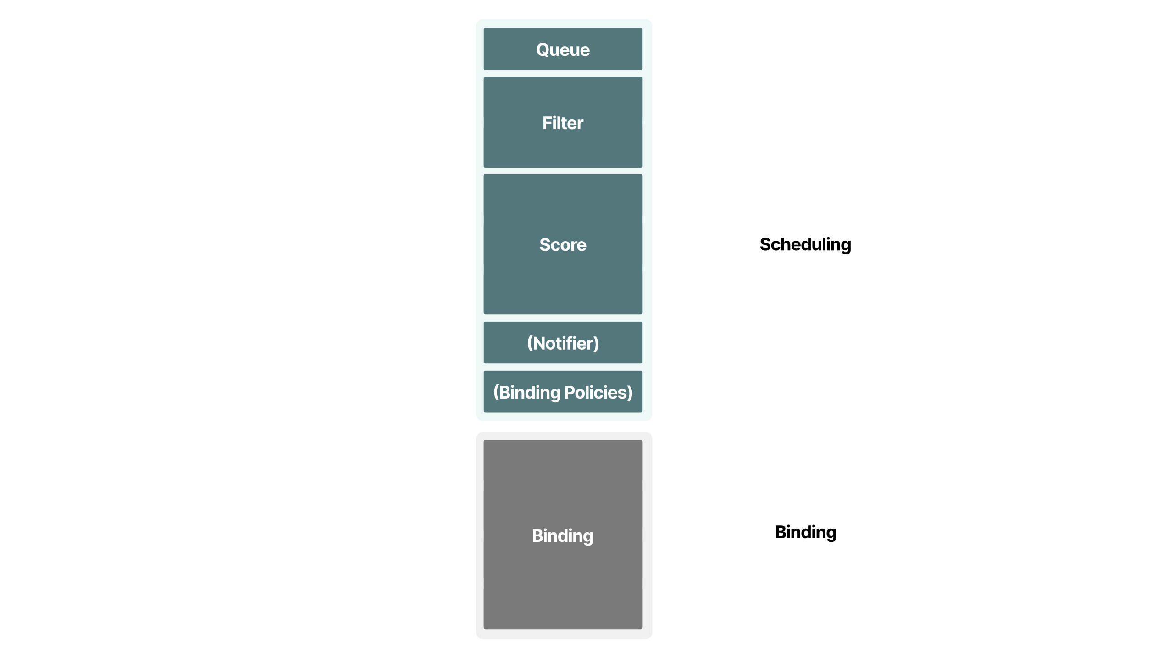
Notes:
and then go through all the process

Slide 31
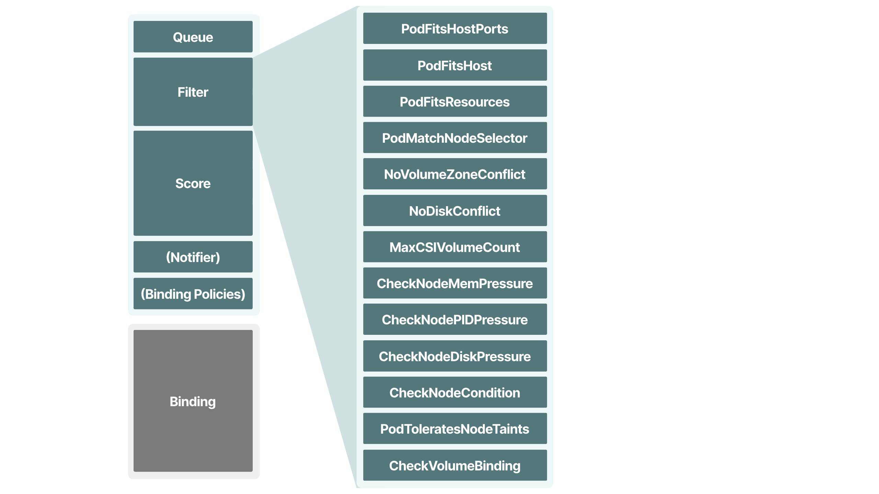
Notes:
of filtering what nodes are available to run the workload with all sorts of complex rules

Slide 32
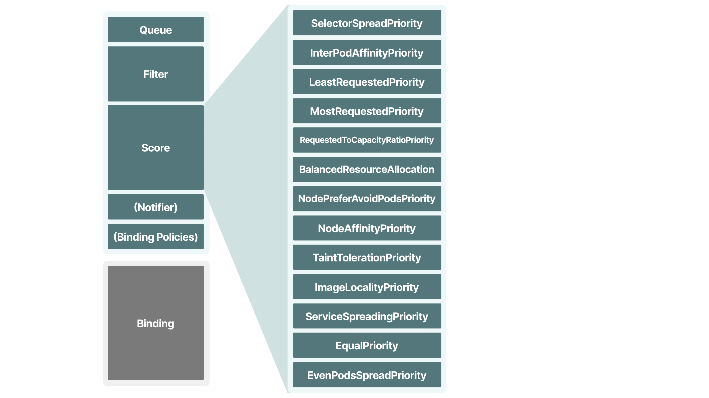
Notes:
then scoring them through some more very complex rules

Slide 33
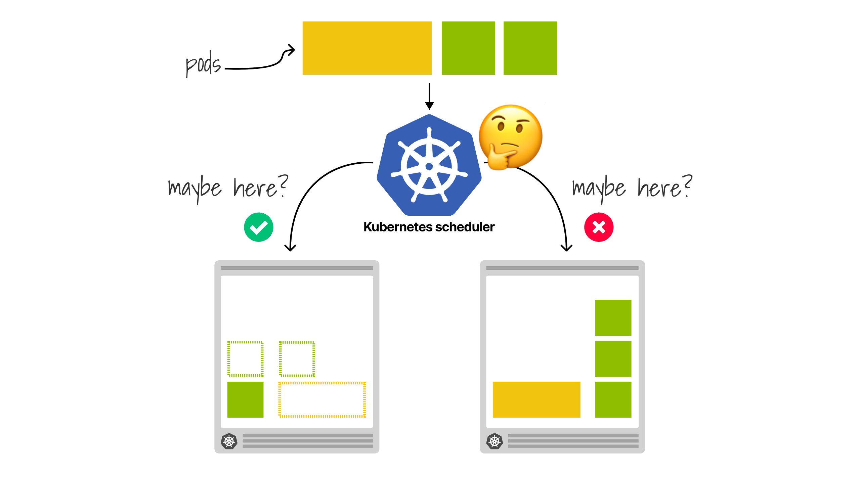
Notes:
before deciding where best to place the workload

Slide 34
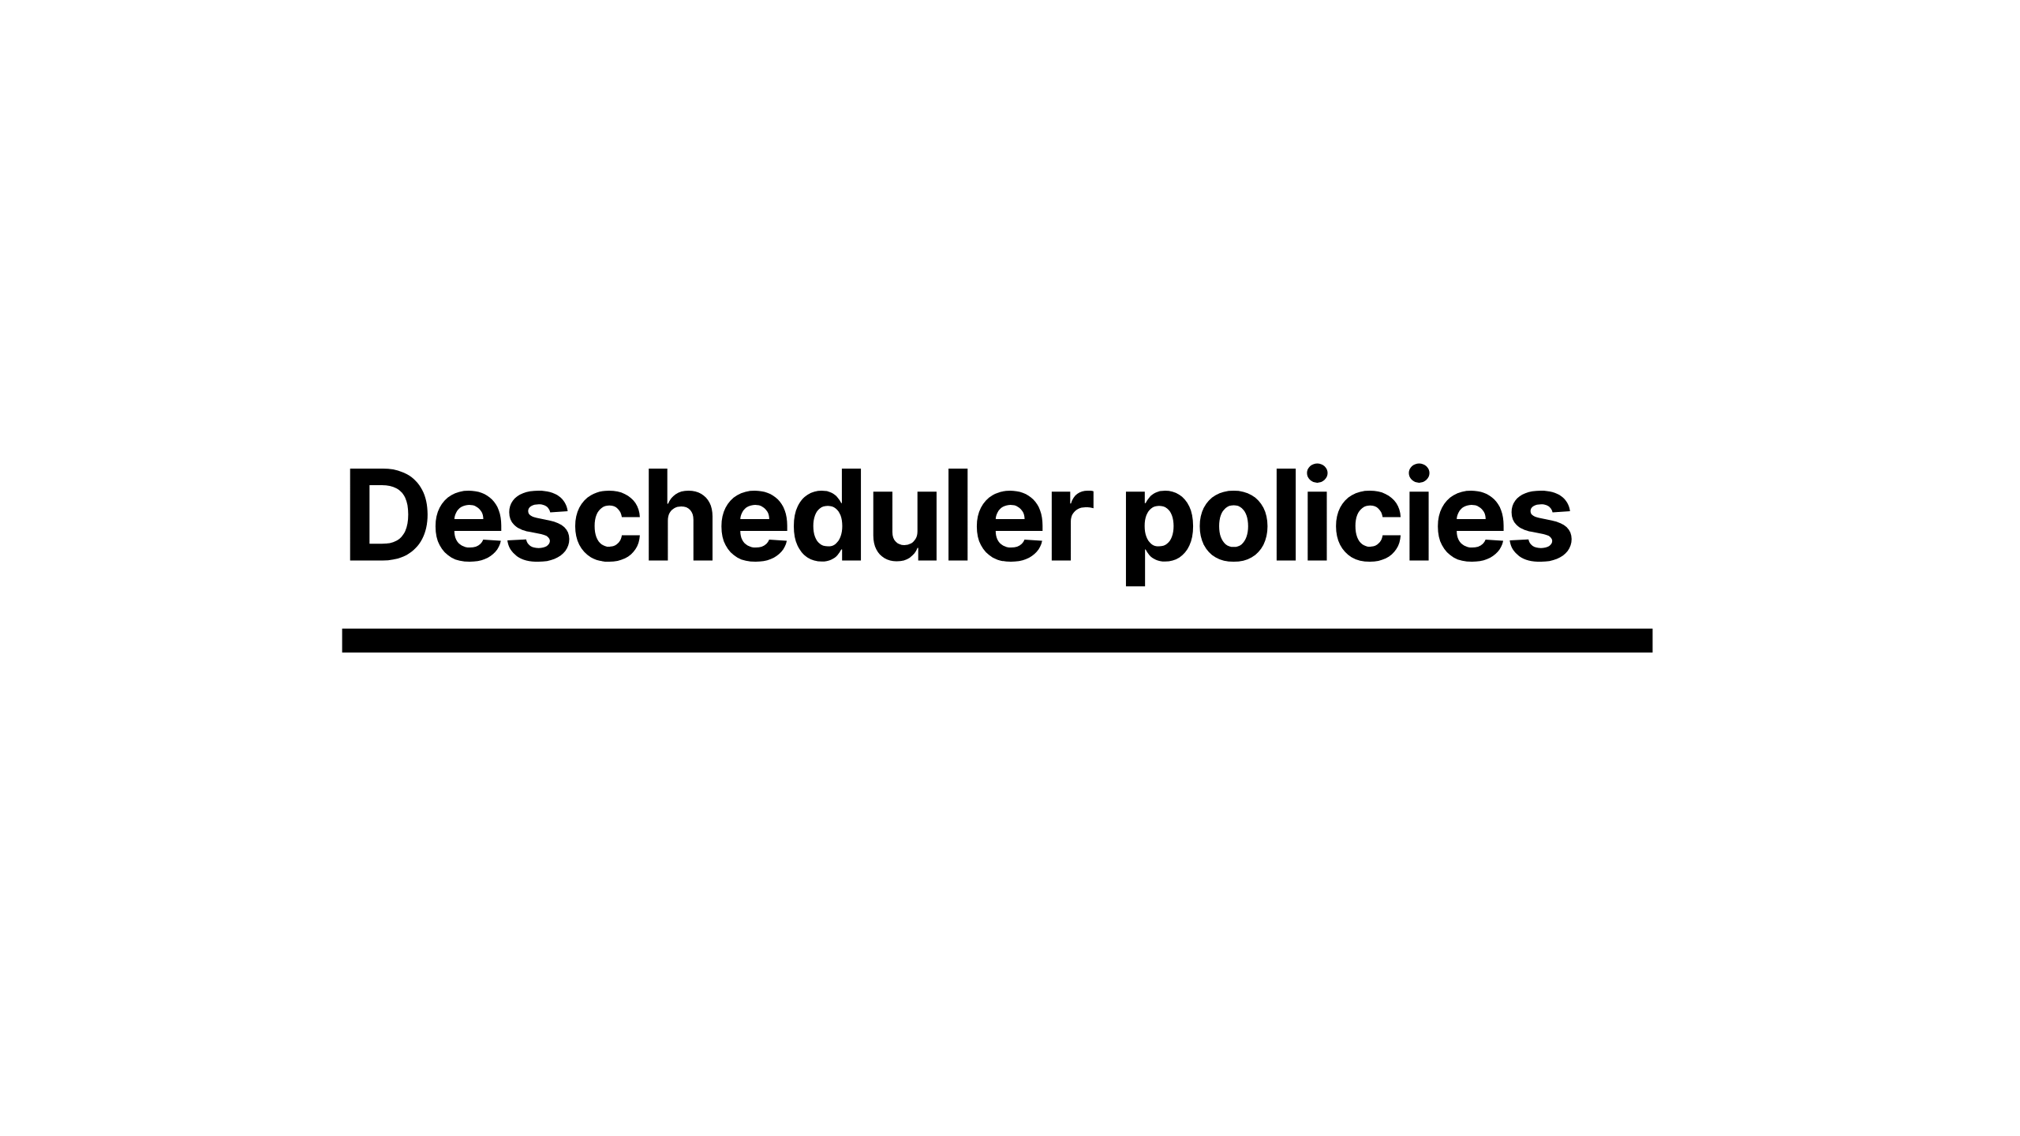
Notes:
In order to do this the descheduler has policies you can define at a cluster level

Slide 35
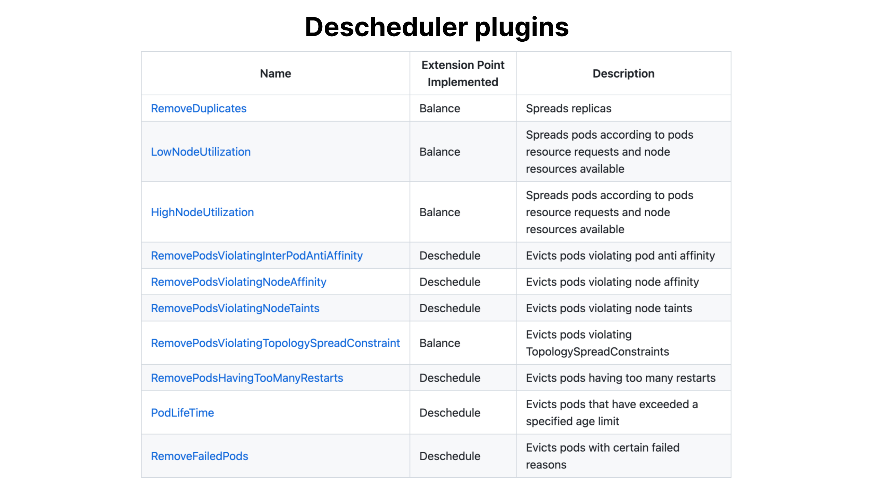
Notes:
these are split into two categories of balance and deschedule
where balance is intended to redistribute your workload across the nodes
the deschedule is intended to cause the workload to be evicted based on some rules such as the lifetime of a pod

Slide 36
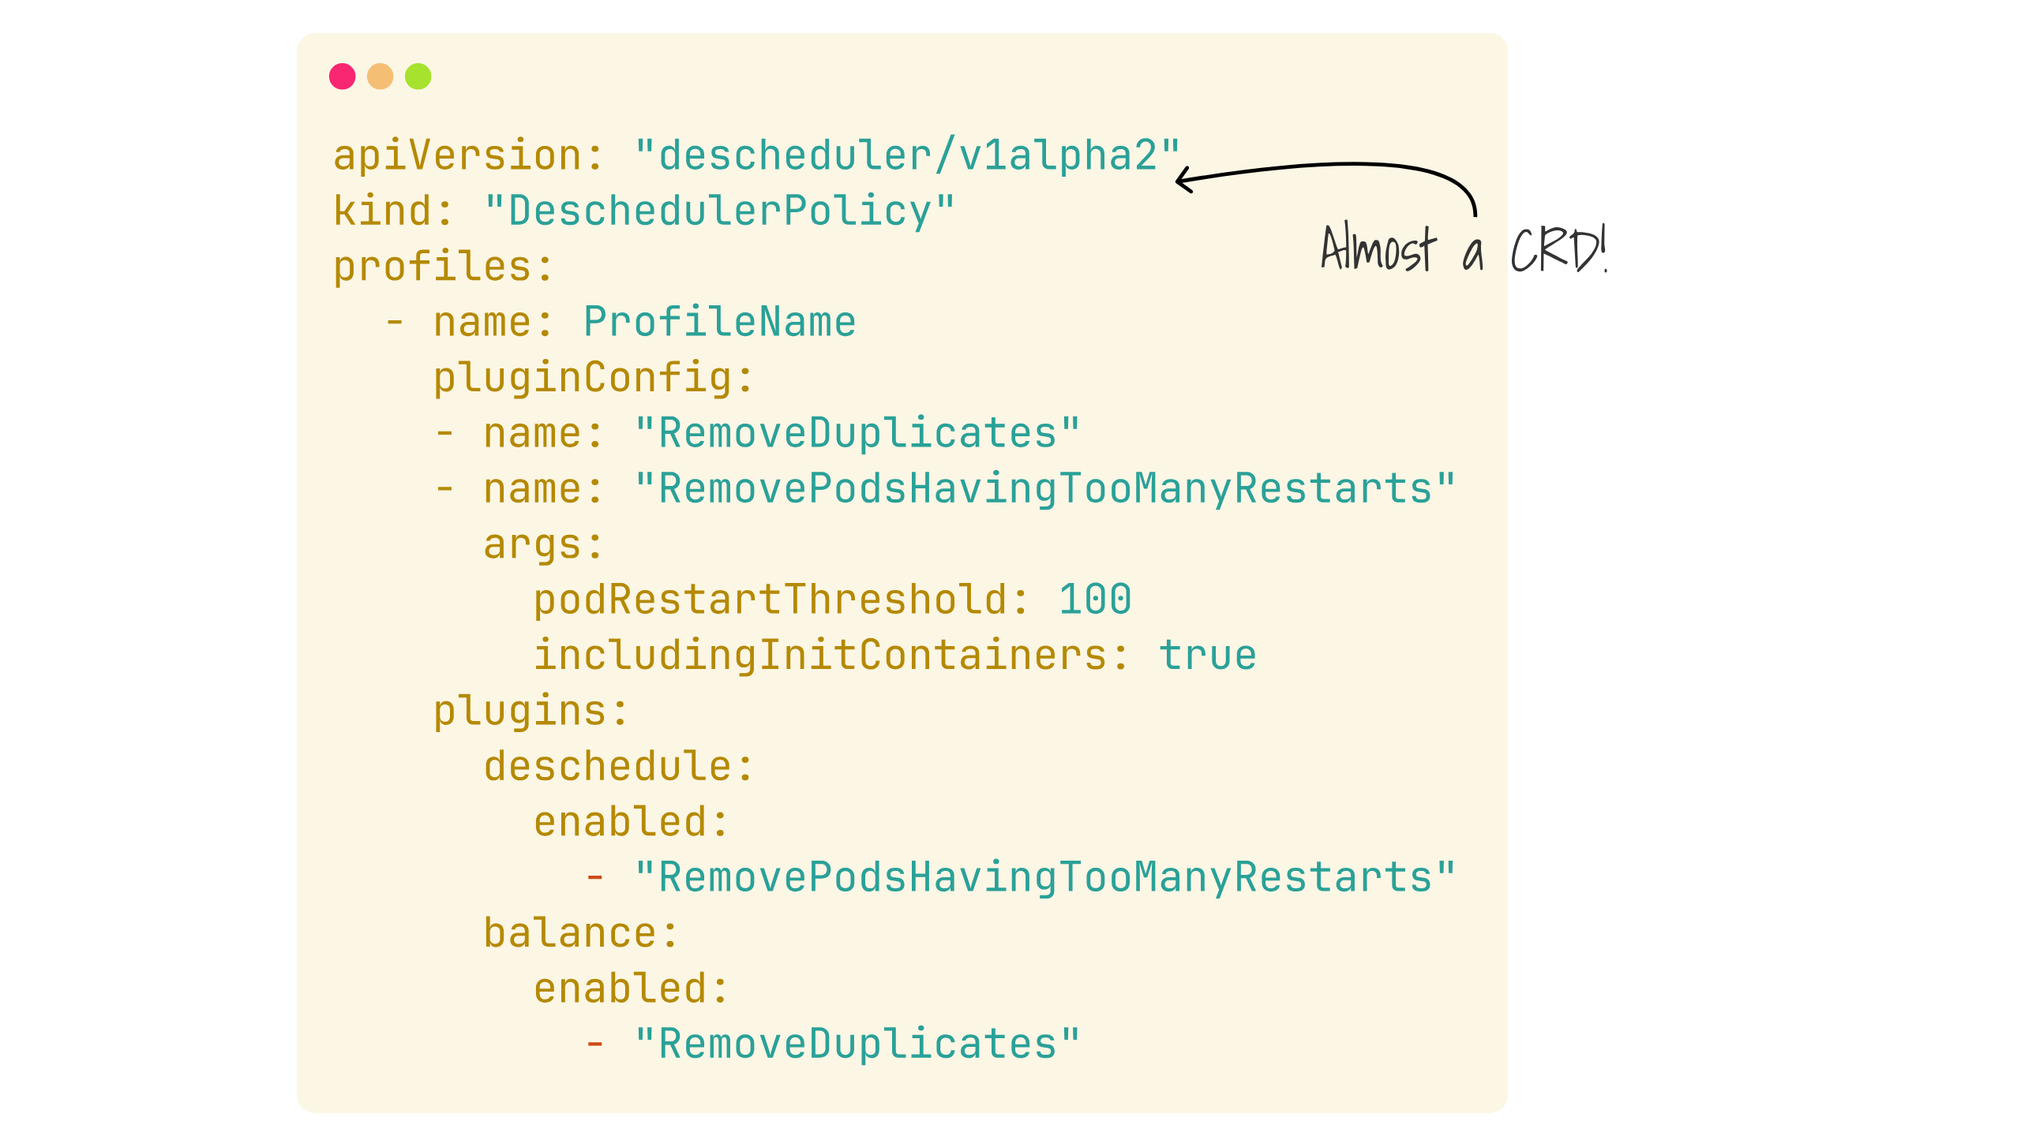
Notes:
And the configuration looks very familiar to other things in Kubernetes in that it closely resembles a CRD
though don't be fooled by this, its not actually a CRD,
you have to put this into a specifically named configmap as a text blob

Slide 37
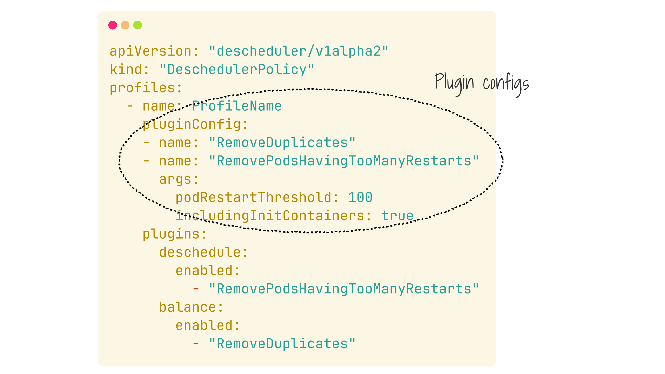
Notes:
So here we can define our plugin configurations in our profile

Slide 38
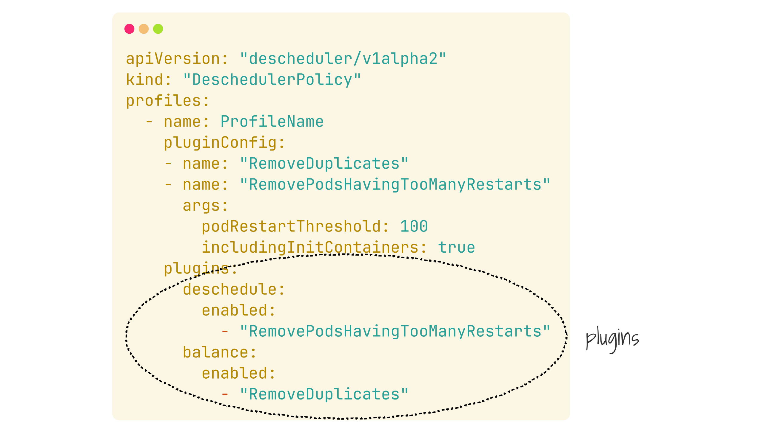
Notes:
And elect which plugins should be enabled

Slide 39
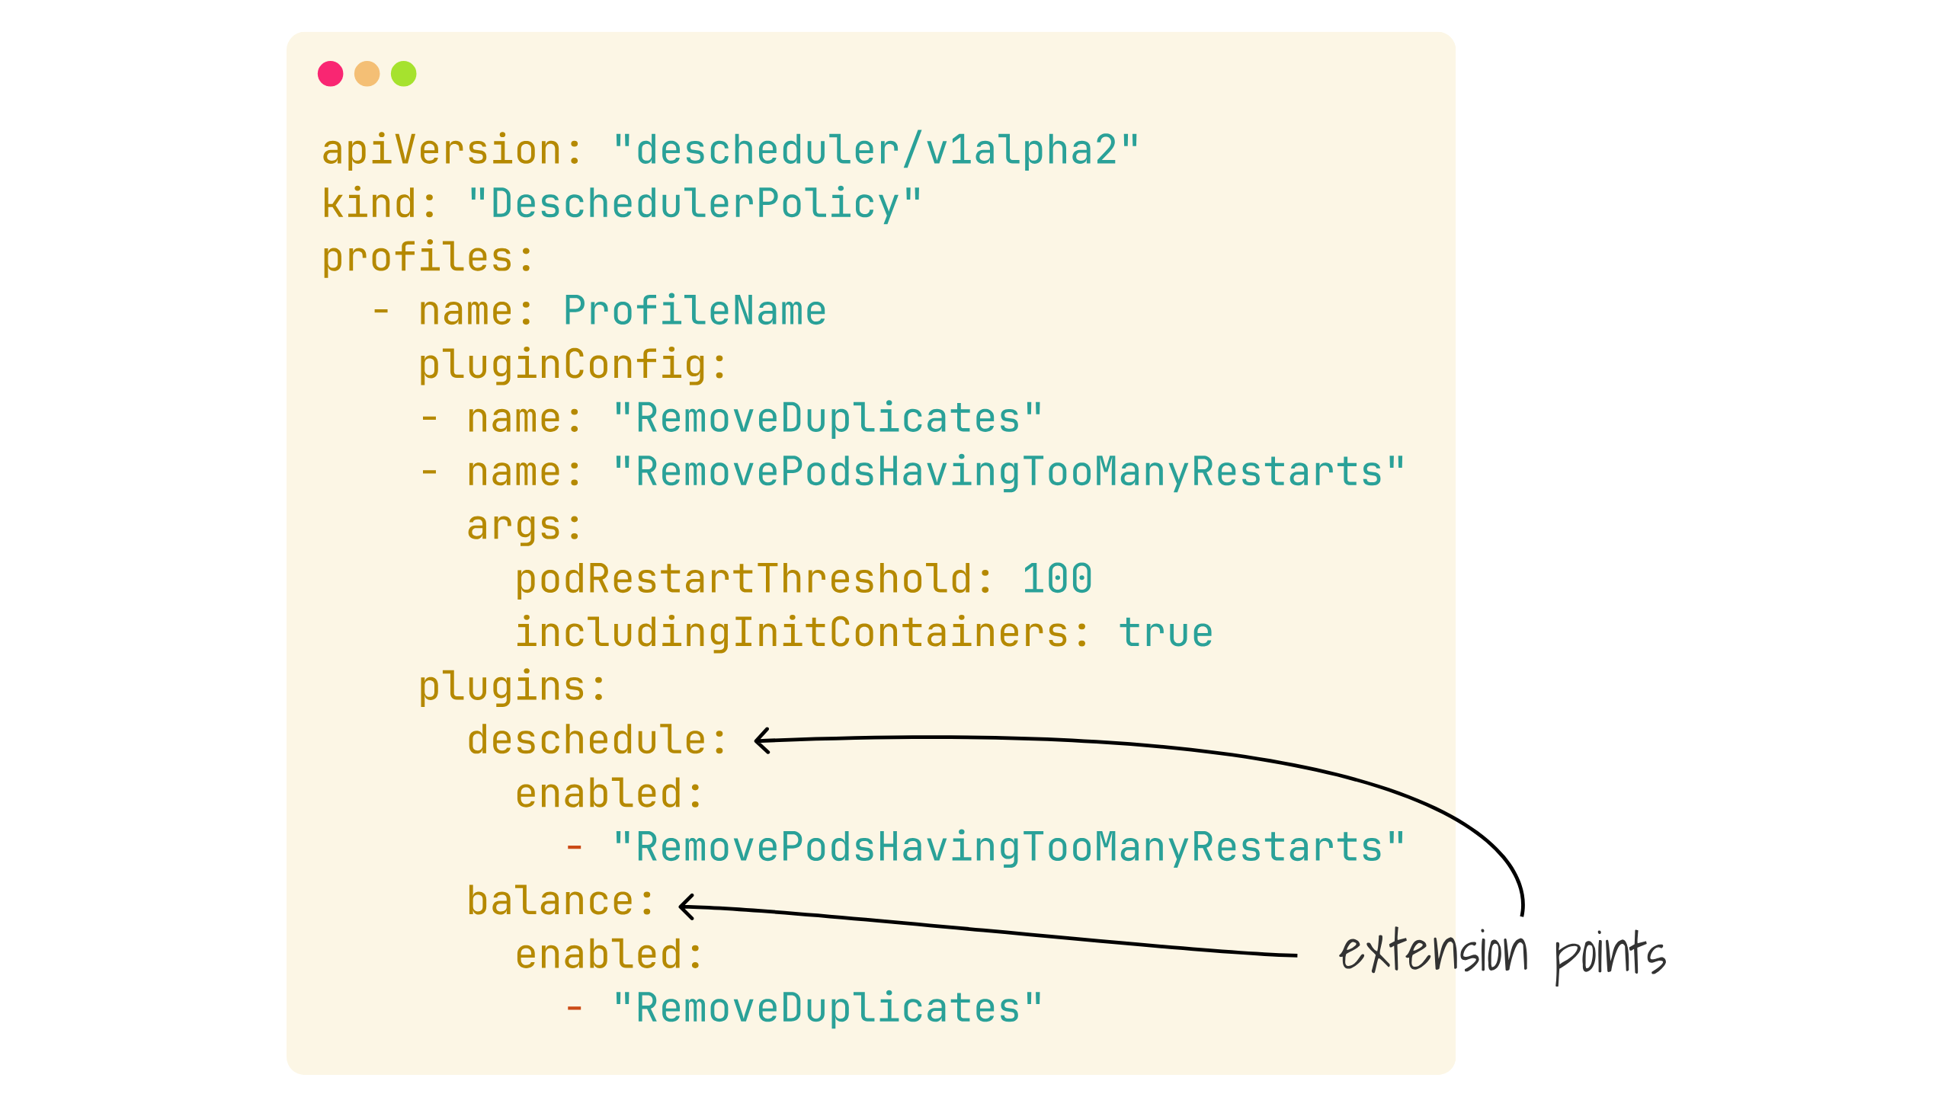
Notes:
and our categories we saw earlier are referred to as extension points

Slide 40
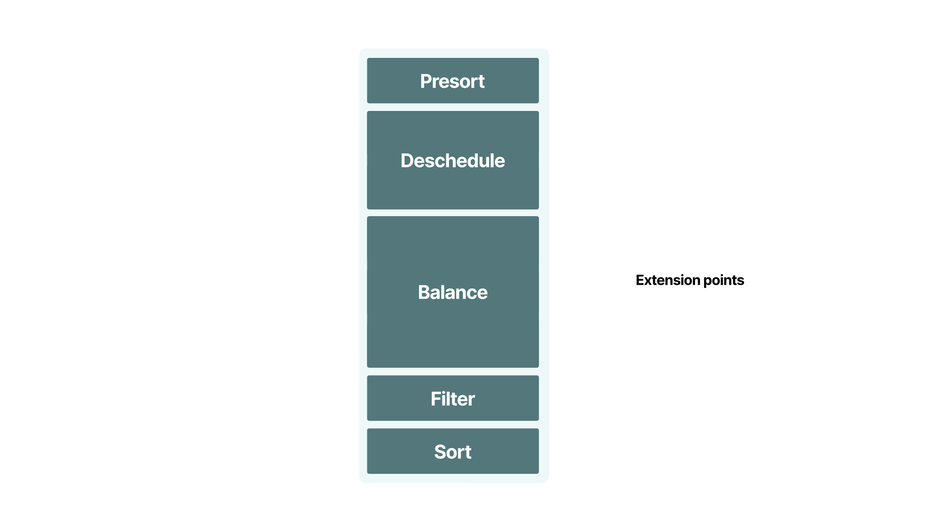
Notes:
there are other extension points available, but we'll be focusing on the deschedule and balance ones today

Slide 41

Notes:
A common use case might be, you've got applications that for whatever reason you want to restart, once an hour, or night because reasons

Slide 42
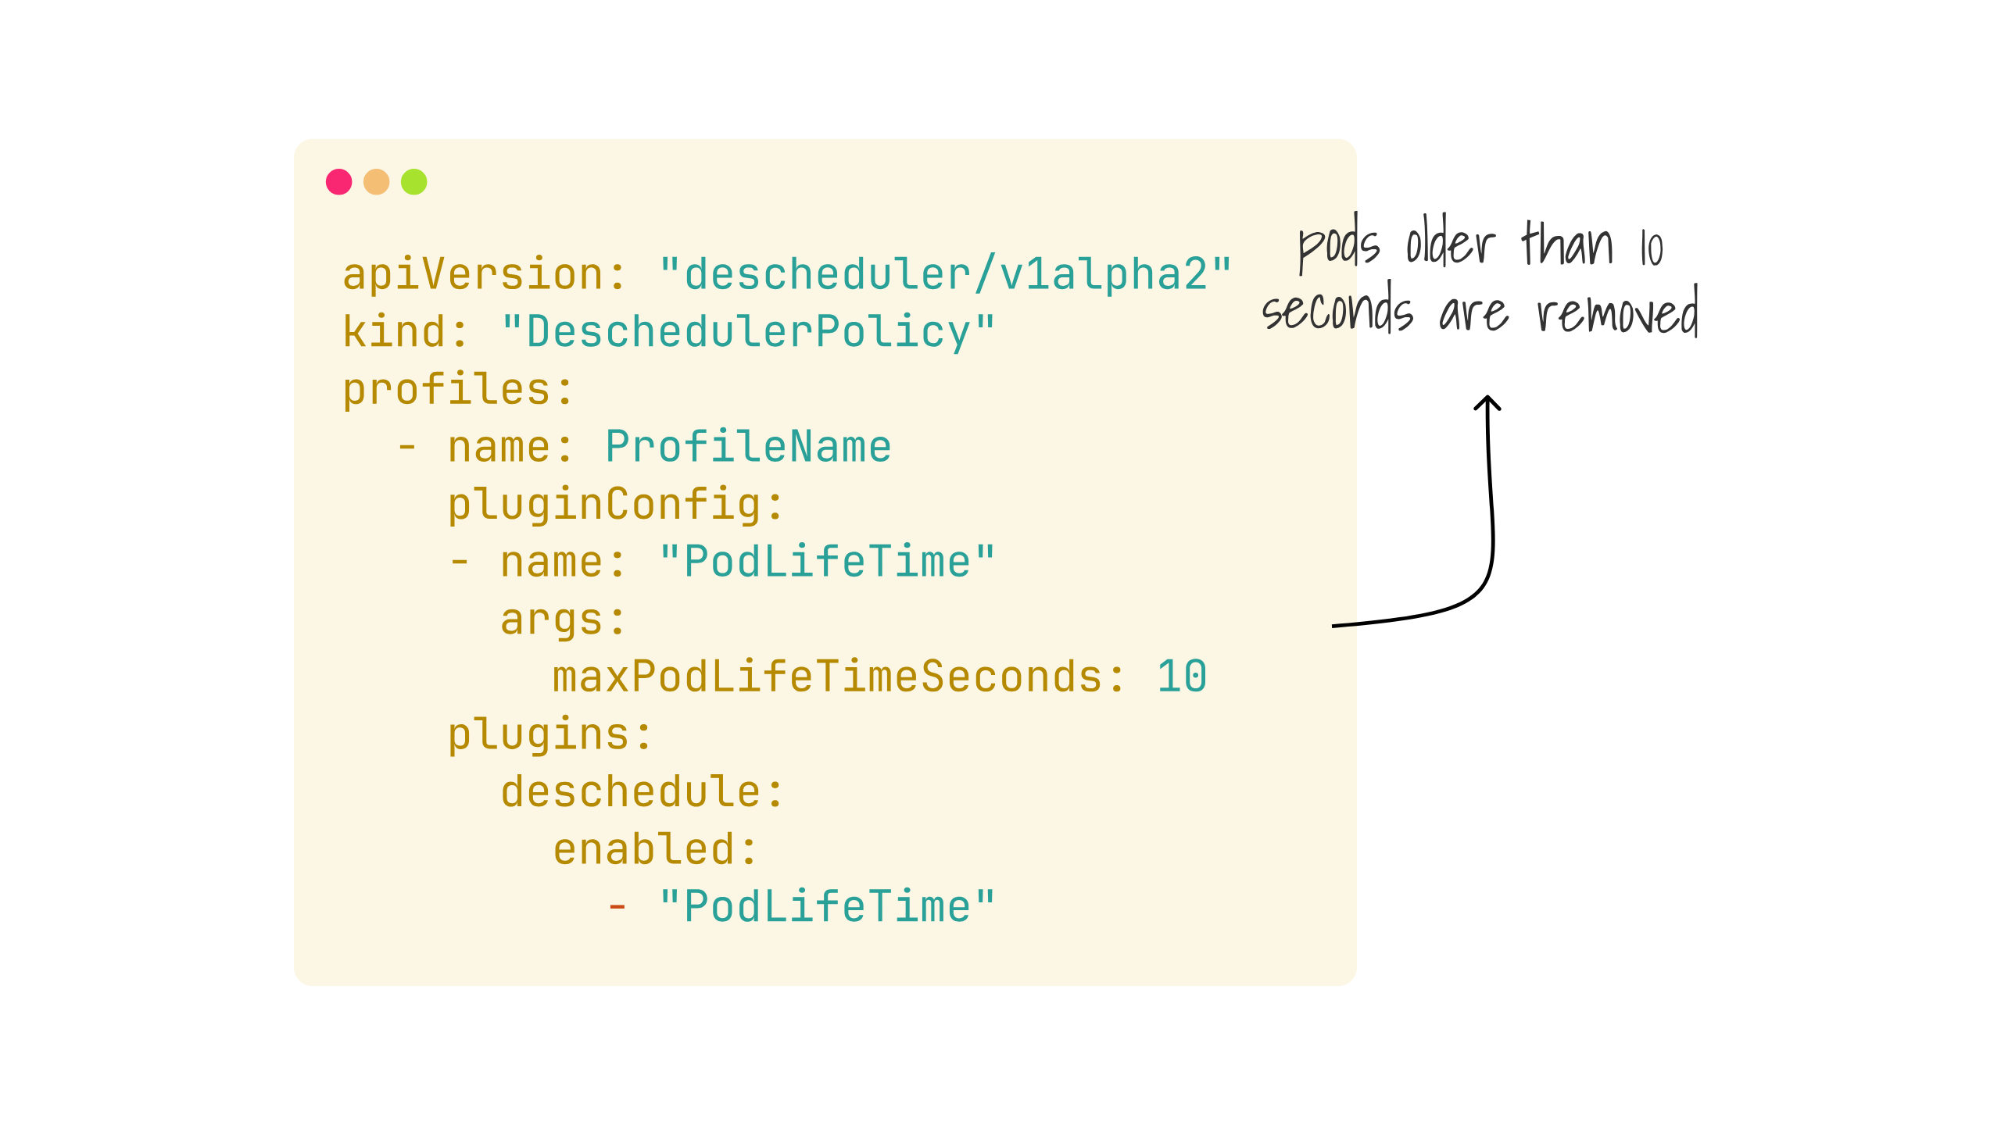
Notes:
So an example of that configuration might look like this, where we will look to restart pods over 10 seconds old

Slide 43
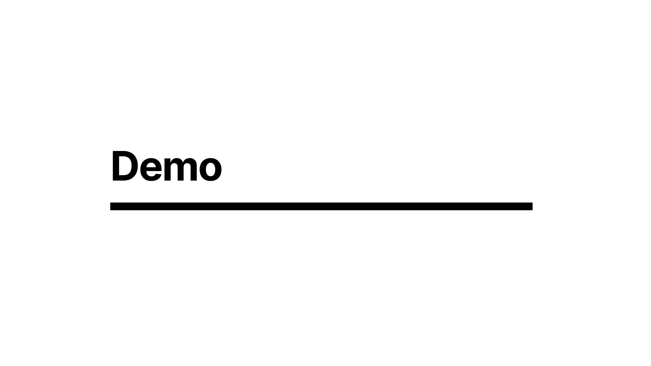
Notes:
this is the exciting part where i pray to the demo gods for the first time today....

Slide 44

Notes:
There are a few options for how you can run the descheduler on your cluster

Slide 45
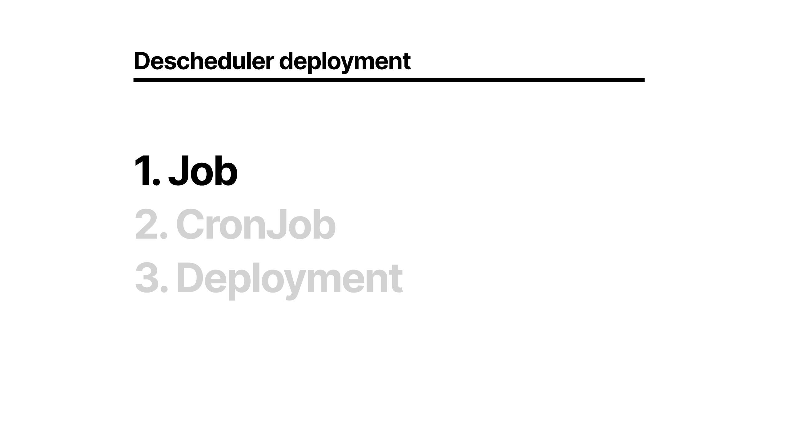
Notes:
You could run it as a one off job, or perhaps you've got some other orchestration system that will create jobs on your cluster for you

Slide 46
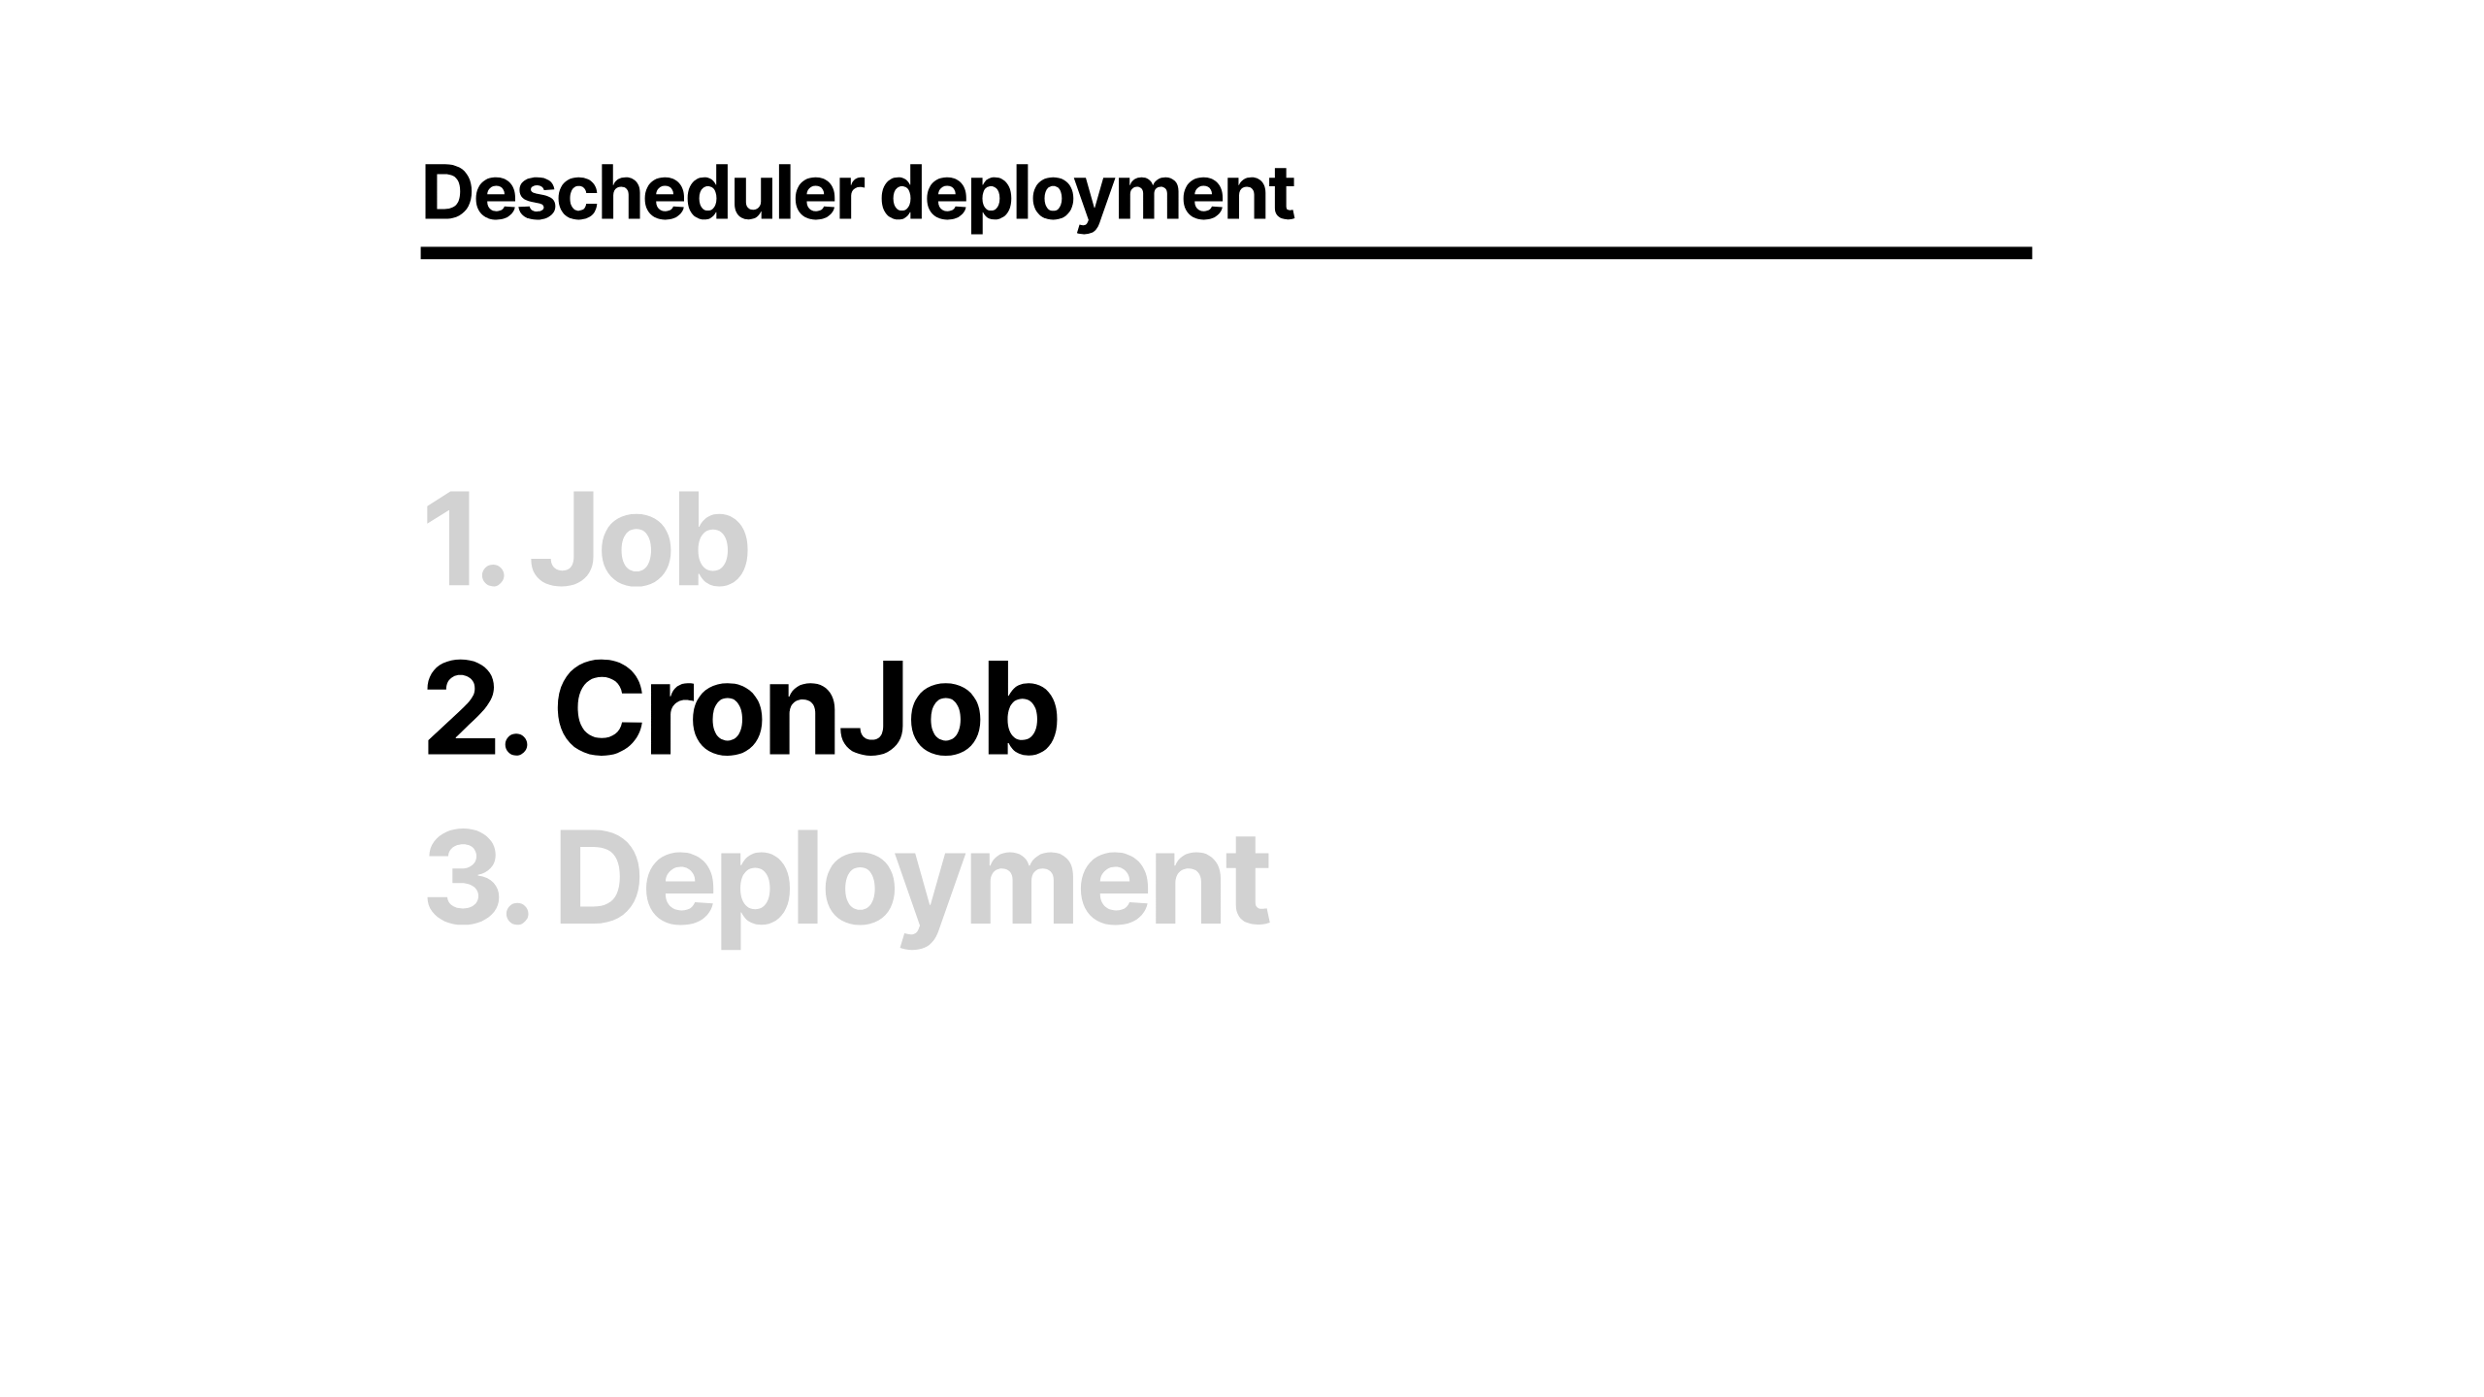
Notes:
Or a cronjob, resulting in periodic jobs being created as you desire

Slide 47
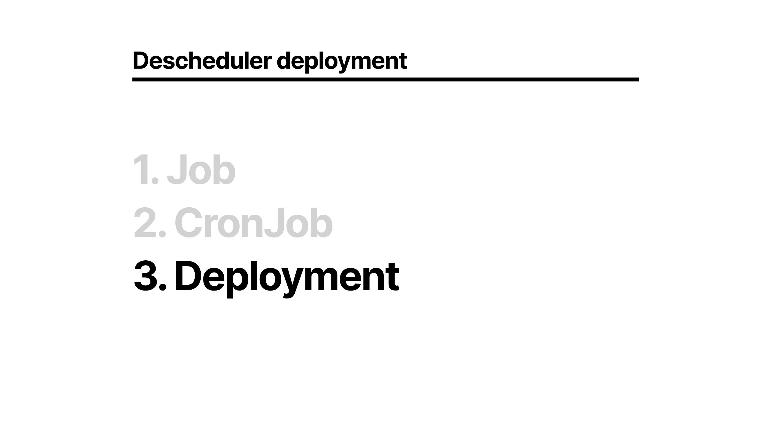
Notes:
Or a deployment that will run all the time in a loop

Slide 48
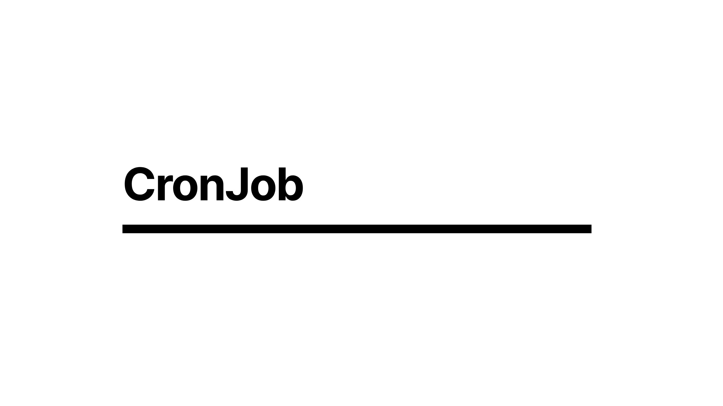
Notes:
To look at cronjob option

Slide 49
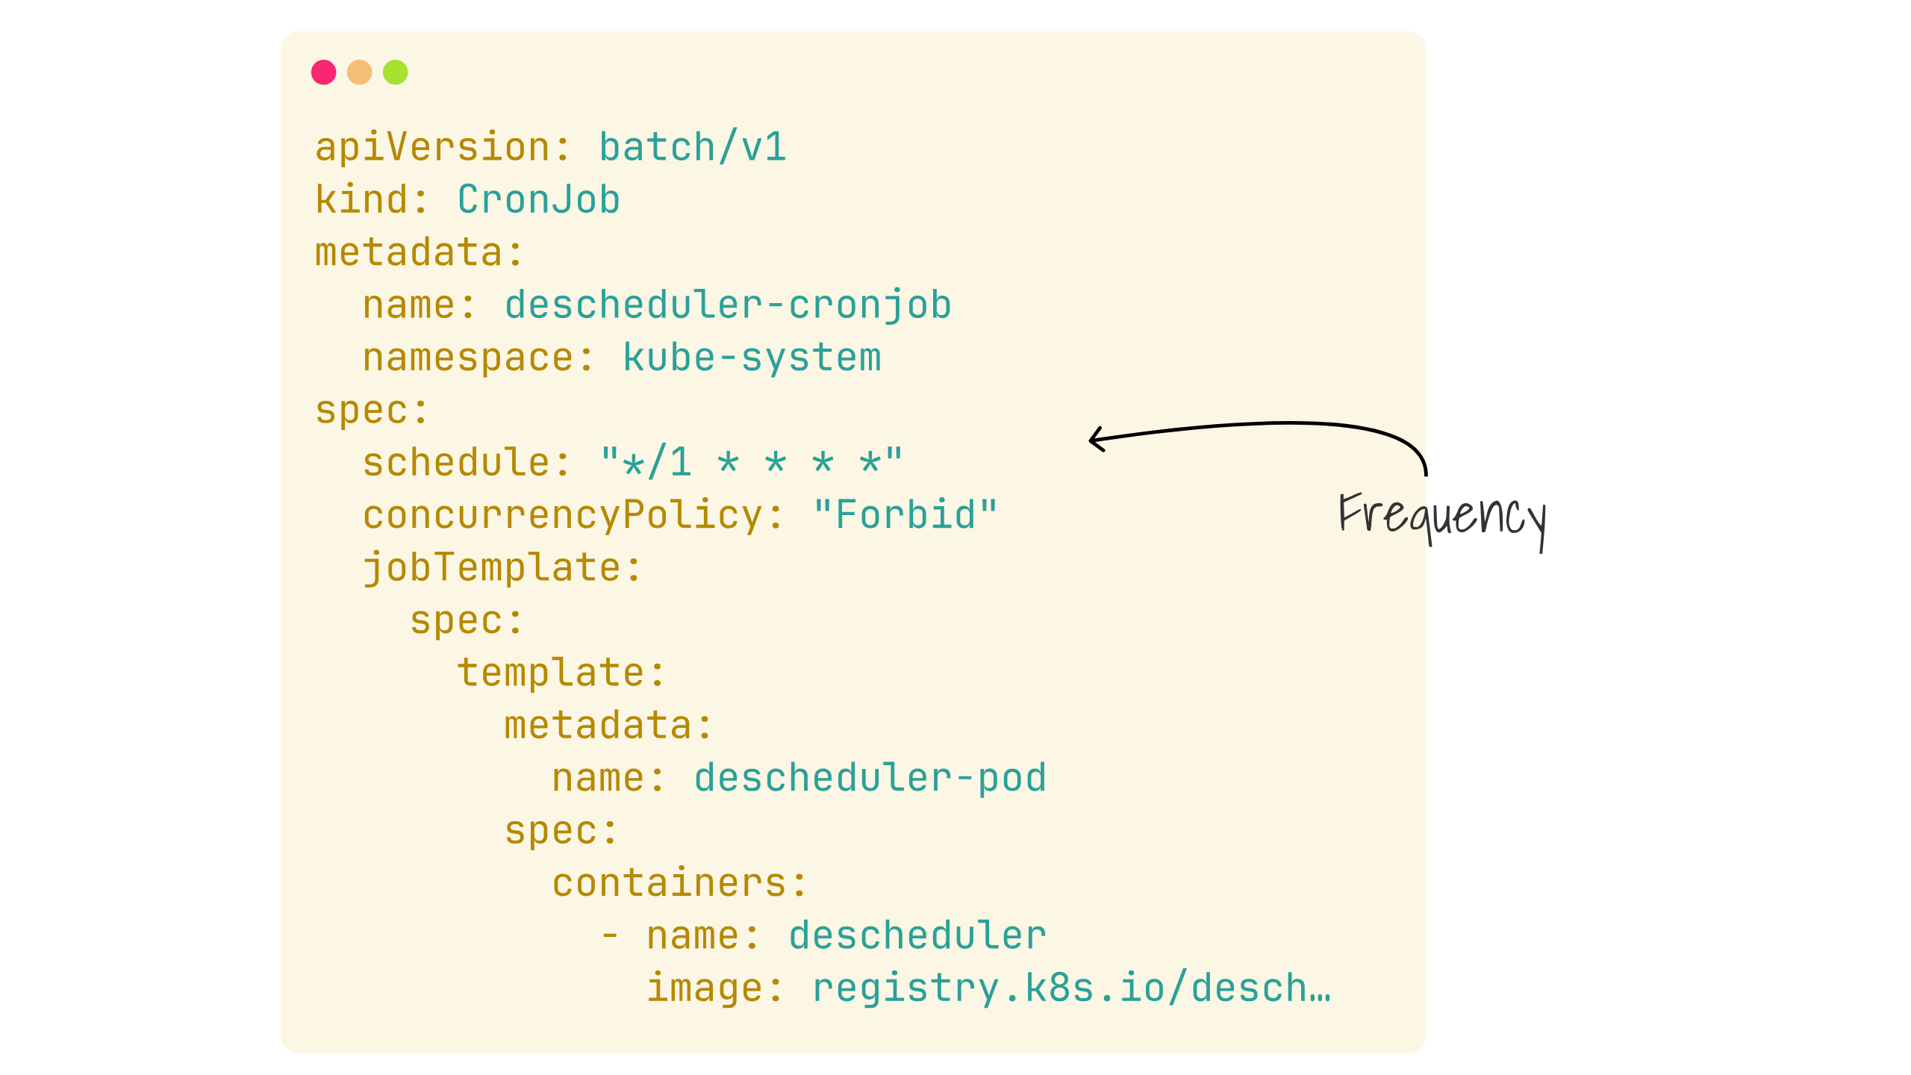
Notes:
Here we can see a cronjob specification, that will execute every minute, depending on your size of cluster and shape of workload this may be undesirable, you may want more or less frequent

Slide 50
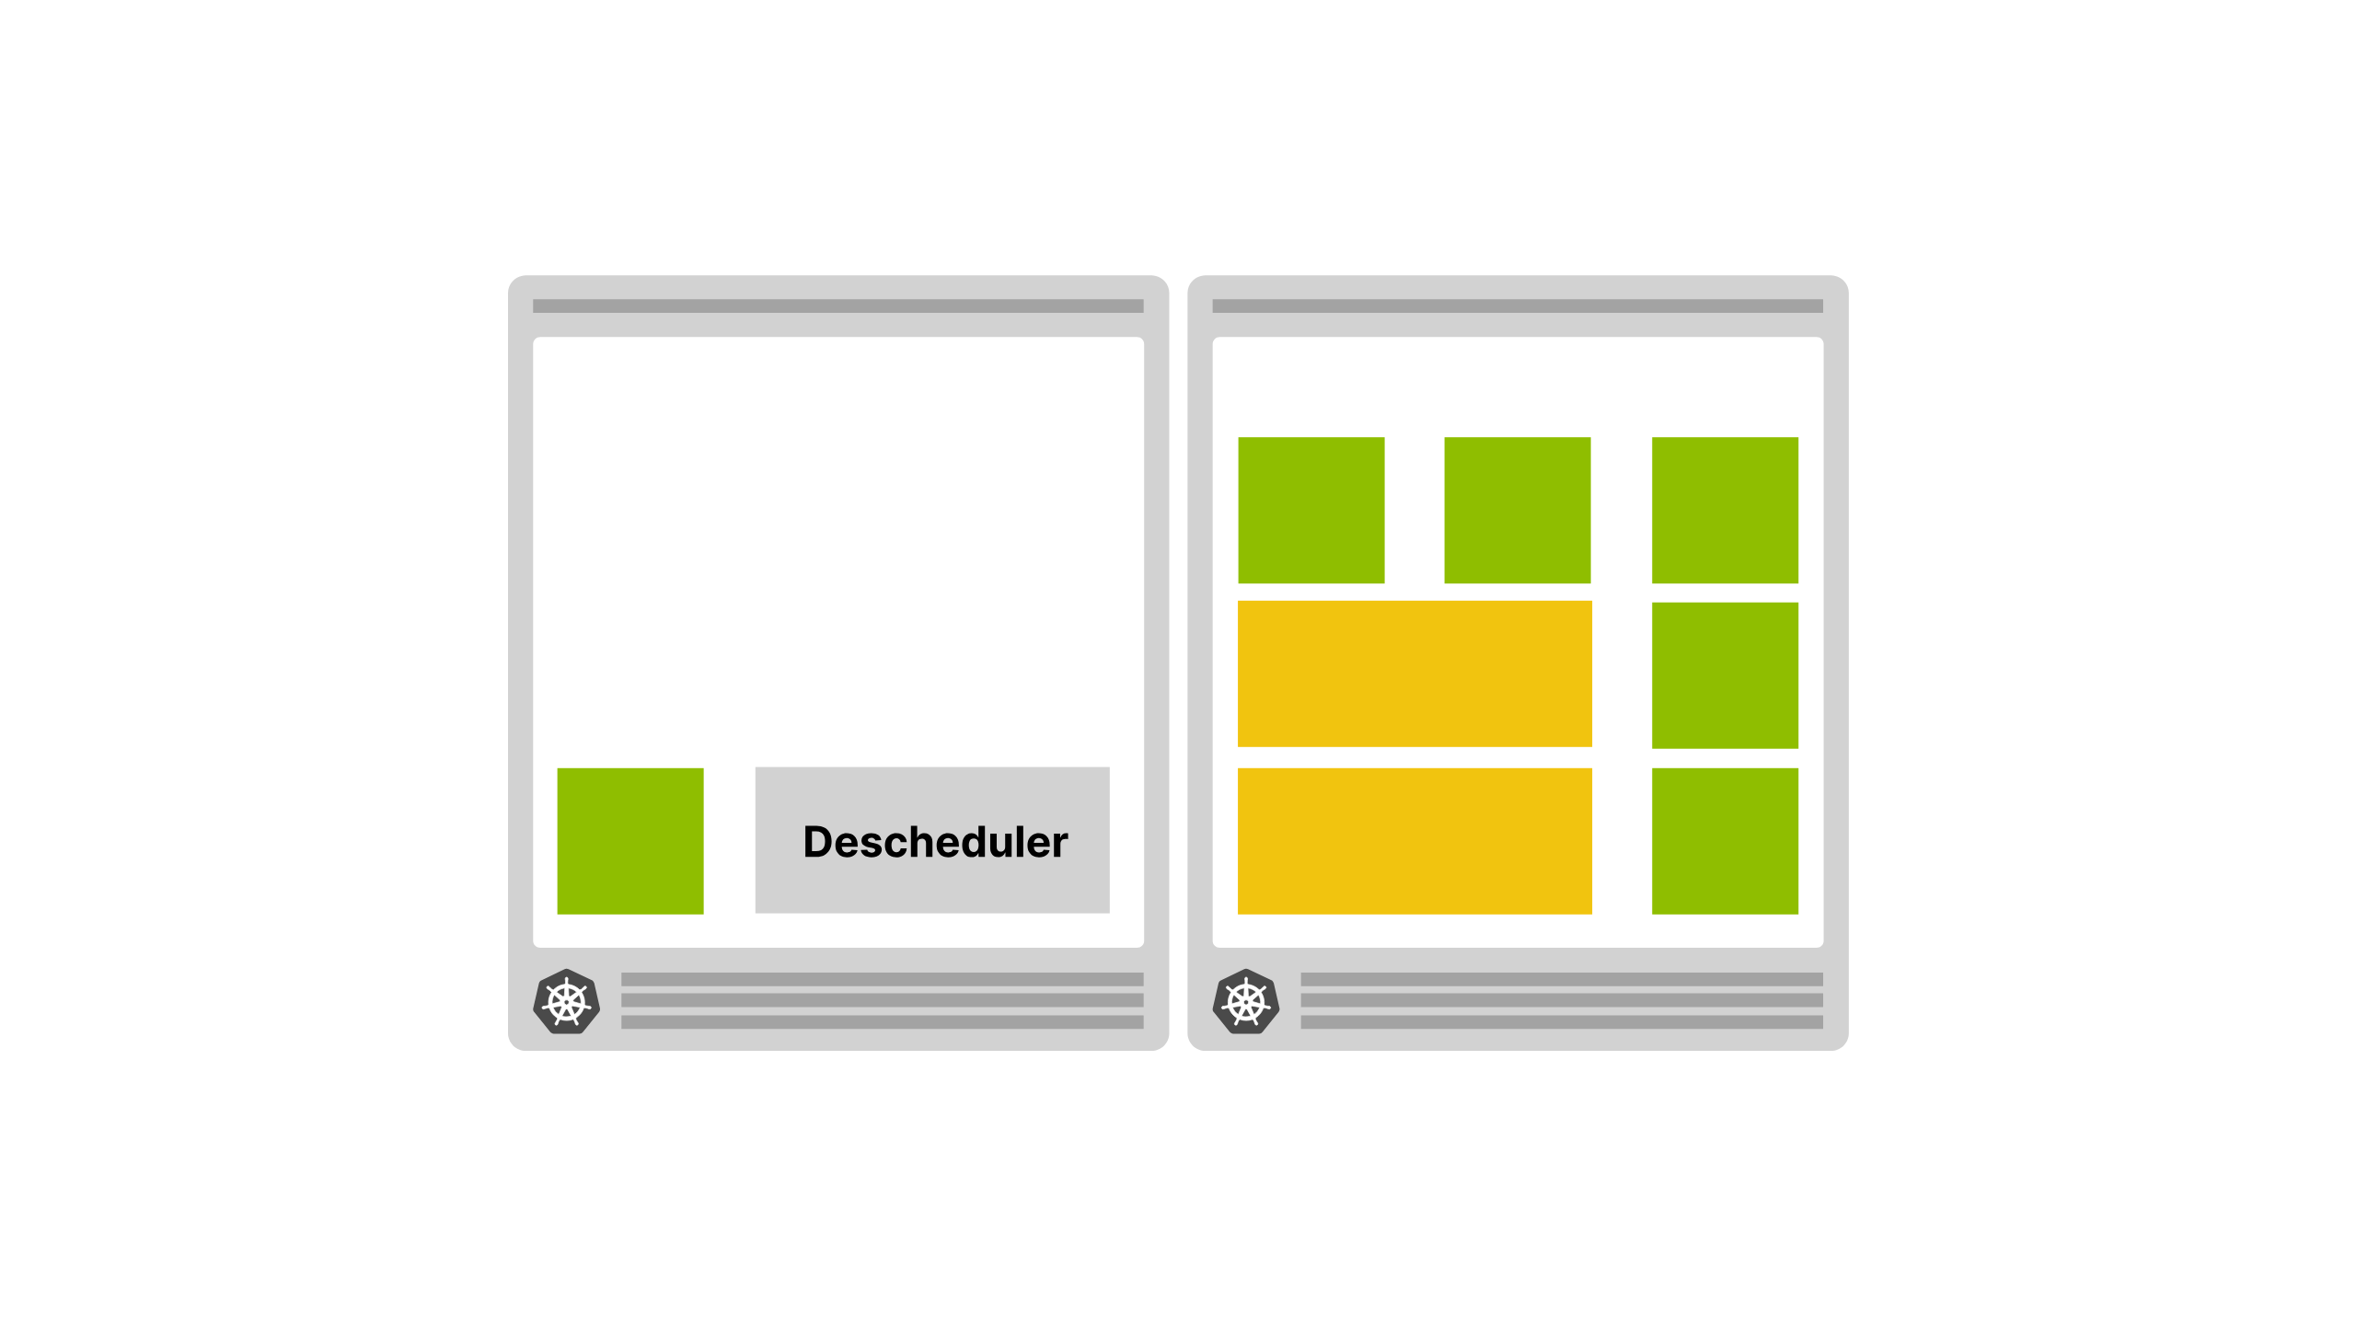
Notes:
Because it runs as a cronjob the descheduler pod is created somewhere on your cluster, allocated dynamically, and of course uses resource of its own

Slide 51
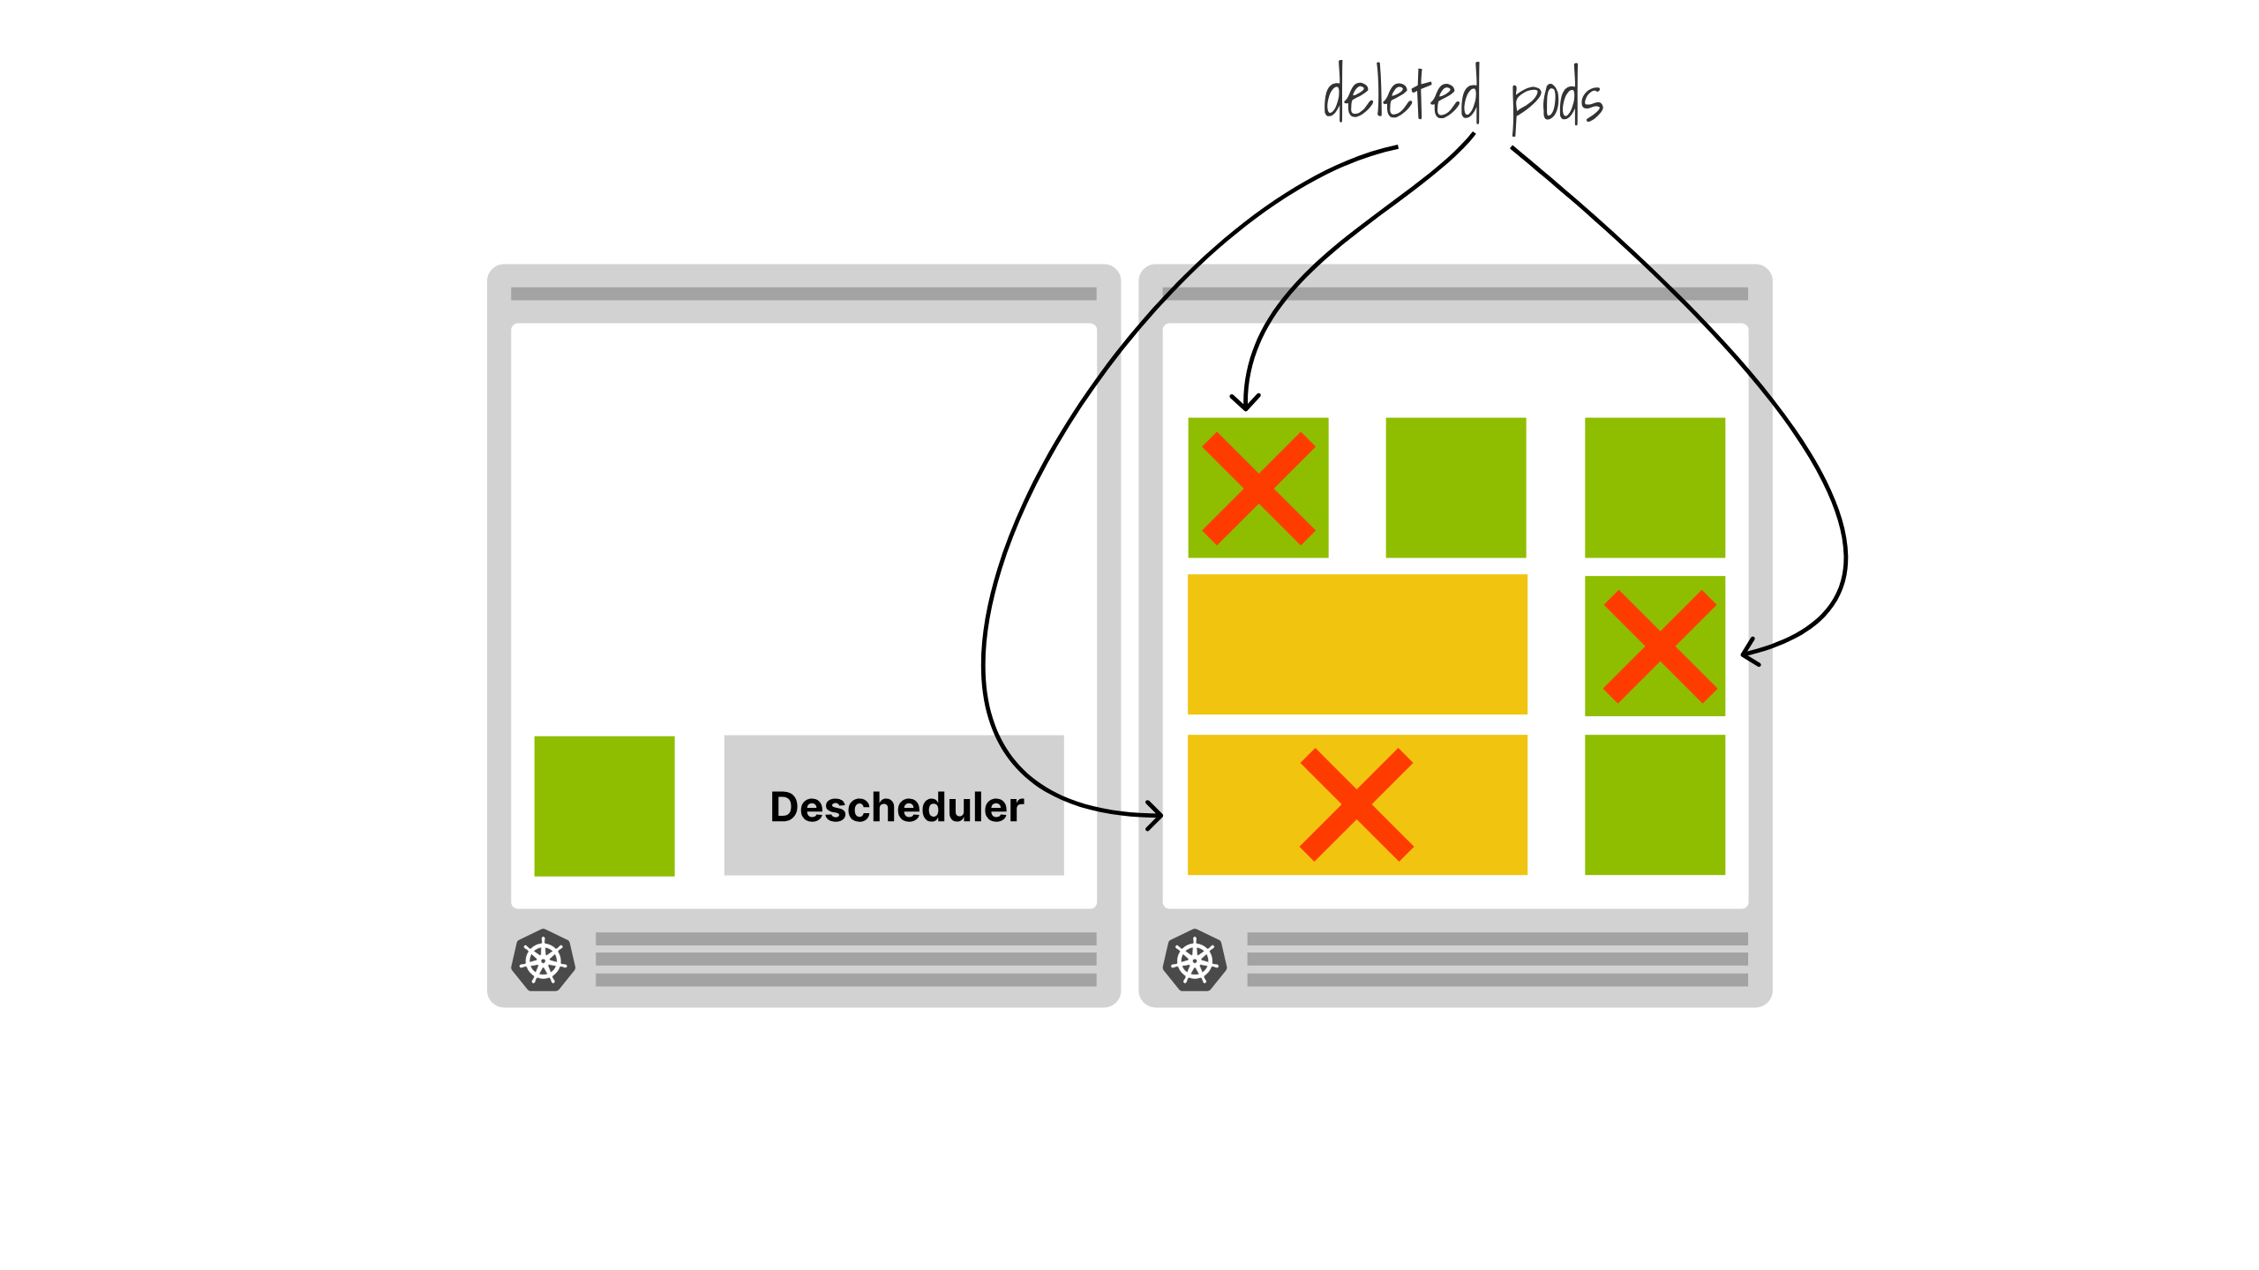
Notes:
which could end up influencing the schuedler when it comes round to rescheduling all the work it deletes

Slide 52

Notes:
So having it disappear as soon as its descheduled the other workloads allows for the new rebalanced scheduling to happen without the presence of the deschedulers influence

Slide 53

Notes:
Another approach is to run the descheduler in a deployment

Slide 54
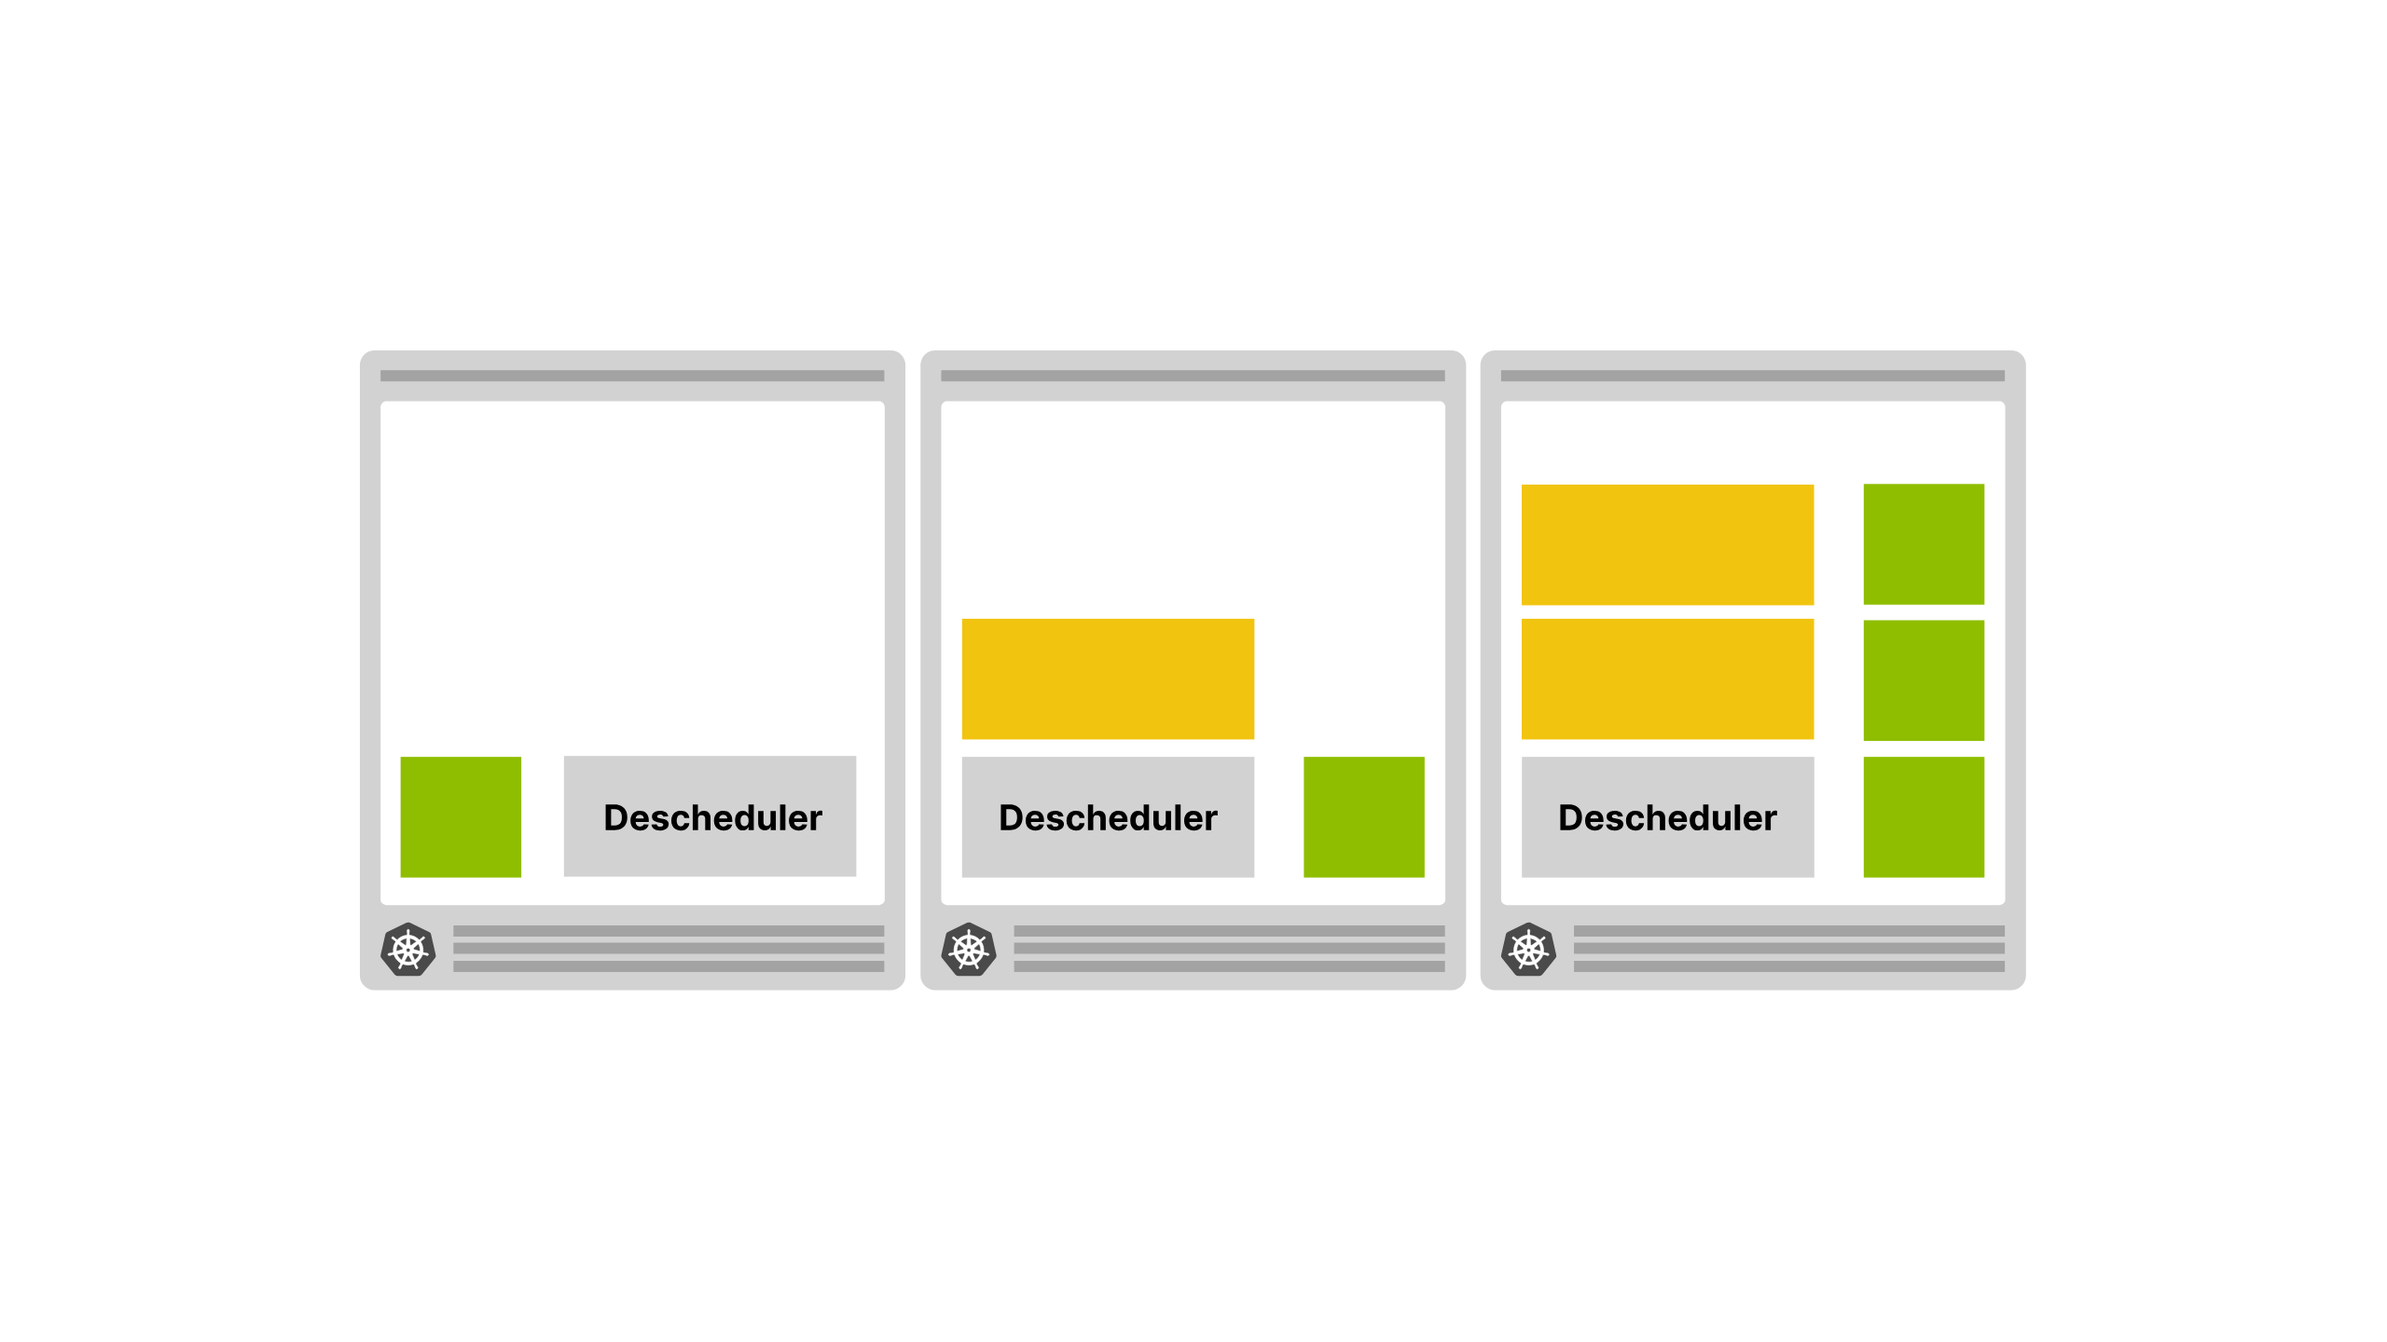
Notes:
It does support a highly available configuration where you can have multiple concurrent deschedulers running

Slide 55
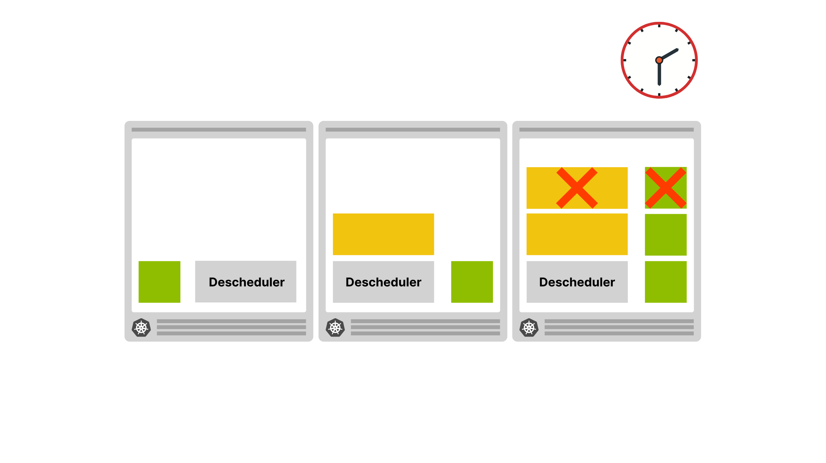
Notes:
And they will periodically run to delete pods

Slide 56
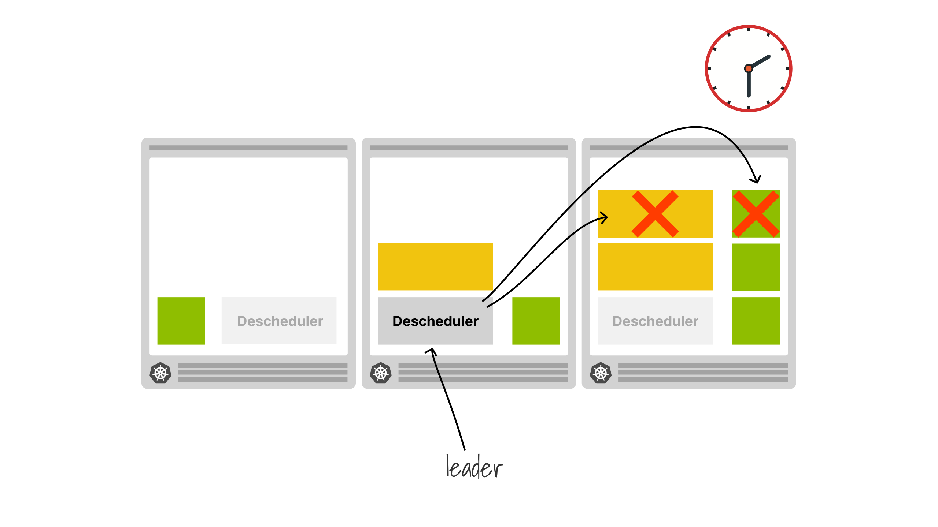
Notes:
However only one descheduler is actually doing the work, they will elect a leader, and the other replicas will only become active if the current leader is unavailable

Slide 57
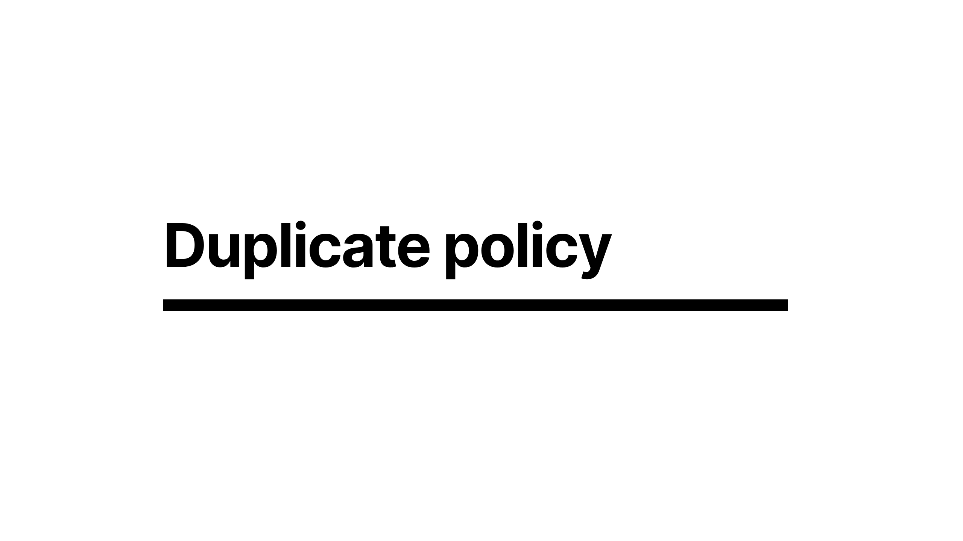
Notes:
So to look at another policy available to you, theres the duplicate policy

Slide 58
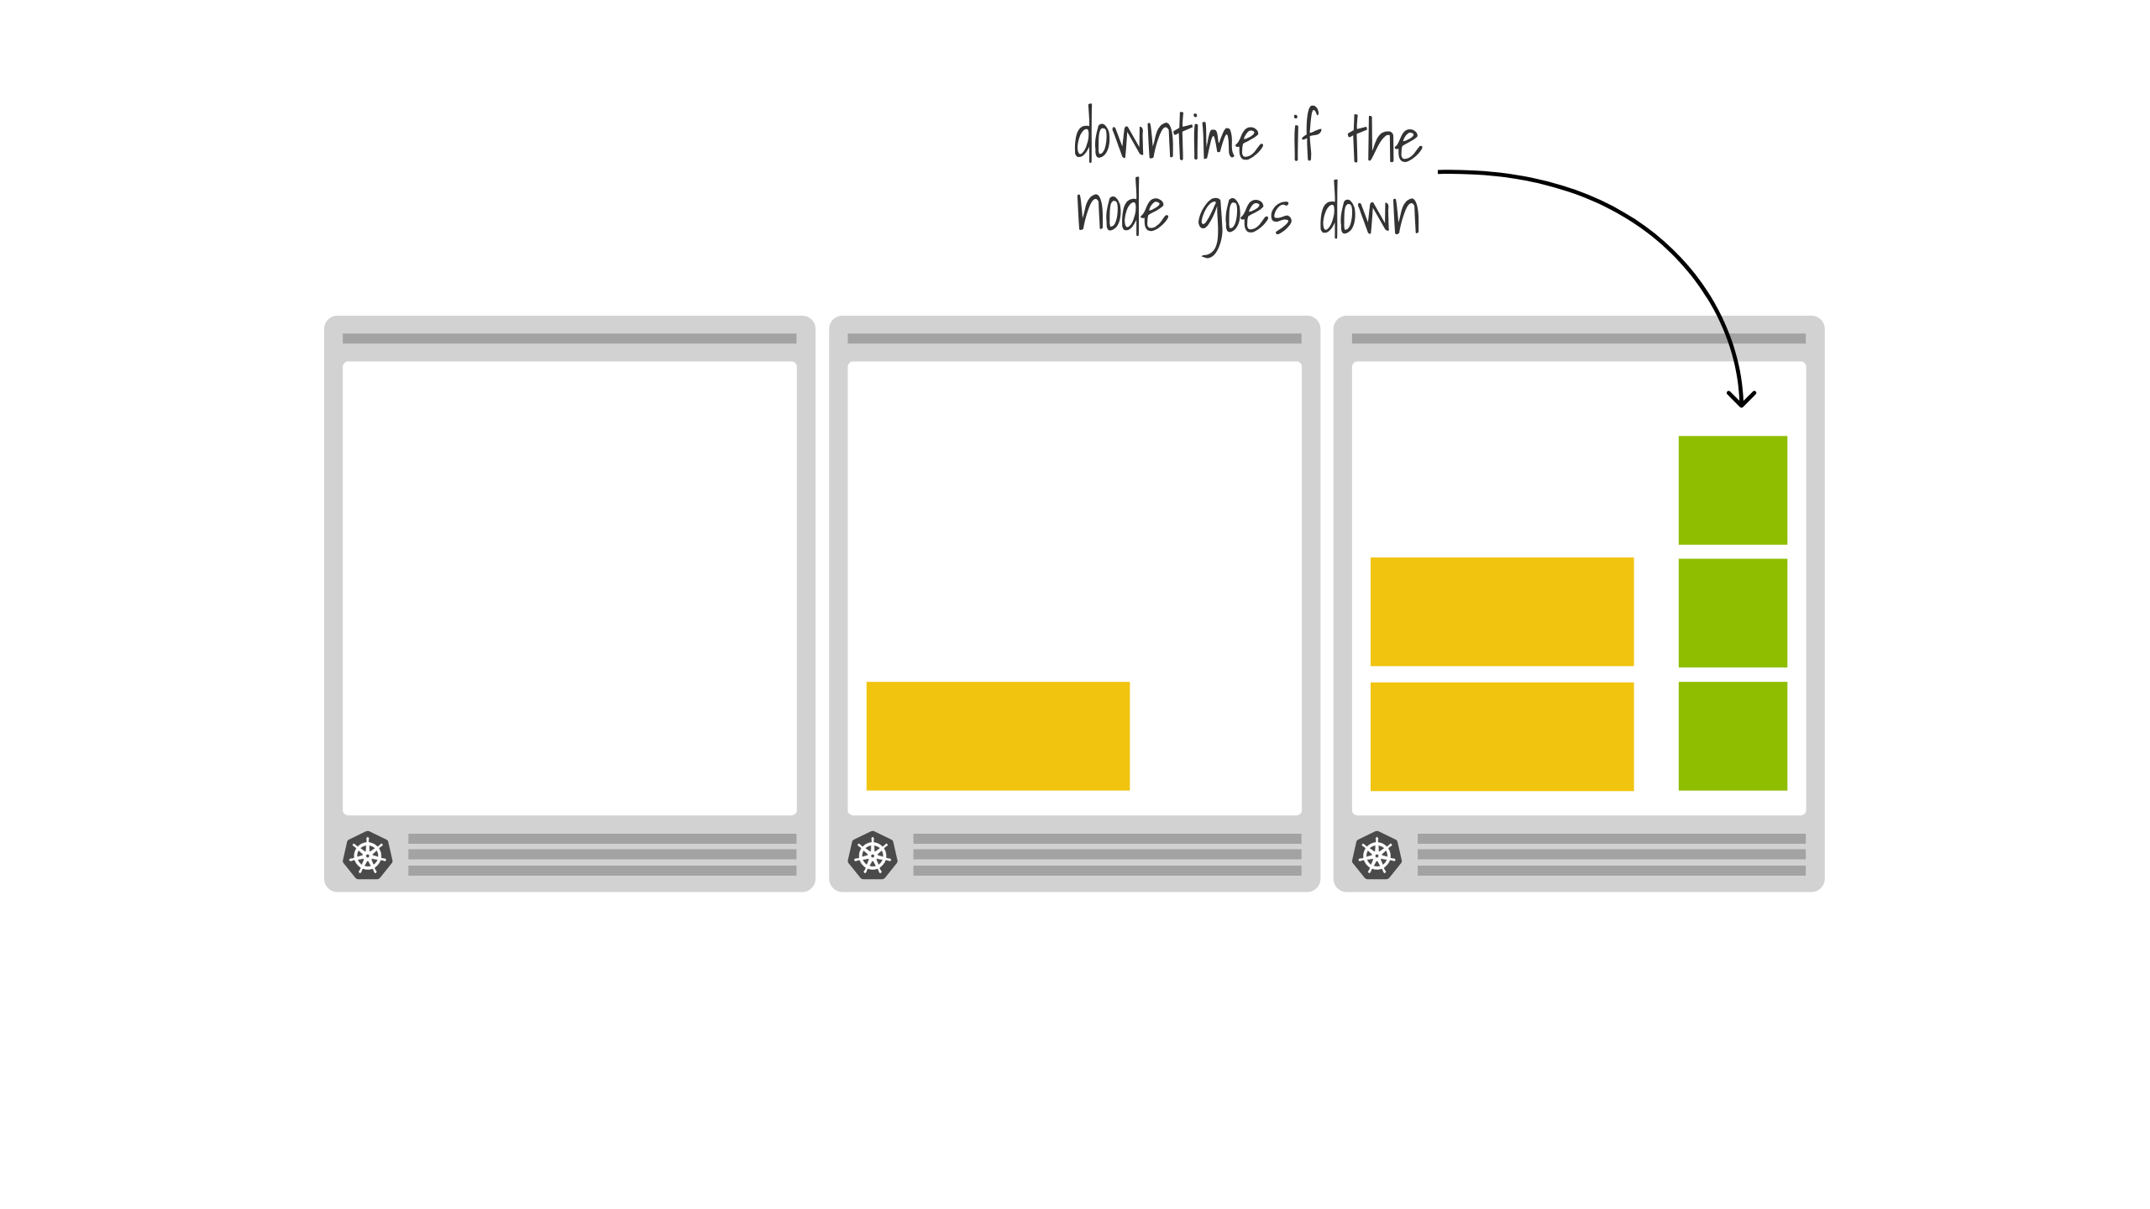
Notes:
if we consider a scenario like this

Slide 59
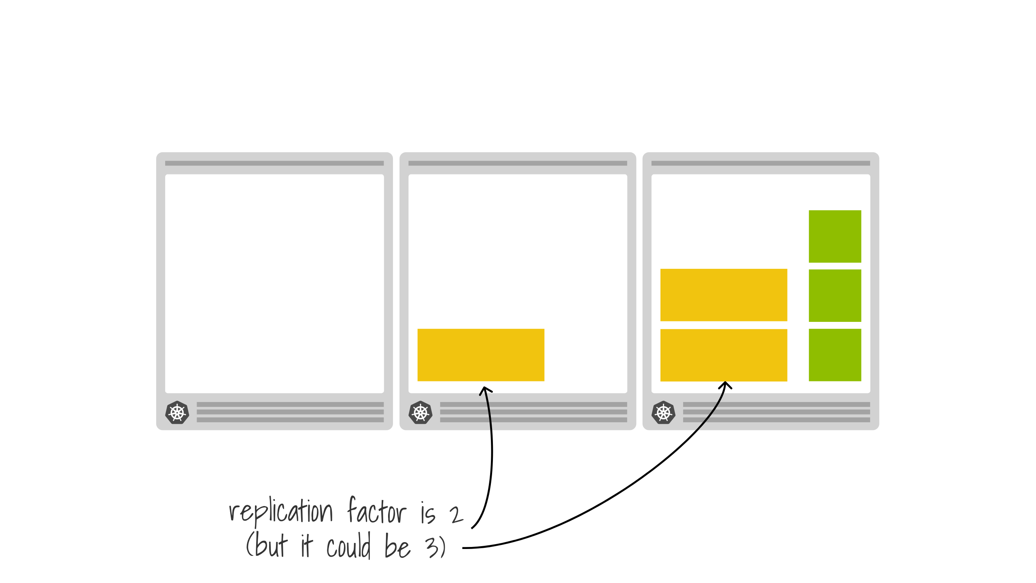
Notes:
if you were to loose the right hand node, your orange pods would suffer a 67% impact and your green pods would be entirely unavailable until the node outage were picked up some 5 minutes later

Slide 60
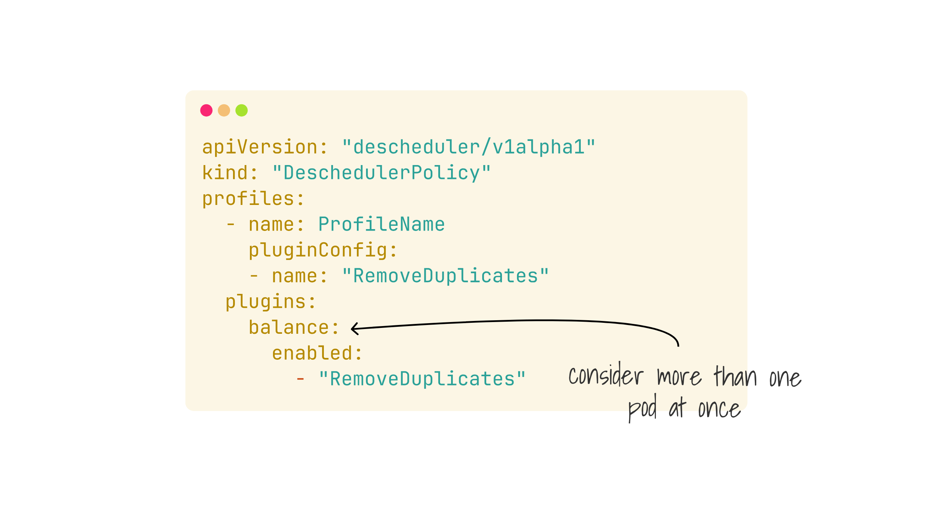
Notes:
which is what the remove duplicates balancer is intended for

Slide 61
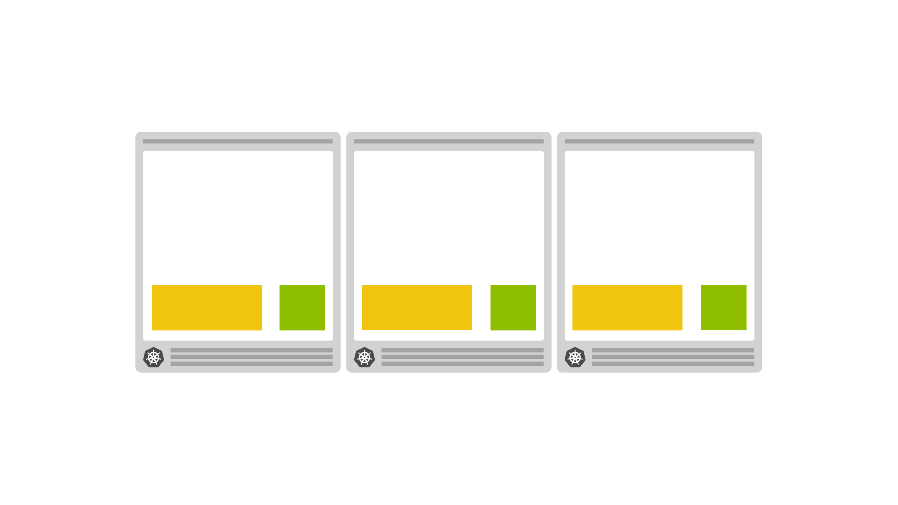
Notes:
which should cause your workload to rebalance across your nodes and reduce your concentration of risk a single node

Slide 62
Notes:
demo gods..

Slide 63

Notes:
Metrics are a pretty big deal in Kubernetes as you are no doubt aware, while there are more advanced metrics capabilities available

Slide 64
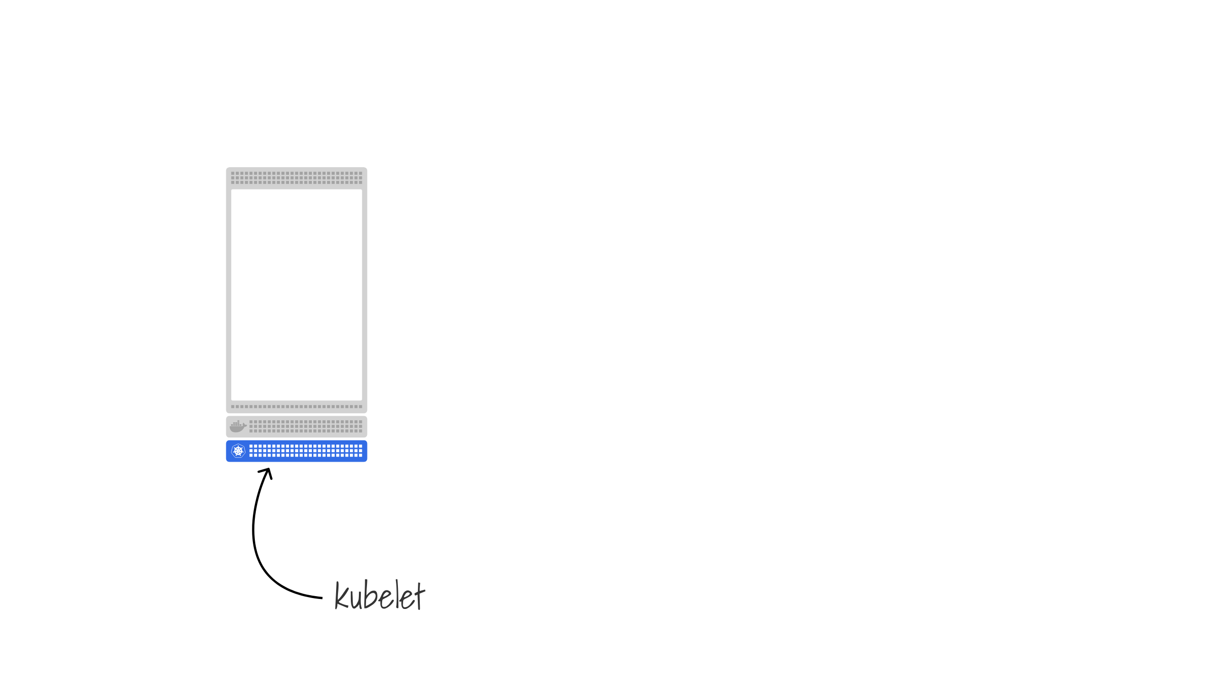
Notes:
the descheduler uses some more primitive and consistently available ones
if we remember how the kubelet that exists on every node works

Slide 65
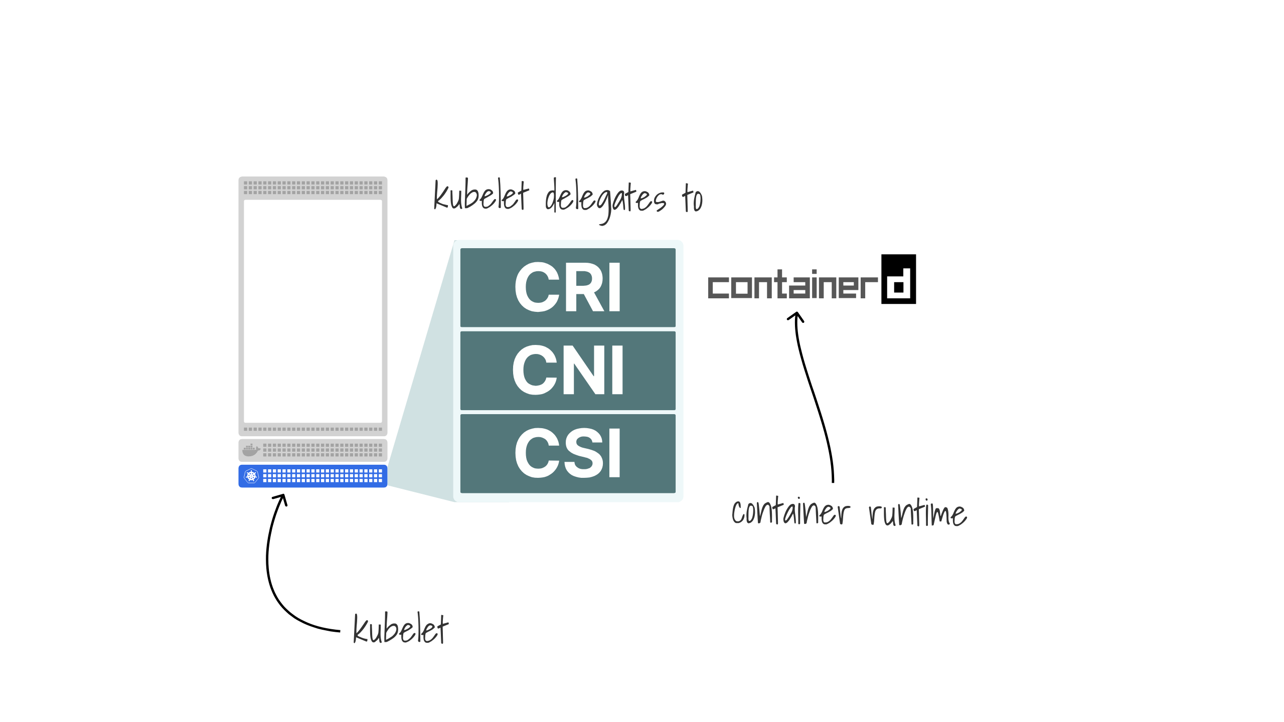
Notes:
The job of the kubelet is to keep the current node synchronized with the state of the control plane.
So it continuously polls the control plane for updates.
Remember when we said that the scheduler assigns pods to nodes?
If the kubelet finds a pod assigned to the current node, it will retrieve the spec for that pod.

Slide 66
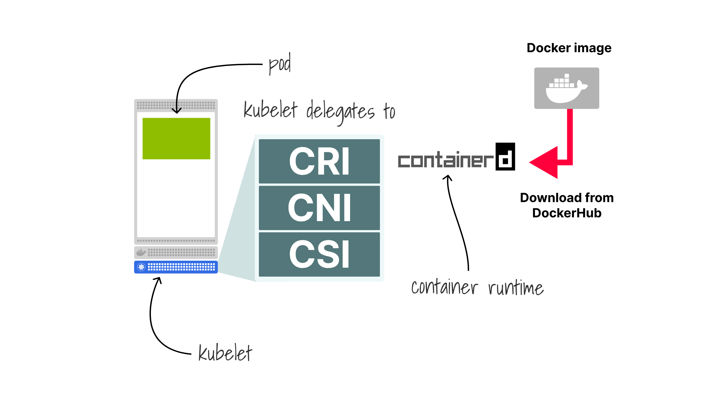
Notes:
causing the docker image to be pulled down, given to container d and start running

Slide 67
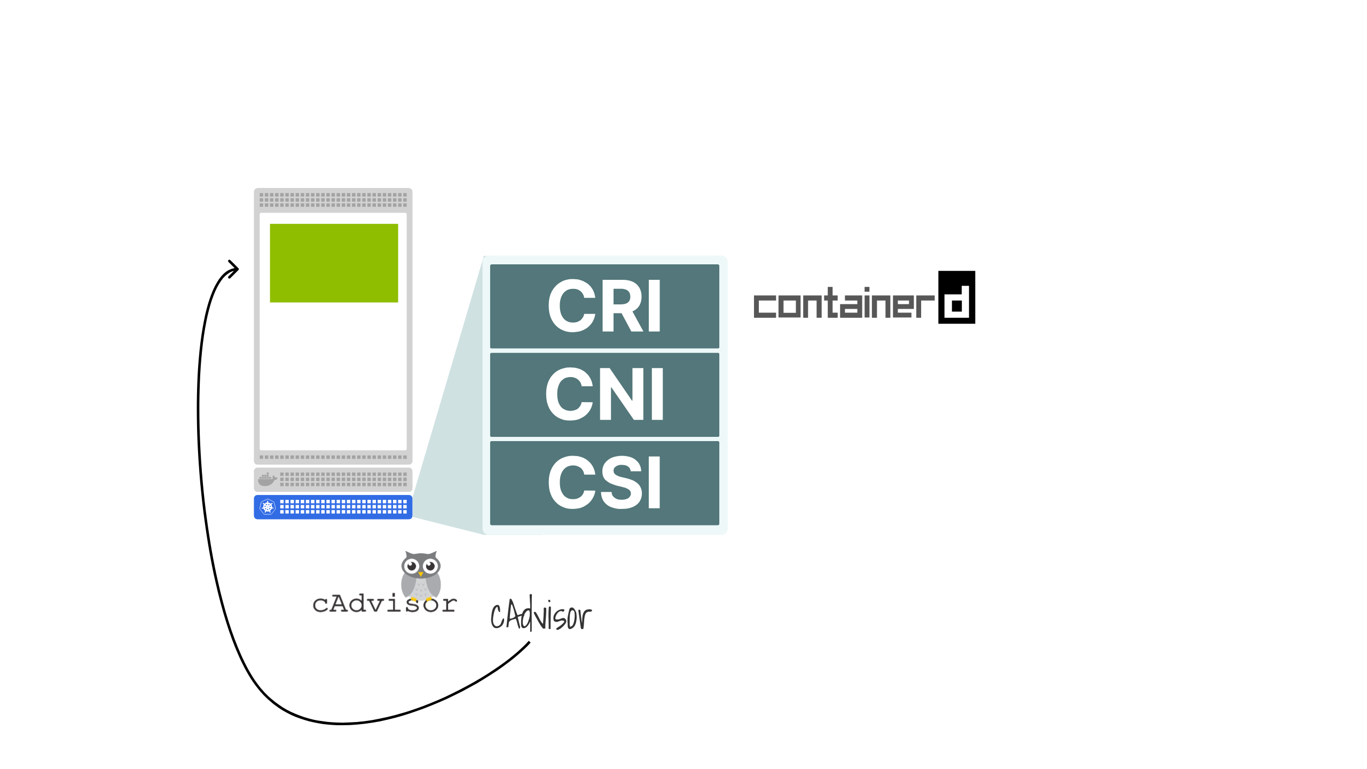
Notes:
the kubelet then reports the ongoing health of the node and the pods to the kubelet, and it uses cAdvisor to gather local metrics on CPU, memory and disk concentration

Slide 68

Notes:
to send off to the Kubernetes api server where that is tracked
for the astute amongst you, cadvisor is due to be replaced in the next release of Kubernetes, but the principal will remain the same

Slide 69

Notes:
using that data allows us to make some interesting decisions on how to deschedule our workloads to reach a more desirable balance

Slide 70

Notes:
an example of that is the high node utilization plugin, which will work to schedule your workloads to maximise your bang for buck on compute nodes

Slide 71

Notes:
so if you have a node looking like this

Slide 72

Notes:
it will identify the under utilized node and deschedule the workload in order to allow your cluster auto scaler to remove the node

Slide 73

Notes:
As a quick refresher

Slide 74

Notes:
1/5
When you provision an EC2 instance, you might think that the memory and CPU available can be used for running Pods.
And you are right.

Slide 75

Notes:
2/5
However, some memory and CPU should be saved for the operating system.

Slide 76

Notes:
3/5
And you should also reserve memory and CPU for the kubelet.

Slide 77

Notes:
4/5
Is the rest made available to the pods?

Slide 78

Notes:
5/5
Not quite yet. You also need to reserve memory for the Eviction threshold.
If the kubelet notices that memory usage is going over that threshold, it will start evicting pods.

Slide 79

Notes:
Daniele (or d5e to his friends)
Did a brilliant talk on this last month, and the considerations on how to right size your cluster, which if you didn't see, then please do seek that out

Slide 80

Notes:
next up is the low utilisation policy

Slide 81

Notes:
which provides a few more options to try and achieve a sweet spot of node

Slide 82

Notes:
utilisation by providing an upper threshold and a lower threshold
in my scenario a node under 20% is considered under utilised
and over 70% is over utilised

Slide 83

Notes:
which will cause the descheduler to rebalance accordingly to try and get the nodes into that sweet spot between

Slide 84

Notes:
last demo gods

Slide 85

Notes:
Related to a lot of this space is the node problem detector
there are loads of things that can go wrong on a node, but without this installed, Kubernetes will be totally unaware and continue to schedule workload on to an unhappy node until it is marked offline 5 minutes after it has totally failed

Slide 86

Notes:
which you can run as a daemonset in your cluster, meaning that it will run on every node

Slide 87

Notes:
and can detect things such as NTP being down or out of sync

Slide 88

Notes:
CPU, memory and disk issues

Slide 89

Notes:
kernel deadlocks, corrupted file systems

Slide 90

Notes:
issues with the container runtime

Slide 91

Notes:
or the kubelet

Slide 92

Notes:
and report that to the Kubernetes controlplane

Slide 93

Notes:
the node controller is the Kubernetes component that is ready to process that information

Slide 94

Notes:
after it has arrived at the api server

Slide 95

Notes:
the node controller lives in the controller manager

Slide 96

Notes:
and can add taints such as unreachable to the node

Slide 97

Notes:
combining this all

Slide 98

Notes:
with the node problem detector deployed

Slide 99

Notes:
if it detects that the node is unreachable

Slide 100

Notes:
the node can be tainted

Slide 101

Notes:
and the taints violation policy

Slide 102

Notes:
could be configured to reschedule the workload on that node

Slide 103

Notes:
causing the descheduler to evict all the pods

Slide 104

Notes:
and allow the scheduler to rebalance the workload

Slide 105

Notes:
preventing any pods being scheduled on the right hand node

Slide 106

Notes:
in combination with the cluster autosscaler

Slide 107

Notes:
it can notice that the utilization is low and trigger the downscaling of that node

Slide 108

Notes:
That was a long journey!
So some key takeaways

Slide 109

Notes:
Vanilla Kubernetes will not rebalance or defrag your nodes and pods

Slide 110

Notes:
The descheduler exists as an add on that will take on this task

Slide 111

Notes:
it is configured by policies that dictate its behaviour and will drive your cluster to a more desirable configuration

Slide 112

Notes:
and it will take low level metrics from the nodes and pods in order to inform this rather than using metrics-server or similar

Slide 113

Notes:
And the node problem detector can be used to provide early reactions to nodes becoming unhealthy and direct your workload to run elsewhere

Slide 114

Notes:
Thank you very much for your time
I've been Chris Nesbitt-Smith
find me on linked in, and do be sure to check out the other webinars we've done with linode
Like, subscribe and whatever the kids do these days

Slide 115

Notes:
I'll now open the floor to any questions, if we don't get to you or you're not watching this in realtime, then please do join the slack community

Slide 116


Slide 117


Slide 118


Slide 119


Slide 120


Slide 121


Slide 122


Slide 123


Slide 124


Slide 125


Slide 126


Slide 127


Slide 128


Slide 129


Slide 130


Slide 131


Slide 132


Slide 133


Slide 134


